Slide 1
Fingerprint Patterns Reference Guide
Rocky Elmore, Auburn University at Montgomery

Slide 2
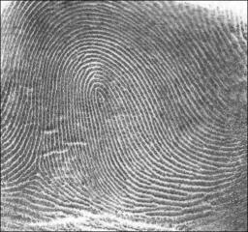
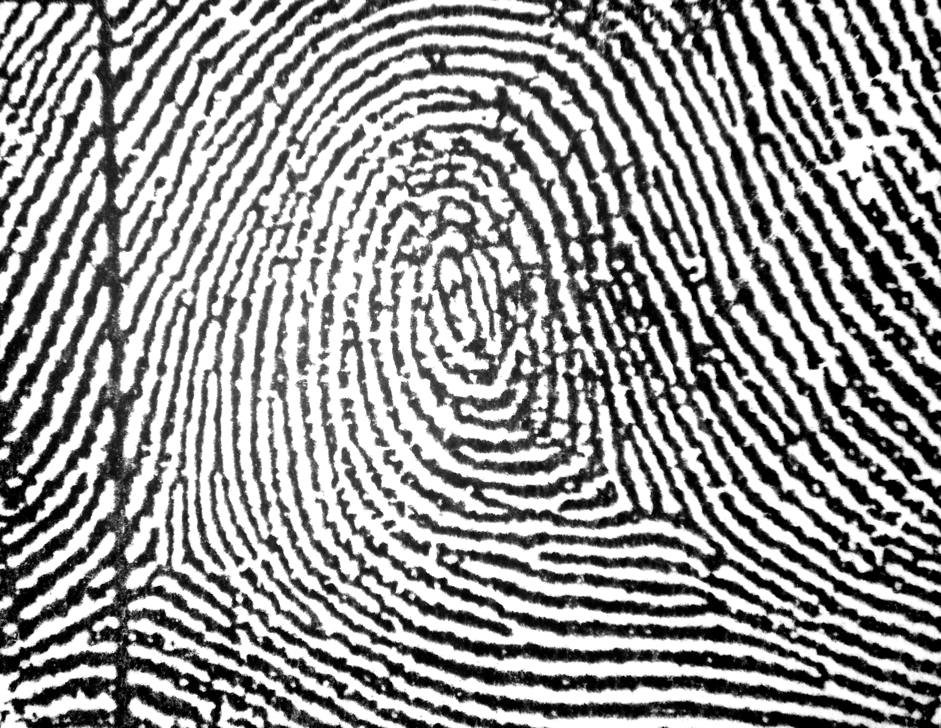
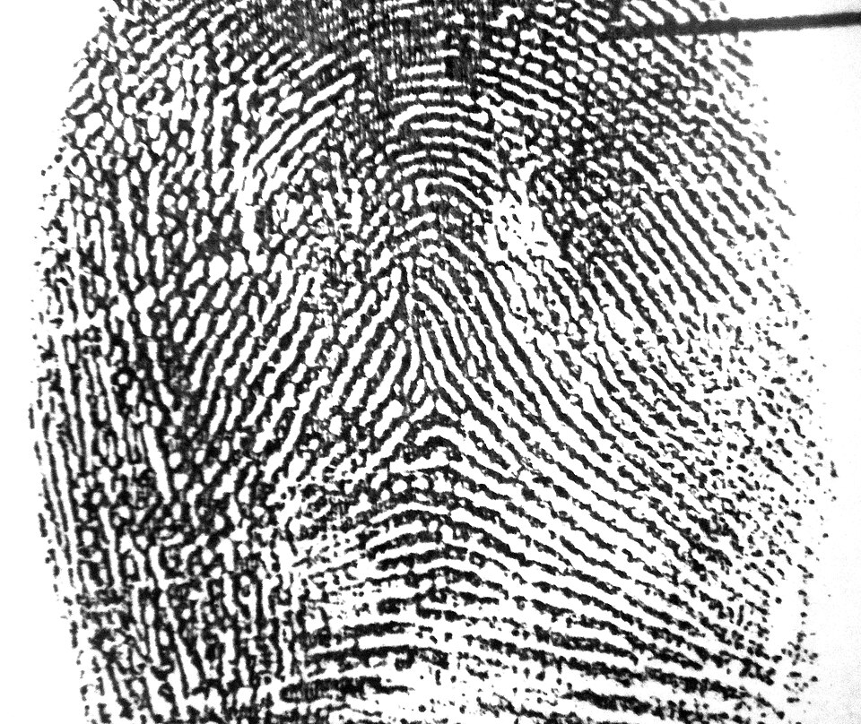
Loop, Whorl, Arch
Loop
Whorl
Arch

Slide 3
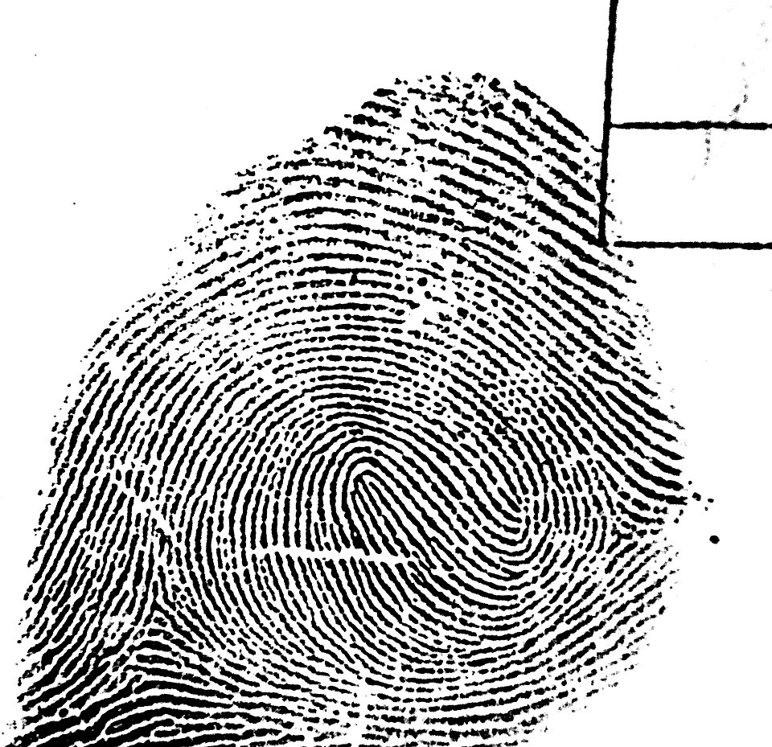
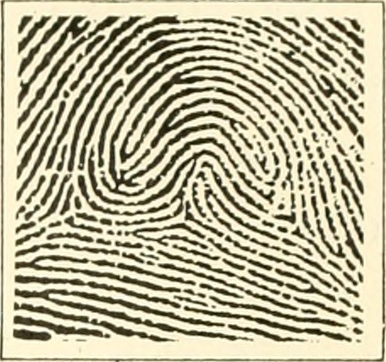
Variations
Double loop whorl
Accidental Whorl

Slide 4
Image Sources
Fingerprint loop image by unknown author. Public Domain
Central pocket loop whorl in a right little finger image by Metrónomo. CC-BY-SA 4.0.
Tented arch in a left index fingerprint image by Metrónomo. CC-BY-SA 4.0.
Double Loop Whorl image by Metrónomo. CC-BY-SA 4.0
Unnamed image by Edward Richard Henry. Public Domain.

