Slide 1
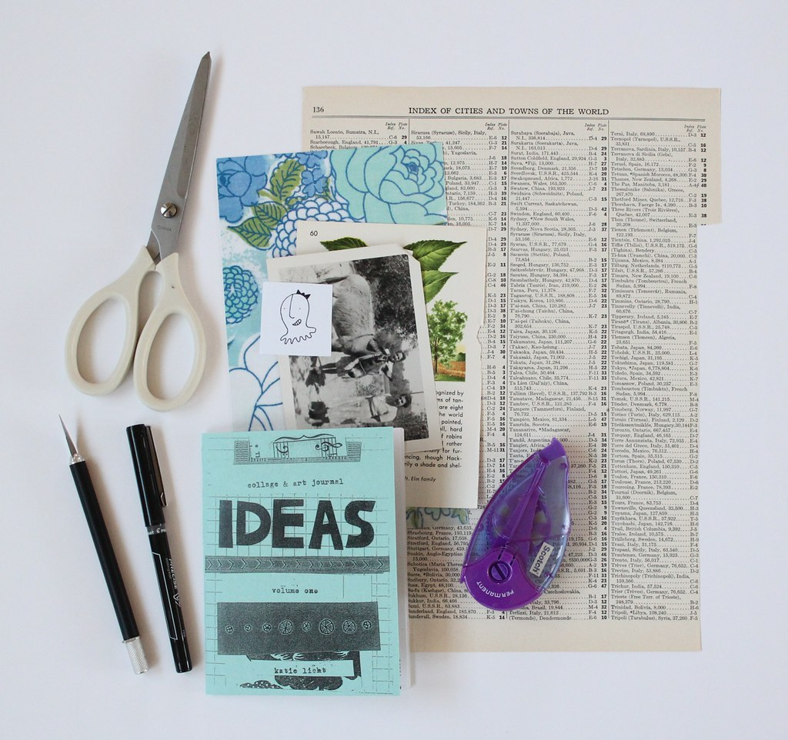
Introduction to Zines
Alexandra J. Reyes and Lucas John Jensen, Georgia Southern University

Slide 2
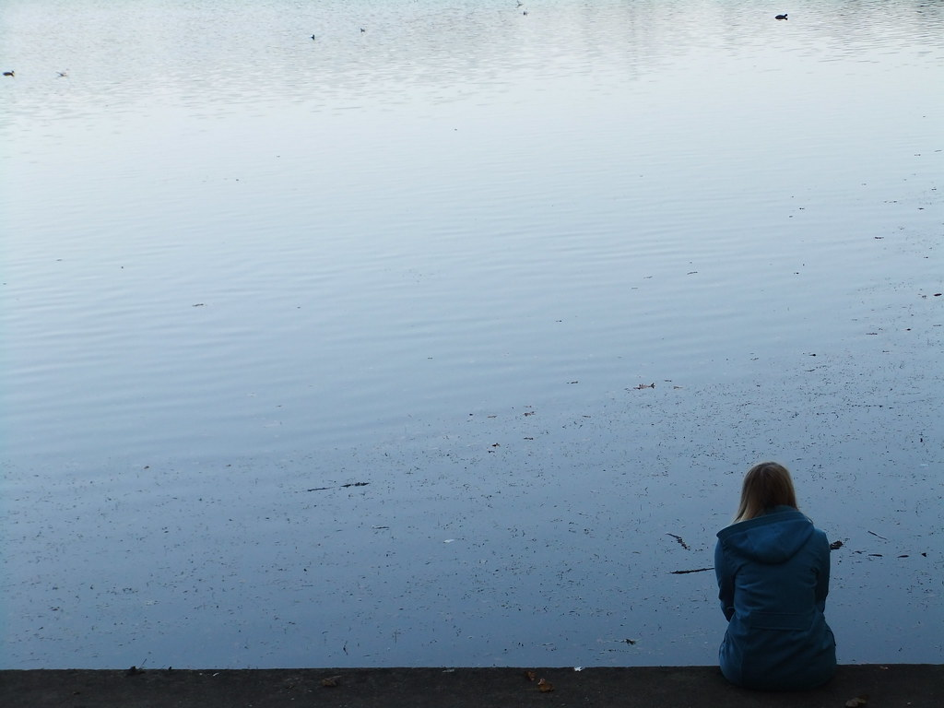
What is identity?
Identity is individual
  Some identities have privileges associated with them.
  Identity can shift over time as we gain knowledge and experience.
  We all have multiple facets of identity that intersect in unique ways.

Slide 3
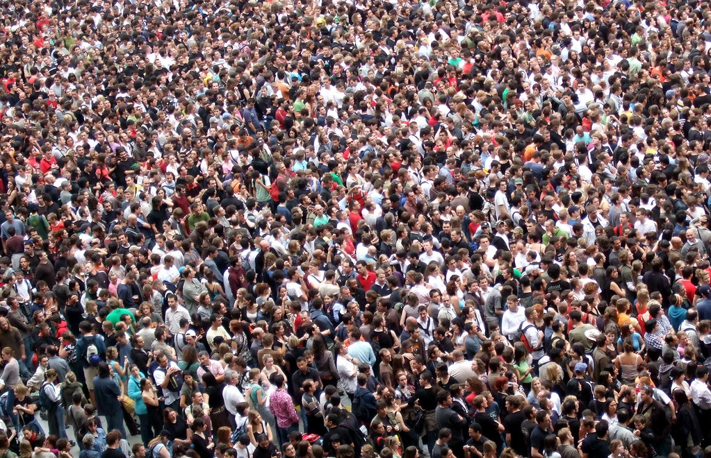
What is culture?
Culture is communal
  Culture is shared, learned, and passed down.
  Culture has surface, shallow, and deep levels.
  Culture includes the perspectives, practices, and products of a community and is more than just food, festivals, and folklore.

Slide 4
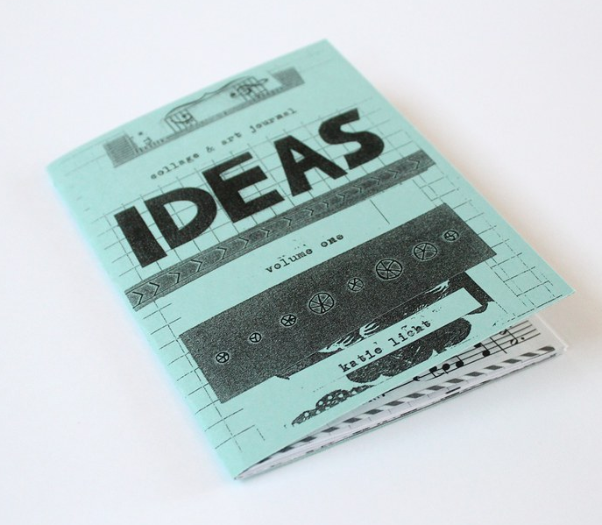
Let’s create some culture zines!
Create a physical (analog) zine
  The zine should be on any topic of your choosing that represents your culture or some aspect of your culture
Record a video of yourself sharing your zine for your classmates and share it to the appropriate platform

Slide 5
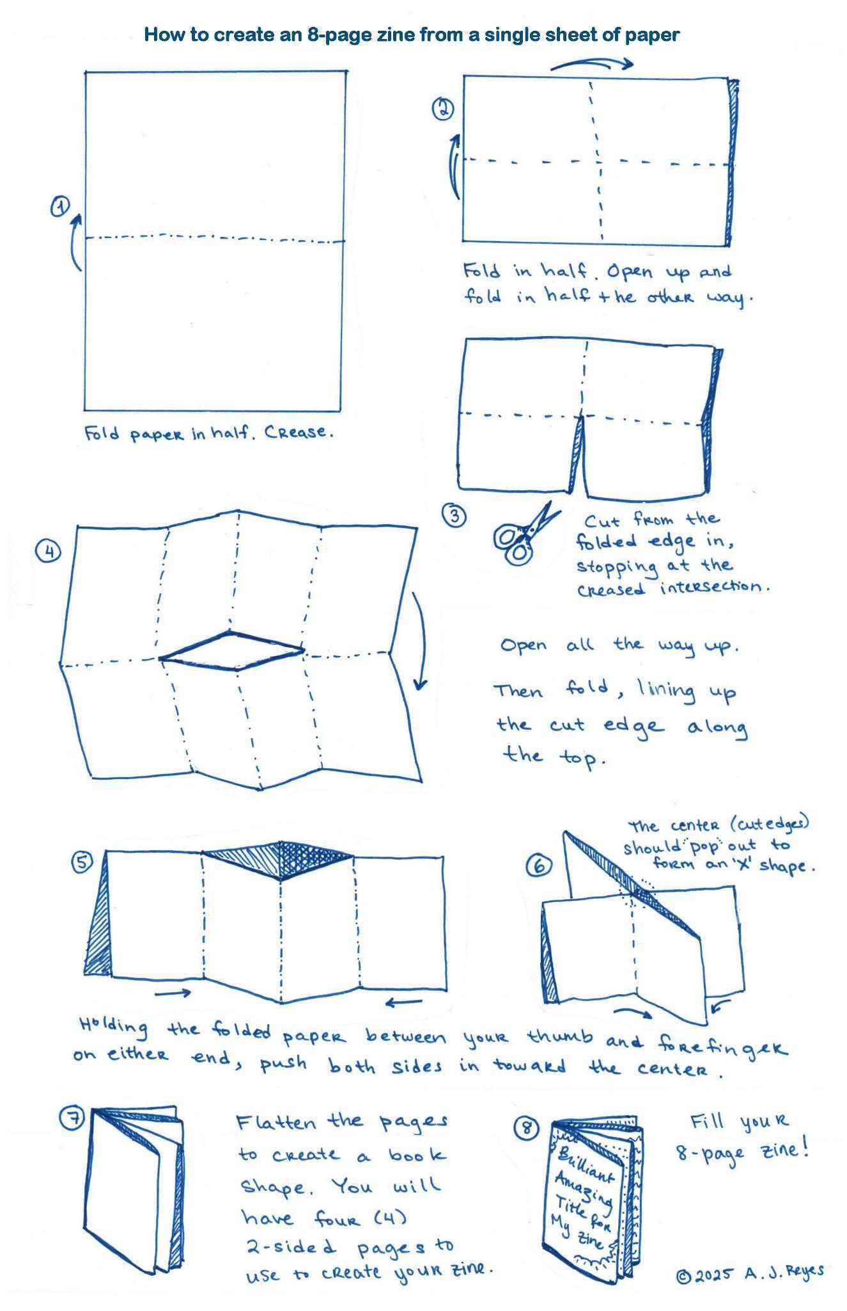
Let’s make a zine!
Be creative and show us your culture!
  Review course materials if you need a refresher on what culture is.
Use varied materials!
  e.g., paper, fabric, images, photos, magazine or book cuttings
Use the 8 pages thoughtfully!
  This zine is telling a story about your culture (or some aspect of it)

Slide 6
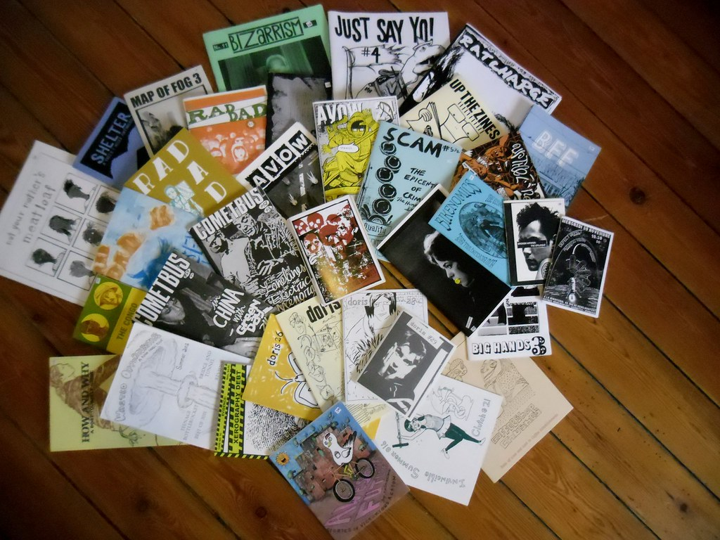
Things to keep in mind
8 pages
  Title page (make it interesting!)
  Include citations for borrowed work
A clear, cohesive theme
Careful planning & attention to detail
Creative and original design
Accurate facts (if applicable)

Slide 7
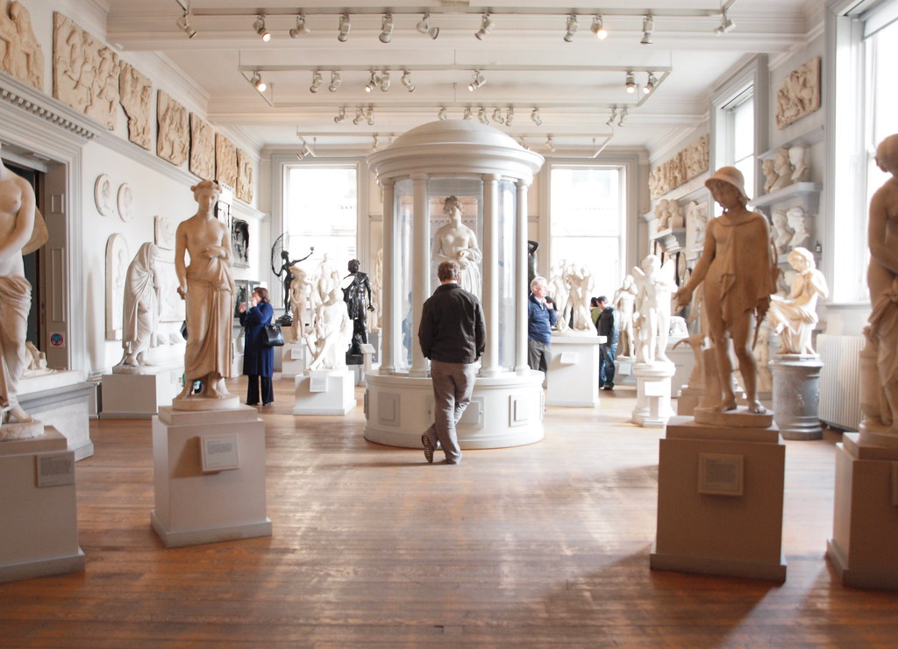
Share your zine with the class!
Watch the video recordings of the zines you and your classmates created.
After watching all the videos, respond to at least one classmate’s zine explanation. You may leave a written comment or a video response.

Slide 8
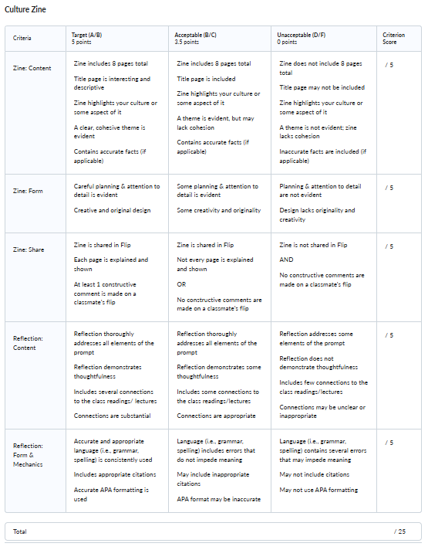
Upload and reflect!
Upload images/scans of your zine, plus a written reflection, to the assignment dropbox.
In your reflection, explain your creative process, curation choices, and the significance of the zine content. Discuss your feelings during creation & video recording, as well as your feelings about viewing your classmates’ work. Connect this project to identity and culture and any applicable readings. Use APA citations as appropriate.

Slide 9
Image Sources
"collage & art journal ideas zine" by katie licht is licensed under CC BY 2.0.
"Alone" by ☺ Lee J Haywood is licensed under CC BY-SA 2.0.
"Crowd" by James Cridland is licensed under CC BY 2.0.
"collage & art journal ideas zine" by katie licht is licensed under CC BY 2.0.
8 page zine instructions by the Authors.
"DISTRO ZINES http://ilostmyidealism.wordpress.com/" by xkidx is licensed under CC BY-SA 2.0.
"Statue Room - Walker Art Gallery" by SomeDriftwood is licensed under CC BY 2.0.
Rubric by the Authors.

