Slide 1
Session 2: PD
Irene A. Bal, Karen Terrell, Hoang Bui, and Stacy Williams, Loyola University Maryland

Slide 2
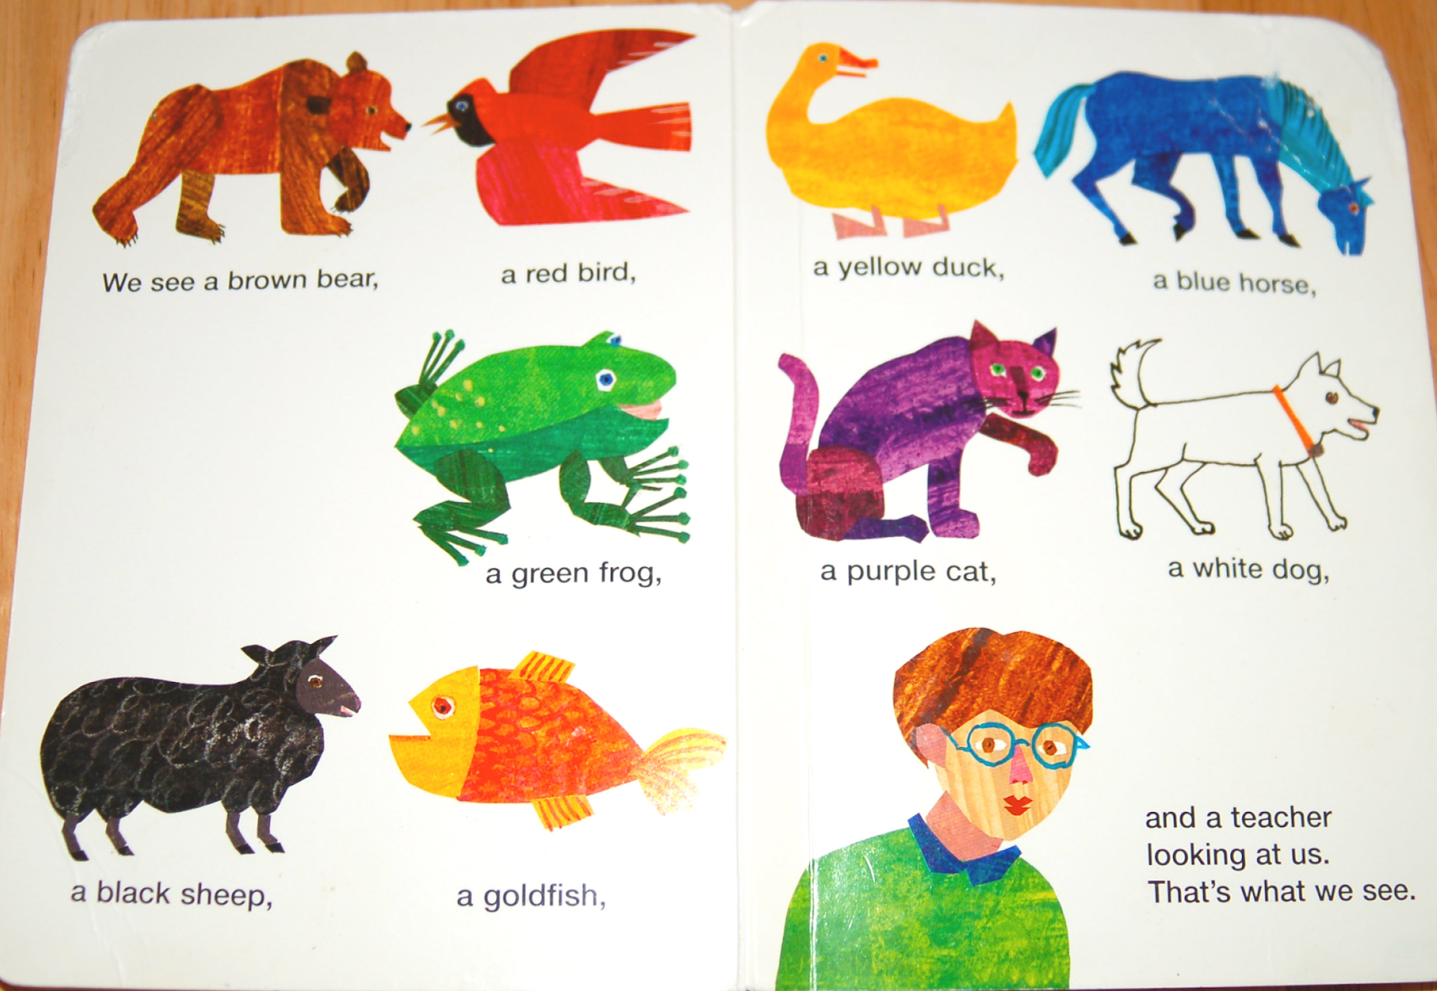
Warm Up Activity: Supervised Machine Learning
Full Lesson: https://www.canadalearningcode.ca/lessons/cats-dogs-machine-learning/
Full Lesson Grade Level: 6-8
Standards
  CSTA 2-DA-08 (Grade 6-8)
  CSTA 2-AP-17 (Grade 6-8)
  AI4K12 2-C-ii (Grade 6-8)
  AI4K12 3-C-iii (Grade 6-8)
    https://ai4k12.org/
  NGSS Practice 1 (Grade 6-8)
  NGSS Practice 2 (Grade 6-8)
Martin, Jr., B. (1967). Brown bear, brown bear, what do you see? Henry Holt and Company.
https://www.canadalearningcode.ca/wp-content/uploads/cats-dogs-ml-download.pdf

Slide 3
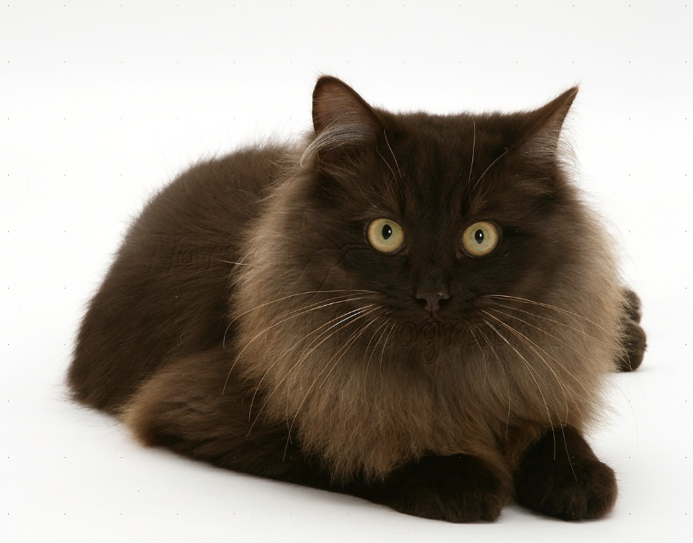
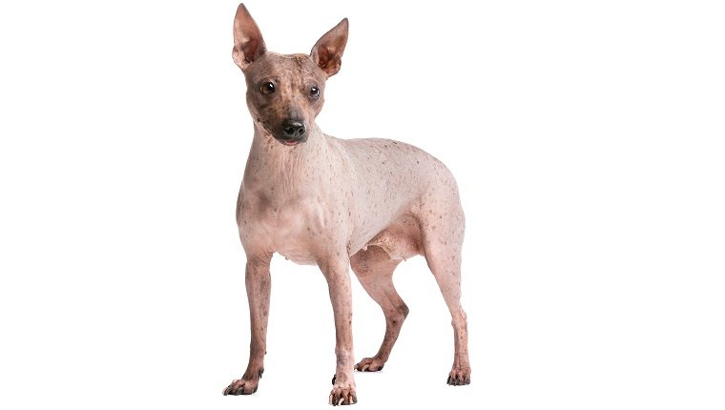
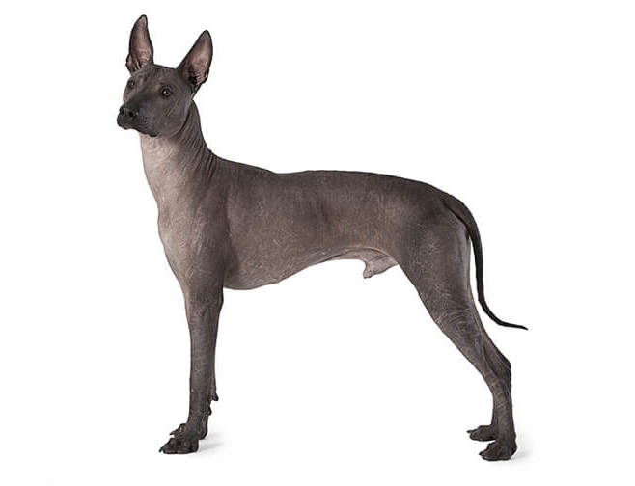
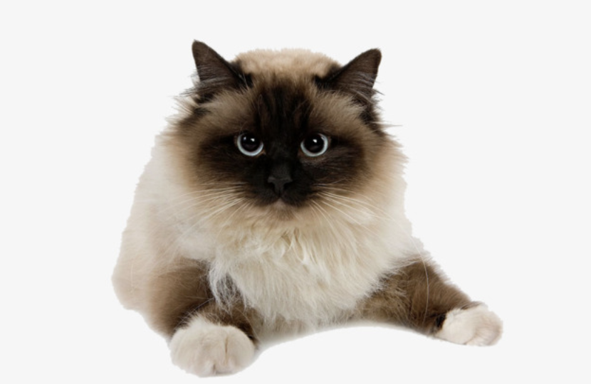
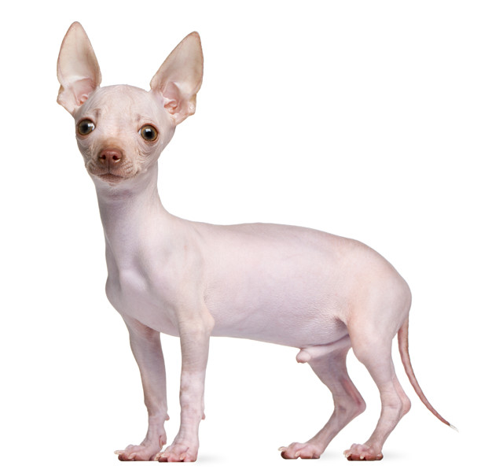
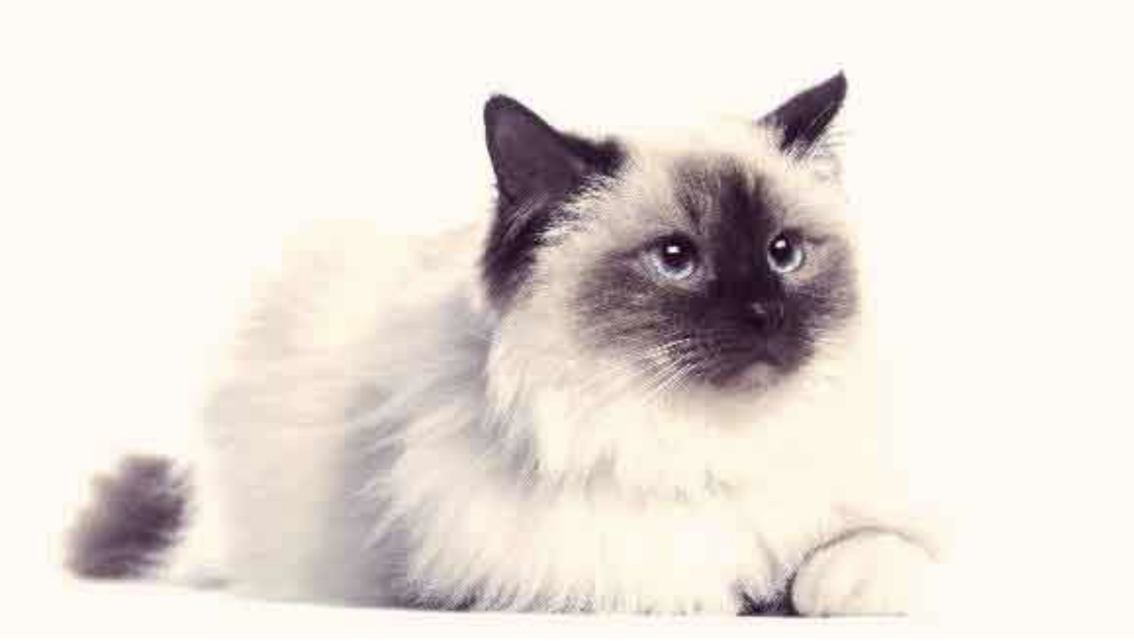
Warm Up Activity: Supervised Machine Learning
Similarities
Similarities
https://www.canadalearningcode.ca/wp-content/uploads/cats-dogs-ml-download.pdf

Slide 4
What Happened?
Algorithm Bias
Did all the cats & dogs get classified correctly?
What group had the higher percentage of correct identifications (cats or dogs)?
What could we have done in our training data (the images on previous slide) to make it more accurate?

