Slide 1
Session 1: CT/CS PD Day
Irene A. Bal, Karen Terrell, Hoang Bui, and Stacy Williams, Loyola University Maryland

Slide 2
11/3/23 Agenda
Morning (9-12:30)
CT/CS Overview (9-9:30)
CT/CS Stations (9:30-10:30)
Break (10:30-10:45)
Coding in Scratch (10:45-11:30)
Micro:Bits (11:30-12:30)
Lunch (12:30-1:15)
Afternoon (1:15-4:00)
Read Aloud (1:15-1:30)
Discussion: CT/CS in Our Classes (1:30-2:00)
TED CS Rollout Plan (2:00-2:15)
Collaboration Brainstorm: CT/CS in Our Classes (2:15-3:15)
Whole Group Share (3:15-3:30)
Wrap Up (3:30-4:00)

Slide 3
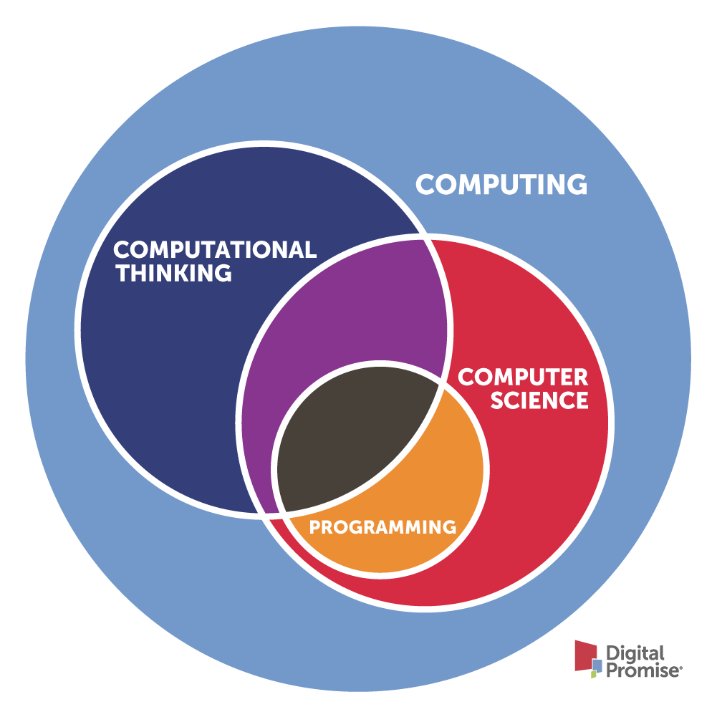
Computational Thinking (CT) & Computer Science (CS)
Computing Education
Computational Thinking
Computer Science
Programming (aka Coding)
https://digitalpromise.org/initiative/computational-thinking/about/

Slide 4
Computational Thinking (CT) Definition
“Computational thinking involves solving problems, designing systems, and understanding human behavior, by drawing on the concepts fundamental to computer science”
(Wing, 2006, p. 33)
https://www.cs.cmu.edu/~15110-s13/Wing06-ct.pdf

Slide 5
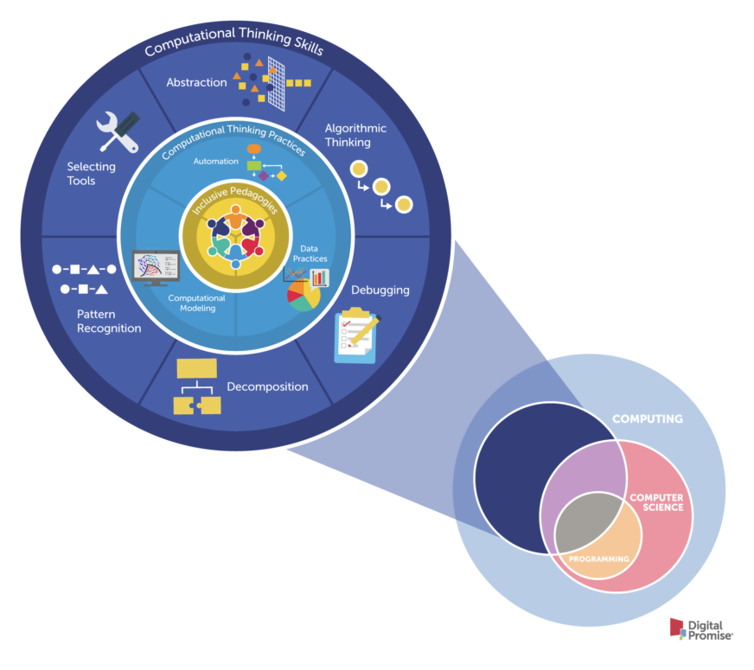
Computational Thinking (CT)
CT Skills
cognitive processes necessary to engage with computational tools to solve problems
CT Practices
combine multiple computational skills to solve an applied problem
Inclusive Pedagogies
strategies for engaging all learners
https://digitalpromise.org/initiative/computational-thinking/about/

Slide 6
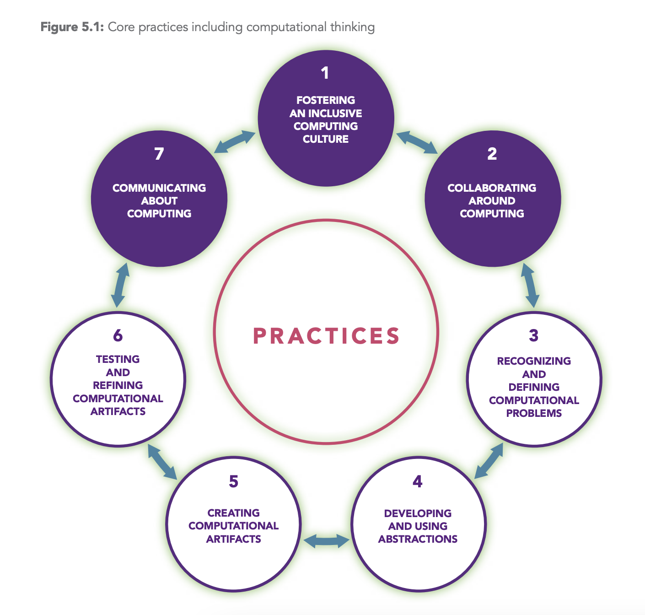
CT Core Practices
Decomposition
  breaking down tasks into simpler tasks.
Pattern Recognition
  finding patterns & similarities to solve complex problems
Abstraction
  creating generalizations by extracting common features from specific examples
Algorithmic Thinking
  identifying the needed steps to solve the complex problem
https://k12cs.org/wp-content/uploads/2016/09/K%E2%80%9312-Computer-Science-Framework.pdf#page=87
K-12 Computer Science Framework (2016) licensed under a Creative Commons Attribution-NonCommercial-ShareAlike 4.0 International License (CC BY-NC-SA 4.0).

Slide 7
Computer Science (CS) Definition
“the study of computers and algorithmic processes, including their principles, their hardware and software designs, their applications, and their impact on society”
(Tucker et al., 2006, p. 2)
https://k12cs.org/wp-content/uploads/2016/09/K%E2%80%9312-Computer-Science-Framework.pdf#page=87

Slide 8
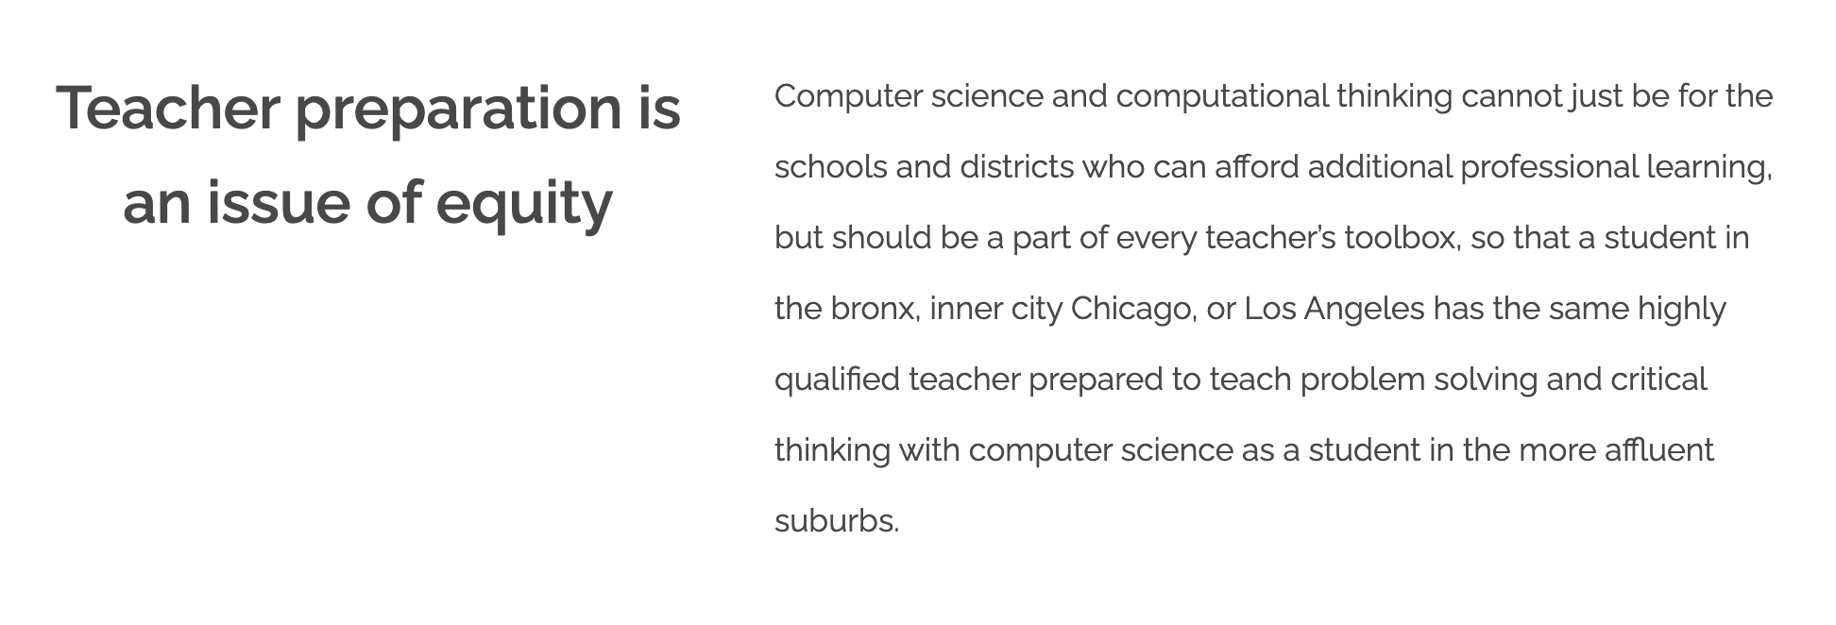
CT/CS Teacher Preparation: Equity
https://www.csfored.org/

Slide 9
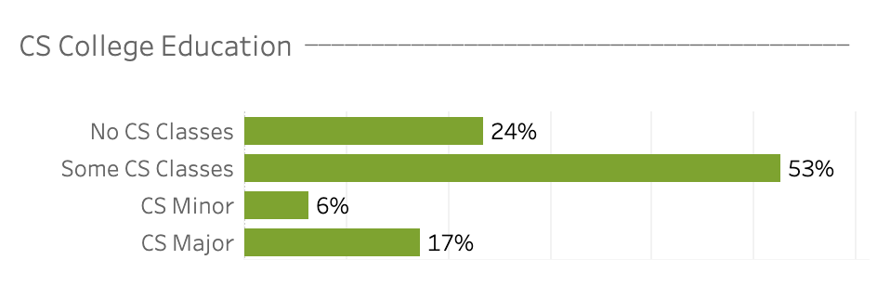
CT/CS Teacher Preparation: Access
N = 2,238 PK-12 Teachers
https://landscape.csteachers.org/

Slide 10
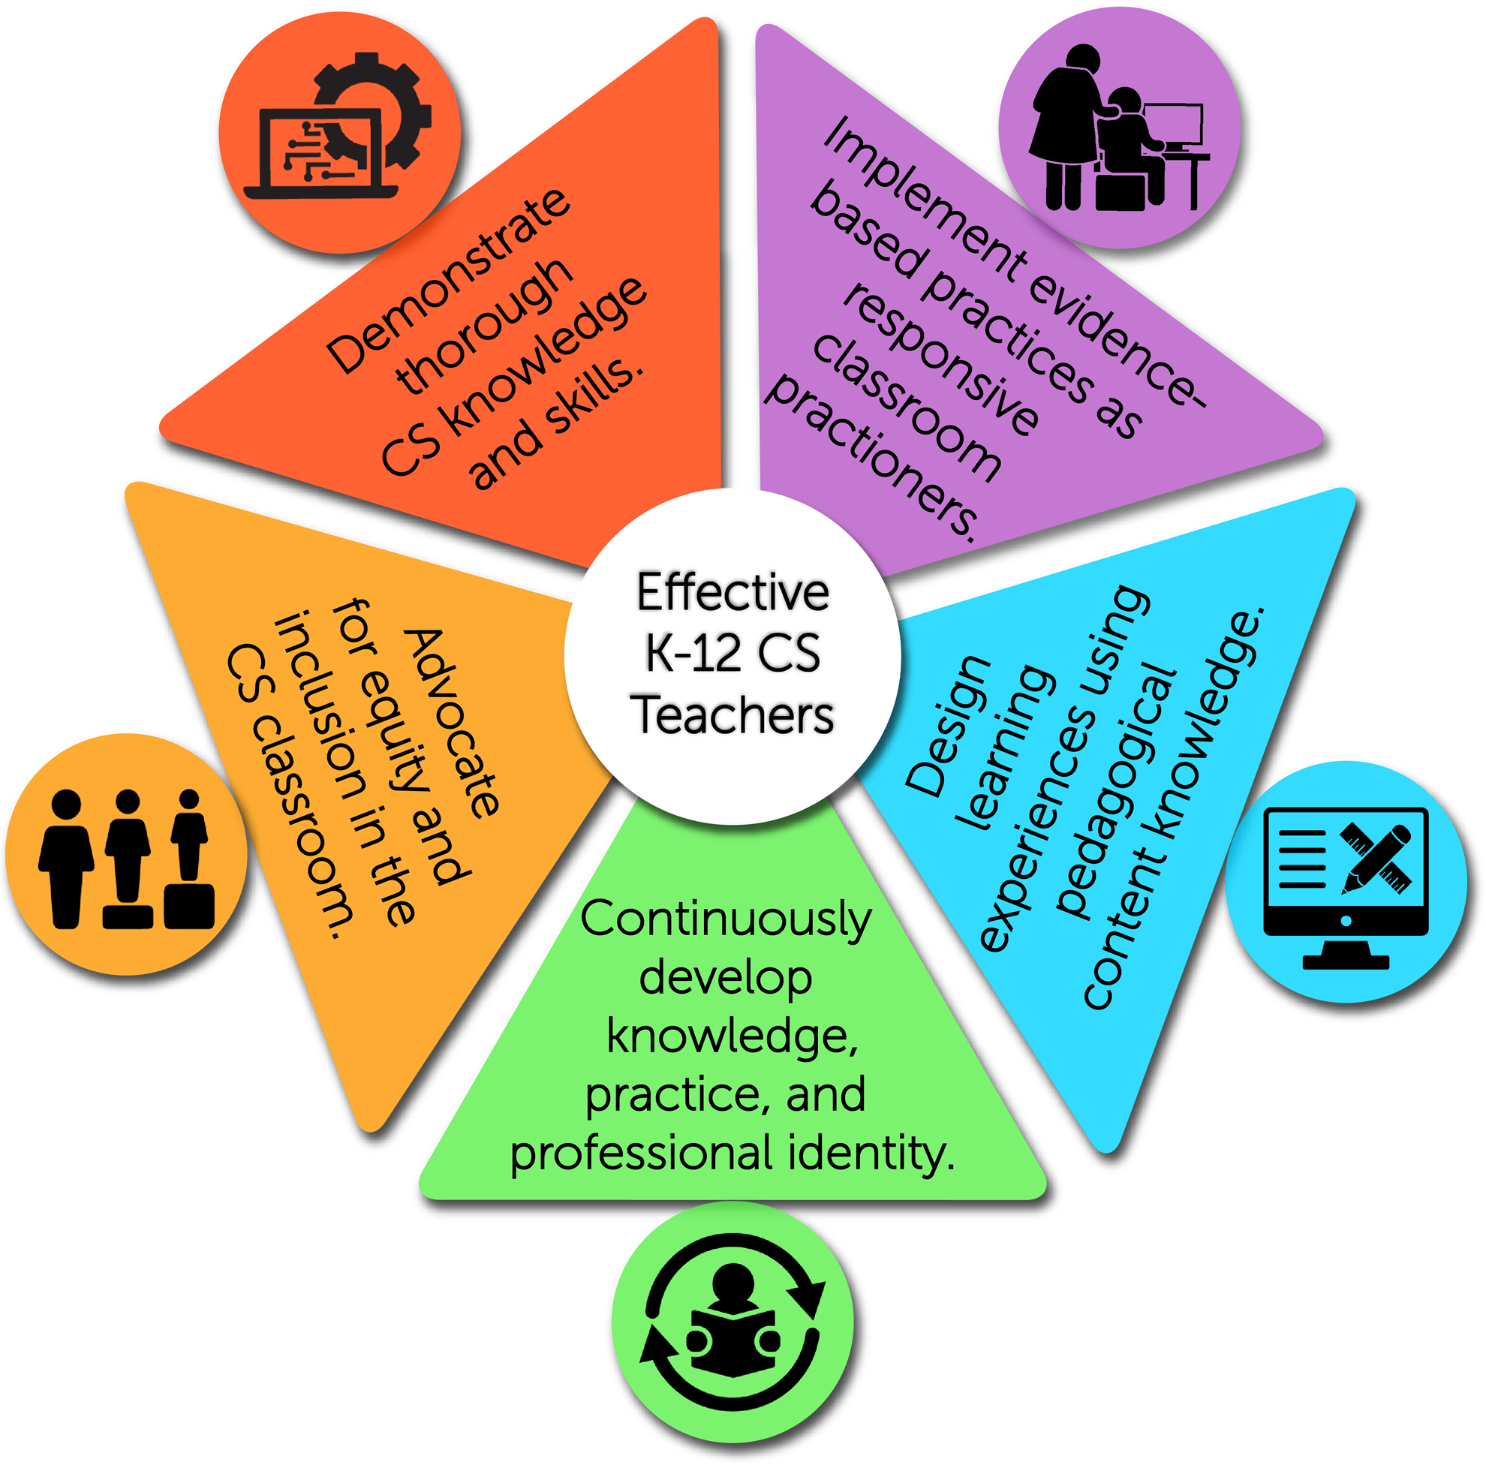
CS Teacher Standards
The purpose is to:
explain what CS teachers should know and be able to do in the classroom.
provide aspirational goals to guide teachers’ professional learning as they continuously develop their teaching practice from novice to master CS teacher.
establish benchmarks for professional development providers as they craft CS PD experiences.
CSTA (2020) Standards for CS Teachers licensed under a Creative Commons Attribution-NonCommercial-ShareAlike 4.0 International License (CC BY-NC-SA 4.0).
https://csteachers.org/teacherstandards/

Slide 11
CT/CS Stations (20 min. each)
Scratch Jr.
Early/Pre-Reader Coding
Tablets Needed (some are provided)
Code.org
K-12
Computers/Tablets Needed
Unplugged
K-12
No Devices Needed
3 Options:
Maze
  K-12 - communication, listening
  Game w/ No Rules
    K-4 - pattern matching, abstraction
  Pixels & Instagram
    6-12 - Geometry, pattern matching, abstraction

Slide 12
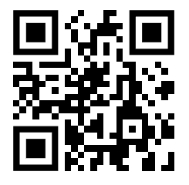
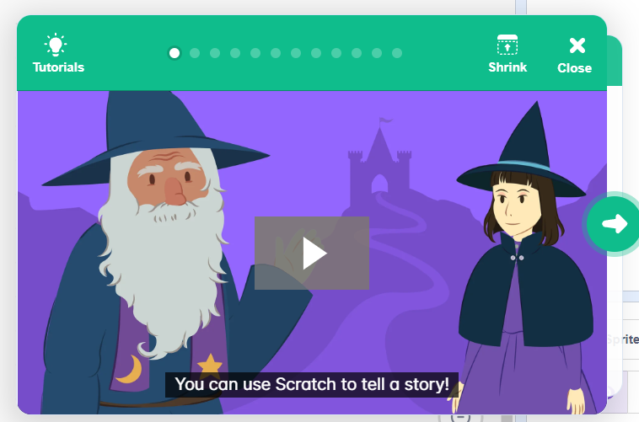
Intro to Scratch - Create a Story
https://scratch.mit.edu/
  Create Scratch account
Start brainstorming ideas for a story!

Slide 13

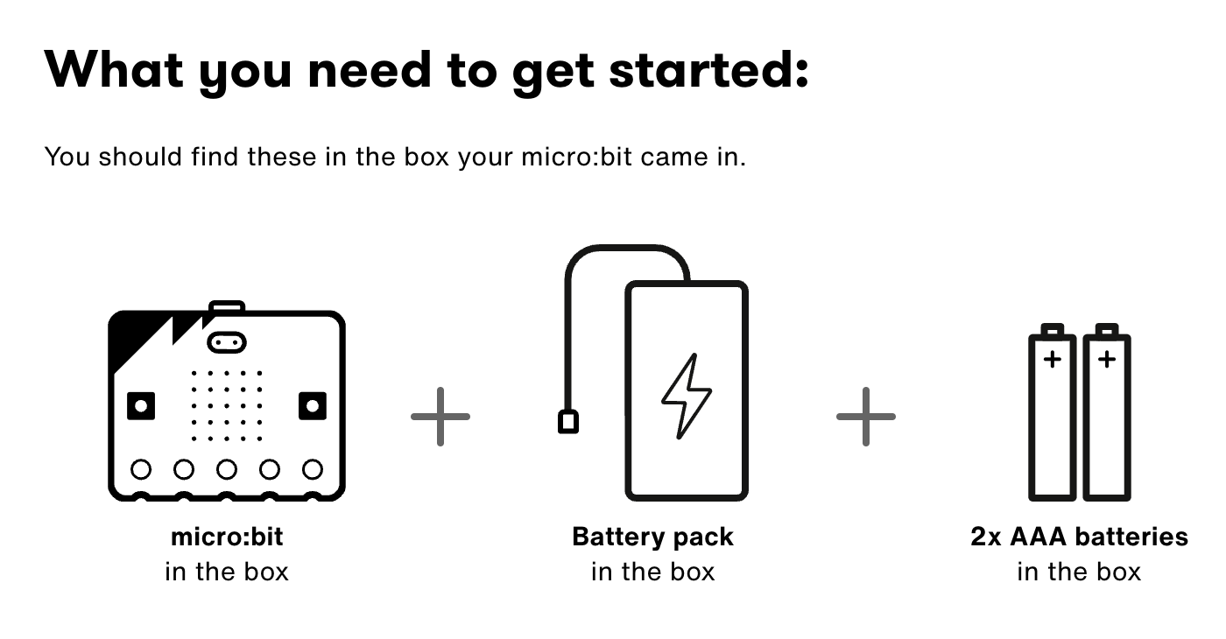
micro:bits
Let’s learn a bit about the tech…

Slide 14

micro:bits…Let’s code
Go to makecode.microbit.org/#
You can sign in with Microsoft using your Loyola account

Slide 15
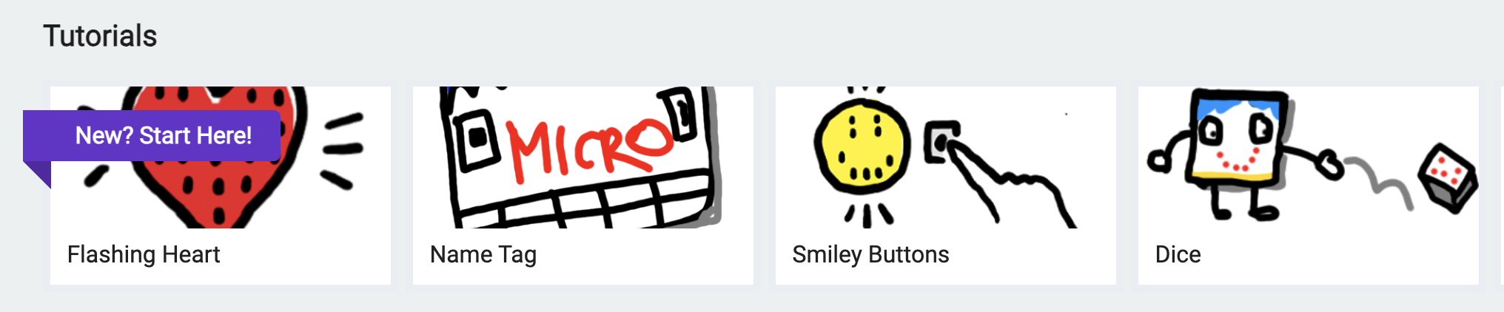
micro:bits…Get warmed up
Get warmed up…
And now, an application:
https://microbit.org/projects/make-it-code-it/environment-exploration/

Slide 16
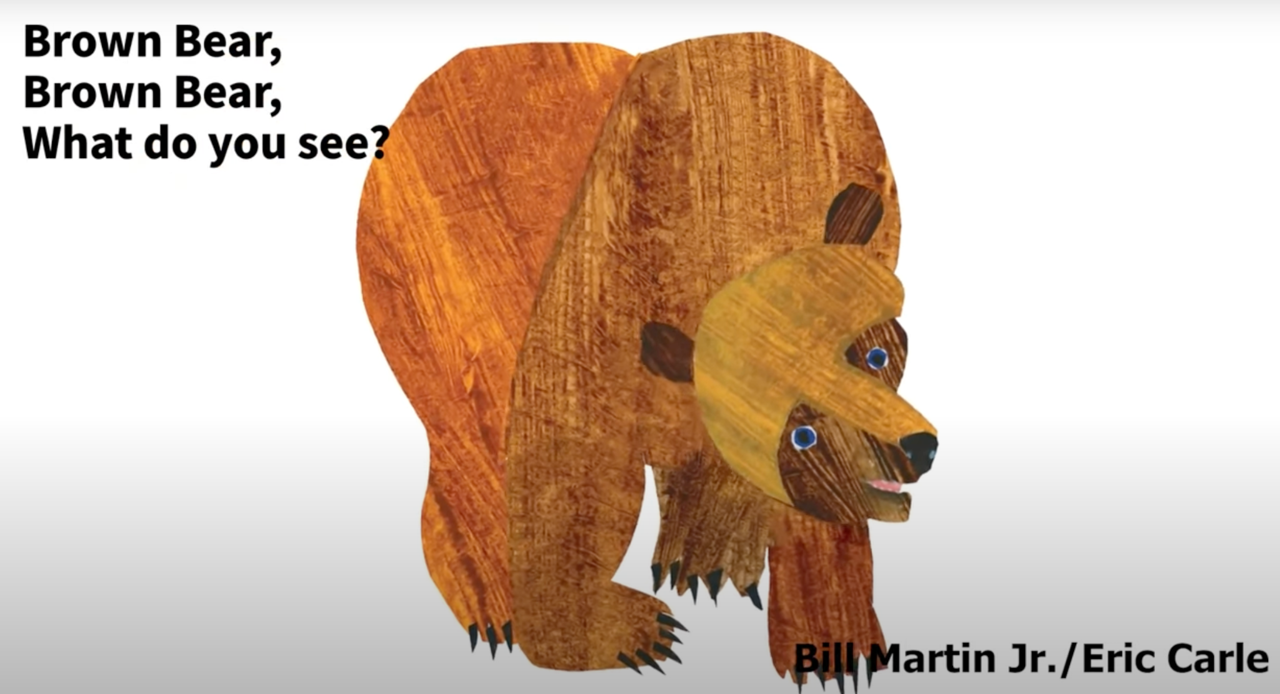
Read Aloud
Martin, Jr., B. (1967). Brown bear, brown bear, what do you see? Henry Holt and Company.

Slide 17
Collaboration Brainstorm: CT/CS in Our Classes
Purpose: Collaborate with colleagues to brainstorm ideas for integrating CT/CS in our teacher preparation courses.
Outcome: Each team develop at least one idea/activity to integrate into current course content. Record ideas on chart paper to share.

Slide 18
Wrap Up!
Share What You Learned!

Slide 19
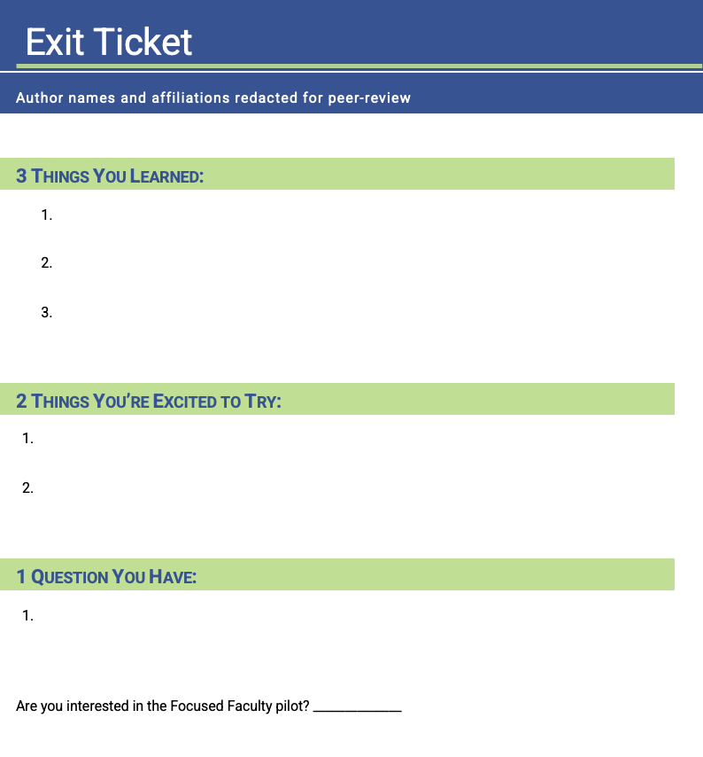
Reflection
Complete the Exit Tickets with a 3-2-1 Reflection!

