Slide 1
Scratch Day for Educators and Caregivers
Ayanna Perkins and Danielle Jones

Slide 2
Agenda
Introduction
Tennessee Computer Science Legislation
Overview of Computer Science and Computational Thinking
Overview of Scratch Jr. `
  Benefits of using Scratch Jr.
Elementary School Hands-On Activity
  First ScratchJr Project
    Activity 1: First ScratchJr Project Walk-through
    Activity 2: ScratchJr Create Your Own Story Project
Break
Overview of Scratch
  Benefits of using Scratch
Middle & High School Hands-On Activity
  Scratch Olympics
    Part I: Background
    Part II: Sprites and Props
    Part III: Microbit Integration*
    Part IV: Gymnastics
    Part V: Gymnastics
Taking it a step further
  Resources for coding
Reflection
Closing

Slide 3
Introductions

Slide 4
Introduce Yourself to the Class
Name
Are you a teacher or a parent
  (If teacher, grade/subject, school, and district)
  If parent, grade and school of child
  If both, share both
Why did you come today?
How can we help our students

Slide 5
Tennessee Computer Science Legislation

Slide 6
July 2017 | Tennessee State Board of Education recently gave final approval to the implementation of the first state-approved set of computer science standards for grades, K-8 which will be incorporated in classrooms in the fall of 2019.
February 2022 | Chapter 979 of the Public Acts of 2022, filed for introduction to ensured all public elementary, middle, and high school students have access to computer science (CS) coursework and resources. It also provides teachers with a no-cost route to earn an additional CS endorsement and offers both teachers and schools incentives to participate in high-quality CS professional development.
April 2022 | Chapter 979 of the Public Acts of 2022, signed by Governor.
Fall 2022 | Computer Science Endorsement Pathway rollout
Fall 2023 | Professional development on new standards, course materials, and resources
 | Computer Science standards for K - 12 available
Fall 2024 | Middle and high school educators must have a Computer Science endorsement to teach courses
 | Elementary school integration requirement begins
 | Middle school course requirement begins
 | Incoming freshman cohort high school course graduation requirement begins
Class of 2028 | The first cohort of high school students who completed the computer science course graduation requirement will graduate from high school

Slide 7
What does this mean for teachers?
Elementary
Middle School
High School
One School Year (1 credit)
Starting with the freshman cohort of the 2024-25
Can be counted as either a third-lab science or a fourth-credit math
Integration in current curricula to expose students to CS before MS and HS.
One Grading Period
Starting with the entering cohort for the middle school 2024-25
*Opportunity for integration across subjects.*

Slide 8
Overview of Computer Science and Computational Thinking
Notes:
Overcoming Barriers to CS Education
Limited resources or funding
Lack of teacher training or confidence
Misconceptions about who can succeed in CS
Competing priorities in school curriculum
What other barriers have you encountered? How can we address them?
The Digital Skills Gap
Growing demand for tech-savvy workers
Not enough qualified candidates to fill positions
CS education helps close this gap
Gives students competitive advantage in job market
How can we better prepare our students for this digital future?

Slide 9
Computer Science
General Definition
  “the study of computers and algorithmic processes, including their principles, their hardware and software designs, their applications, and their impact on society” Tucker et al., 2003
Shorter Definition
  the formal academic study of computers and processes

Slide 10
teaches important, transferable skills
Computer Science
confidence
commitment
communication
creative
problem solving
cooperative learning
Notes:
But, CS is relevant to all fields. We want students to follow their passion, and we are supporting them build skills that can open more doors.
Creativity
Collaboration
Persistence/Commitment
‘grit’
Problem Construction & Solving
CS benefits ALL students by teaching important, transferable skills. It drives innovation, creativity, problem solving, and collaboration, and it supports mathematical thinking. These are 2st century skills that students need for any career.

Slide 11
Computational Thinking
General Definition
  “a way of solving problems, designing systems, and understanding human behavior that draws on concepts fundamental to computer science” Wing, 2006
Shorter Definitions
  Skills and practices used to create solutions for a computer
Notes:
Computational thinking is a fundamental skill for everyone, not just computer scientists.” (Wing, 2006).
Computational Thinking is a system of understanding and solving problems in a logical way that people and computers can understand.
It is the ability to integrate human creativity and insight with machine computing
Pixar Movies: Inside Out, The Incredibles, Soul, Bugs Life, Finding Nemo
Programmers and Artist working together to create a new in

Slide 12
Seeing the “Big Picture” of Computer Science
Computational Thinking (CT)
  Using special thinking patterns and processes to pose and solve problems or prepare programs for computation
Benefits
a strategic thought process
all students can learn
can be applied across many content areas
an entry point for teachers
Notes:
Benefits of Early CS Exposure
Builds confidence with technology at a young age
Develops computational thinking skills
Encourages persistence and resilience
Fosters curiosity about how things work
Sets foundation for advanced CS concepts later

Slide 13
Overview of Scratch Jr.

Slide 14
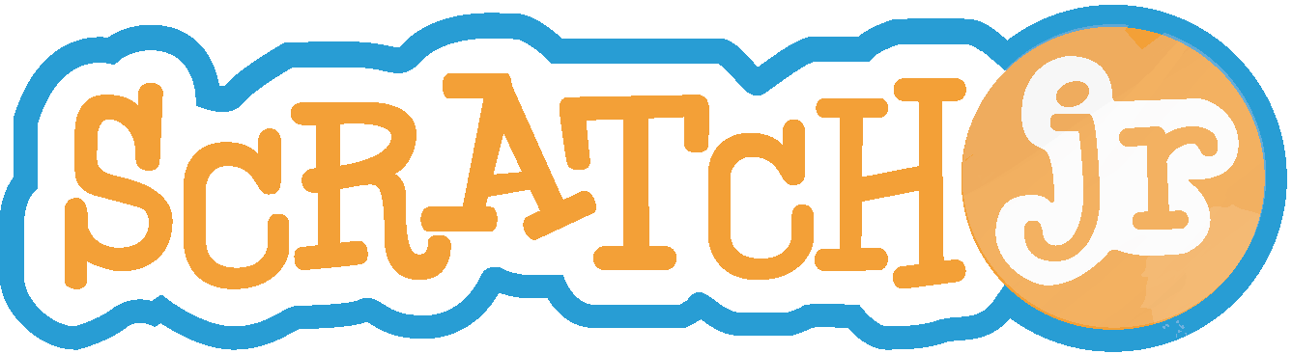
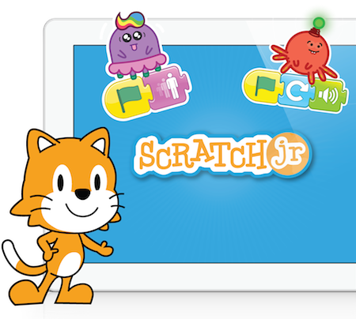
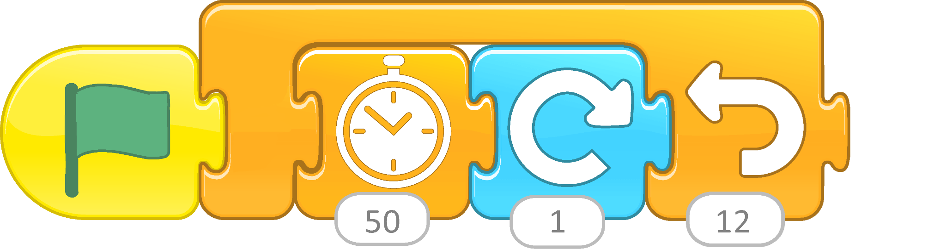
Scratch Jr.
Scratch Jr is geared toward young students aged 5 to 7 and allows children to create interactive games and stories with a basic programming language. Kids can snap together blocks to make characters come to life with movement and design edits.
Available as app on iOS, Fire, and Android devices and on unofficial website.

Slide 15
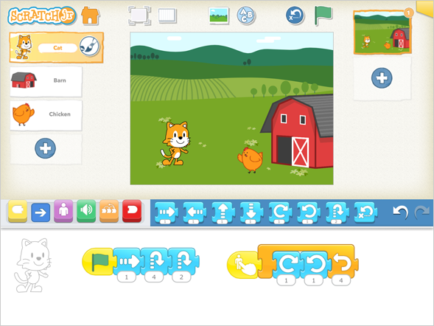
Benefits of using Scratch Jr.
Designed for non-readers
Intuitive interface
Variety of choices
Storytelling and Creativity
Source: https://www.commonsense.org/education/reviews/scratchjr
Notes:
Low Barrier To Entry
Usable with several grade levels
Intuitive interface
Children can navigate and use the app independently after some initial guidance.
Variety of choices
Kids can choose from many characters and scenes, and use ready-made programs for backward design.
Storytelling and creativity
Kids can combine storytelling and artistic creativity with programming code blocks.

Slide 16
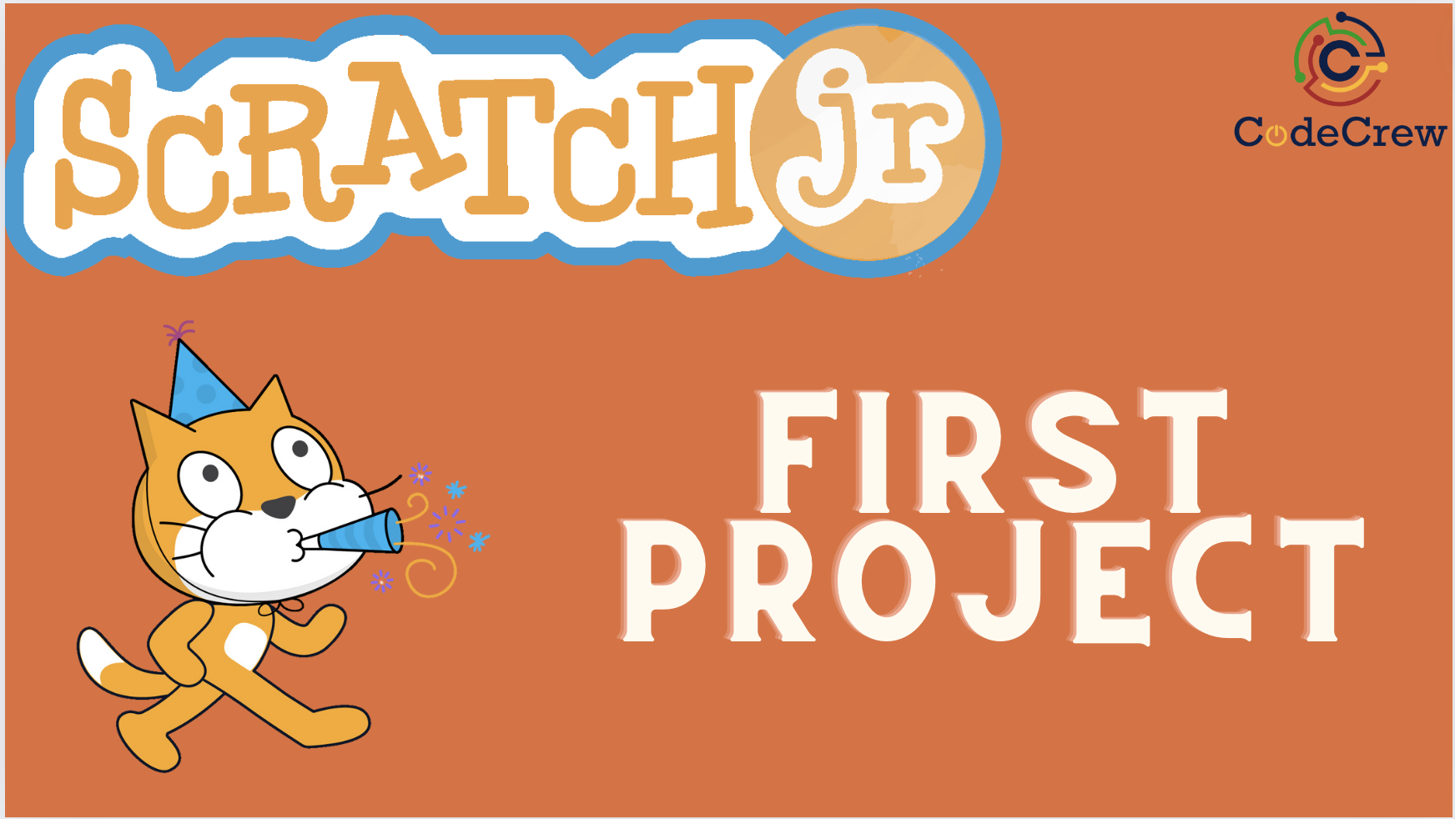
K-5 Project First Project
Activity 1: First ScratchJr Project Walk-through
Activity 2: ScratchJr Create Your Own Story Project

Slide 17

Break Time

Slide 18
Overview of Scratch

Slide 19
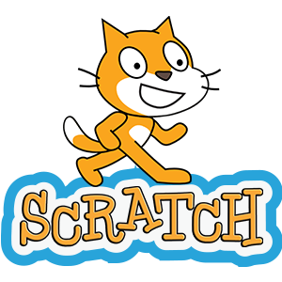
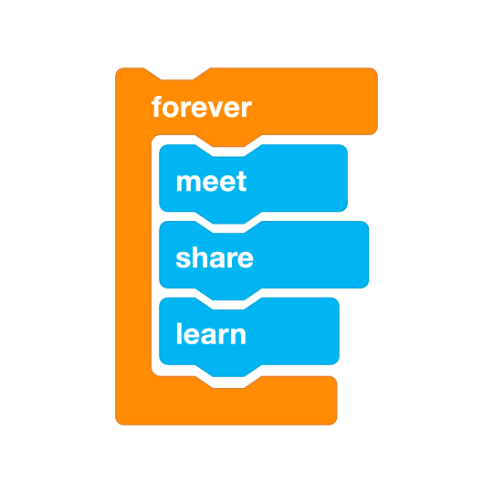
Scratch promotes…..
Computational Thinking
Problem solving skills
Creative teaching and learning
Self-expression
Collaboration
Equity in computing
Scratch is the world’s largest coding community for children and a coding language with a simple visual interface that allows young people to create digital stories, games, and animations. Scratch is always free and is available in more than 70 languages.
Scratch is designed, developed, and moderated by the Scratch Foundation, a nonprofit organization.

Slide 20
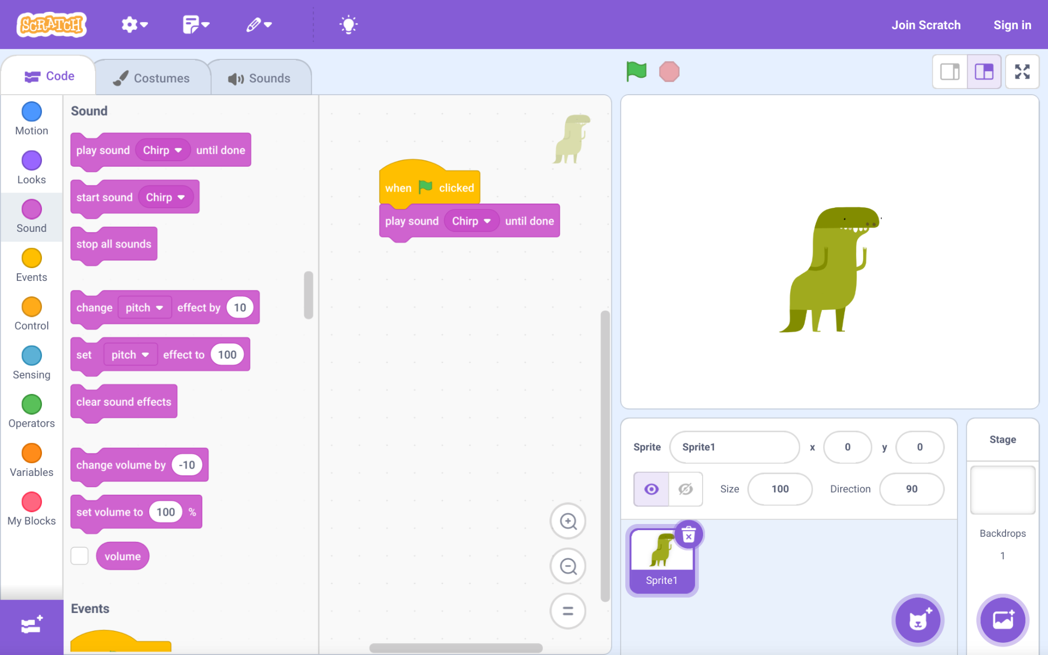
Benefits of using Scratch
can easily integrated into different subjects
“tackle meaningful projects that express understanding of novels, historical events, and math and science concepts while also reinforcing coding and computational thinking skills”
draws students of all types into coding
teaches all the essential concepts of coding
massive community for support and resources,
lays a foundation for future learning
“removes the obstacles that beginners often find so difficult (syntax, terminology, etc.) “
Source: https://www.commonsense.org/education/reviews/scratch
Notes:
Low Barrier To Entry
Usable with several grade levels
Intuitive interface
Children can navigate and use the app independently after some initial guidance.
Variety of choices
Kids can choose from many characters and scenes, and use ready-made programs for backward design.
Storytelling and creativity
Kids can combine storytelling and artistic creativity with programming code blocks.

Slide 21
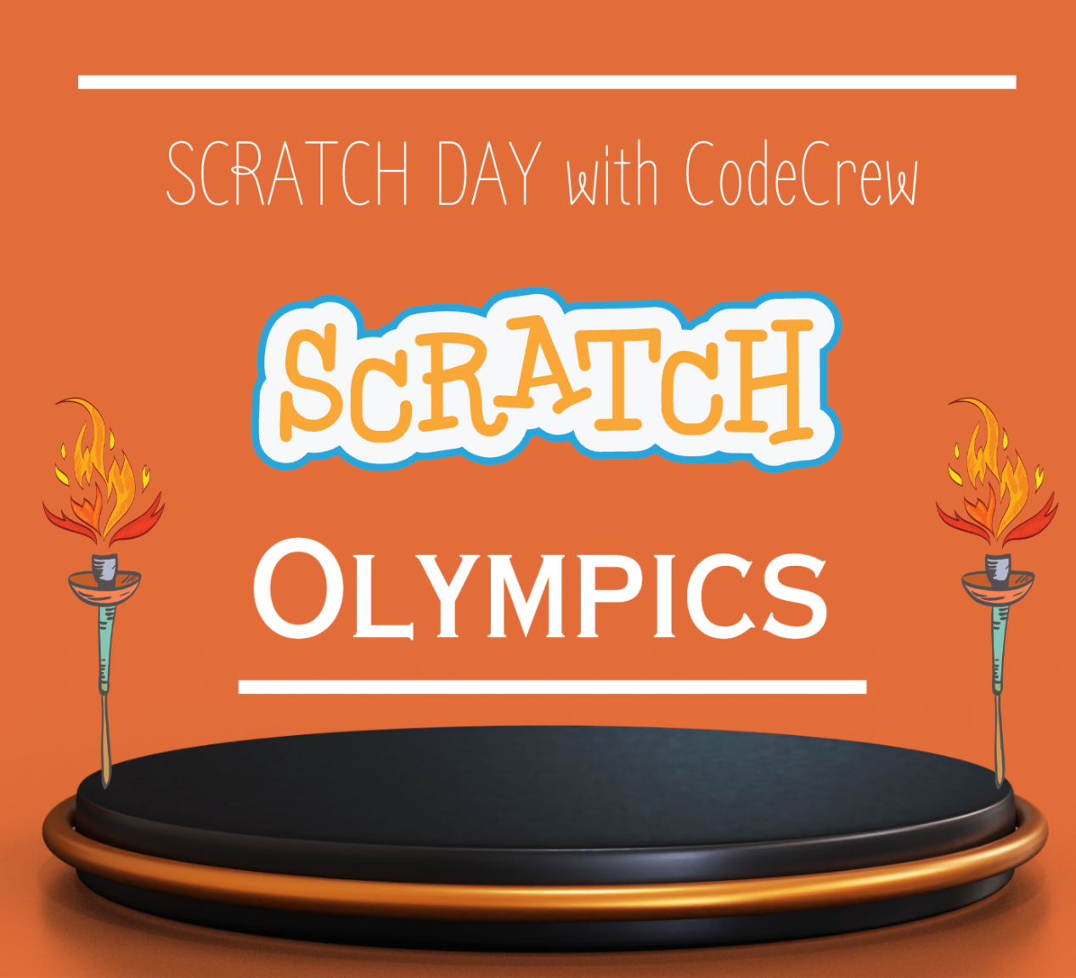
6 - 12 Project Scratch Olympics
Part 1: Background
Part II: Sprites and Props
Part III: Microbit Integration *
Part IV: Gymnastics
Part V: Artistic Gymnastics

Slide 22
Taking it a step further

Slide 23
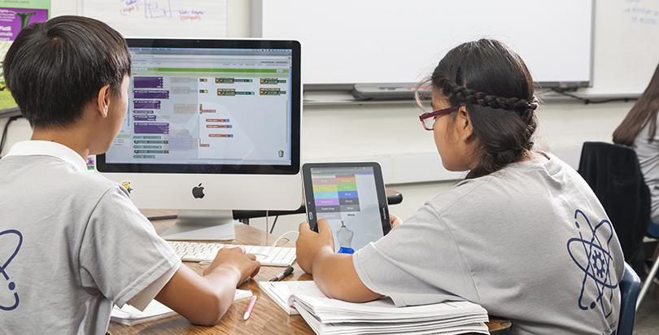
Next Steps: Bringing CS to Your Classroom
Start small: Incorporate one CS lesson or activity
Explore free online CS resources and curricula
Collaborate with colleagues to develop CS integration ideas
Advocate for CS education in your school or district
Continue your own CS learning journey
What's one action you'll take to bring more CS to your students?

Slide 24
Additional Scratch Resources
Explore for FREE
  Scratch Educator Meetups
  Creative Computing Guide designed by the Creative Computing Lab at the Harvard Graduate School of Education
  Educators Resources by the Scratch Foundation
  Coding As Another Language (CAL) curriculum by Prof. Marina Umaschi Bers and her DevTech Research Group
  CS First curriculum by Google
  Code Club hosted by the Raspberry Pi Foundation
Brainstorm ways to bring Scratch to your school or community.
  After-school club
  Summer Camp
  Integration into core subjects classes
  Standalone Instructional Unit

Slide 25
Staying Current with CS Trends
Join professional CS educator networks
Attend CS education conferences and workshops
Follow CS education blogs and social media
Participate in online CS courses and webinars
Collaborate with local tech companies or universities
What resources have you found helpful for professional development in CS?

Slide 26

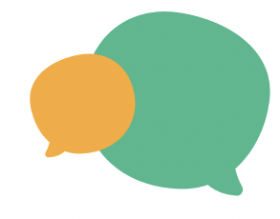
Let’s Reflect
How could you use Scratch as a tools to teach foundation skills?
Why use it (pros/cons)? Difficulty level?
What students learn when they use?
How might you explore connecting CS with real world or your classroom?

Slide 27
End of the Day

Slide 28
Closing Survey
QR Code for Survey
Please stay a few minutes for a picture!
bit.ly link to survey

