Slide 1
Scratch Jr. Introduction Project
Elexis Allen

Slide 2

SCRATCH JR FIRST PROJECT

Slide 3
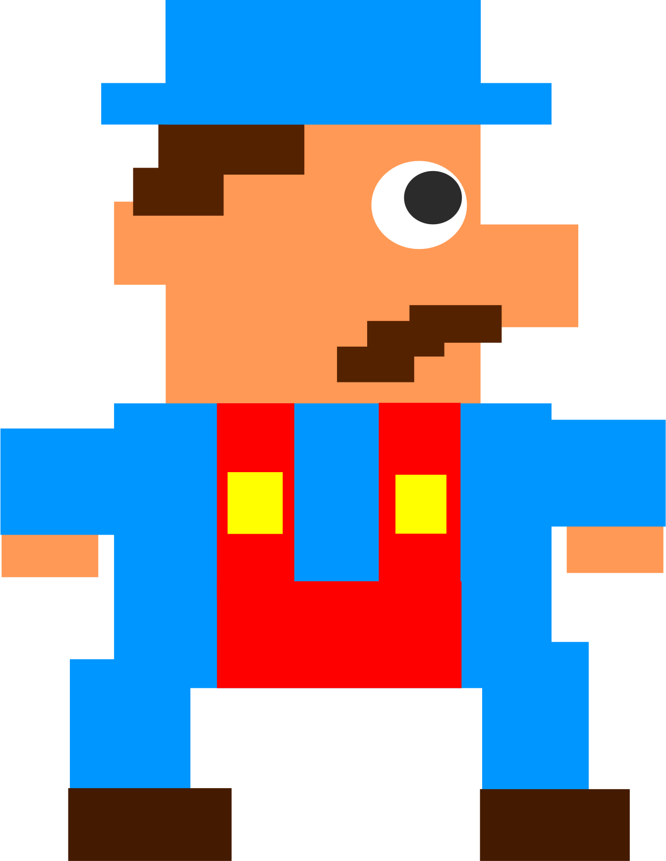
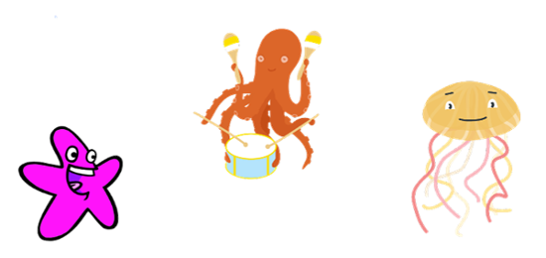
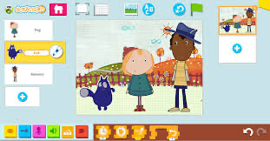

WHAT IS SCRATCH JR.?
BLOCK CODING
PROGRAMMING LANGUAGE!
FUN!
VIDEO GAMES!
STORYTELLING!

Slide 4
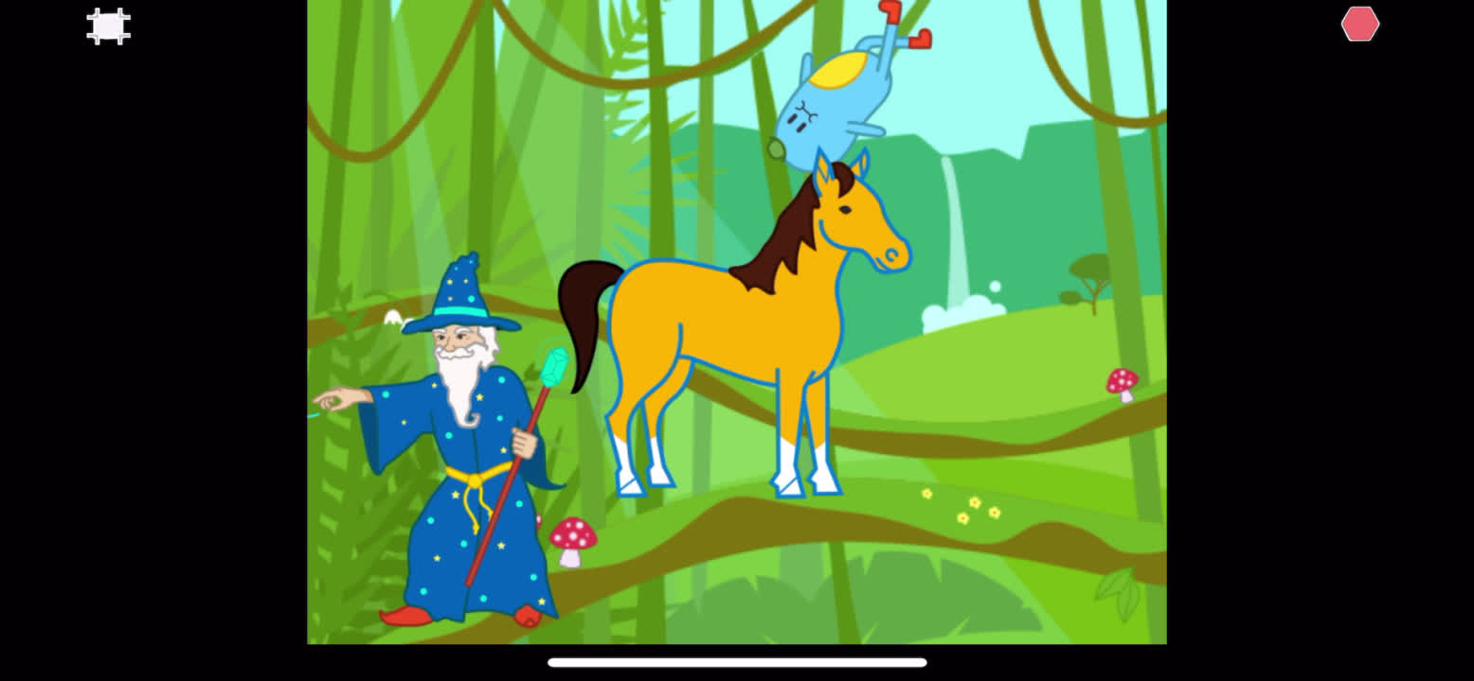
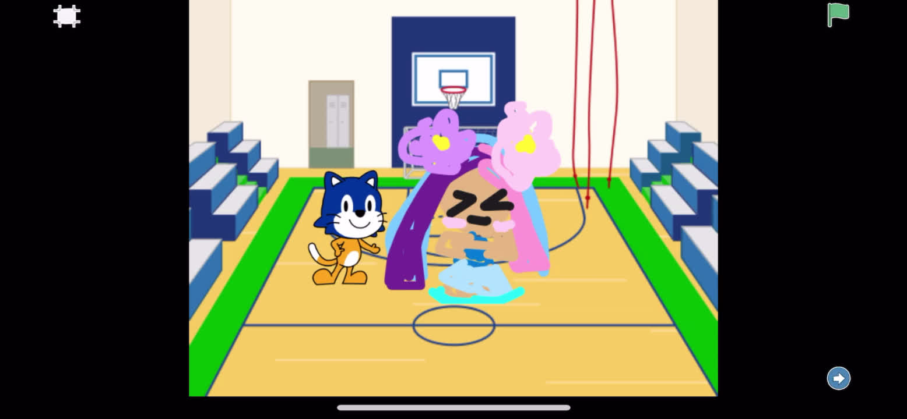
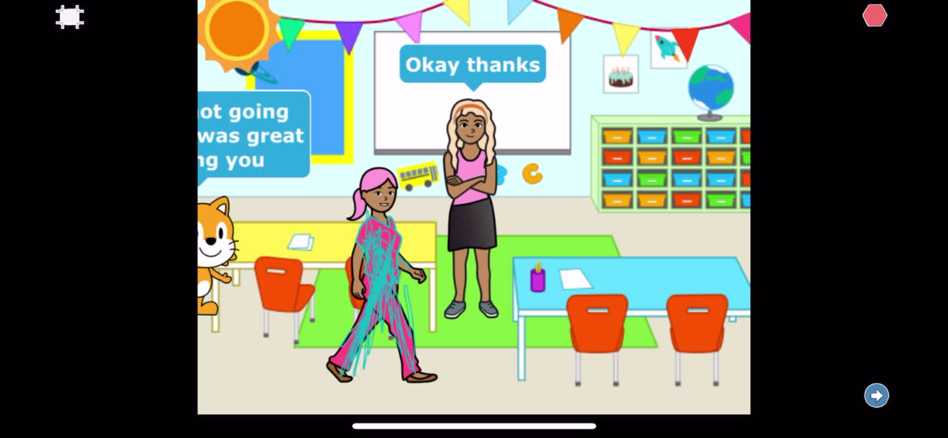
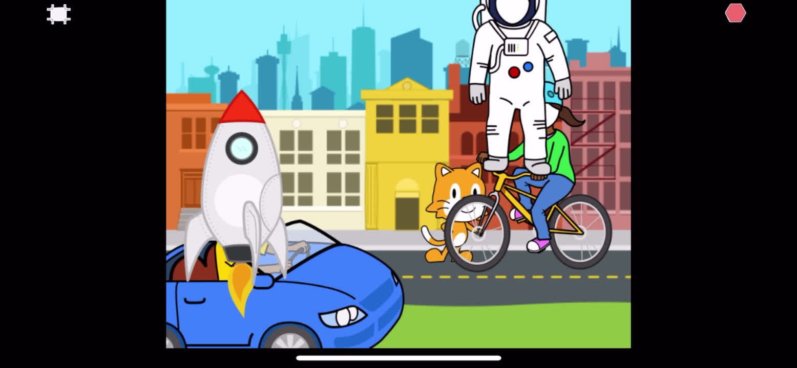
PROJECTS FROM CUBCODERS JUST LIKE YOU!

Slide 5
LET’S SCRATCH!

Slide 6
COMMANDS

Slide 7
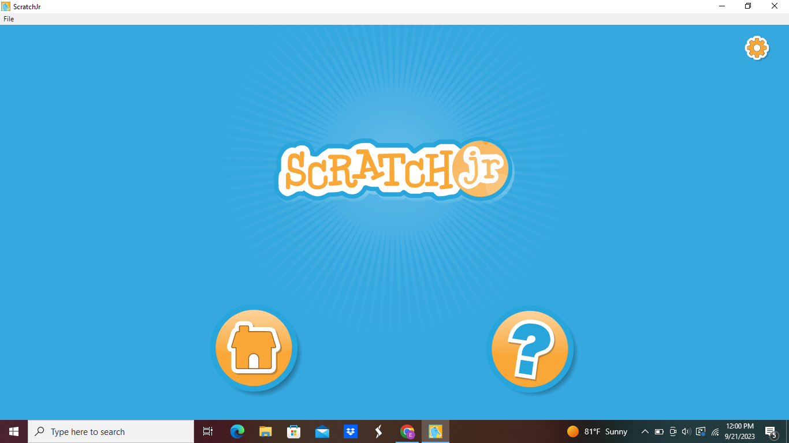
START HERE

Slide 8
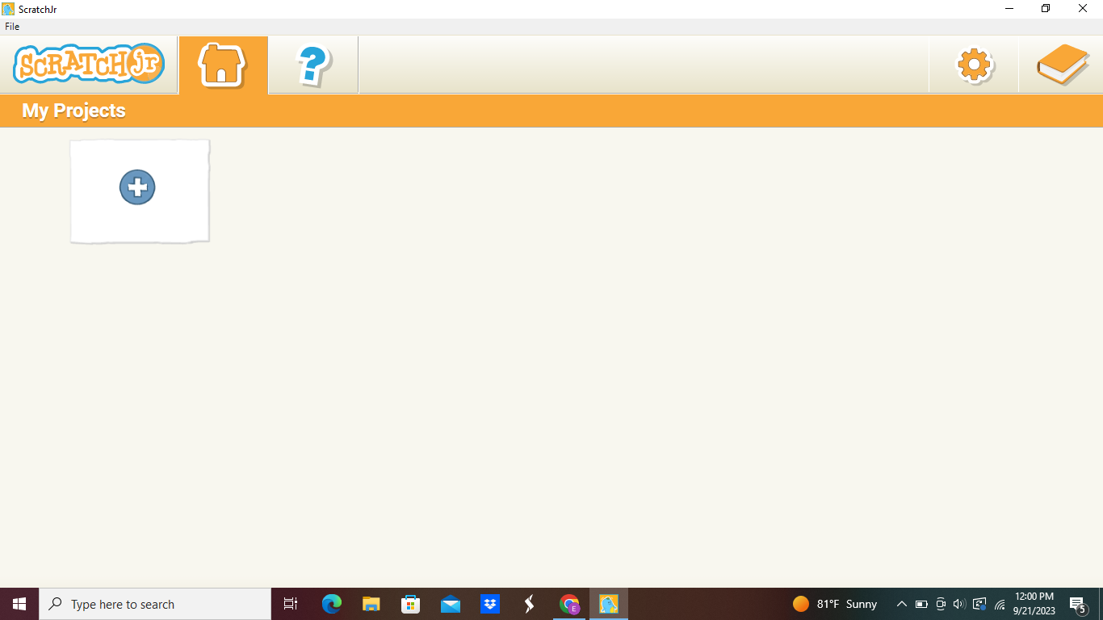

Slide 9
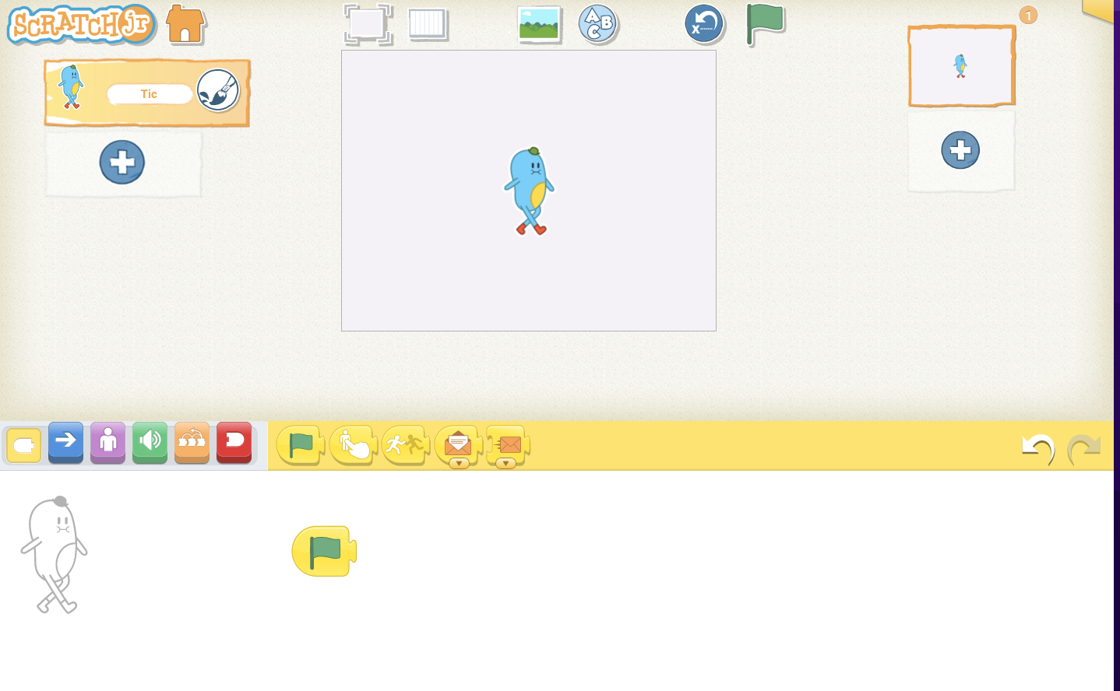
COMMANDS

Slide 10
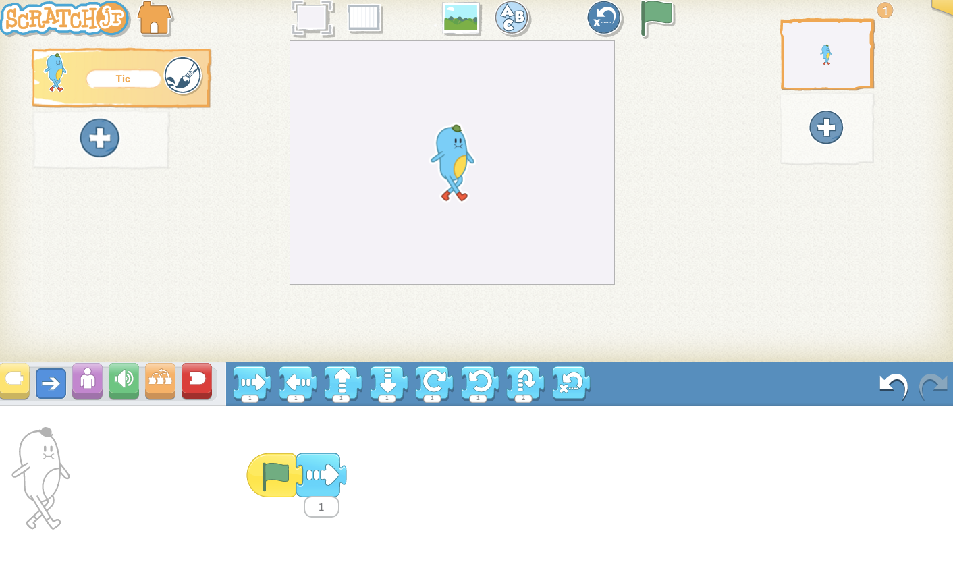
COMMANDS

Slide 11
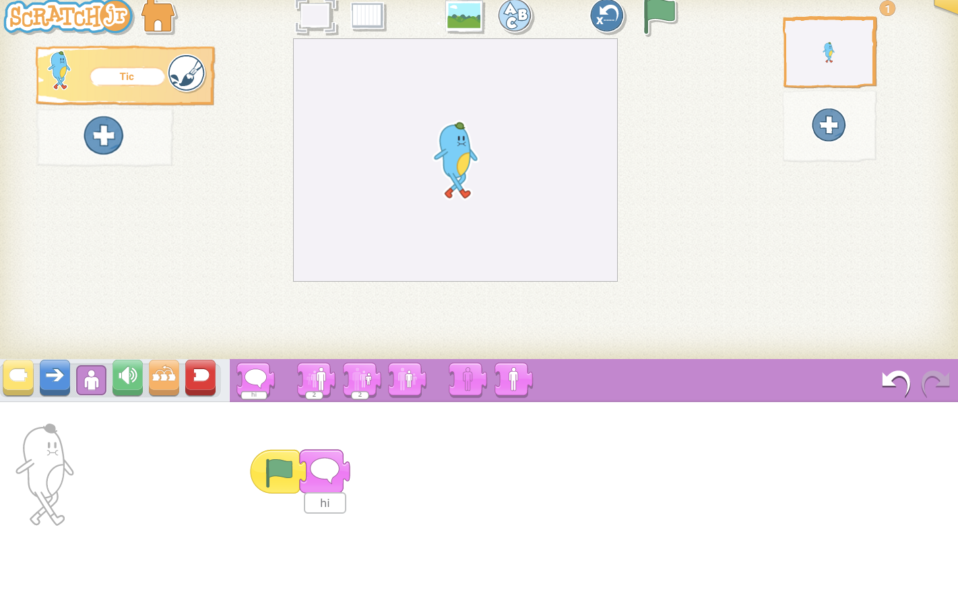
COMMANDS

Slide 12
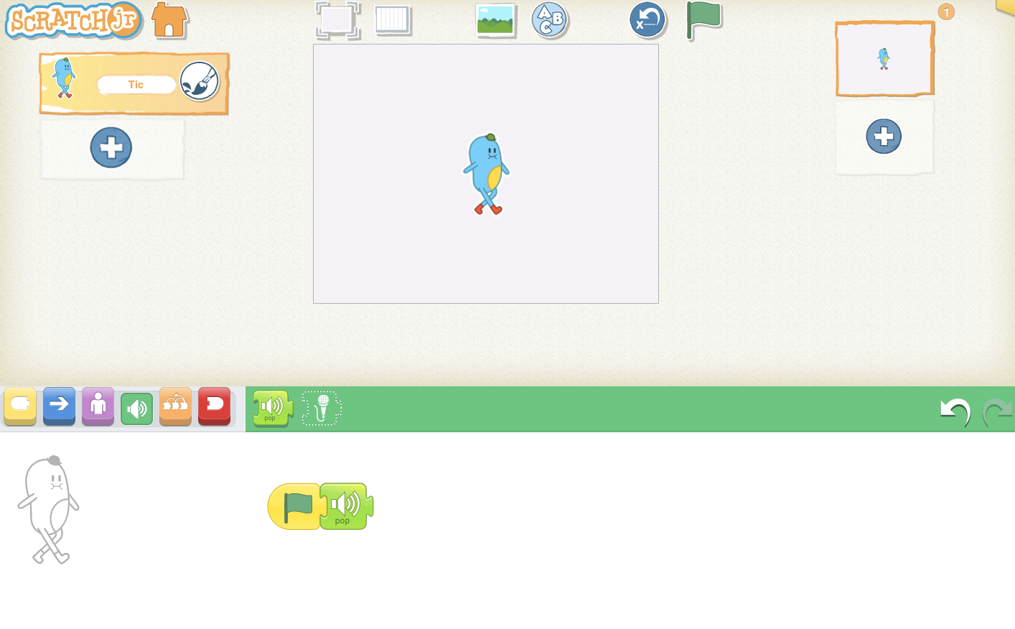
COMMANDS

Slide 13
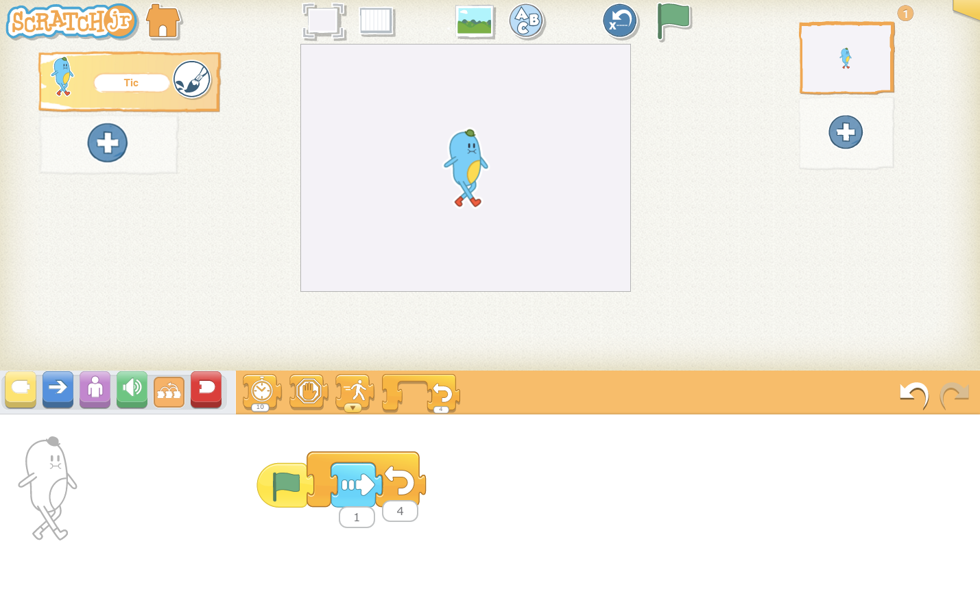
COMMANDS

Slide 14
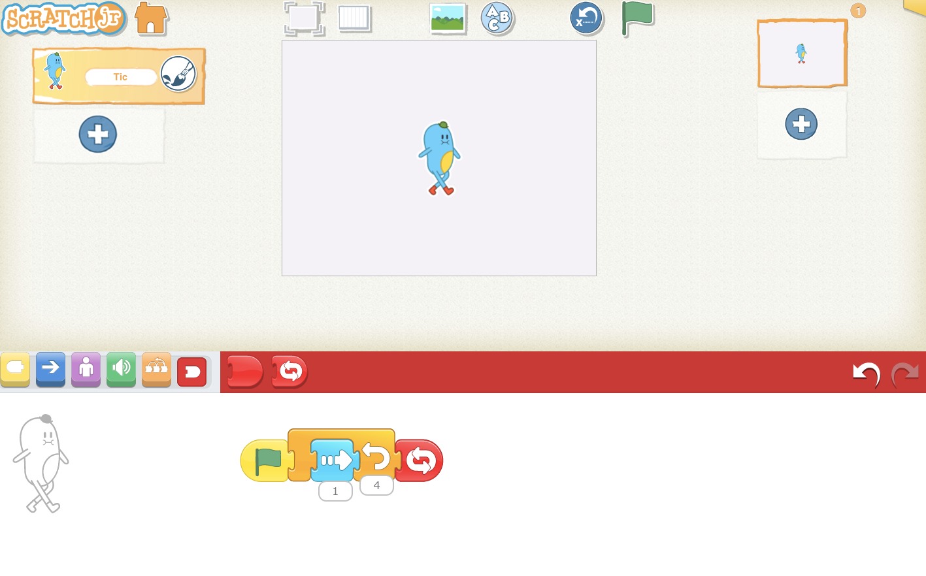
COMMANDS

Slide 15
CHARACTERS

Slide 16
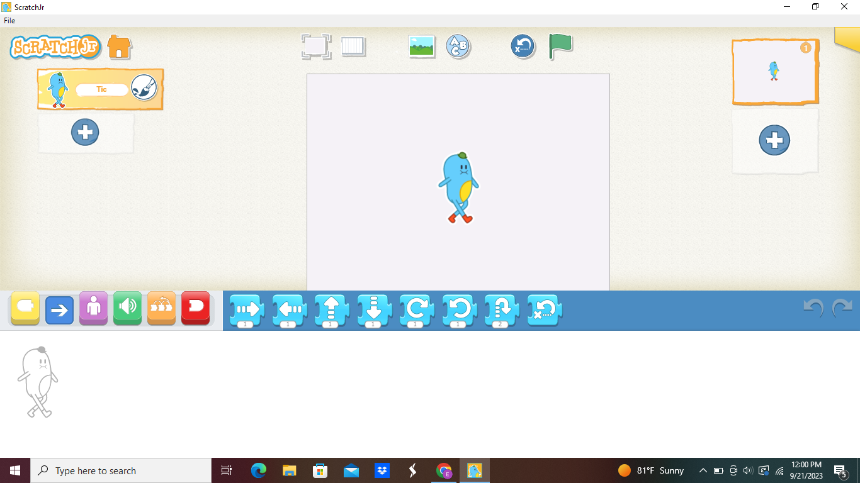

Slide 18
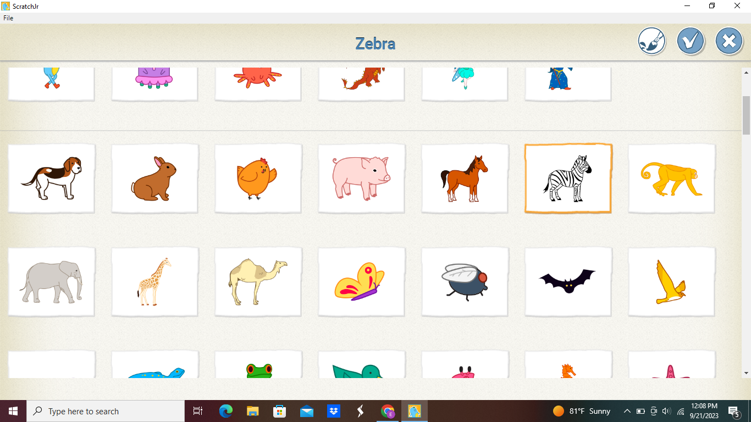
1
2

Slide 19
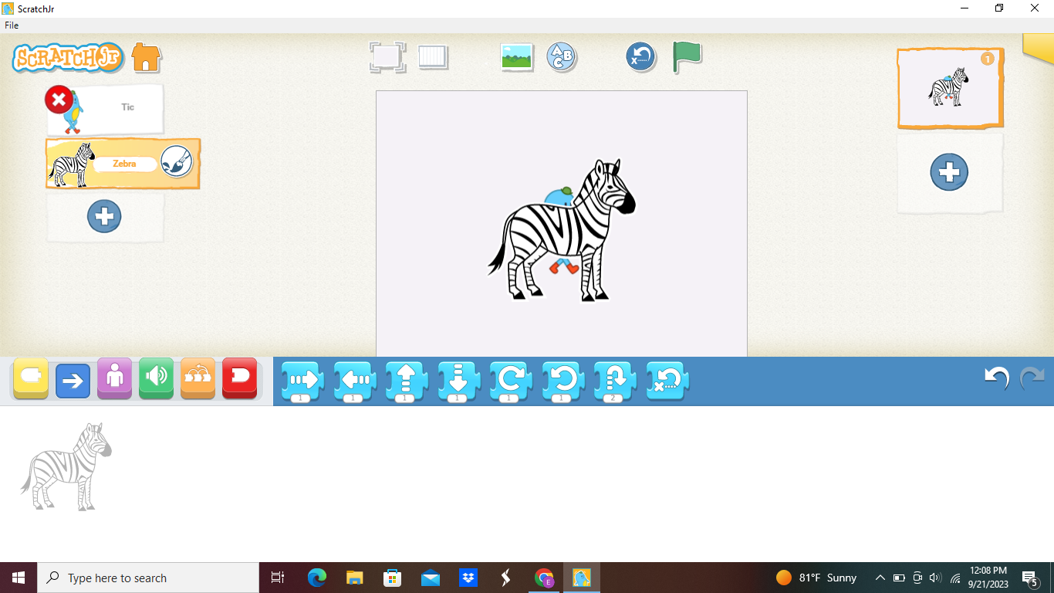

Slide 20
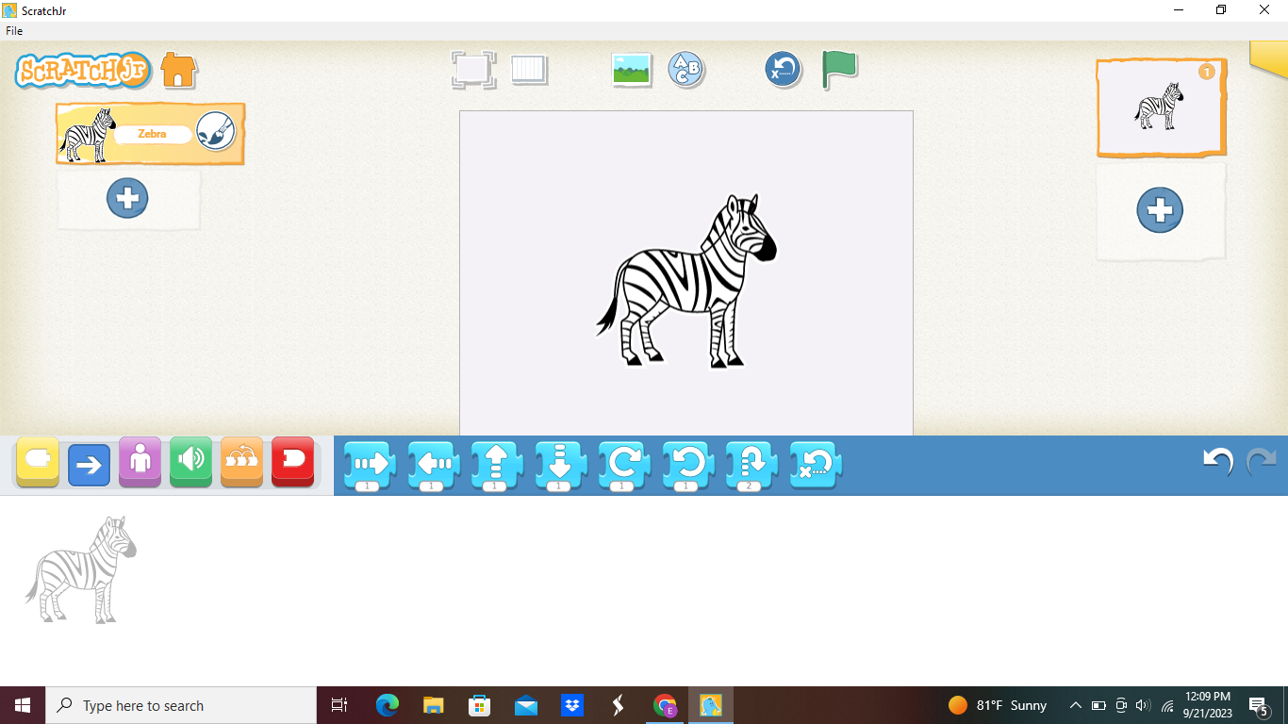

Slide 21
BACKGROUND

Slide 22


Slide 23
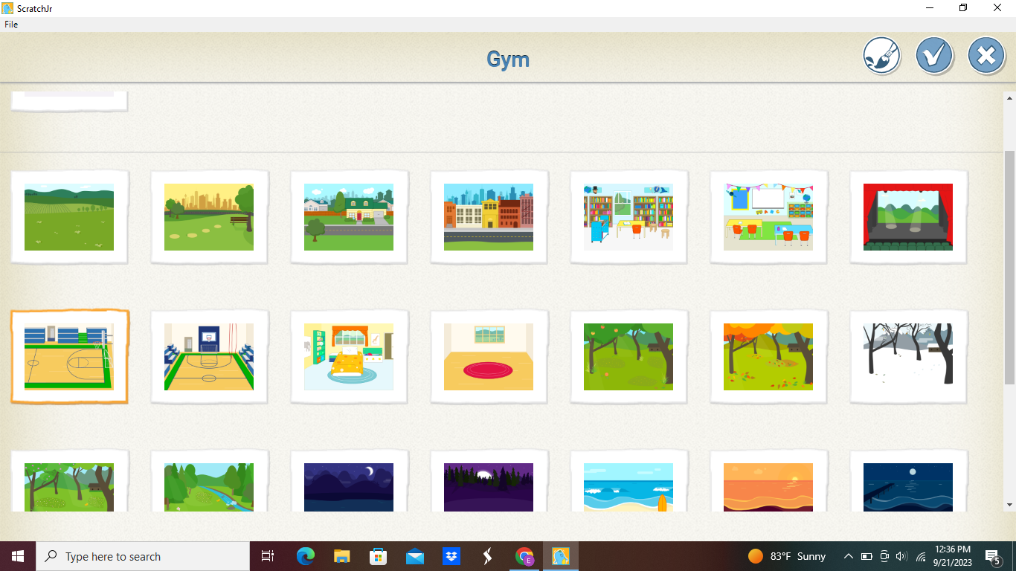

Slide 24
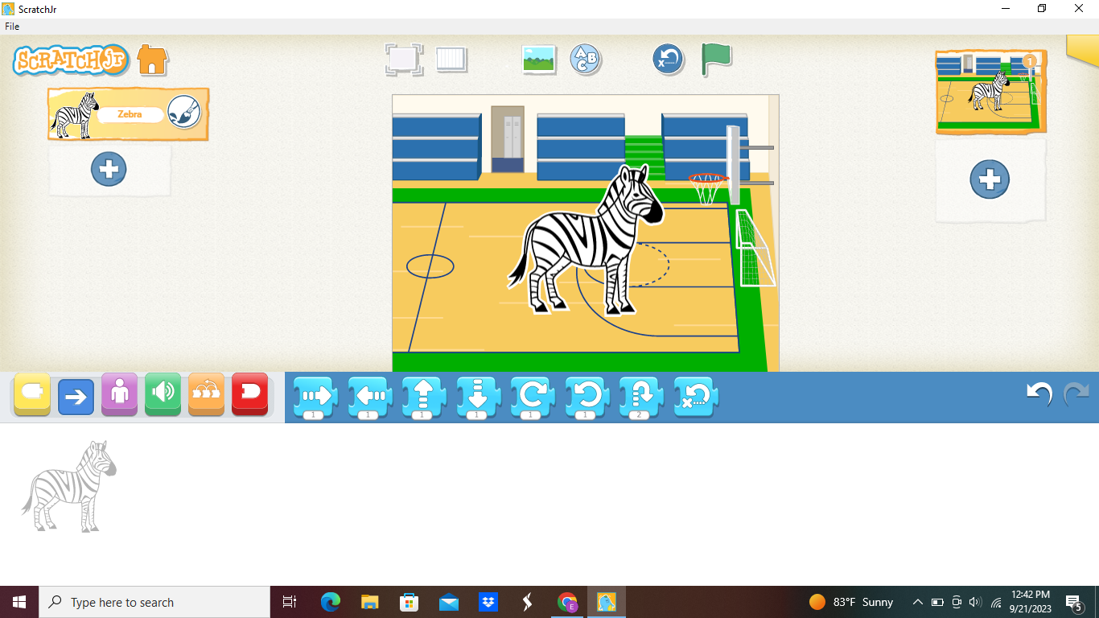

Slide 25
SHRINK CHARACTER

Slide 26
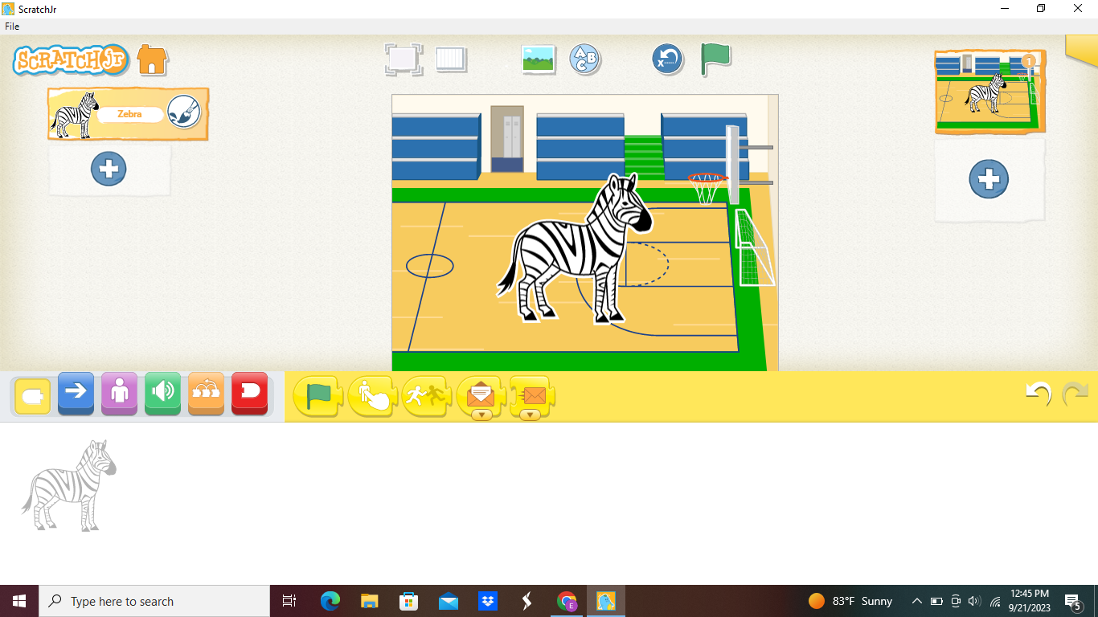
1
2

Slide 27
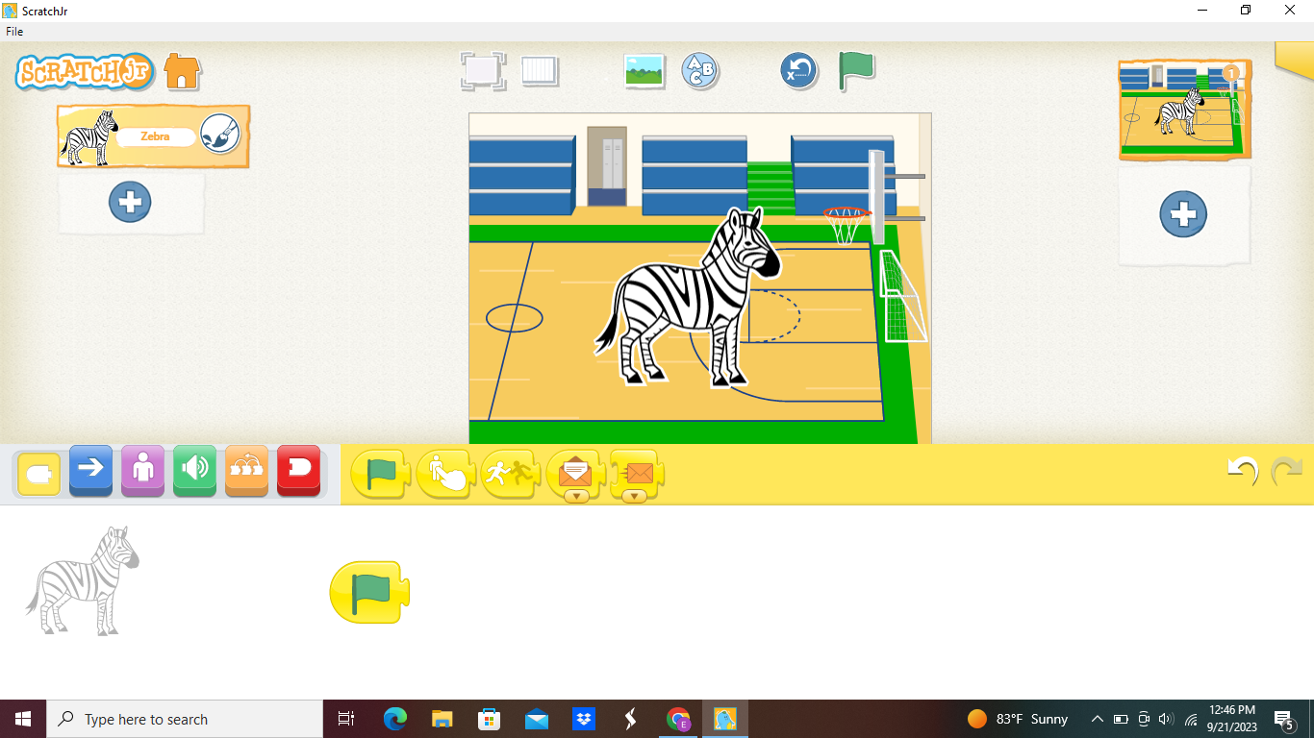

Slide 28
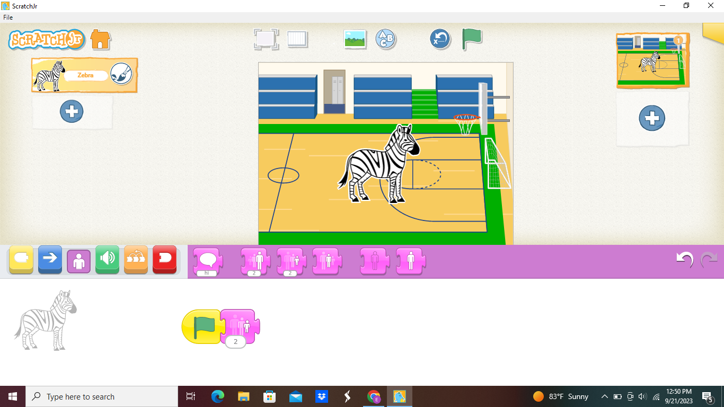
2
1

Slide 29
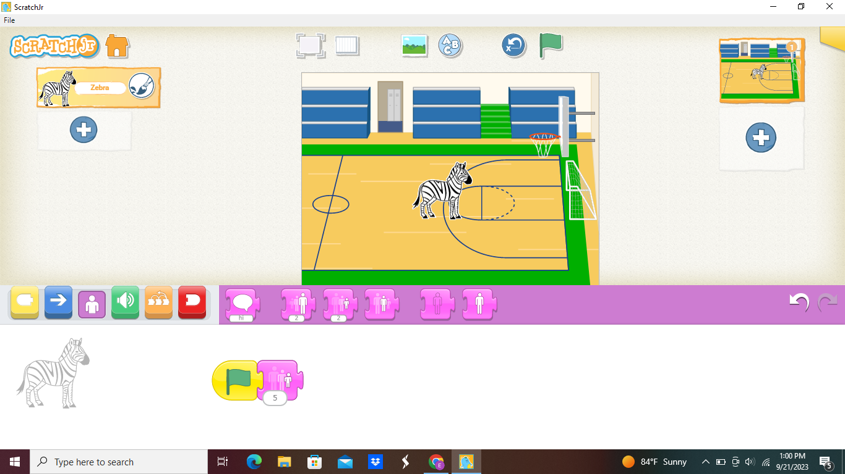
2
1

Slide 30
ADD ANOTHER CHARACTER

Slide 31


Slide 32
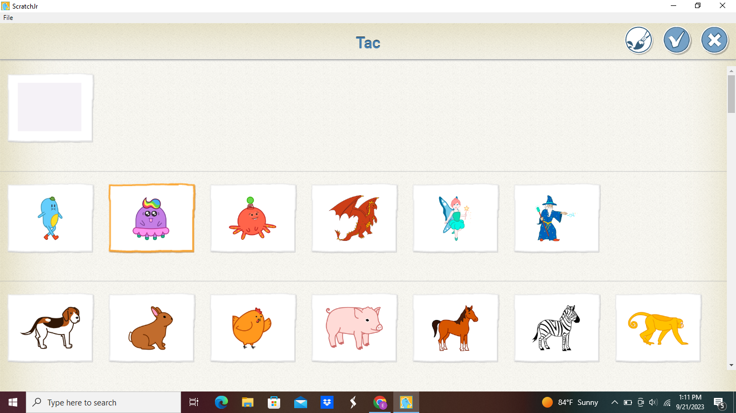

Slide 33
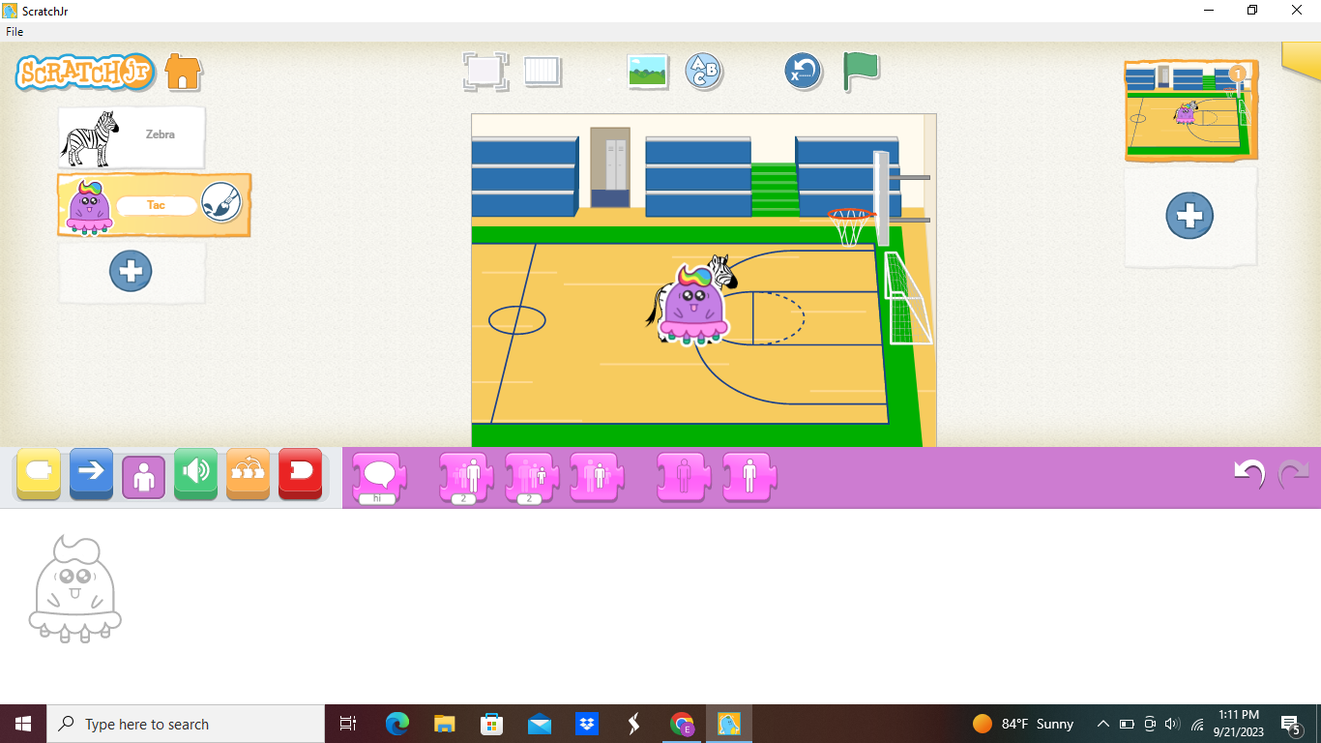

Slide 34
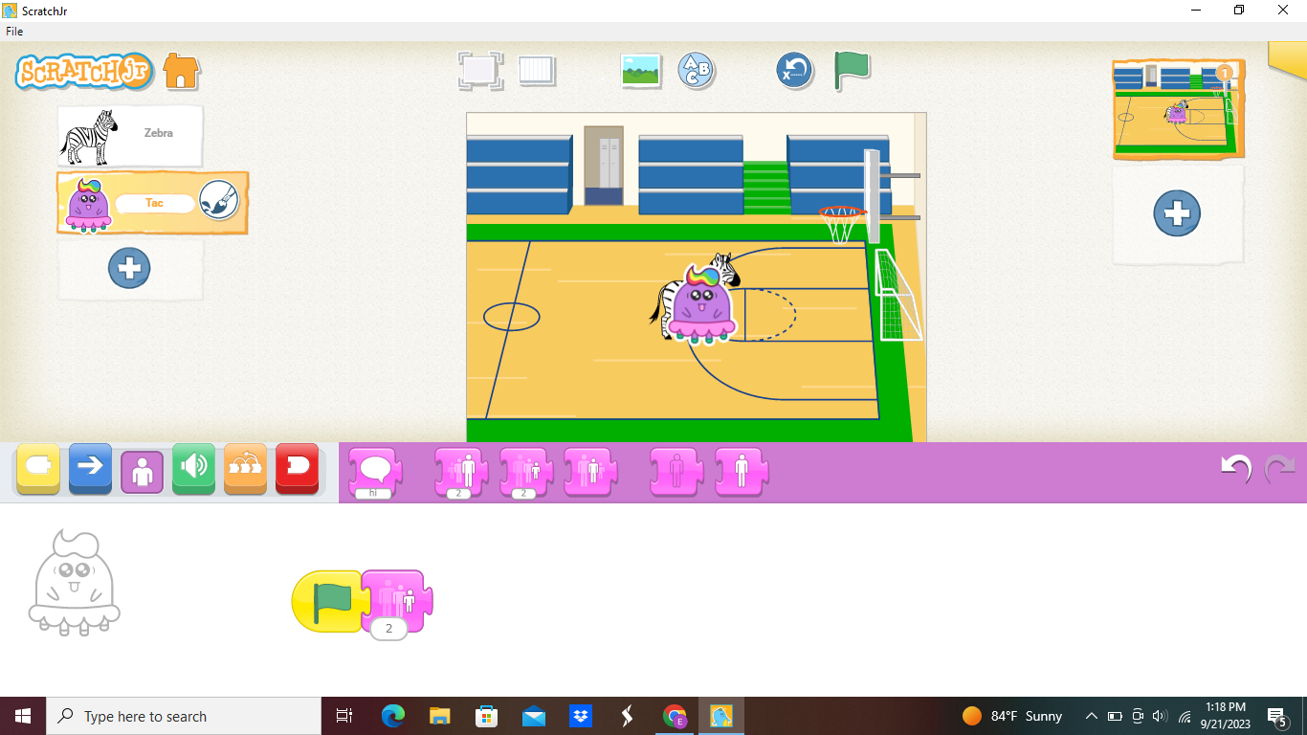

Slide 35
POSITION CHARACTERS

Slide 36
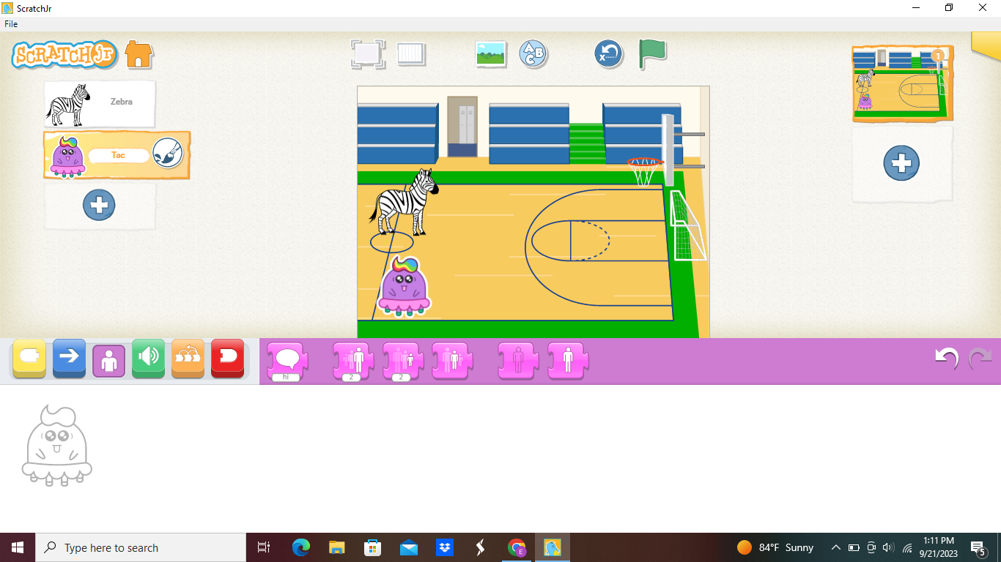

Slide 37
CLICK ON CHARACTER 1

Slide 38
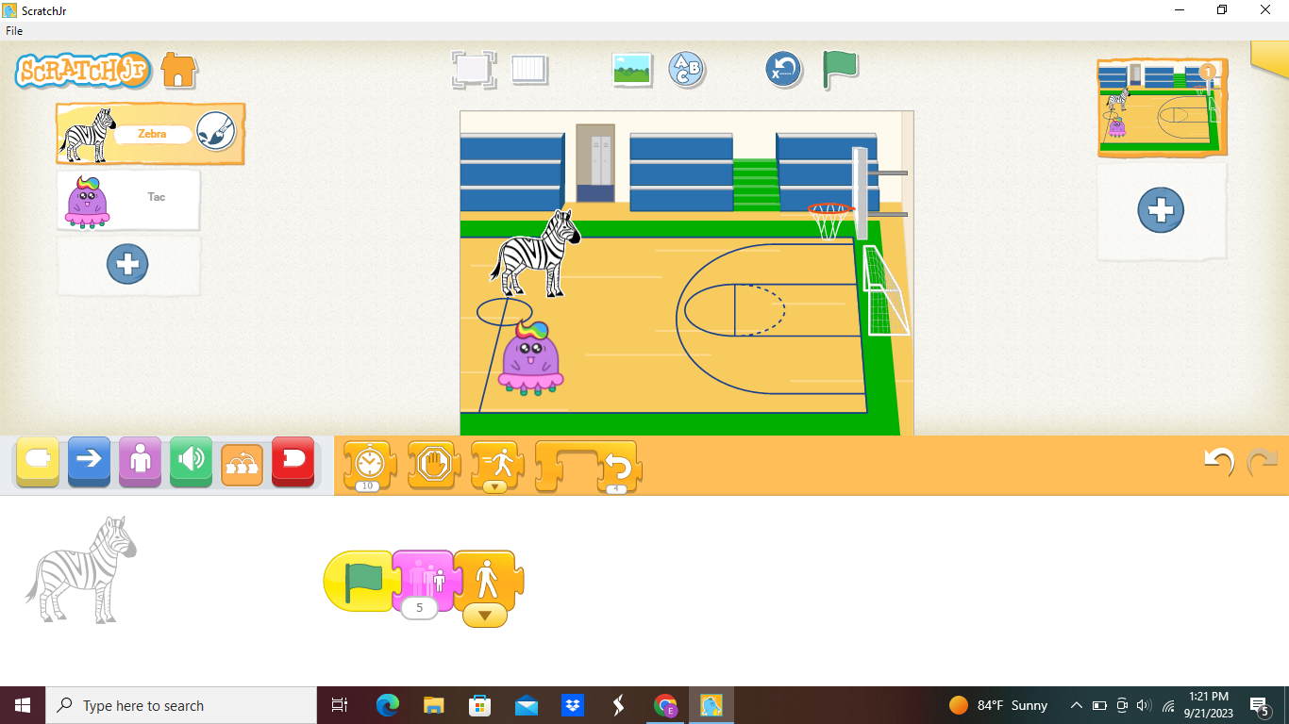
2
1
3

Slide 39
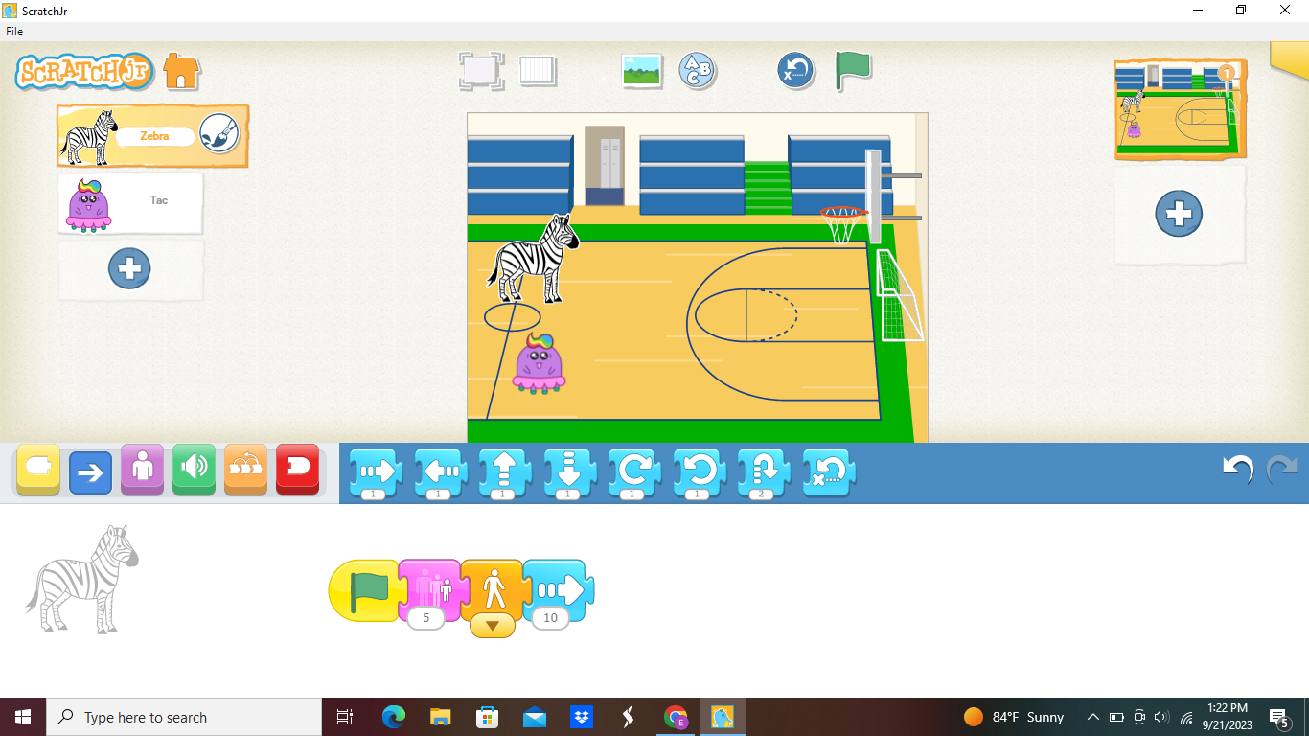
4
2
1
3

Slide 40
WHAT HAPPENED?

Slide 41
CLICK ON 2ND CHARACTER AND ADD CODE!

Slide 42
WHO WON YOUR RACE?

Slide 43
CREATE YOUR OWN STORY!

Slide 44
REQUIREMENTS
  ATLEAST 3 CHARACTERS
  3 ACTIONS PER CHARACTER
  3 PAGES

