Slide 1
Scratch Olympics
Kiyah Stokes

Slide 2
Welcome
What’s your favorite sport?
What’s your favorite song?
Have you coded before?

Slide 3
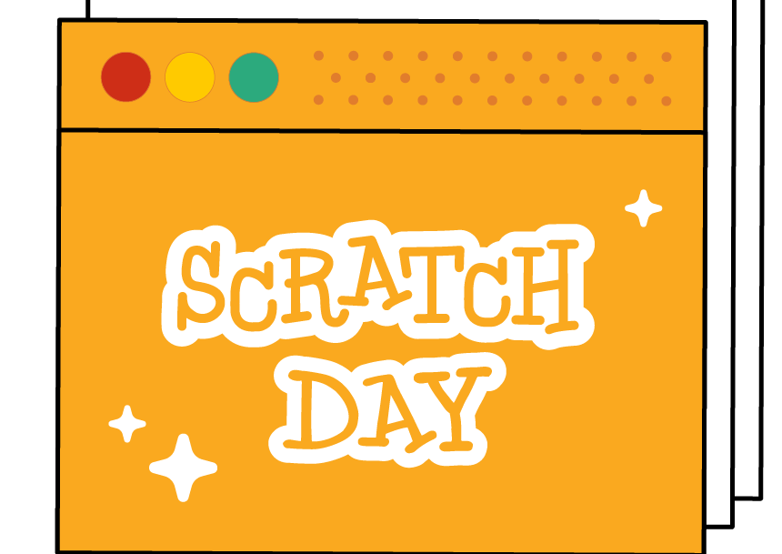
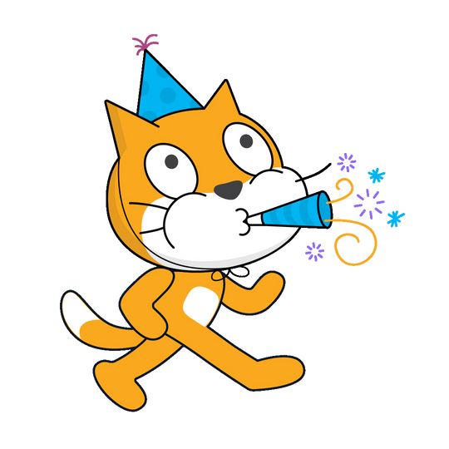


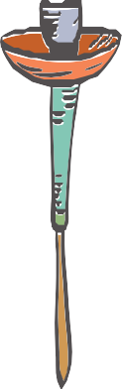
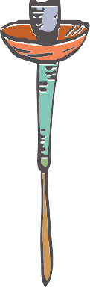
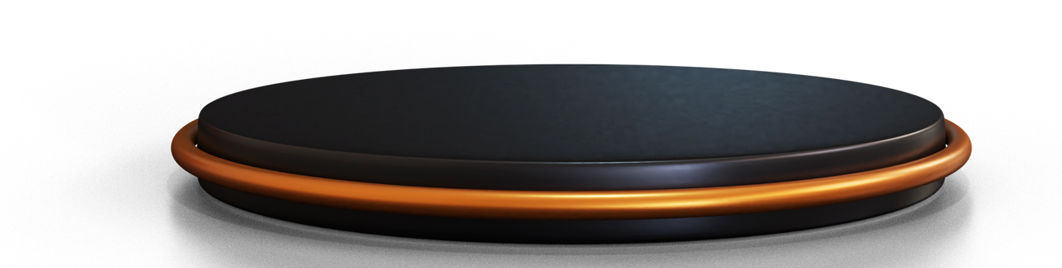
Olympics
edition

Slide 4
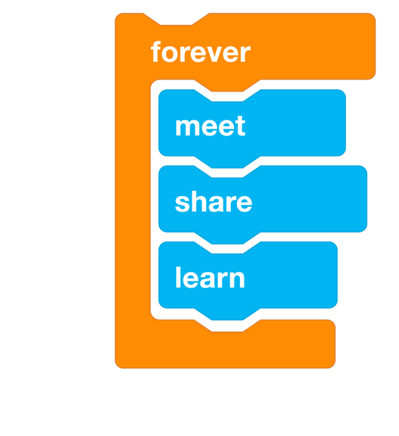
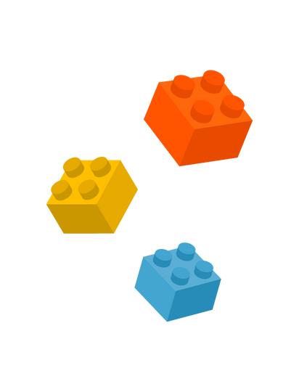
What will you do?
The olympics are upon us! What better way to celebrate than building a scratch game! Today you will be creating an Interactive track and field and gymnastics game! You will program a microbit for all of your movements.

Slide 5
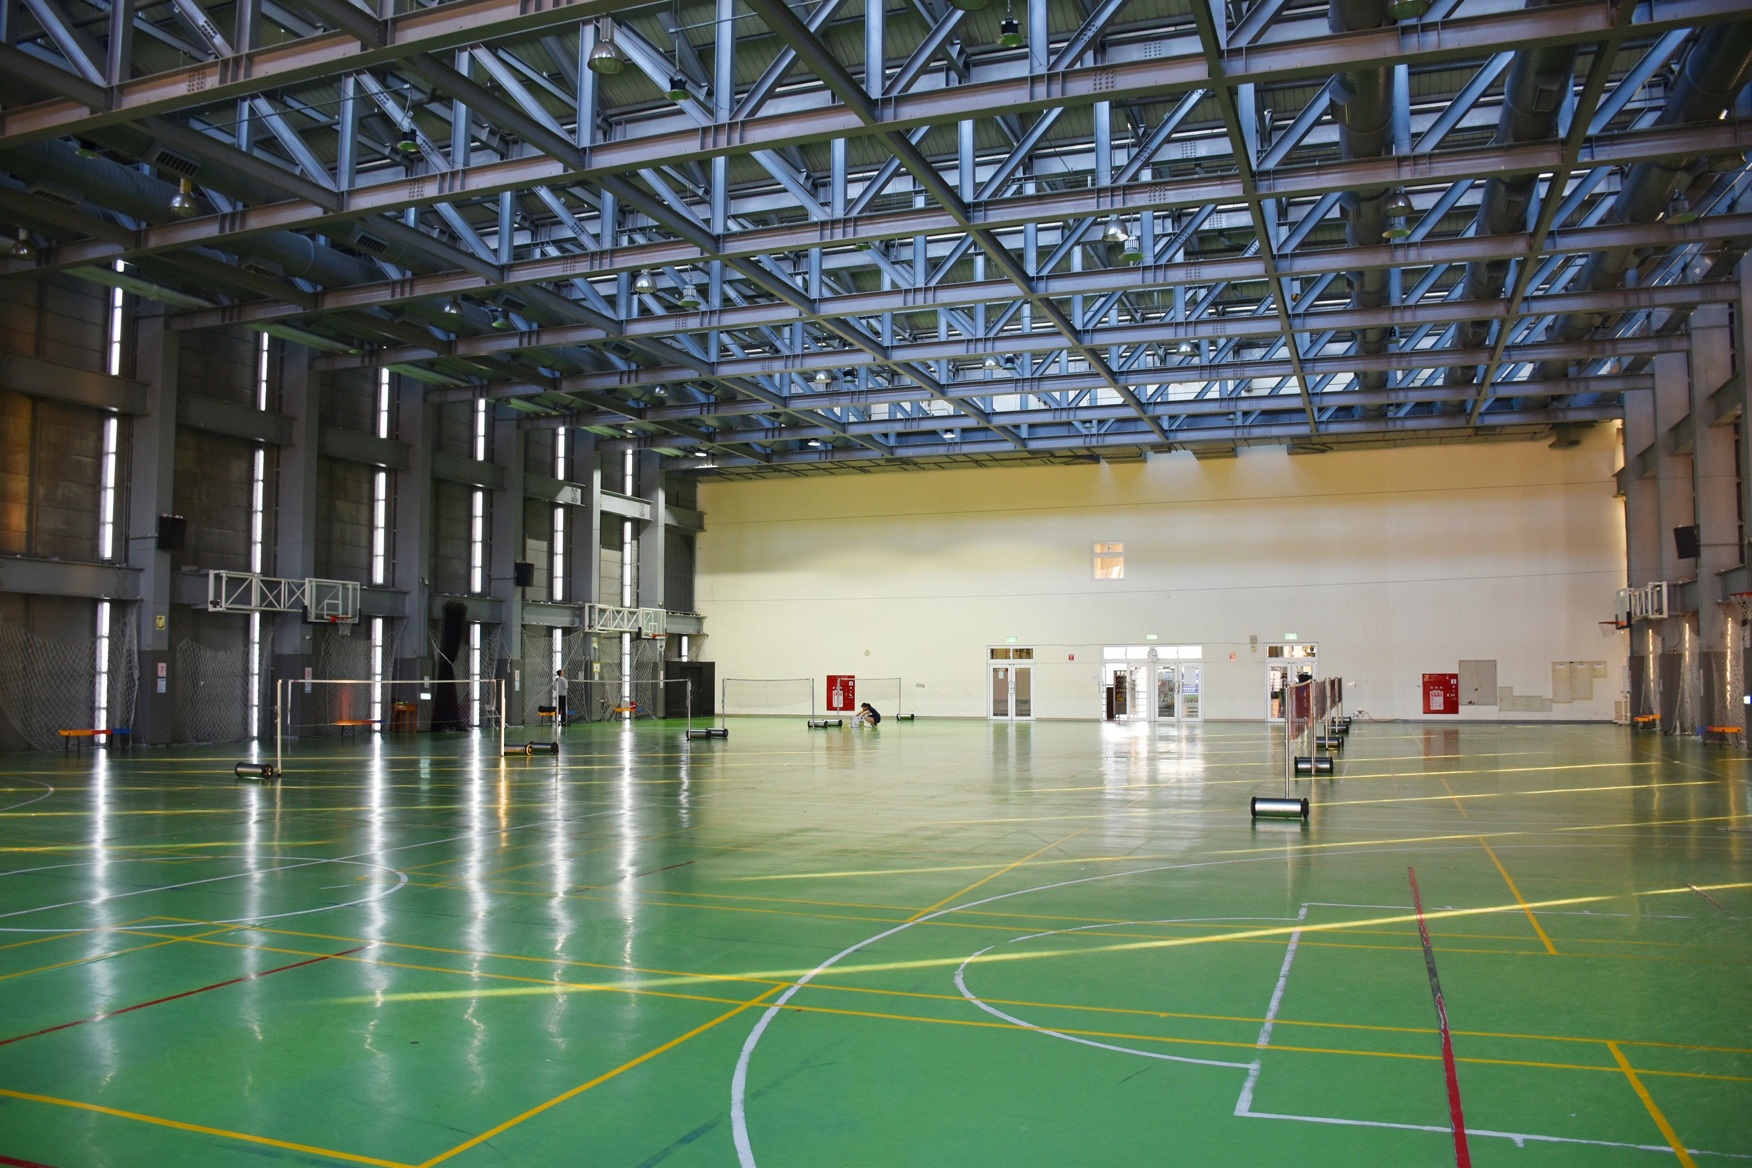
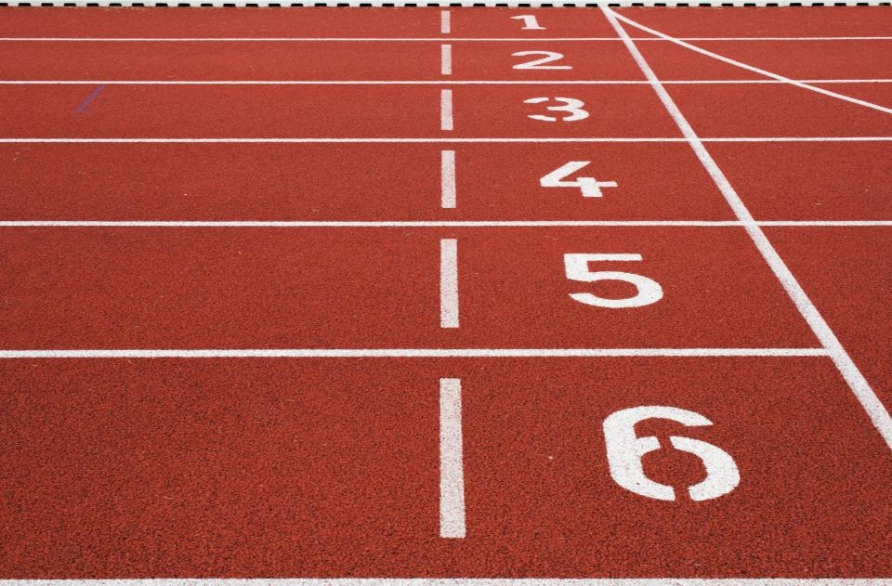
Setup
Download your backdrops
Track
and
Gym_floor
Photo by Andy Kuo on Unsplash
Photo by Austris Augusts on Unsplash

Slide 6

Part I: Background
You should have recieved the backdrops from the flash drive at this point. First, let’s program our backdrops according to our events, which will be track and gymnastics
Click on the backdrop section of the editor. It should now be highlighted in purple.
Next, look toward the left of the editor, you should see a backdrop tab. Click on it.
You will now upload your backdrops you downloaded from the flashdrive.
Both backdrops should be uploaded into the editor. The names of the backdrops should already be changed but if not make sure they are “Track” and “Gym_floor”.

Slide 7
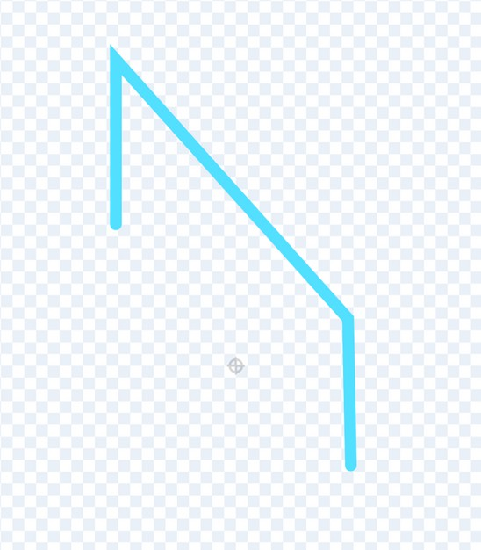

Part II: Sprites and Props
We will be working with sprites in our program: our CAThlete and other props
First, let’s program our props for Track. We will need a announcer and hurdles
Hover over the sprite button and click on the paint brush. We will be drawing our hurdles. When the first is completed duplicate it.
Place the hurdles along the track and space them out.

Slide 8
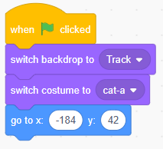
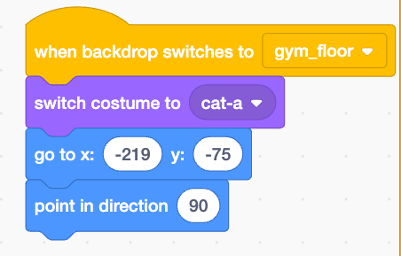
Part II: Sprites and Props
Next, let’s program our CATthlete!
Hover over the sprite button and add “Scratch” the cat. We will be adding multiple blocks.
When “Green flag” clicked
When backdrop switches to “gym_floor”
These two blocks will position our cat to where they would perform their events. Next, we are going to position the cat and backdrops with motion and looks blocks.

Slide 9
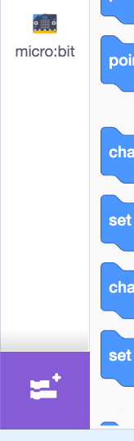
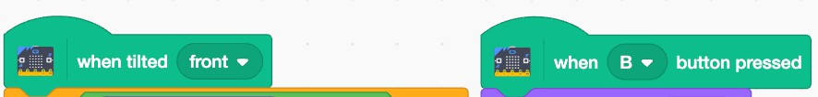
Part III: Microbit Integration
In this section, we will be programming our controller for the game, which is our microbit. Under the coding tab at the very bottom there is an extension block. Click on the block and find the microbit extension.
After clicking the extension, the microbit tab should pop up under the block selection.
Under the microbit block tab grab these blocks:
When tilted
When A button pressed

Slide 10
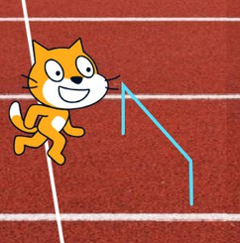
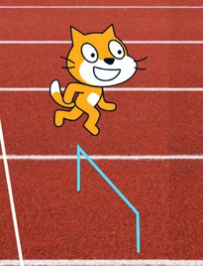
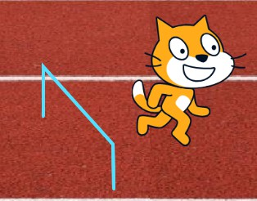
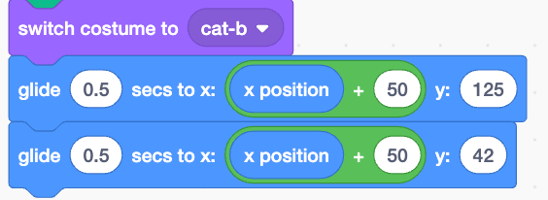
Part III: Microbit Integration
We are going to program our microbit to make our cathlete jump when the B button is pressed. You will need to pay attention to the X and Y coordinates for this to operate correctly.
Depending on where your cat is positioned, you need to place them directly over the first hurdle. Record those coordinates, then repeat on the landing.
You will need to use the glide blocks to make the jump animations as smoothly as possible and also change the cats costume. The first glide is the air position, the second is the landing position.

Slide 11
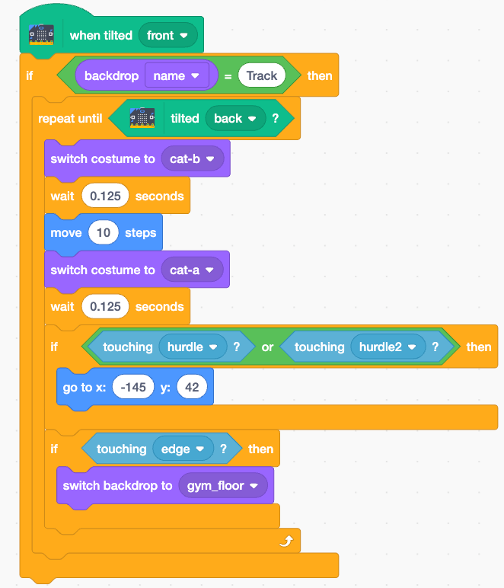
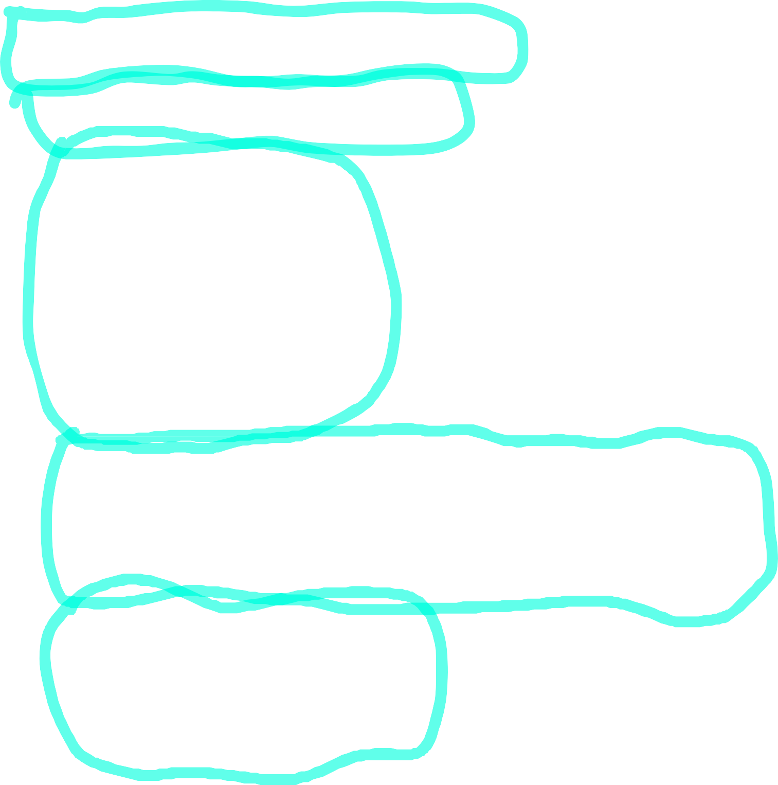
Part III: Microbit Integration
Finally, we are programming our run! The block we will be using is the when tilted block.
We attach an if block to only run code if the background is the track.
Inside we add a repeat until block to mimic a running animation until the microbit is tilted back.
Inside the tilted until block, add switch costume, wait, and move blocks
Directly after the last wait block add an if statement, this will prevent the our cathlete from running through the hurdles. Add a go to block to reset the cathlete to its previous position
Directly after the last if statement, add another if statement. This will take us to our next event and backdrop!

Slide 12
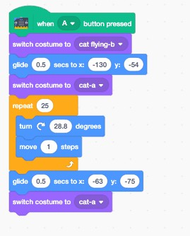
Part IV: Gymnastics
Get ready to channel your inner Simone Biles! We are starting our gymnastics event code. The only microbit block to add is the when button pressed
Add the switch costume block
Add the glide block then another switch costume. This will glide our cathlete into the air
Now let’s add a flip in the air with a repeat block. Inside the repeat block, add a turn right block and move block. Numbers will be based on cat’s position again
Then finally Glide down!

Slide 13
Part V: Artistic Gymnast
It’s your turn to create a routine for the balance beam!

Slide 14
Formatting Guidelines
Copy and paste your slides into this template (you may have to reformat some slides).
Make sure you have copyright permissions to use the images/graphics in your presentation.
Add alternative text to images/graphics by hovering your cursor over the image, right-clicking on it, and selecting “View Alt Text…” from the list of options.

Slide 15
Slide Titles and Subtitles
Unique slide titles helps visually impaired individuals navigate your presentation with a screen reader.
Add titles and sub-titles to your slides by selecting the Review tab and selecting “Check Accessibility”
Then use the Slide Title option in the Accessibility ribbon.

Slide 16
Image Sources
Be sure to provide sources for your images if you did not create them.

