Slide 1
Session III: Sustain Food
Ugur Kale¹ and Yuahnua Wang²
¹Indiana University, ²West Virginia University

Slide 2
Introduction (Day 1)

Slide 3
Sustaining Food for Accessing Local and Healthy Food

Slide 4
Connections….
Sustain Food
Grow Food
Access Food

Slide 5
Small Scale Farms
Similar to community and home gardening, small scale farming (e.g., family farms) is critical to local and healthy food access

Slide 6
Small Scale Farms
However, sustainability of food from such sources in WV is problematic since less than 1% of the agricultural land in the state is used for specialty crops (fruits, vegetables, mushrooms, and etc.)

Slide 7
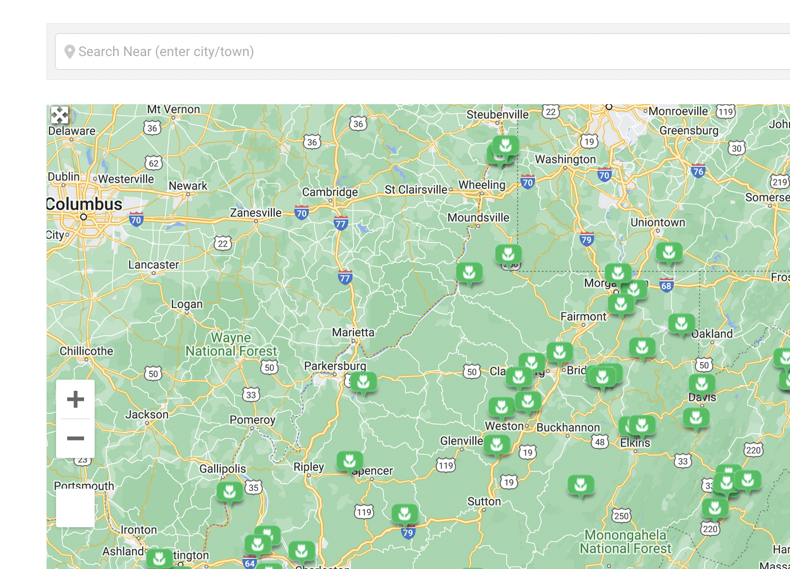
Do we have enough farms?
Let’s check this map around a location (e.g., your placement school):
https://farmfreshwv.com/wv-farms/
Put the address or the Zip Code

Slide 8
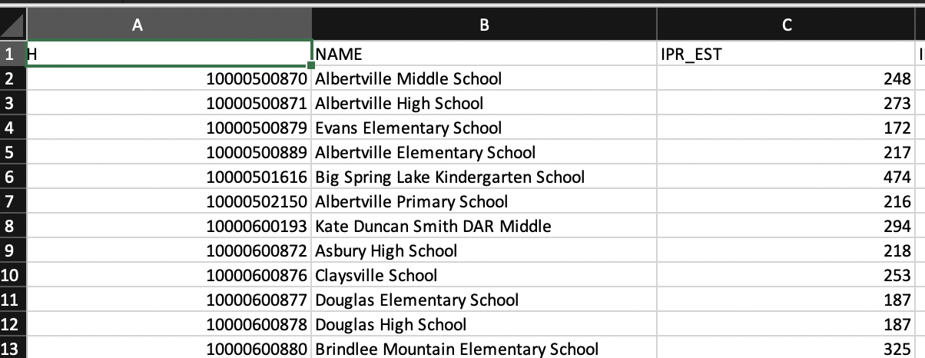

Even if there is a food store, can anyone buy?
Let’s check your School Neighborhood Poverty Level:
https://tinyurl.com/schoolpovertyindicator
Income-to-poverty ratio (IPR), which is the percentage of family income that is above or below the federal poverty threshold set for the family’s size and structure.
The IPR indicator ranges from 0 to 999. Lower IPR values indicate a greater degree of poverty. A family with income at the poverty threshold has an IPR value of 100.
Search your placement school
Find IRP indicator
Zoom in/out to view 2-mile scale

Slide 9
So how are these related?
Let’s make a concept map
Local farms
Poverty
Food Access
Others?
Food stores
Geography

Slide 10
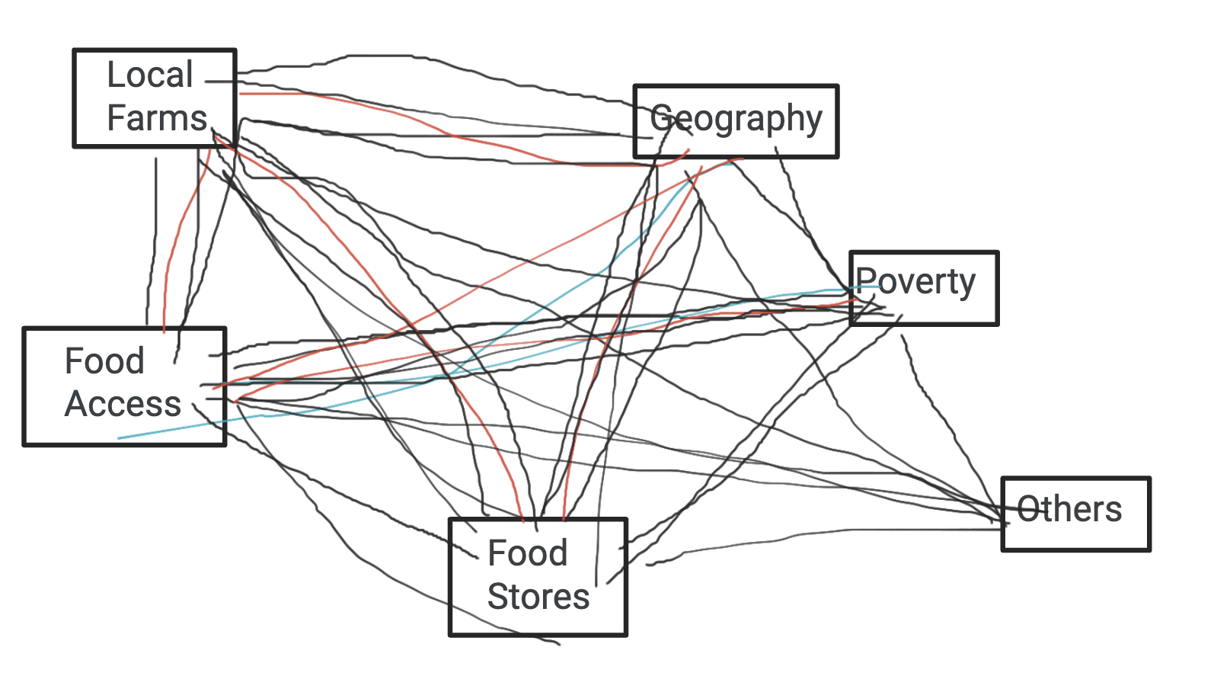
From last year

Slide 11
Local farms central to food access

Slide 12

Agricultural Robots?
In order to make farming more sustainable, agricultural robots have been explored as one of the methods as they can automate various dull tasks such as picking, harvesting, weeding, spraying, or monitoring for farmers.
Caption: Aerial view of a tractor systematically plowing a field, showcasing an agricultural task

Slide 13

Feasible?
Experimenting with such robots may not be feasible due to their high cost.
Caption: Displaying two visually appealing and charming robots

Slide 14
Model Agricultural Robots instead?
Accessible programming platforms such as Minecraft (a 3D virtual space where users develop structures via manipulating blocks) has been explored to model a variety of robotics tasks

Slide 15
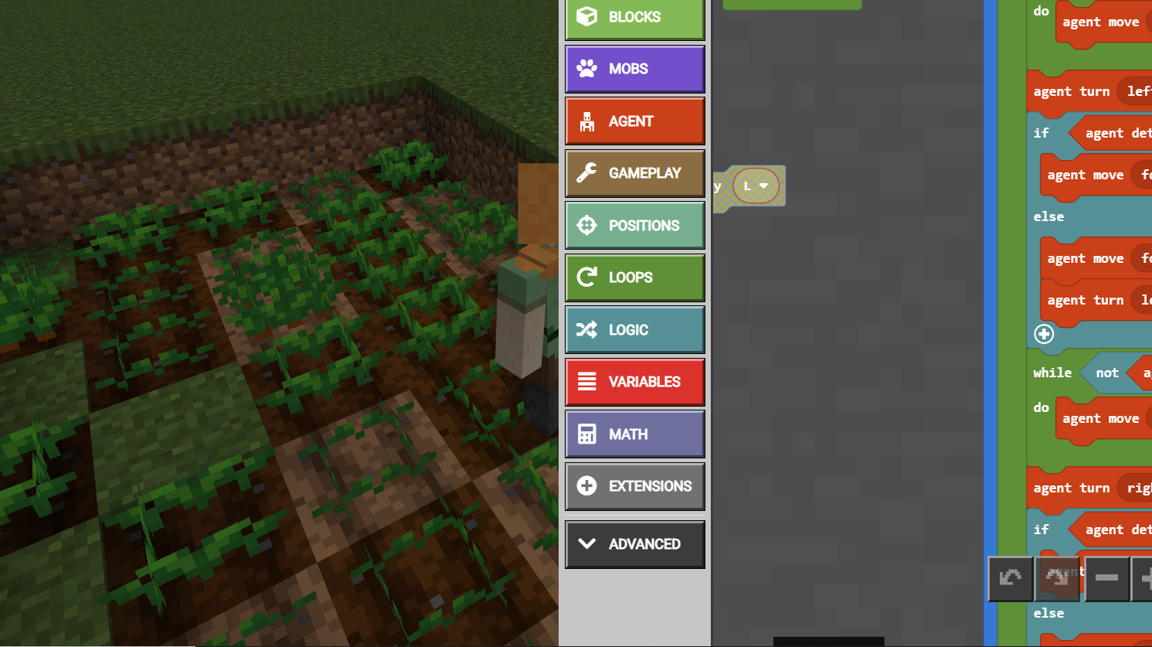
Minecraft Education with Coding!
Snapshot

Slide 16
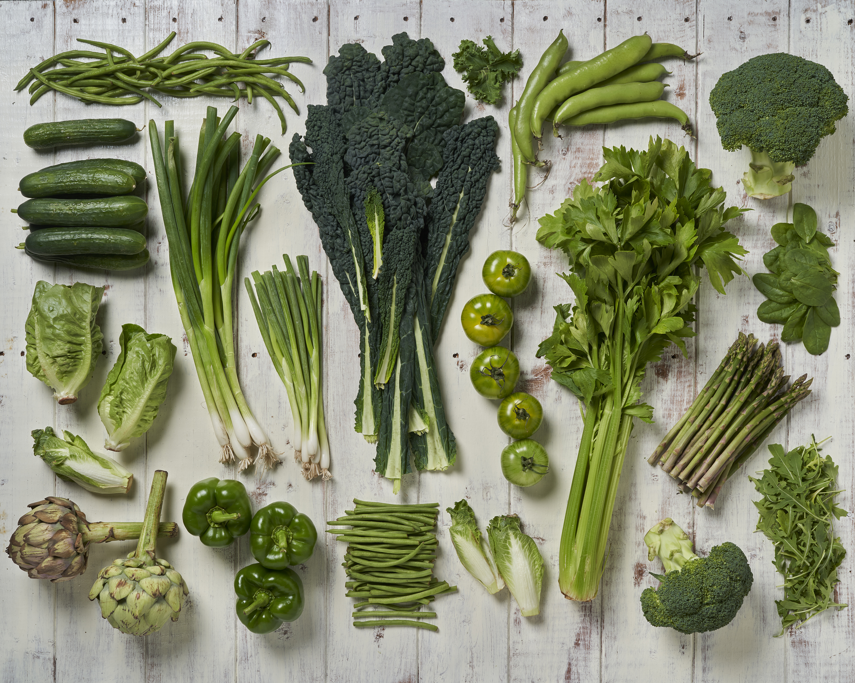
An Example Guiding Question
A large number of cucumber seeds need be planted in a family-owned farm but it takes a lot of work for the family to prepare the soil and plant the seeds in a short amount of time.
Can we automate these tasks such that they are more efficiently completed
for a planting area with a specified size as well as
for a planting area with any size?

Slide 17
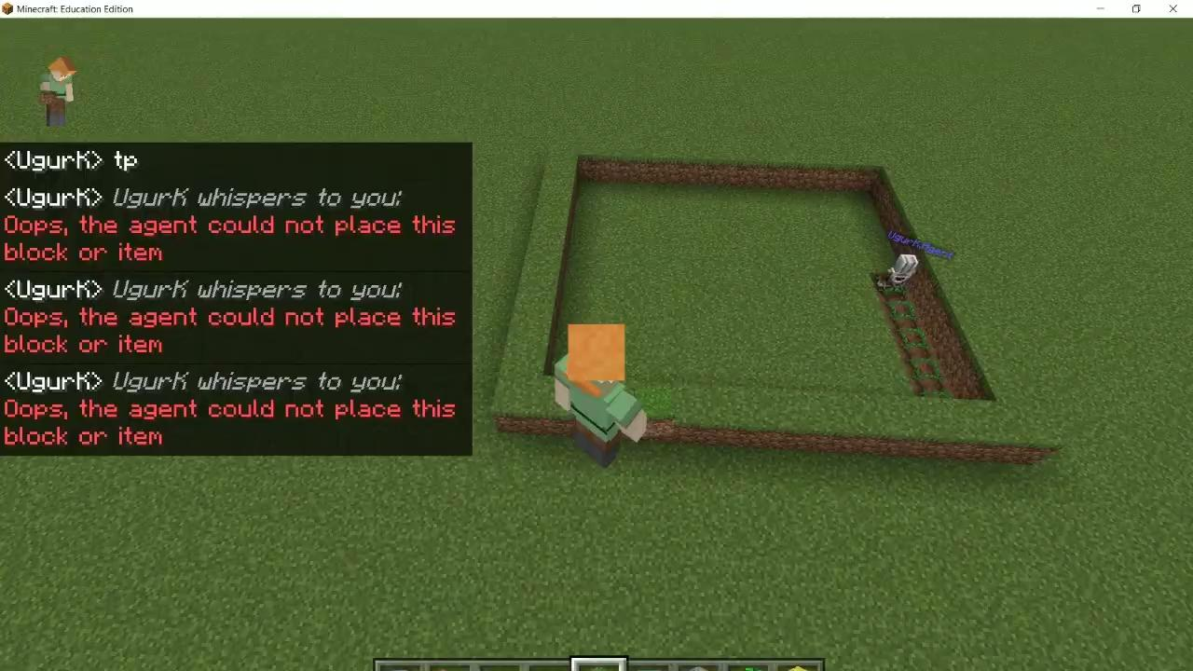
Let’s see how it looks when it is automated

Slide 18
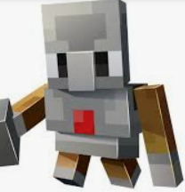
Can you think about the algorithm used?
9 X 9

Slide 19
Let’s get in the world!
A join code and a link to be generated
Use the link in your browser
  OR
use the code in Minecraft Education to join the world.

Slide 20
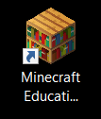
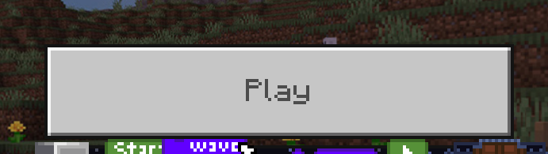
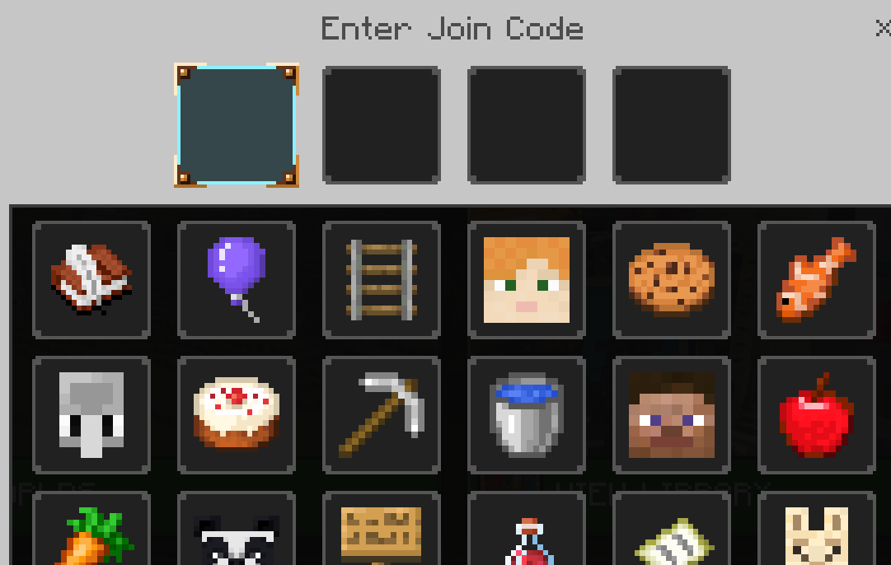
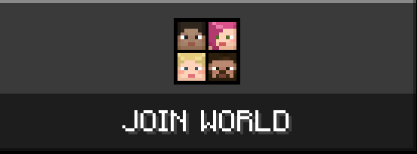
Use the code to Join
1-Launch MineCraft Education
2-Click Play
4-Enter the Code (given) to join
3-Click Join World

Slide 21
If unable to join
Just create a new world
Play
Create New
Templates
Block of Grass

Slide 22
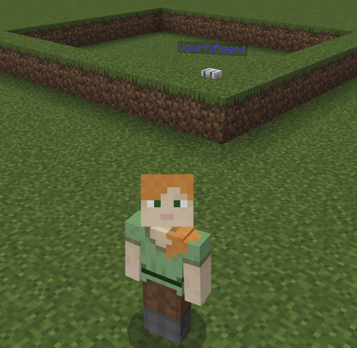
First, explore the world (5min)

Slide 23

Practice placing and destroying blocks (5min)
Right click to place
Left click to destroy

Slide 24
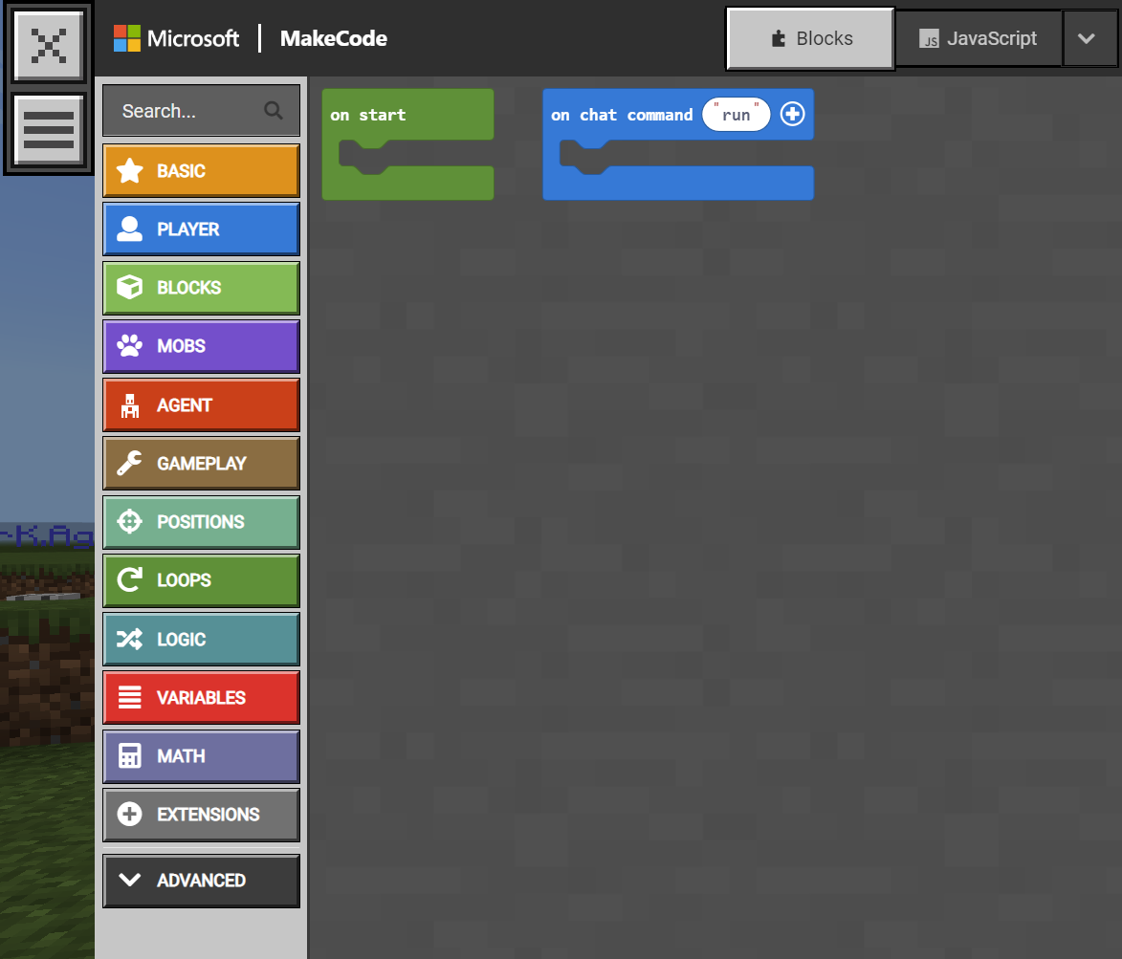
Launch Codebuilder
Click “C”

Slide 25
Practice on chat command for the agent
To turn left
To turn right
To move forward
To move backward
To teleport to a location
To teleport to the player
To place a block
To destroy a block

Slide 26
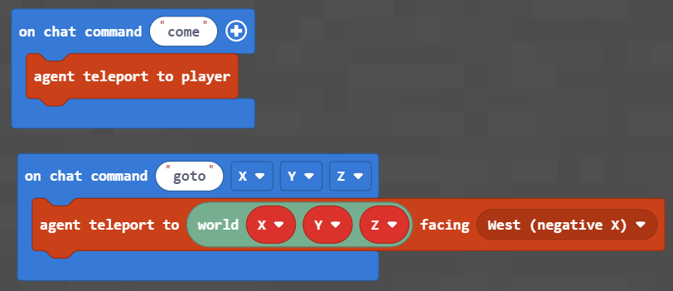
on chat command -> Teleport
To teleport to the player
To teleport to a location

Slide 27
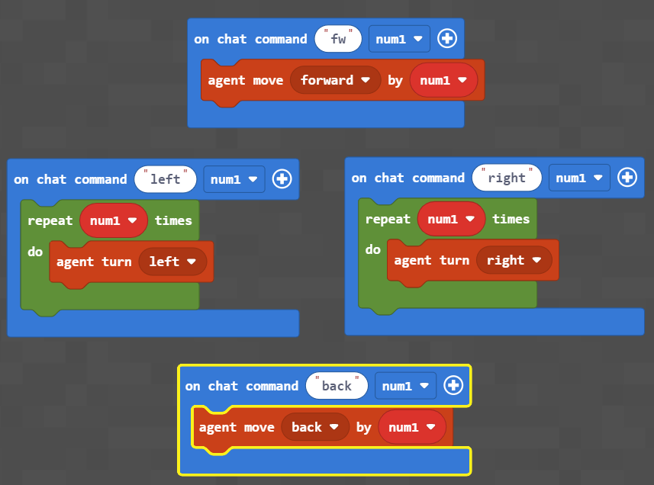
on chat command 🡪 Navigate
To move forward (num 1 steps)
To turn left
(num 1 time)
To turn right
(num 1 time)
To move backward (num1 steps)

Slide 28
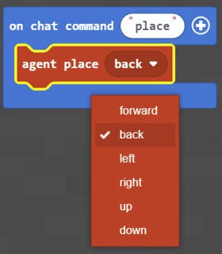
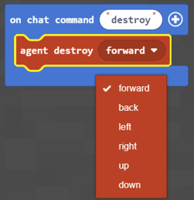
on chat command -> Interact with blocks
To place a block
In a direction
To destroy a block
In a direction

Slide 29
on chat command -> Try anything and any combination
(until the end of the class)

Slide 30
Demonstration (Day 2)

Slide 31
Let’s see how it looks when it is automated

Slide 32
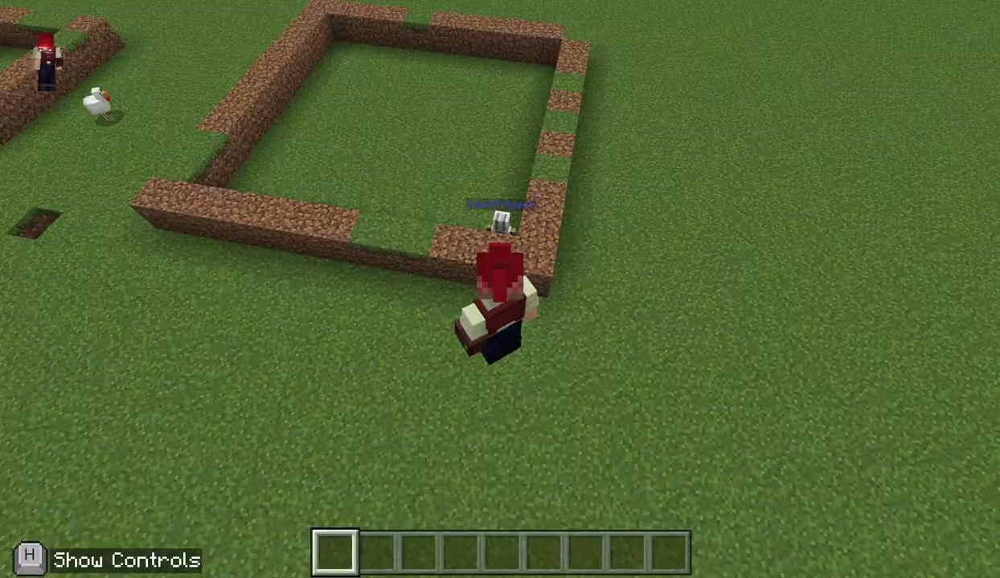
First, let’s make an area!

Slide 33
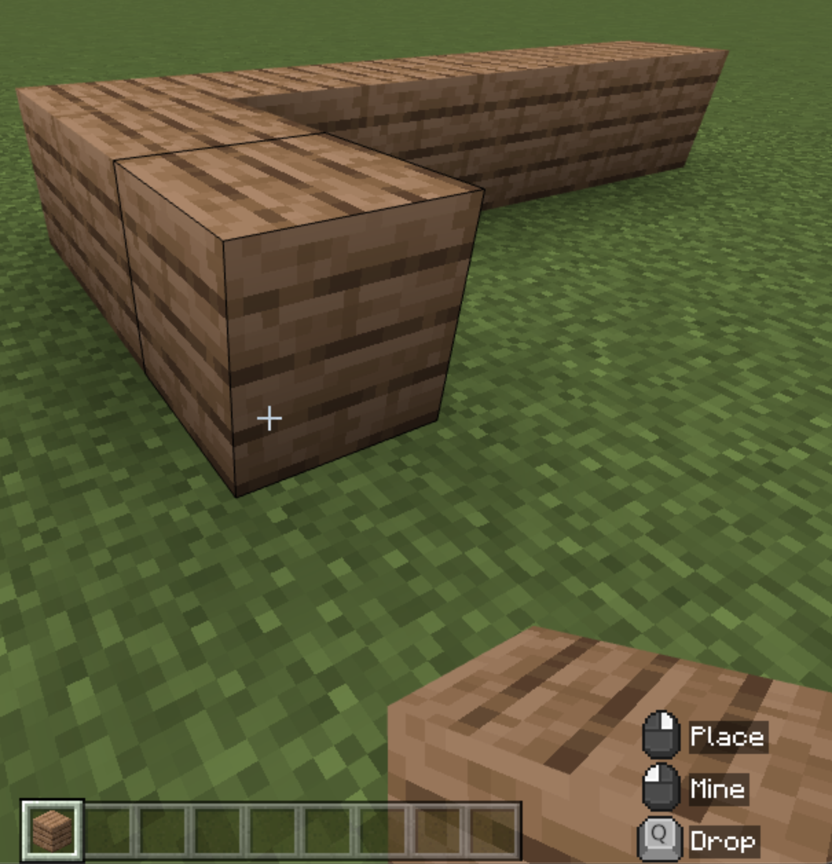
This can be automated too but for now, just make it by block by block

Slide 34
Now can you automate your agent to move inside the area?

Slide 35
It helps if you determine where agent should start
For instance, you may wish that the agent always starts at the right bottom corner!

Slide 36
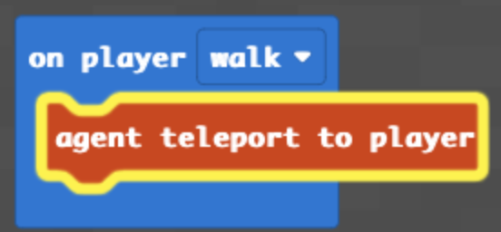
You can use the following command so that agent follows you (while you walk). This way, navigate to a location of your choice (e.g., right bottom corner of your field) and agent will be there!

Slide 37

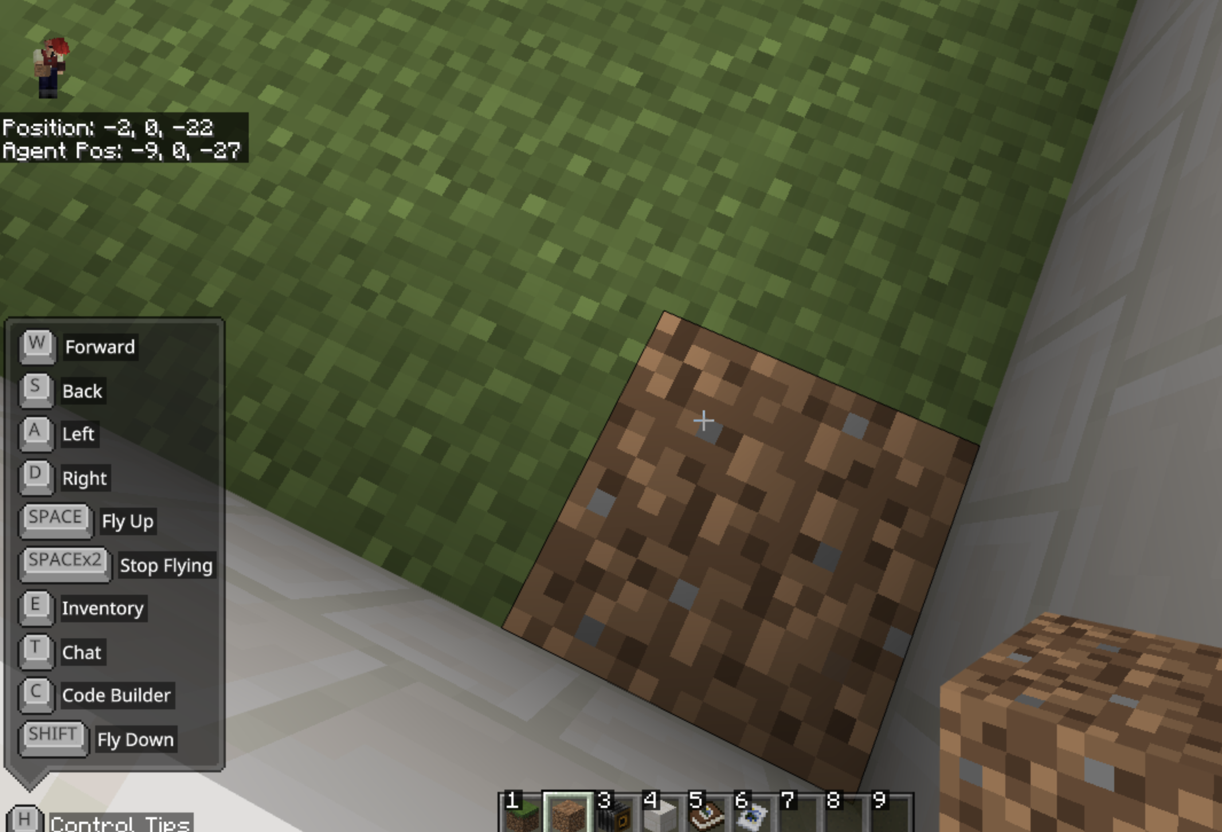
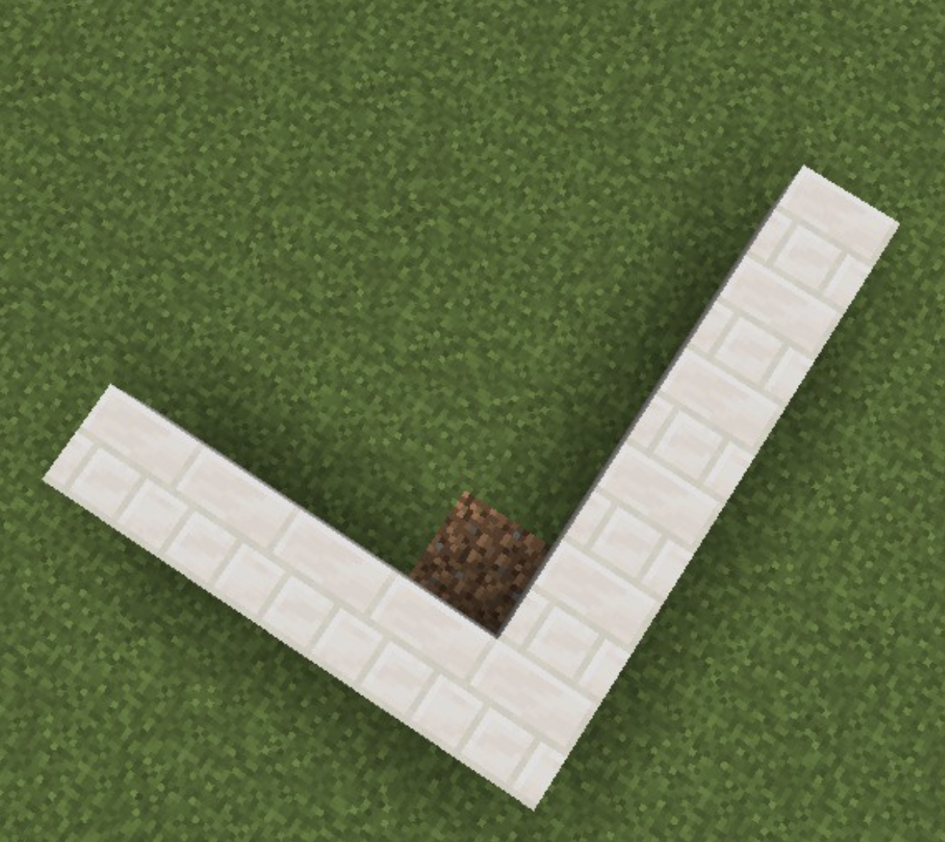
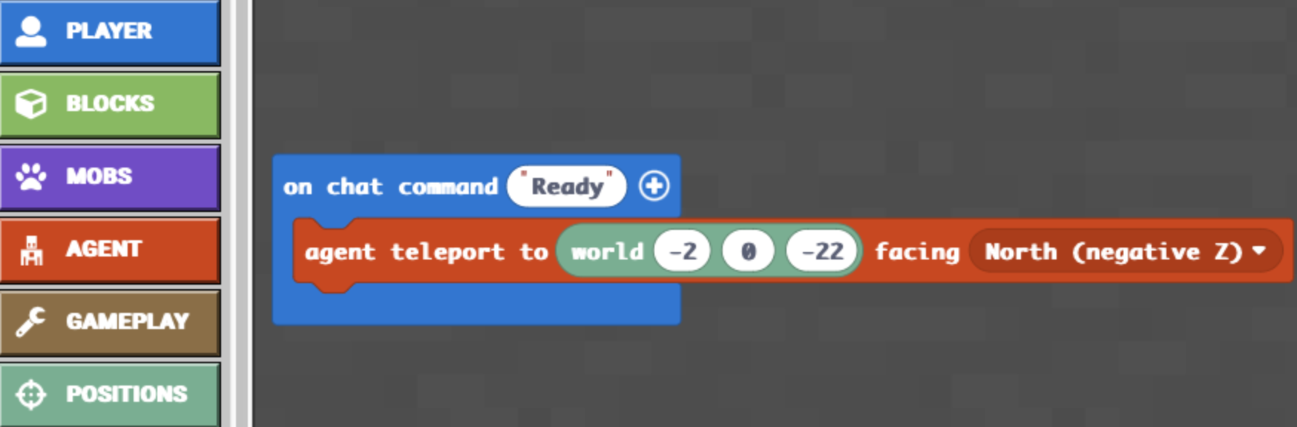
You can also teleport the agent to the location of your choice
First, identify the coordinates of the location of your choice by going there and reading it from the screen on the left top part:
Second, use the following command, enter the coordinates, and adjust the facing so that agent teleports to that location, facing the direction you want.

Slide 38
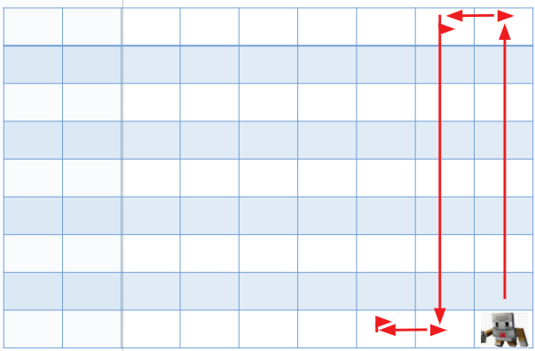
Now can you automate your agent to move inside the area?
Move→ should make agent keep moving in the red arrows’ direction
←–---------------Y —--------------------->
←–--------X ----->

Slide 39
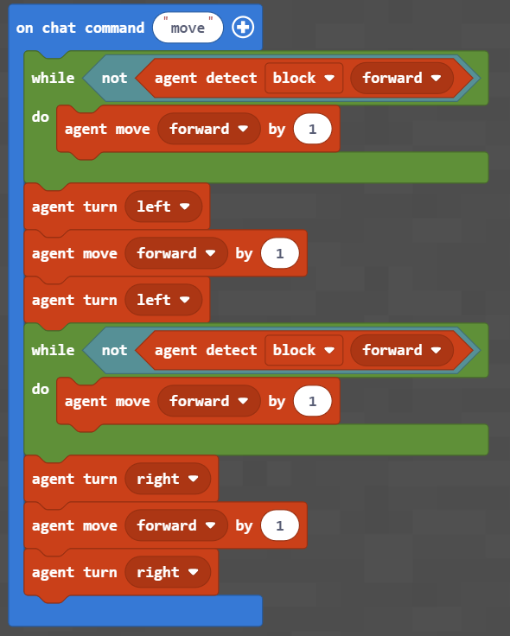
let’s look the algorithm used

Slide 40
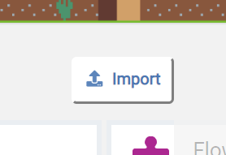

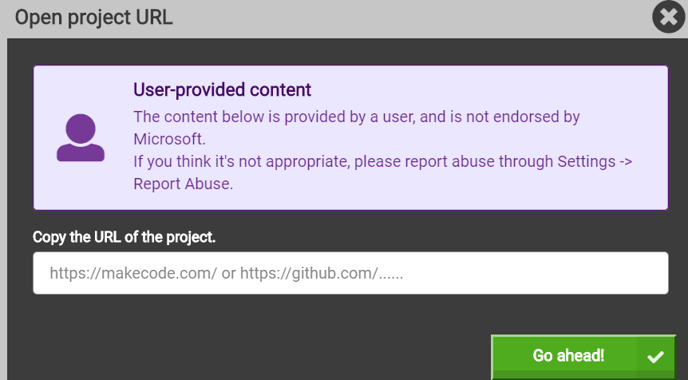
Import the Code (the URL sent in the email)
https://makecode.com/_WD2JDTeP5iqJ
https://makecode.com/_PE5fmYT77CXT

Slide 41
Modify it to see its effects

Slide 42
How many times do we need to repeat this set of codes to be able to cover the entire area (9X9)?
How many times?

Slide 43
let’s think about modifying the codes to see its effects

Slide 44
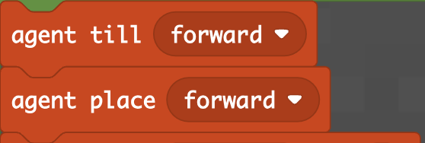
Moving done! Ok but how about tilling and planting?

Slide 45
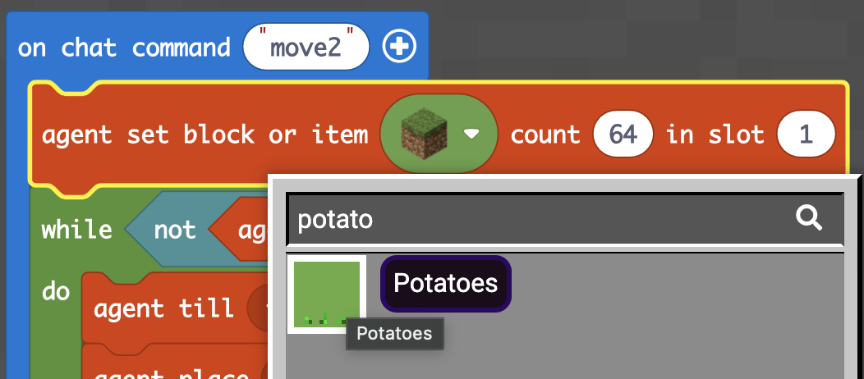
But first make sure the agent has seeds!

Slide 46
How about areas different than 9X9?
Work in groups to code it
for the following sizes of areas:
6 X 6 ?
8 X 9 ?
3 X 3 ?
5 X 5 ?

Slide 47
How about any area with any given size?
You will code this next week:
L X W ?
L stands for Length
W stands for Width

Slide 48
Practice & Application
(Next week, Day 1)

Slide 49
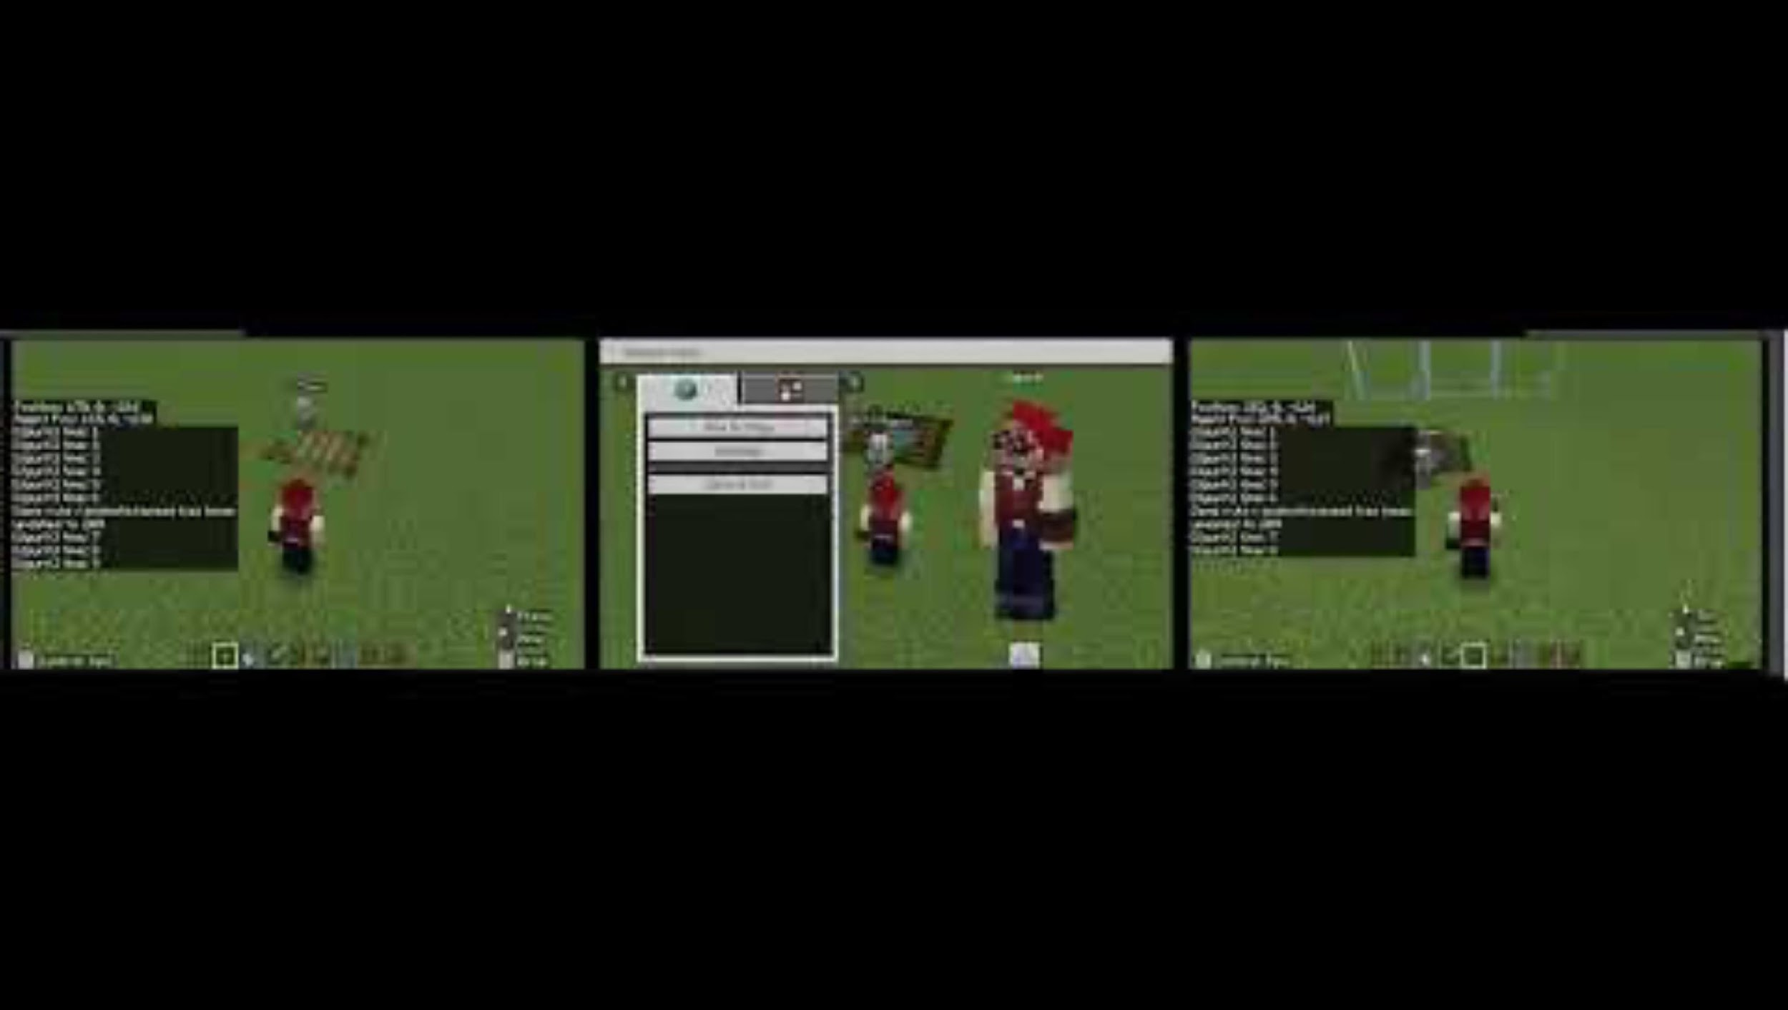
Extending previous examples to simulations

Slide 50
During the class:
  We will share & modify & your projects
  We will also remix one of your peers’ project

Slide 51
Prior to the class:
Think about your existing lesson idea
Imagine
  A world (Search in Minecraft…e.g., biomes)
  A structure (e.g., building, garden, pool, lake, waterslide, roller coaster any space, etc.)
  Animals
Create them in Minecraft
Automate something in it
  e.g., Creation of a structure

Slide 52
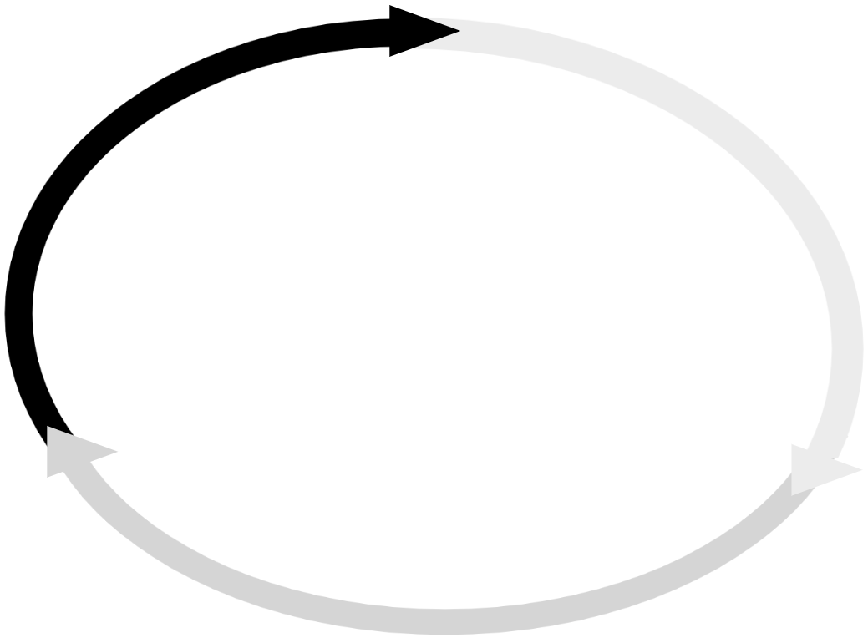

Imagine → Draw → Develop
Make
Debug
Part A
Part B
Part C
…
Debug
Make
Debug
Make
Debug
Make
…
Test
Test
Test
Test

Slide 53
Submit your project to the Learning Management System
Export your Minecraft world (save it on your computer)
Copy the URL of your code file
Submit the Minecraft world and the URL

Slide 54
Practice & Application
(Next week, Day 2)

Slide 55
Group Lesson Design
Work in (grade) groups to design a full lesson
Use the Group Lesson Design Template given
  Objectives and contextual issue to address
    Timeline of learning activities to follow
    CT practices, processes, and concepts to promote
    CT activities suitable for the grade level
Submit your lesson on the Learning Management System

Slide 56
Modify an Existing Lesson
Work individually to modify an existing lesson
Choose an existing lesson:
  A lesson from your placement classroom
  A published source
Use the Modification Guideline given
Make a modification in the lesson plan to improve it towards supporting students’ computational thinking in science
Submit your modification on the Learning Management System

