Slide 1
Session II: Grow Food
Ugur Kale¹ and Yuahnua Wang²
¹Indiana University, ²West Virginia University

Slide 2
Introduction (Day 1)

Slide 3
Growing Food to Address Food Access?

Slide 4
An Introduction & Resource Guide to Garden-Based Learning (GBL)
With Examples from the North Elementary School Garden Program
Jim Rye, WVU Professor Emeritus and Monongalia County WVU Extension Master Gardener
02/14/2023
I am not an expert in Horticulture.
My gardening knowledge derived chiefly from:
WVU Extension Master Gardener certification…& required continuing education & volunteering in our community.
Ongoing contact with WVU Mon County Agricultural Extension experts.
Teaching “garden-based learning” to WVU preservice & in-service teachers.
Assisting with a school garden program at North Elementary School
Home gardening & related resources (use term Extension as part of Internet searches).

Slide 5
But Please, Dig Deeper!
This presentation is just the “tip of the iceberg!” Peruse resources/organizations on GBL/school gardens listed in this presentation, e.g.:
      Checklist for Starting a School Garden. Ohio State University Extension
      Cornell Garden-based Learning. Cornell Agricultural Extension, College of Agriculture & Natural Scienceards
      Planning Toolkit: School Gardening (video, featuring Farm to School program) & School Gardens (fact sheet). USDA Food and Nutrition Service.
      Seeds of Success Toolkit. KidsGardening. (Home - KidsGardening)
      Note: When searching for resources etc., include the word “Extension”.
Notes:
&

Slide 6
And Before You Begin…
Discuss initial plans with & secure support of your principal.
Discuss with principal local resources that could “help your garden grow,” e.g., funding sources, custodial staff, academic coach, librarian, technology, parents, volunteers, your County Extension Service & Extension Master Gardeners, local colleges, business partners.
Start “small” & seek teacher-partners; form a school garden committee (with parent representation) and annual plan.
Ask yourself: Which academic disciplines/standards can be integrated with GBL; think “project-based” learning.
Always think about safety precautions to take…beyond what is listed for a lesson/activity. Contact your school district science supervisor and follow science safety rules that your school has in place. Another excellent resource: Your County Agricultural Extension Agent.
Notes:
&

Slide 7
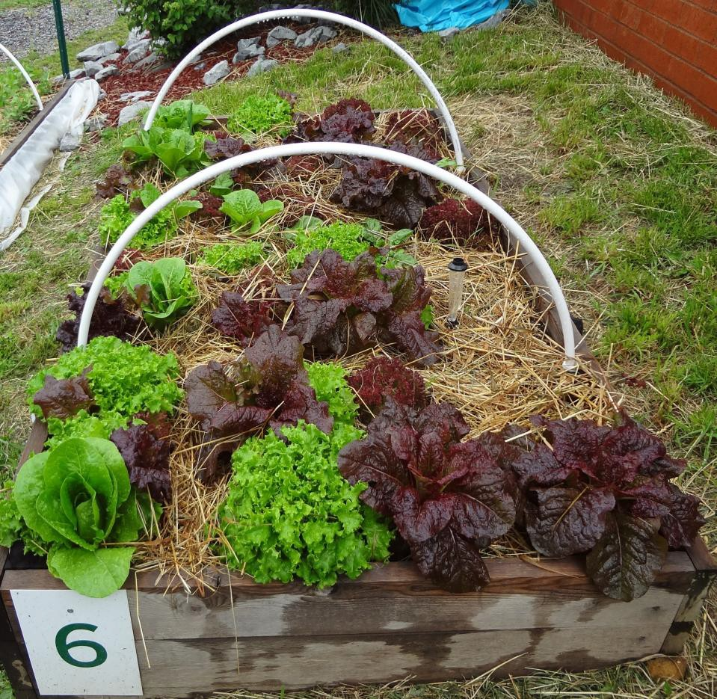
Who Among You Is a Gardener?
Who Has Done GBL with Children?
From reading the articles about “Cucumbers and Vocabulary” and “Germinating Fractions:”
        What is one way that your attitude or preparedness to do GBL changed? (Give an example)
What is one “take away” that you might adapt for your future teaching?
What did you find most enlightening from viewing the “GBL at North Elementary” video?
Raised bed of lettuce grown by North Elementary students

Slide 8
True or False:
In Order to Do GBL, You Need an Outdoor Space of Land for Growing Vegetables.

Slide 9
Example Components & Benefits of Garden-Based Learning
Can be limited to activities in the school classroom, e.g., seed germination and vermicomposting.
Student learning in STEM, ELA, & other disciplines in standard curriculum should be chief focus!
Growing vegetables & fruits for human consumption…and increasing healthy food choices.
Enhancing local food availability & food justice (e.g.,
school cafeteria, farmer’s market, food pantries).
Creating pollinator habitat; environmental steward-
ship, e.g., seed saving, composting, citizen science.
See Pollinator Partnership (e.g., No Fear of Stings &
Your School & Pollinators)
Facilitating a life-long pursuit/hobby.
Involving parents as volunteers & caretakers;
enhancing “gardening at home.”
Don’t Forget: What you create needs maintenance!

Slide 10
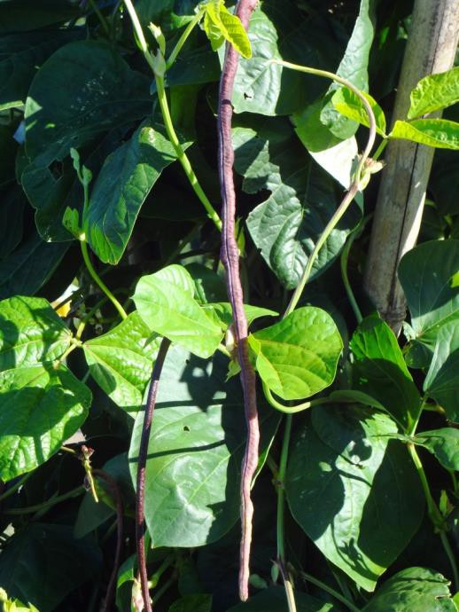
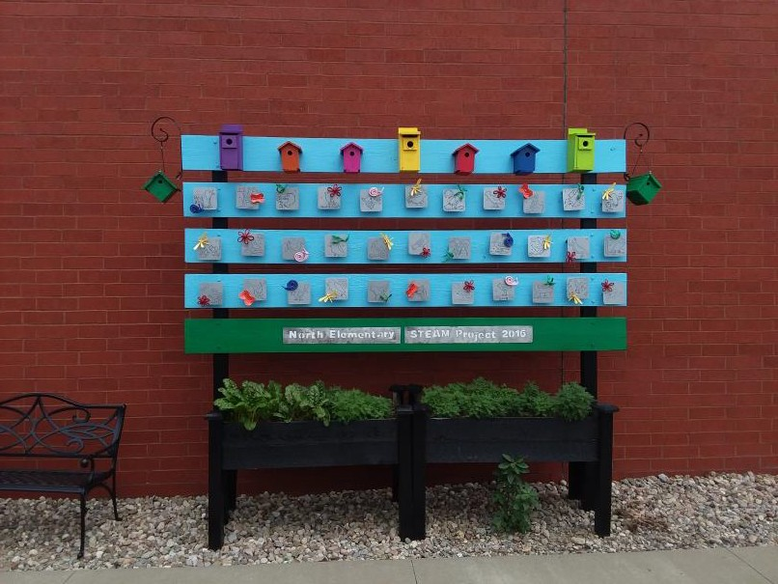
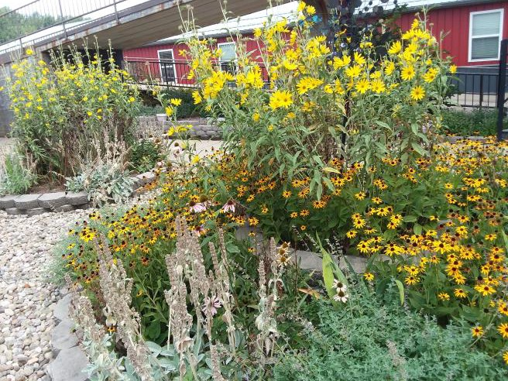
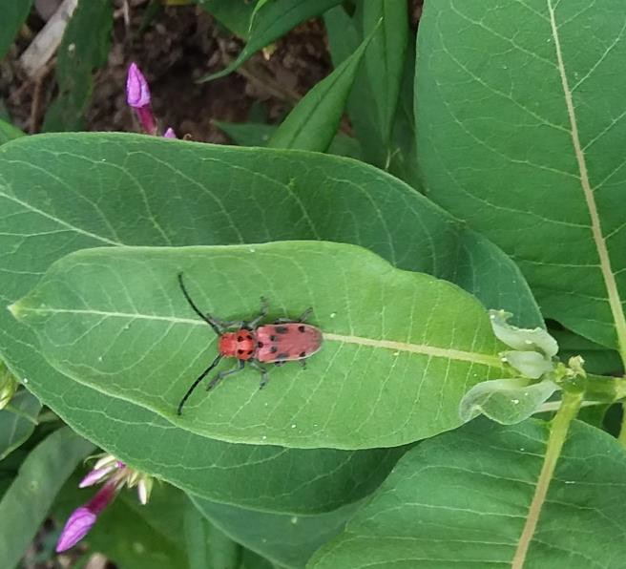
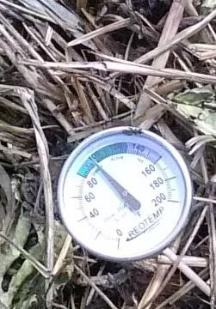
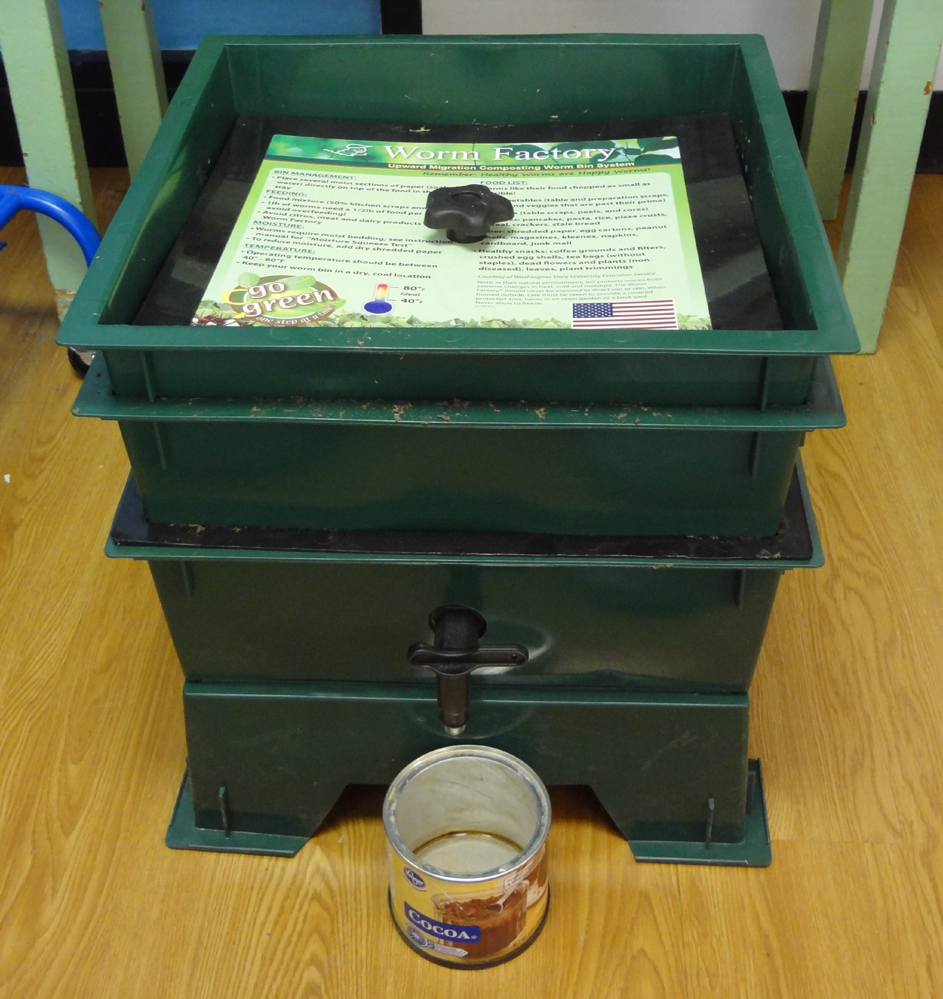
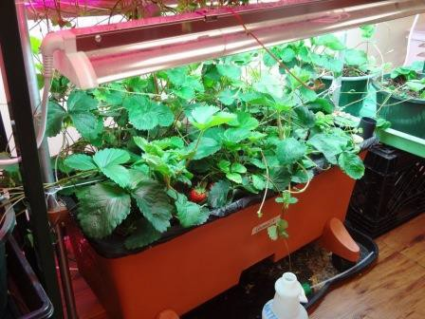
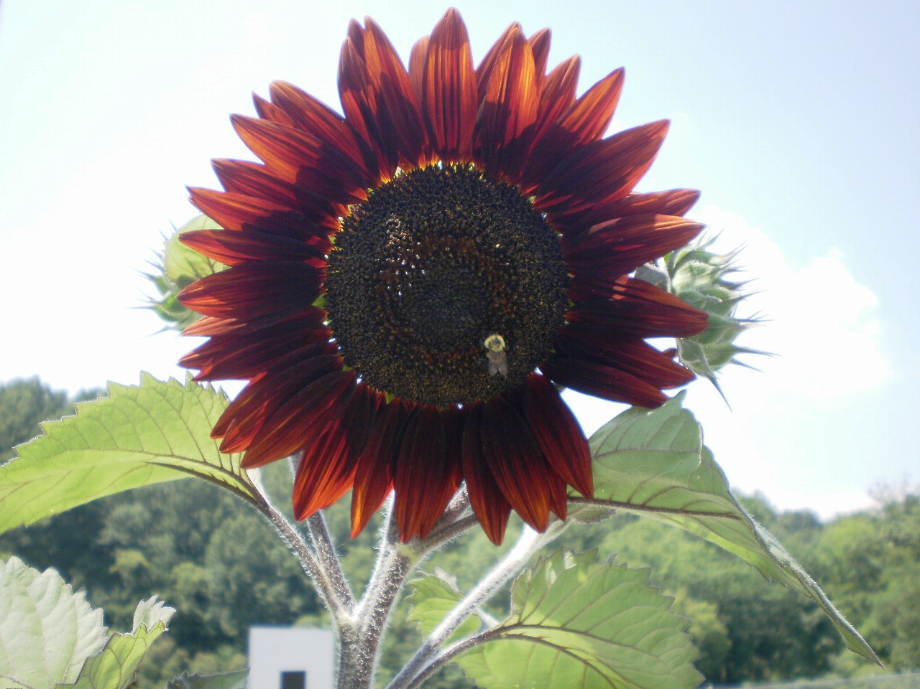
What Learning Opportunities Do These Photos from North Elementary School GBL Bring to Mind? (Click on photos to reveal embedded websites)

Slide 11
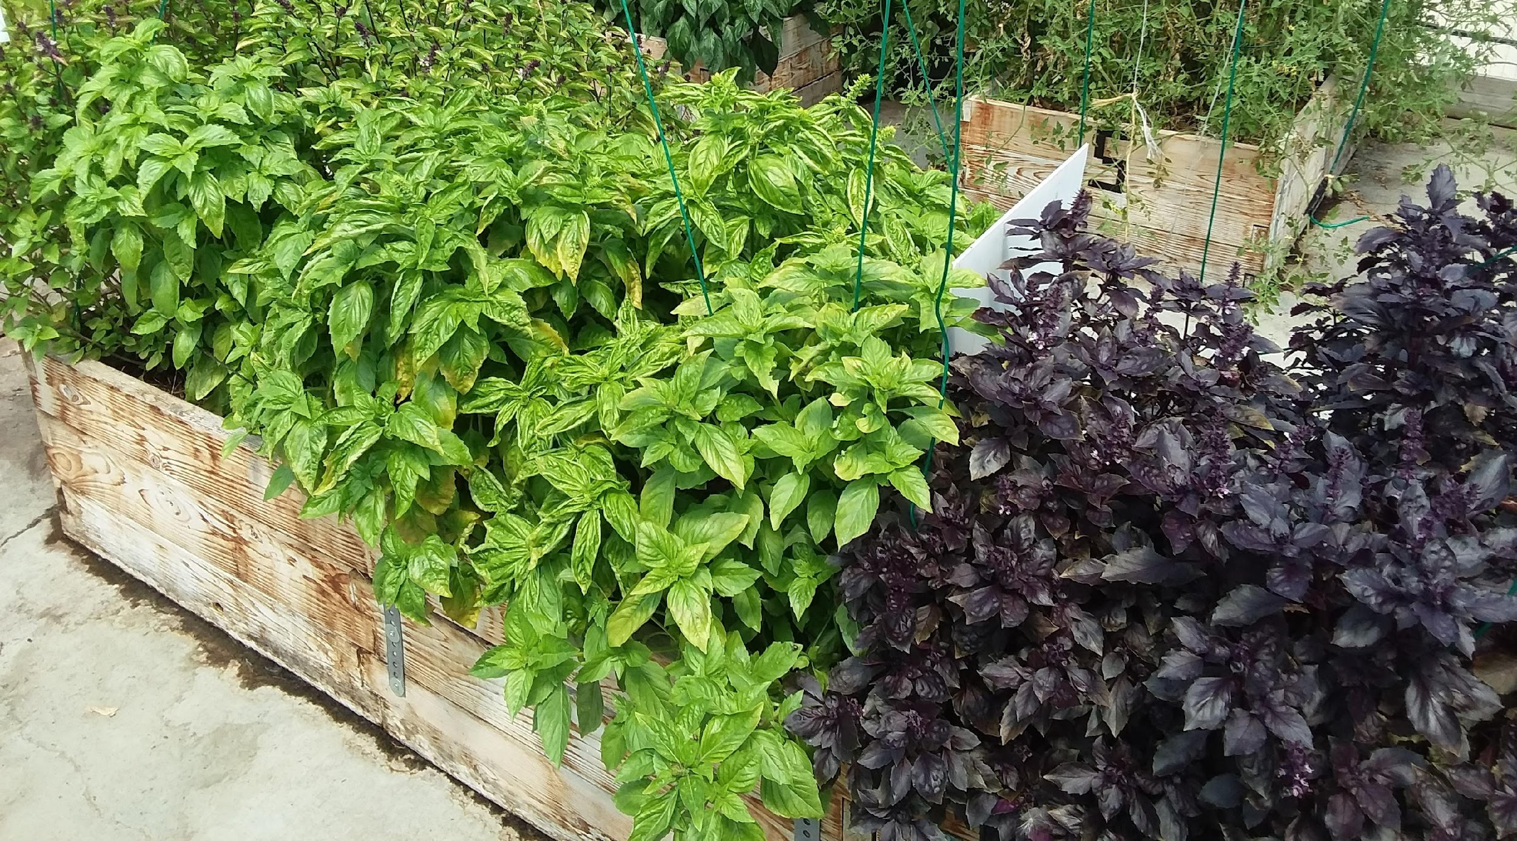

OOPS Don’t Forget the Herbs!
(for culinary and companion planting--not medicinal--purposes)
Pinch off to prolong leaf production
Three varieties of basil in the North Elementary School high tunnel. Grown from “The Pyramids of Basil” transplants: A Project that received recognition as an “Elementary School Winner” in year 2020 Cartons2Gardens contest sponsored by Evergreen Packaging and KidsGardening.

Slide 12
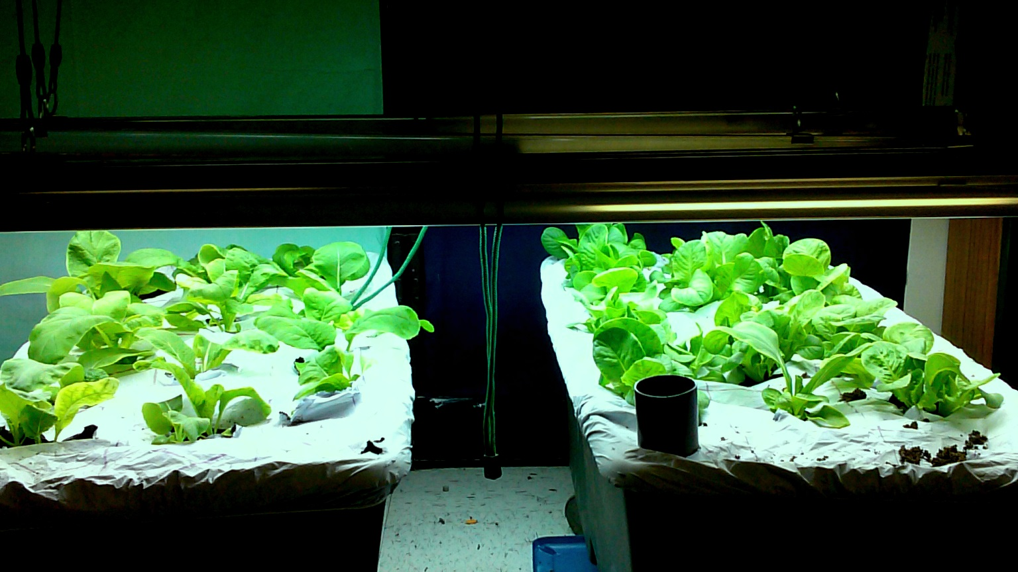
Asian Greens Growing in Earthboxes under Supplemental Lighting in Classroom
Nasturtium

Slide 13
SAFE, NON-TOXIC, AND TOXIC PLANTS (for humans)
Pertains mainly to flowers, vines, and shrubs that might be planted in school gardens. However, the leaves of some “food” plants—notably the Solanaceae family (e.g., tomatoes, peppers, potatoes)—are toxic.
Remember that students can have allergies to fruits and vegetables that are grown in food gardens: Check with school nurse about your students.
Check to see if the flower (etc.) that you want to grow is on a reputable “safe for” or “non-toxic to” humans list. Two example reference lists (see also NCSU Plant Toolkit):
University of California Safe and Poisonous Garden Plants. https://ucanr.edu/sites/poisonous_safe_plants/about/
California Poison Control System. Plants. (see Non Toxic and Toxic Plants) https://calpoison.org/topics/plant#nontoxic-common
Flowers in food gardens: Best to stick to “safe” list. Still, no “guarantee” plant is safe for all (e.g., allergies).
What about flowers/plants (e.g., milkweeds) in “pollinator gardens” that are separate from food gardens?
(see University of GA Extension)
        Establish rule: Look but do not touch!
        Communicate to all teachers the plants that are growing there!

Slide 14
Examples of Additional GBL Safety Precautions
Safety Contract. Build “gardening safety rules” (e.g., always ask teacher before touching or tasting) into a general “science safety” contract. Students take home & review with parent/caregiver.
Equipment & Supplies. Read and follow safety precautions found on the labels of equipment and supplies. Use clean equipment and containers/other supplies. Do not let students handle adult sized tools.
Safe soil. For food gardens, you want “safe” soil (e.g., not “contaminated” with heavy metals like lead and arsenic). In general, using commercially available horticultural mixes/packaged soil in raised beds/containers is your best option. Contact your County Extension Office for guidance on food gardening in safe soil. Also, see USDA Food Safety Tips for School Gardens, which describes several Good Agricultural Practices and Good Handling Practices.
Buried Utility Lines. Before digging, make sure that the location of underground utility lines are marked (Ms. Utility: call 811 or access on-line).
.
No Pesticides. Do not use pesticides (includes herbicides) or “treated” seeds.
Protect Eyes. Be mindful of protecting students’ eyes, e.g., don’t place stakes at eye level or cover tops of stakes that might pose an eye hazard.
Allergies. Protect students who have allergies/reactions to what is being grown as well as bee stings (coordinate with school nurse).
Wash Hands. Always wash hands before harvesting (ideally, before working in the garden) and after working in the garden. Students who are ill should not be in the garden.

Slide 15
Some Additional Safety Recommendations for Gardening Indoors
MOLD. Avoid conditions that foster mold growth. (Allow air flow; don’t overwater)
DUST. Minimize “dust” when working with dry germination media/planting mix. (Recommend teacher wear face mask and hydrate planting mixes outdoors/students “stand back.” Note: Wetting down germination mix while it is still inside the bag (and bag is inside a “mixing” tub), reduces dust.
SUPPLEMENTAL LIGHTS.
Generally, lights are not needed for “germination only” investigation.
If going beyond germination to produce seedlings indoors, supplemental lighting is needed.
Before purchasing or using any lights for growing plants indoors, consult your school district science supervisor and school principal on allowable and proper/safe use of supplemental lighting.
Always follow manufacturer’s instructions on use of lights.
Only teacher manipulates lights and students are told to not stare at lights.
Fluorescent lights contain mercury (bulbs should be protected by covers/guards); LED lights do not contain mercury. If using LED grow lights, recommend those in which light output appears white to the eye.
WATERING
Keep water away from electrical outlets and lights.
Avoid water spills, e.g., students work “inside” of supply tubs/trays.

Slide 16
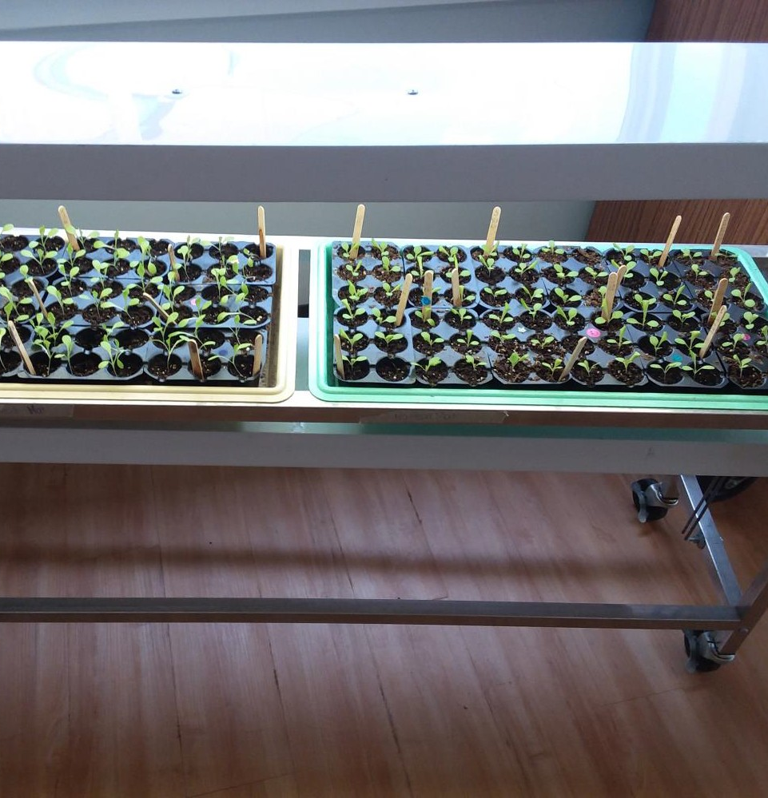
One Simple and Widely Applicable GBL Application: Seed Germination
Example of a 2-level seed germination cart (with lights) that can hold 4 trays of seedlings.
Seedlings shown are lettuce, which are grown in cell/plug trays (72 total cells per tray) and nested in Perma nest trays that fit the cart.

Slide 17
Sample Resources on Seed Germination and Needs of Seeds
(Some used in preparation of this presentation)
University of Minnesota Extension. Starting seed indoors.
University of New Hampshire Extension. Starting plants indoors from seed.(AU: C.H. Williams and B. Sideman)
Penn State University Extension. Seed and seedling biology (AU: L. Stivers, T. Dupont) https://extension.psu.edu/seed-and- seedling-biology
National Gardening Association. From seed to seed: Plant science for k-8 educators. https://garden.org/onlinecourse/PartI5.htm
North Carolina Extension, Caldwell County. Tips for seeding success. (AU: E. Snyder, T. Lovejoy). https://caldwell.ces.ncsu.edu/2017/03/453677/
Missouri Botanical Garden. Starting plants from seed indoors.
National Gardening Association. From seed to seed: Plant science for k-8 educators.
Vendors of seeds such as Johnny’s Select Seeds: Guidelines for Staring Seed Indoors.

Slide 18
Needs of Seeds
Water/hydration. Keep surface of soil continually moist until germination, but don’t overwater. Water “stress” a bit later stages of seedling development. Note: Some seeds with thick coats (e.g., peas) also benefit from presoaking.
Air (specifically, oxygen).
Heat/optimal temperature (varies by plant) (heat mat speeds indoor germination of many seeds)
Appropriate light conditions (most vegetable seeds do not need light to
germinate, however, lettuce seeds do)
Soil aeration (exchange of gases; allows CO2 to escape)
Some perennial flower seeds need scarification or stratification to break
dormancy and germinate. Some seeds also need light to germinate.
May benefit from dilute soluble fertilizer boost after true leaves appear,
depending on amount of fertilizer in the seed starting mix.

Slide 19
Some Science & Engineering Practices Used in Seed Germination

Slide 20
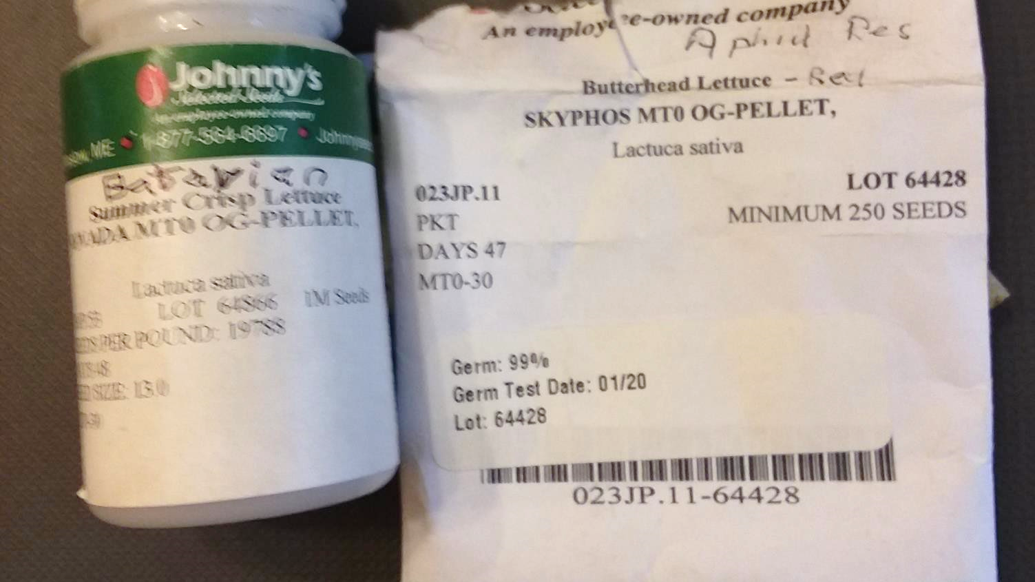
Asking Questions

Slide 21
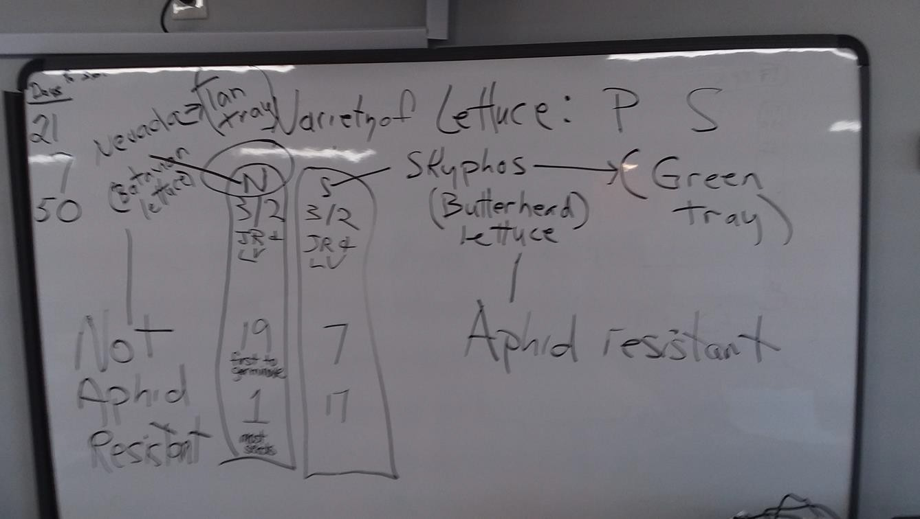
Planning/Conducting Investigations
Nevada (N) “Batavian/Summer Crisp” lettuce. Skyphos (S) “Butterhead” lettuce.

Slide 22
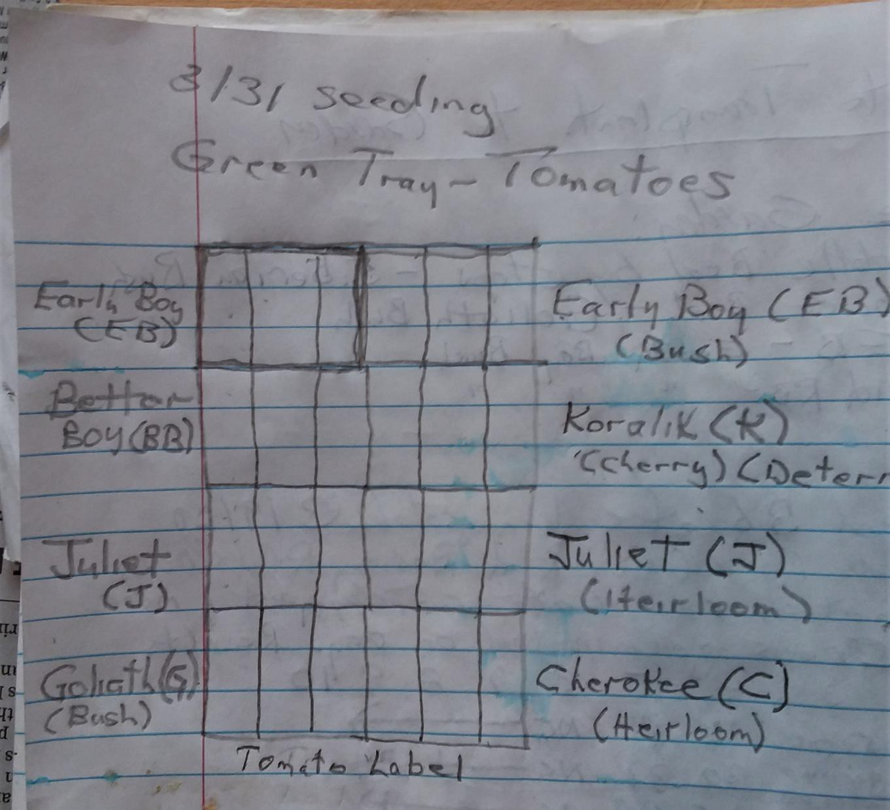
Developing/Using Models

Slide 23
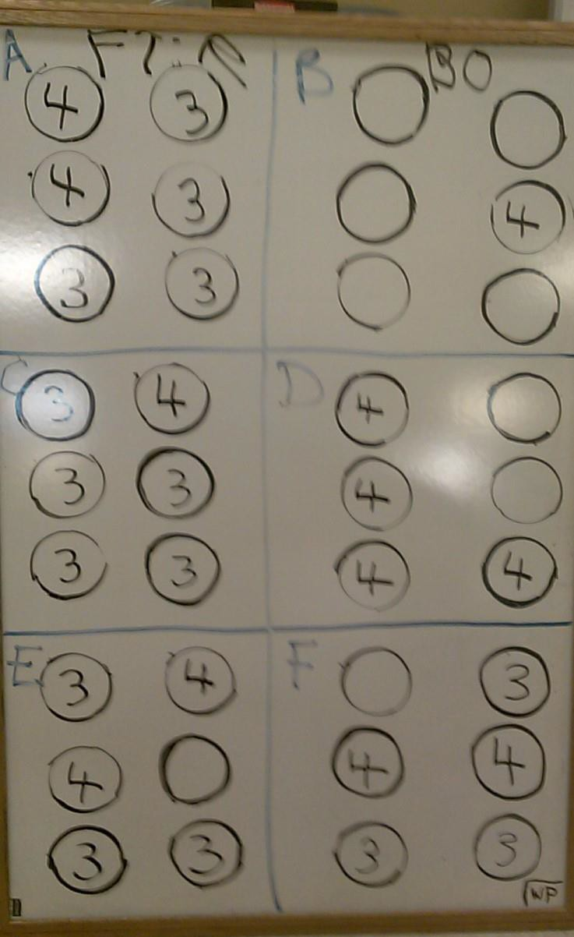
-Analyzing and Interpreting Data
-Using Mathematics
Data collection procedures and models developed collaboratively with Dr. Ashley Kooken, former WVU science methods instructor.

Slide 24
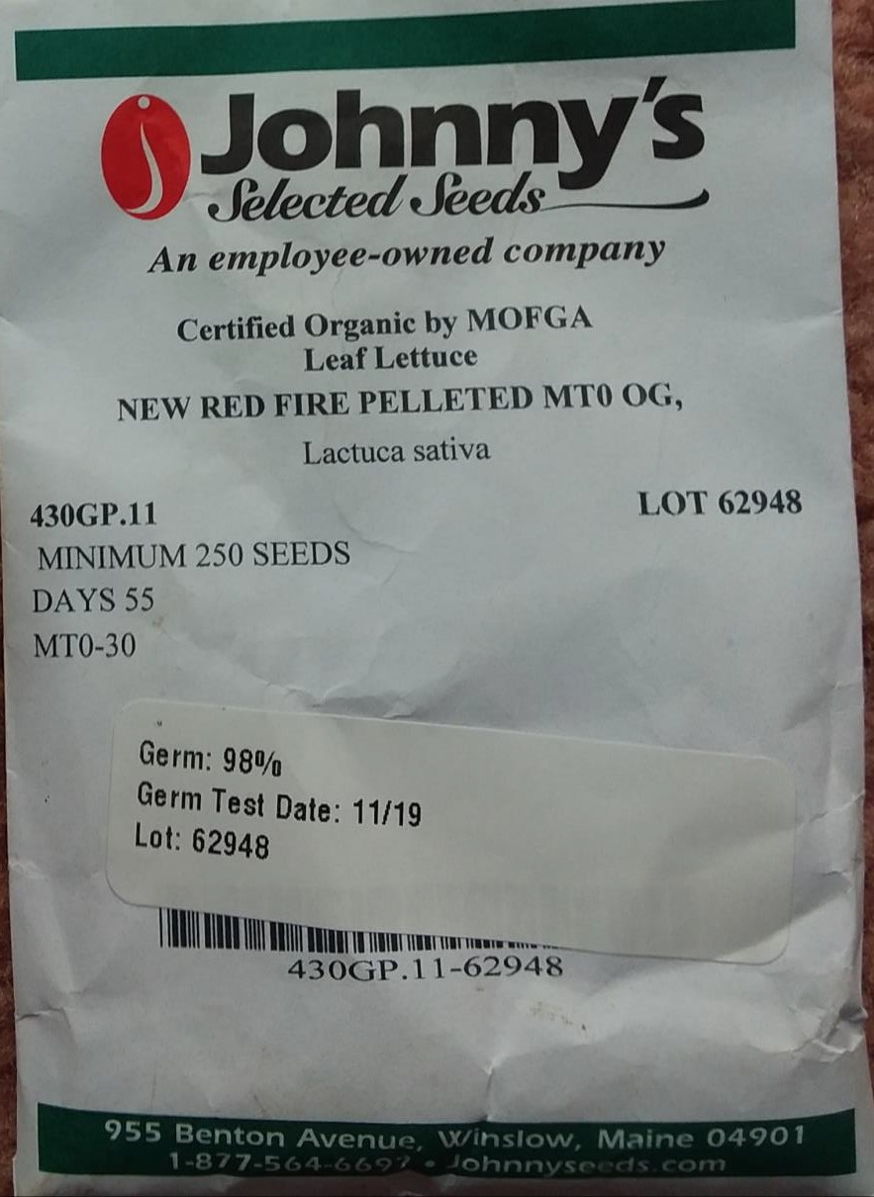
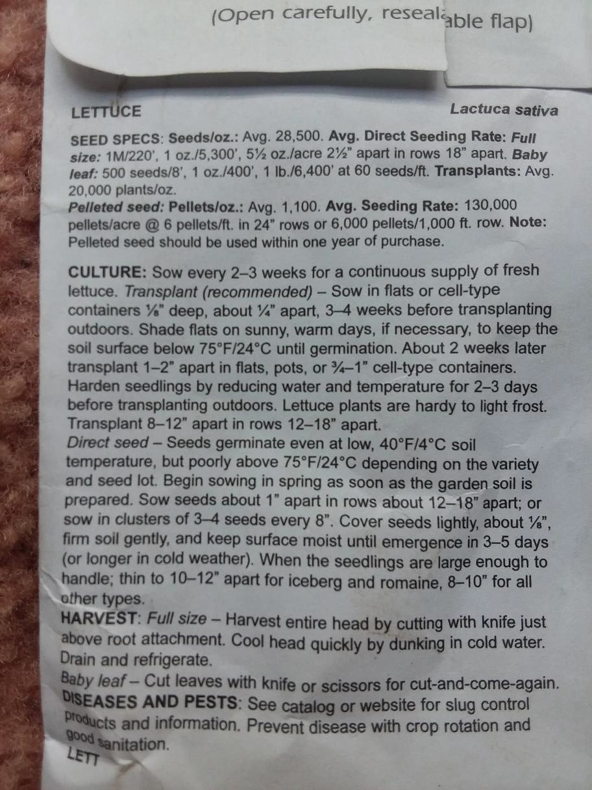
Obtaining, Evaluating, Communicating Information (and ELA integration!!)

Slide 25
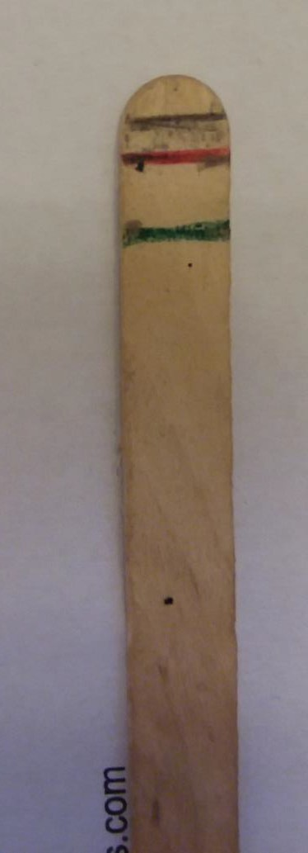
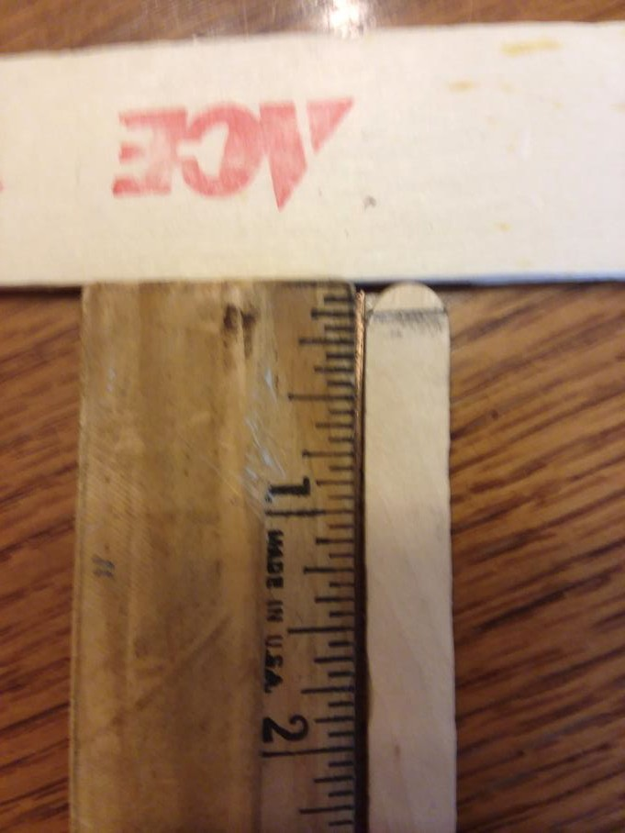
Calibrate a Craft Stick for Depth to Plant Seed
Black line:1/8 in or .3 cm
Red line: ¼ in or .6 cm
Green line: ½ in. or 1.3 cm

Slide 26
Reposition Labeled Sticks (plastic is best) as Needed to Support a Piece of Plastic to Be Laid Over Top of Each Tray to Create a Humidity Tent

Slide 27
General Guidelines for Seedling Care After Germination
Your County Agriculture Extension Agent/Service and associated Master Gardeners and University Extension websites (see links provided in this presentation) are outstanding resources for raising and transplanting seedlings and caring for them through harvest. Here are just a few guidelines for seedling care prior to transplanting to the garden.
HEAT MAT AND HUMIDITY TENT. IF you are using them, make sure to remove no later than the end of the germination period.
LIGHTING. Once germination is underway, you will need to provide supplemental lighting. Continue to raise lights to keep them above seedling canopy (follow instructions for fluorescent vs. LED). This means you may need to rearrange your seedlings according to their rate of linear growth, e.g., taller vs shorter seedlings in separate trays and under separate lights. Consider using a timer. Keep lights on 14-16 hr/day.
MOISTURE. Monitor moisture level of “soil” at the top of each cell: When dry, water. Ideally, use bottom
watering technique. Do not overwater!
DISEASE. Remove diseased seedlings and those with mold growing in cell.
POTTING UP. (Transplanting seedlings to larger cells/containers). Avoid producing “pot bound” seedlings in
which roots are girdling an extensive and tight root mass.
  Need to pot up is most critical when germinating the seeds of “large” plants (e.g., tomatoes, eggplants)
in relatively small cells (e.g., tomato or eggplant seeds germinated in 72-cell plug tray).
  Do not transplant until the seedlings have at least 4 true leaves.

Slide 28
Seedling Care After Germination (continued)
FERTILIZING. Seedlings germinated in a seed starting mix containing no supplemental fertilizer (NPK) will need a “weak” liquid fertilizer once true leaves develop. Even if germination mix contains supplemental fertilizer, seedlings in latter stages of development (e.g., 4 weeks after germination) may benefit from addition of dilute liquid fertilizer.
HARDENING OFF. Plants need to be acclimatized to the new environment (generally outdoors) in which they will be transplanted, starting 1-2 weeks before they are transplanted (not sooner than the region’s last frost date—May 15 for Monongalia County) for tomatoes, peppers, and eggplants).
  See “time from germination to transplanting” from UMaine Extension to ascertain when you would start the hardening off process, e.g., it takes 5-7 weeks before tomatoes are ready to transplant, so you would start the hardening off process at least 1 week before the week of transplanting.
  Hardening off is generally accomplished through a stepped approach in which the seedlings are moved to that new environment for increasingly longer periods of time each day starting with only 2 hours. See Penn State Extension guide to hardening transplants. Adding less water, and using shade cloth or horticultural fleece to reduce exposure to direct sunlight, also may be employed.

Slide 29
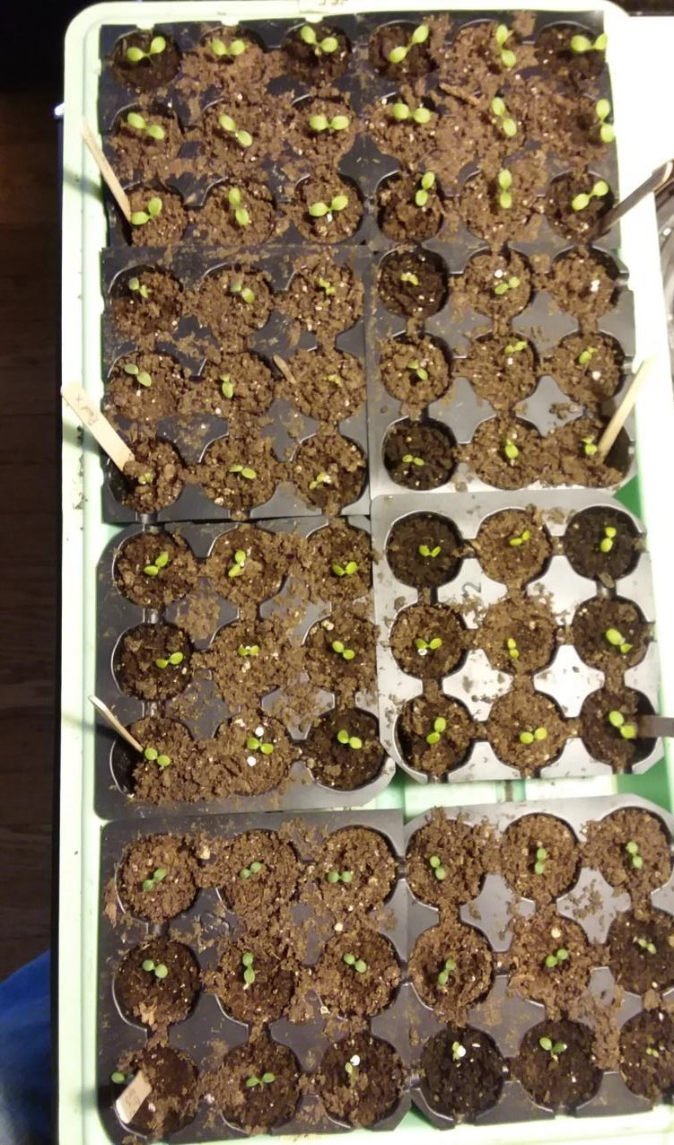
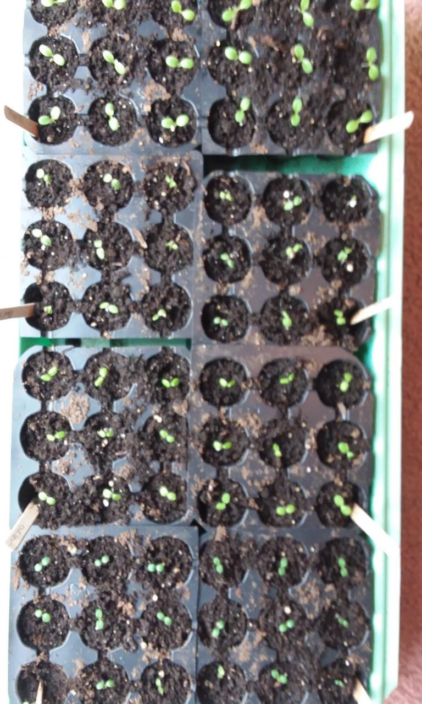
When to Water Seedlings

Slide 30
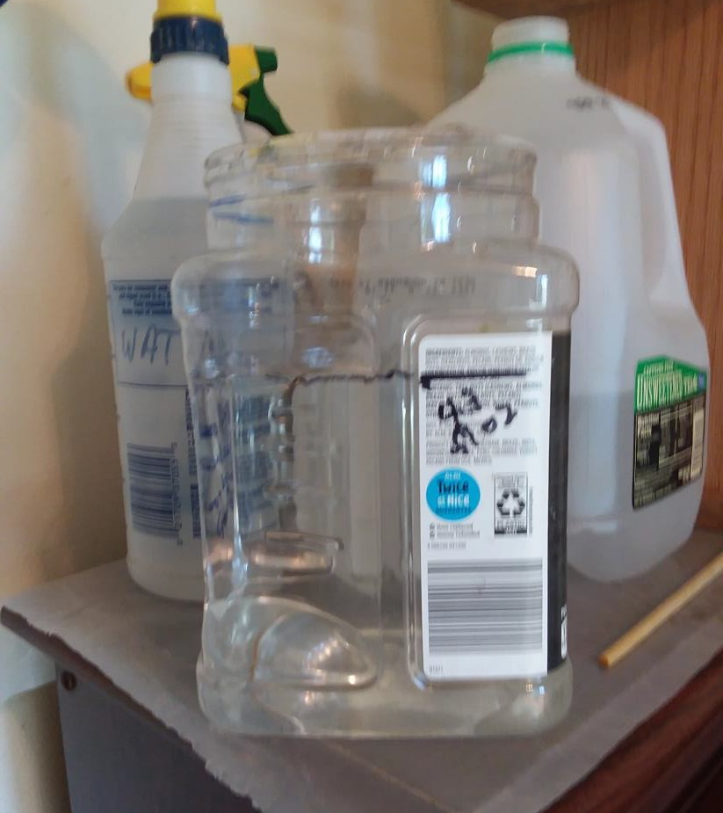
Bottom Watering of Seedlings
My experience: To rehydrate a flat of 72 young seedlings, add 43 fl. oz. (1273 mL) water to bottom of leak-proof tray.
All water is usually taken up.
If considerable water does remain after ~30 minutes, must pour off.
A resource on bottom watering from the Rusted Garden: https://www.youtube.com/watch?v= rMrCV6bLT8A

Slide 31
Some Additional GBL Resources
Plant Databases
Missouri Botanical Garden Plant Finder (missouribotanicalgarden.org)
North Carolina State University https://plants.ces.ncsu.edu/
USDA Plants Database https://plants.usda.gov/home
Gardening and GBL “Know How”
Clean Soil. Hawaii State Department of Health.
EarthBox Learning Center. https://earthbox.com/learning-center
Encyclopedia of Gardening Techniques by the American Horticultural Society.
Healthy Food Choices in Schools-School Gardens. Extension Foundation and USDA
How to grow a school garden. by Bucklin-Sporer, A. & Pringle, R.
State/University Extension Agencies e.g., West Virginia University Extension Gardening and Garden Calendar
(Note: At any State Extension site, simply “search” for any plant/technique etc. to see if they provide guidance)
The Vegetable Gardener’s Bible by Smith, Edward.
Curricula/Lessons
Agriculture (National) in the Classroom. https://agclassroom.org/matrix/
Captain Planet Foundation https://captainplanetfoundation.org/
Dig In (USDA): https://www.fns.usda.gov/tn/dig-lessons
Edible Schoolyard (resource library): https://edibleschoolyard.org/resource-search
Farm to School Network. https://www.farmtoschool.org/resources
Grow for it. North Carolina State Extension. https://growforit.ces.ncsu.edu/
Growing Minds Farm to School Program: https://growing-minds.org/
Massachusetts Farm to School. https://www.massfarmtoschool.org/guide-types/classroom-lessons/
National Science Teachers Association (NSTA) Resources. https://www.nsta.org/resources
Pollinator Partnership. https://www.pollinator.org/
Science and plants for schools. https://www.saps.org.uk/
University of Georgia Extension: School Garden Resources, Curri ulum. https://extension.uga.edu/programs-services/school-garden-resources/curriculum.html
Whole Kids Foundation & American Heart Association: https://www.wholekidsfoundation.org/assets/documents/school-garden-lesson-plans.pdf

Slide 32
Demonstration (Day 2)

Slide 33
Now think about seed germination
  plug trays
  pack of cucumber seeds
  bags of potting mix/soil
  heat mats
  grow lights

Slide 34
What may be some conditions impacting germination?

Slide 35
What may be some conditions impacting germination?
How do heat and light affect the germination together?

Slide 36
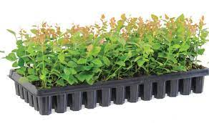


What may be some conditions impacting germination?
How do heat and light affect the germination together?
 | No heat | Heat
No Light
Light

Slide 37
You have already been collecting the data

Slide 38
Let’s visualize it!
We’ll use Googlesheet
We will come up with a visual (graph)
The total # of seeds that have germinated by each day (cumulative)

Slide 39
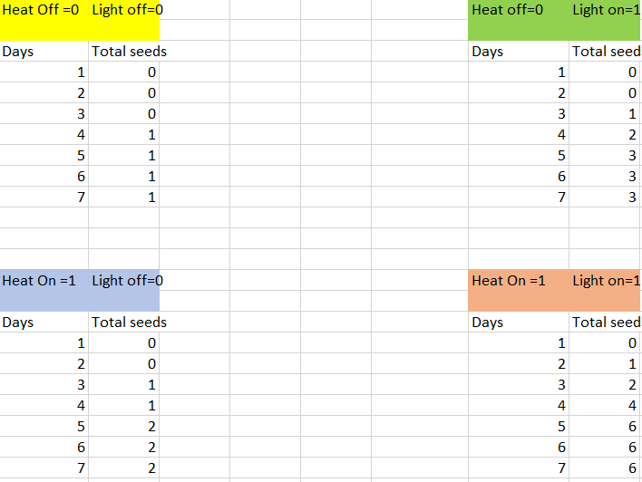
Let’s first enter the total # of seeds that have germinated by each day for your condition at https://tinyurl.com/data440

Slide 40
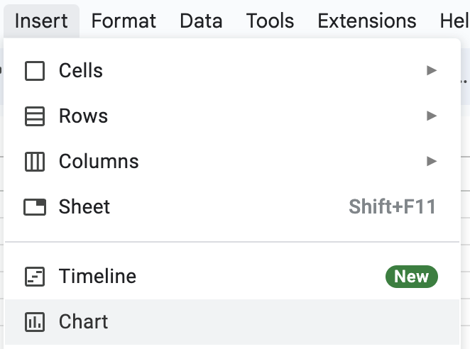
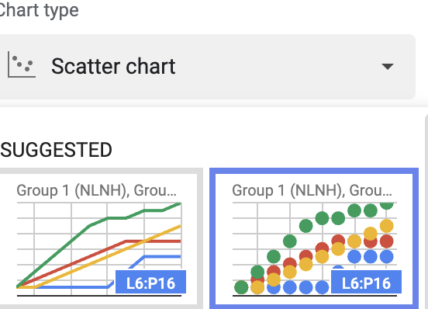
Let’s put all in one graph!
Identify the relation relationship between the day and percentage of germinated seeds
Graph the relationship in Google sheets. First select the data on the sheet
Then, insert Chart: next select Scatter Chart:

Slide 41
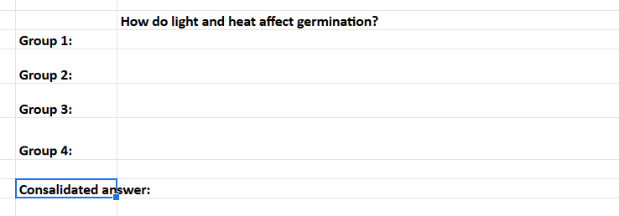
What’s your interpretation of data?

Slide 42
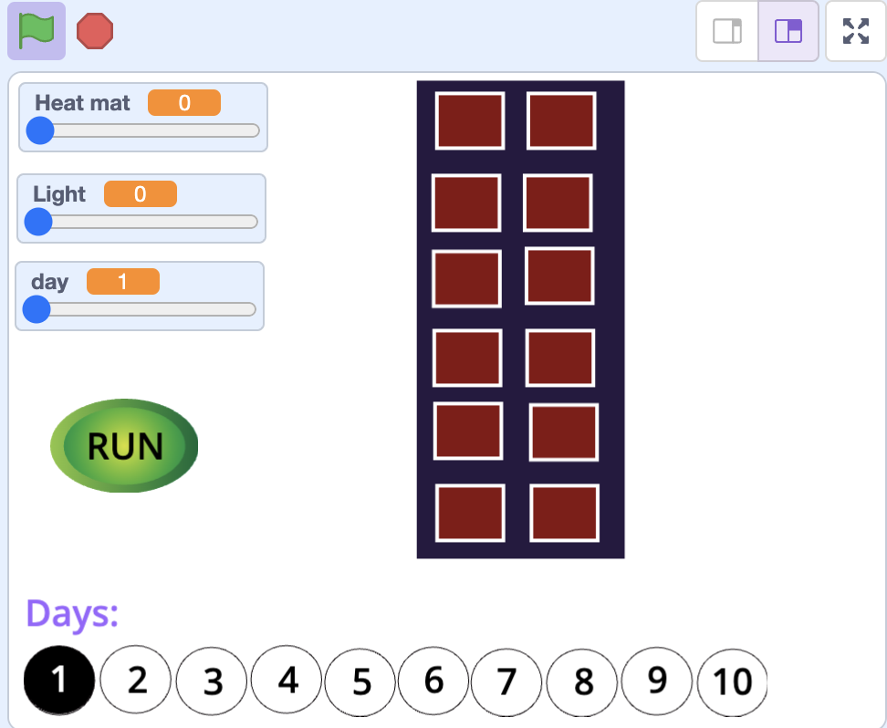
Let’s put the data in a simulation
Remix the following Scratch project as a group
It should show all the seeds germinating in a selected day
(e.g., cells turn green if the seeds germinate)

Slide 43
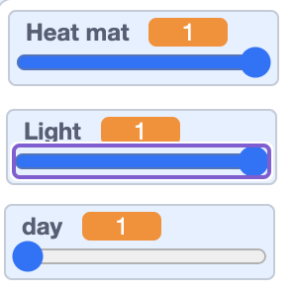


Heat mat and light variables can be set to 1 or 0.
1 means there is heat/light and 0 means there is NO heat/light
day variable can be set to any number between 1 and 10.
RUN button should broadcast a message about the condition set:
NLNH, NLYH, YLNH, YLYH
This Tray should have 10 costumes. Each costume should depict all the seeds that have germinated by a given day such as
Costume 1 is for day 1, Costume 2 for day 2, and etc….
When this sprite receives the message (e.g., NLNH), it should switch to the costume for a selected day (e.g., Costume 5 if day is set to 5).

Slide 44
Practice & Application
(Next week, Day 1)

Slide 45
During the class:
  We will share & modify & your projects
  We will also remix one of your peers’ project

Slide 46
Prior to the class:
Think about your existing lesson idea
Imagine and Draw:
  simulation idea
  game idea
  animation idea
  or etc…

Slide 47


Imagine → Draw → Develop
Make
Debug
Part A
Part B
Part C
…
Debug
Make
Debug
Make
Debug
Make
…
Test
Test
Test
Test

Slide 48
Check if your coding project has these CT concepts
Sequences
e.g., series of programing/coding
Events
e.g., when green flag clicked
e.g., when a sprite is clicked
Loops
e.g., repeated of sequences
Parallelism
e.g., sequences happening simultaneously
Conditionals
making decisions based on conditions using if or if/else blocks
Data
e.g., storing, retrieving, or updating values in containers called variables

Slide 49


Submit your project to the Learning Management System
Share your Scratch project
→ Copy its URL
→ Post it in Discussion Board

Slide 50
Practice & Application
(Next week, Day 2)

Slide 51
Group Lesson Design
Work in (grade) groups to design a full lesson
Use the Group Lesson Design Template given
  Objectives and contextual issue to address
    Timeline of learning activities to follow
    CT practices, processes, and concepts to promote
    CT activities suitable for the grade level
Submit your lesson on the Learning Management System

Slide 52
Modify an Existing Lesson
Work individually to modify an existing lesson
Choose an existing lesson:
  A lesson from your placement classroom
  A published source
Use the Modification Guideline given
Make a modification in the lesson plan to improve it towards supporting students’ computational thinking in science
Submit your modification on the Learning Management System

