Slide 1
Session I: Access Food
Ugur Kale¹ and Yuahnua Wang²
¹Indiana University, ²West Virginia University

Slide 2
Introduction (Day 1)

Slide 3
Pop Quiz!
Ready?

Slide 4
What’s the sum of numbers between 1 and 200?
1,2,3,4…………………………197,198,199,200
# of pairs: 200/2=100
So….100 pairs X 201 = 20100
Generic solution is = N/2 * (1+N)
Problem

Slide 5
What’s the sum of numbers between 1 and 200?
1, 2,3,4………………………………………197,198,199,200
# of pairs: 200/2=100
So….100 pairs X 201 = 20100
Generic solution is = N/2 * (1+N)
Problem
decompose

Slide 6
What’s the sum of numbers between 1 and 200?
1, 2,3,4………………………………………197,198,199,200
# of pairs: 200/2=100
So….100 pairs X 201 = 20100
Generic solution is = N/2 * (1+N)
Problem
decompose
pattern
1+200=201

Slide 7
What’s the sum of numbers between 1 and 200?
1, 2,3,4………………………………………197,198,199,200
# of pairs: 200/2=100
So….100 pairs X 201 = 20100
Generic solution is = N/2 * (1+N)
Problem
decompose
4+197=201
3+198=201
pattern
2+199=201
1+200=201

Slide 8
What’s the sum of numbers between 1 and 200?
1, 2,3,4………………………………………197,198,199,200
# of pairs: 200/2=100
So….100 pairs X 201 = 20100
Generic solution is = N/2 * (1+N)
Problem
decompose
4+197=201
3+198=201
pattern
2+199=201
1+200=201

Slide 9
What’s the sum of numbers between 1 and 200?
1, 2,3,4………………………………………197,198,199,200
# of pairs: 200/2=100
So….100 pairs X 201 = 20100
Generic solution is = N/2 * (1+N)
Problem
decompose
4+197=201
3+198=201
pattern
2+199=201
1+200=201

Slide 10
What’s the sum of numbers between 1 and 200?
1, 2,3,4………………………………………197,198,199,200
# of pairs: 200/2=100
So….100 pairs X 201 = 20100
Generic solution is = N/2 * (1+N)
Problem
decompose
4+197=201
3+198=201
pattern
2+199=201
1+200=201
abstract

Slide 11
What’s the sum of numbers between 1 and 200?
1, 2,3,4………………………………………197,198,199,200
# of pairs: 200/2=100
So….100 pairs X 201 = 20100
Generic solution is = N/2 * (1+N)
Problem
decompose
4+197=201
3+198=201
pattern
2+199=201
1+200=201
abstract
algorithm

Slide 12
Computational thinking (CT) is…..
a means to understand and solve complex problems
using computer science concepts and techniques such as
  decomposition,
  pattern recognition,
  abstraction, and
  algorithms

Slide 13
Initiatives to Promote CT
Digital Promise, Nation of Makers, Code.org
Computer Science for All
NSF investing $120 million over the next five years to promote computer science education nationwide

Slide 14
Limited opportunities
Large and affluent schools targeted More unique than common in public schools
Competing curriculum priorities and lack of funds

Slide 15
Promising initiatives….
….but enough?
Initiatives such served around many educator, however
  Isolated topic - Sole coding focus
  Not connects to other subject-matter areas

Slide 16
Need for Content Specific CT Practices
Research and Development Goal:
To help inservice and preservice teachers integrate computational thinking in their teaching of mathematics and science
Research:
Coding means Computational Thinking?
Research:
Teachers’ Access to Computational Thinking?
Piloting:
Helping inservice and preservice teachers integrate CT?

Slide 17
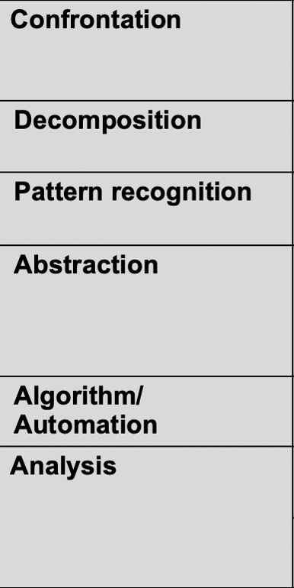
One good way to practice Computational Thinking is…..
….PROGRAMMING / CODING!
WHY:......Because recursive process enabling learners to explicitly practice CT skills:
  Use multiple attempts to work on a problem
  Decode a challenging tasks
  Develop, test, and refine solutions

Slide 18
It can be challenging

Slide 19
However, programming can be visual
Via tools such as Scratch

Slide 20

Enough talking?
Let’s do it!

Slide 21
Let’s start with no computer!
unplugged activities → plugged activities

Slide 22
Unplugged activities

Slide 23
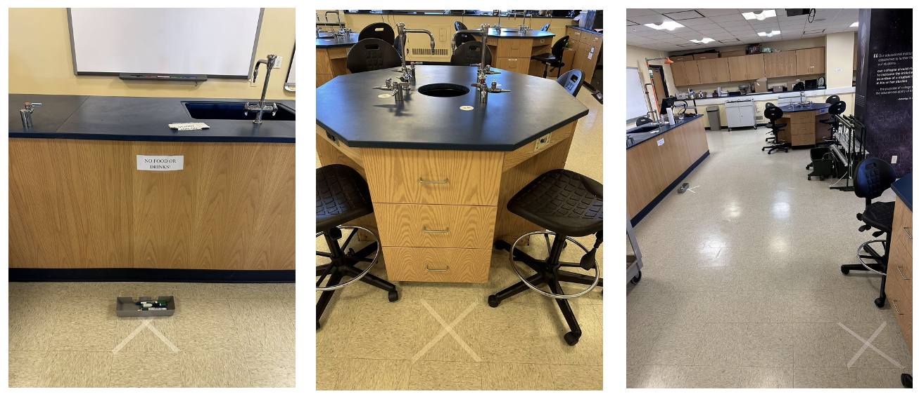
Unplugged activity 1 – get a marker

Slide 24
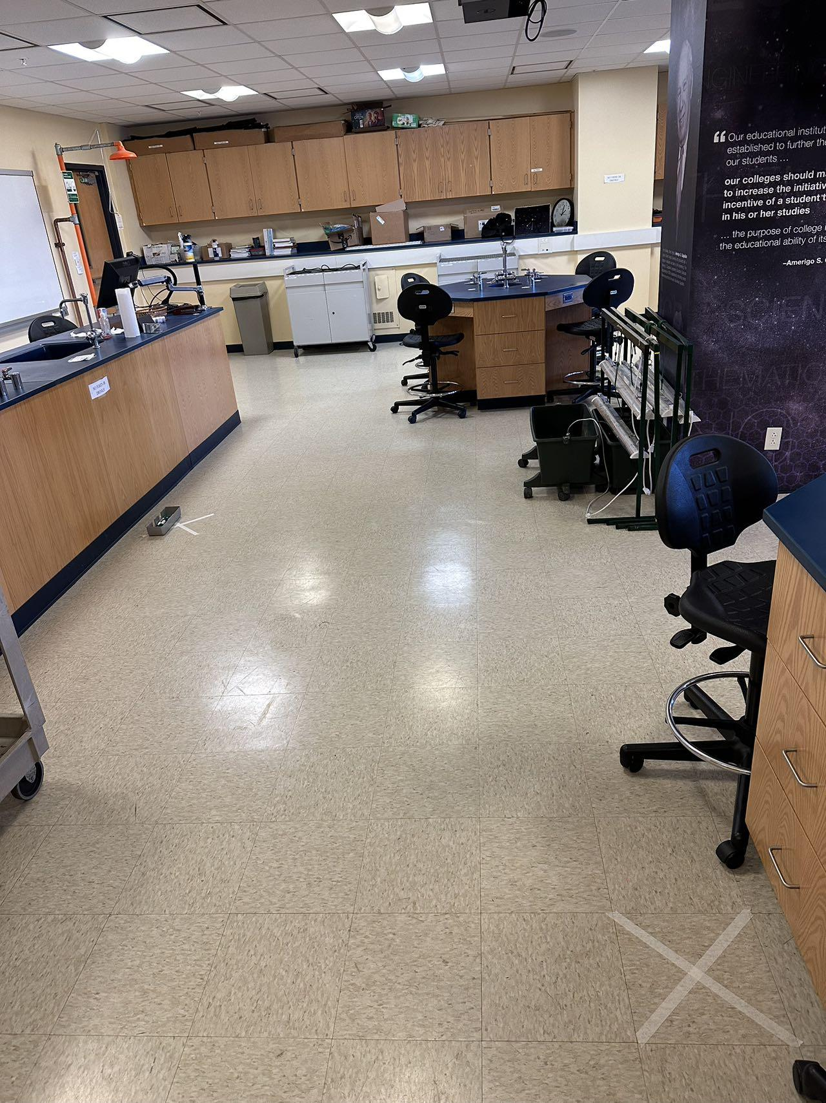
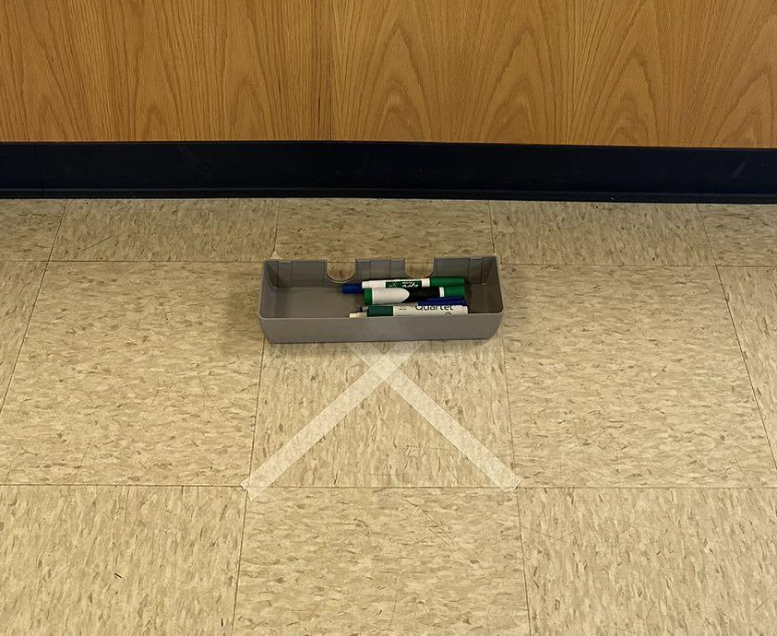
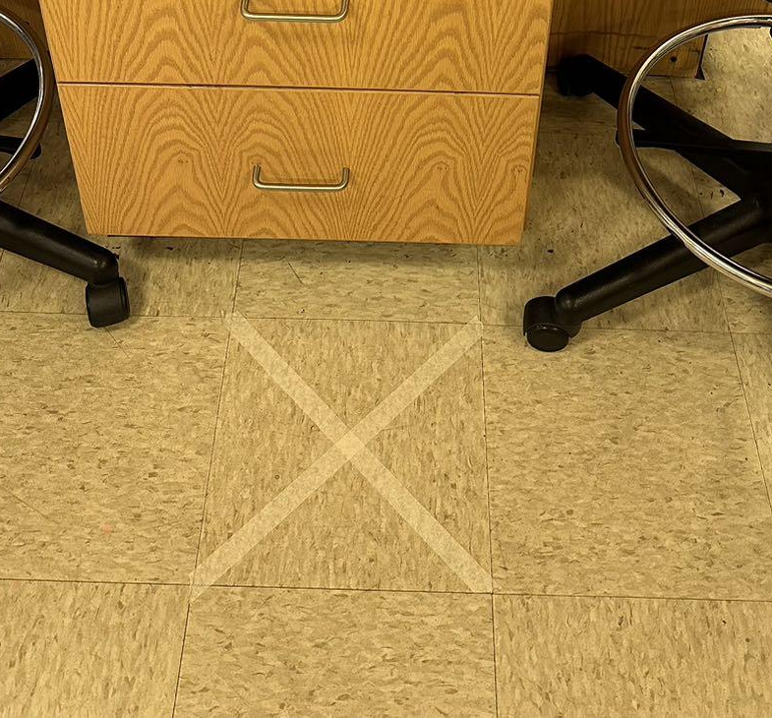
Objective: get one marker from the box
Two volunteers, please!
Mark your starting square with tapes
One person acts as a robot to get the marker
The other person directs the “robot” where to go
  Which direction? (Forward, backward, right, left…)
  How many steps?
Record the directional commands on the whiteboard.

Slide 25
Unplugged activity 1
CT Processes
Any CT Processes do you see in this activity?
Confrontation: Being confronted with a given problem. Defining the problem
Decomposition: Breaking the problem into smaller chunks
Pattern recognition: Identifying patterns among smaller chunks
Abstraction: Identifying underlying characteristics to filter out details
Algorithm/Automation: Generating and automating steps for solving the problem
Analysis: Analyzing solutions by debugging or troubleshooting
Notes:
“… breaking down a difficult problem into more familiar ones that we can solve (problem decomposition), using a set of rules to find solutions (algorithms), and using abstractions to generalize those solutions to similar problems.”

Slide 26
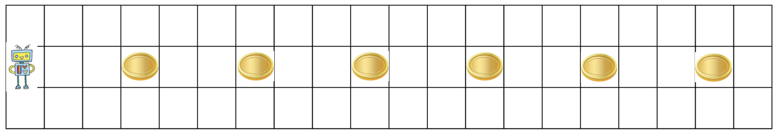
Unplugged activity 2
The robot wants to collect the six gold coins, one by one.
What commands you will use?

Slide 27
Unplugged activity 2-Commands
Move forward 2 steps
Pick a gold coin
Move forward 2 steps
Pick a gold coin
Move forward 2 steps
Pick a gold coin
Move forward 2 steps
Pick a gold coin
Move forward 2 steps
Pick a gold coin
Move forward 2 steps
Pick a gold coin

Slide 28
Unplugged activity 2-Commands
Move forward 2 steps
Pick a gold coin
Move forward 2 steps
Pick a gold coin
Move forward 2 steps
Pick a gold coin
Move forward 2 steps
Pick a gold coin
Move forward 2 steps
Pick a gold coin
Move forward 2 steps
Pick a gold coin
Any pattern?

Slide 29
Unplugged activity 2-Commands
Move forward 2 steps
Pick a gold coin
Move forward 2 steps
Pick a gold coin
Move forward 2 steps
Pick a gold coin
Move forward 2 steps
Pick a gold coin
Move forward 2 steps
Pick a gold coin
Move forward 2 steps
Pick a gold coin
Any pattern?

Slide 30
Unplugged activity 2-Commands
Move forward 2 steps
Pick a gold coin
Move forward 2 steps
Pick a gold coin
Move forward 2 steps
Pick a gold coin
Move forward 2 steps
Pick a gold coin
Move forward 2 steps
Pick a gold coin
Move forward 2 steps
Pick a gold coin
Any pattern?
Repeat 6 times
Move forward 2 steps
Pick a gold coin

Slide 31
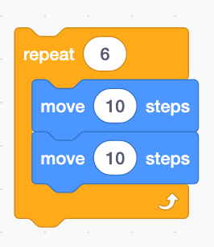
Unplugged activity 2-Commands
Move forward 2 steps
Pick a gold coin
Move forward 2 steps
Pick a gold coin
Move forward 2 steps
Pick a gold coin
Move forward 2 steps
Pick a gold coin
Move forward 2 steps
Pick a gold coin
Move forward 2 steps
Pick a gold coin
Any pattern?
Repeat 6 times
Move forward 2 steps
Pick a gold coin
Move forward 2 steps
Pick a gold coin
Scratch

Slide 32


Unplugged activity 2
CT Processes
Let’s discuss the CT process involved…

Slide 33
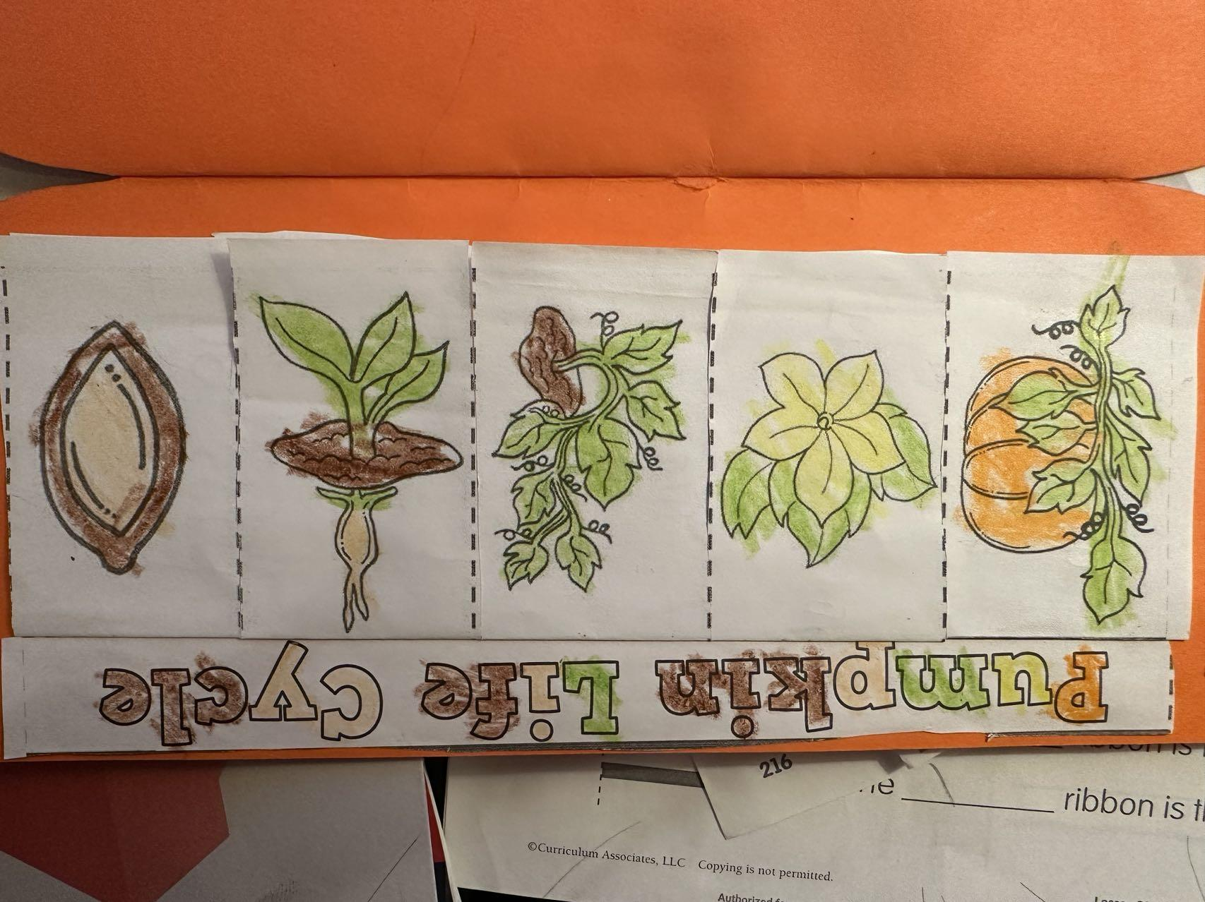
Unplugged activity 3-incorporate CT in science
Order the picture below to show the sequence of pumpkin growth.

Slide 34
The correct order

Slide 35
The correct order
End here?

Slide 36
Any pattern?

Slide 37
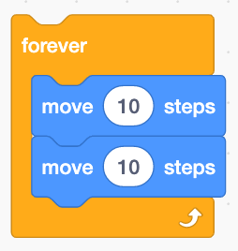
Forever
Scratch

Slide 38
Pumpkin life cycle
Science

Slide 39
Unplugged activity 3
CT Processes
Let’s discuss the CT process involved…

Slide 40
Brainstorm unplugged activities related to science

Slide 41
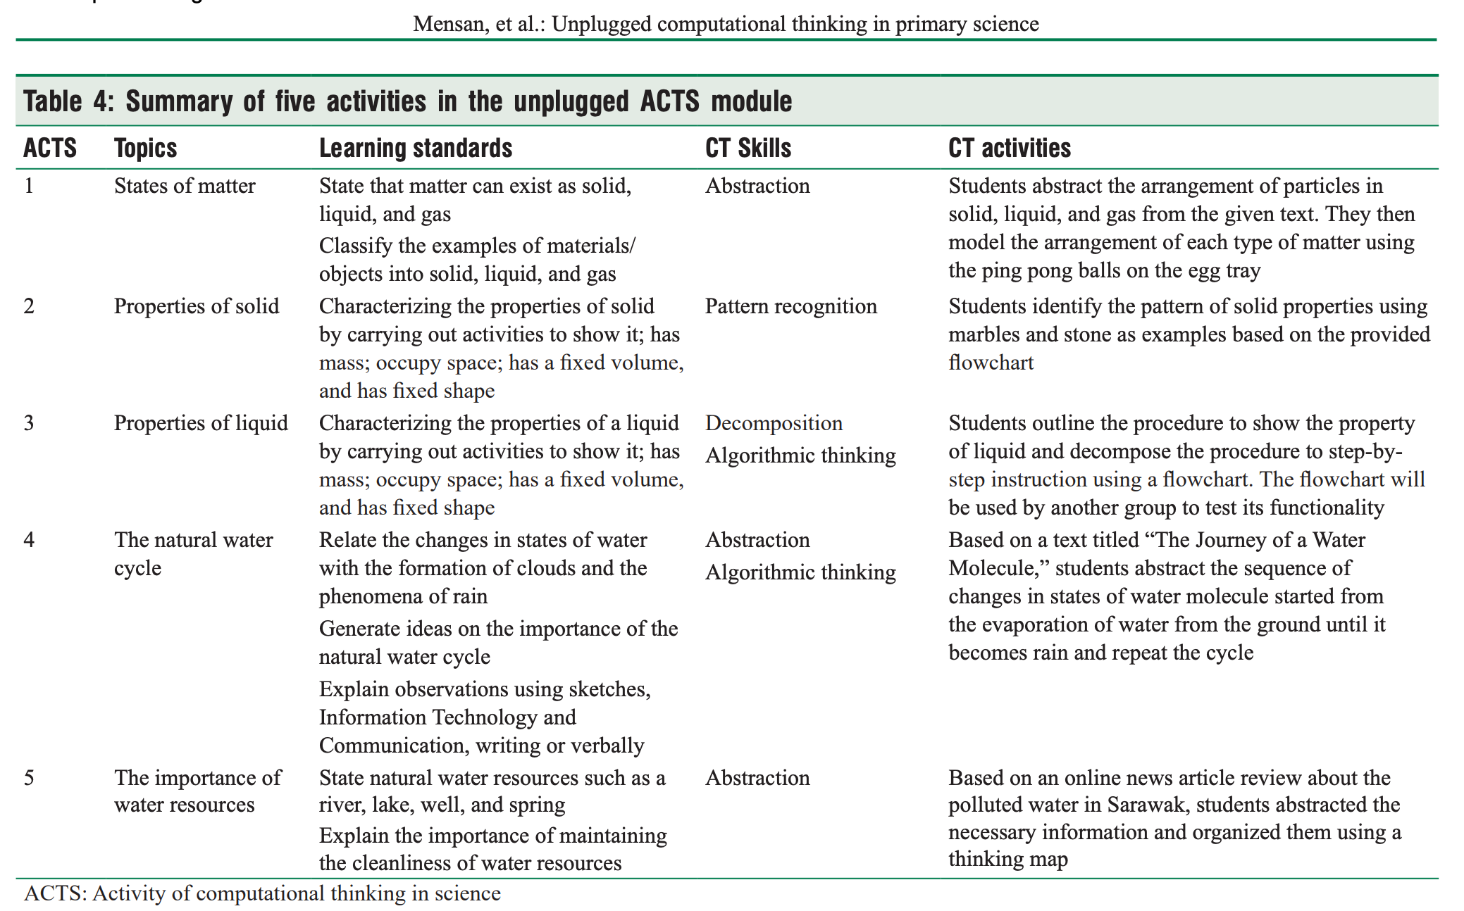
Mensan, T., Osman, K., & Majid, N. A. A. (2020). Development and validation of unplugged activity of computational thinking in science module to integrate computational thinking in primary science education. Science Education International, 31(2), 142-149. from https://www.icaseonline.net/journal/index.php/sei/article/view/194

Slide 42

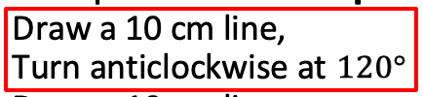
Unplugged activity 4: draw a regular polygon
Goal: Work with your table group, draw an equilateral triangle on the whiteboard. (divide the whiteboard into four parts, and use one part to draw a triangle)
Steps:
One person holds the marker, and another person gives directional commands. Commands must include:
  The length of the line
  The angle needs to turn
  The direction of the turning (clockwise, anticlockwise)
Record the direction
An example: Draw an equilateral triangle on the whiteboard
  Draw a 10 cm line,
  Turn anticlockwise at
  Draw a 10 cm line
  Turn anticlockwise at
  Draw a 10 cm line
  Turn anticlockwise at
Repeat 3 times

Slide 43
Share your work

Slide 44
Draw a square
In another part of the whiteboard
Draw a square
Record the commands on the whiteboard.

Slide 45
Share your work

Slide 46
Draw a regular pentagon
In another part of the whiteboard
Draw a regular pentagon
Record the commands on the whiteboard.

Slide 47
Share your work

Slide 48
Draw a regular hexagon
In another part of the whiteboard
Draw a regular hexagon
Record the commands on the whiteboard.

Slide 49
Share your work

Slide 50




Let’s discuss…
………….
Side #
3
4
5
6
7, 8, 9, 10…..
n
Angle
?
?
What do you notice?

Slide 51
Let’s discuss…
The formula for the angle that needs to turn
If I want to draw a regular polygon with the side of n, what are some directional comments?

Slide 52
CT Processes
Any CT Processes do you see in this activity?

Slide 53
Let’s draw the shapes in Scratch
Draw an equilateral triangle first.
Then, try to draw a regular polygon with sides of n.

Slide 54
Let’s draw a triangle in Scratch
Side #
3
Angle

Slide 55

2. Sign in Scratch!
1. Go to https://scratch.mit.edu/
3. Click Create

Slide 56
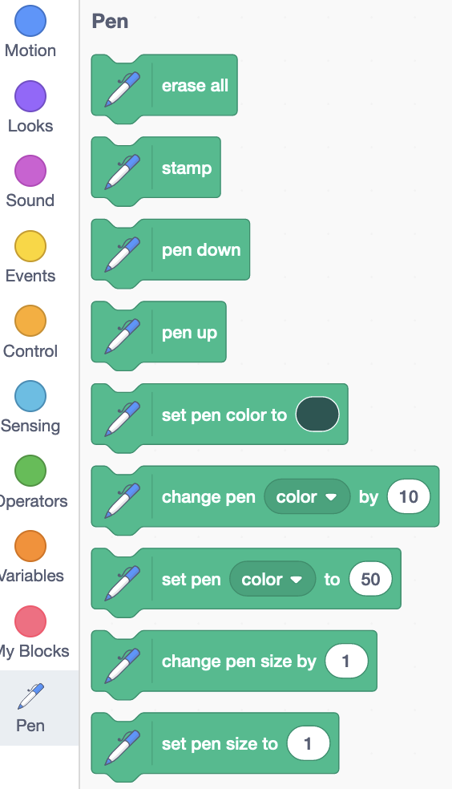

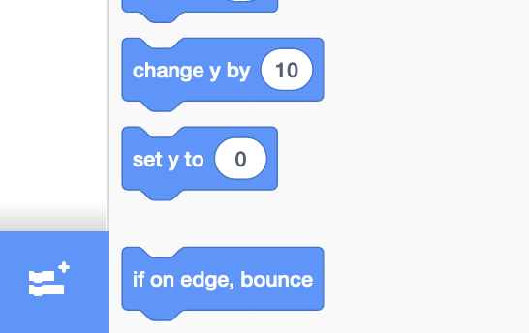
Use the Pen Blocks
Side #
3
Angle
1
2
3

Slide 57
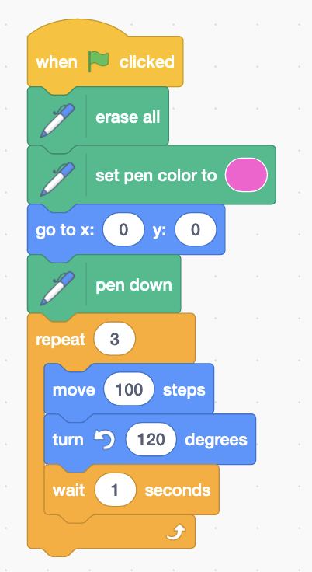
Use these codes in Scratch
Side #
3
Angle

Slide 58
Let’s draw a polygon with N sides in Scratch
A polygon
N sides
Angle?

Slide 59
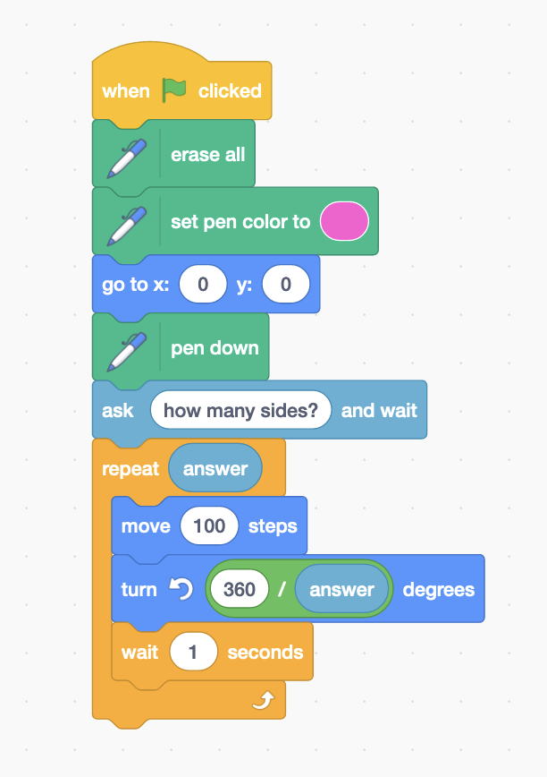
Use these codes in Scratch
A polygon
N sides
Angle?

Slide 60
Use these codes in Scratch
A polygon
N sides
Angle?

Slide 61
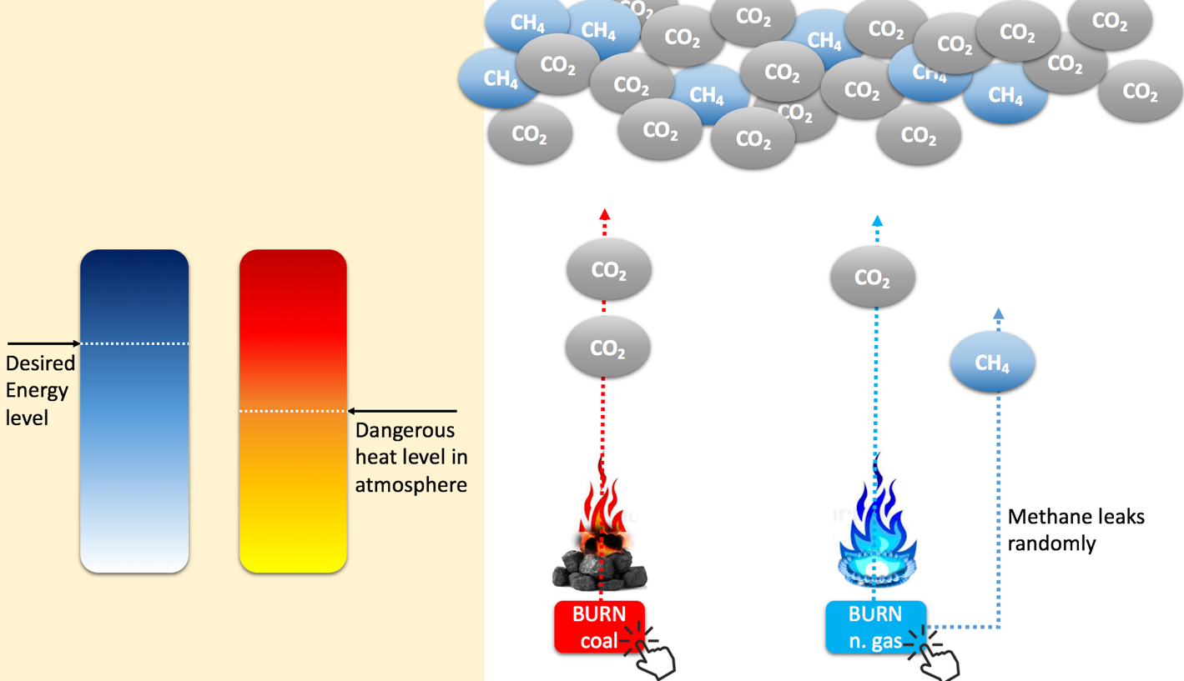
A more sciencey example: Energy sources

Slide 62
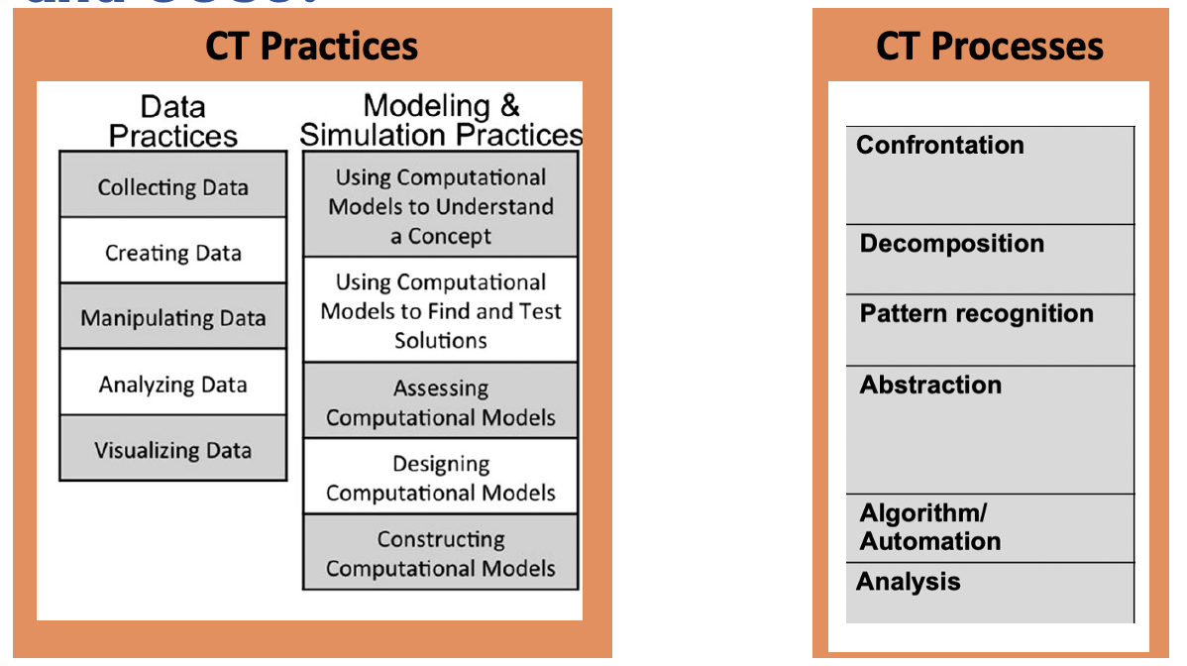
Connecting it to Science (NGSS)? Can see SEPs and CCSs?

Slide 63
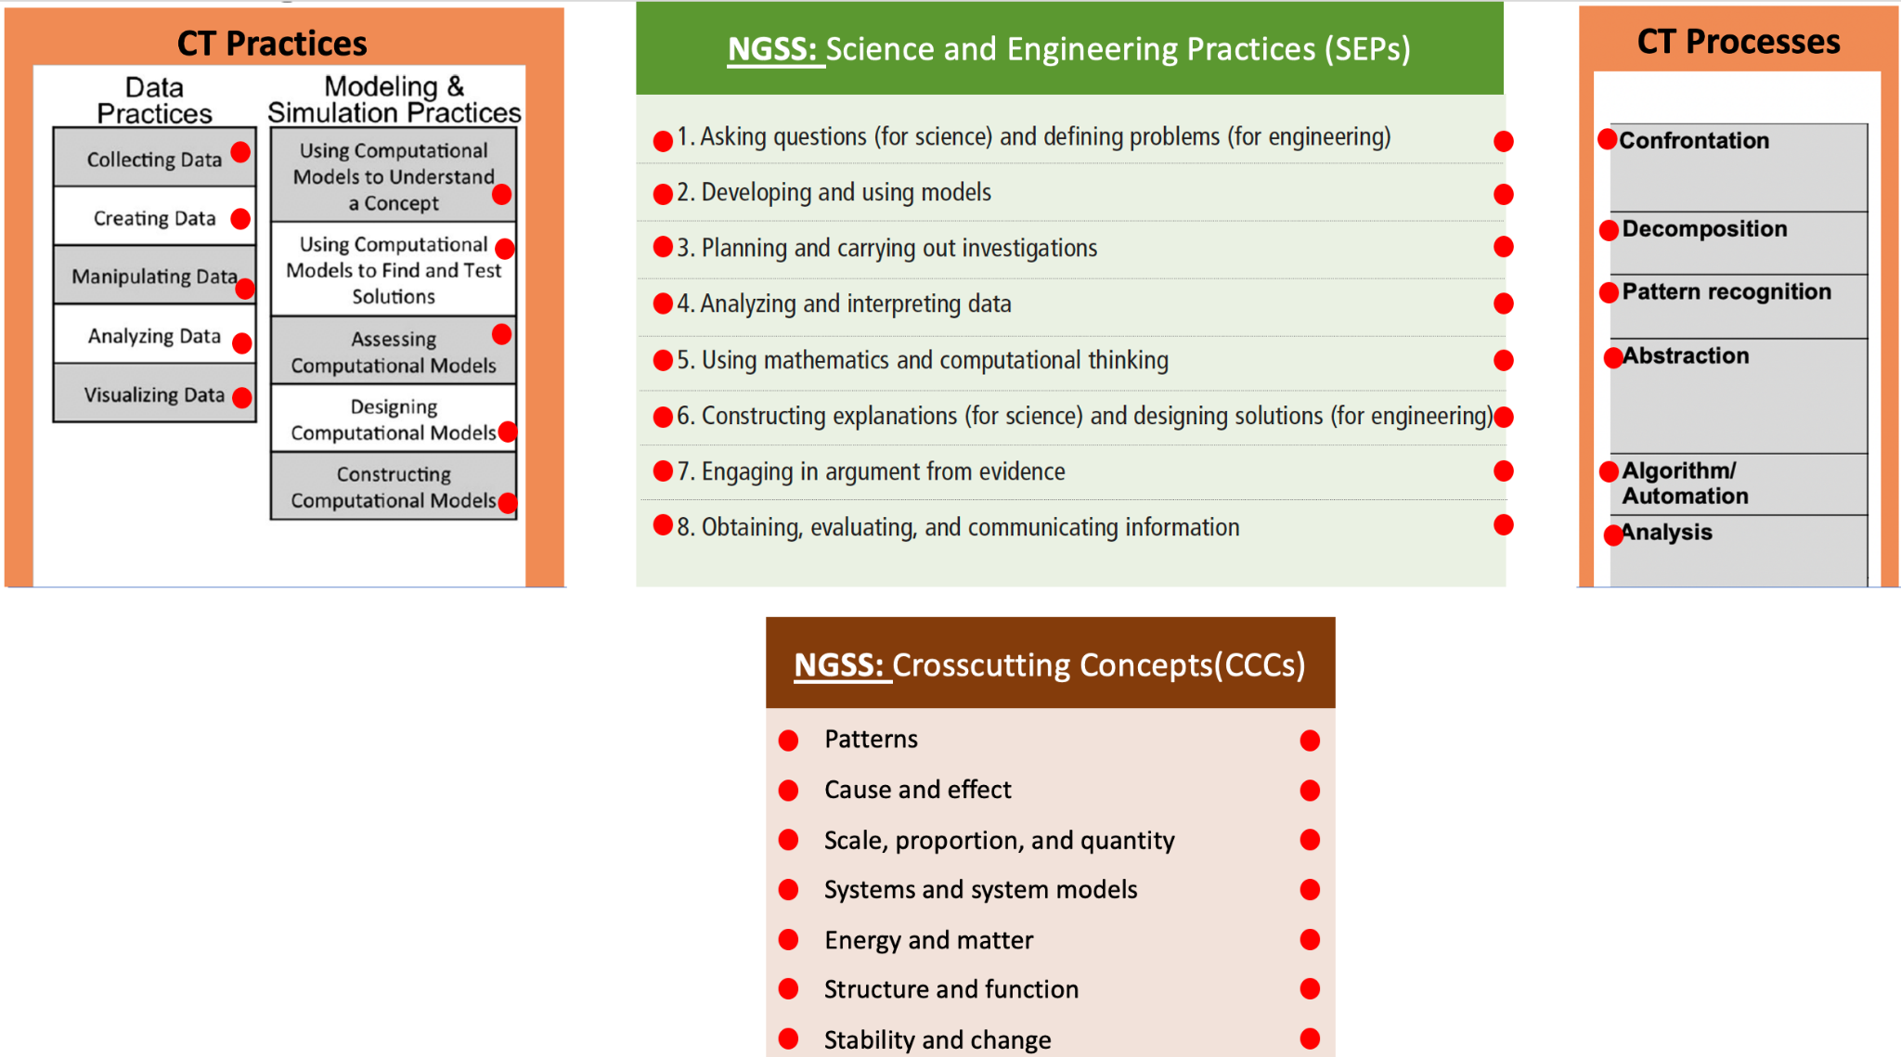
Connecting it to Science (NGSS)? Can see SEPs and CCSs?

Slide 64
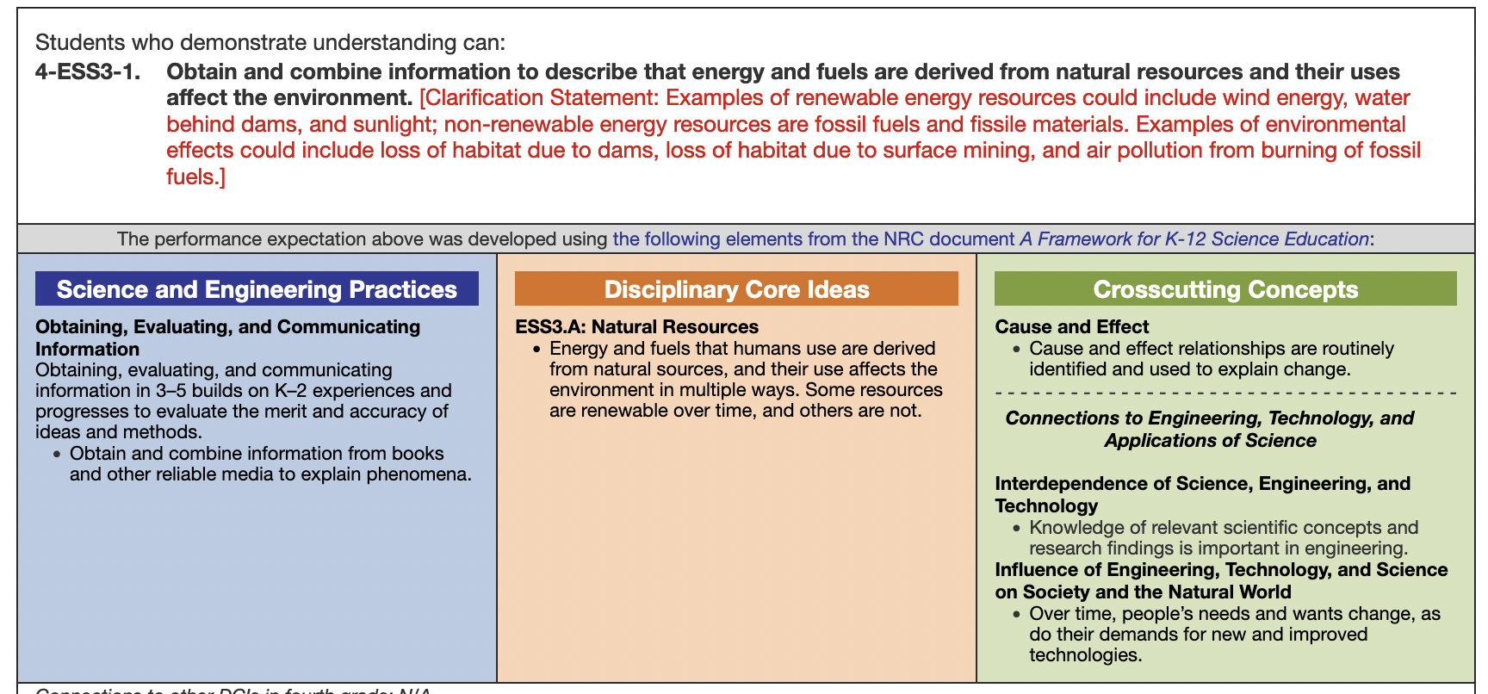
Connecting it to Science (NGSS)? Can see SEPs and CCSs?
NGSS Lead States. 2013. Next Generation Science Standards: For States, By States. Washington, DC: The National Academies Press. From https://www.nextgenscience.org/trademark-and-copyright/trademark-and-copyright

Slide 65
Demonstration (Day 2)

Slide 66
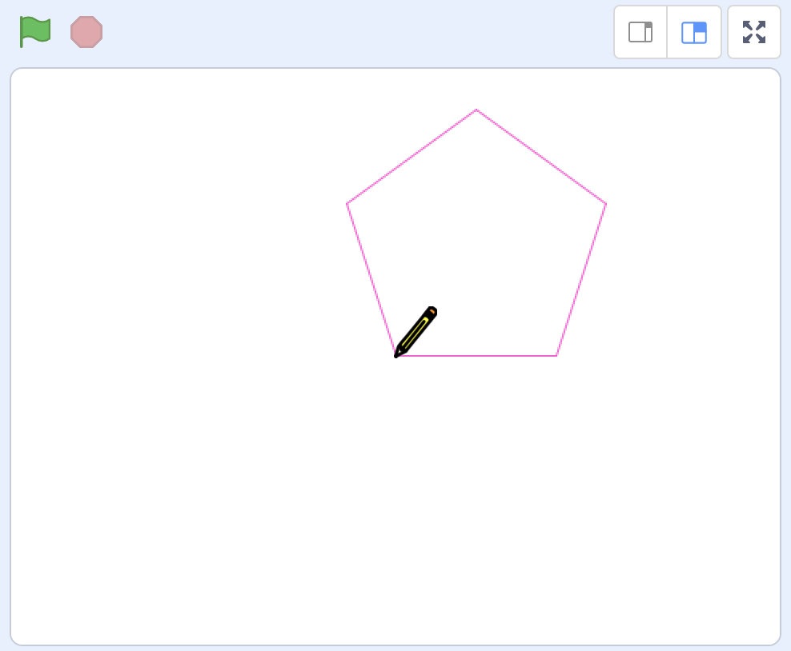
Remember the Polygons?

Slide 67
Let’s make it more sciencey!

Slide 68
and let’s start with a question!
What is V=I*R means?
Ring a bell?

Slide 69
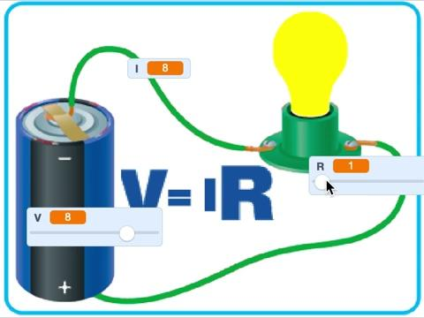
Watch this
example simulation

Slide 70
Go to Scratch (Sign in please)
https://tinyurl.com/ohm440
“See inside”
Add a formula/equation for
  calculating “I” based on “V” and “R”:
                I= V/R

Slide 71
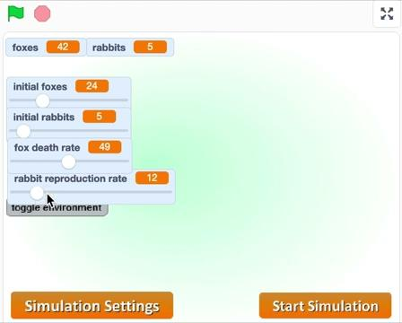
See another simulation

Slide 72
Beside the cognitive benefits on learning, what else does Computational Thinking offers?

Slide 73
Beside the cognitive benefits on learning, what else does Computational Thinking offers?
CT can be used to:
To promote self-expression, connection, and questioning To engage learners in the social, economic, political challenges of the world that directly impact them
To develop computational identity and digital empowerment

Slide 74
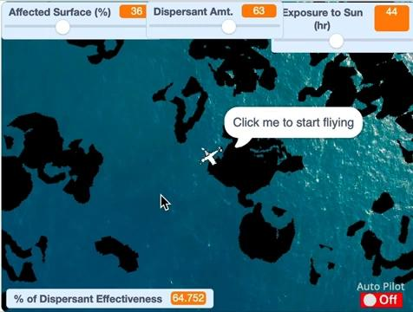
See Example:
Oil Spill

Slide 75
More contextual issues

Slide 76
Food Access
WV is ranked the 8th highest in the nation regarding the uncertain availability of nutritionally adequate and safe food at the household level.
West Virginians with limited food access tend to be located in certain locations, often labeled as “food deserts”

Slide 77
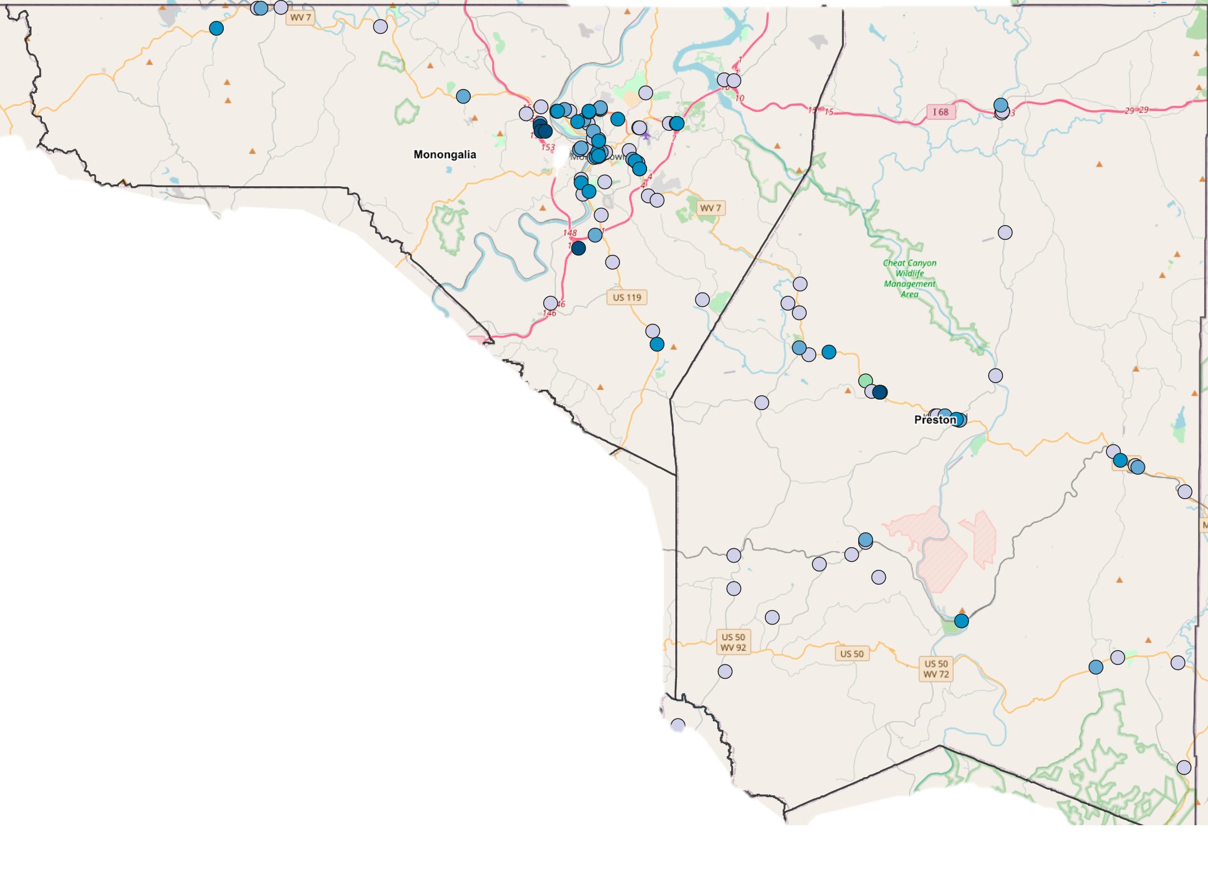
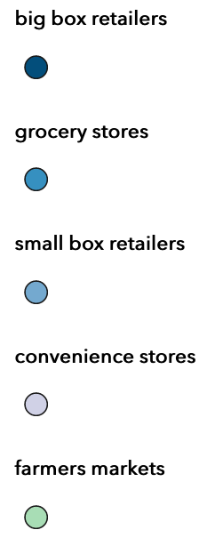
This map shows different food retailers in Mon county.
Which retailers may have nutritious food options for a healthy diet?
Mon County
# of Access
County 2

Slide 78
“How do we really know if residents may really have more difficulty accessing healthy food in a county compared to another one and what can be done to help close the gap?”

Slide 79
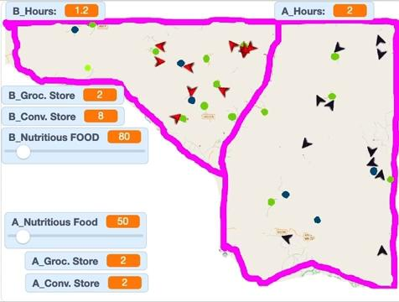
Click here to video link

Slide 80
Go to Scratch (Sign in please)
https://tinyurl.com/foodaccess440
Do NOT “See inside” yet
Run the simulation multiple times AND
Figure out the equation (using Excel)
  calculating “Nutritious Food” based on the kind of food retailers visited!

Slide 81
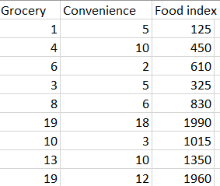
What’s the pattern?

Slide 82
What’s the pattern?

Slide 83
Connecting it to Science (NGSS)? Can see SEPs and CCSs?

Slide 84
Connecting it to Science (NGSS)? Can see SEPs and CCSs?

Slide 85
What else may impact food access?

Slide 86
How about changing the equation to reflect
Median family income
B: Mon county: 70K
A: Preston county: 50K
% of deer hunt in District 1
B: Mon county: 10%
A: Preston county: 25%
% of mining surface (acid-mine drainage)
B: Mon county: 50%
A: Preston county: 20%

Slide 87
So, what should happen?
Median family income
B: Mon county: 70K
A: Preston county: 50K
% of deer hunt in District 1
B: Mon county: 10%
A: Preston county: 25%
% of mining surface
B: Mon county: 50%
A: Preston county: 20%

Slide 88
You will code this in the simulation next week

Slide 89
Practice & Application
(Next week, Day 1)

Slide 90
During the class:
  We will share & modify & your projects
  We will also remix one of your peers’ project

Slide 91
Prior to the class:
Choose any of the factors:
  Family income
  Hunting
  Mining surface
  All above
Code your choice of the factor in the original simulation within a week

Slide 92
Prior to the class:
Median family income
B: Mon county: 70K
A: Preston county: 50K
% of deer hunt in District 1
B: Mon county: 10%
A: Preston county: 25%
% of mining surface (acid-mine drainage)
B: Mon county: 50%
A: Preston county: 20%

Slide 93

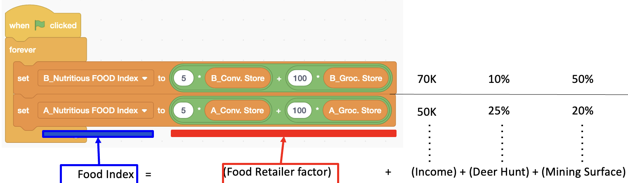
Prior to the class:
Go to https://tinyurl.com/foodaccess440
“See inside” then modify the code under red arrow sprite (o ) to take into account your factor

Slide 94


Submit your project to the Learning Management System
Share your Scratch project
→ Copy its URL
→ Post it in Discussion Board

Slide 95
Practice & Application
(Next week, Day 2)

Slide 96
Group Lesson Design
Work in (grade) groups to design a full lesson
Use the Group Lesson Design Template given
  Objectives and contextual issue to address
    Timeline of learning activities to follow
    CT practices, processes, and concepts to promote
    CT activities suitable for the grade level
Submit your lesson on the Learning Management System

Slide 97
Modify an Existing Lesson
Work individually to modify an existing lesson
Choose an existing lesson:
  A lesson from your placement classroom
  A published source
Use the Modification Guideline given
Make a modification in the lesson plan to improve it towards supporting students’ computational thinking in science
Submit your modification on the Learning Management System

