Slide 1
slides
This presentation is based on the version originally published by Code.org and published here in modified form under the Creative Commons license: CC BY-NC-SA 4.0

Slide 2
Course D - Lesson 12
Conditionals with Cards

Slide 3
Warm Up

Slide 4
Reflect:
We use the word “if” to make sure that some action only occurs when it is supposed to.
Finish this statement:
If I do well in my classes, then....

Slide 5
Vocabulary
Conditionals - Statements that only run under certain conditions.

Slide 6
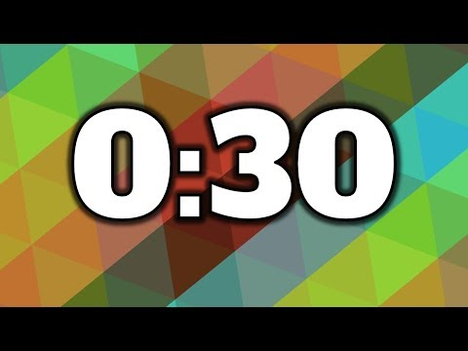
Reward
If you can be completely quiet for thirty seconds, I will ________ .

Slide 7
“If” Statement
What was the condition of the reward?
The condition was IF you were quiet for 30 seconds.
If you were quiet, the condition would be true, and you would get the reward.
If you weren't quiet, the condition would be false, so the reward would not apply.
Can we come up with another conditional?

Slide 8
“Else” Statement
Sometimes, we want to have an extra condition, in case the “IF” statement is not true.
This extra condition is called an “ELSE” statement.

Slide 9
“Else” Statement (Example)
When the “IF” condition isn’t met, we can look at the “ELSE” for what to do.
Example: IF I draw a king from this deck of cards, everybody claps.
Or ELSE, everyone says “Awwwwe.”

Slide 10

Let’s Try It
Analyze what just happened.
What was the IF?
What was the ELSE?
Which condition was met?

Slide 11
Believe It or Not…
We have even one more option:
If I draw a 7, clap.
Else if I draw something less than 7, you say "YAY".
Else say "Awwwwe".

Slide 12
If, Else-If, Else
This is why we have the terms If, Else-If, and Else:
If is the first condition.
Else-If gets looked at only if the "If" isn't true.
Else gets looked at only if nothing before it is true.

Slide 13
Activity

Slide 14
Here is a sample algorithm:
if (CARD is RED)
Award YOUR team 1 point
Else
Award OTHER team 1 point

Slide 15
Challenge
Do This
Write your own conditional statements using the playing cards
Figure out what happens for each draw.
As you play, write down the score during each round.
After three rounds, circle the winner.

Slide 16
Wrap Up

Slide 17
Flash Chat - What Did We Learn?
If you are supposed to do something when the value of a card is more than 5, and you draw a 5, do you meet that condition?
When you need to meet several combinations of conditions, we can use something called "nested conditionals."
  What do you think that means?
  Can you give an example of where we saw that during the game?

Slide 18
Reflect:
What are some of the conditionals you used today?
Can you come up with some more that you would use with a deck of cards?

