Slide 1
slides
This presentation is based on the version originally published by Code.org and published here in modified form under the Creative Commons license: CC BY-NC-SA 4.0

Slide 2
Course C - Lesson 2
My Robotic Friends Jr.

Slide 3
Warm Up

Slide 4
Reflect:
When would you need to complete a list of steps in order?

Slide 5
Vocabulary
Algorithm - A list of steps to finish a task.
Bug - An error in a program that prevents the program from running as expected.
Debugging - Finding and fixing errors in programs.
Program - An algorithm that has been coded into something that can be run by a machine.

Slide 6
Activity

Slide 7
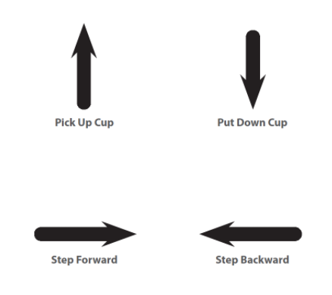
Symbol Key
Pick Up Cup
Put Down Cup
Step Forward
Step Backward

Slide 8

Let’s Try one together

Slide 9



Programming Your Robots
Look at Cup Stacking Ideas
With your partner, choose one design for your robot to do

Slide 10
The “Program”
In pairs, discuss how the stack should be built, using only arrows.
Write down your algorithm on a piece of paper.

Slide 11
Running and Debugging Your Robots
Now it’s time to be a robot! One partner read your code while the other partner acts it out
Be on the lookout for bugs. If you see one, have the robot finish the instructions as best as it can.
Discuss the bug with your partners and come up with a solution.
Keep testing the algorithm until it works!

Slide 12
Discuss
What was the most difficult part of coming up with the instructions?
When you were the robot, what was the hardest part of following the instructions you were given?

