Slide 1
Transformations Throwdown
Brian T. Johnson, Rebecca Bramwell, Josef Stamps, Katie Patterson, and Kyle Jones, Lakeside Junior High School, Springdale Arkansas

Slide 2
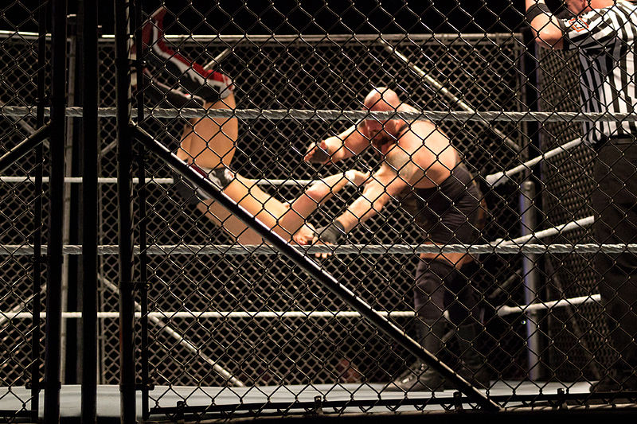
Transformations Throw Down
Demonstrate Your Knowledge of Transformations, Dilations and Symmetry
In Connect the Dots
Anton from USA, CC BY-SA 2.0 <https://creativecommons.org/licenses/by-sa/2.0>, via Wikimedia Commons

Slide 3
How It Works…….
Read the Question on the Screen
Find all the examples of a given transformation, dilation, rotation, line of symmetry, etc. (there could be more than one example)
List them on the white board before the timer runs out
Correct Answers get to connect the dots (1 per correct answer)
Add your team’s initial to each square you complete
The most squares completed wins!!!

Slide 4
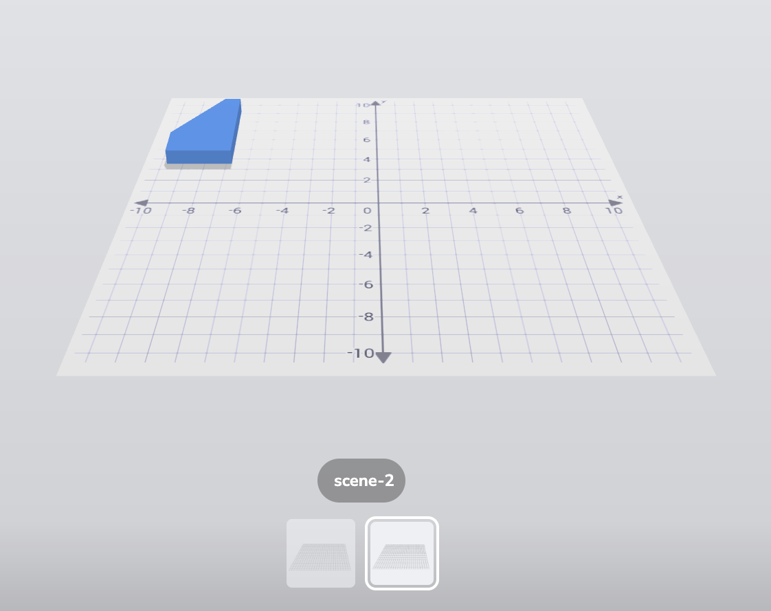
Click the Scenes and practice rotating the images to determine which ones are examples…….

Slide 5

How can you move the objects and the scenes?
Practice!

Slide 6
Round One
https://asblr.com/CJzyS
All transformations could be a single transformation or part of a sequence.

Slide 7
How It Works…….
Read the Question on the Screen
Find all the examples of a given transformation, dilation, rotation, etc.
Write the correct answers on your team’s white board
Each Correct Answer gets to mark on the board

Slide 8
Round Two
https://asblr.com/face7c
All transformations could be a single transformation or part of a sequence

Slide 9
Round Three-Dilations Dust Up
https://asblr.com/JPAuo
All transformations could be a single transformation or part of a sequence

Slide 10
Round Four-Symmetry Scrum
https://asblr.com/cAuKb

Slide 11
Round Five -Congruenty Things
https://asblr.com/cAuKb

Slide 12
Transformations Throw Down
Day 2
Demonstrate Your Knowledge of Transformations, Dilations and Symmetry in
Connect the Dots
Anton from USA, CC BY-SA 2.0 <https://creativecommons.org/licenses/by-sa/2.0>, via Wikimedia Commons

Slide 13
Day 2 Round 2

Slide 14
Day Two Round 3
Back to the Symmetry Scrum

Slide 15
Day 2 Round 4
Congruent Things (go to scene 7)

