Slide 1
Transformations Throwdown
Brian T. Johnson, Rebecca Bramwell, Josef Stamps, Katie Patterson, and Kyle Jones, Lakeside Junior High School, Springdale Arkansas

Slide 2

Engage-Partner Practice with moving through the scenes/operating in augmented reality inside Assemblr
-Explore-First round of challenges (easy)
- Explain: Review of initial challenges on screen (the why of correct/incorrect answers)
Elaborate: 2-5th rounds of challenges (dilations, symmetry, measurement of transformations (how far?)
Evaluate: Verbal feedback on correct answers/discussion of why? (Also survey completion discussing how participating in the throw down influenced/deepened their learning)
(Northern, 2019)

Slide 3
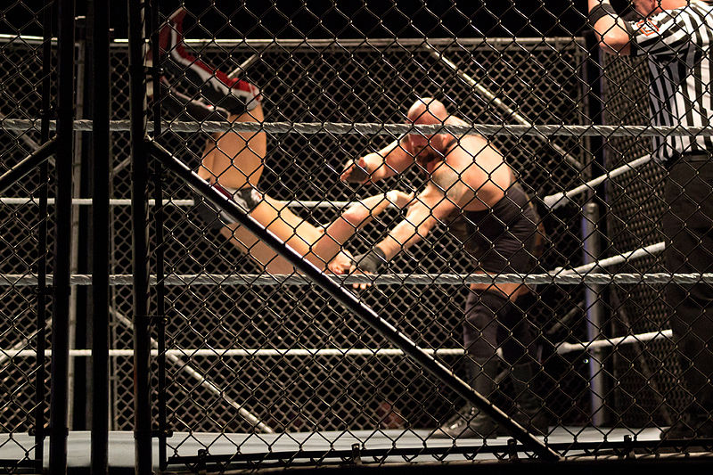
Transformations Throw Down
Demonstrate Your Knowledge of Transformations, Dilations and Symmetry in
Connect the Dots
Anton from USA, CC BY-SA 2.0 <https://creativecommons.org/licenses/by-sa/2.0>,
via Wikimedia Commons

Slide 4
How It Works…….
Read the Question on the Screen
Find all the examples of a given transformation, dilation, rotation, etc.
Write the correct answers on your team’s white board
Each Correct Answer gets to mark on the board

Slide 5
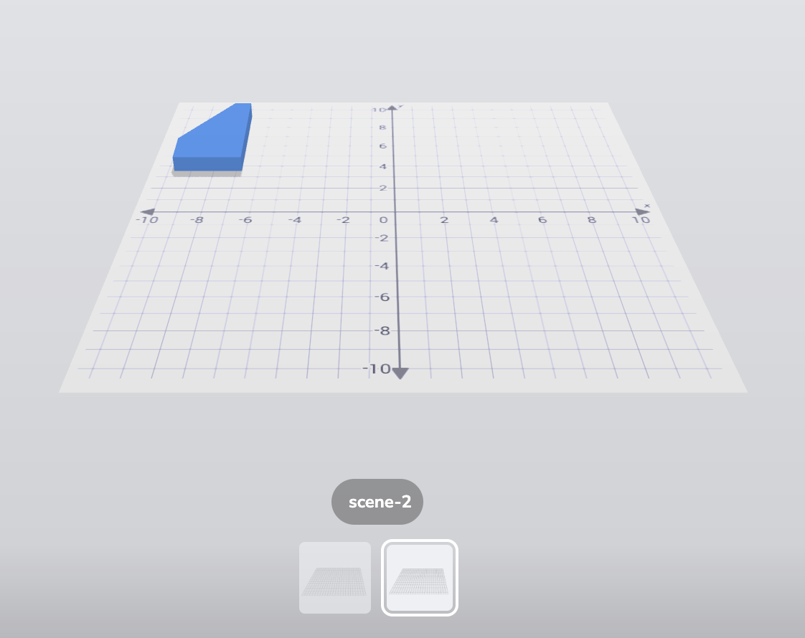
Using the site, https://asblr.com/CJzyS
Click the Scenes to Determine which ones are examples of

Slide 6

How can you move the objects and the scenes?
Practice!

Slide 7
Round One
https://asblr.com/CJzyS
All transformations could be a single
transformation, or a part of
a sequence.

Slide 8

All transformations could be a single
transformation, or a part of
a sequence.
Scene 1
Reflection Description (Across What?)
Scene 3
Is it a Reflection (Yes/No)
Scene 5
Is it a reflection?
How much did it move to the right?
Notes:
Student Slide One
Reflected across the x-axis
Scene 3: Yes it is a reflection
Scene 5: No-its a rotation
3a. What is it? (a rotation and a translation)

Slide 9
Transformations Throw Down
Day 2
Demonstrate Your Knowledge of Transformations, Dilations and Symmetry in
Connect the Dots
Anton from USA, CC BY-SA 2.0 <https://creativecommons.org/licenses/by-sa/2.0>, via Wikimedia Commons

Slide 10
Round 1 Which scenes are….
1.Translated into a new quadrant
2.Reflected across the Y axis
3. Reflected across the X axis
4. Translated
5. Translated Up
6. Rotated 90 degrees
Notes:
Student Slide One
Translated into a new quadrant (2,4.5,6,7)
Reflected across Y-axis (5.6)
Reflected across X-Axis (1,2,4)
Translated (2,4, 5, 6)
Translated up (5)
Rotated 90 degrees (5, 6)
Translated AND rotated (4,5,6,7)

Slide 11
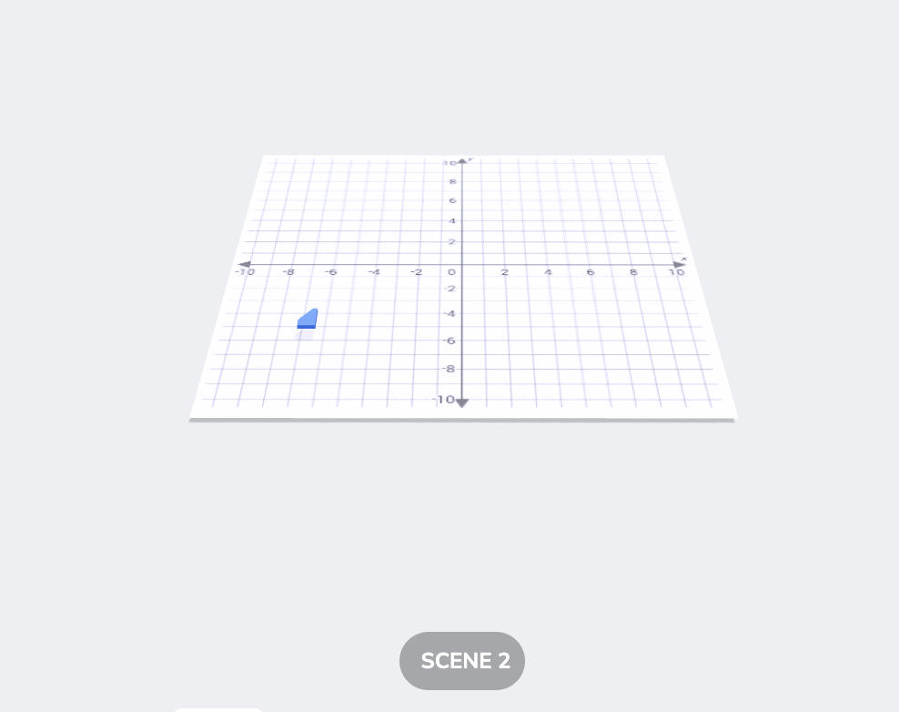
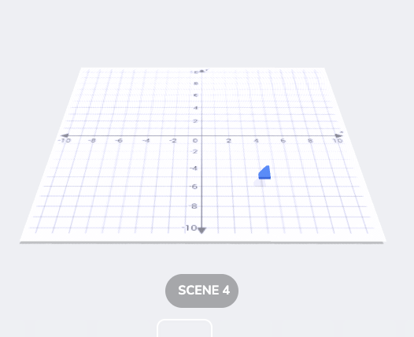
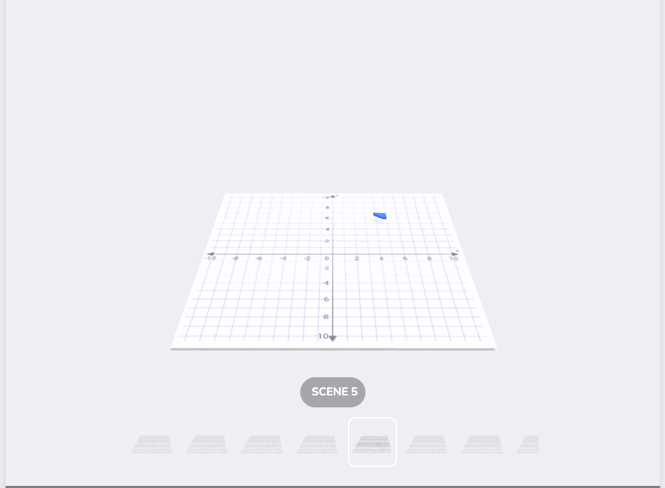
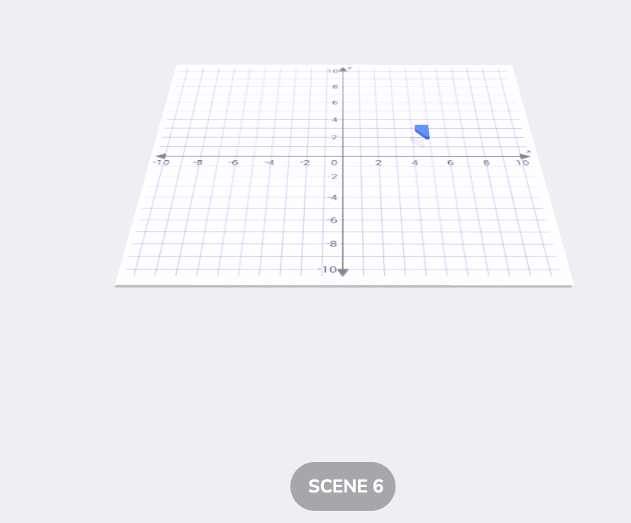
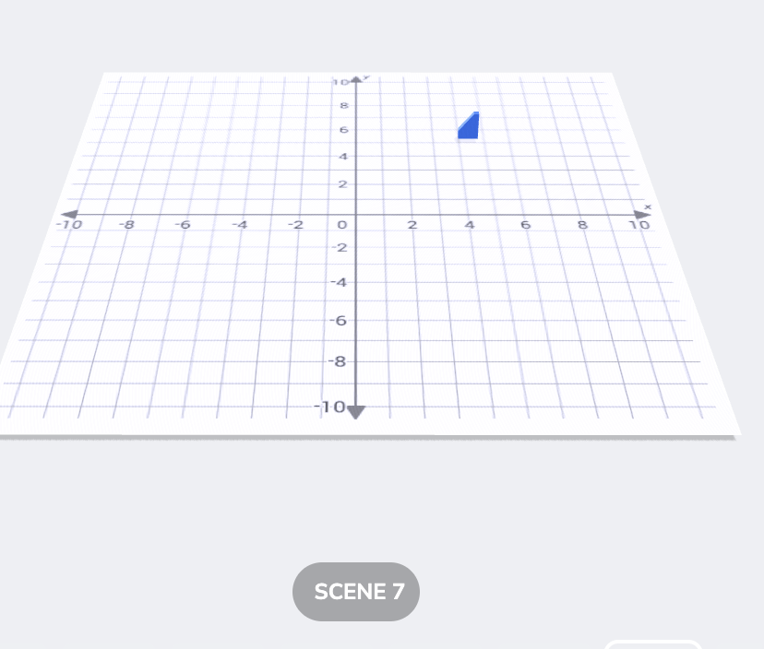
1.Translated into a new quadrant

Slide 12
2.Reflected across the Y axis

Slide 13
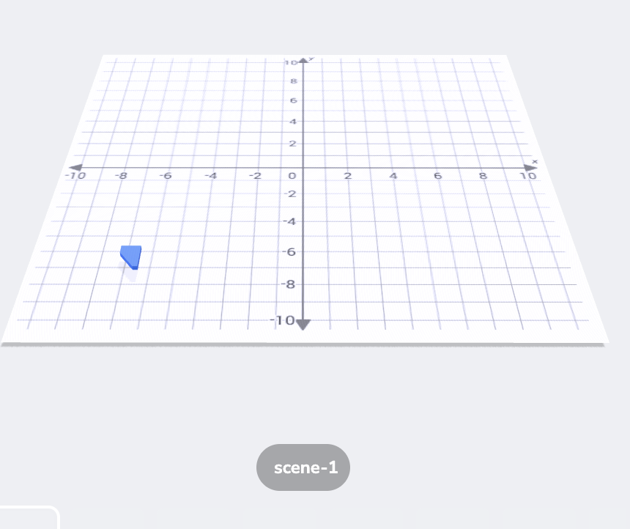
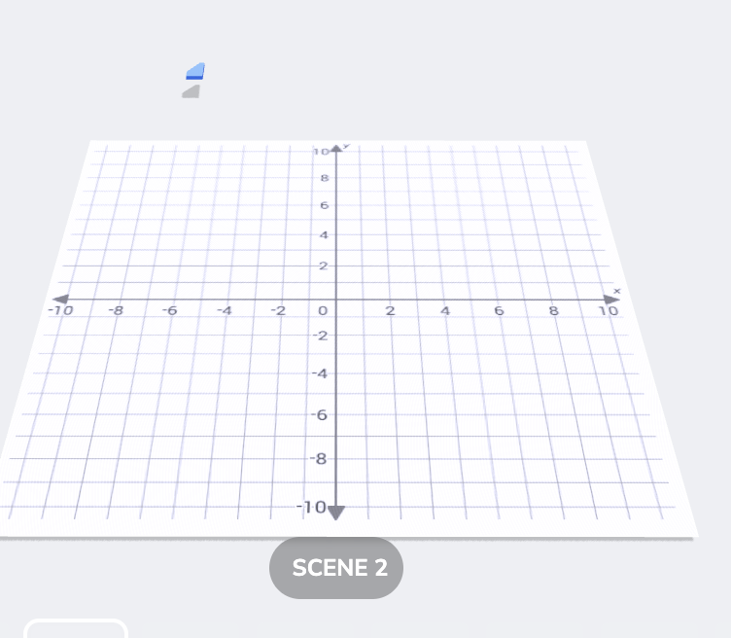
3. Reflected across the X axis

Slide 14
4. Translated

Slide 15
5. Translated Up

Slide 16
6. Rotated 90 degrees

Slide 17
How It Works…….
Read the Question on the Screen
Find all the examples of a given transformation, dilation, rotation, etc.
Write the correct answers on your team’s white board
Each Correct Answer gets to mark on the board
All transformations could be a single
transformation, or a part of a sequence.

Slide 18
Round 2
1.Translated into a new quadrant
2.Reflected across the Y axis
3. Reflected across the X axis
4. Translated
5. Translated Up
6. Rotated 90 degrees
Notes:
Student Slide One
Translated into a new quadrant (1,2,3,4.5,)
Reflected across Y-axis (2,4)
Reflected across X-Axis (1,5)
Translated (2,4, 5, 6)
Translated up (5)
Rotated 90 degrees (5, 6)
Translated AND rotated (4,5,6,7)

Slide 19
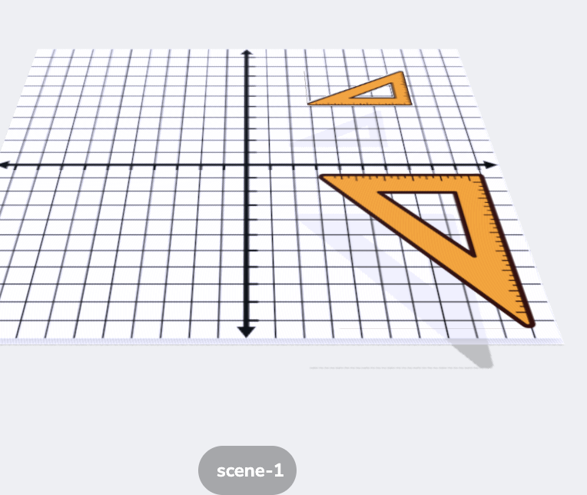
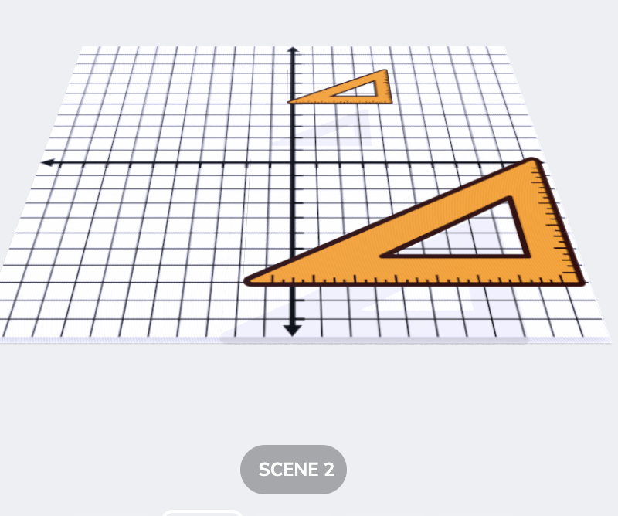
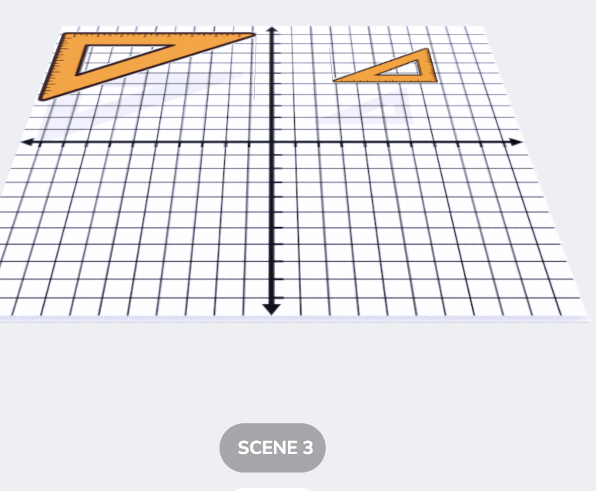
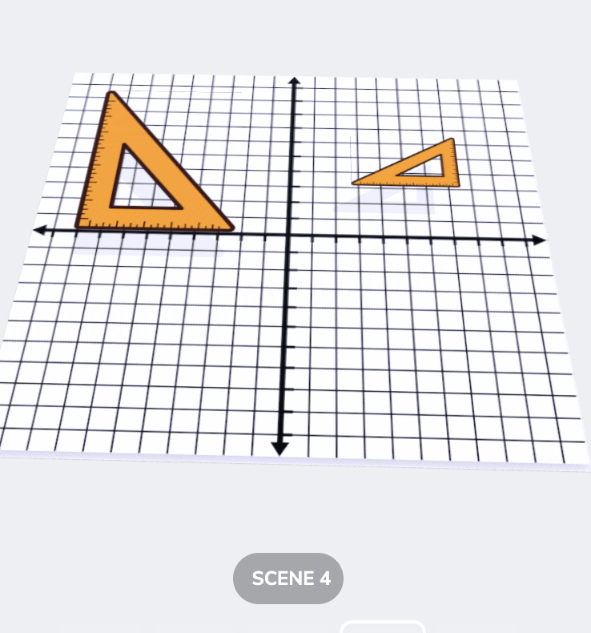
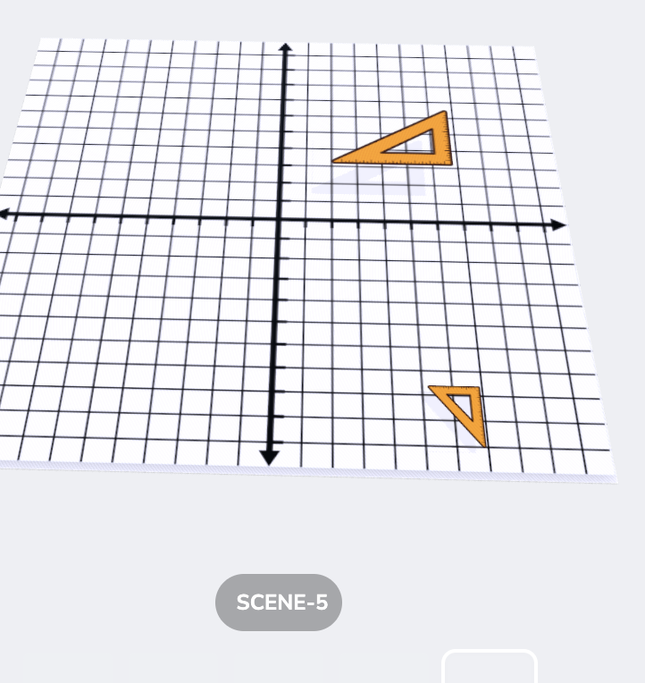
1.Translated into a new quadrant

Slide 20
2.Reflected across the Y axis

Slide 21
3. Reflected across the X axis
Notes:
1,2,5

Slide 22
4. Translated

Slide 23
5. Translated Up
Notes:
No examples

Slide 24
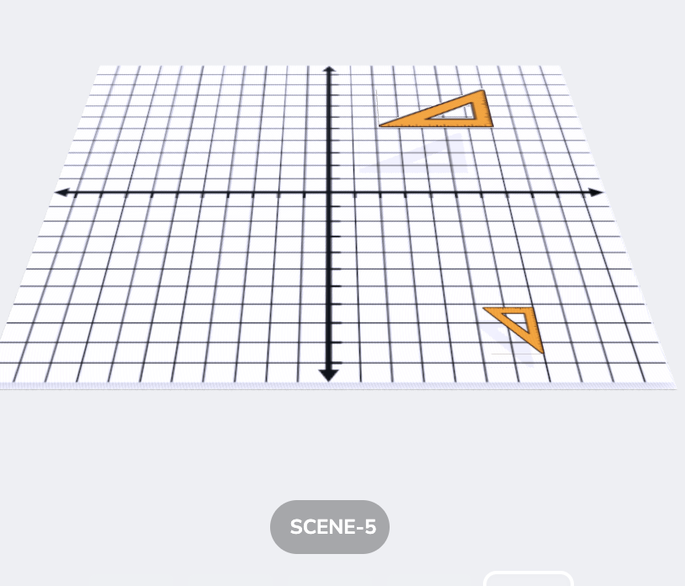
6. Rotated 90 Degrees

Slide 25

Round 3
How many lines of symmetry in…….
Scene 1
Scene 3
Scene 5
Scene 8
Scene 10
Notes:
1 Scene 1 (ZERO)
2. Scene 3 (
3. Scene 5
4. Scene 8
5. Scene 10

Slide 26

Scene One
Notes:
No Lines of Symmetry

Slide 27
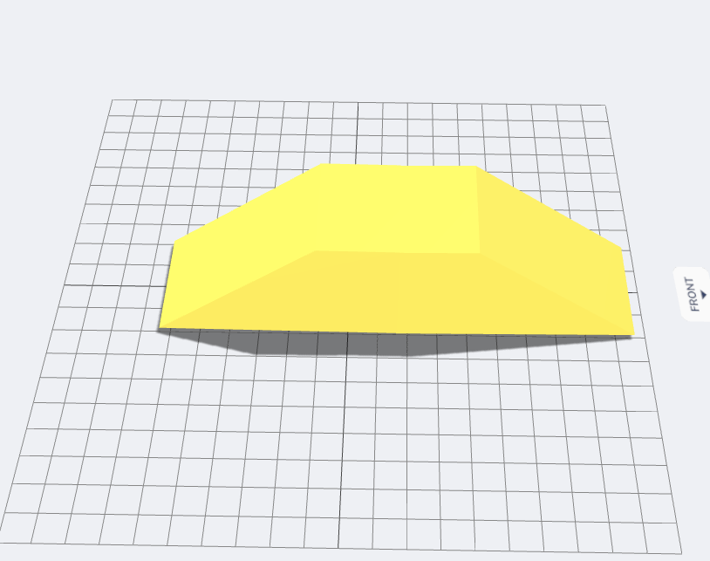
Scene 3

Slide 28
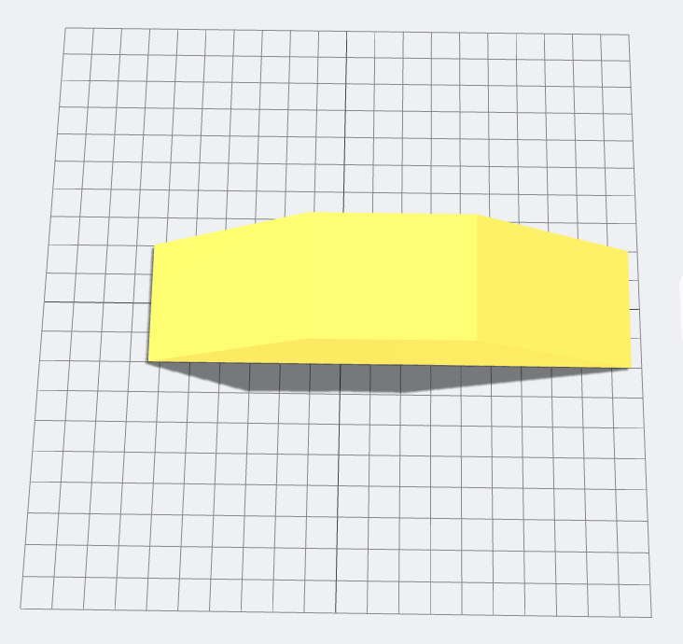
Scene Three Continued

Slide 29
Scene Three Continued

Slide 30

Scene Four

Slide 31

Scene Seven

Slide 32
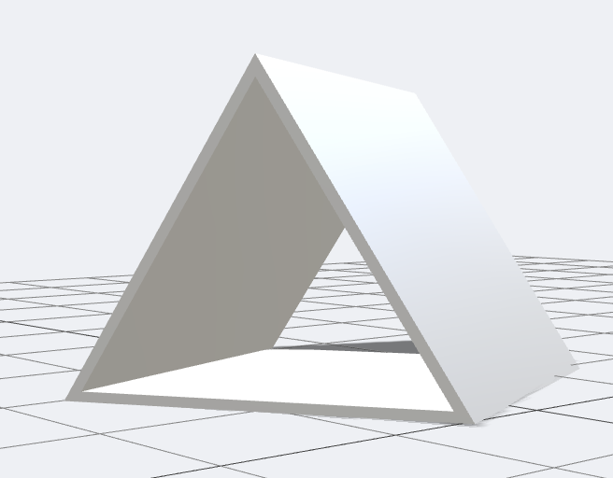
Scene Nine

Slide 33
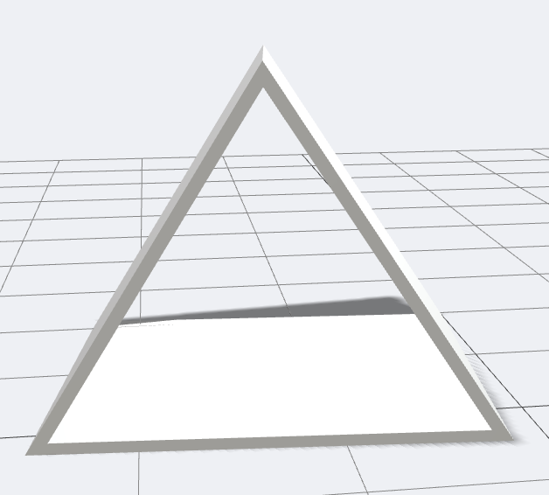
Scene Nine

Slide 34
Round Four: Lines of Symmetry
1. Which shapes have no lines of symmetry?
2. Which shape(s) have only one line of symmetry?
3. Which shapes have > 3 lines of symmetry?
4. Which shapes have > 4 lines of symmetry?
Notes:
Lines of symmetry/asymmetery
No lines of symmetry (Scene 1,6,8)
Shapes with only one line of symmetry (Scene 4,5,7)
Shapes with greater than 3 lines of symmetry (Scenes 2,3, 9)
Shapes with greater than 4 lines of symmetry (Scene 2,3,9)

Slide 35
Round Five-Congruenty Things Scene
How many figures are not
congruent to figure 1?
Which figures
are congruent
to figure 1? (write down their numbers)
Notes:
Not Congruent to Figure 1 (4)
Are Congruent to Figure 1 (#’s 2,4,7)

Slide 36
Round Six
https://asblr.com/JPAuo
Dilated
Dilated and Rotated
Dilated by a factor of >2
Translated across X axis
Moved left 3 units
Rotated >180 degrees
Notes:
https://asblr.com/JPAuo
Dilated (1,2,3,4,5,6)
Dilated and Rotated (1,3,4,5)
DIlated by a factor of greater than 2 (1,2,3)
Translated across the X Axis (1,2,5)
Moved Left 3 units (NONE)
Rotated greater than or equal to 180 degrees (3,4,5)

Slide 37
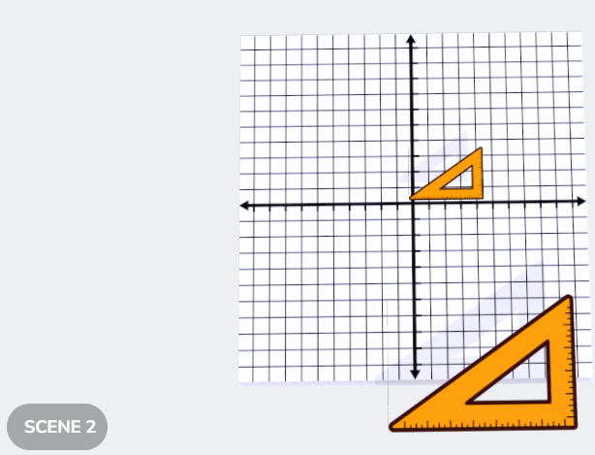
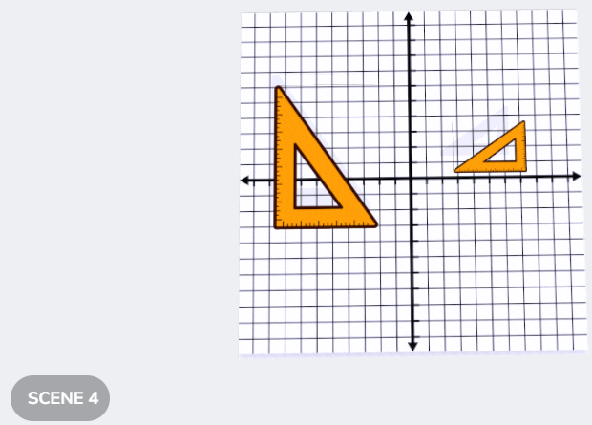
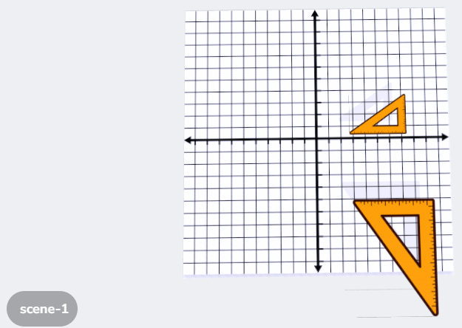
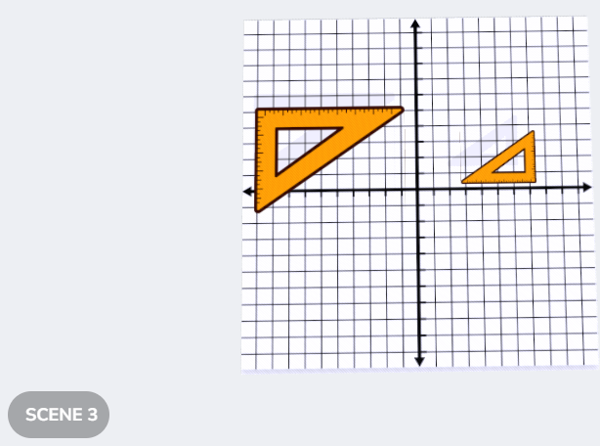
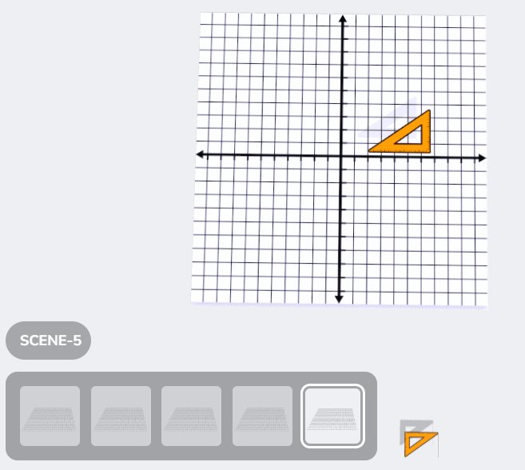
1. Dilated

Slide 38
2. Dilated and Rotated

Slide 39
3. Dilated by a Factor of > 2

Slide 40
4. Translated Across the X-Axis

Slide 41
5. Moved Left 3 Units
None! Some moved more than three units to the left, but no transformation was exactly a translation of 3 units left.

Slide 42
6. Rotated >180 degrees

