Slide 1
SHOWCASING ROBOTS
Girl Scouts Robotic Badges - Day 3
By Meize Guo¹ and Jue Wang²
¹University of Florida, ²University of Idaho

Slide 2
ORDER STARSHIP

Slide 3
HOW DO YOU FEEL ABOUT COMPUTER SCIENCE?
When I say computer science, what are the top three words in your mind? Why?
What does a typical computer scientist look like to you?
Can you tell me what you think computer science is?

Slide 4
WHAT CAN ROBOTS DO?
What is robot in your words?
Can you give me some examples of robot in your life?
When I say robot, what are the top three words in your mind?

Slide 5
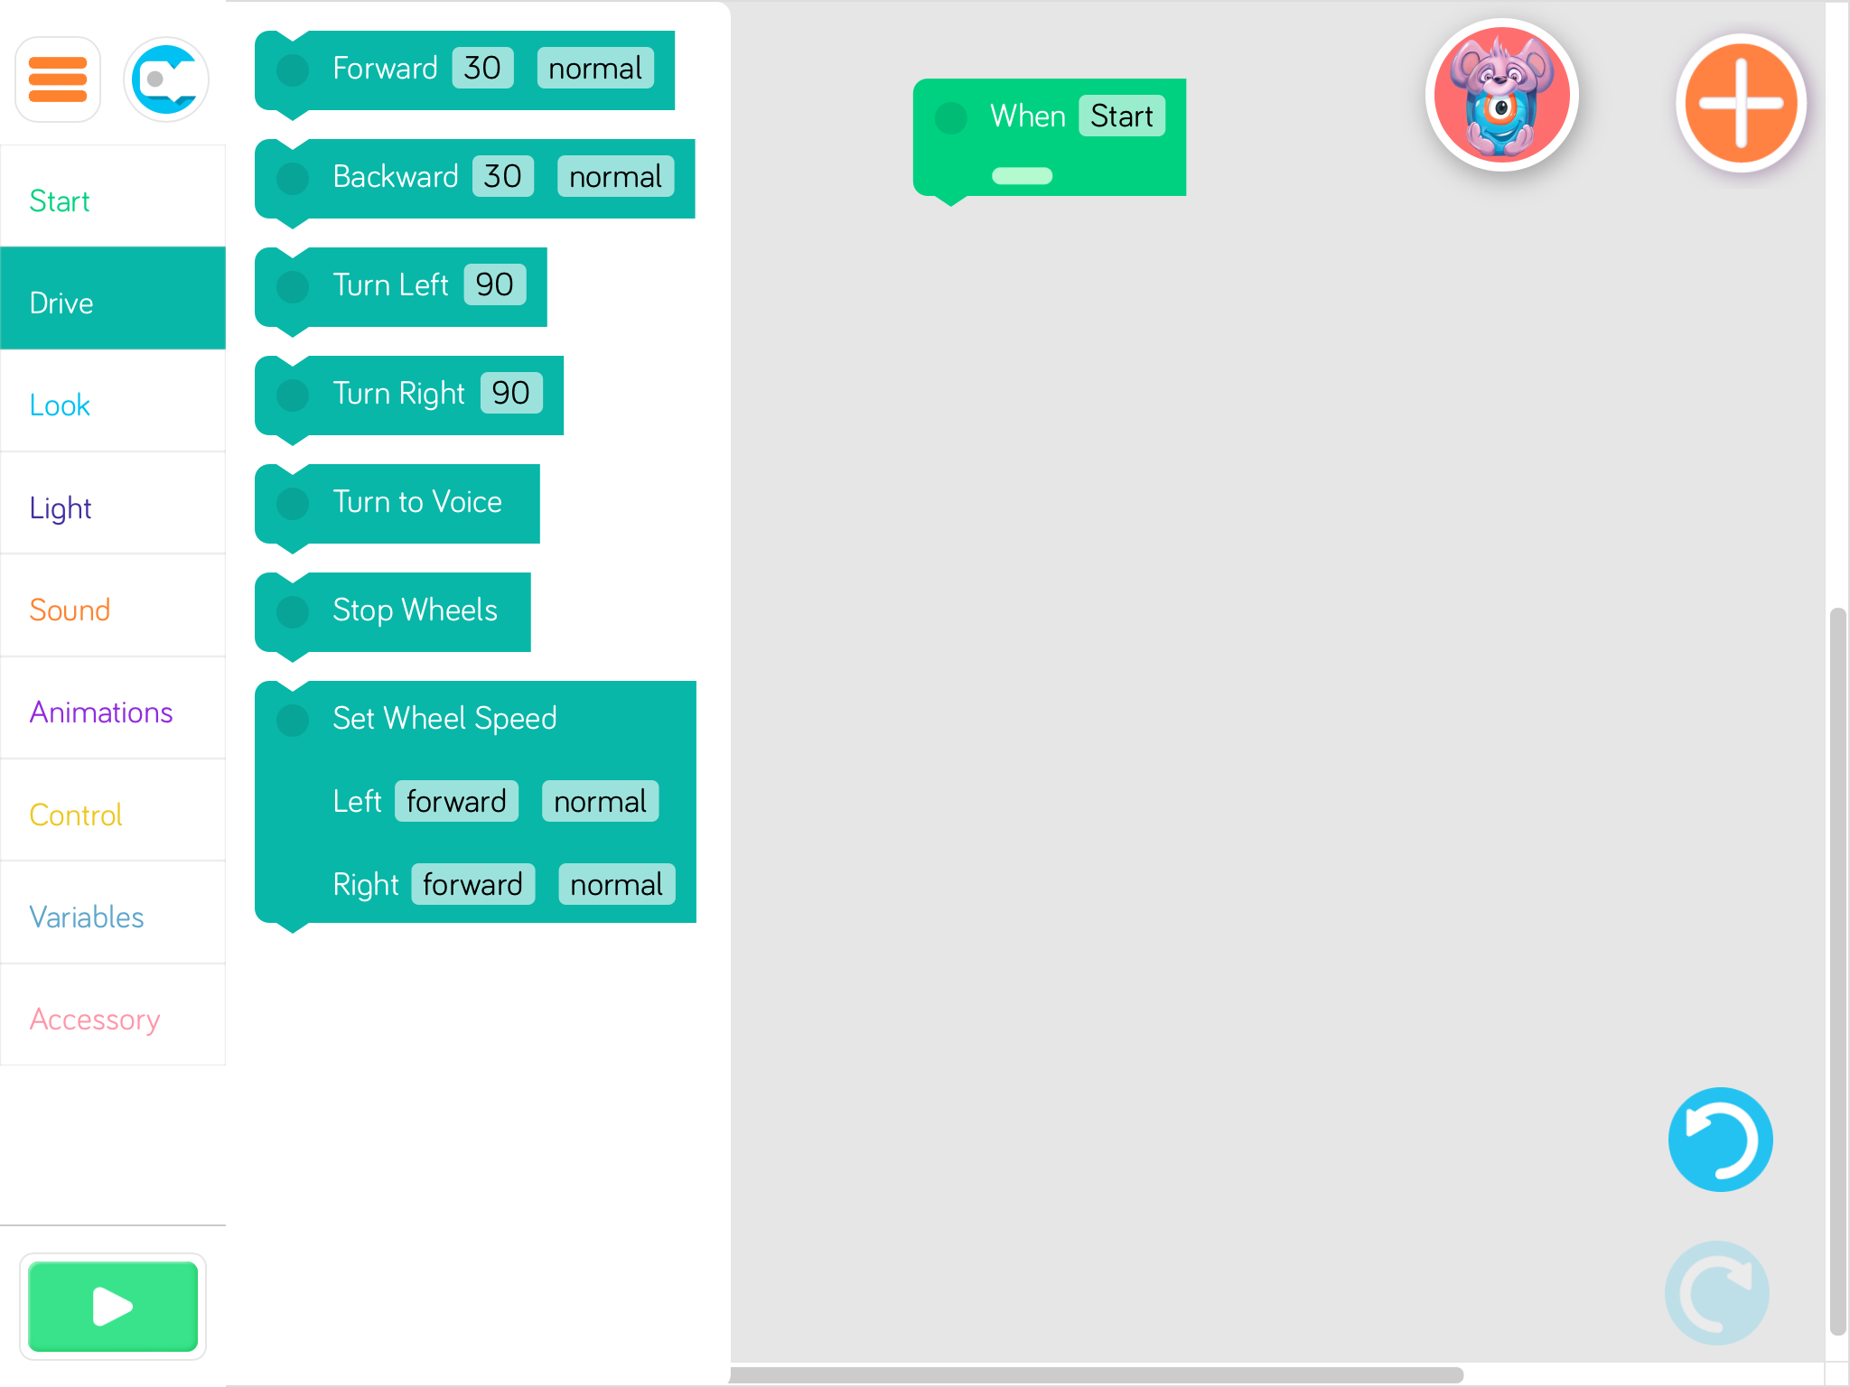
BLOCKLY WITH DASH
Left Middle Right
1. Open the App
2. Connect Dash
3. Functions in left, middle,
right areas
4. Delete a block
5. Run your program

Slide 6
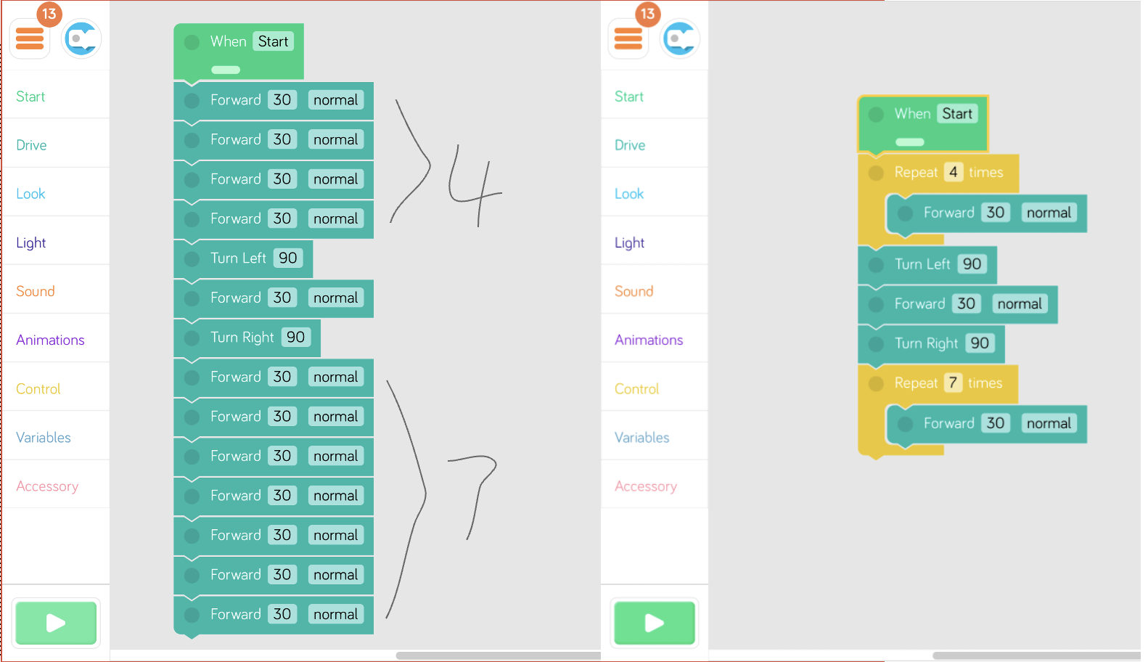

Slide 7
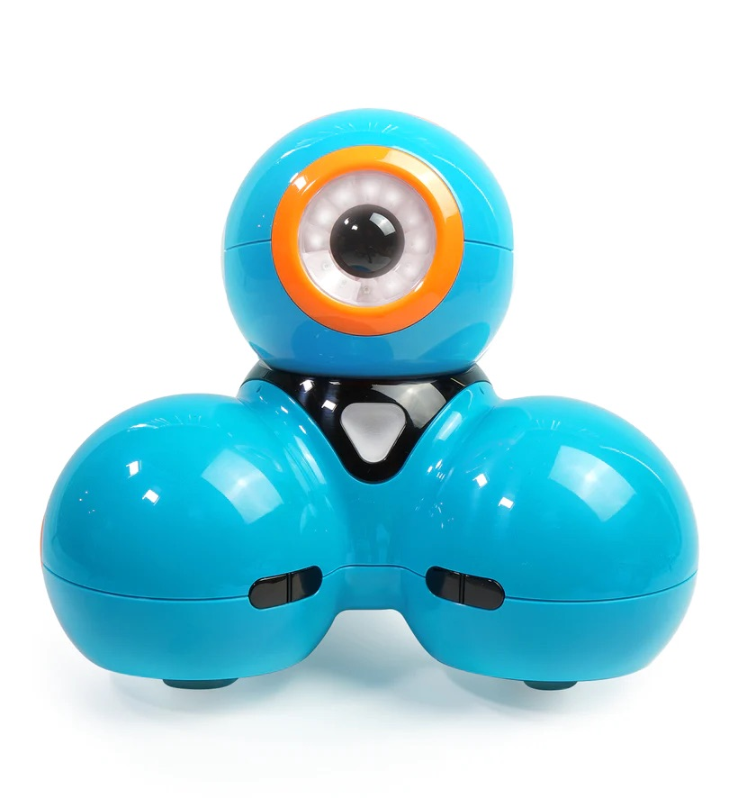
SAFETY INFORMATION
Do not put your hands close to the wheels.
Treat the Dash as your friend.
Watch the Dash move and do NOT move with it.

Slide 8
LET’S SEE THE STARSHIP ROBOTS
Where is robot now?
Let’s go out and see the robot!

Slide 9
GIRLS
YOU CAN DO IT!

