Slide 1
Programming Robot
Girl Scouts Robotic Badges - Day 2
By Meize Guo¹ and Jue Wang²
¹University of Florida, ²University of Idaho

Slide 2
WHAT DOES PROGRAMMING/CODING MEAN TO YOU?
When I say programming/coding, what are the top three words in your mind? Why?
What does a typical programmer/coder look like to you?
Can you tell me what you think programmers/coders can do?

Slide 3
CAN YOU DO PROGRAMMING?
How hard do you think programming is?
Rate easy to hard from one to ten.
How do you feel about coding a robot?
Rate easy to hard from one to ten.
Do you know anyone who can code or program?

Slide 4
PRACTICE THE LANGUAGE: ALGORITHM
Algorithm:
An algorithm is a set of step-by-step instructions that describe how to perform a task.
These steps are used to solve a problem or reach a result

Slide 5
LET’S PLAY FIRST
Dr.G will play the robot.
You will play the coders.
Give Dr.G algorithm (a set of step-by-step instructions) to pick up her basketball.
One step of instruction each time!

Slide 6
PROGRAMMERS DO:
Think about the goal: what do you need to do?
Step-by-step instructions: write all the steps down.
Test the code: run the robots.

Slide 7
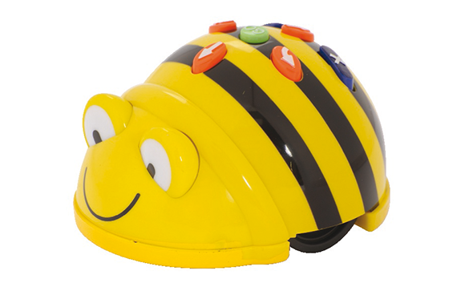
SAFETY INFORMATION
Do not put your hands close to the wheels.
Treat the Beebots as your friend.
Watch the Beebots move and do NOT move with it.

Slide 8
GIRLS
YOU CAN DO IT!

