Slide 1
Designing Robot
Girl Scouts Robotic Badges - Day 1
By Meize Guo¹ and Jue Wang²
¹University of Florida, ²University of Idaho

Slide 2
How do you feel about computer science?
How hard do you think computer science is?
Rate easy to hard from one to ten.
How do you feel about coding a robot?
Rate easy to hard from one to ten.
Do you know anyone who can code or program?
Do you think you can code or work as a programmer in the future? Why or why not?

Slide 3
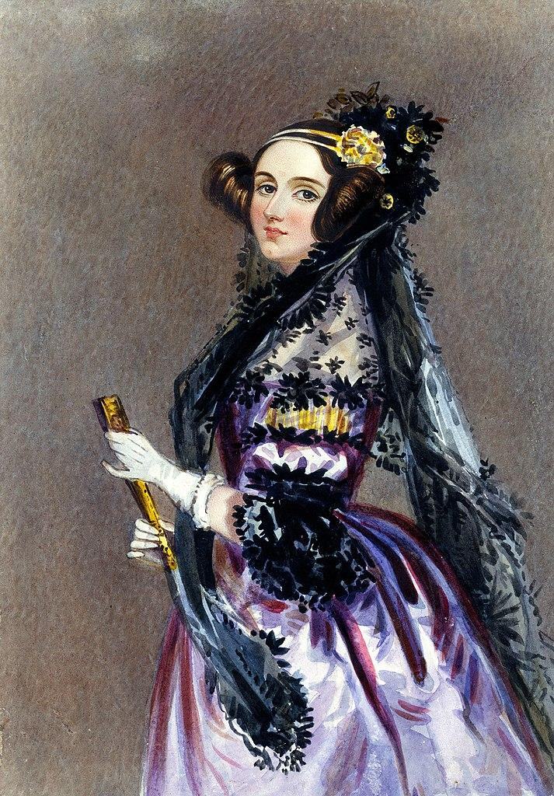
DECEMBER 10, 1815 — NOVEMBER 27, 1852
ADA LOVELACE
Women have been programming since before it was a thing.
Ada Lovelace, she's often credited as the first computer programmer.
Her work on Charles Babbage's Analytical Engine contains notes of the first machine-implemented algorithm.

Slide 4
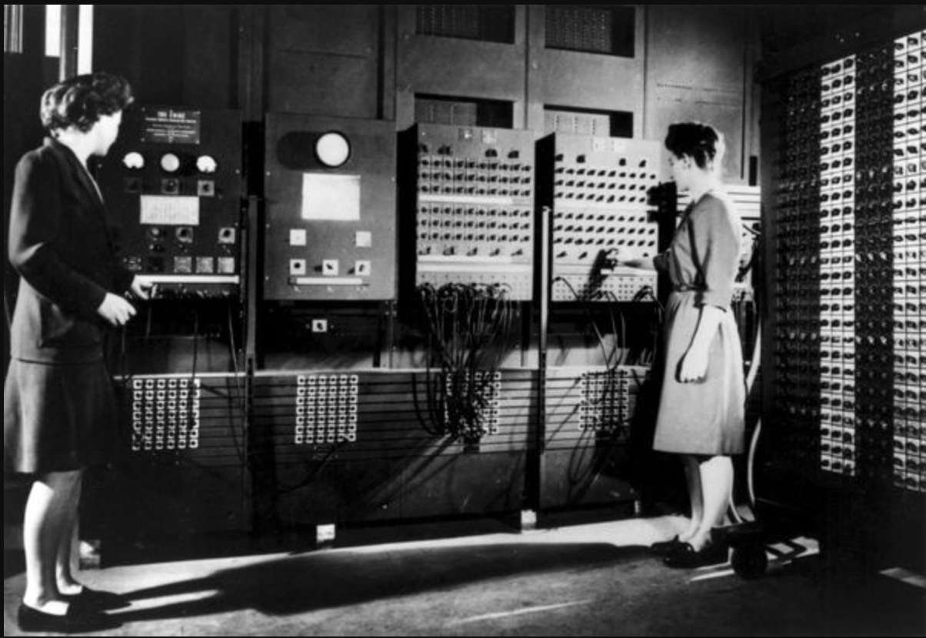
FIRST COMPUTER
The ENIAC programmers included a number of women:
Betty Jean Jennings (Jean Bartik),
Marlyn Wescoff Meltzer,
Ruth Lichterman Teitelbaum,
Kay McNulty Mauchly Antonelli,
Frances Bilas(Frances Spence),
Frances Elizabeth "Betty" Holberton.

Slide 5
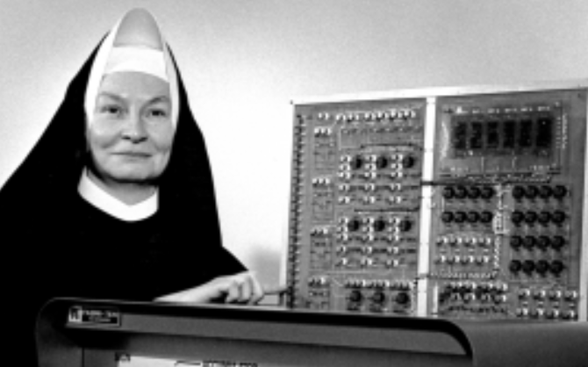
Sister Mary Kenneth Keller
1965
The first person to earn a Ph.D. in computer science in the United States.
She got her degree from the University of Wisconsin-Madison.

Slide 6
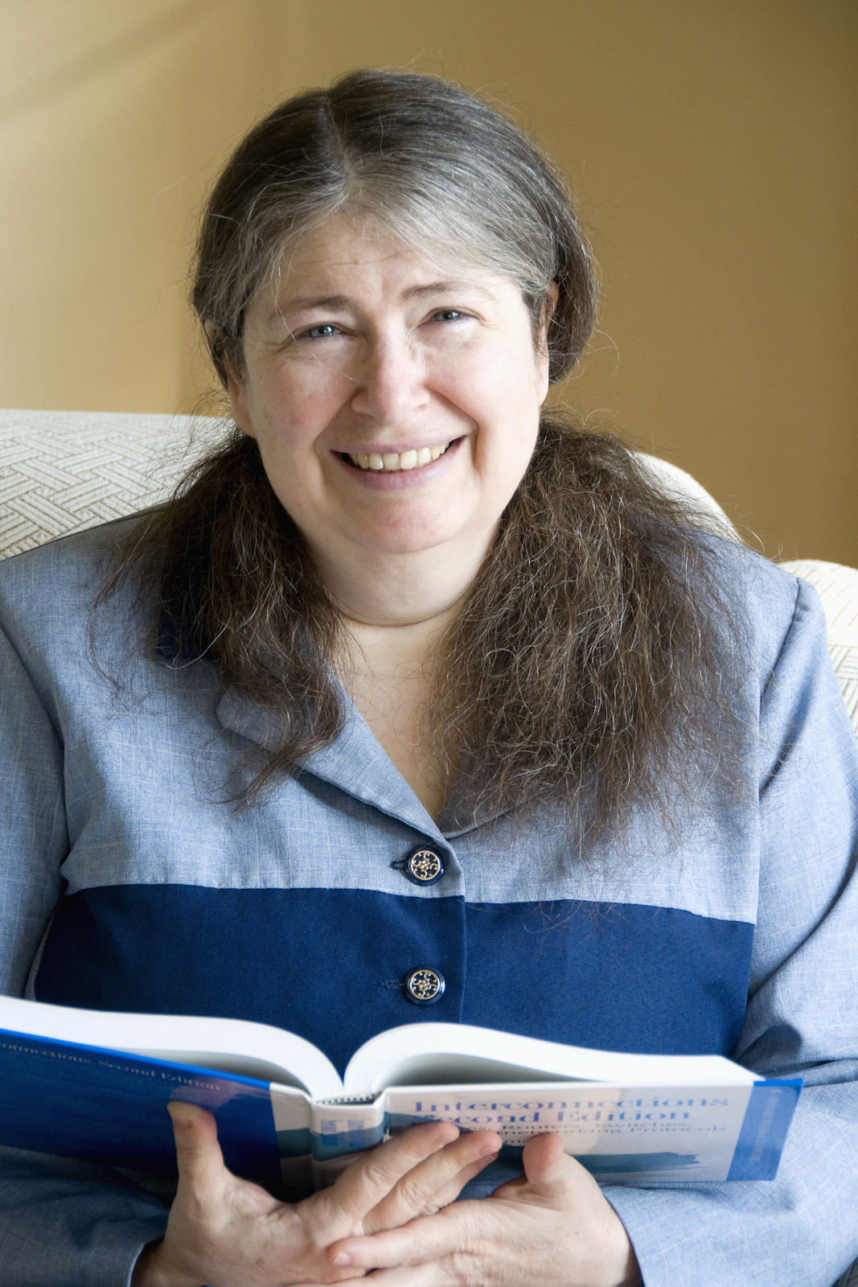
Radia Perlman
1985
Often called "the Mother of the Internet."
Radia Perlman's work on spanning tree protocol enabled the development of modern networking.

Slide 7
BEFORE HANDS-ON
Have you experienced any robots?
What can these robots do?
How do the robots function?
What do robots mean to you?
If you can design/create a robot, what do you want it to do?

Slide 8
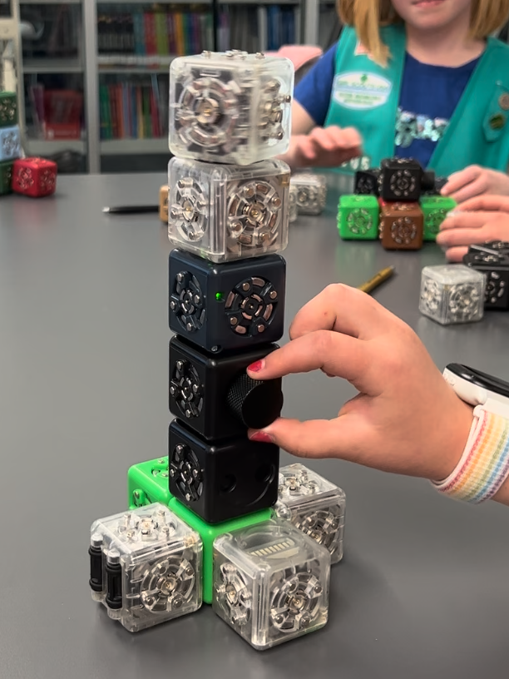
LET’S MEET CUBELETS!

Slide 9
GIRLS
YOU CAN DO IT!

Slide 10
TALK ABOUT YOUR CUBELETS ROBOT!

Slide 11
Image Sources
Portrait of Ada Lovelace. Possibly by Alfred Edward Chalon. Public Domain image
ENIAC Programmers. U.S. Army photo from the archives of the ARL Technical Library. Public Domain image.
Mary Kenneth Keller. Unknown author. Fair use
Radia Perlman. Author unknown. Public domain image
Cubelet Creation. Meize Guo and Jue Wang. CC-BY-NC-SA

