Slide 1
Computational Thinking (CT)
Rachel H. Billman¹, Kandace M. Hoppin¹, and Julia Murphy²
¹Towson University, ²Baltimore County Public Schools

Slide 2




WHY IS COMPUTATIONAL THINKING IMPORTANT?
WHAT IS COMPUTATIONAL THINKING?
Objectives
HOW DO I TEACH COMPUTATIONAL THINKING?

Slide 3





DESCRIBE THE PROCESS FOR LOOKING UP A NAME IN AN ALPHABETIZED LIST?
How would you...
How would you…
BUILD A STANDALONE STRUCTURE OUT OF LEGOS?
COOK A MEAL (RICE, MEAT, AND VEGETABLES) TO ENSURE EVERYTHING IS READY AT THE SAME TIME AND NOTHING GETS COLD?
*Make a set of directions or draw a diagram to describe the process for the selected option. Make sure no steps are left out!

Slide 4

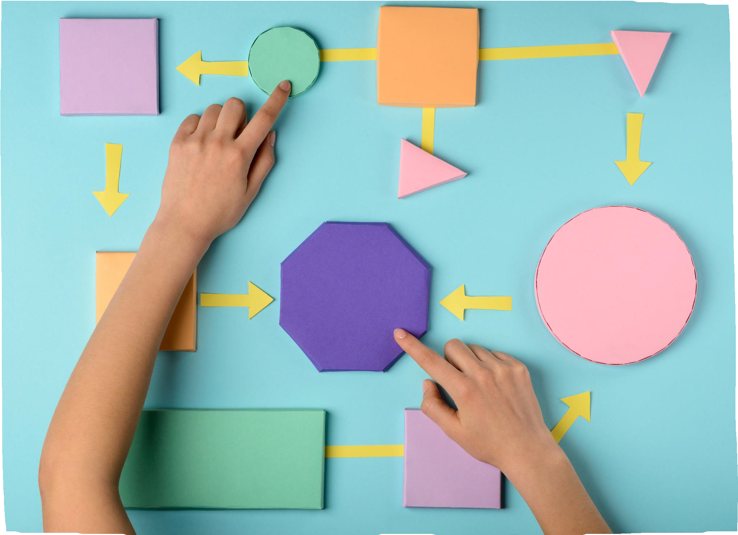
A way of thinking
Computational thinking refers to the thought processes involved in expressing solutions as computational steps or algorithms that can be carried out by a computer. (Cuny, Snyder, & Wing, 2010; Aho, 2011; Lee,
2016).

Slide 5



What is Computational Thinking?
IT IS NOT COMPUTER SCIENCE, BUT A WAY OF THINKING
CRITICAL AND LOGICAL THINKING PROCESS
CAN BE APPLIED TO COMPUTER SCIENCES OR ANY CONTENT AREA

Slide 6

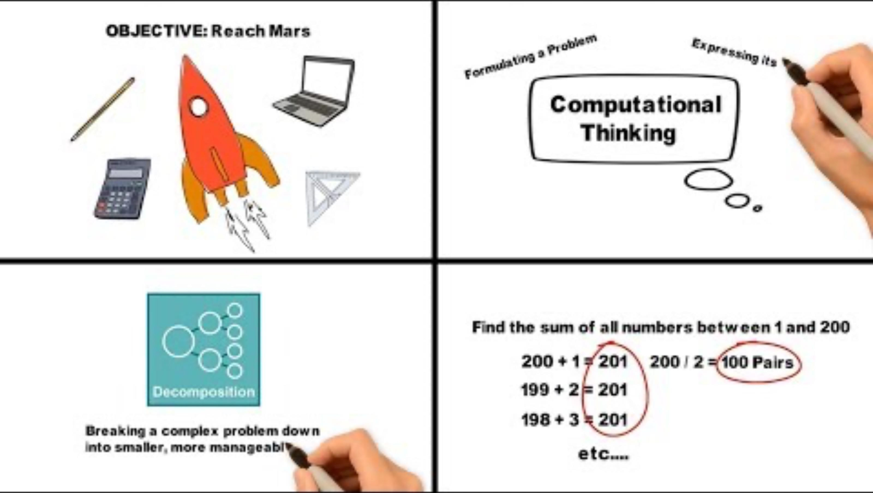



What is Computational Thinking?

Slide 7





What are CT Activities?
Computers and CT
CT does not require a computer! We can teach CT skills without the use of technology
Just because students are using computers does not mean that they are learning CT!
Some CT activities can include designing algorithms, decomposing problems, and modeling phenomena

Slide 8





CT problem solving process:
What does this look like in practice?
THE PROBLEM
DECOMPOSITION
PATTERN RECOGNITION
CT involves taking that complex problem and breaking it down into more manageable problems (decomposition).
These smaller, more manageable problems can be looked at individually, and we should consider how similar problems have been solved previously (pattern recognition)
A complex problem is
presented.
ABSTRACTION
Focussing on the important, relevant details, and leaving out any irrelevant details (abstraction).
ALGORITHMS
Simple steps or rules should be identified and designed (algorithms).
PROGRAM
These steps and rules can be used to "program" someone/something (ex. computer) to help solve this large, complex problem.
adopted from https://www.bbc.co.uk/bitesize/guides/zp92mp3/revision/1#:~:text=The%20four%20cornerstones%20of%20computational%20thinking&text=decomposition%20%2D%20breaking%20down%20a%20c omplex,information%20only%2C%20ignoring%20irrelevant%20detail

Slide 9
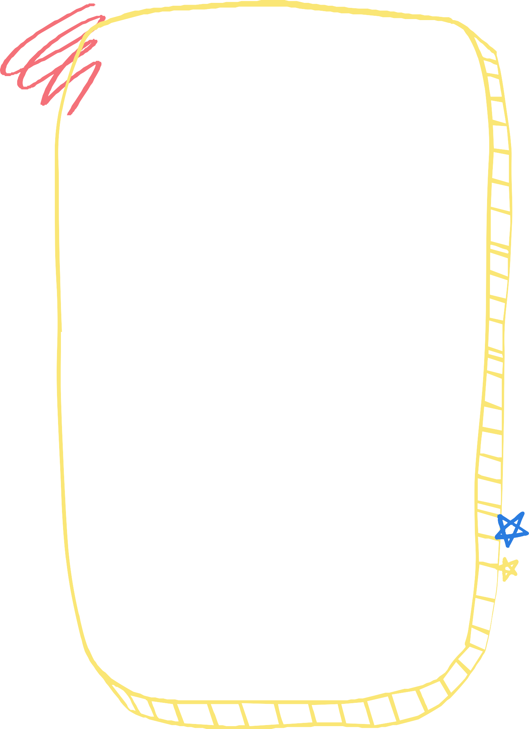



Let's use our vocabulary!
Where did you use...
DESCRIBE THE PROCESS
FOR ALPHABETIZING GRADED
PAPERS?
BUILD A STANDALONE
STRUCTURE OUT OF LEGOS?
DECOMPOSITION
PATTERN RECOGNITION
ABSTRACTION
ALGORITHMS
COOK A MEAL (RICE, MEAT, AND VEGETABLES) TO ENSURE EVERYTHING IS READY AT THE SAME TIME AND NOTHING GETS COLD?

Slide 10






Why is CT important?
HTTPS://WWW.BUSINESSINSIDER.COM/APPLE-CEO-TIM-COOK-WHY-COLLEGE-DEGREE-ISNT-NECESSARY-2019-3
FUTURE JOBS
COMPUTER BASED JOB MARKET
CODING AND THE JOB MARKET
Most jobs that our students wi l have years from now do not even exist today!
The US Bureau of Labor Statistics project that STEM occupations wi l grow "over two times faster than the total for ALL occupations by 2029
Apple CEO Tim Cook believes that "every kid in the US have some level of coding education before they graduate high school"

Slide 11
Sphero Activities and Exploration

Slide 12

DISCUSS
Were these tasks challenging for you and your partner(s)? Why?
What CT skills/steps did you use? (reference your resources!)

Slide 13
Computational Thinking & (insert state name) Standards
GRADES 3-5
GRADES K-2
(INSERT STATE NAME) COMPUTER SCIENCE (CS) FRAMEWORK & STANDARDS:
(INSERT STATE CT/CS STANDARDS and/or OVERVIEW OF SKILLS)
(INSERT STATE CT/CS STANDARDS and/or OVERVIEW OF SKILLS)
CONCEPTS COVERED
GRADES 6-8
HIGH SCHOOL
(INSERT CONCEPTS/ CATEGORIES COVERED FROM STATE CS/CT STANDARDS)
(INSERT STATE CT/CS STANDARDS and/or OVERVIEW OF SKILLS)
(INSERT STATE CT/CS STANDARDS and/or OVERVIEW OF SKILLS)

Slide 14




(INSERT STATE’S NAME)’S Computer Science Standards
INSERT DIRECT LINK TO STATE STANDARDS
FRAMEWORK

Slide 15


ISTE Standards
HTTPS://WWW.ISTE.ORG/STANDARDS/FOR-STUDENTS

Slide 16

What content areas should focus on computational thinking?
SHOULD STUDENTS ONLY RECEIVE INSTRUCTION ON COMPUTATIONAL THINKING IN A COMPUTER SCIENCE COURSE?

Slide 17



Examples of Computational Thinking across the curriculum +
ANALYZING REAL PROBLEMS
HISTORY AND MAKING CIRCUITS
STORYTELLING WITH SCRATCH
Collect data or identify relevant data sets; use tools to analyze data sets; represent data in various ways to facilitate problem-solving and decision-making
Students analyzed a book about migration in the United States and created a paper circuit timeline to show the story of migration, immigration, and/or forced relocation
Use Scratch to tell a story or summarize a story

Slide 18
Examples of Computational
Thinking Across the
Curriculum:
UNPLUGGED ACTIVITY
BUILDING SENTENCES UNPLUGGED ACTIVITY
DRAWING GEOMETRIC SHAPES
We do not always have to use computers to teach algorithms!
Here is an example of an unplugged activity for teaching algorithms and following directions
Another unplugged activity to do a fill in the blank activity (emphasizes variables)
Use Scratch to draw an equilateral triangle
Code.org. (n.d.). Happy Maps. Code.org. Retrieved December 5, 2024, from https://studio.code.org/s/course1/lessons/1/levels/1

Slide 19

Examples of Computational Thinking
Across the Curriculum
+ additional resources
Click the links for more information
SCRATCH.MIT.EDU
CODE.ORG
MORE ISTE IDEAS
ISTE has a library of tools to help teachers incorporate computational thinking into their curriculum

Slide 20




Equity in Computer Science Education
“The purpose of equity in computer science is not to prepare all students to major in computer science and to go on to careers in software engineering or technology, instead, it is about ensuring that all students have foundational knowledge that will allow them to productively participate in today’s world and make informed decisions about their lives.

Slide 21
Equity in Computer Science Education
Equity is not just about whether the classes are available, but also about how those classes are taught, how students are recruited, and how the classroom culture supports diverse learners and promotes retention. The result of equity is a diverse classroom of students, based on factors such as race, gender, disability, socioeconomic status, and English language proficiency, all of whom have high expectations, and feel empowered to learn.” (K12CS, P.23)
HTTPS://K12CS.ORG/

Slide 22
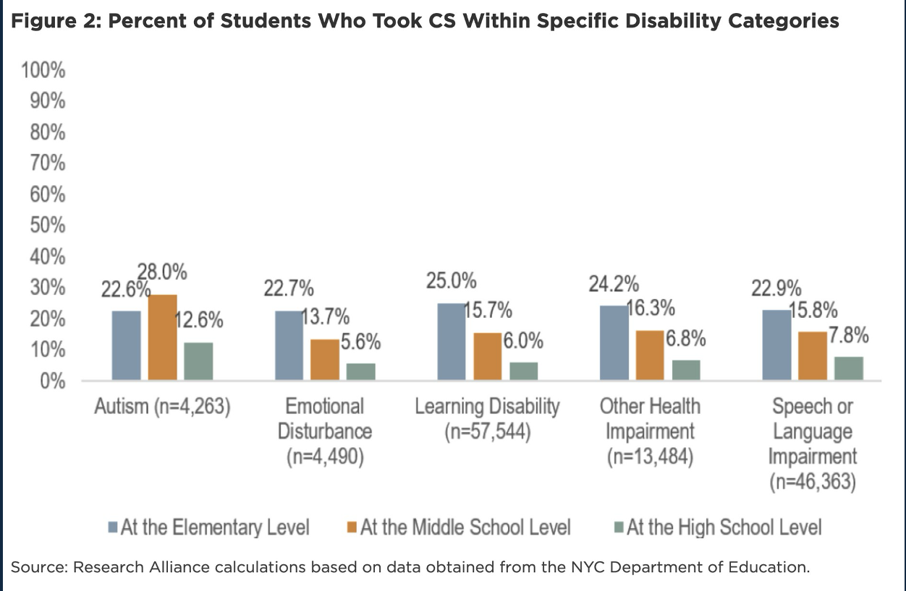
Computer Science for All Initiative: Research Alliance & NYU https://steinhardt.nyu.edu/research-alliance/research/what-extent-are-students- disabilities-included-k-12-computer-science

Slide 23

What does CT look like in special education?
© Billman & Hoppin, 2024
When we are looking to teach CT, how can we address the needs of ALL learners?
Examples from Bouck & Yadav, 2020:
Use explicit instruction and immediate feedback
Include CT vocabulary in instruction
Explore ways that CT can be integrating into the mathematics curriculum-how can it support instruction of the content?
Use the resources in your classroom - mobile devices, computers, robots?
Use vetted lesson plans from code.org, ISTE, etc.
Students with disabilities should also access problem solving strategies– an important concept taught through CT!
Students with more intensive needs in the classroom, including students with ID or ASD can be taught to code
ALIGNING UDL PRACTICES + INCLUSIVE PEDAGOGIES TO CS/CT!
HTTPS://CTRL.EDUCATION.UFL.EDU/WP- CONTENT/UPLOADS/SITES/5/2020/06/CTRL-TACTIC- UNIVERSALDESIGN.PDF
BOUCK, E. C., & YADAV, A. (2020). PROVIDING ACCESS AND OPPORTUNITY FOR COMPUTATIONAL THINKING AND COMPUTER SCIENCE TO SUPPORT MATHEMATICS FOR STUDENTS WITH DISABILITIES. JOURNAL OF SPECIAL EDUCATION TECHNOLOGY, 0162643420978564. HTTPS://DOI.ORG/10.1177/0162643420978564

Slide 24









Your turn to practice!
Design an activity
TODAY YOU WILL BRAINSTORM HOW TO INCORPORATE COMPUTATIONAL THINKING INTO YOUR CLASSROOM FOR ALL STUDENTS!

Slide 25
Design an activity:
Brainstorm HOW you would incorporate computational thinking skills into a lesson you have taught or planned for.
Consider some of the following:
ASSESSMENT?
UNPLUGGED ACTIVITY?
REINFORCEMENT?
Could you use some of the suggested resources to enhance an assessment in your lesson?
Do you require computers or devices to incorporate CT into your lesson plan, or can it be an "unplugged" activity?
Can you teach/reteach a concept using CT skills?

Slide 26


Please include:
LESSON PLAN OBJECTIVE
DESCRIBE THE ACTIVITY
What is the lesson plan objective you are addressing?
Describe the activity or activities and your plan. Be sure to include CT terminology!
Once you've planned + outlined these elements, make sure to share your CT activity idea!

