Slide 1
Using Roblox to explore Natural Selection
Aishat Olere Balogun¹ and Amber Dehner²
¹Indiana University Bloomington; ²Bloomington High School North

Slide 2
What is Natural Selection?
Review of previous information about natural selection, use the following to guide the discussion and review
What are Darwin's 5 Postulates of Natural Selection?
Explain the interaction of mutation and selection in producing evolutionary change
Describe the different modes of selection and differentiate between them
Students provide answers which are written down
Instructor uses this opportunity to address any mistakes or misconceptions that come up.
- Play the video on the next slide to also review previous content

Slide 3
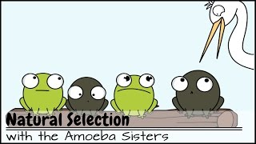
Review Natural Selection video with Amoeba sisters

Slide 4
Go over the Expectations & Rules Form
Be civil and respectful to each other
Be Safe
Do not share your password
Do not invite people you do not know
Only post appropriate and related content
I agree to the stated expectations and will accept any actions taken if I violate the rules mentioned.
Student Signature:
Parent/Guardian Signature:
Note: This should be given to students before this lesson.

Slide 5
Explore Natural Selection
Find out who has used roblox before
Create groups based on familiarity with the program
Students are allowed to work individually if they wish to

Slide 6
Lesson & Activity
In this lesson Roblox games will be used to model evolution specifically to show the process of natural selection.
First Activity: Students will play and review several Roblox games. These games were already existing in the Roblox system and we want to see how they applied the principles of evolution and natural selection we learned about.
Second Activity: Students will be given the opportunity to create their own Roblox game which will reflect how natural selection occurs within their chosen environment.

Slide 7
First Activity: Play and Review Multiple Roblox games
Play the following games and provide a critique based on your experience. You should include a picture of the starting page of the game and the ending page showing your game data.
Play all games and at the end of the game answer the following question
What evolution topics were presented in the game?
How well did they cover evolution topics?
What issues did you face while playing the game?
Using the following rating of 1 to 10 rate, with 1 =least & 10 = most
Provide Annoying rating 1 - 10
Provide Fun/like rating 1 to 10
Submit the pictures and your review on the canvas page created for this assignment

Slide 8
Instructions: Roblox
Sign into your Roblox account at www.roblox.com
Create an account if you do not have one
Do not use your full name or identifying information
Let your teacher know your username
DO NOT USE INAPPROPRIATE USERNAMES

Slide 9
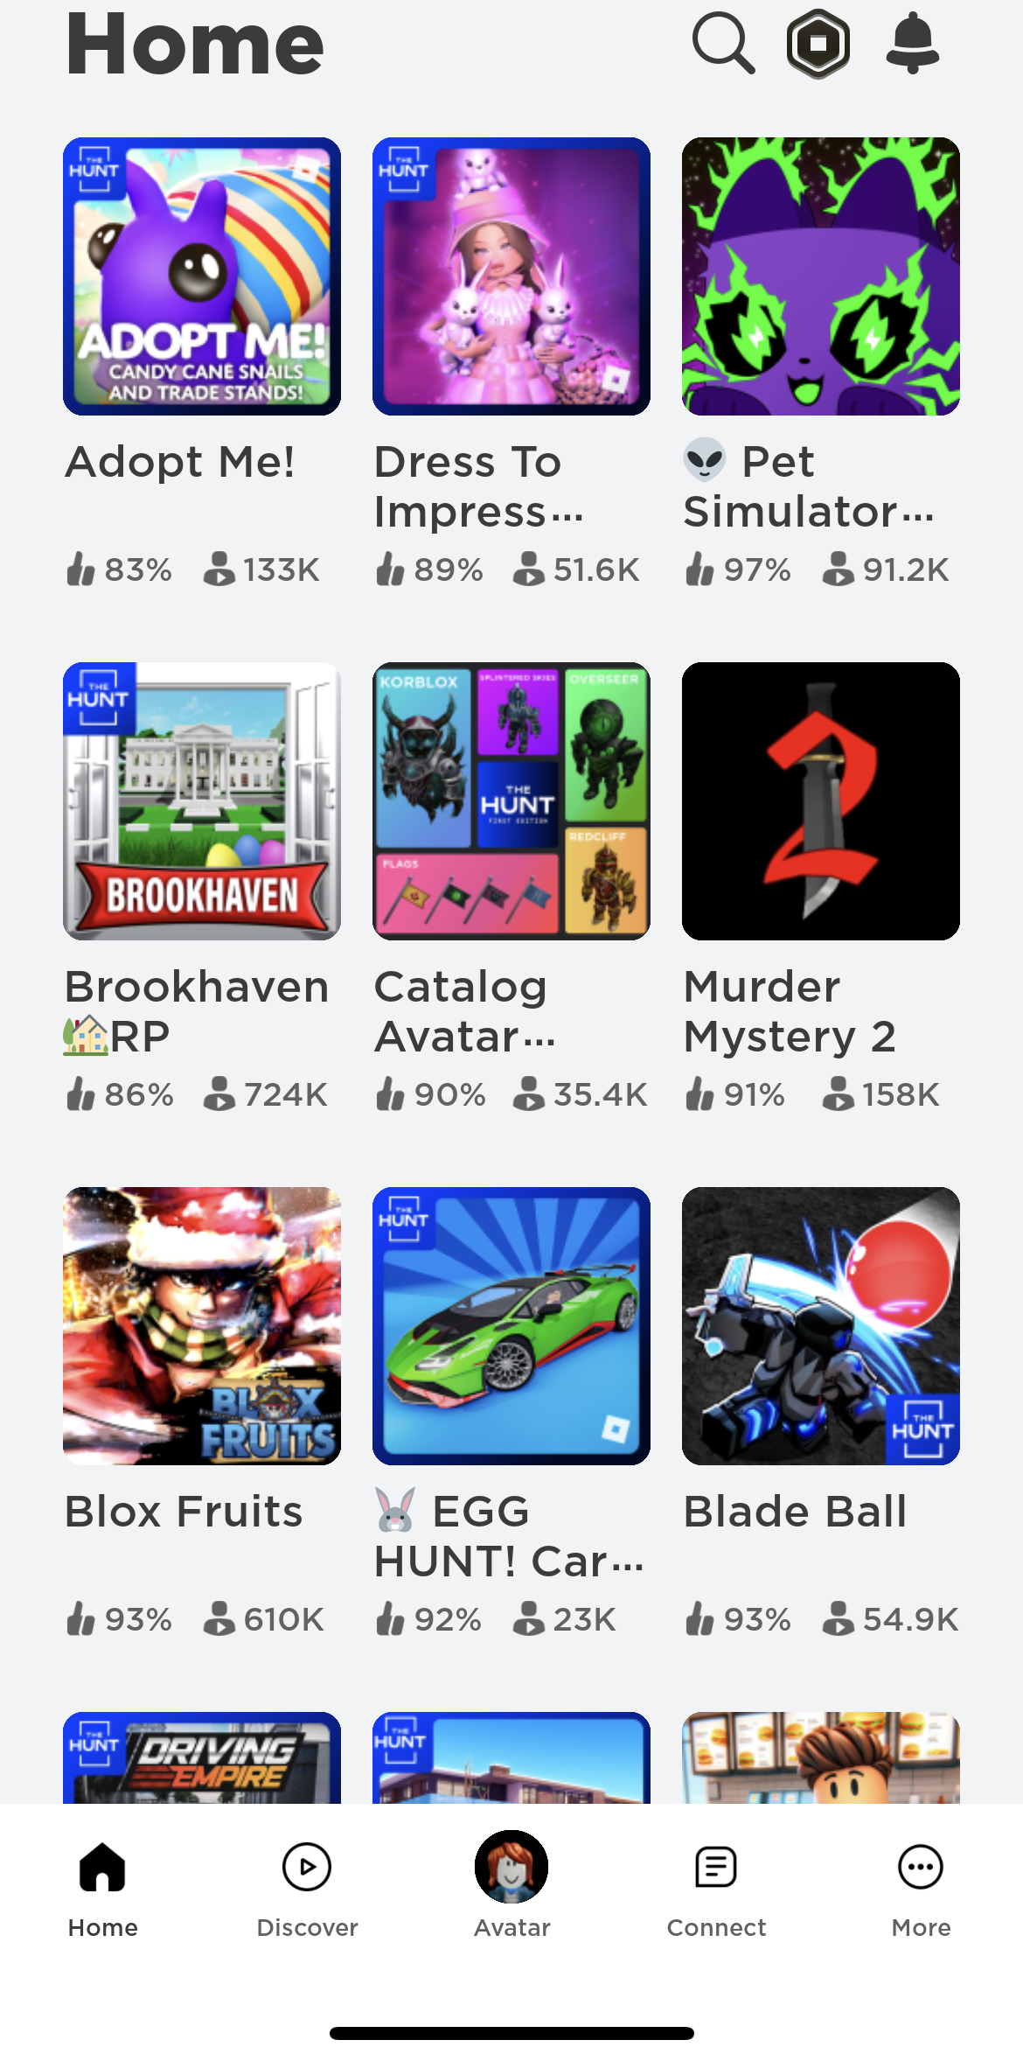
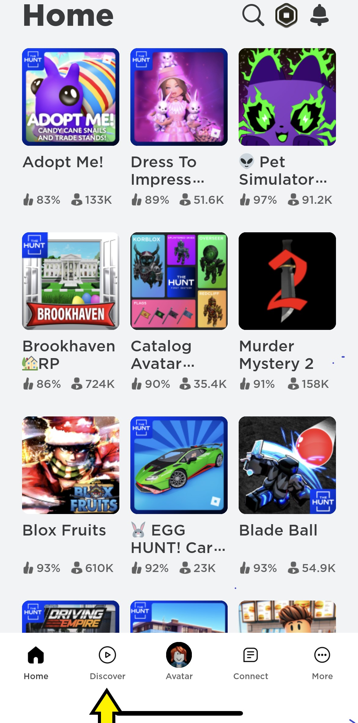
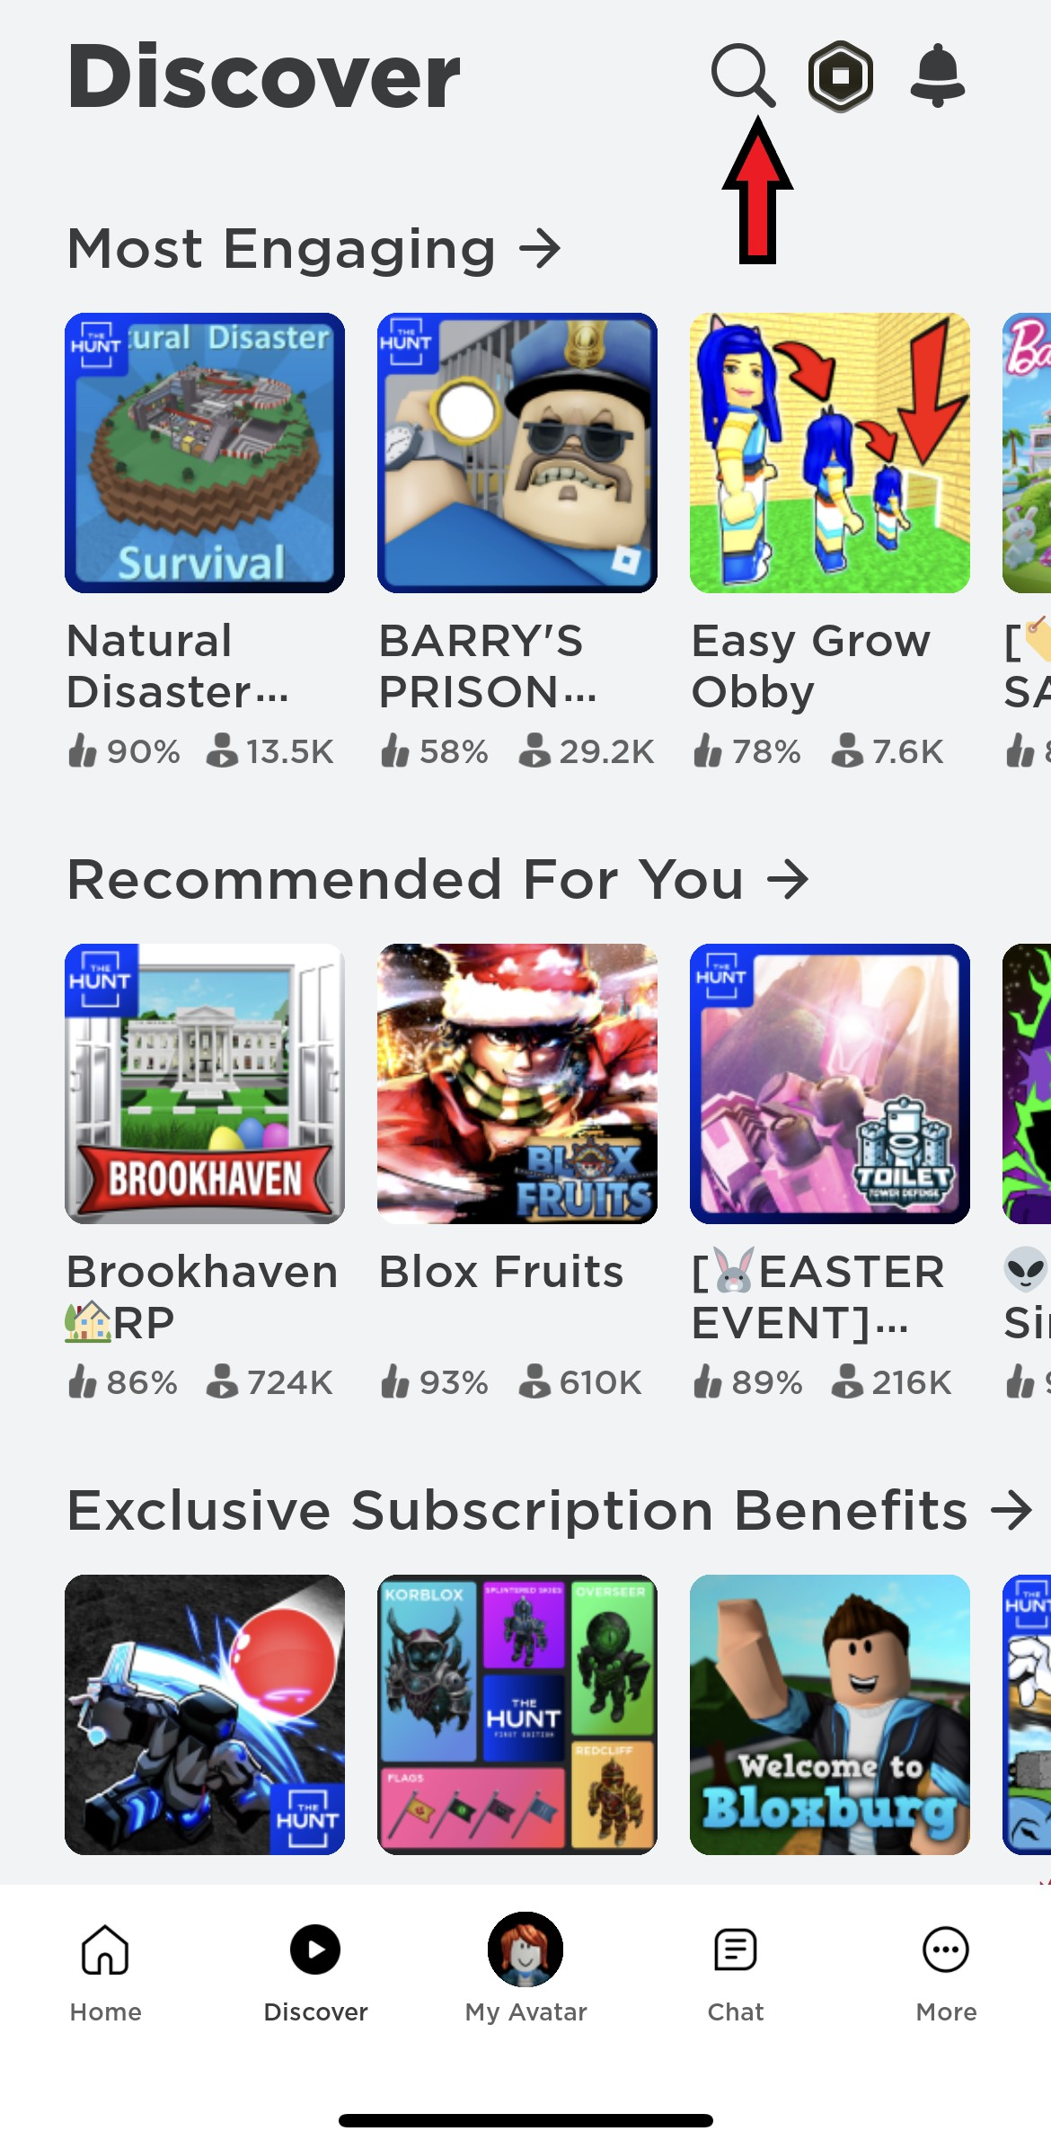
Roblox log in images: Home-Discover-Search

Slide 10
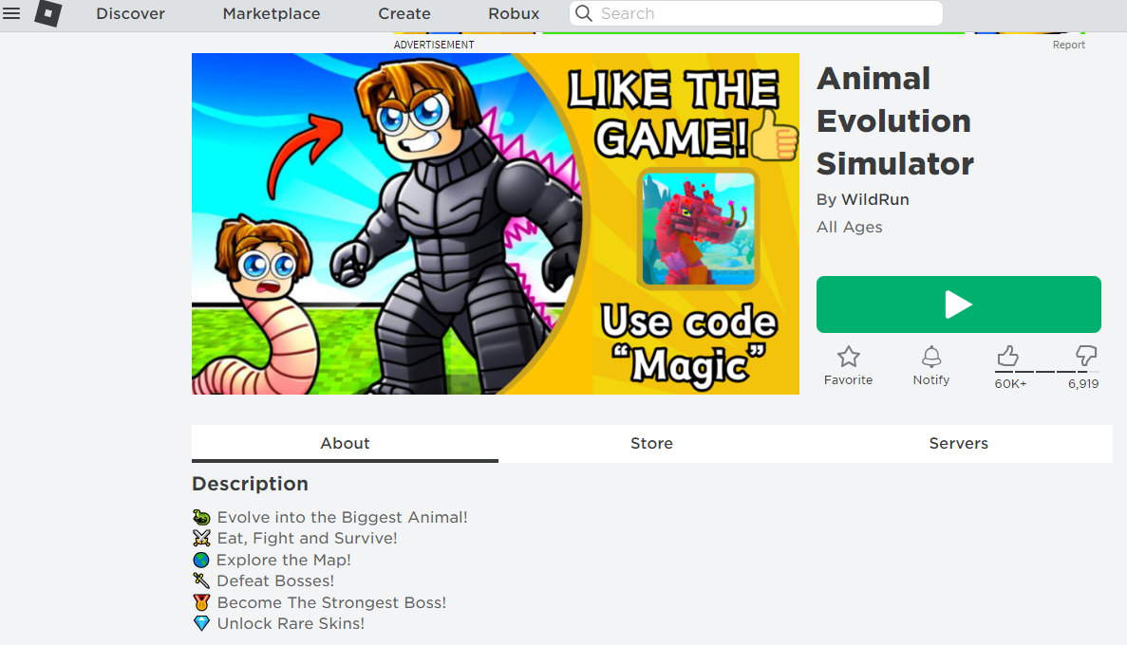
Links to Roblox games for Activity 1
https://www.roblox.com/games/8880590553/Animal-Evolution-SimulatorLinks to an external site.

Slide 11
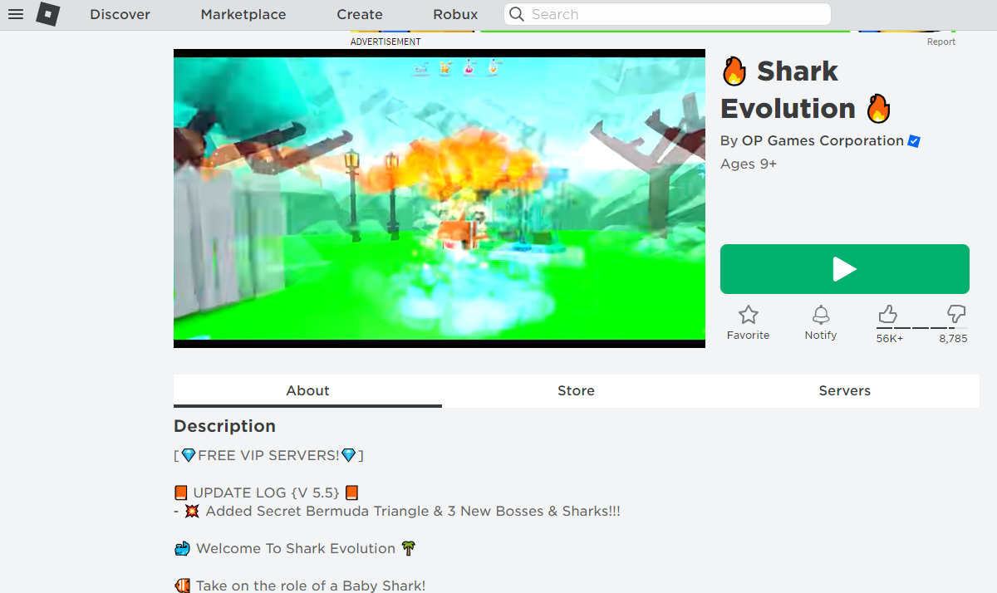
Links to Roblox games for Activity 1
https://www.roblox.com/games/5600963870/Shark-EvolutionLinks to an external site.

Slide 12
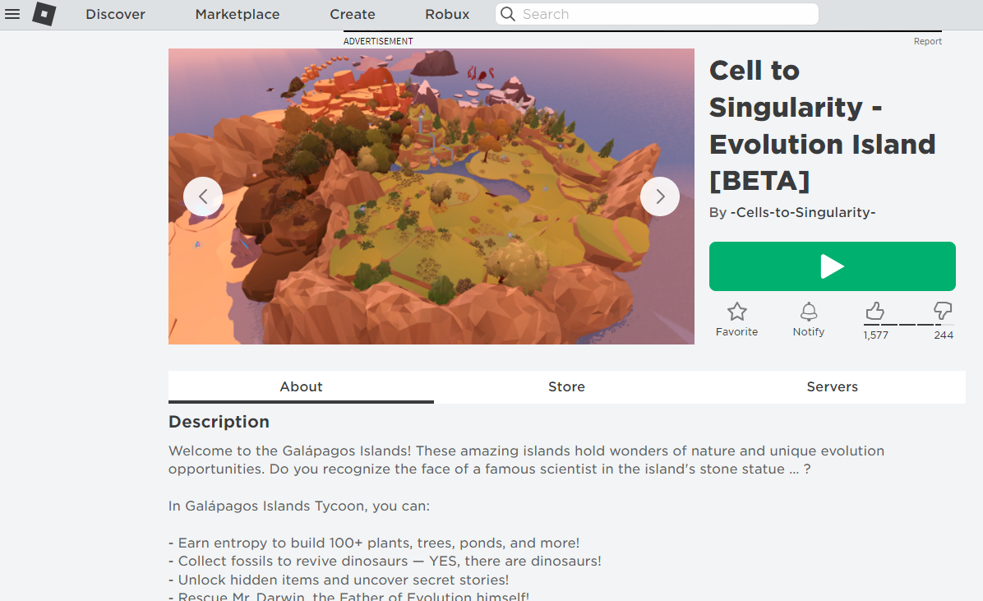
Links to Roblox games for Activity 1
https://www.roblox.com/games/10059951165/Cell-to-Singularity-Evolution-Island-BETALinks to

Slide 13
Second Activity: Game Creation Create your storyboard
Create a storyline with your group about the game
Include the following representation of natural selection in your game
Variation:
Heritability
Environment
Also describe the environment this will be happening in.
Write down your script for the game you intend to create. The environment and live organisms could be real or imaginary as long as they reflect the tenets of natural selection.
Submit the link to your game to the shared Google document created for this assignment

Slide 14
Instructions: Roblox
Sign into your Roblox account at www.roblox.com
Create an account if you do not have one
Do not use your full name or identifying information
Let your teacher know your username
DO NOT USE INAPPROPRIATE USERNAMES

Slide 15
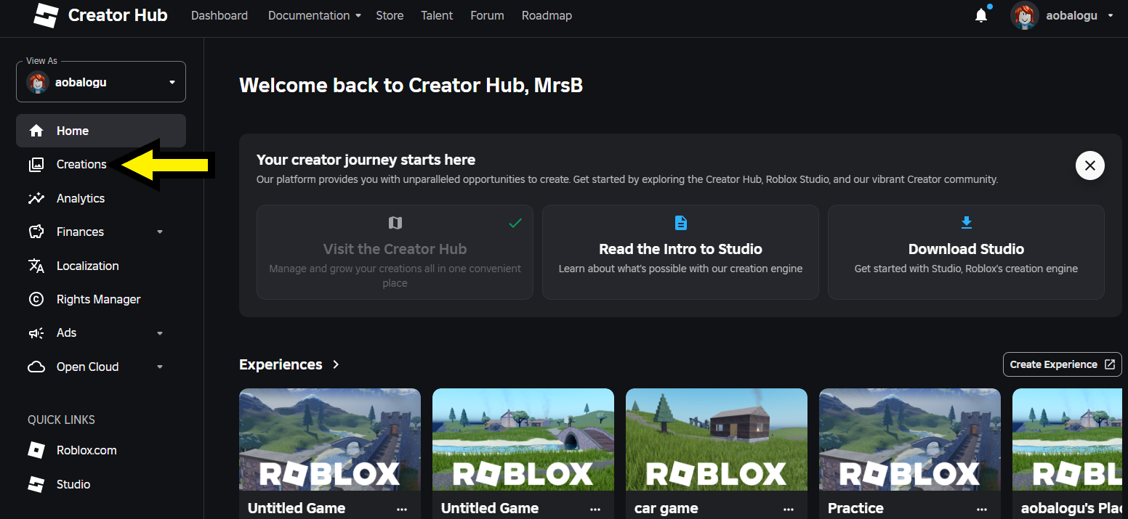
Log in to Roblox and Select Creations

Slide 16
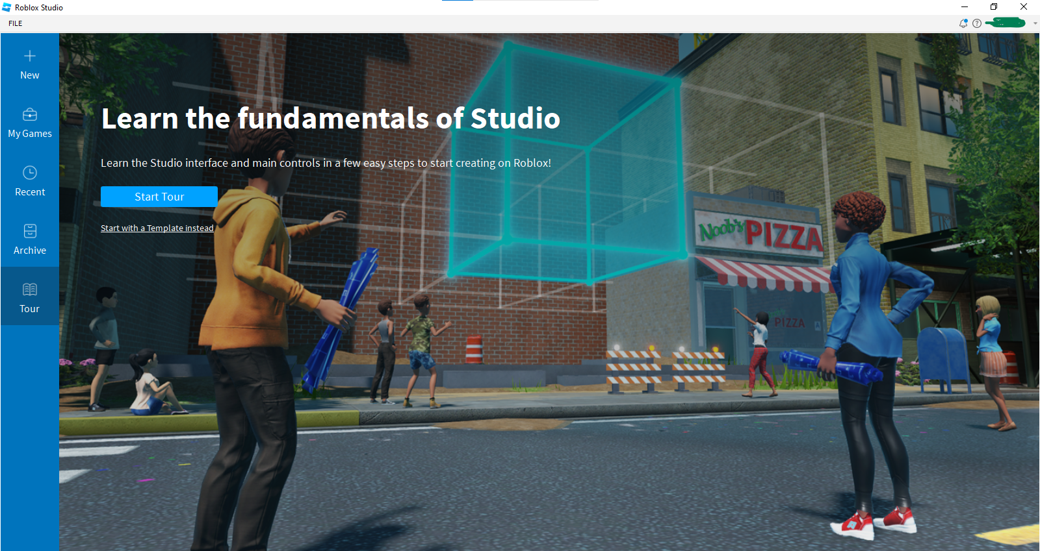
Follow the instructions to download and log in to Roblox studio

Slide 17
Select the start tour option and follow the instructions to familiarize yourself with how the game works

Slide 18
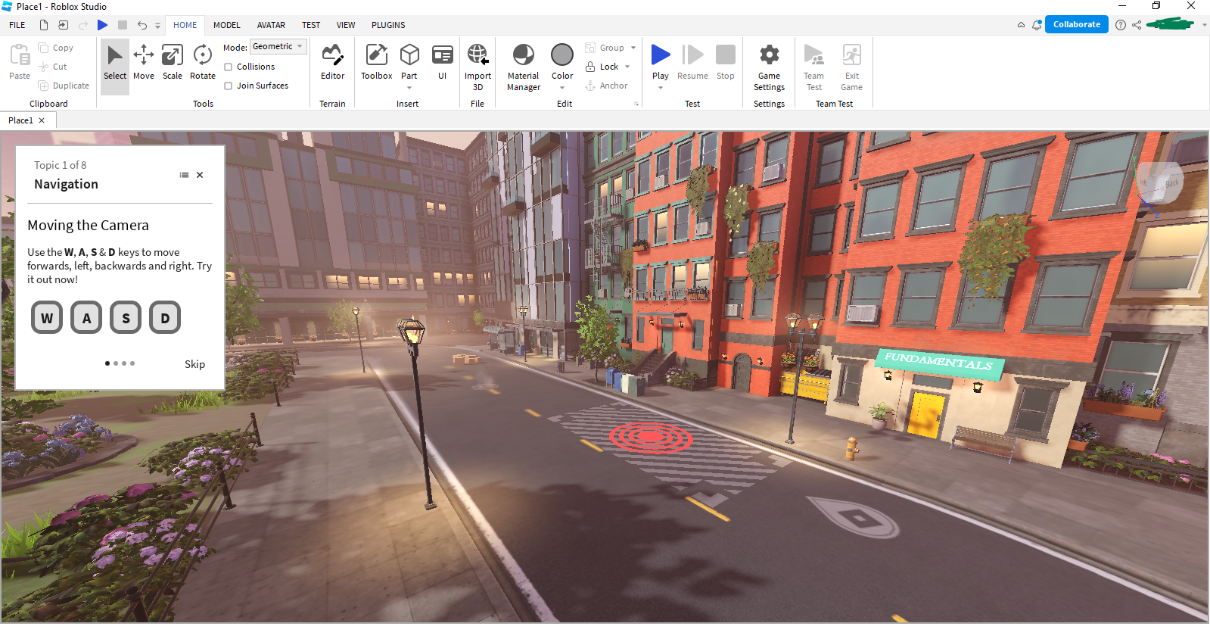
Using the start tour, follow the instructions to learn how to navigate and create your own game using the settings

Slide 19
To Collaborate, click on the collaborate option

Slide 20
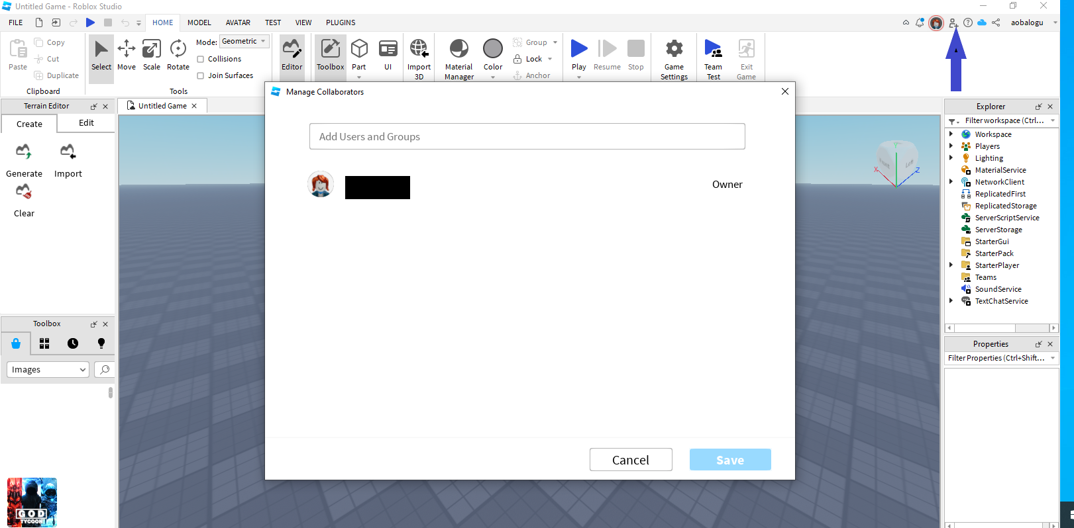
Add team member’s information

Slide 21
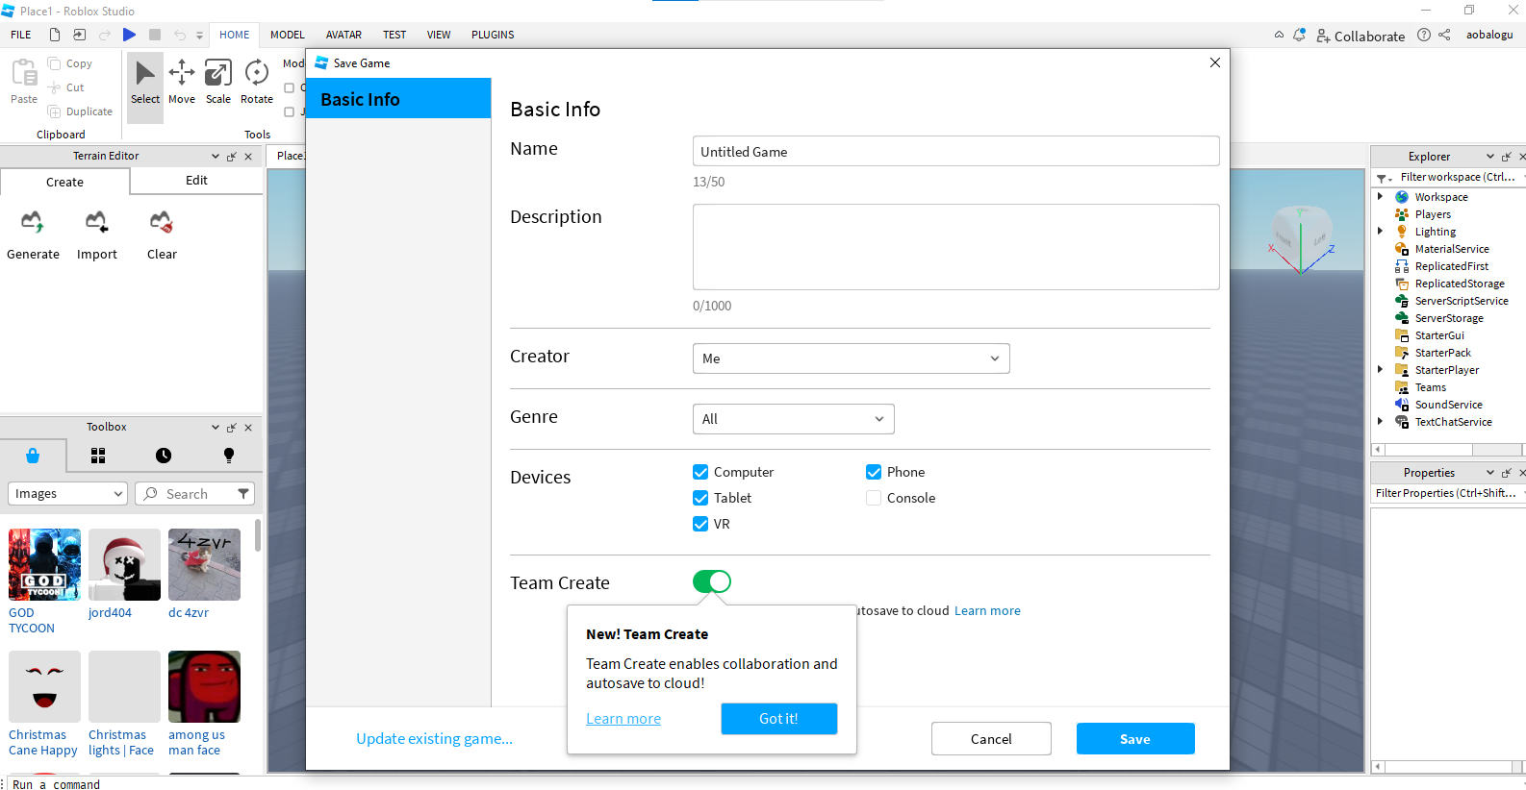
Saving your completed game

Slide 22
Follow the instructions to create your game

Slide 23
The second option, use a template: Follow the built in information and prompts to complete your game

Slide 24
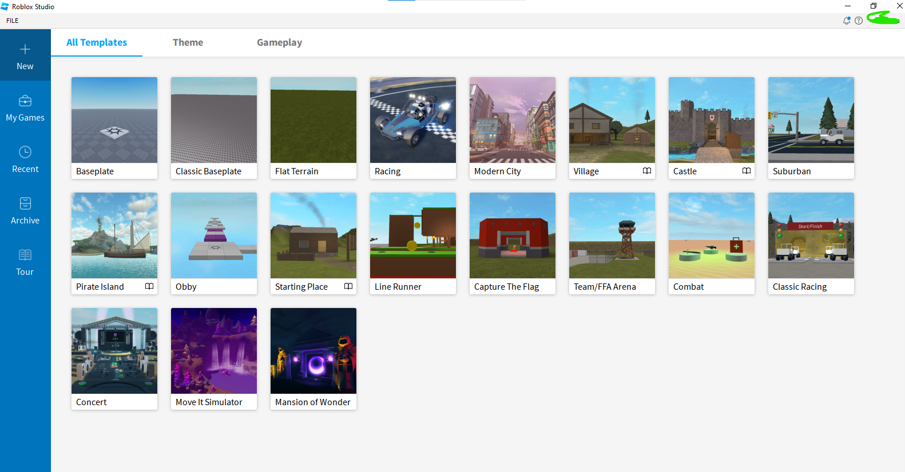
The second option, use a template: Follow the built in information and prompts to complete your game

Slide 25
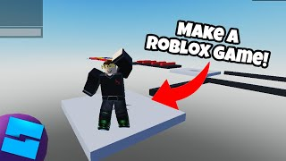
If you decide to use the second template options, review the following video before you start

Slide 26
Saving your completed game

Slide 27
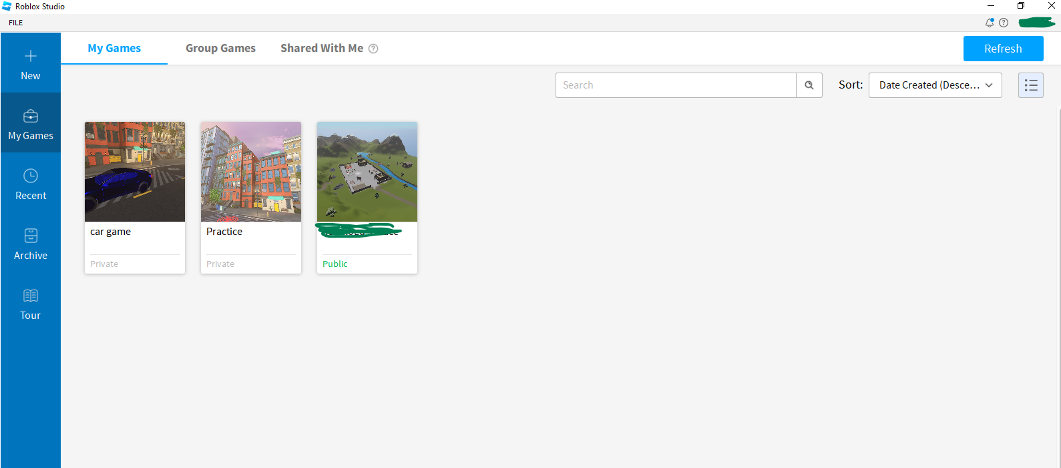
Where to access your completed game

Slide 28
Example of Student storyboard & Game (The link to the game was not shared for privacy reasons)
Birds are all originally the same species and look the same. However, due to different environments, various species emerged.
When you step on the Minecraft block and enter the flat area, you first see a garden-like place. Small light blue birds are hiding in this garden. Because from a distance, these sky-blue birds look like flowers, making them very easy to hide from enemies. So originally, birds of different colors lived, but only the light blue birds were able to survive due to their colors, so only the light blue birds remained
If you look to the right again, you will see red birds. These birds have evolved to look like apples, and in fact, from a distance, they just look like apples on a tree.
In another area of the game, because the terrain is hilly, they always use a lot of strength in their legs to prevent themselves from rolling down, and since protein food is produced on the ground, they do not need wings, so they can maintain those muscular legs
Lastly pigeons live in the city. In places where people live, all birds other than pigeons are delicious and have been caught and eaten, so only the pigeon, which is an unappetizing bird, is left.

