Slide 1
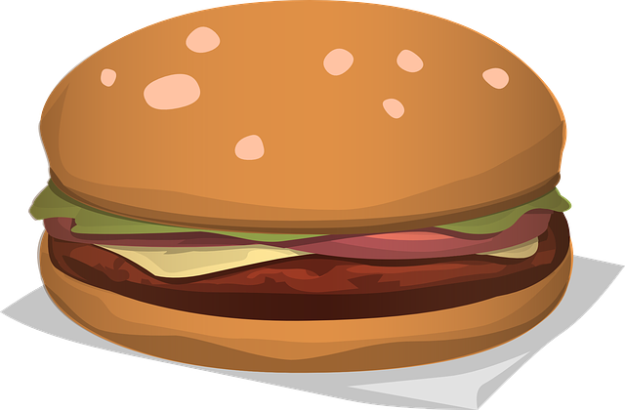
Finch Linear Equations Extension “Burger Time”
By Brian Johnson and Rebecca Bramwell

Slide 2
Warm Up/Reminders
Teams of 2-3 today
Logging in
Finch Care-Walking the Dog
Change settings (enable extensions)
Measure either nose to nose, or tail to tail
Saving your challenge programs

Slide 3
Downloading the Finch App
Google “Finch Connection App”

Slide 4
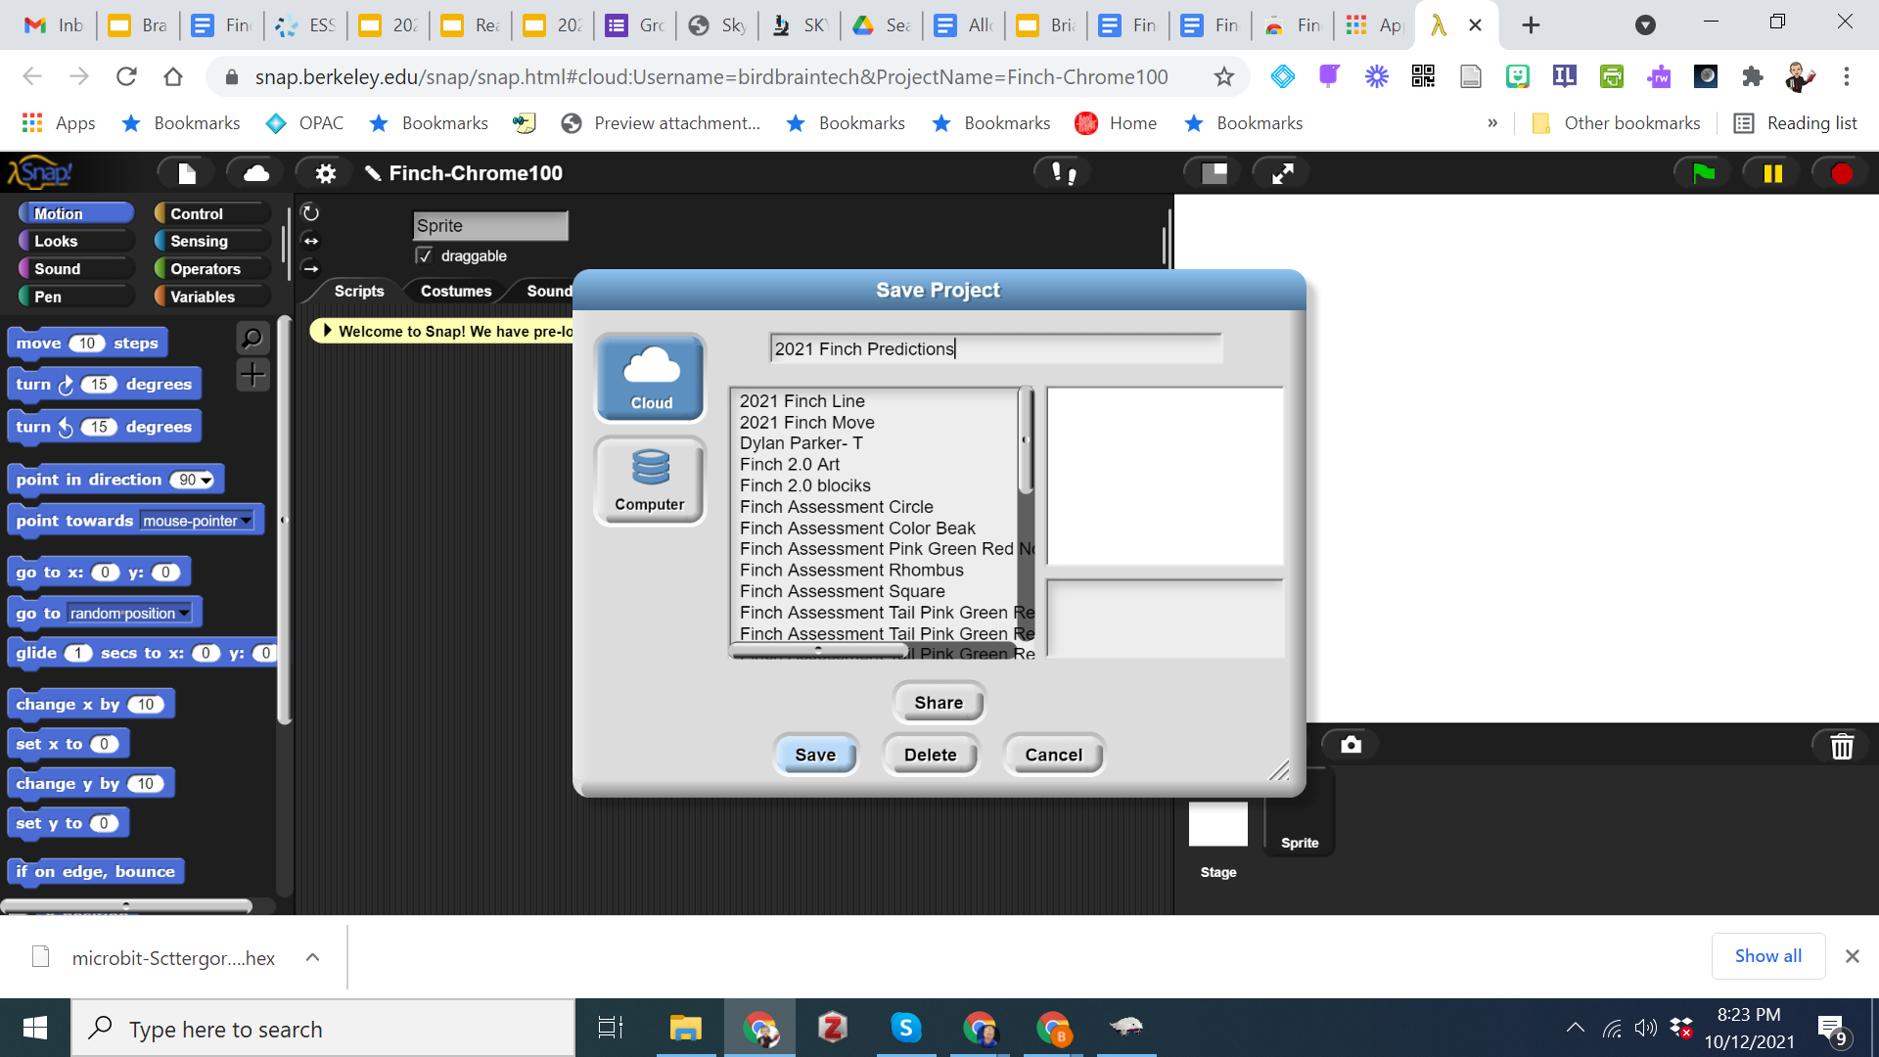
Saving Programs

Slide 5
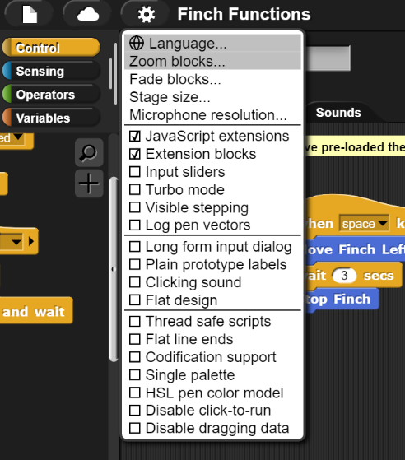
Click the setting cog in the top menu
Enable Javascript extensions &
Extension blocks

Slide 6
Coding Hints
Precision
Speak Out Your Code
Work with a Partner If You Have One
Complete a task card.
Call an adult over to you BEFORE testing your solution
Explain your reasoning and test it out!
Complete the reflection
Move on to the next task!
HOW MANY TASKS CAN YOU COMPLETE?!

Slide 7
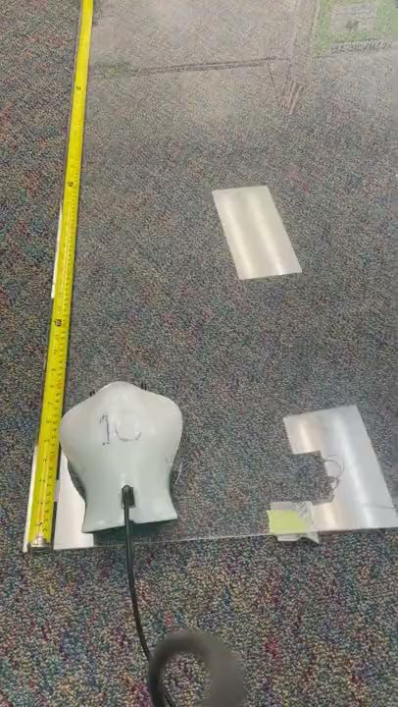
Challenge 1
Notes:
Note: Times/Values for Finch Robot #10
Constants (2): Left wheel 30; Right wheel 50
Independent Variable; Time (test with different numbers of seconds: 1, 4,7, 10)
Dependent Variable: Distance
13 inches?
Explanation: Due to the additional power to the left wheel, the Finch will turn slightly to the right

Slide 8
Challenge 2
Notes:
Constant: Power left 45; Power right 45
Independent Variable: Distance
Dependent Variable: Time
Explanation: Trials could lead to a calculation of 1 sec =s …. Distance in inches. Or results could be tested and checked to determine the final answer.

Slide 9
Challenge 3
Notes:
Constants : Power right 25; 8 seconds of time
Independent Variable: 14
Dependent Variable: Left power
Explanation (Toughest challenge) Students may initially try equal power on right and left wheels (25); but the Finch will roll approximately 22 inches (waaaay more than 14). They will need to key in on the relationship between a smaller (than 25) value for the left wheel and how far it will turn. (The greater the value, the greater the turn and the smaller total distance-inverse relationship between left wheel power and the total distance traveled)

Slide 10
Now Design and Test Your Own Challenge(!)
Design considerations:
1 . Choose two of the settings to be your constants
2. Choose one independent variable. This is the part you will change and test (should be whatever given is that you did not choose for the constant).
3. Run at least three different trials and record the information on the table.
4. Stop and reflect.
5. Use the information to predict what the distance would be with the given settings. Then, call an adult over to observe! Be ready to explain why!
Constant | Constant | Independent Variable | Dependent Variable
Write constant here | Write constant name here | Write independent variable here | Write independent variable here

Slide 11
Sources
OpenClipart-Vectors. (n.d.). Hamburger. Retrieved January 16, 2024 from https://pixabay.com/vectors/hamburger-cheeseburger-burger-lunch-576419/

