Slide 1
Fortune-Telling Finches Presentation
By Brian Johnson and Rebecca Bramwell

Slide 2
Content Objectives:
The Students will:
What?
AR.Math.Content.8.F.B.4
Construct a function to model a linear relationship between two quantities
* Determine the rate of change and initial value of the function from: a verbal description of a relationship, two (x, y) values, a table, or a graph
Use the relationship between power, time and speed to predict an outcome
Identify independent and dependent variables and constants in linear equations
Program robots in Snapcode to test predictions
How?
Model appropriate care of robots
Why?
Demonstrate problem solving/computational thinking skills
Prepare for High School and 21st Century Careers
Language Objective:
TSW (The Student will)
Discuss/problem solve with words to program robots collaboratively in groups

Slide 3
I can...
Use the relationship between power, time and speed to predict an outcome
Identify independent and dependent variables and constants in linear equations
Program robots in Snapcode to test predictions
The Finch Robot Challenge!

Slide 4
Engage-Robots in action video
-Explore: 1st challenge “get robot to move in various directions”
- Explain: Students realize a connection between the left/right power, time, and distance as well as the association with forward or backward movement and direction
Elaborate: Students use variable change tracked in a table to make a prediction about a given input or output
Evaluate: Students test their prediction and reflect on their function.

Slide 5
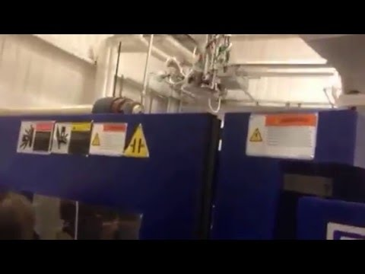

Slide 6
I can use coding to make predictions about how a Finch will move and explain the process in relation to the 8 Mathematical Practices.

Slide 7
Set Up

Slide 8
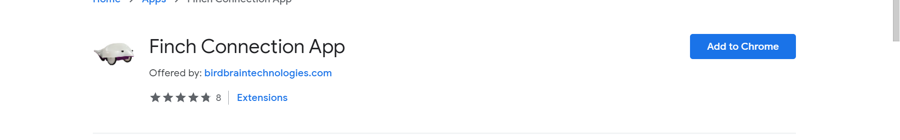
Downloading the Finch App
Google “Finch Connection App”

Slide 9
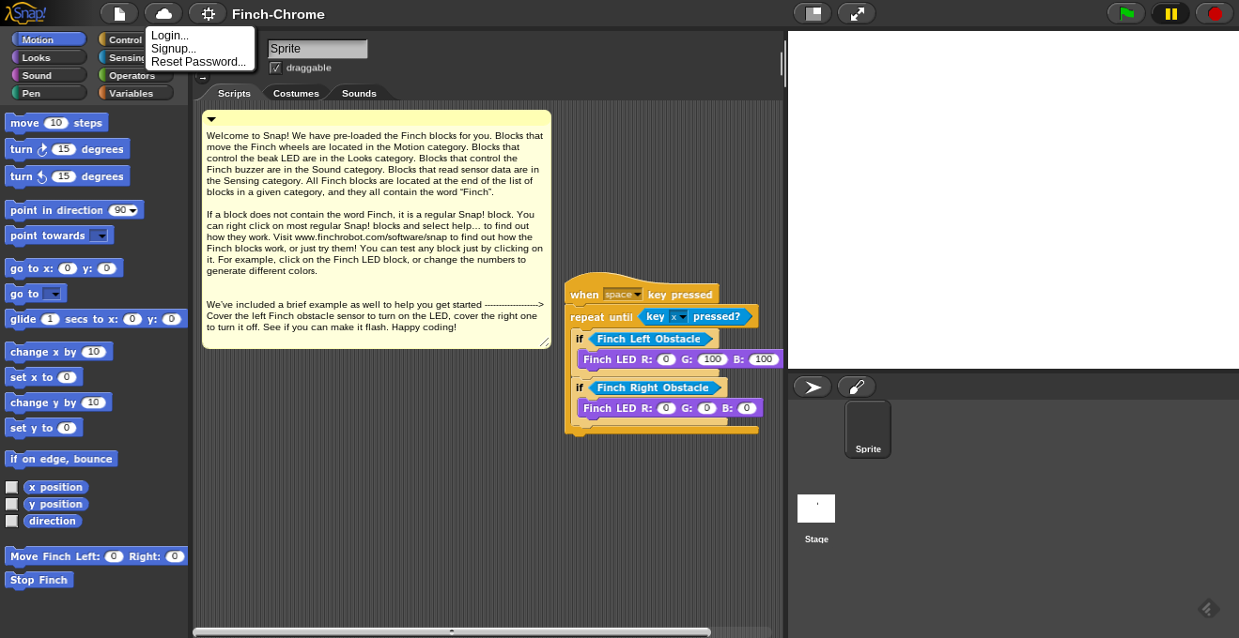
Set Up a Finch Account

Slide 10
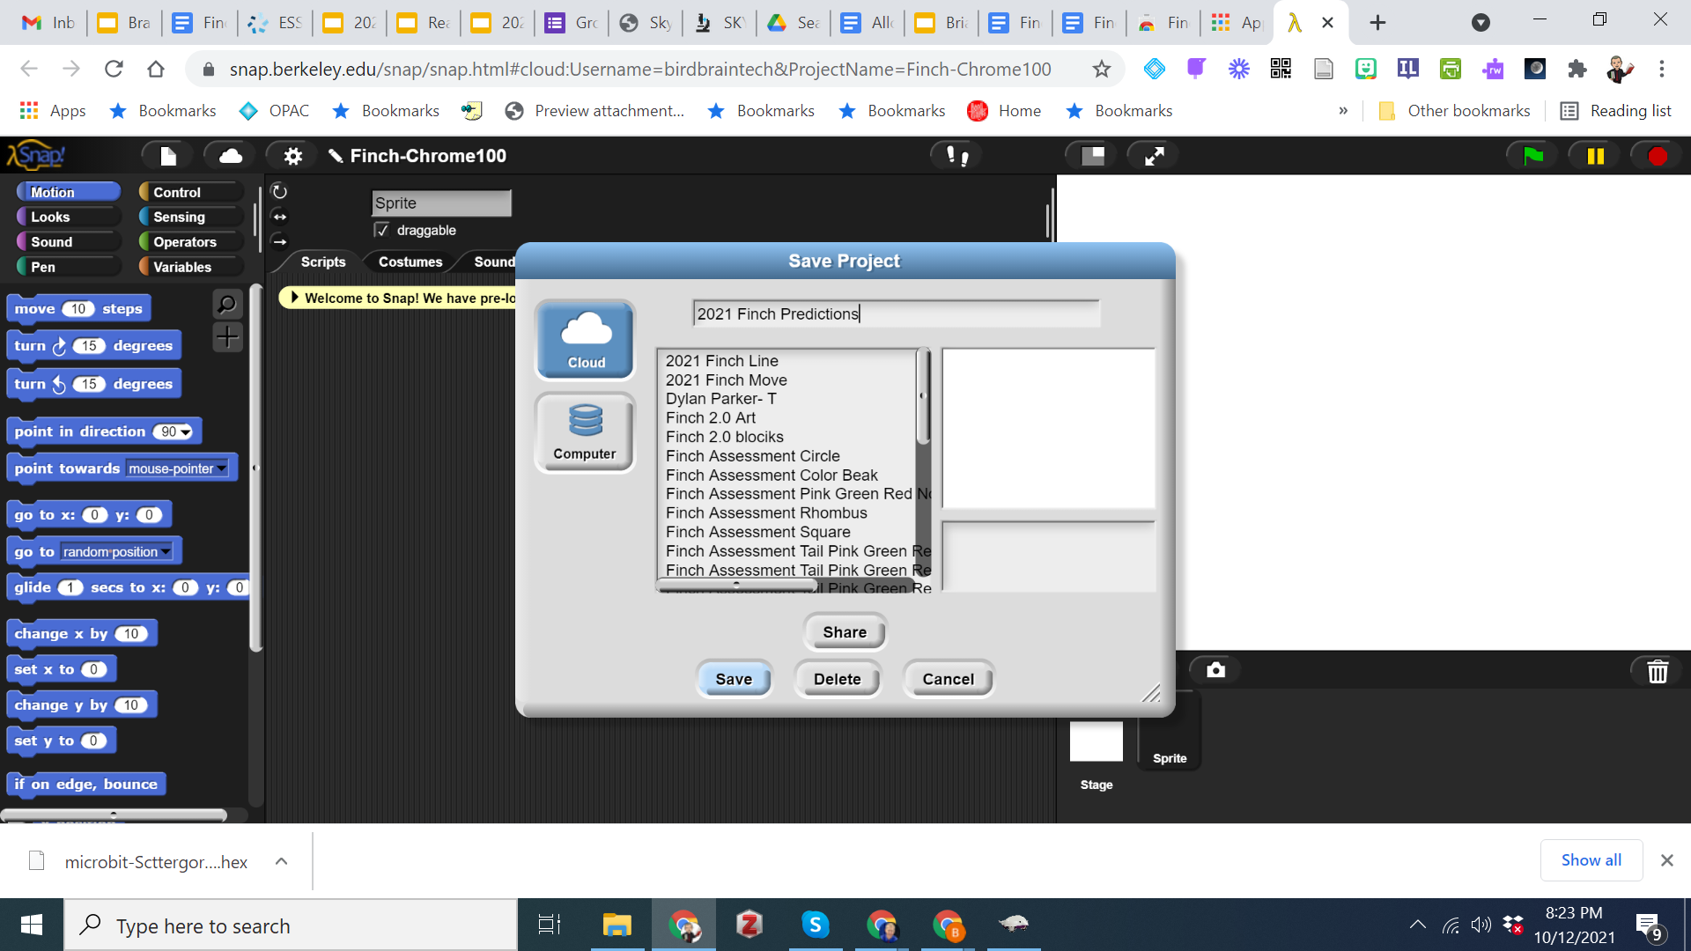
Saving Programs

Slide 11
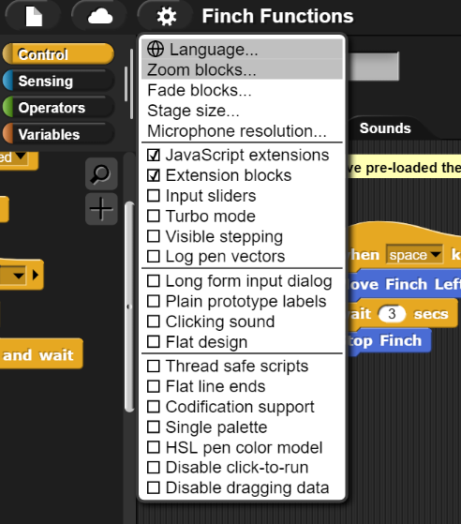
Click the setting cog in the top menu
Enable Javascript extensions &
Extension blocks

Slide 12
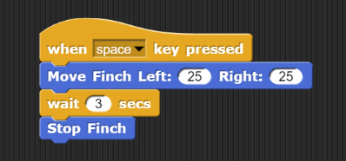
Opening Code

Slide 13

Opening Challenge
Get the Finch Robot to Move
Move Forward/Backward
Turn Left/Right
How Fast Will It Move?
Reflect: What did you notice?
____ was different than I thought it would be because_________
I originally thought _____, but I learned that_______
Notes:
Start here on Monday 5/21

Slide 14
Reflect: What did you notice?
____ was different than I thought it would be because_________
I originally thought _____, but I learned that_______

Slide 15
Common Core Standards: Mathematics
Make Sense of Problems and Persevere in Solving Them.
Reason Abstractly and Quantitatively.
Construct Viable Arguments and Critique the Reasoning of Others.
Model with Mathematics.
Use Appropriate Tools Strategically.
Attend to Precision.
Look for and Make Use of Structure.
Look for and Express Regularity in Repeated Reasoning.
National Governors Association Center for Best Practices & Council of Chief State School Officers (2010)

Slide 16
Constant
Independent Variable
Dependent Variable
Key Terms

Slide 17
Constant - the part that isn’t going to change throughout the trials
Independent Variable - the part that you’re going to change in order to test out how it affects the dependent variable
Dependent Variable - the part that you are going to measure and hypothesize about
Key Terms

Slide 19
Power Left: 25
Time: 5 seconds, then 2 seconds, then 10 seconds
Power Right: 25
Distance: Record this each time
Notes:
If these were the instructions, classify each box as a constant, independent variable, and dependent variable

Slide 20
Day 2
Finch Linear Equations
Notes:
Goal: by the end of the day “everything on the sheet done”

Slide 21
Common Core Standards: Mathematics
Make Sense of Problems and Persevere in Solving Them.
Reason Abstractly and Quantitatively.
Construct Viable Arguments and Critique the Reasoning of Others.
Model with Mathematics.
Use Appropriate Tools Strategically.
Attend to Precision.
Look for and Make Use of Structure.
Look for and Express Regularity in Repeated Reasoning.
National Governors Association Center for Best Practices & Council of Chief State School Officers (2010)

Slide 22
Set Up Reminders

Slide 23
Saving Programs

Slide 24
Click the setting cog in the top menu
Enable Javascript extensions &
Extension blocks

Slide 25
Opening Code

Slide 26

What to do reminders
Do you remember
-how to make the Finch go forward/backward?
-walk the Finch “dog”?

Slide 27
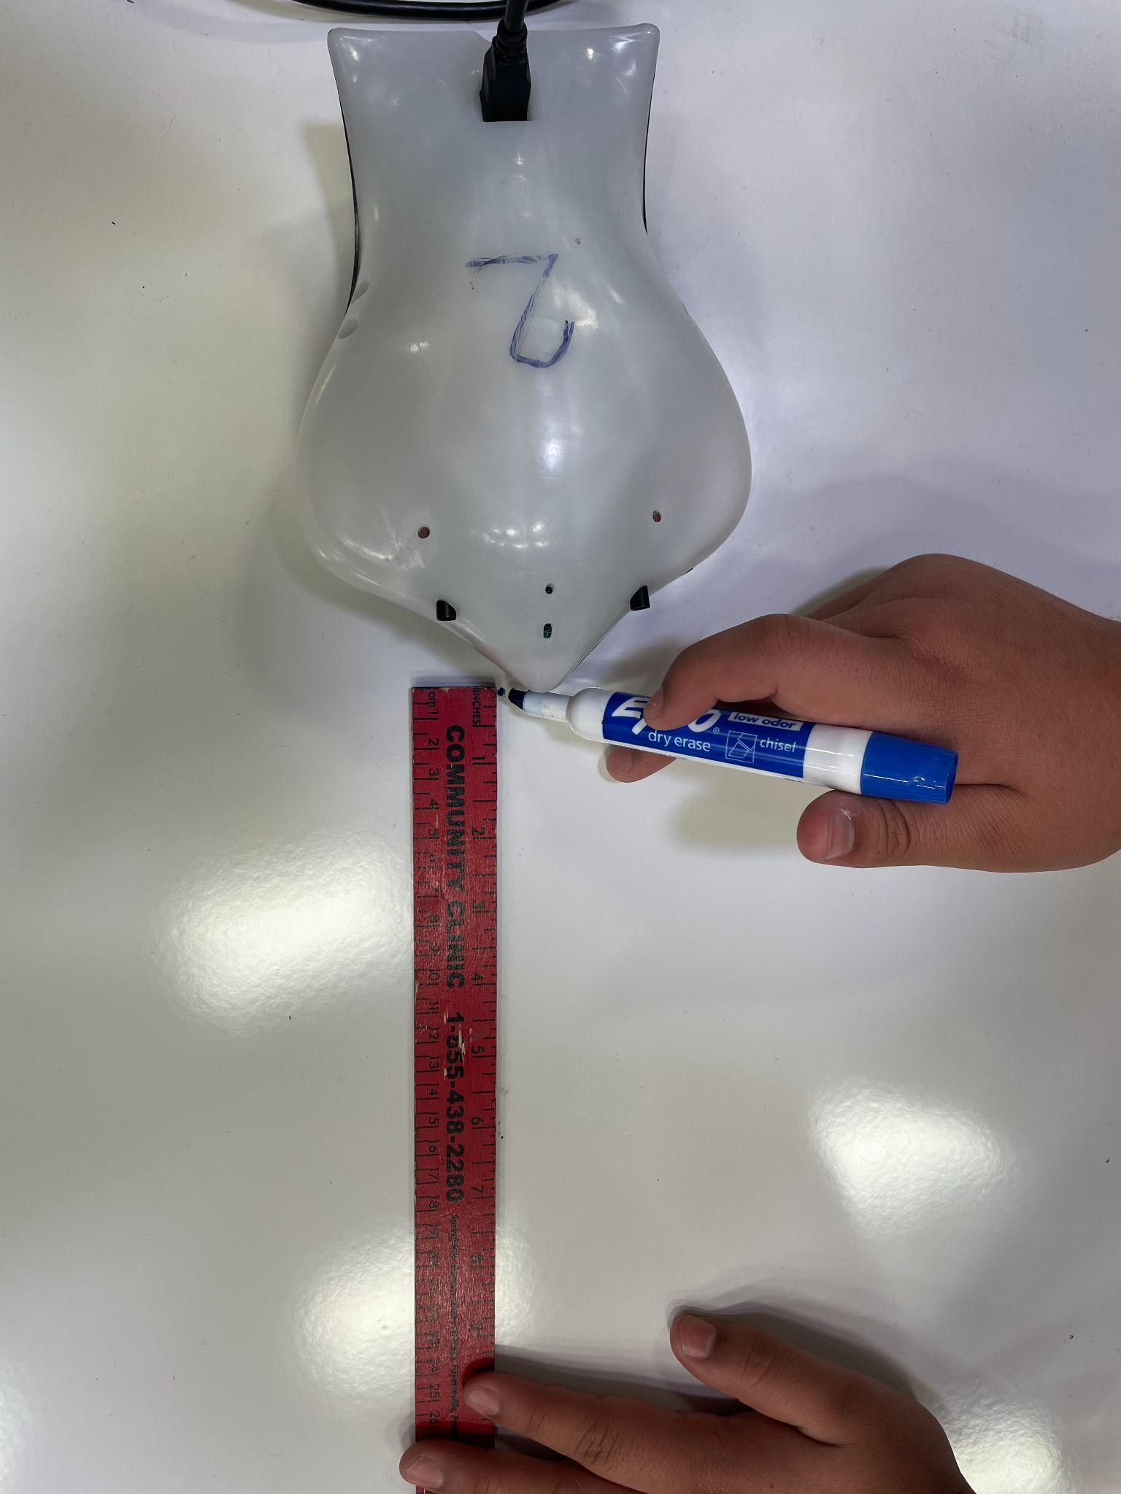
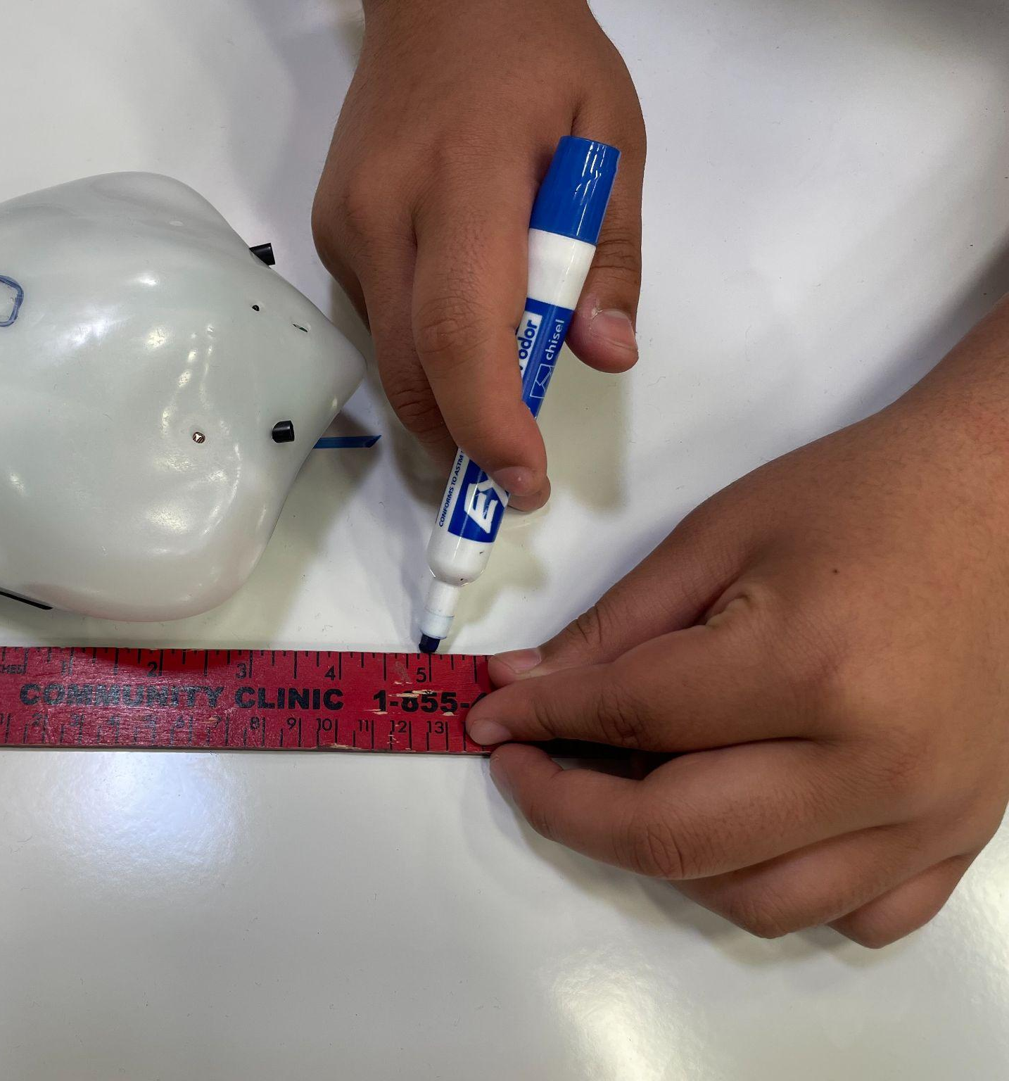
Measurement hints
Tail to tail…..or nose to nose? Choose one (not both)

Slide 28
Constant: | Constant: | Independent Variable: | Dependent Variable
Power Left | Power Right | Time | Distance
25 | 25 | 2
25 | 25
25 | 25
How did you measure your distance?
Was it precise?
How can you justify your measurement?
Notes:
Power left 25 and power right 25 for 5 seconds. How far did it go? approximately 11 in
Did they all go the same distance?
Why not?
Try again at 2 seconds and measure. (4.5 in)
Look at your data. How far would it go if you ran it for 10 seconds? Submit your answer and then we will all run it together. (23 in)
In this case, the constants were the power, the independent variable was the time in seconds, and the dependent variable was distance.

Slide 29
Constant: | Constant: | Independent Variable: | Dependent Variable
Power Left | Power Right | Time | Distance
25 | 25 | 2 | 4.5 in
25 | 25 | 5
25 | 25
Record the distance when the Finch runs for 5 seconds.
THEN, PAUSE & PREDICT what the distance would be if it ran for 10 seconds.
Use the table, graph, and description at the bottom of your page to justify your answer.
Notes:
Power left 25 and power right 25 for 5 seconds. How far did it go? approximately 11 in
Did they all go the same distance?
Why not?
Try again at 2 seconds and measure. (4.5 in)
Look at your data. How far would it go if you ran it for 10 seconds? Submit your answer and then we will all run it together. (23 in)
In this case, the constants were the power, the independent variable was the time in seconds, and the dependent variable was distance.

Slide 30
Constant: | Constant: | Independent Variable: | Dependent Variable
Power Left | Power Right | Time | Distance
25 | 25 | 2 | 4.5 in
25 | 25 | 5 | 11 in
25 | 25 | 10
Notes:
Power left 25 and power right 25 for 5 seconds. How far did it go? approximately 11 in
Did they all go the same distance?
Why not?
Try again at 2 seconds and measure. (4.5 in)
Look at your data. How far would it go if you ran it for 10 seconds? Submit your answer and then we will all run it together. (23 in)
In this case, the constants were the power, the independent variable was the time in seconds, and the dependent variable was distance.

Slide 31
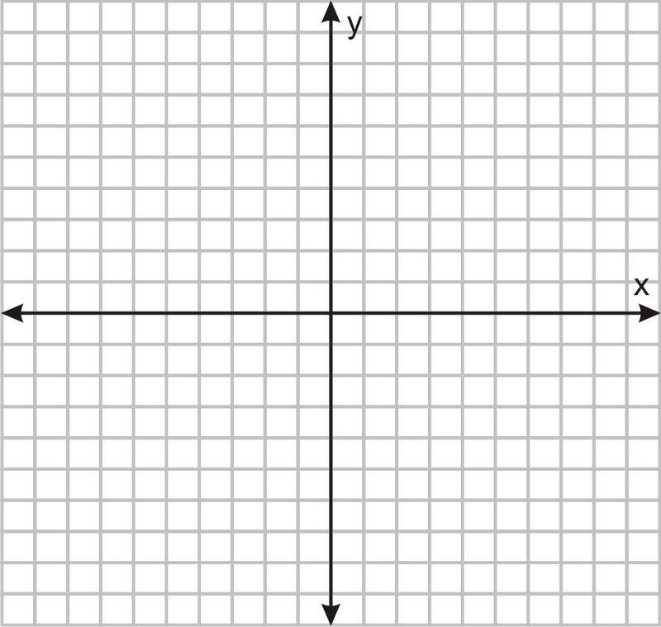
 | Describe the relationship in words. | y=_______x+______
Time | Distance
2 | 4.5
5 | 11
10 | 23
Notes:
Words could be - The finch moves at 2.17 or 2.4 inches per second; The equation would be y=2.17 or 2.4x with b=0; The graph would have a positive slope.

Slide 32
Clean up and Debrief!
PARTNER 1
Return the Finch and cord to the box
Return the tape measure or yard stick to Dr. J.
Sit at a table with your partner and continue to work on the questions and 8 mathematical practice blanks
PARTNER 2 (With the Chromebook)
Save your program and close your Chromebook.
Take the clipboard and move to a table where you can sit with your partner and continue to work on the questions and 8 mathematical practice blanks

Slide 33
What did you notice?
When did you use the 8 MP?

Slide 34
I can use coding to make predictions about how a Finch will move and explain the process in relation to the 8 Mathematical Practices.

Slide 35
On Thursday during PrimeTime:
A competition with more challenges
The partners/group that work through the most gets free Whataburger vouchers.

Slide 36
On Tuesday during PrimeTime:
A competition with more challenges
The partners/group that work through the most gets 30 free Whataburger vouchers.

Slide 37
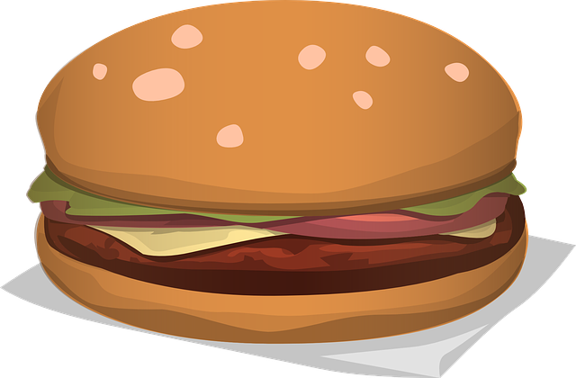
Finch Linear Equations Extension
“Burger Time”

Slide 38
On Thursday during PrimeTime:
A competition with more challenges
The partners/group that work through the most gets 10 free Whataburger vouchers.

Slide 39
Warm Up/Reminders
Teams of 2-3 today
Logging in
Finch Care-Walking the Dog”
Change settings (enable extensions)
Measure either nose to nose, or tail to tail
Saving your challenge programs

Slide 40
Downloading the Finch App
Google “Finch Connection App”

Slide 41
Saving Programs

Slide 42
Click the setting cog in the top menu
Enable Javascript extensions &
Extension blocks

Slide 43
Measurement hints
Tail to tail…..or nose to nose? Choose one (not both)

Slide 44

TIME TO MAKE A GUESS!
WITHOUT RUNNING IT, what do you predict the distance will be for 10 seconds?
Constant: Power Left 25 | Constant: Power Right 25 | Independent Variable: Time | Dependent Variable Distance
25 | 25 | 5
25 | 25 | 2
25 | 25
Notes:
Power left 25 and power right 25 for 5 seconds. How far did it go? approximately 11 in
Did they all go the same distance?
Why not?
Try again at 2 seconds and measure. (4.5 in)
Look at your data. How far would it go if you ran it for 10 seconds? Submit your answer and then we will all run it together. (23 in)
In this case, the constants were the power, the independent variable was the time in seconds, and the dependent variable was distance.

Slide 45
In this case,
the constant was the power on the left and the right,
the independent variable was the time in seconds,
and the dependent variable was distance.

Slide 46
Coding Hints
Complete a task card.
Call an adult over to you BEFORE testing your solution
Explain your reasoning and test it out!
Complete the reflection
Move on to the next task!
HOW MANY TASKS CAN YOU COMPLETE?!
Precision
Speak Out Your Code
Work with a Partner If You Have One

Slide 47
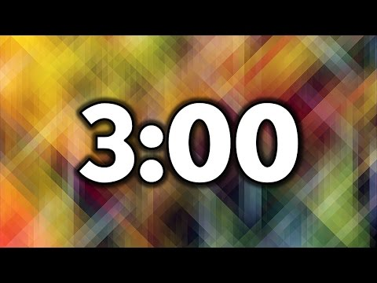
Reflect
What did you learn about today? Summarize what we did and things you noticed in two sentences.

Slide 48

Reflect
Work with your partner to summarize what we did and what you learned in 15 words or less!

Slide 49
Common Core Standards: Mathematics
Make Sense of Problems and Persevere in Solving Them.
Reason Abstractly and Quantitatively.
Construct Viable Arguments and Critique the Reasoning of Others.
Model with Mathematics.
Use Appropriate Tools Strategically.
Attend to Precision.
Look for and Make Use of Structure.
Look for and Express Regularity in Repeated Reasoning.
National Governors Association Center for Best Practices & Council of Chief State School Officers (2010)

Slide 50
Sources
Eschborn, A. (2015, September 7). 5 minute timer [Video]. YouTube. https://www.youtube.com/watch?v=_W0bSen8Qjg
Eschborn, A. (2015, September 7). 7 minute timer [Video]. YouTube. https://www.youtube.com/watch?v=W9kVd-OKMzs
Eschborn, A. (2015, September 7). 3 minute timer [Video]. YouTube. https://www.youtube.com/watch?v=iHdviZkM7S4
Eschborn, A. (2015, September 7). 6 minute timer [Video]. Youtube. https://www.youtube.com/watch?v=2Zdyu2lE-dM
Johnson, B .T. (2016. February 10). Factrory robots in Northwest Arkansas [Video]. YouTube. https://youtu.be/54bgHri7hDI
National Governors Association Center for Best Practices & Council of Chief State School Officers. (2010). Common core state standards for mathematics. Retrieved January 8, 2024 from https://corestandards.org/mathematics-standards/
OpenClipart-Vectors. (n.d.). Hamburger. Retrieved January 16, 2024 from https://pixabay.com/vectors/hamburger-cheeseburger-burger-lunch-576419/

