Slide 1
What is Government?
American Government: Defining Government
View notes for guidance on each slide
Notes:
The blue text on a blue textured background do not provide enough color contrast. The side design could be revised to include a less distracting background.

Slide 2
Emergency medical services, fire departments, and police departments are all paid for by government through the tax base.
Notes:
Image source- Photo by Yassine Khalfalli on Unsplash
Only the body text was included on the slide. The slide was not given a unique title and the dark text overlaid on the background image with darker lighting makes it nearly impossible to
read the content. The size of the background image could be reduced to fit under the body text.

Slide 3
Types of Goods
Government also performs the important job of protecting common goods: goods that all people may use free of charge but that are of limited supply, such as fish in the sea or clean drinking water. Because everyone can use these goods, they must be protected so a few people do not take everything that is available and leave others with nothing. Some examples of common goods, private goods, public goods, and toll goods are listed on the next slide.
Notes:
No true accessibility issues other than the content could possibly be presented in a way that it is broken up or organized a little better.

Slide 4
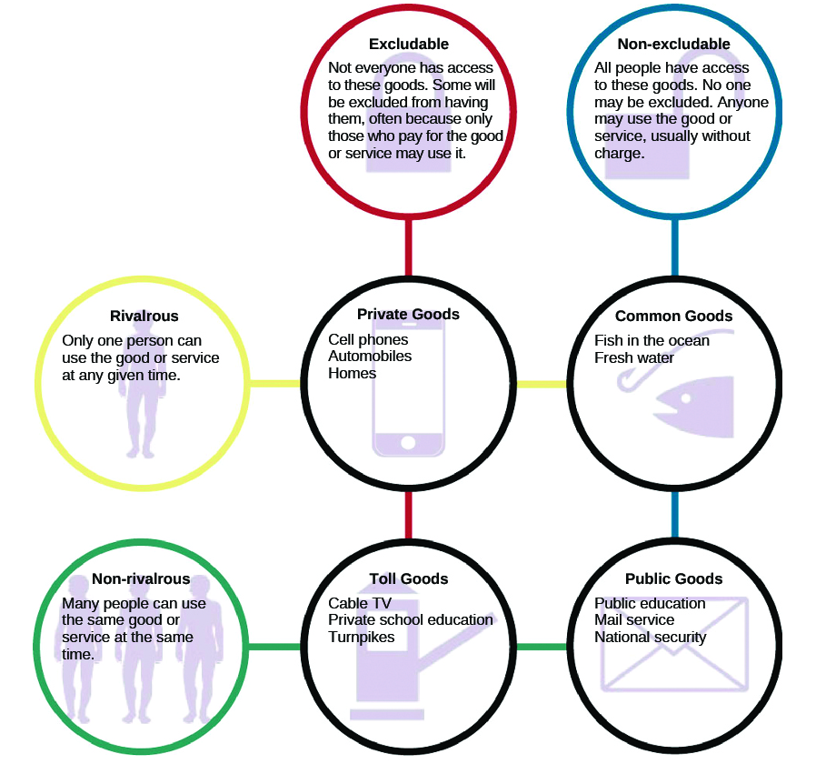
Types of Goods
Notes:
The same slide title was used as the previous slide. Each slide should have its own unique slide title.
The graphic organizer was added as an image and no long description or alternative text was provided.

Slide 5
Milestones
Voting
Voting, however, is not the only form of political engagement in which people may participate. Individuals can engage by attending political rallies, donating money to campaigns, and signing petitions. Starting a petition of one’s own is relatively easy, and some websites that encourage people to become involved in political activism provide petitions that can be circulated through email. Taking part in a poll or survey is another simple way to make your voice heard.
Votes for Eighteen-Year-Olds
Young Americans are often reluctant to become involved in traditional forms of political activity. They may believe politicians are not interested in what they have to say, or they may feel their votes do not matter. However, this attitude has not always prevailed. Indeed, today’s college students can vote because of the activism of college students in the 1960s. Most states at that time required citizens to be twenty-one years of age before they could vote in national elections. This angered many young people, especially young men who could be drafted to fight the war in Vietnam. They argued that it was unfair to deny eighteen-year-olds the right to vote for the people who had the power to send them to war. As a result, the Twenty-Sixth Amendment, which lowered the voting age in national elections to eighteen, was ratified by the states and went into effect in 1971.
Are you engaged in or at least informed about actions of the federal or local government? Are you registered to vote? How would you feel if you were not allowed to vote until age twenty-one?
Notes:
Too much text was added to a single slide. The text was added in paragraph form rather than as ordered and unordered lists with summarized statements for each item. The content
needs to be summarized better and might need to be broken up across multiple slides.

Slide 6
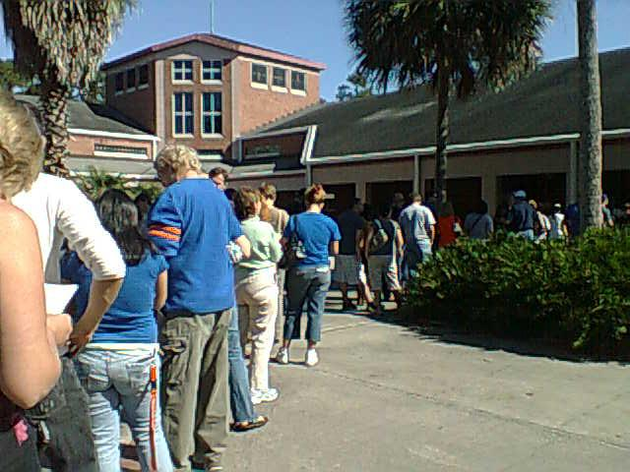
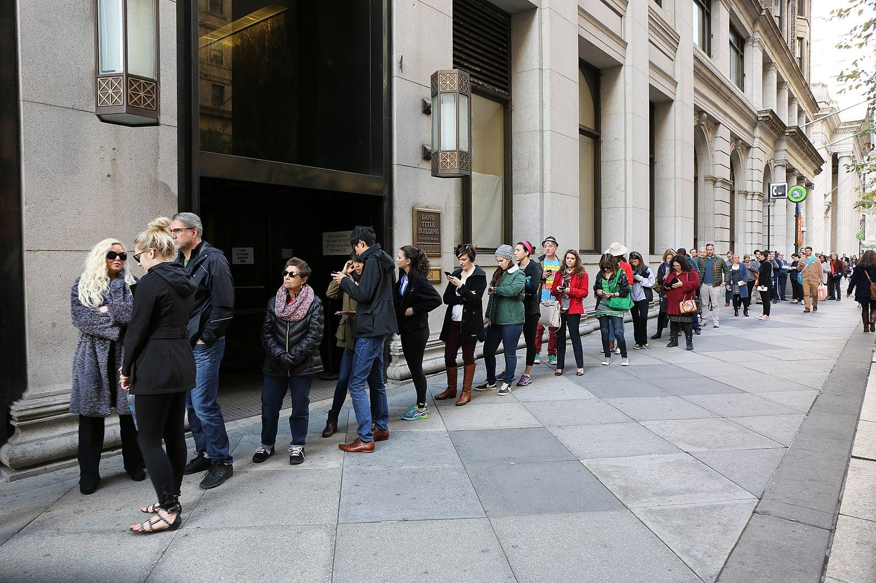
Voting
Voters line up to vote early outside a Florida polling station in 2008. Many who had never voted before did so because of the presidential candidacy of then-senator Barack Obama
Despite the challenges of the COVID-19 pandemic, people from Philadelphia lined up to participate in early voting for the 2020 presidential election
The Florida Voting and Philadelphia Voting images are both licensed in the Public Domain
Notes:
Captions were provided below each image, however, the reading order for the two images and the two captions is completely out of order. If you start with the title and use the tab key to
test the reading order, you will find that it jumps from the title to the blue rectangle behind the to pictures, to the caption below the image on the right, to the caption below the image on the left,
up to the image on the left, over to the image on the right, and then down to the citation at the bottom of the slide. The order for the items on this slide should be set so that everything is read
from top to bottom and left to right.

