Slide 1
What is Government?
American Government: Defining Government

Slide 2
Emergency medical services, fire departments, and police departments are all paid for by government through the tax base.
Notes:
Image source- Photo by Yassine Khalfalli on Unsplash

Slide 3
Types of Goods
Government also performs the important job of protecting common goods: goods that all people may use free of charge but that are of limited supply, such as fish in the sea or clean drinking water. Because everyone can use these goods, they must be protected so a few people do not take everything that is available and leave others with nothing. Some examples of common goods, private goods, public goods, and toll goods are listed on the next slide.

Slide 4
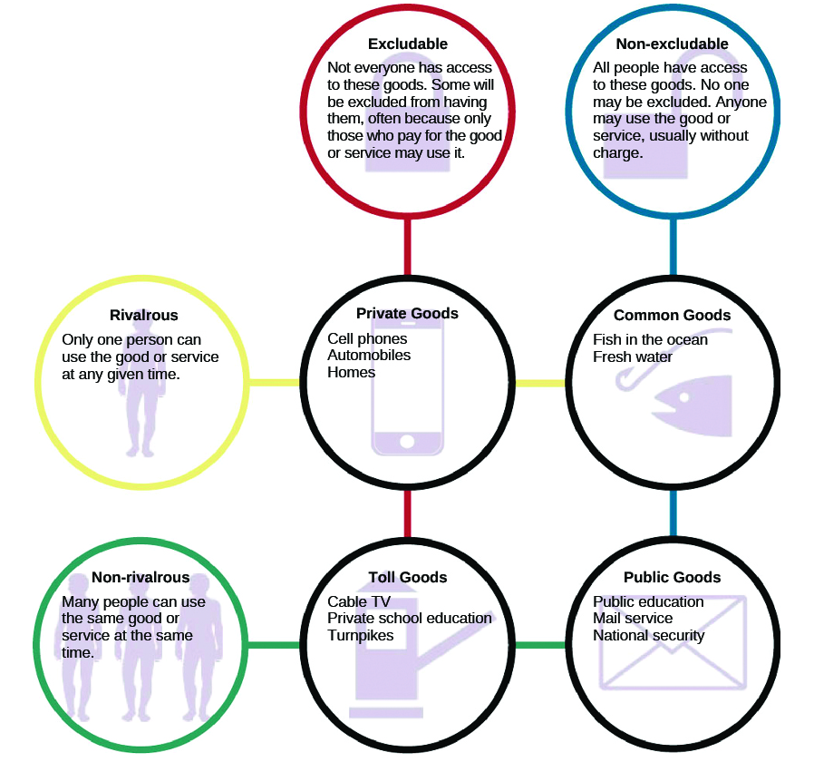
Types of Goods

Slide 5
Milestones
Voting
Voting, however, is not the only form of political engagement in which people may participate. Individuals can engage by attending political rallies, donating money to campaigns, and signing petitions. Starting a petition of one’s own is relatively easy, and some websites that encourage people to become involved in political activism provide petitions that can be circulated through email. Taking part in a poll or survey is another simple way to make your voice heard.
Votes for Eighteen-Year-Olds
Young Americans are often reluctant to become involved in traditional forms of political activity. They may believe politicians are not interested in what they have to say, or they may feel their votes do not matter. However, this attitude has not always prevailed. Indeed, today’s college students can vote because of the activism of college students in the 1960s. Most states at that time required citizens to be twenty-one years of age before they could vote in national elections. This angered many young people, especially young men who could be drafted to fight the war in Vietnam. They argued that it was unfair to deny eighteen-year-olds the right to vote for the people who had the power to send them to war. As a result, the Twenty-Sixth Amendment, which lowered the voting age in national elections to eighteen, was ratified by the states and went into effect in 1971.
Are you engaged in or at least informed about actions of the federal or local government? Are you registered to vote? How would you feel if you were not allowed to vote until age twenty-one?

Slide 6
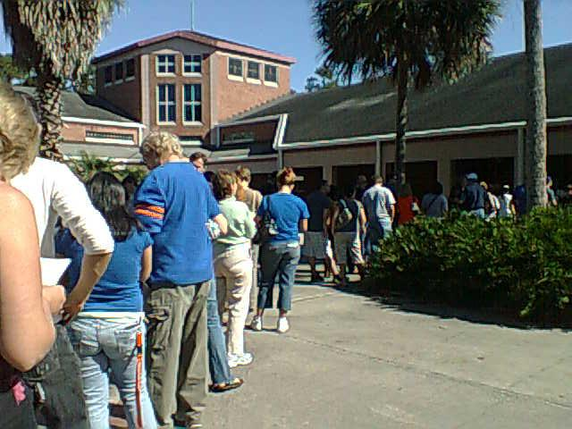
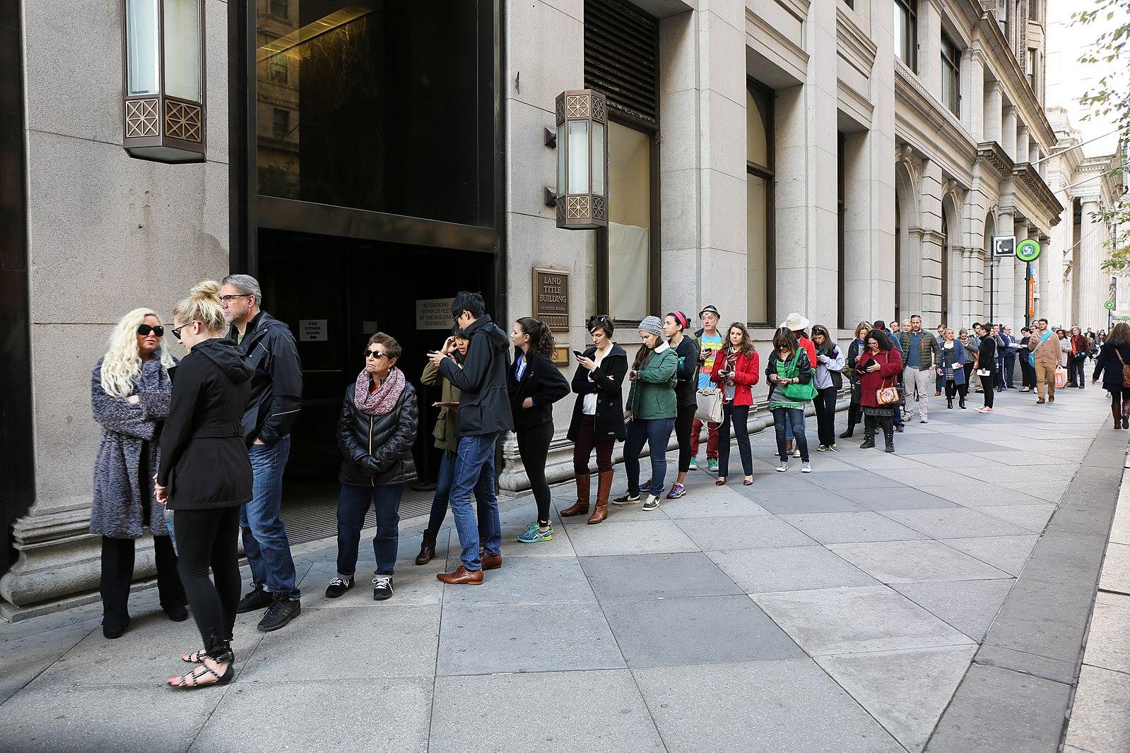
Voting
Voters line up to vote early outside a Florida polling station in 2008. Many who had never voted before did so because of the presidential candidacy of then-senator Barack Obama
Despite the challenges of the COVID-19 pandemic, people from Philadelphia lined up to participate in early voting for the 2020 presidential election
The Florida Voting and Philadelphia Voting images are both licensed in the Public Domain

