Slide 1
#A11Y: EC Summer Institute on Accessibility
Day Two Afternoon Session Presentation
By Chris Smith¹, Crystal Patrick², Donna Murray², Ginger Starling², and Meghan McGrath² ¹ North Carolina Virtual School, ² North Carolina Department of Public Instruction

Slide 2
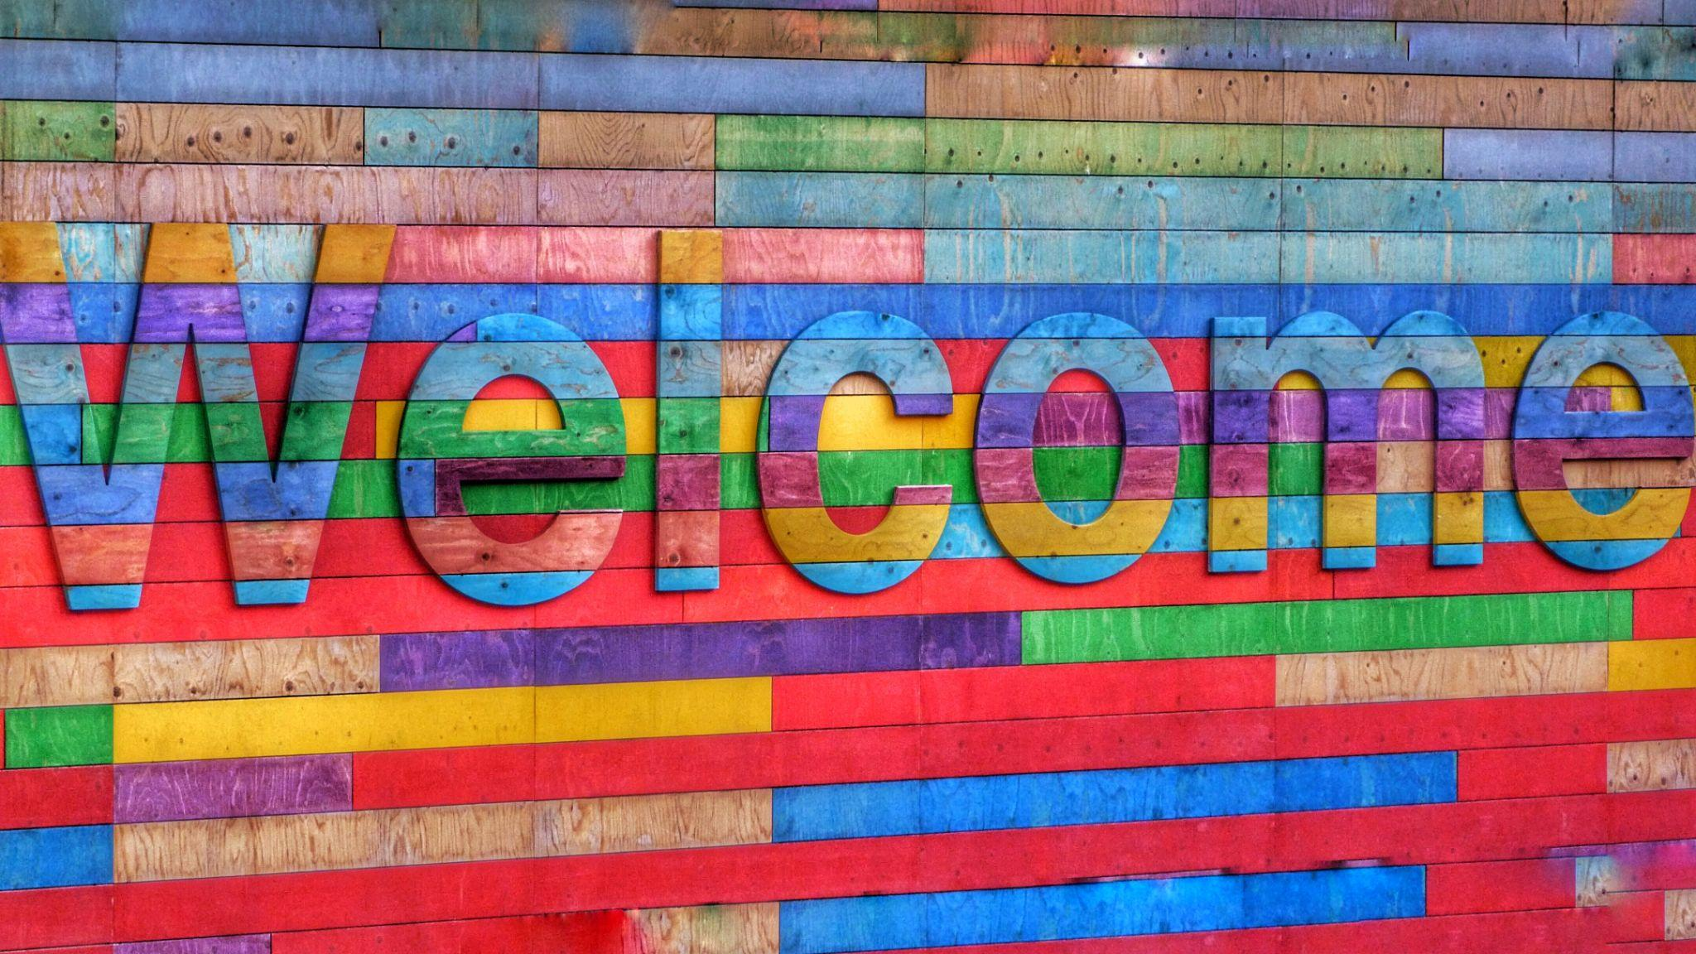
Day Two Afternoon Welcome Back!
Photo by Belinda Fewings on Unsplash
Notes:
Welcome to the final session of the Summer Institute. So far, over the past day and a half, we defined accessibility, investigated individual needs and how to assess them, identified strategies for building accessible content, and explored options for creating more accessible reading opportunities. This afternoon, we will focus on creating more accessible math opportunities and discussion considerations for addressing accessibility during the procurement process.

Slide 3
The POUR Principles
The POUR Principles were developed as part of the World Wide Web Consortium’s (W3C) Web Accessibility Initiative (W3C Web Accessibility Initiative, 2019). POUR stands for:
Perceivable
Operable
Understandable
Robust
https://youtu.be/dzzlJQXmJIw, National Center on AEM (2018)
https://youtu.be/0vauZJBWhXs, CAST (2022)
Notes:
The POUR Principles were developed as part of the World Wide Web Consortium's (W3C) Web Accessibility Initiative (W3C Web Accessibility Initiative, 2019). POUR stands for Perceivable, Operable, Understandable, and Robust. When individual teachers are designing materials they should always remember to apply the POUR principles. The National AEM Center’s Designing for Accessibility with POUR video (3:04) was shown to provide participants a more in-depth introduction to the principles. As they watched the videos, learners were asked to reflect specifically on how the POUR principles could be integrated into designing accessible math content. Following the video, we went into a deeper discussion of the POUR Principles by introducing the following steps:
Think about how to make content and materials perceivable to all students based on their individual needs from the data collected.
Identify strategies for making content operable to ensure effective navigation of content, not all students can use a mouse to navigate. In this section understanding the importance of key commands will surface.
Creating understandable content is essential based on student needs. There are a lot of common accessibility features now built into platforms and software to help assist with making content more understandable. At this time introduce Clusive as a potential resource for making content more understandable, as well.
Robust accessibility will help to ensure there is more compatibility with other devices and content.

Slide 4
Mathematics and Accessibility
Presenting mathematical content and other complex scientific notations such as chemical formulas is not something that the basic Internet protocols were designed to support (Hayes, 2009).
As a result, mathematical content often renders differently from one web-browser to another.
Notes:
Presenting mathematical content and other complex scientific notations such as chemical formulas is not something that basic Internet protocols were designed to support (Hayes, 2009). As a result, mathematical content often renders differently from one web-browser to another.

Slide 5
History of Accessible Math Design
The following strategies have been tried over the years as options for addressing accessible math design concerns:
Expressions and formulas were captured and presented as images
LaTex markup language
MathML markup language
Notes:
Originally, mathematical and other complex scientific notation was added to digital content as images with embedded text, because the standard World Wide Web protocols did not support entering and displaying the content correctly. After some time, the LaTeX markup language was developed to address some of the issues with inserting mathematical and scientific notation as images. However, the LaTeX language brought about additional accessibility and design. So, the MathML markup language was eventually created. We will talk about each of these three stages on the next few slides.

Slide 6
Adding Mathematical Content as Images
One strategy that has been used to address the differences in rendering math on the web has been to insert the expressions, equations, and/or functions as images.
Notes:
One strategy that has been used to address the differences in rendering math on the web has been to insert the expressions, equations, and/or functions as images, However, this strategy brings about additional concerns. When we talk about images and accessibility, we have already identified the fact that all instructional images with embedded text require alternative text. Adding alt text for an image has become pretty seamless with most modern technologies. You would add alternative text to a mathematical expression the same way you would add alt text to any other image. So, if you added f(x)=12-x² as an image, you would add alternative text for the image the same way you would read the function aloud as an IEP accommodation, which would be, “f of x equals twelve minus x squared.” While that process sounds simple enough, visual impairments occur on a spectrum from low vision all the way to no vision. Low vision individuals can generally access and view text content with the help of assistive technologies like screen magnifiers, built-in zooming features, etc. However, the embedded text on the images becomes distorted as the content is magnified. Therefore, inserting math into digital content as images is not the most efficient, effective, or accessible option.
Let’s take a look at what happens as we try to increase the size of the function that is displayed in the image on this slide. The image has already been enlarged a little bit. Notice how the text inside the image is already slightly blurry. Watch what happens as we expand the image to take up most of the empty space on the bottom of the slide. The more the image is enlarged, the blurrier it will continue to get.

Slide 7
The LaTeX Markup Language
A mathematical expression using the LaTeX Markup Language.
The LaTeX Markup Language used to generate the image displayed on the left.
\frac{x^{2}-8 x+12}{x^{2}-3 x-18}
Notes:
Donal Knuth who was a professor at Stanford University became so concerned with the deteriorating quality of how mathematical content was represented in the digital world that he developed TeX, which was a formatting language for entire documents including mathematics. Leslie Lamport from Microsoft Research later came along and added to Knuth’s work to form the LaTeX markup language (Hayes, 2009). While the LaTeX language did fix the rendering issue across multiple browsers, it brought about a new accessibility issue. LaTeX basically presents mathematical content as an image with text that can be magnified without distortion. So, it fixes the assistive technology issue we previously identified, but the problem with LaTeX is that it cannot be read by screen readers. As a result, additional work was needed to further improve the accessibility of digital math content on the web.
Now, if we were to try to resize the image on the left with the visually correct version of the expression in this example, the text would get blurrier just like it did with the image on the previous slide, but that is due to the way I had to capture the expression to add it to the slide. If the expression were added directly using the LaTeX language, the text could be resized without any distortion.
The example of the LaTeX markup language version on the right side of the slide came from using the built in equation editor in the Canvas learning management system. There are a number of modern applications that come with some sort of built-in equation editor. You will want to explore and research the technology you are using to determine which language is being used to render the final math expression.

Slide 8
The MathML Markup Language
A mathematical expression using the LaTeX Markup Language.
The LaTeX Markup Language used to generate the image displayed on the left.
\frac{x^{2}-8 x+12}{x^{2}-3 x-18}
Notes:
MathML, which was endorsed by the World Wide Web Consortium (W3C) in 1998, is the most recent and accessible version of a mathematical markup language that is currently available (Hayes, 2009). Unlike LaTeX, MathML does not convert the math into an image. Instead, it relies on the eXtensible Markup Language (XML) which is a standard specifically designed to structure documents on the World Wide Web (Achard et al., 2001). Both the NIMAC and Bookshare offer math content in XML files. MathML addresses all of the barriers that we have previously identified related to accessibility issues with math, however, it relies on MathJax which is code that is inserted into the headers of websites and learning management systems causing both MathML and TeX mathematical content to be rendered in MathML for the browsers that support it and HTML and CSS for the browsers where MathML is not supported (Cervone, 2009). As an example, MathML renders properly in the Mozilla Firefox web browser, but Google Chrome does not recognize MathML for security purposes.
Most modern learning management systems like Instructure’s Canvas, have integrated equation editors into their rich content editors to assist educators with creating correctly rendered mathematical content. However, equation editors like those found in Canvas render the math in LaTeX rather than MathML. In recent years, Canvas has configured a way to allow LMS administrators to enable MathJax at the site level to address this issue. We will not spend much time going into detail about that process because we want to focus more on more simplistic strategies that can be implemented to create accessible math experiences.

Slide 9
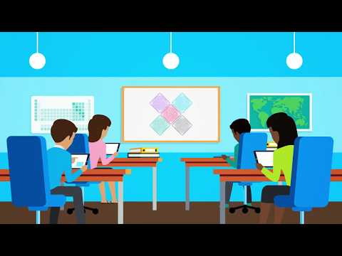
Equatio
https://www.youtube.com/watch?v=BWmPQ7mcKrM (Texthelp, 2017)
Notes:
Let’s watch this video about Equatio. We began by having participants watch the Introducing EquatIO Texthelp video to get a better understanding of what the tool is and how it works. Basically, Equatio allows users to take a screenshot of mathematical expressions, even in paused videos like those found on Khan Academy, and the tool renders the text in MathML format and reads it aloud properly.

Slide 10
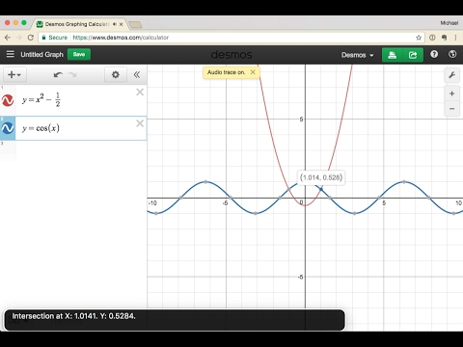
Desmos
https://www.youtube.com/watch?v=EqqiqTkThi8 (Desmos, 2017)
Notes:
Let’s watch this video about Desmos. Desmos is a free online scientific graphing calculator that can be used to replace the traditional TI-85 calculators. Desmos has been specifically designed to integrate in various ways with multiple screen reading technologies. Participants were shown the Accessibility Features in the Desmos Graphing Calculator for a more detailed explanation of the accessibility features that are available through the tool. While talking TI-85 calculators were the traditional go to for braille and screen readers completing higher level math courses the Desmos offers the same features with ease of use and learning only one program at a time. Desmos is the built-in calculator for the NC online test that are deemed calculator active.

Slide 11
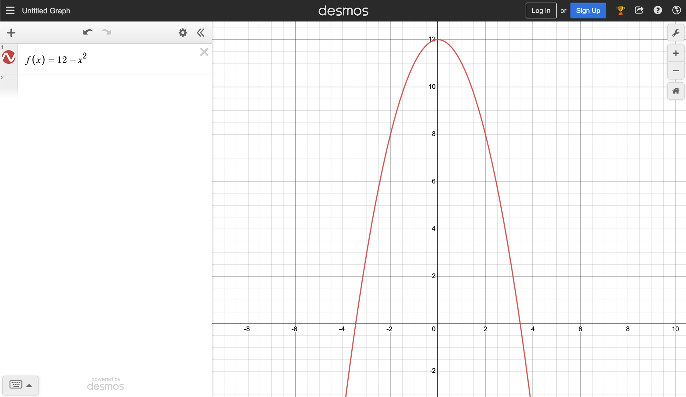
Experimenting with Desmos Activity
Notes:
Since Desmos is a free web-based application that does not have to be installed, we are going to give you about 10 minutes to experiment with different aspects of the tool. We would like for those of you who have a background in mathematics to partner with other teachers who do not share a similar background. We will be moving around the room to observe and answer questions as you explore Desmos.

Slide 12
Accessibility and the Procurement Process
Image by Tumisu from Pixabay
Acquiring Accessible Formats: The AEM Center
Notes:
There are different ways to access or acquire accessible formats. While larger curriculum programs and products are commercially available through the procurement process, educational materials are not always accessible. As previously mentioned, teacher made materials are not always available in accessible formats for students who require them. In this session we explored best practices to acquire materials in accessible formats for students.
For larger programs and large curriculum purchases best practice for decision makers to be knowledgeable about accessible materials. When this language is written into purchase agreements and procurements, for both print and digital based materials student accessibility is greater from the start. Language in these agreements should include clauses to provide accessible materials to the NIMAC, the National Instructional Materials Access Center. IDEA 2004 established the NIMAC to be an online file repository for instructional/ educational materials that can be converted by Accessible Media Producers (AMPs) for student use and acquisition. When files are readily available in the NIMAC local or national conversion by AMPs is expedited to ensure a timely manner of acquiring materials for the students.
Starting with the procurement process, sample language is available from the AEM Center to share with those in education agencies making purchasing decisions. Let’s review where to find and share sample contract language.

Slide 13
North Carolina’s AEM Planning Tool
North Carolina has developed their own Accessible Educational Materials planning tool. This tool is good to share with all the teachers on a student’s team to ensure all accessible formats that are required are being requested in a timely manner.
Notes:
The final resource we will explore is the NC’s AEM planning tool. This planning tool is good to share with all the teachers on a students team to ensure all accessible formats that are required are being requested in a timely manner. Depending on the AMP it could take days or even 6+ months to secure the needed format, so pre planning is essential. The planning tool can be shared electronically with all teachers on a student’s schedule at any time but it is recommended to share 3-6 months prior to a new semester starting. This tool can assist teams with ensuring that all teachers have input in securing accessible formats for the content they are charged with teaching.

Slide 14
The Final Activity- Self-Exploration of Accessibility
We have presented and explored a variety of content and resources over the past two days. Now it is your turn to explore the topic in more depth on your own:
Personalizing the Reading Experience
Personalizing the Writing Experience
Teaching with Accessible Math
Notes:
At this point in the Summer Institute, a lot of information had been shared, so we are going to conclude the final session by giving you the opportunity to explore some additional resources on personalizing experience in reading, writing, and math on your own. You can choose to pair up, work in small groups, or work independently to explore the following resources on your own:
Personalizing the Reading Experience
Personalizing the Writing Experience
Teaching with Accessible Math
During this activity, identify any additional wonders (questions) or wows (a ha moments) that might not have been covered over the course of the past two days. We will come back together at the conclusion of the exploration time to conclude today’s session.

Slide 15
Day Two Final Thoughts
Notes:
Congratulations! We have officially made it to the end of Day Two. We have shared a lot of information with you over the past two days including establishing common understanding, defining the terminology, recognizing various abilities and needs, digital accessibility considerations, introducing the AEM Quality Indicators, determining students needs, exploring needs assessment resources, acquiring accessible formats, and personalizing the learning experience. You were introduced to Micah, Jeremy, Courtney, and Gabrielle and unique content design considerations that come about with diverse student populations.
We appreciate that you all chose to join us over the past two days and would love for the conversation to continue beyond this Summer Institute. The session materials will be available in the Participant Resources folder for you to review and use beyond this Summer Institute. If you have questions after we leave, please feel free to reach out to us Chris Smith (chris.smith@ncpublicschools.gov), Crystal Patrick (crystal.patrick@dpi.nc.gov), or Donna Murray (donna.murray@dpi.nc.gov) with any questions that you may have.
For those of you who are returning tomorrow, we will spend some time digging deeper into determining students needs, exploring needs assessment resources, acquiring accessible formats, and personalizing the learning experience. If you are not able to join us tomorrow, you will still have access to all the presentation materials for Day Two through the Participant Resources folder. Please feel free to review those materials and reach out to us Chris Smith (chris.smith@ncpublicschools.gov), Crystal Patrick (crystal.patrick@dpi.nc.gov), or Donna Murray (donna.murray@dpi.nc.gov) with any questions that you may have.
Conclusion image obtained from the NC Virtual Shutterstock Subscription Stock Photo ID: 760108510

