Slide 1
#A11Y: EC Summer Institute on Accessibility
Day Two Morning Session Presentation
By Chris Smith¹, Crystal Patrick², Donna Murray², Ginger Starling², and Meghan McGrath² ¹ North Carolina Virtual School, ² North Carolina Department of Public Instruction

Slide 2
Day Two Agenda
8:30 Breakfast Snacks Provided
9:00 Morning Session Start Time
12:00 Lunch
1:00 Afternoon Session Start Time
4:00 Adjourn

Slide 3
Session Setting and Structure
Day Two Morning- Determining students needs and exploring needs assessment resources
Day Two Afternoon- Acquiring accessible formats and personalizing the learning experience

Slide 4
Establishing Session Norms
Embrace culture of empathy
Focus on building capacity
Be solution oriented
Share expertise
Honor safe space for all learners to grow
Notes:
Establishing these norms from the beginning of the lesson is important to allow all participants to feel comfortable with sharing what they do and do not already know for growth and new understanding to occur.

Slide 5
Reviewing the Definition for Accessibility
“A person with a disability can acquire the same information, engage in the same interactions, and enjoy the same services in an equally effective, equally integrated manner, with substantially equivalent ease of use as a person without a disability.”
(National Center on Accessible Educational Materials, n.d., p. 1)
Notes:
It is important to establish a common definition for accessibility in the beginning of the lesson, because the term accessibility has been associated with other various technical concerns such as Internet connectivity.

Slide 6
Identifying Different Types of Learners
Image by Deb from Pixabay
Notes:
All learners acquire information differently, some are visual, auditory or tactual. Teams often need to stop to reflect on a student's unique learning preferences and needs to acquire information. For a student who is significantly visually impaired they may learn more effectively through learning a tactile mode of instruction often this may be braille. However they may also be highly auditory learners in addition to their need for tactile materials. Teams need to determine individual student needs based on a ponderance of the data collected.
In this session we will review tools teams can use from determining the students’ needs to collaborating with the whole team to ensure effective implementation and use in coordination with assistive technology. In summary students require information and materials that are accessible to them in formats which may require accommodations and/or assistive technology (AT) that meet their individual needs.

Slide 7
Determining Student Need- AEM Four-Step Process
Step 1- determine the learner’s need
Step 2- select the accessible format(s)
Step 3- acquire materials in the accessible format(s) needed
Step 4- provide supports needed for learners to effectively use accessible formats
Notes:
To determine individual student needs for accessibility teams must have a greater understanding of recommended and available tools. The National AEM Center (2022a) provides a four-step process for providing accessible content to individuals with disabilities who need them, which include:
Step 1 is to determine the learner’s need
Step 2 is to select the accessible format(s) needed
Step 3 is to acquire materials in the accessible format(s) needed
Step 4 is to provide supports needed for learners to effectively use accessible formats
We will expand a little on this topic in more detail on the next couple of slides.

Slide 8
Determining Student Need- Factors to Consider
Be cognizant some students may require more than one format
Consider their acquisition level or current use of assistive technology
Determine if the student has the appropriate assistive technology or if new AT is required based on their need
Remember that some situations may require multiple tools to be used at the same time
Notes:
Let’s take a few minutes to review the information and tools that are available on the Determining a Learner’s Need page. There are several tools that are available and recommended to use when determining the students' needs. When determining student needs, there are multiple factors that should be considered. Teams responsible for determining need should:
Be cognizant some students may require more than one format
Consider their acquisition level or current use of assistive technology
Determine if the student has the appropriate assistive technology or if new AT is required based on their need
Remember that some situations may require multiple tools to be used at the same time
The AEM Navigator helps to guide and facilitate teams through the four steps from determination to student acquisition and implementation. The Navigator is downloadable but can be completed collaboratively depending on the team. Generally, it has been shown to be more effective when all team members complete the Navigator collaboratively at the same time, however, there may be times where outside factors impact the ability of the team to work synchronously together, therefore, teams can determine their most effective way to complete the Navigator. There are several additional tools available for teams such as a Student Summary Worksheet (SSW), which could be added to the data collection in the present level of student performance for students who are served under the Individuals with Disabilities Education Act (IDEA). The Student Summary Worksheet is typically completed after all the information has been gathered, however knowing all teams are starting at different points of entry for this process there may be adequate data to complete the SSW.

Slide 9
The AIM Explorer
Photo by Denise Jans on Unsplash
Notes:
The AIM Explorer is a free downloadable application tool for teams to offer a simulation for assessing students' need for accommodations and accessible materials. The app provides grade level text to assess student need and use of common features such as magnification, highlighted text for color and contrast. This can be used in conjunction with any other tool as a piece of data collection to determine the students' needs.

Slide 10
The Protocol for Accommodations in Reading (PAR)
Photo by Ismail Salad Osman Hajji dirir on Unsplash
Notes:
The Protocol for Accommodations in Reading (PAR) is an available download from Don Johnston for assessing a student’s needed reading accommodations. The PAR is free, however the uPAR is a fee based subscription that some school systems may have, which should be considered for when talking about accessible educational materials. uPAR is a tool that first requires students to complete an assessment which then shows each student’s optimal reading method (silent versus read aloud) and reading level for each. The difference between the free and the paid version is that the paid version includes software that automatically analyzes and tracks student progress and it allows teachers to get reports for individuals or the entire class. The free package comes with a teacher guide along with data and scoring forms and student passages for grades 1-10. Teachers can use the free version to manually assess and track individual student reading progress (Johnson, 2023).
Kids reading image obtained from the NC Virtual Shutterstock Subscription Stock Photo ID: 307383305

Slide 11
Additional Reading Resources for Teachers
Lit2Go
https://etc.usf.edu/lit2go/books/
Storyline Online
https://www.storylineonline.net/
Notes:
Additionally, teachers can provide their students with access to Storyline Online (Pre-K through 3rd Grade) or Lit2Go (K-12) which both provide grade-level text that can either be accessed in print form, audio files, or video read-aloud (Storyline Online only). The teams are then tasked with ensuring the student has the appropriate assistive technology to access their materials.

Slide 12
The SETT Framework
Image by Amy from Pixabay
Notes:
When determining appropriate assistive technology the SETT framework developed by the late Dr. Joy Zabala is highly recommended (Zabala, n.d.). Most are familiar with the main graphic organizer for data gathering tool which gives the SETT its essential meaning. However teams truly need to start with the Consideration of AT Needs. The rationale for starting with the consideration tool is to ensure teams are looking at the whole child, for both strengths and needs, in all domains. In addition it looks at existing tools and tasks the students may already be performing or reviewing interventions that are already implemented. The recommendation is for teams to collaboratively work through the entire SETT framework in this order:
Consideration of AT Needs
Scaffold for Data Gathering
Scaffold for Tool Selection (downloadable)
Implementation and Evaluation of the Effectiveness Planning
Needs image obtained from the NC Virtual Shutterstock Subscription Stock Photo ID: 406959166

Slide 13
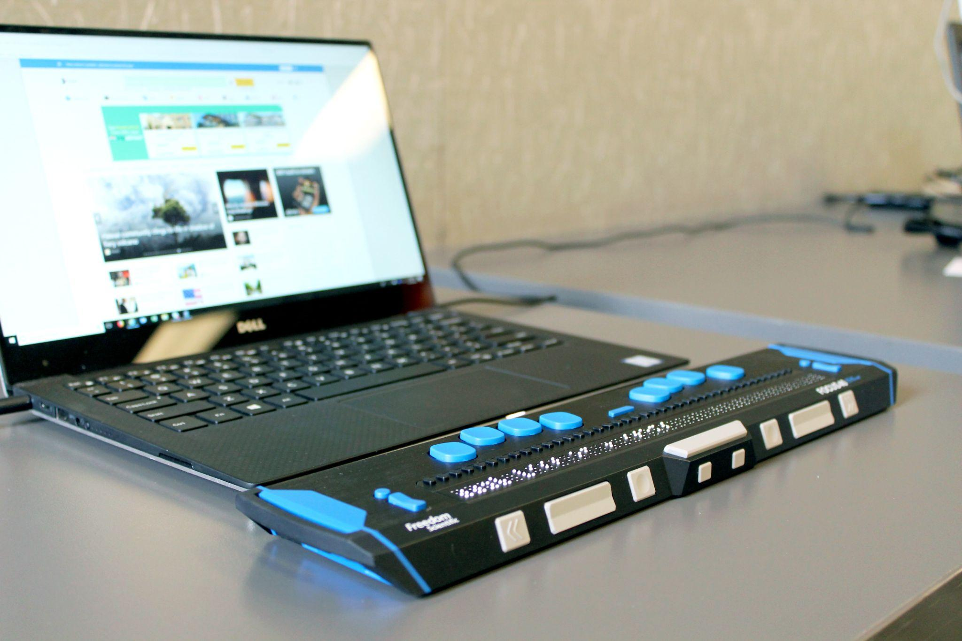
Identifying Student Needs Activity
Photo by Elizabeth Woolner on Unsplash
Notes:
This activity can be completed by electronically or printing the materials that were discussed earlier today, so participants can have access for active engagement. Learners were asked to approach this activity from the perspective of a student they had previously worked with to determine if what is currently in place is the best option. If the current accommodations were not determined to be the best option, learners were asked to consider additional information or resources may be needed for the student to have the ability to acquire, engage and enjoy the same information as non-disabled peers with an equal and equivalent ease of use. Learners were reminded to refer to the definition established for accessibility on the National AEM Center’s What is Accessibility website while completing this activity.

Slide 14
Accessible Media Producers (AMPs)
According to the CAST’s National AEM Center (2022a), accessible media producers (AMPs) are services that convert materials, including textbooks and related curriculum materials, to one or more student-ready accessible formats.
Photo by Findaway Voices on Unsplash
Notes:
According to the CAST’s National AEM Center (2022b), accessible media producers (AMPs) are services that convert materials, including textbooks and related curriculum materials, to one or more student-ready accessible formats. To close out the morning session for Day Two, we will spend some time exploring some of the largest AMPs.

Slide 15
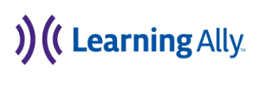
Introducing Three of the Largest AMPs
Notes:
Introduce the three most commonly recognized AMPs which included Bookshare, Learning Ally, and the Louis Database. These organizations operate under the Chafee Amendment for copyright laws to provide accessible formats to eligible persons, while they do not all have the same eligibility requirements they all perform the same task, they convert print and digital materials to accessible for student use.

Slide 16
Louis Database
The most restrictive AMP based on eligibility for resources is the American Printing House for the Blind (APH) to gain free materials through their federal Quota program students must be or function at the definition of legal blindness.
Notes:
The most restrictive AMP based on eligibility for resources is the American Printing House for the Blind (APH) to gain free materials through their federal Quota program students must be or function at the definition of legal blindness. An annual registration is held to determine eligible students. However APH operates the Louis Database for accessible materials. This database can be accessed by registered users seeking to locate and purchase accessible formats of materials. Again materials purchased through the Quota system are only available for registered students but if non registered students require the formats they are available for direct purchase. However the Louis Database is an excellent resource for educators to look for materials in accessible formats across several AMPs at one time. The time for production of materials that are not already available will vary on the format from days to several months.

Slide 17
Bookshare
Bookshare is the world’s largest online digital library of accessible formats and currently they offer over 1 million titles.
Notes:
Bookshare is the world’s largest online digital library of accessible formats and currently they offer over 1 million titles. Bookshare is federally funded and originated from IDEA 2004 as a means to provide accessible formats of NIMAC files in a timely manner for students. Timely manner is roughly defined as at the same time as non-disabled peers. Remember, Bookshare operates under the Chafee Amendment for copyright laws and their eligibility is based on those laws, while there are restrictions only allowing access to National Instructional Materials Access Center (NIMAC) sourced materials to students served with an IEP. IDEA 2004 established the NIMAC to be an online file repository for instructional/ educational materials that can be converted by AMPs for student use and acquisition (National AEM Center, 2021). Bookshare offers a variety of formats including audio, braille, large print and epub. Meeting the timely manner requirement for students is most often achieved through preplanning and having materials available on a student’s electronic Bookshare shelf. Requesting materials can take 3-5 days, so pre planning aids significantly in a timely manner.

Slide 18
Learning Ally
Learning Ally offers about 80,000 titles and requesting new titles may take 3-6 months for them to be available for students.
Notes:
Finally, we explored Learning Ally which is a fee based AMP that offers human read, digital audio and epub formats of materials. Due to Learning Ally offering human read materials they do not have an agreement with the NIMAC to secure NIMAS files for conversion. Learning Ally offers about 80,000 titles and requesting new titles may take 3-6 months for them to be available for students.

Slide 19
Local AMPs in North Carolina
In early 2020, before the pandemic hit North Carolina started an AMPup for Braille to help grow the number of AMPs in the state to make braille materials more widely available by making the process more time efficient and effective for local AMPs.
Notes:
Some Education Agency’s employ their own AMPs which can produce local conversion of materials. Local AMPs are certified through the NIMAC and are capable to securely download NIMAC sourced files to be converted into the accessible formats for student use. Traditionally AMPs have mostly been braillists to convert print materials to embossed or electronic braille. However with the growing need for additional formats and accommodations required for students additional personnel are becoming AMPs. Information and training materials for becoming an Accessible Media Producer is available directly from NIMAC. In early 2020, before the pandemic hit North Carolina started an AMPup for Braille to help grow the number of AMPs in the state to make braille materials more widely available by making the process more time efficient and effective for local AMPs. This PLC of AMPs meets once a month to problem solve and share ideas among the group. If your organization would like more information on this PLC to start your own or collaborate with others, please contact the NC State NIMAC Coordinator.

Slide 20
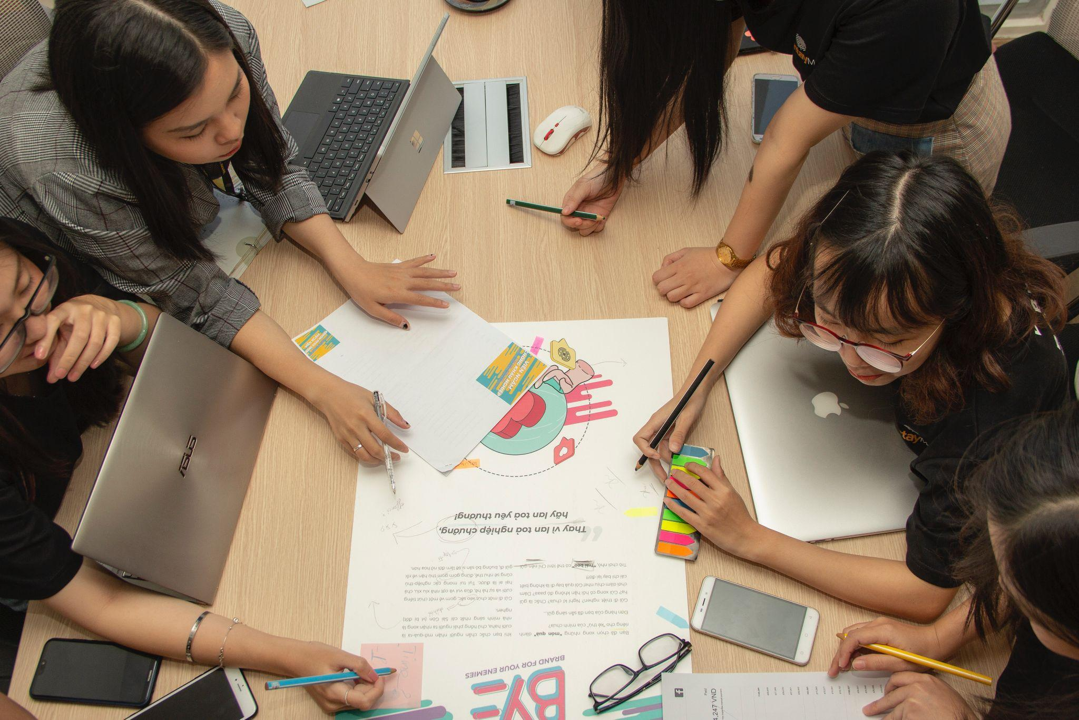
Exploration of AMPs Activity
Create a chart to understand eligibility criteria and formats available from the three national AMPs. Identify if there are any local AMPs available in your area and where they are.
Photo by Van Tay Media on Unsplash
Notes:
To wrap up the morning session, learners will create a chart to investigate eligibility criteria and formats available from the three national AMPs. They will also explore local opportunities in their areas to determine if there are any local AMPs available and what their capacities are. Learners will be given approximately 15 minutes for this activity.
Photo by Van Tay Media on Unsplash

Slide 21
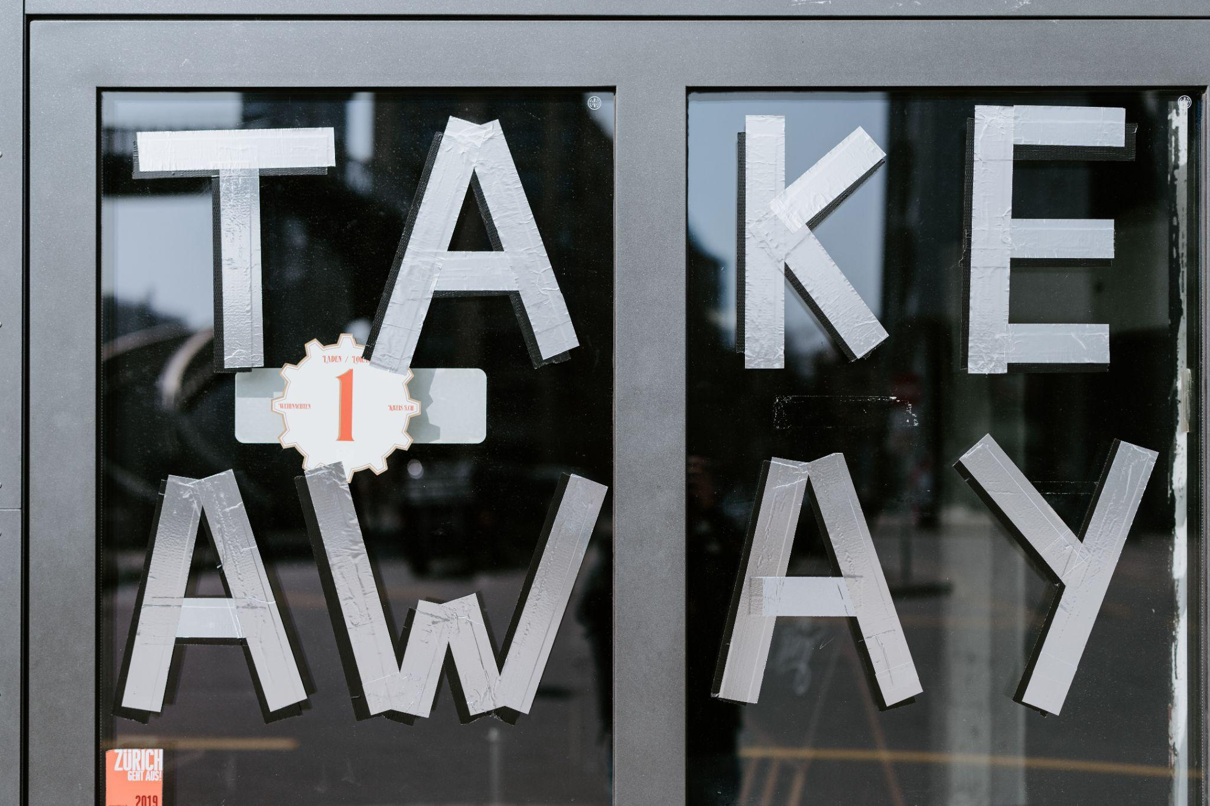
Day Two Morning Key Takeaways
Photo by Claudio Schwarz on Unsplash
Notes:
This morning we began by exploring options that are available to assess and identify individual student needs. From there, we went on to investigate additional resources for supporting those individual needs in reading. When we return for the afternoon session, we will be exploring options for creating accessible math content and will discuss how accessibility should be an important consideration during the procurement process.

