Slide 1
#A11Y: EC Summer Institute on Accessibility
Day One Afternoon Session Presentation
By Chris Smith¹, Crystal Patrick², Donna Murray², Ginger Starling², and Meghan McGrath² ¹ North Carolina Virtual School, ² North Carolina Department of Public Instruction

Slide 2
Establishing Session Norms
Embrace culture of empathy
Focus on building capacity
Be solution oriented
Share expertise
Honor safe space for all learners to grow
Notes:
Establishing these norms from the beginning of the lesson is important to allow all participants to feel comfortable with sharing what they do and do not already know for growth and new understanding to occur.

Slide 3
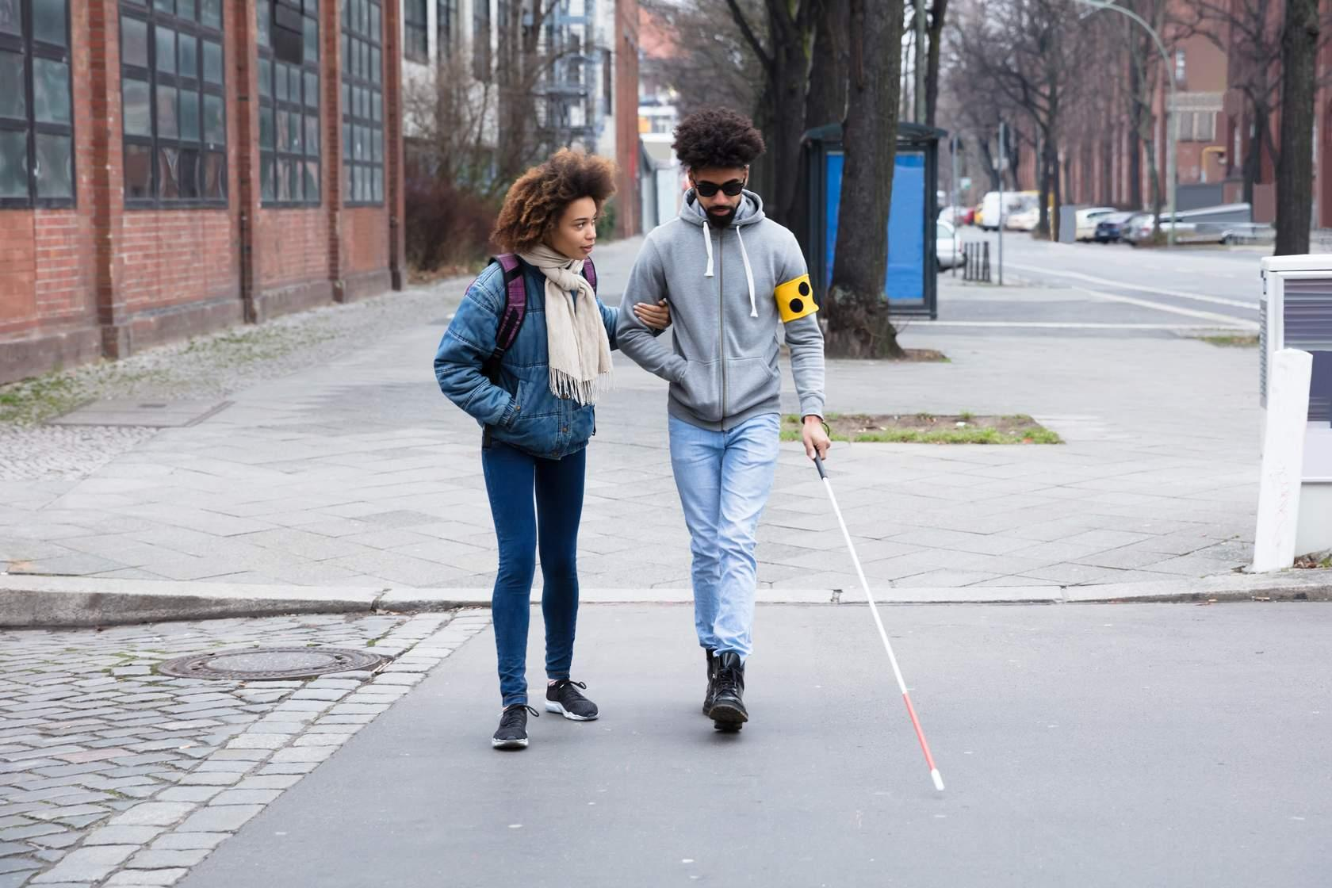
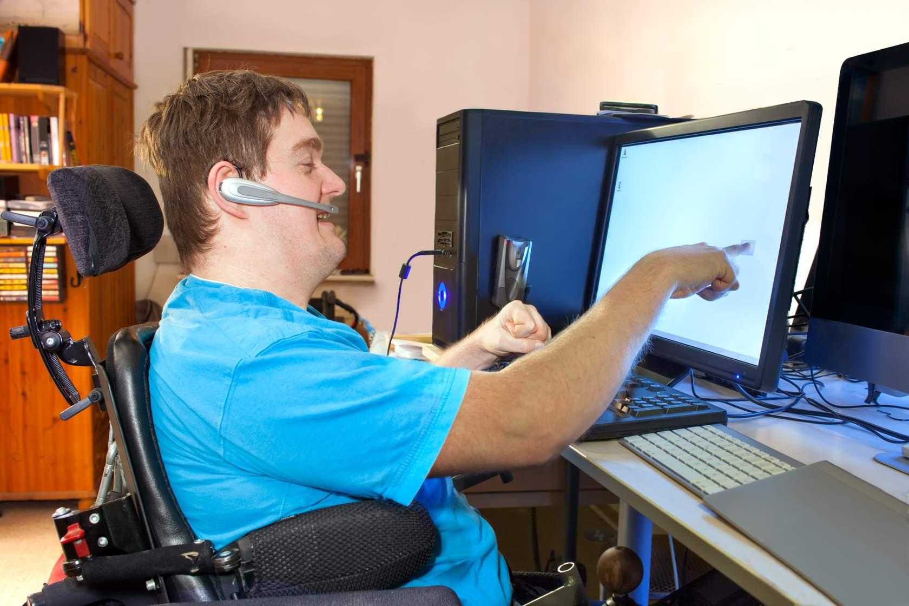
Reviewing the Student Profiles
Micah
Courtney
Jeremy
Gabriella
Notes:
ACTIVITY: Instruct participants to use their notetaking guide and complete a Gallery Walk using this the link below to read the profiles of each of the four students we will be referencing throughout the day. As they read each profile, they will note key information that may be helpful to know as we think about accessibility.
https://docs.google.com/presentation/d/18arZB6v-CrtCD6sHuhPkTN3PW9wHulE4vw_UY1DM638/edit?usp=sharing
After the Gallery walk, instruct the participants to keep these students in mind as we talk about accessibility and the strategies and tips we share. How will this affect/benefit each individual student?
Micah:
is considered legally blind due to a childhood illness
struggles to view text that is too small or that uses color to emphasize different information
relies on screen reading technology to navigate online classes
Courtney:
was born with a degenerative hearing disorder that left her deaf as a young child
Does communicate through sign language but prefers the use of captions and transcripts over the use of an Interpreter when navigating online classes
Jeremy:
was born with cerebral palsy
has very minimal muscular movement of his hands and fingers which means he is unable to operate a standard keyboard
uses speech operated software to interact and control his computer
Gabriella:
Has a diagnosis ADD and Dyslexia
Needs information broken into chunks
Can handle videos that are limited to about ten minutes or less
Content area text must be read aloud

Slide 4
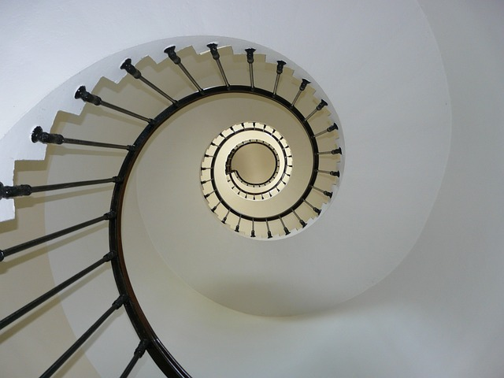
Accessibility is A Continuous Process
Very few IEPs, 504 Plans, and/or individual student needs are the same
This is a continuous process where we are constantly going in to add additional supports to instruction and courses
Image by Francis from Pixabay
Notes:
You will never hear us say that our courses are 100% accessible, partially because that statement is nearly impossible to live up to. However, we do address each of the concepts we discussed in this video during the course development process and then we revisit more specific needs as we are made aware of IEP and 504 Plan requirements.

Slide 5
Main Areas of Concern
Content delivery system (Canvas, Google Classroom, SeeSaw, etc.
School websites, teacher webpages, and social media
Digital textbooks
Software
Files
Photo by Domenico Loia on Unsplash
Notes:
Some of the main areas of concern related to accessibility in education include:
Content delivery/learning management systems (e.g. Canvas, Brightspace, Moodle, Blackboard, Google Classroom, SeeSaw, etc.)
School, institutional, or organizational websites, teacher/faculty websites, and social media
Textbooks and Educational Materials
Software
Files

Slide 6
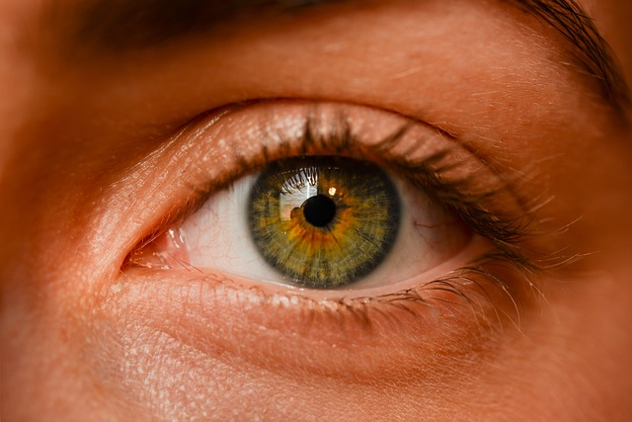
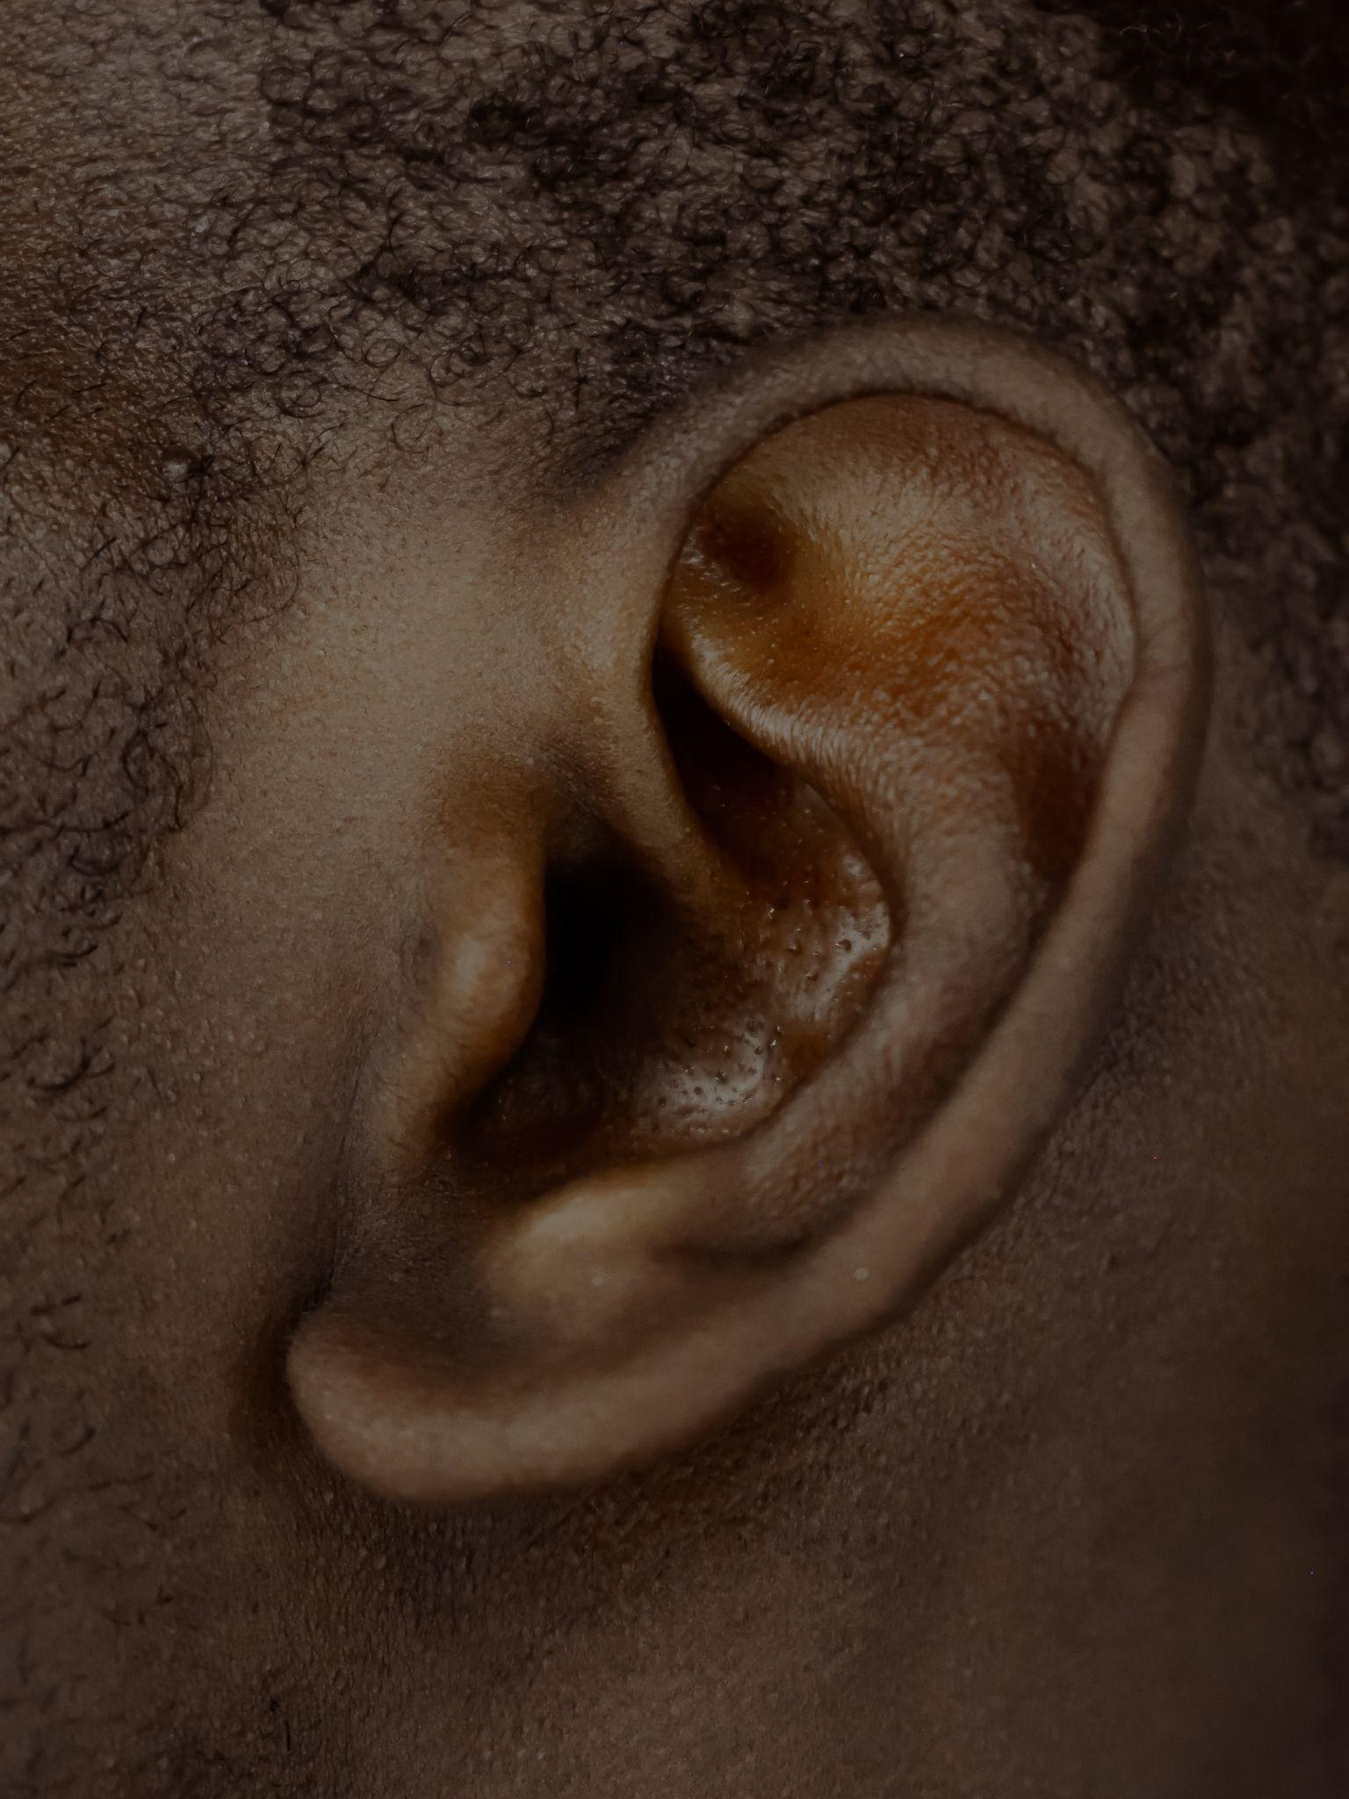
Varying Abilities Need Access
Image by Sofie Zbořilová from Pixabay
Photo by Dylann Hendricks | 딜란 on Unsplash
Image by Jackson David from Pixabay
Photo by Robina Weermeijer on Unsplash
Notes:
When it comes to thinking about digital accessibility, you will find that you may think of some disability categories automatically.
For Example:
What are some digital difficulties you may anticipate for a person with low vision or blindness?
Have participants list some.
You may think of people with visual disabilities who need screen readers in order to access the content on the computer or color contrast features who those with low vision.
What are some digital difficulties you may anticipate for a person with mobility disabilities?
Have participants list some.
you may think of those with mobility issues who may need other methods for navigating electronic document such as keyboard versus mouse navigation.
What are some digital difficulties you may anticipate for a person who are hard of hearing or are deaf?
Have participants list some.
you may think of those with hearing disabilities who need captioning services or transcripts for videos.
but…..
What are some difficulties you may anticipate for a person with a specific learning disability? Other Health Impairment?
Have participants list some
Let’s not forget those hidden disabilities that are more cognitive in nature such as:
A student who is Other Health Impairments due to ADD and needs less clutter on a page an more defined chunks of content
or a student who has Specific Learning Disabilities in reading who needs their content areas like SS and Science text in audio format in order to access the content.
Cognitive Disabilities
Autism
ETC…….

Slide 7
Making Text Accessible
Color should not be used to emphasize text
Use Bold and Italics
Underlying reserved for hyperlinks
Paragraph text size 14 font
Use Heading styles
Photo by Marcus dePaula on Unsplash
Notes:
Making Text Accessible: The following steps should be taken to ensure text accessibility is addressed properly:
· Color should not be used independently to emphasize text. If color is used for emphasis, bold and/or italics font styles should also be used and contrast between the text and background colors should meet WGAG 2.0 Standards.
· Underlying should only be used for hyperlinks and not for emphasizing content
· A minimum font size of 14 should be used for documents and websites and a larger font should be used for slide presentations
· Forget the funky font- Often people ask what are the “best fonts”. This is a topic that has been widely debated, but the least complicated and the more clear the font is, the better. A San Serif font without the extra strokes and lines tends to be better.
· Semantic structure is very important. This involves the built in structure in word processing, presentation, and rich content editor technologies that allow content creators to format text using paragraph, title, and heading levels to organize and visually present text.
When the proper semantic structure is used during the content design process, screen reader and keyboard only users are able to use assistive technologies to navigate through different parts of the text using keyboard shortcuts. If a semantic structure is not configured properly, users can only interact with the content in its entirety and cannot navigate back and forth through different parts of the content.

Slide 8
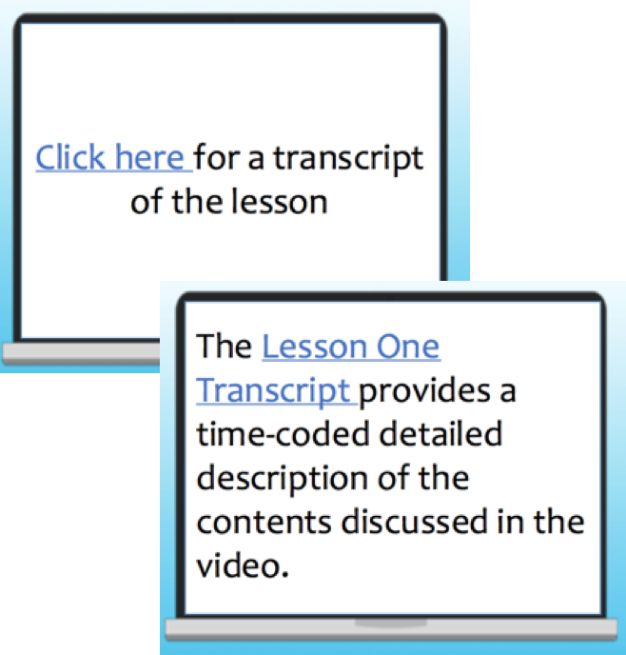
Hyperlinks
Should be set to open in a new window
No “Click Here” or “Here”
File and/or document names should not be used
Notes:
Hyperlinks: All too often, phrases like “Click Here” or “Here” are used for linking content in an email, on a document, or on a webpage. However, creating hyperlinks this way causes several different accessibility issues.
Screen reading technology allows users to choose an option that pulls out a list of all the URLs or web links on a page. The software then reads the list of links out loud to users. If there were 10 links on a page and they were all set up as “Click Here,” the screen reader would read “Click Here” 10 times in a row and the user would not know what each link was nor would they know where each link led to.
Non-descriptive hyperlinks also cause problems with voice controlled software like Dragon Naturally Speaking. Voice controlled software relies on each aspect of the content having a unique name. If a voice controlled software were to open the same page with 10 links that are all named “Click Here,” all 10 pages would open in either new windows or new tabs at the same time, which would also be very confusing.
When formatting hyperlinks, they should be:
· Set to open in a new window
· Not use non-descriptive titles (e.g. Click Here, Here, etc.)
· Descriptive but actual file names should not be used
For example: Instead of writing Click Here for a transcript of the lesson, you might write, “The Lesson One Transcript provides a time-coded, detailed description of the contents discussed in the video.” Notice how descriptive the name of the hyperlink in the second example is and how additional context was provided to help learners gain a better understanding of where the hyperlink should be taking them.

Slide 9
Keyboard Navigation Shortcuts
PC Control (Ctrl) ^
^A Selects all items
^B Bolds highlighted items
^C Copy highlighted items
^F Find information
^K insert hyperlink
^P Print or Save as PDF
^V to paste selected
^Z undo last action
MAC Command (Cmd) ⌘
⌘A Selects all items
⌘B Bolds highlighted items
⌘C Copy highlighted items
⌘F Find information
⌘K insert hyperlink
⌘P Print or Save as PDF
⌘V to paste selected
⌘Z undo last action
Notes:
Basic commands that many people use as “shortcuts”. Ask the audience who uses some of the commands.
Explain that keyboard commands are intended so that you can navigate a computer desktop, applications, and web pages without the use of a mouse.

Slide 10
Keyboard Navigation Activity
Basic Commands
Key Commands | Function
Tab | Move Forward
Shift + Tab | Move Backward
Enter | Open link/button
Notes:
Explain that we are going to give it a try using these basic keyboard commands on the screen..
Activity:
Have participants navigate to www.readingrockets.org. Once they are all on the website, have them put their mouse/trackpad away. Instruct them to look to use the basic keyboard navigation commands that are noted on the slide and navigate to the tab “Helping Struggling Readers”.
Navigate around the room assisting the participants.
Explain that keyboard commands are essential to those with visual impairments.

Slide 11
Reading Order
Presentation Slides:
Need to ensure content and elements are read in the correct order.
How to check?
We will learn and practice this afternoon!
Notes:
Reading Order: When a keyboard is used for navigation or a screen reader is used, the order in which items are read is very important. In documents and on web pages, the reading order is determined by the use of the semantic structure we discussed on the previous text formatting slide. However, in presentations, the reading order is determined by the order in which items were placed on each slide. When designing presentations it is best to use one of the available pre-built slide layouts, because the proper reading order has already been set. If you integrate additional items such as textboxes, images, audio, and/or video to the prebuilt layouts or if you generate your own layout, you will need to specifically check the reading order for each slide. Microsoft has included a feature in the build in Check Accessibility tool that scans the entire presentation and brings up a single report with reading order errors (PowerPoint reading order tutorial document). However, the process is not as intuitive in Google Slide. To test the reading order for a Google Slides presentation, you must complete the following steps:
1. Click on each slide one at a time in the order in which they appear
2. Click on the first item on the slide and then press the Tab button on your keyboard to navigate from one item to the next. You can use Shift + Tab to navigate backwards.
3. If there is an item that is out of order, you will need to right click on that item, hover over Order, and click either Send Backwards or Send Forward to adjust the reading order for each object.
4. Repeat this process for each slide in your presentation.
Unfortunately, Google Slides does not provide a way to scan the reading order for an entire presentation at one time nor does it provide the comprehensive reading order report. However, you can minimize the amount of work you have to do with adjusting the reading order by using the following strategies:
1. Use the pre-built slide layouts and try to limit the addition of new content outside of the spaces provided
2. When you have to add content outside of a pre-built layout design, the reading order is determined by the order in which you add content to the slide. If you are adding three text boxes and you copy one and paste it three times to get the other four, as you start to drag those boxes around, they can get out of order very quickly. So, it is best to add each item as a new option and one at a time.
3. As you complete the design process of each slide, check the reading order for that slide before moving on to designing the next slide. If you follow this process, it will minimize the amount of work you have to do in the end.
4. Anytime you move, add, and/or delete content on a slide during the revision process, always remember to double-check the reading order.

Slide 12
Alternative Text for Images
Yes!
Give text meaning to static images related to content
Short, concise about 100 characters
Describe the content of graphs and charts
Intent of image (e.g., to complete a form or access a hyperlink)
No!
Avoid Alt text for decorative images
Avoid excessive detail
Do not use URL as an Alt Text
Provide for emojis 🙂 inserted
Notes:
Alternative Text for Images: All non-text and non-video elements such as images, charts, graphs, etc. must include alternative (alt) text. Alt text is a feature that screen readers use to describe the contents of an image to someone who may be visually impaired. The following concepts should be considered when adding alternative text to images:
· When adding alt text, you should avoid the use of phrases like, “picture of” or “image of” because the screen reader already alerts learners that they are interacting with pictures/images.
· The descriptions should be clear, concise, and brief for more simplistic images. More complex images may require longer descriptions that can be added to a separate slide or document and linked out to
· Images that are used for decorative purposes should use open quotes (“ “), which tells the screen reader to ignore the image. Please note: the use of purely decorative images should be limited as they can become distracting and can take away from the instructional purposes. Also, it is equally important to note that this strategy should not be used to avoid adding alt text to important images.

Slide 13
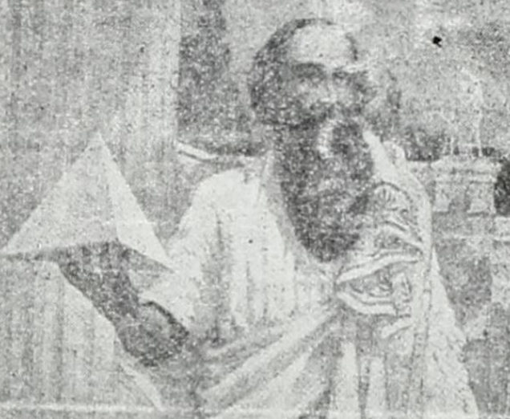
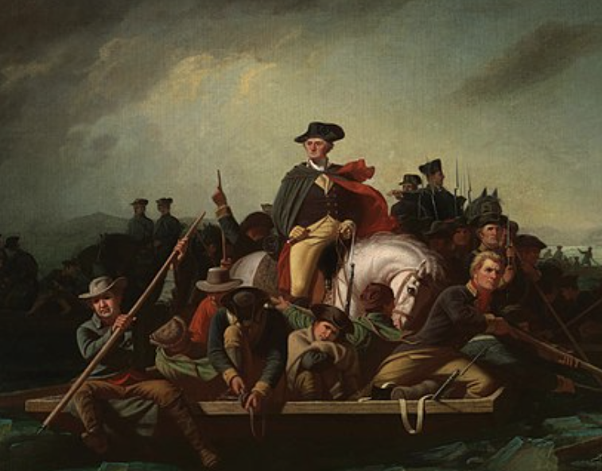
Adding Appropriate Alt Text
Illustration of Pythagoras licensed in the Public Domain
Decorative divider obtained through Microsoft Clipart
Washington Crossing the Delaware licensed in the Public Domain
Internally generated image of a mathematical function
Notes:
Four different images are presented on the Adding Appropriate Alt Text slide in the Day One Afternoon presentation. Explanations for possible alt text for the four images are included below:
Top left image- A sketch of Pythagoras. The alt text would be different for the image depending on how it is used. If the image is used to go along with an introduction for the Pythagorean Theorem in a math course, then simply stating that it is a sketch of Pythagoras would be enough. However, if you were adding the image to an assignment in an art class, it would require the addition of a more descriptive explanation for the colors, medium, and other important artistic features to be included in the alt text. While we did say that “picture of” or “image of” should not be used, the phrase sketch of can be used because it describes a more specific type of image.
Bottom left image- George Washington crossing the Delaware with his army. Again, if you were adding the image to a history course, this would be sufficient alt text. However, if you were adding the image to an art class it would be important to note that it is an oil painting on a canvas along with other artistic details.
Top right image- This image is a little more difficult to identify. It is supposed to represent a decorative divider that might be used to separate content on a page. In this particular case, the image would not be adding any instructional value to the page, therefore, it would be given the open quotes (“ “) for alternative text.
Bottom right image- A mathematical function. When accessibility first started being addressed, the common strategy for making math content accessible was to add equations, functions, and other expressions as images and to give them alternative text similar to what you would do in a read-aloud situation. However, mathematical content should be added as text using the MathML markup language as opposed to images with alternative text. We will talk more about that language in tomorrow's session. If you were forced to add the function represented in this example as an image, the alt text would read, “f of x equals twelve minus x squared.”

Slide 14
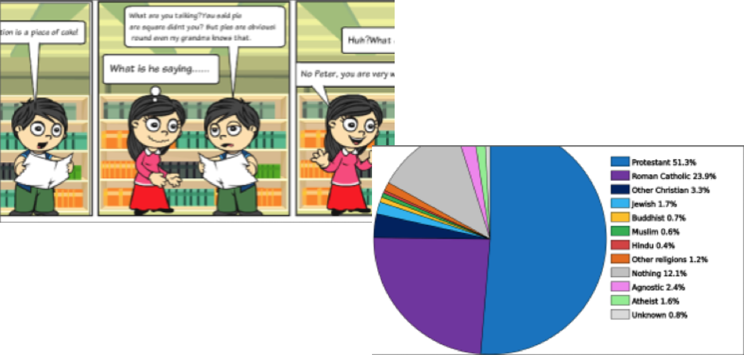
Embedded Text on Images
Accessible Version
Google CopyFish Extension
Images internally generated by NCVPS
Notes:
Text that is embedded in images can not be picked up or read by screen-reading technology. The use of text embedded in images should be limited to only certain essential situations. When images with embedded text are added to online content, all text content found in the images must be displayed in an alternative format.
For the two examples on this slide, the first is a comic strip with a boy and a girl speaking to each other. To make that image accessible, an additional document, in the form of a script, could be created and linked above the image.
The second image is a pie chart representing the different religions around the world. The percentages for each religion are what is important on the chart and not the different colors. To make the chart accessible, an additional document could be created that includes a list of the religions and their percentages from least to greatest or greatest to least depending on the purpose of the chart.

Slide 15
Creating Accessible Tables
Insert as plain text not as images
Avoid using tables just for visual appeal
Columns and rows should have headers
Do not merge cells or leave cells blank
Image by OpenIcons from Pixabay
Notes:
When it comes to tables, they should always be created using the text editor feature that is built into the software that is being used. Tables should never be inserted as screenshots or images. Tables should also not be used simply for the purpose of making content more visually appealing or to organize content on a page. An example of this would be using a table to center the title of a page with images on both sides of the title. One might set up a table in order to get the two images and title aligned properly but that is not accessible when it comes to screen reading technology.
Columns and rows in the table should have headers to show how all the items in the different cells in the table align to each other. Screen reading technology reads tables from top to bottom and left to right. Tables should also not have cells that are merged or blank.
One easy way to think about an example of when tables should be used is to think about a calendar. Calendars traditionally have column headers which are the days of the week. The one thing they are missing is row headers. To make the calendar accessible, you would need to add an additional column on the left side that contained row headers for Week 1, Week 2, Week 3, etc.

Slide 16
Video and Audio Accessibility
Video with speaking parts must have captions (transcripts optional)
Videos without speaking parts must have audio descriptions
Audio files must have transcripts
YouTube (for finding CC videos and for captioning videos)
Image by Gerd Altmann from Pixabay
Notes:
There are two main types of videos. Videos can have speaking parts or they can simply be a series of slides or images that may or may not include embedded text with only music playing in the background. For videos that have speaking parts, captions are required. Captions can be either open or closed. Open captions are always on the screen and can not be minimized or closed out. They are essentially subtitles that you might add using a video editing software. Closed captions allow users to click the CC button to turn captions on and off. While transcripts for videos with speaking parts are helpful, they do not provide a comparable experience like captions provide which is why captions are required and transcripts are suggested.
Videos that do not have speaking parts and only have music require audio descriptions. The audio descriptions are basically a narration of the information that is being presented throughout the video. Audio descriptions can be added using most common video editing software.
Audio files, unless they are a narration of text that is presented on the screen/slide, must have transcripts. If the audio is a word-for-word narration of the text that is being displayed, then a note can be added to go along with the audio file letting viewers know that the audio is exactly what is being shown on the screen.
YouTube is a great tool that helps with locating videos that already have closed captions and with captioning your own videos. YouTube uses Google’s speech-to-tech tool to auto caption all videos that are uploaded. You can then go back in through the YouTube editing tools to revise the auto captions and improve the accuracy.

Slide 17
Video Creation Tips and Tricks
When possible, create a script ahead of time
Speak at a slower pace and articulate words clearly
Avoid using words like here, there, this, that, etc.
Avoid using language that ties the content to a particular data/time
Describe important visuals
Image by StockSnap from Pixabay
Creating Accessible and High-Quality Videos (AEM Center)
Notes:
Audio and Video Accessibility: Audio files, unless they are a narration of text that is presented on the screen/slide, must have transcripts. If the audio is a word-for-word narration of the text that is being displayed, then a note can be added to go along with the audio file letting viewers know that the audio is exactly what is being shown on the screen.
There are two main types of videos. Videos can have speaking parts or they can simply be a series of slides or images that may or may not include embedded text with only music playing in the background. For videos that have speaking parts, captions are required. Captions can be either open or closed. Open captions are always on the screen and can not be minimized or closed out. They are essentially subtitles that you might add using a video editing software. Closed captions allow users to click the CC button to turn captions on and off. While transcripts for videos with speaking parts are helpful, they do not provide a comparable experience like captions provide which is why captions are required and transcripts are suggested.
Videos that do not have speaking parts and only have music require audio descriptions. The audio descriptions are basically a narration of the information that is being presented throughout the video. Audio descriptions can be added using most common video editing software.
YouTube is a great tool that helps with locating videos that already have closed captions and with captioning your own videos. YouTube uses Google’s speech-to-tech tool to auto caption all videos that are uploaded. You can then go back in through the YouTube editing tools to revise the auto captions and improve the accuracy.
Please use the links below to access some more tip and tricks on creating accessible videos:
Teaching with Accessible video (National Center on Accessible Educational Materials)- https://aem.cast.org/use/teaching-accessible-video
Creating Accessible Video (National Center on Accessible Educational Materials)- https://aem.cast.org/create/creating-accessible-video
Creating Accessible Videos (University of Colorado)- https://www.colorado.edu/accessible-technology/resources/creating-accessible-videos

Slide 18
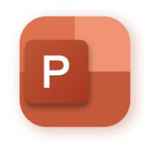
Working with Word (Docs) and PowerPoint (Slides)
Notes:
For this activity, learners can decide whether they preferred to participate independently, with a partner, or in small groups. Two different files were created for this activity. The first file was a document that could be opened in Microsoft Word or Google Docs. The second file was a presentation that could be accessed through Microsoft PowerPoint or Google Slides. Each of the two files were designed to contain specific accessibility-related issues that were presented earlier in the afternoon session.
There are two parts for this activity. For the first part, learners are supposed to see how many accessibility issues they can identify for each of the two files. The rule was that they could not use any automatic accessibility checkers to identify the issues and they had to briefly identify each issue they identified.
Learners will have approximately 20 minutes to identify as many accessibility issues as possible. After the 20 minutes has concluded, everyone will come back together as a whole group and learners will be asked to identify and explain the errors they found in a whole-group setting. As each error is identified, the entire group will talk through the strategies that would be used to fix the errors as the instructors demonstrates those steps using the computer and projector. A teacher guide was created to help the instructors with remembering what errors were built into the two files.

Slide 19
National AEM Center- Quality Indicators
QI 1: A Coordinated System
QI 2: Provision in a Timely Manner
QI 3: Written Guidelines
QI 4: Learning Opportunities and Technical Assistance
QI 5: Data Collection
QI 6: Data Use
QI 7: Resource Allocation
Notes:
One of the driving factors that led to the development of this two day training was the goal to create a coordinated system for planning, implementing, and evaluating efforts to provide accessible instructional materials and technologies to the students who need them, which is the sole mission of the National AEM Center Cohort program. To accomplish this goal, it is important to collect as much stakeholder input as possible to ensure the final plan is indeed comprehensive. So, the remainder of the afternoon session for Day One will be dedicated to introducing the AEM Quality Indicators with Critical Components for K-12.
The good news about the AEM Quality Indicators is that they can be used to improve accessibility efforts at a system/district, organizational, or state level. Since a big aspect of the AEM Quality Indicators is to develop coordinated systems, it would not necessarily be implemented at the school level. Of course, schools that are a part of the larger co-cohort would benefit, learn from, and make adjustments to current practices based on the work of the larger cohort.
Approximately 40 minutes will be spent on the first part of this lesson which involves the instructors going through the AEM Quality Indicators with Critical Components for K-12 document. The instructors will use this document to highlight and discuss each of the quality indicators and their intent in a whole group setting. The seven Quality Indicators (QIs) include:
Quality Indicator 1: A Coordinated System
Quality Indicator 2: Provision in a Timely Manner
Quality Indicator 3: Written Guidelines
Quality Indicator 4: Learning Opportunities and Technical Assistance
Quality Indicator 5: Data Collection
Quality Indicator 6: Data Use
Quality Indicator 7: Resource Allocation
As the statements and intent for each QI are presented and discussed, participants will given the opportunity to ask clarifying questions about the indicators. During this time, the session presenters, who are also members of the state AEM Leadership Team will not share any of the discussions the Leadership Team has had so far about each of the indicators in an effort to reduce any bias that might arise in responses during the follow-up activity.

Slide 20
Quality Indicators- Wows and Wonders Activity
Image by Gerd Altmann from Pixabay
Notes:
For this activity, learners will be divided into seven groups (one group per QI). Each group will be given a piece of large chart paper where they will be asked to write down ideas that came out of the group discussion as they collaborated to identify wonders and wows for their respective QIs. Learners will be given approximately 15-20 minutes to complete this part of the activity. Once the initial discussion has concluded, the plan is to give each individual learner a few post it notes so they could participate in a gallery walk where they will provide additional wonders and wow’s to the chart paper for other groups.

Slide 21
Day One Wrap-Up Discussion
Image by Gerd Altmann from Pixabay
Notes:
Congratulations! We have officially made it to the end of Day One. We have shared a lot of information with you today including establishing common understanding, defining the terminology, recognizing various abilities and needs, digital accessibility considerations, and introducing the AEM Quality Indicators. You were introduced to Micah, Jeremy, Courtney, and Gabrielle and unique content design considerations that come about with diverse student populations.
For those of you who are returning tomorrow, we will spend some time digging deeper into determining students needs, exploring needs assessment resources, acquiring accessible formats, and personalizing the learning experience. If you are not able to join us tomorrow, you will still have access to all the presentation materials for Day Two through the Participant Resources folder. Please feel free to review those materials and reach out to us Chris Smith (chris.smith@ncpublicschools.gov), Crystal Patrick (crystal.patrick@dpi.nc.gov), or Donna Murray (donna.murray@dpi.nc.gov) with any questions that you may have.
Conclusion image obtained from the NC Virtual Shutterstock Subscription Stock Photo ID: 760108510

