Slide 1
#A11Y: EC Summer Institute on Accessibility
Day One Morning Session Presentation
By Chris Smith¹, Crystal Patrick², Donna Murray², Ginger Starling², and Meghan McGrath² ¹ North Carolina Virtual School, ² North Carolina Department of Public Instruction

Slide 2
Day One Agenda
8:30 Breakfast Snacks Provided
9:00 Morning Session Start Time
12:00 Lunch
1:00 Afternoon Session Start Time
4:00 Adjourn

Slide 3
Establishing Session Norms
Embrace culture of empathy
Focus on building capacity
Be solution oriented
Share expertise
Honor safe space for all learners to grow
Notes:
Establishing these norms from the beginning of the lesson is important to allow all participants to feel comfortable with sharing what they do and do not already know for growth and new understanding to occur.

Slide 4
Session Setting and Structure
Day One Morning- Establishing common understanding, defining the terminology, and recognizing various abilities and needs
Day One Afternoon- Digital accessibility considerations and introducing the Quality Indicators
Day Two Morning- Determining students needs and exploring needs assessment resources
Day Two Afternoon- Acquiring accessible formats and personalizing the learning experience

Slide 5
Why is Accessibility Important?
Image by 3D Animation Production Company from Pixabay
Image by Gerd Altmann from Pixabay
The Legal Requirements Section 508 and ADA
The Human Aspect
Notes:
Why is accessibility important? In order to answer that questions, we have to look at two different pieces of the puzzle. The first of those two pieces are the legal requirements around accessibility and then the most important piece of all is the human aspect. Come along with me as we take a look at accessibility in digital instruction.

Slide 6
The Legal Considerations
Section 508 of the Rehabilitation Act of 1973
Reauthorized in 1998
Requires access to electronic and information technology to an entity that receive federal funding
Applies to employees and the public
Americans with Disabilities Act of 1990 (ADA)
Civil Rights legislation
The “Equal Opportunity” law that prohibits discrimination and guarantees that people with disabilities have the same opportunities as those without disabilities
Notes:
There are two main laws that have significantly impacted those with disabilities:
ADA
Americans with disabilities Act
Civil Rights legislation that ensured people of all ability levels had equal access and opportunity.
Applies to public and private organizations
Section 508
Part of the Rehabilitation Act of 1973
Requires that entities who receive any federal funding must ensure that any information or tools available to the public must be accessible to ALL individuals regardless of any impairments.
This law is what required closed captioning for telecommunications.
This includes ANY electronic media such as videos, word documents, PDFs, presentation slides, web pages, etc.
When we break that down, it also means any correspondence that is given to students or sent home to parents, newsletters, homework, etc.
Sources:
https://www.ada.gov/ada_intro.htm
https://www.access-board.gov/law/ra.html#section-508-federal-electronic-and-information-technology

Slide 7
Who’s Checking?
~800
Notes:
OCR Complaints
Any individual who experiences difficulties with accessing electronic content in the educational setting can file a complaint with the Office of Civil Rights with the US Department of Education
Any public facing document and ANYONE can file. Doesn’t have to be directly connected.
A letter of complaint will be sent to the entity that has the violation.
Ask this question:
In 2019: it was estimated that OCR would send out was
Answer will fade in: ~800
These complaints affect both K12 and IHEs
Considering the events over the last few years, what do you think has happened with that number?
Sources:
DT&L Conference August 2019​
https://www2.ed.gov/images/ed-gov-hat.png
US Department of Education

Slide 8
Who Should be Considered in Schools?
The student
Family members
Colleagues
Image by Gerd Altmann from Pixabay
Notes:
Beyond the law, accessibility is the ethical and morally right thing to ensure for all of our students.
Accessibility ensures that everyone has an equal opportunity to learn and access information.
As teachers, we primarily think of our students as we begin to think about accessibility. These are the people that we interact with on a daily basis and who we have a direct relationship with. They are the ones we need to consider as we begin to plan our lessons, activities, and communication.
However, we need to also remember the family member. The caregiver is the one who offers the support at home. While we are not required to offer learning materials for a caregiver’s specific need, we do need to make sure than all correspondences are accessible. This includes any informational letters, memos, webpages, etc.
Finally, our colleagues. You may have someone on staff who needs to use a screen reader or captioning in order to access content. The tips and guidance we provide here today will help you accomplish this.
Sources:
"Teacher Helping Students Working At Computers In Classroom" by City of Seattle Community Tech is licensed under CC BY-NC 2.0.
"The Association for Persons with Disabilities in Bloemfontein" by World Bank Photo Collection is licensed under CC BY-NC-ND 2.0.
"Me at Work" by jessamyn is licensed under CC BY-NC-SA 2.0

Slide 9
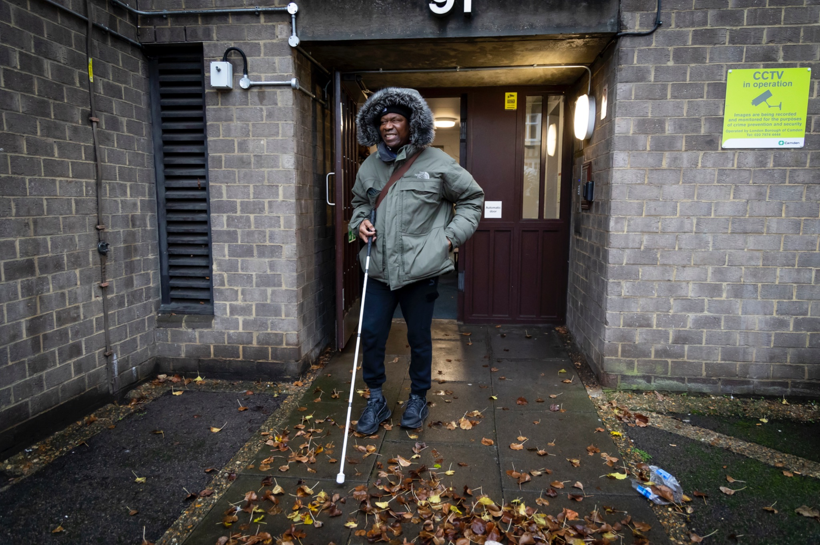
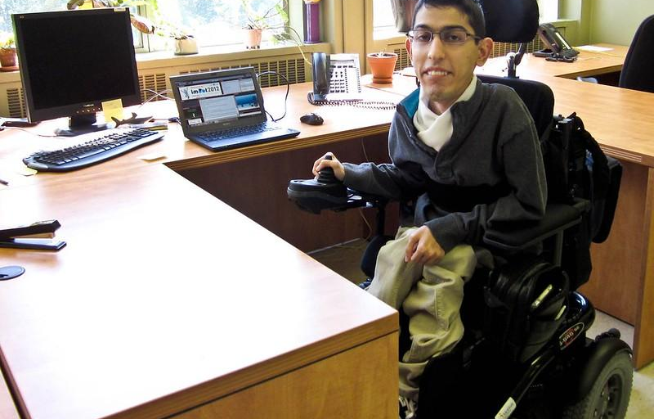
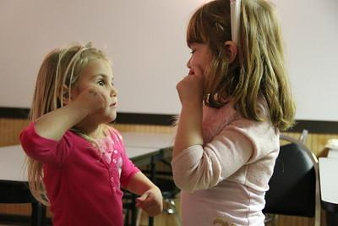
Accessibility- The Human Aspect
Micah
Visually impaired
Jeremy
Cerebral Palsy
Course Development Training- Accessibility
Courtney
Deaf or hard of hearing
Gabriella
Traumatic Brain Injury
Notes:
Meet Our Students Jigsaw Activity
For this activity, four different student profiles have been created for you to explore. All four characters and their characteristics are fictitious, but the scenarios are realistic. The link in the center of the image leads to an Articulate Storyline object that provides more information on how each student might be directly impacted by content that is not accessible and what considerations must be taken to support the unique student needs represented.
Divide the room into four groups and assign each group one of the four students. Learners should be given 15 minutes to review the information on their assigned student. Once learners have had ample time to review the profiles, bring everyone back as a whole group. Each group should be given 2 to 3 minutes to teach others about the particular student they reviewed. A few minutes (about 5) should be reserved for any questions at the end of the activity.
Image citations:
Micah- Photo by Centre for Ageing Better on Unsplash
Courtney- "Learning sign language" by daveynin is licensed under CC BY 2.0.
Jeremy- “Milad Haji Hassan” by Simon Fraser University is licensed under CC BY 2.0
Gabriella- Photo by Nicole Wolf on Unsplash

Slide 10
Defining The Terminology

Slide 11
Defining Accessibility
“A person with a disability can acquire the same information, engage in the same interactions, and enjoy the same services in an equally effective, equally integrated manner, with substantially equivalent ease of use as a person without a disability.”
(U.S. Department of Education, 2013, para. 3)
Notes:
It is important to establish a common definition for accessibility in the beginning of the lesson, because the term accessibility has been associated with other various technical concerns such as Internet connectivity.

Slide 12
Defining Assistive Technology
According to the Assistive Technology Industry Association (ATIA), the term assistive technology refers to a set of products, equipment, and systems that have been developed to break down barriers individuals may experience in a given environment.

Slide 13
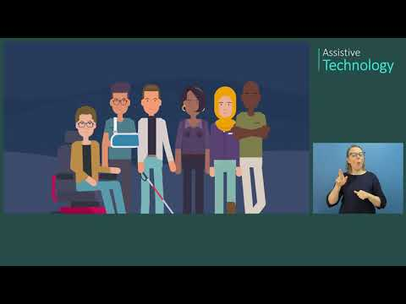
Assistive Technology in Action
https://youtu.be/DBxmADjQlI4 (MSFTEnable, 2021)
Notes:
Assistive technology is specific to one person. While accessibility considers specific disabilities, we know that individuals have specific needs that may not specifically be met by accessibility standards alone. Individuals who fall into this category need tools that improve their functionality. Therefore a team of specialists work with students to identify unique needs and determine the best assistive technology options to support student needs.
Please show the short Assistive Technology YouTube video to demonstrate some examples of assistive technologies in action. To capture the human impact of assistive technology, the following videos can be shared with learners to view independently outside of the session (if you are running ahead of schedule, you can have participants choose videos to explore during the session):
Jane Velkovski TED video (mobility)
Assistive Technology in Action - Meet Elle (eye gaze and Dynavox)
Assistive Technology Devices in Action For People With Disabilities (low-tech examples)

Slide 14
Zabala’s SETT Framework
Promotes Collaborative Decision-Making When:
Identifying assistive technology services for students with disabilities
Implementing assistive technologies within an educational setting
Evaluating the effectiveness of the assistive technology implementation
SETT Stands For
S: Student- The individual’s strengths and needs
E: Environment- Where the individual will be completing the task
T: Task- The specific things the student needs to be able to do in order to meet expectations
T: Tools- The specific tools that will be essential for the individual to complete the tasks

Slide 15
Essential for Some Beneficial for All Activity
Have you ever:
turned on captions because you couldn’t understand what was being said in a movie?
found it difficult to read red font on a black background?
fluently read script font?
been overwhelmed by too many images, colors, and text on a page?
had your mouse stop working and been unable to navigate a webpage?
used keyboard commands to copy and paste content?
Notes:
Activity: Instruct the participants to raise their hand if they can answer “yes” to the following questions. The animation is set so that each question appears after you click. Read each question allowed beginning with “Have you ever….”
After you review these, stress how building accessible content for those with disabilities actually benefits those without one. A conscious effort to provide digital material enhances the usability and experience for EVERYONE!!!
If time allows, provide learners with the opportunity to add two or three additional similar scenarios related to accessibility concerns for the group to respond to. After completing the interactive activity, stress how building accessible content for those disabilities’ benefits others. A conscious effort to provide accessible digital material enhances the usability and learning experience for everyone.

Slide 16
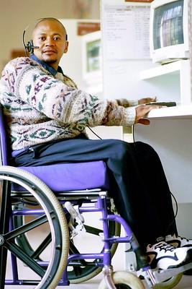
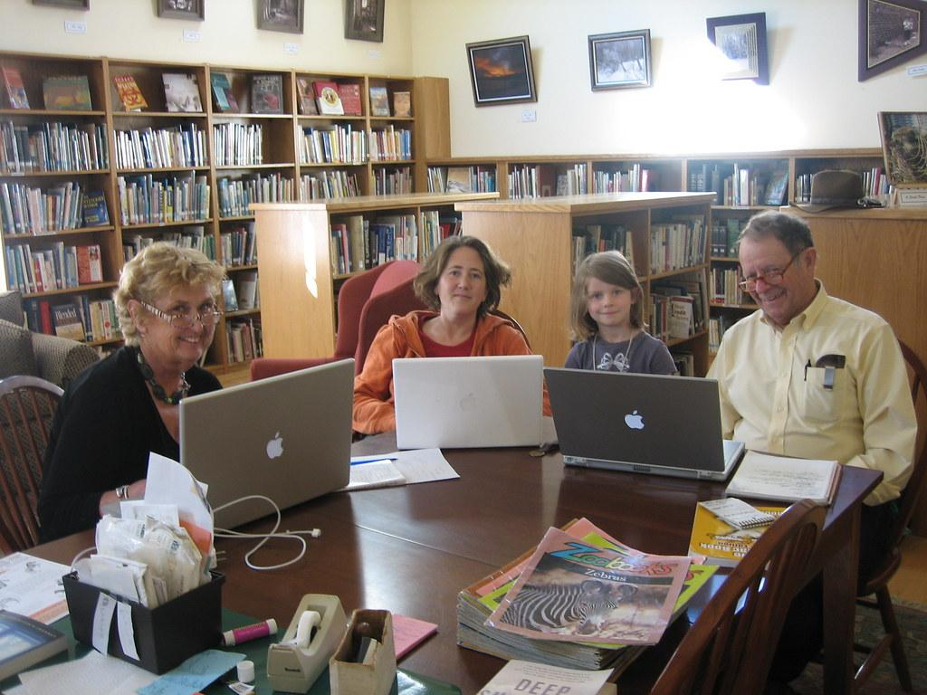
Who Should be Considered?
The student
Family members
Colleagues
Notes:
Beyond the law, accessibility is the ethical and morally right thing to ensure for all of our students.
Accessibility ensures that everyone has an equal opportunity to learn and access information.
As teachers, we primarily think of our students as we begin to think about accessibility. These are the people that we interact with on a daily basis and who we have a direct relationship with. They are the ones we need to consider as we begin to plan our lessons, activities, and communication.
However, we need to also remember the family member. The caregiver is the one who offers the support at home. While we are not required to offer learning materials for a caregiver’s specific need, we do need to make sure than all correspondences are accessible. This includes any informational letters, memos, webpages, etc.
Finally, our colleagues. You may have someone on staff who needs to use a screen reader or captioning in order to access content. The tips and guidance we provide here today will help you accomplish this.
Sources:
"Teacher Helping Students Working At Computers In Classroom" by City of Seattle Community Tech is licensed under CC BY-NC 2.0.
"The Association for Persons with Disabilities in Bloemfontein" by World Bank Photo Collection is licensed under CC BY-NC-ND 2.0.
"Me at Work" by jessamyn is licensed under CC BY-NC-SA 2.0

Slide 17
Universal Design for Learning (UDL)
Representation
Engagement
Action and Expression
Image by Gerd Altmann from Pixabay
Notes:
The previous activity leads into the discussion about UDL. There is no “one way, one size fits all” way of delivering content. A person who uses the UDL principles accounts for a multitude of factors including not only the content but the mode of learning that his/her students best learn from, equal access to the learning, choice in how the information is learned and how the learner shows their knowledge from the content. UDL principles benefit and are designed with everyone in mind. The three main considerations for UDL include:
Representation
Engagement
Action and Expression

Slide 18
Summary
Universal Design for Learning
Considers and addresses the learning modalities, preferences, and needs of all learners.
Accessibility
Everyone can access and benefit
Assistive Technology
Promotes inclusion
Considers and addresses the needs of a specific individual with special needs
Considers and addresses the needs of those with special needs
Specific focus on those with special needs
Notes:
This is used to give a visual on how all work to together and they promote inclusion opportunities for all learners. Use the Venn diagram to summarize the main similarities and differences between UDL, Accessibility, and Assistive Technology.

Slide 19
The Cheesecake Factory
Analogy Activity
Imagine that the menu at The Cheesecake Factory is a lesson. How does it represent the principles of:
UDL
Accessibility
Assistive Technology
Image by Pexels from Pixabay
Notes:
Activity:
Taking what you know now about UDL, Accessibility, and Assistive Technology, you will apply what you have learned to this activity. We will use The Cheesecake Factory as an analogy to represent the principles of UDL, accessibility, and assistive technology.
Participants will pair up, access the website for The Cheesecake Factory, and evaluate how the restaurant exhibits the principles with their menu. They will record their findings on their assigned Google Slides document. Allow the participants 10 minutes to complete the activity and then share out.
Access these links from participant guide:
https://www.thecheesecakefactory.com/menu
https://www.thecheesecakefactory.com/allergy
Possible responses could include:
UDL: Different cuisine options like: Italian, American, Asian, Dietary options: low carb, low calorie
Accessibility: Allergy tool, allergy-free options
Assistive Technology: customized, made-to-order meals as needed
Source:
The Cheesecake Factory (Public Domain photo)

