Slide 1


Universal Design for Learning Title Slide
Created by Ali Söken

Slide 2
Outline
Free writing
The myth of average
UDL principles
Useful tools
Activity development

Slide 3
Free-writing (5 minutes)
Take a few minutes to think about a moment when you learned something important. Please answer the following questions:
What did you learn?
What helped you learn?
Why was it a valuable learning experience?

Slide 4
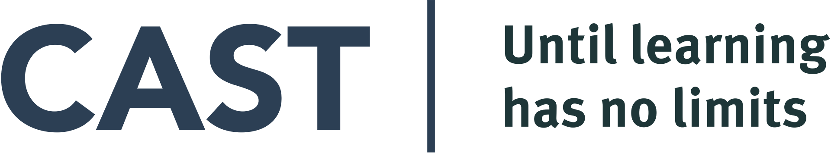

Universal Design for Learning
UDL:
Is a framework to improve and optimize teaching and learning for all people
Is a set of principles for curriculum development that give all individuals' equal opportunities to learn
https://www.researchgate.net/publication/268150466_Universal_design_for_learning_Initiatives_on_the_move_Understanding_the_impact_of_the_Race_to_the_Top_and_ARRA_funding_on_the_promotion_of_universal_design_for_learning
https://www.interact123.com/post/_cast

Slide 5
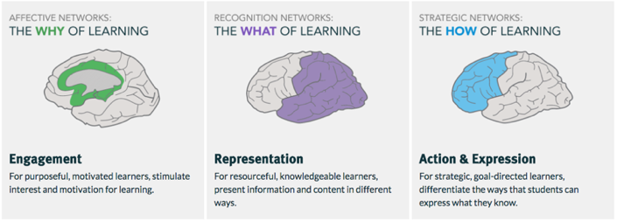
Universal Design for Learning - Guidelines
https://www.taat.org/professional-development
https://www.youtube.com/@UdlcenterOrg
Note. From “Universal Design for Learning: Teacher Planning for Technology Integration” by E. Michela, in (2020) A. Ottenbreit-Leftwich & R. Kimmons (Eds.), The K-12 Educational Technology Handbook, 2020, EdTech Books (https://edtechbooks.org/k12handbook/universal_design_for_learning). Source: cast.org

Slide 6
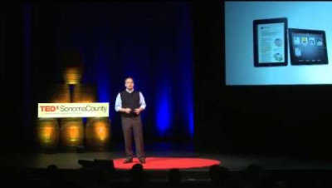
The myth of average (10 min)
The air force example
  How do you design one cockpit that can fit the most individuals?
Link: https://www.youtube.com/watch?v=4eBmyttcfU4

Slide 7
The myth of average answer
Answer: 0
Ban the average
Design to edges

Slide 8
The myth of average discussion
Designing for average learners means nothing.

Slide 9
WHY of learning - Engagement
Provide options for
  Recruiting interest
  Sustaining effort and persistence
  Self-regulation

Slide 10
WHY of learning – Engagement 2
Recruiting interest
NBC Learn
Online Museum tours (Obias, 2016)
Ted Ed (n.d.): Customized video lessons
Sustaining effort & persistence
Rubric-maker.com
Online whiteboard
Self regulation
Goal-setting tools
Reflection strategies
Useful suggestions: http://castprofessionallearning.org/free-udl-resources-and-tips/ (CAST, n.d.)

Slide 11
WHAT of learning - Representation
Provide options for
  Perception
  Language, mathematical expression and symbols
  Comprehension

Slide 12
WHAT of learning – Representation 2
Perception
Effective color - contrast
Readability
Closed-captioning (CC)
Sign language
Text-to speech
Language, mathematical expressions and symbols
Vocabulary
Academic English
Glossary
Wordle (patterns)
3D geometry
Google Earth
Comprehension
Activities for further understanding
Online tools
Visual thinking tools

Slide 13
Examples of Representation
Visuwords
http://www.visuwords.com/
Word it out
https://worditout.com/
Word Clouds
https://www.wordclouds.com/
Math Open Reference
http://www.mathopenref.com/

Slide 14
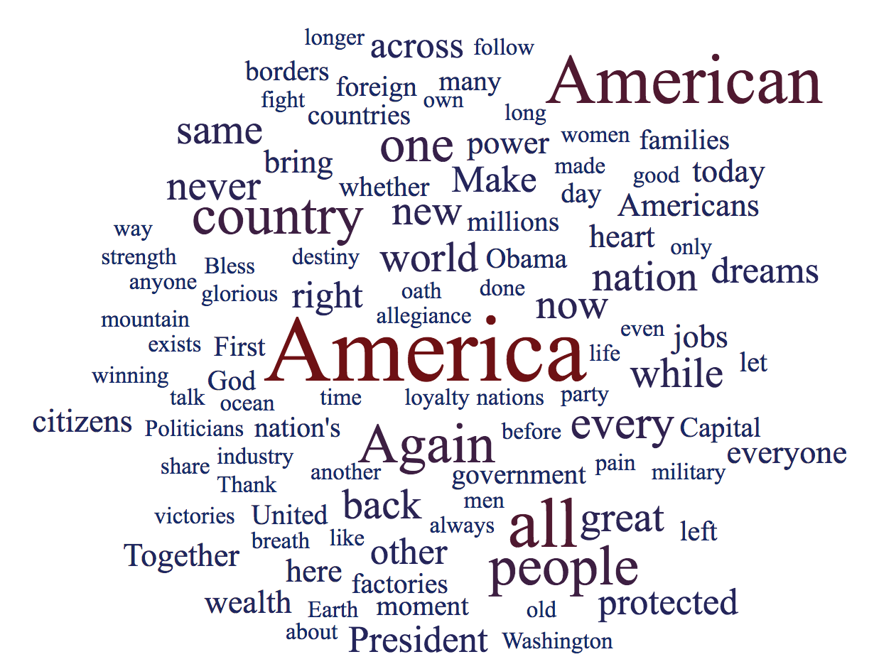
Example: Word cloud
Inaugural speech of Donald Trump (Politico, 2017)

Slide 15
HOW of learning – Action and Expression
Provide options for
  Physical action
  Expression and communication
  Executive functions

Slide 16
WHAT of learning – Action and Expression 2
Physical action
Camera Mouse
Eye-tracking
Virtual Keyboard
Expression and communication
Animoto
Scratch
Voicethread
Grammar/Spell Check
Book Builder
Executive functions
Brainstorming
Assignment Calculator
Mind-map tools
Graphs
Charts

Slide 17
Examples of Action and Expression
Assistive Technologies (Web Accessibility in Mind, n.d.)
http://webaim.org/articles/motor/assistive
Glogster
http://edu.glogster.com/
Book Builder
http://bookbuilder.cast.org/
Brainstorming Tool: MindMup
www.mindmup.com

Slide 18
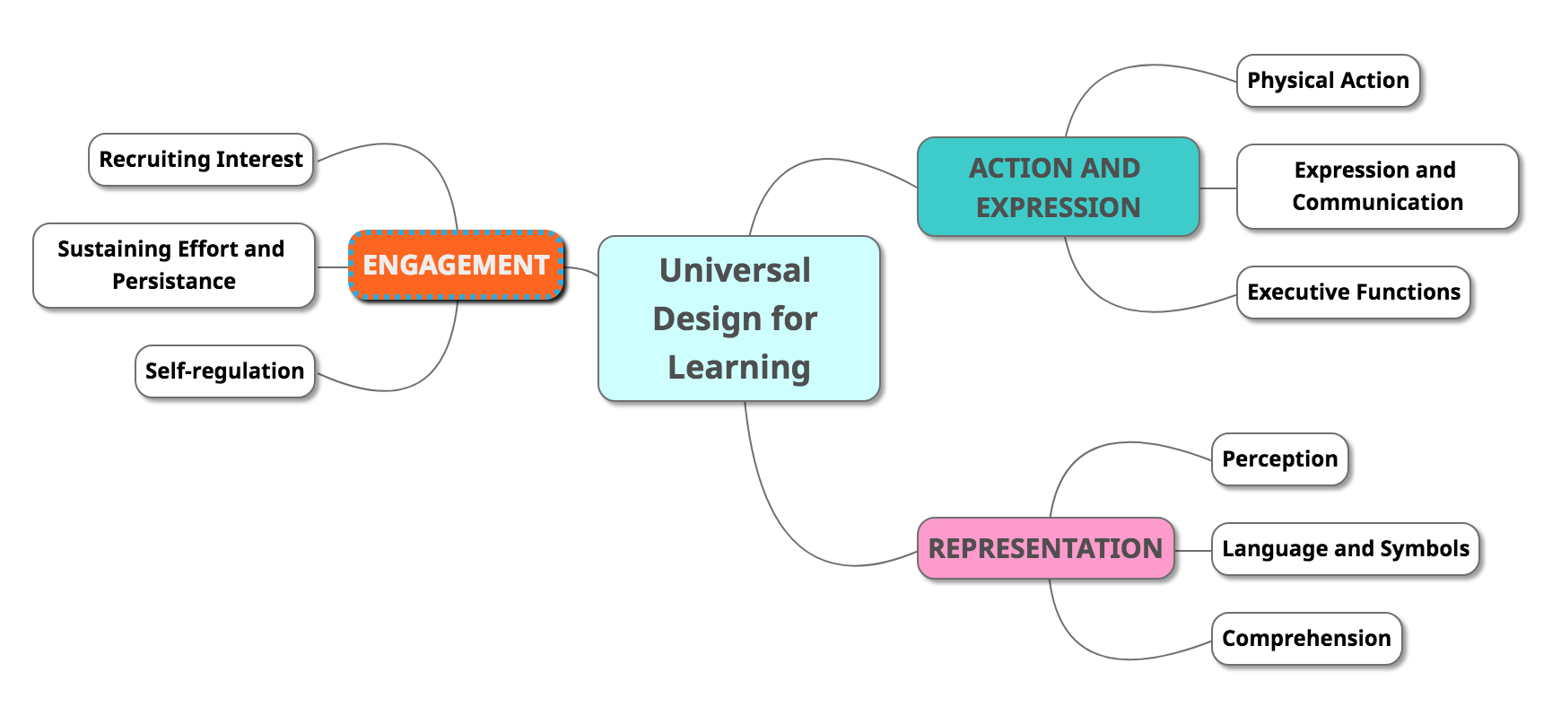
Example Mind Map

Slide 19
More resources
Accessibility
Mercury Reader
Read and Write
Google maps
Summarize This
Rewordify
Open Dyslexic
YouTube CC
Google Keep
Camera Mouse
Picto4Me
Google Slides CC
Engagement
Ted Ed: Customized video lessons
QR Code Generator: Create codes
Nearpod: Customized lessons
Representation
Book Creator: Create & read books
Lucidpress: Publishing software
Action and Expression
Adobe Spark: Storytelling tools
Tour Builder Google: Virtual tours
Anchor: Podcast creating tool

Slide 20
Activity (20 Min)
Access: Universal Design for Learning - Implementation Worksheet
Prompt: Revise an activity or lesson plan that you have recently facilitated or develop a new activity as a group. Consider the potential barriers that your students may face and how UDL principles can address them.
Share-out: Each group will share their ideas.

Slide 21
Feedback/Suggestions
Assessment:
Share one thing that helped you to revise your teaching
Provide one suggestion to make this learning experience better or more efficient

Slide 22
Thank you
Any questions/comments

Slide 23
References
CAST. (n.d.). About CAST professional learning. Retrieved May 29, 2023, from
https://www.cast.org/learn/about
Obias, R. (2016, February 19). 12 world-class museums you can visit online. Mental Floss. https://www.mentalfloss.com/article/75809/12-world-class-museums-you-can-visit-online
Michela, E. (2020). Universal Design for Learning: Teacher planning for technology integration. In A.
Ottenbreit-Leftwich & R. Kimmons (Eds.), The K-12 educational technology handbook. EdTech Books. https://edtechbooks.org/k12handbook/universal_design_for_learning
Politico. (2017, January 20). Full text: 2017 Donald Trump inauguration speech transcript. https://www.politico.com/story/2017/01/full-text-donald-trump-inauguration-speech-transcript-233907
TEDEd. (n.d.). Home. https://ed.ted.com/
TEDx Talks. (2013, June 19). The myth of average: Todd Rose at TEDxSonomaCounty. YouTube.
https://youtu.be/4eBmyttcfU4
Web Accessibility in Mind. (2012, October 12). Motor disabilities: Assistive technologies.
https://webaim.org/articles/motor/assistive

