Slide 1
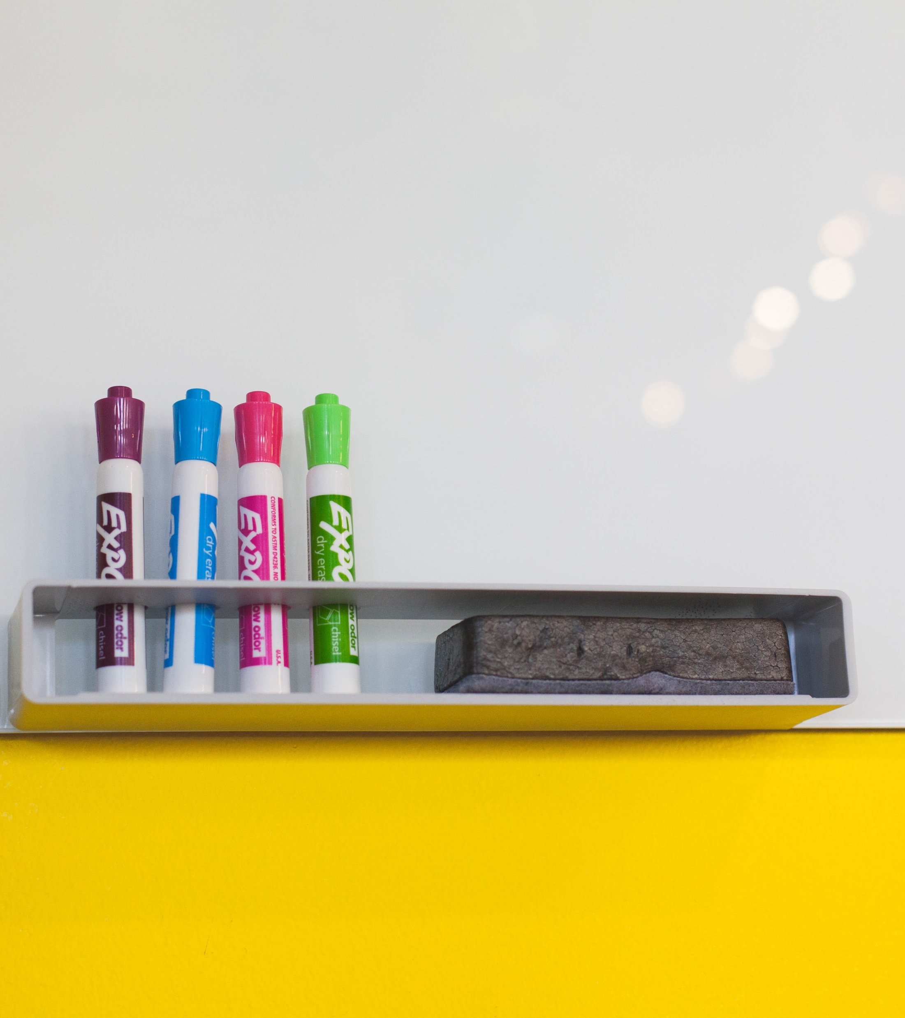
UDL Academy
Breanne Kirsch, Briar Cliff University
Untitled. CC0.

Slide 2
Day 1 Agenda
Introduce academy
The research behind UDL
What is UDL?
What is learner variability?
Disabilities, Accommodations, and Adaptive Technology at BCU – Jeanene Sampson
Faculty Panel on UDL Implementation
Project Work – Worksheet 1
Agenda by Nick Youngson CC BY-SA 3.0 Alpha Stock Images

Slide 3
Your Action Items
•Pair Presentation (10-15 minutes)
•Project Work and Worksheets 1-6 (7 will be due after you implement UDL in one or more of your courses)
•Post-Academy Evaluation (online OR paper copy)
•Share your current (pre-UDL) course syllabus and your updated course syllabus after participating in the UDL Academy
•Participate and Ask Questions
“To Do” by FinnPetersenSH. Pixabay License.

Slide 4
Brain Based Learning Networks
Brain-based research indicates three distinct yet inter-related learning networks (Rose, Meyer, Hitchcock, 2005):
1.Recognition Learning Network (what)
How we make sense of presented information
2.Affective Learning Network (why)
How motivation & participation impacts learning
3.Strategic Learning Network (how)
How we demonstrate our learning or mastery
This Photo by Unknown author is licensed under CC BY-NC.

Slide 5
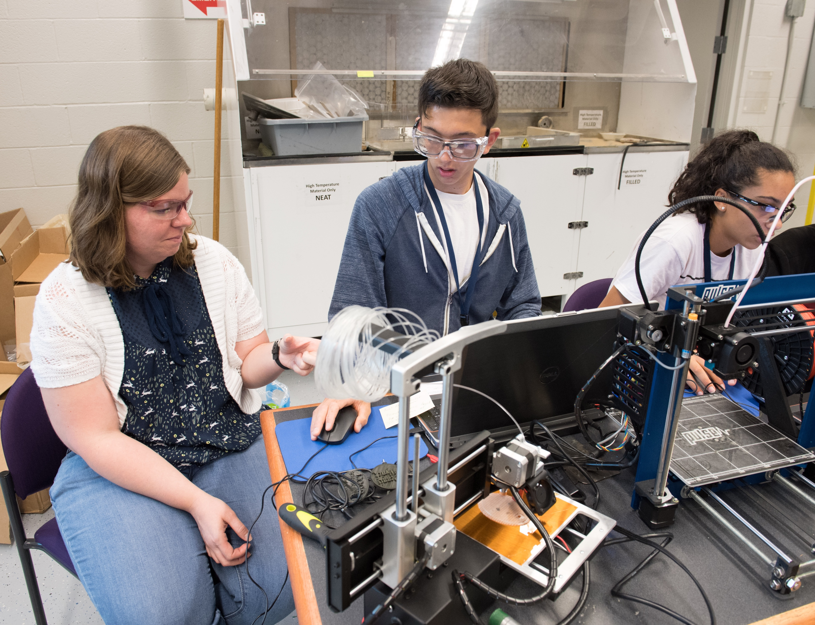
UDL Background
•https://udlguidelines.cast.org/
•“The UDL Guidelines (2012), whose foundation includes over 800 peer reviewed research articles, provide benchmarks that guide educators in the development and implementation of UDL curriculum. These Guidelines serve as a tool with which to critique and minimize barriers inherent in curriculum as educators aim to increase opportunities to learn.” -http://udloncampus.cast.org/page/udl_about
•Reach Everyone, Teach Everyone- Tobin and Behling
This Photo by US Army Research Laboratory is licensed under CC BY-SA.
Notes:
*

Slide 6
What is Universal Design for Learning?
“Light bulb” by Elionas. Pixabay License

Slide 7
YouTube Video
https://youtu.be/AGQ_7K35ysA
Notes:
https://youtu.be/AGQ_7K35ysA

Slide 8
Why UDL?
https://youtu.be/bIGwqVJ58HY
Notes:
https://youtu.be/bIGwqVJ58HY

Slide 9
Universal Design
"Universal Design is the design and composition of an environment so that it can be accessed, understood and used to the greatest extent possible by all people regardless of their age, size, ability or disability... If an environment is accessible, usable, convenient and a pleasure to use, everyone benefits. By considering the diverse needs and abilities of all throughout the design process, universal design creates products, services and environments that meet peoples' needs. Simply put, universal design is good design."
National Disability Authority. (2020). What is universal design. Universal design. https://universaldesign.ie/what-is-universal-design/.
Notes:
http://universaldesign.ie/what-is-universal-design/

Slide 10
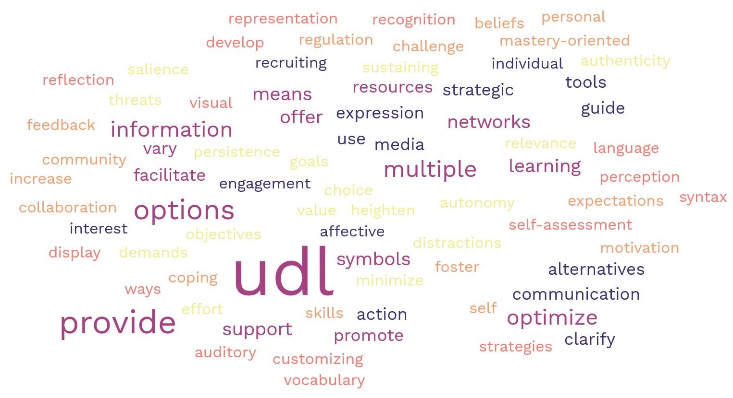
Universal Design for Learning
"Universal design for learning (UDL) is a set of principles for designing curriculum that provides all individuals with equal opportunities to learn. UDL is designed to serve all learners, regardless of ability, disability, age, gender, or cultural and linguistic background. UDL provides a blueprint for designing goals, methods, materials, and assessments to reach all students including those with diverse needs."
TEAL Center Fact Sheet No. 2: Fact Sheet: Universal Design for Learning
Notes:
https://www.flickr.com/photos/gforsythe/9101797199/in/album-72157626965187420/
https://lincs.ed.gov/state-resources/federal-initiatives/teal/guide/udl

Slide 11
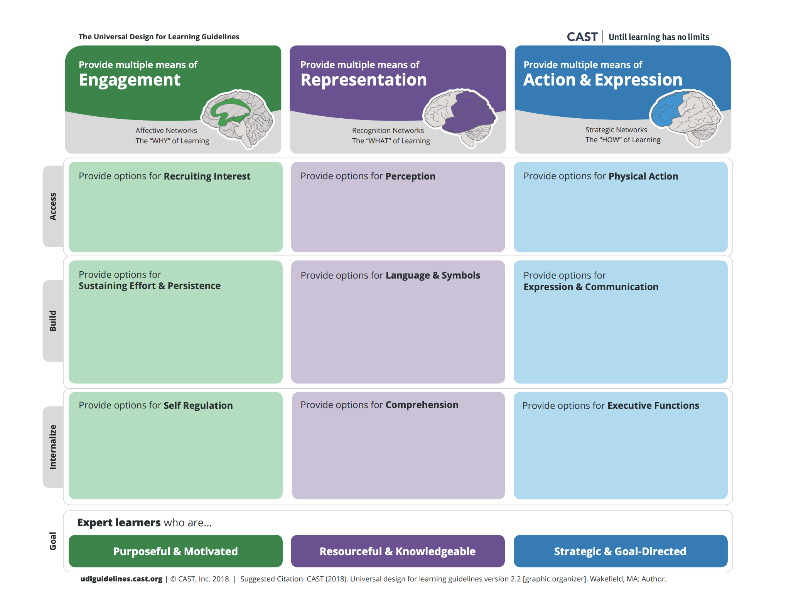
UDL Principles
"UDL is an approach to the creation of learning experiences and interactions that incorporates multiple means of
engaging with content and people
representing information, and
expressing skills and knowledge (CAST, 2014b)."
Notes:
Reach Everyone, Teach Everyone p 2

Slide 12
UDL on College Campuses
“Light bulb” by Elionas. Pixabay License

Slide 13
Access
"When we change our mind-set—when we chop off the end of the word accessibility and think only about access—we free ourselves to create colleges and universities that truly serve the needs of an increasingly diverse population of learners."
Reach Everyone, Teach Everyone: Universal Design for Learning in Higher Education p.1
Image by onlineakhil. Pixabay License.
Notes:
Reach Everyone Teach Everyone, page 1

Slide 14
YouTube Video
https://youtu.be/O_MCvjkd8Jc
Notes:
https://youtu.be/O_MCvjkd8Jc

Slide 15
YouTube Video
https://youtu.be/4yUYQgcWGGA
Notes:
https://youtu.be/4yUYQgcWGGA

Slide 16
What is Learner Variability?
“Light bulb” by Elionas. Pixabay License

Slide 17
Educationally, does one size fit all?
Unknown Author
Notes:
Unknown author. Based on a comic by Hans Traxler, Chancengleichheit, in: Michael Klant , [Hrsg.], Schul-Spott : Karikaturen aus 2500 Jahren Pädagogik ,Fackelträger, Hannover 1983, S. 25

Slide 18
Learner variability is the rule, not the exception
"Options are essential to learning, because no single way of presenting information, no single way of responding to information, and no single way of engaging students will work across the diversity of students that populate our classrooms. Alternatives reduce barriers to learning for students with disabilities while enhancing learning opportunities for everyone" (Council for Exceptional Children, 2011).
Notes:
Reach Everyone, Teach Everyone pp 24-25

Slide 19
YouTube Video
https://youtu.be/eYN-qrKIIYI
Notes:
https://youtu.be/eYN-qrKIIYI

Slide 20
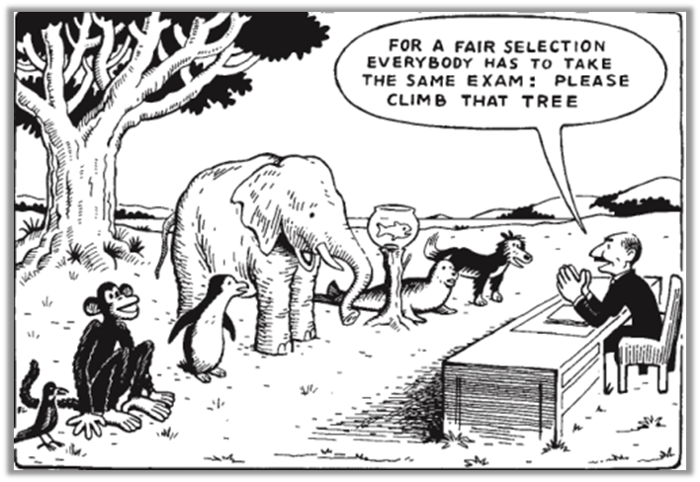
"Firm goals, flexible means" ?
Notes:
Unknown author. Based on a comic by Hans Traxler, Chancengleichheit, in: Michael Klant , [Hrsg.], Schul-Spott : Karikaturen aus 2500 Jahren Pädagogik ,Fackelträger, Hannover 1983, S. 25

Slide 21
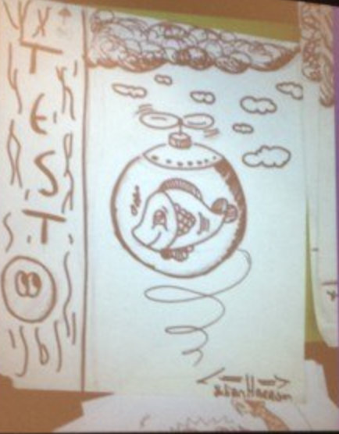
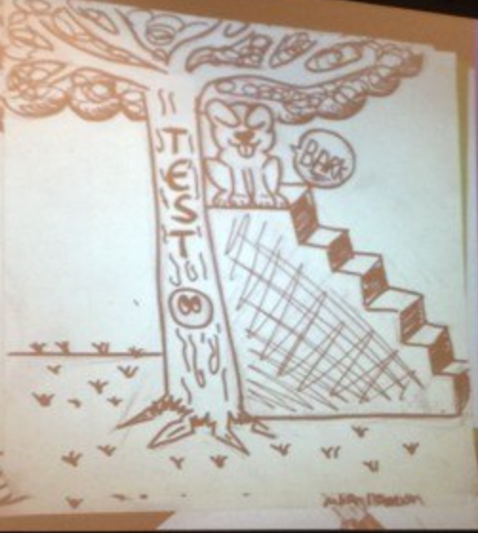
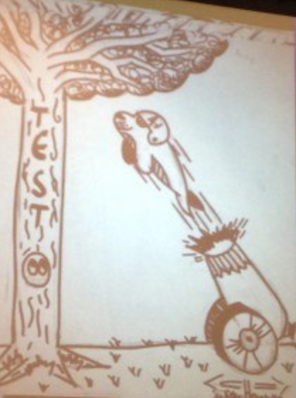
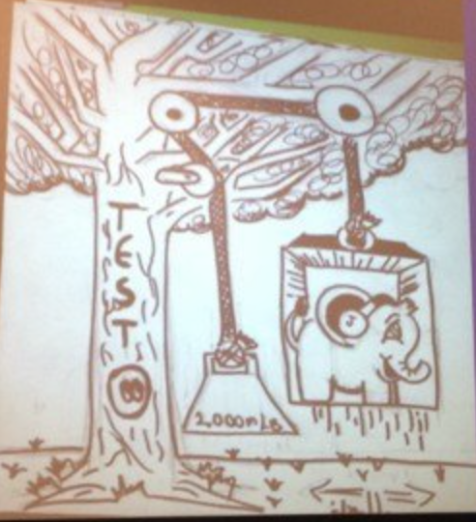
Should we hold all students to the same high standard?
"… it’s incumbent upon us as educators to do everything we can to help our students meet the high standard. This will likely mean allowing different paths to reaching the standard, and providing ongoing, descriptive feedback to students as they are working to meet the standard that has been set: what is working, what is not working, what else they might try."
Mulder, D. (2014, April 18). Getting real about differentiation. Center for Advancement of Christian Education. https://cace.org/getting-real-about-differentiation/
Drawings by a student of Rick Wormeli, presented at an Association for Middle Level Education conference.
Notes:
https://cace.org/getting-real-about-differentiation/

Slide 22
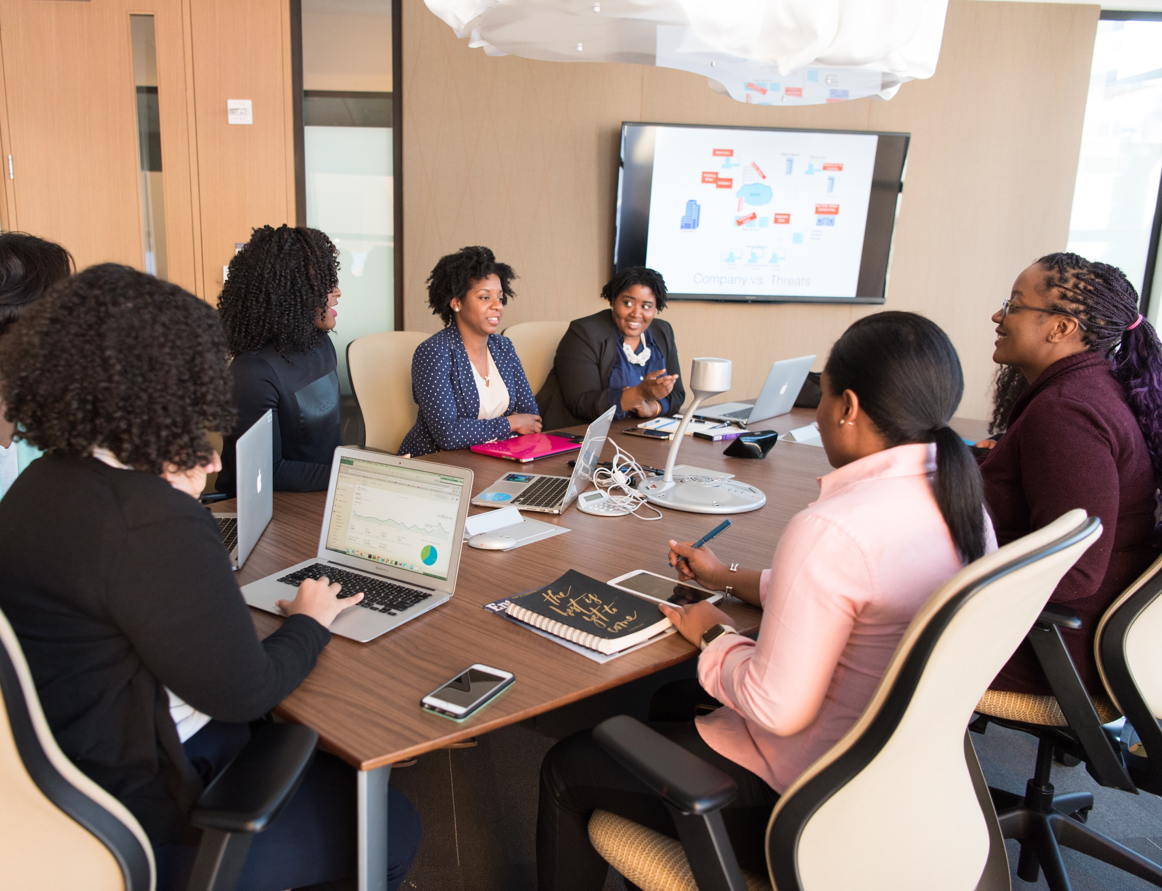
Pair Presentations Preparation
https://udlguidelines.cast.org/
This Photo by Christina Morillo. Used with a Pexells License.

Slide 23
What's Ahead: Days 2-5 Agenda
Day 2- UDL Syllabus and Multiple Means of Representation
Day 3- UDL Assessment and Multiple Means of Action & Expression
Day 4- Blended Courses & Multiple Means of Engagement
Day 5- Making Digital Learning Resources More Accessible, Evaluation and Celebration

Slide 24
Multiple Means of Representation & UDL Syllabus
“Light bulb” by Elionas. Pixabay License

Slide 25
Day 2 Agenda
Multiple Means of Representation Overview and Examples
UDL Syllabus
Pair Presentations
Questions and Discussion
Project Work- worksheet 2 and Syllabus Updates
Agenda by Nick Youngson CC BY-SA 3.0 Alpha Stock Images

Slide 26
Multiple Means of Representation
"Learners differ in the ways that they perceive and comprehend information that is presented to them. For example, those with sensory disabilities (e.g., blindness or deafness); learning disabilities (e.g., dyslexia); language or cultural differences, and so forth may all require different ways of approaching content. Others may simply grasp information quicker or more efficiently through visual or auditory means rather than printed text. Also learning, and transfer of learning, occurs when multiple representations are used, because they allow students to make connections within, as well as between, concepts. In short, there is not one means of representation that will be optimal for all learners; providing options for representation is essential." -UDL Guidelines Representation

Slide 27
Guidelines for Representation
Perception
Interact with flexible content that doesn't depend on a single sense like sight, hearing, movement, or touch.
Language & Symbols
Communicate through languages that create a shared understanding.
Comprehension
Construct meaning and generate new understandings.

Slide 28
YouTube Video
https://youtu.be/cgvsXh9K4rk
Notes:
https://youtu.be/cgvsXh9K4rk

Slide 29
YouTube Video
https://youtu.be/xptOQeJSLVc
Notes:
https://youtu.be/xptOQeJSLVc

Slide 30
Example student barrier and design strategy
Potential Student Experience | Common Barriers | Possible Design Strategy
Students sometimes struggle with text-based presentations. | There are only text on slides. Slides are NOT available before class. | Design presentations with little text, such as short sentences or phrases with major points. Use visual representations when possible. Make the presentation available electronically to students before class. This gives students the option to view the slides how they want and take notes on their own devices.

Slide 31
Example student barrier and design strategy
Potential Student Experience | Common Barriers | Possible Design Strategy
Students have to miss class sometimes and lose access to what was taught in a given class day. | There's only one way to access a synchronous class. | Record the class (seek student permission first) and give students access to the recordings for review or to catch up for necessary misses.

Slide 32
Example student barrier and design strategy
Potential Student Experience | Common Barriers | Possible Design Strategy
Learners vary in background knowledge and language levels. | New vocabulary that hasn't been defined. Lessons don't build on previous lessons. No way to practice with new material and gain immediate feedback. | Create a glossary of new terms and share this with students before the lecture. Explain new symbols or words the first few times they are used. Remind students what they should already know at the beginning of a presentation so they have it fresh in their mind during the presentation. Have students apply what they learned that day for the sake of transfer to long term memory.

Slide 33
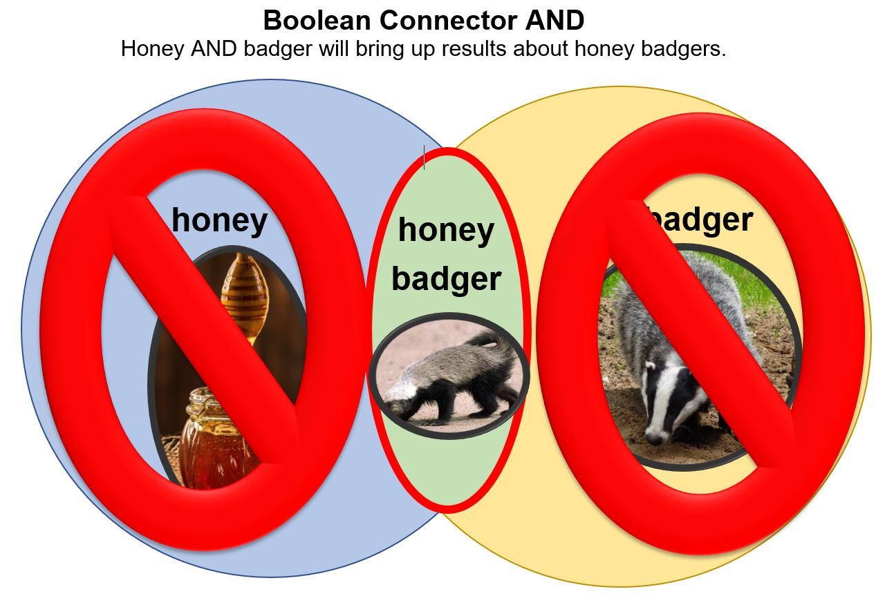
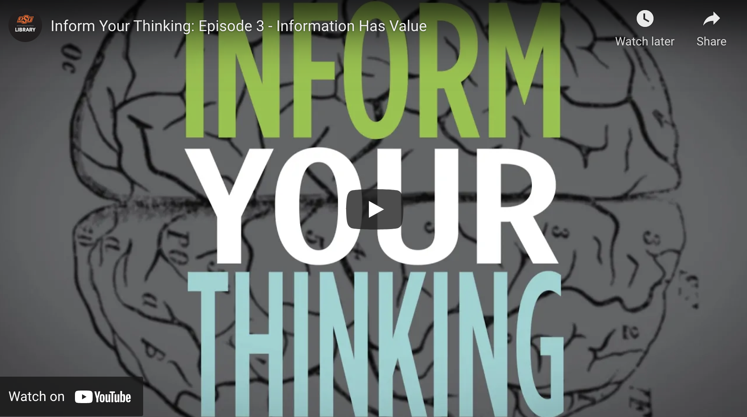
Multiple ways to take in information
In LIBS 301 and 101, we include different kinds of visual and auditory representation each week, including...
Introduction video
Slides w/o audio
Videos
Infographics

Slide 34
Syllabus
http://udloncampus.cast.org/page/planning_syllabus
https://briarcliff.libguides.com/UDL
Image by mohamed_hassan. Pixabay Licence.

Slide 35
Multiple Means of Action & Expression & Assessment
“Light bulb” by Elionas. Pixabay License

Slide 36
Day 3 Agenda
Multiple Means of Action & Expression Overview
UDL Assessment
Examples
Pair Presentations
Questions and Discussion
Project Work and Assignment Updates – worksheet 2, part 2
Agenda by Nick Youngson CC BY-SA 3.0 Alpha Stock Images

Slide 37
Multiple Means of Action & Expression
"Learners differ in the ways that they can navigate a learning environment and express what they know. For example, individuals with significant movement impairments (e.g., cerebral palsy), those who struggle with strategic and organizational abilities (executive function disorders), those who have language barriers, and so forth approach learning tasks very differently. Some may be able to express themselves well in written text but not speech, and vice versa. It should also be recognized that action and expression require a great deal of strategy, practice, and organization, and this is another area in which learners can differ. In reality, there is not one means of action and expression that will be optimal for all learners; providing options for action and expression is essential." - UDL Guidelines Action & Expression

Slide 38
Guidelines for Action & Expression
Physical Action
Interact with accessible materials and tools.
Expression & Communication
Compose and share ideas using tools that help attain learning goals.
Executive Functions
Develop and act on plans to make the most out of learning.

Slide 39
YouTube Video
https://youtu.be/4334q7IVc0c
Notes:
https://youtu.be/4334q7IVc0c

Slide 40
YouTube Video
https://youtu.be/HGqf6a5CE3M
Notes:
https://youtu.be/HGqf6a5CE3M

Slide 41
UDL Assessment
http://udloncampus.cast.org/page/assessment_udl

Slide 42
Example student barrier and design strategy
Potential Student Experience | Common Barriers | Possible Design Strategy
Some students have trouble taking notes while listening to a lecture. | Only individual note taking is available. | Recommend collaborative or group note taking. Suggest students audio record the lecture for later review. Provide lecture recordings to the students for review.

Slide 43
Example student barrier and design strategy
Potential Student Experience | Common Barriers | Possible Design Strategy
Some students may not like speaking in front of a large class if they are introverted or shy. | The only way to ask questions is in front of the class. | Use a backchannel for student chats and questions. Break lectures up into 10-15 minute chunks with time for practice or questions. Reserve the last part of class for students to write down takeaways from the day's class and raise additional questions. Respond to these as justified.

Slide 44
Example student barrier and design strategy
Potential Student Experience | Common Barriers | Possible Design Strategy
Students may be distracted by technology including smart phones and laptops with social media or texts from friends. | Technology provides instructional support, but also many opportunities for distraction. | Discuss challenges of technology and distractions. Talk about keeping only class materials open on their screens. Include activities and ask students questions to keep them engaged and reduce wandering. Give students breaks during long classes.

Slide 45
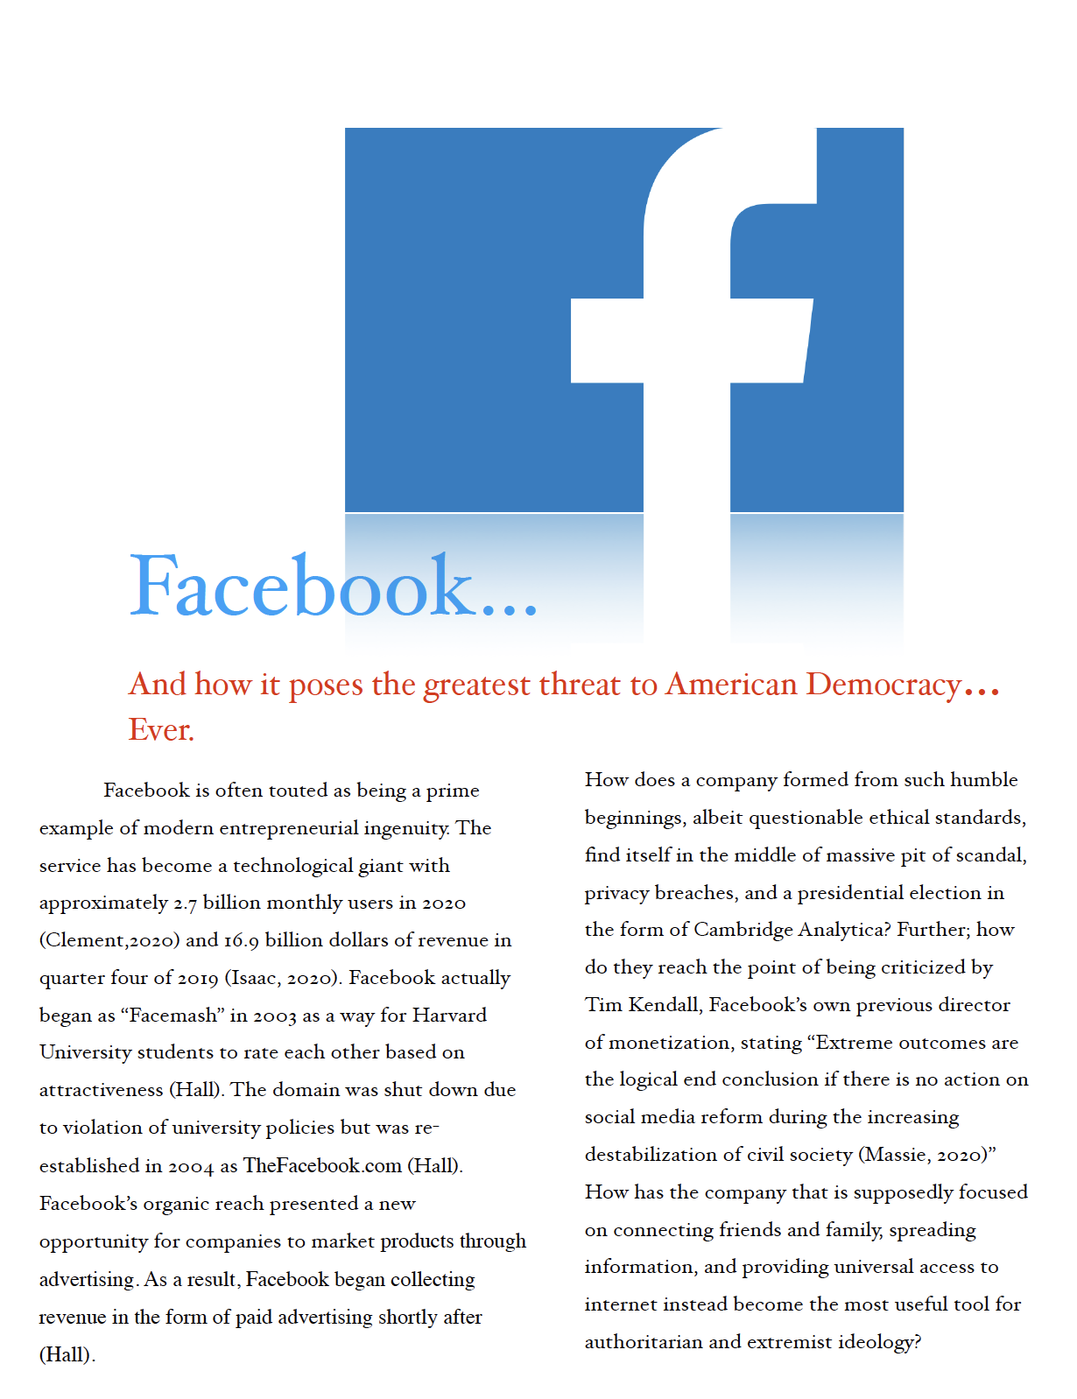
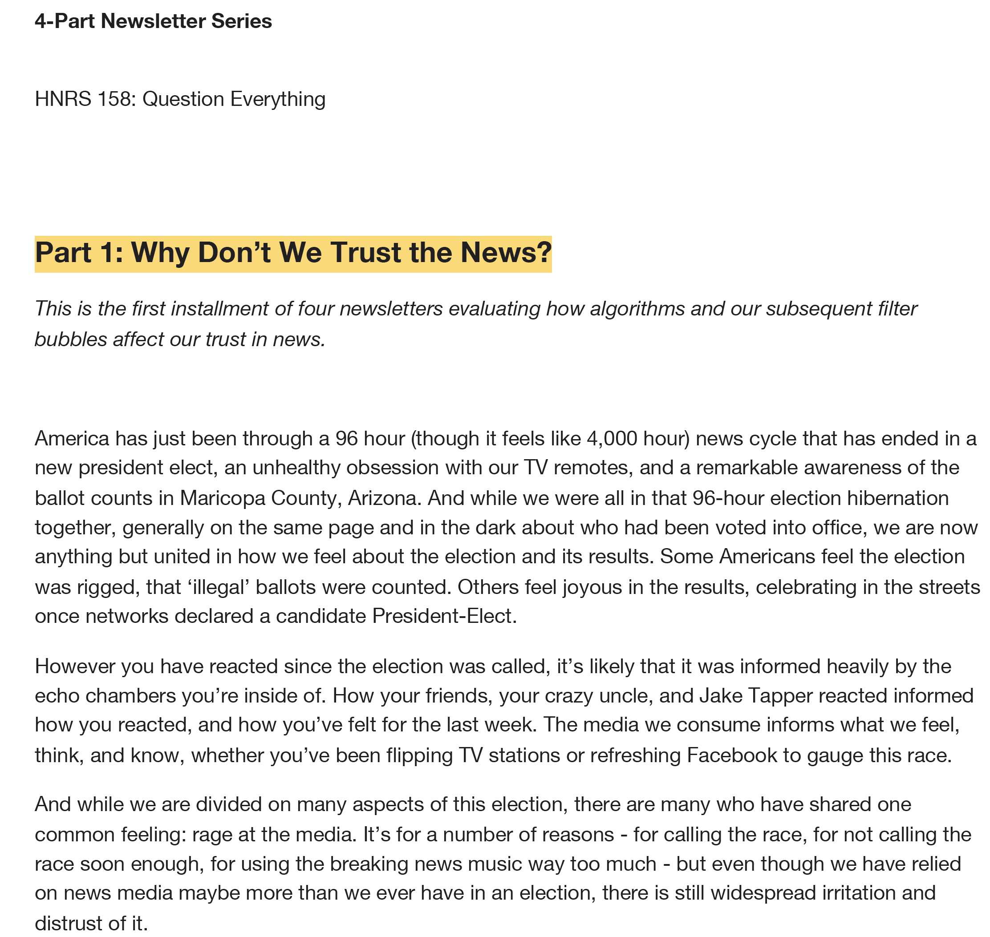
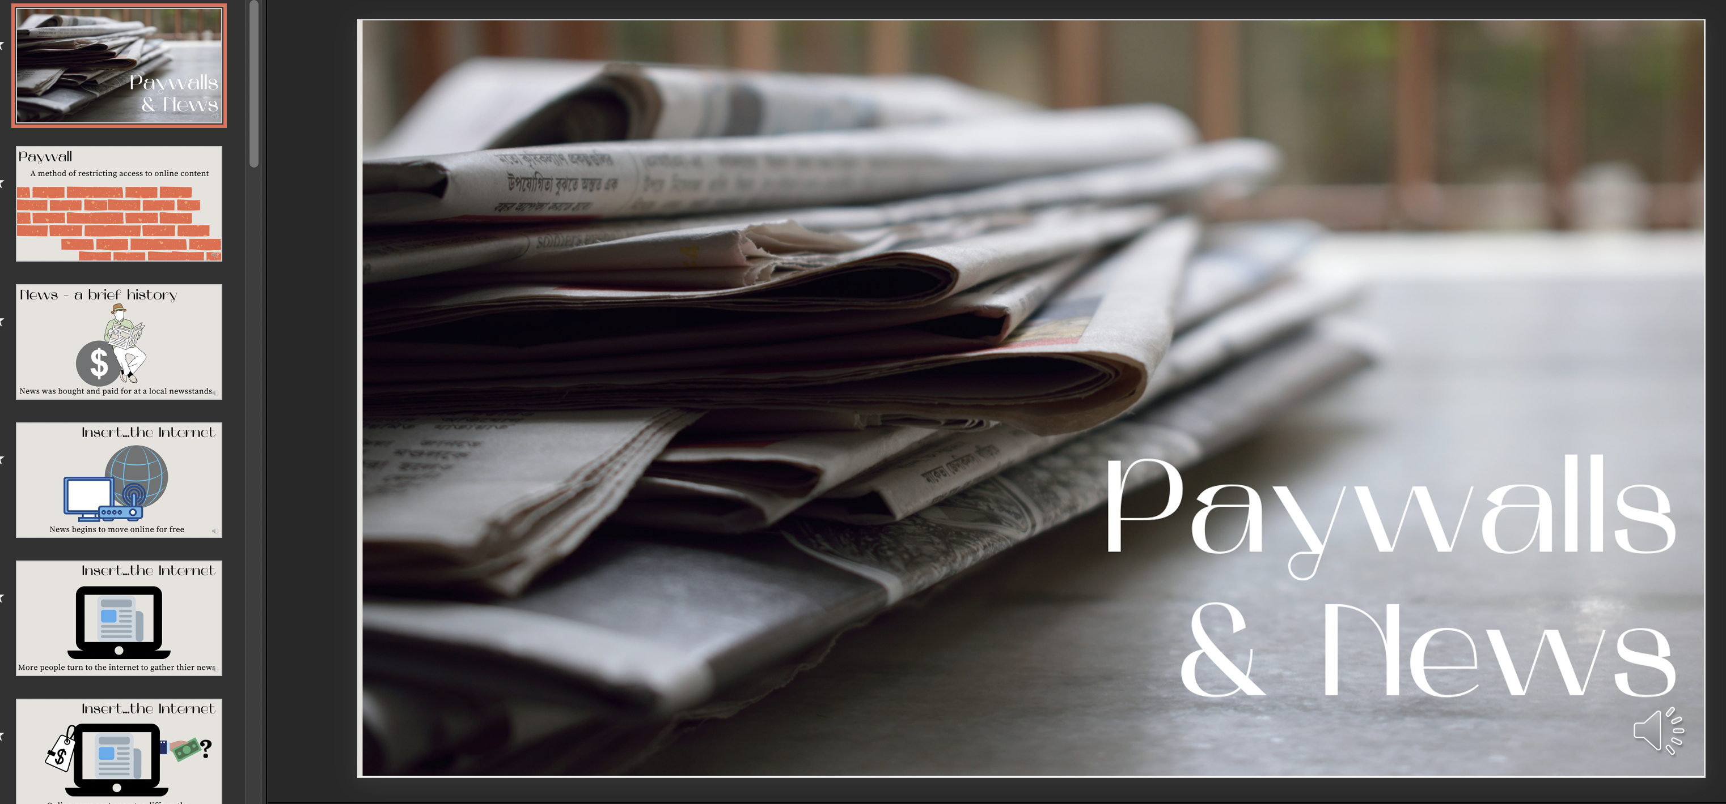
Example Assignments in Multiple Formats

Slide 46
Multiple Means of Engagement & Blended Courses
“Light bulb” by Elionas. Pixabay License

Slide 47
Day 4 Agenda
Multiple Means of Engagement Overview
Blended Courses
Examples
Pair Presentations
Questions and Discussion
Project Work – worksheets 3-4
Agenda by Nick Youngson CC BY-SA 3.0 Alpha Stock Images

Slide 48
Multiple Means of Engagement
Affect represents a crucial element to learning, and learners differ markedly in the ways in which they can be engaged or motivated to learn. There are a variety of sources that can influence individual variation in affect including neurology, culture, personal relevance, subjectivity, and background knowledge, along with a variety of other factors. Some learners are highly engaged by spontaneity and novelty while others are disengaged, even frightened, by those aspects, preferring strict routine. Some learners might like to work alone, while others prefer to work with their peers. In reality, there is not one means of engagement that will be optimal for all learners in all contexts; providing multiple options for engagement is essential. -UDL Guidelines Engagement

Slide 49
Guidelines for Engagement
Recruiting Interest
Spark excitement and curiosity for learning.
Sustaining Effort & Persistence
Tackle challenges with focus and determination.
Self Regulation
Harness the power of emotions and motivation in learning.

Slide 50
YouTube Video
https://youtu.be/-2k_81HWtSM
Notes:
https://youtu.be/-2k_81HWtSM

Slide 51
YouTube Video
https://youtu.be/tYu7rFpYd4g
Notes:
https://youtu.be/tYu7rFpYd4g

Slide 52
Blended Courses and Case Based Learning
http://udloncampus.cast.org/page/planning_course
http://udloncampus.cast.org/page/teach_case
Photo by Ayo Ogunseinde. CC0

Slide 53
Example student barrier and design strategy
Potential Student Experience | Common Barriers | Possible Design Strategy
Students are bored during a lecture. | The lecture is too long. There is no time for students to reflect on content and think. Content is not relevant to student's everyday lives. | Use the flipped classroom model and have students view a video lecture prior to class and use interactive activities during class. Break long lectures up into short mini lectures. Include activities and practice for students to reflect and respond in class with think-pair-share activities, response systems, or a few multiple choice questions. Refer to current events or local events from students interests for increased engagement and relevance.

Slide 54
Example student barrier and design strategy
Potential Student Experience | Common Barriers | Possible Design Strategy
Students are not interested in the course from the first day of class. | Students don't choose the content. Topics are not relevant and seem inauthentic to students. | Ask students why they chose to take the course and what they hope to learn. Use real-world, high-interest examples related to the course content, and give students an opportunity to discuss it individually or in small groups.

Slide 55
Example student barrier and design strategy
Potential Student Experience | Common Barriers | Possible Design Strategy
Learners feel overwhelmed during lectures. | No clear goals for the class. There are few opportunities for feedback. | Set clear and manageable learning outcomes for each class. Share an outline or agenda each class. Include formative assessment practice activities like Kahoot gamified assessment quizzes, self-check questions, or a scenario to practice what they learned. Use exit or entrance tickets where students answer a couple short questions about course materials and then give those back during the next class.

Slide 56
Day 5 Agenda
Making Digital Learning Resources More Accessible
EdTech Tools
Activity
Project work (worksheets 5-6)
Worksheet 7 after fall semester and course observations
Evaluate the UDL Academy and Celebration
Agenda by Nick Youngson CC BY-SA 3.0 Alpha Stock Images

Slide 57
General Accessibility Recommendations
Alt-text
Captions
Built-in Office Features
Accessibility Checkers
Image by Keneeko. Pixabay License.

Slide 58
Alt-Text and Images

Slide 59
Captions
Auto captioning and editing in YouTube (under 15 minutes for unverified accounts- links to a smartphone)
PowerPoint presentation captions

Slide 60
Word Headings

Slide 61
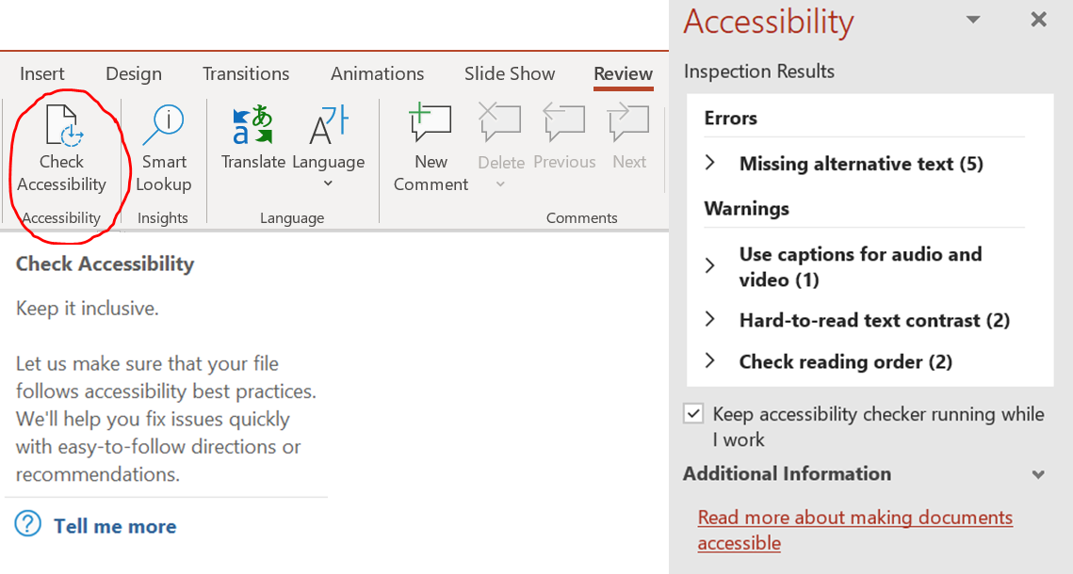
PowerPoint and Word Accessibility Checker Tools

Slide 62
Resources
Books on UDL
Accessible Instructional Design- Edyburn- section about online UDL
Reach Everyone, Teach Everyone- Tobin and Behling
UDL Navigators in Higher Education: A Field Guide- Black and Moore
Free UDL Course
Learning Designed Community
UDL Implementation and Research Network Videos
UDL Libguide
UDL Practice
WebAIM Resources

Slide 63
EdTech Tool Resources
Shared Google Doc with Recommended EdTech Tools
EdTechTeacher
Using Media Ethically
Create Images - edit photos, create infographics, create GIFs, screenshots, etc.
Stock Images - royalty free, high-definition photos curated by professional photographers for the public to freely use.
Create Music - Resources for royalty free music to use
Create Videos - You can create animated videos, screencasts (record your computer screen), and more

Slide 64
Your Action Items
•Pre-Academy Questionnaire
•Pair Presentation (10-15 minutes)
•Project Work and Worksheets 1-6 (7 will be due after you implement UDL in one or more of your courses)
•Post-Academy Evaluation (online or paper copy)
•Share your current (pre-UDL)course syllabus and assignments; and your updated course syllabus and assignments before the beginning of next semester
•Participate and Ask Questions
“To Do” by FinnPetersenSH. Pixabay License.
]=

