Slide 1
Immersive Books:
How to Create AR Materials that Flourish
By Sarinporn Chaivisit¹, Younglong Kim², Thanh Do³, and Ayodeji Ibukun² ¹ Kasetsart University, Thailand; ² Oklahoma State University, United States; ³ Thai Nguyen University, Vietnam

Slide 2
Overview
1. Introduction & Workshop Objective
2. Checking Materials for an Individual Book
3. Creating an AR book
4. Presenting Your Progress

Slide 3
Introduction
Objective
To help you gain skill sets in integrating Augmented Reality (AR) into your professional lives. You will create your own AR books that you can use in your classrooms.

Slide 4
Poll Results
Group 1
(AR book)
Group 2 (CV)

Slide 5
Required Equipment
A laptop computer
Smartphone or tablet to participate in AR app creation activities.
Individual content
Some text content of one or two paragraph(s)
Images
YouTube video link(s) related to the lesson that you would like to teach.

Slide 6
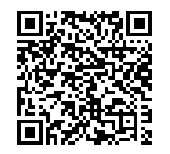
Showcase of AR Books
(Downloading Zappar App)

Slide 7
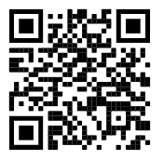
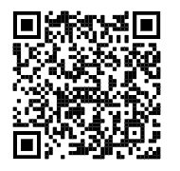
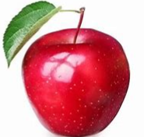
Download the Zappar App on your phone

Slide 8
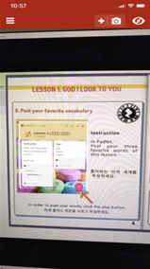
Image of the Zappar App

Slide 9
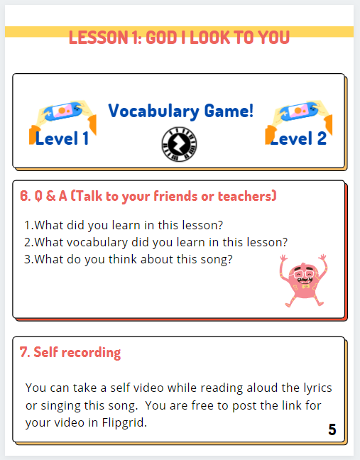
Second image of the Zappar App

Slide 10
Third image of the Zappar app

Slide 11
Sample AR Books
Click the book images to explore these sample AR books.

Slide 12
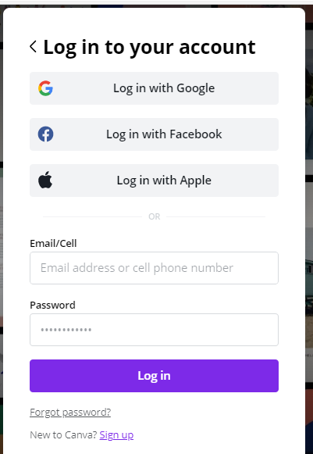
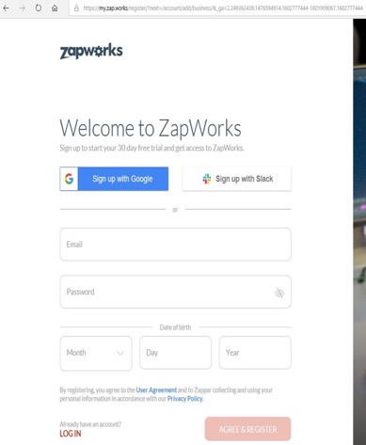
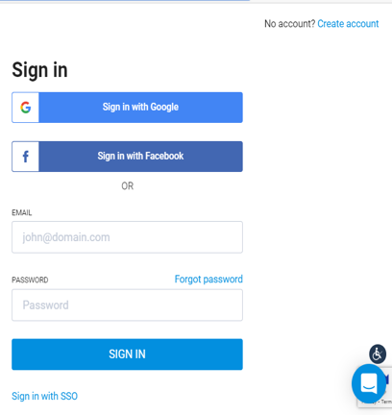
Set Up Canva and Zappar
Canva
Zappar
Flipsnack
** Each link will be in the chat room.

Slide 13
Set Up Canva and Zappar pg. 2
Canva
Zappar
Flipsnack
Please type “done” once you complete signing up on these three websites.
** 15 minutes will be given and let us know if you any have questions.

Slide 14
Main Steps to Create an AR Book
Create paper-based instruction on Canva
Add multimedia content on Zappar
Turn paper-based instruction into a book on Flipsnack

Slide 15
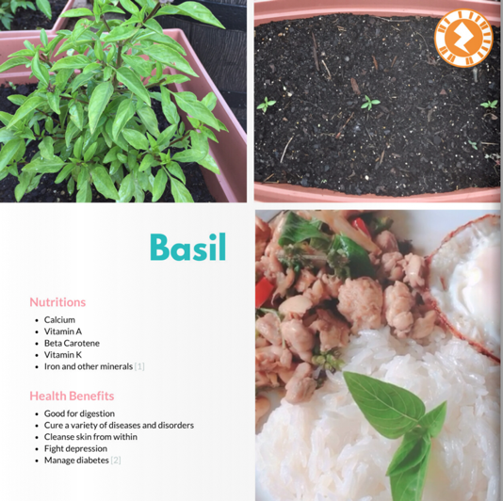
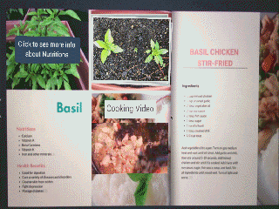
Sample Product

Slide 16
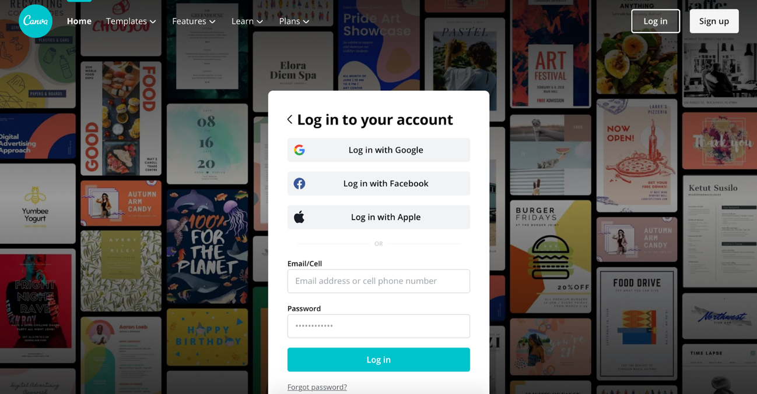
Log in to Canva.com

Slide 17
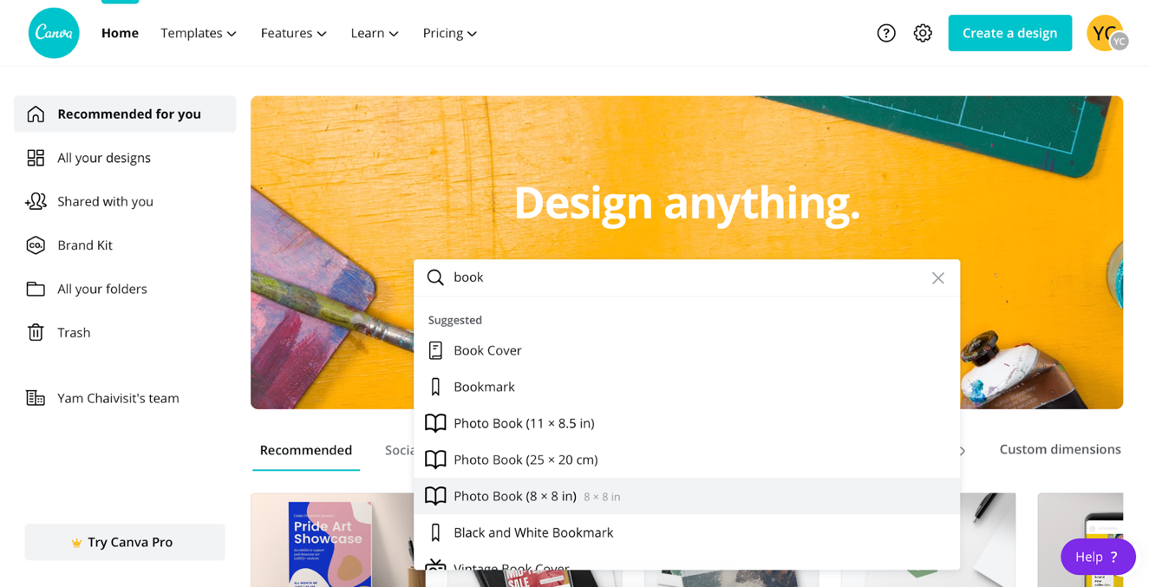
2. Search for a book template

Slide 18
3. Select Photo Book (8 x 8 in)

Slide 19
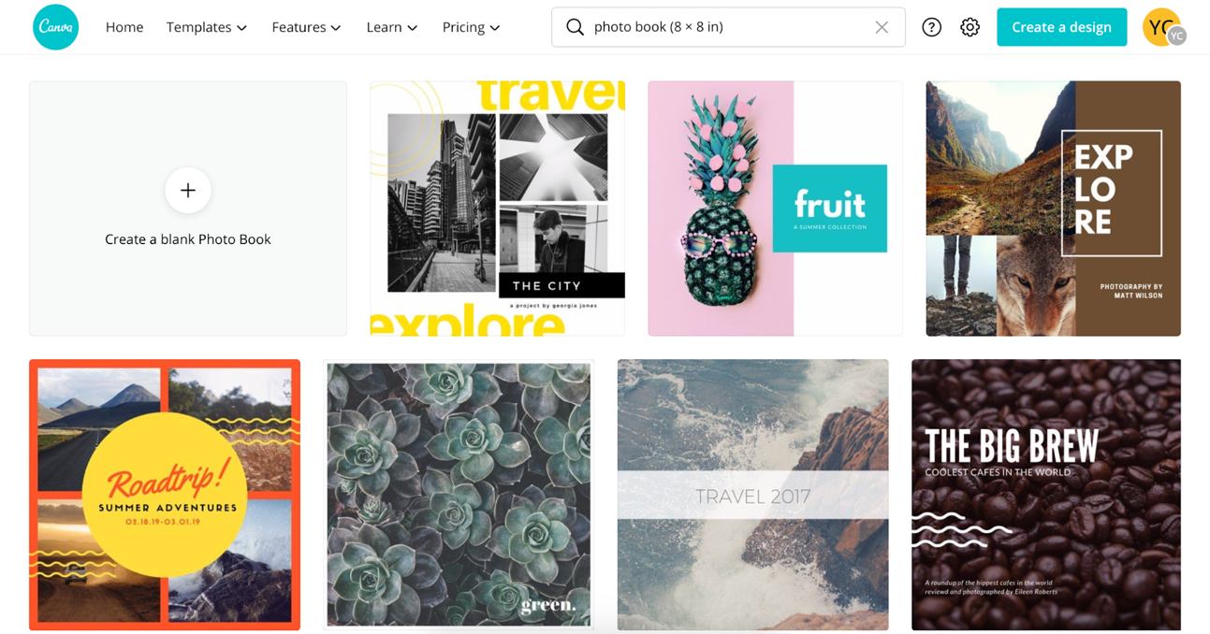
4. Select a template

Slide 20
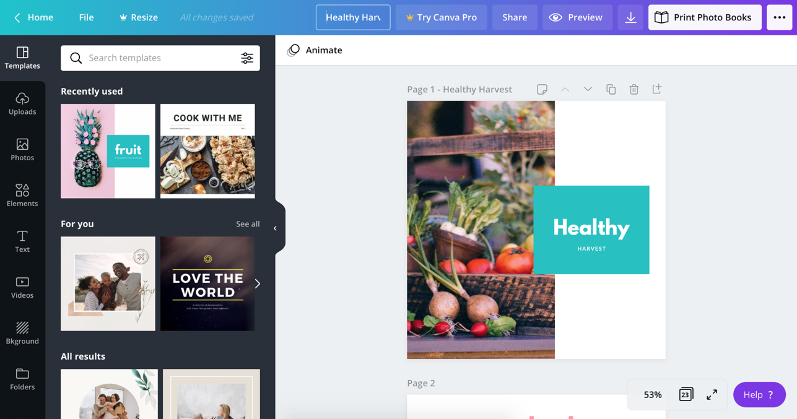
5. Rename the book title

Slide 21
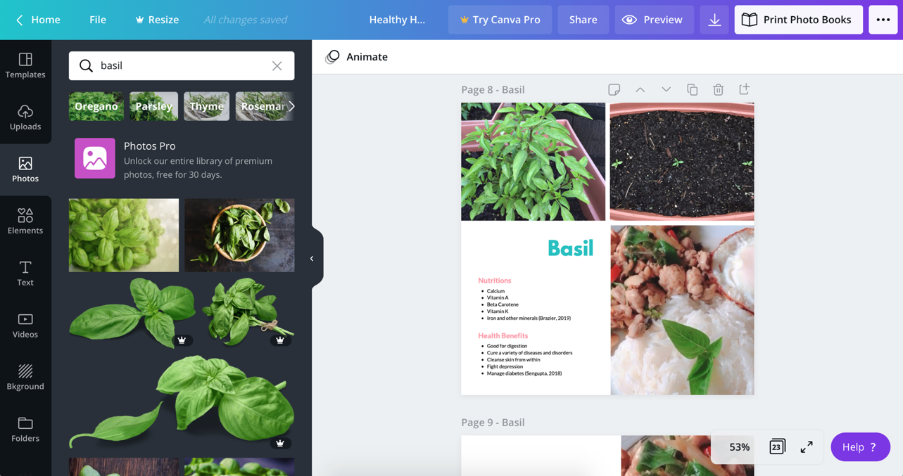
6. Add content such as pictures and texts

Slide 22
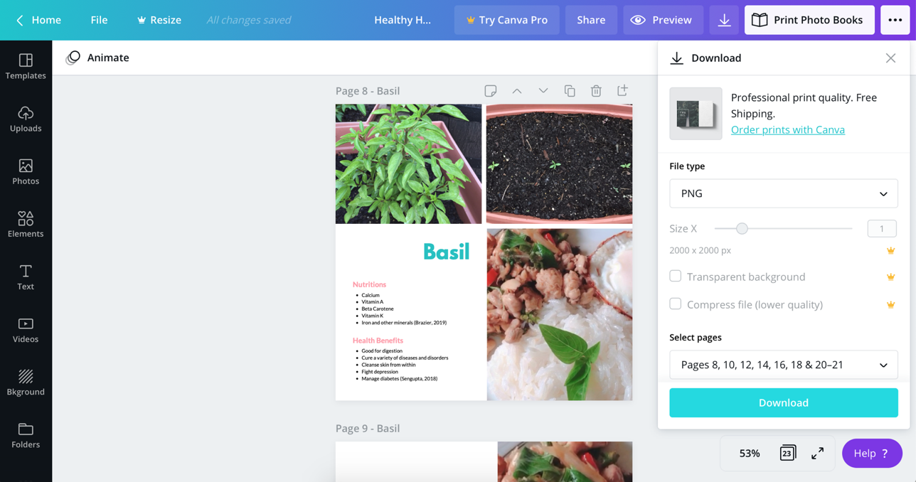
7. Save pictures on your drive

Slide 23
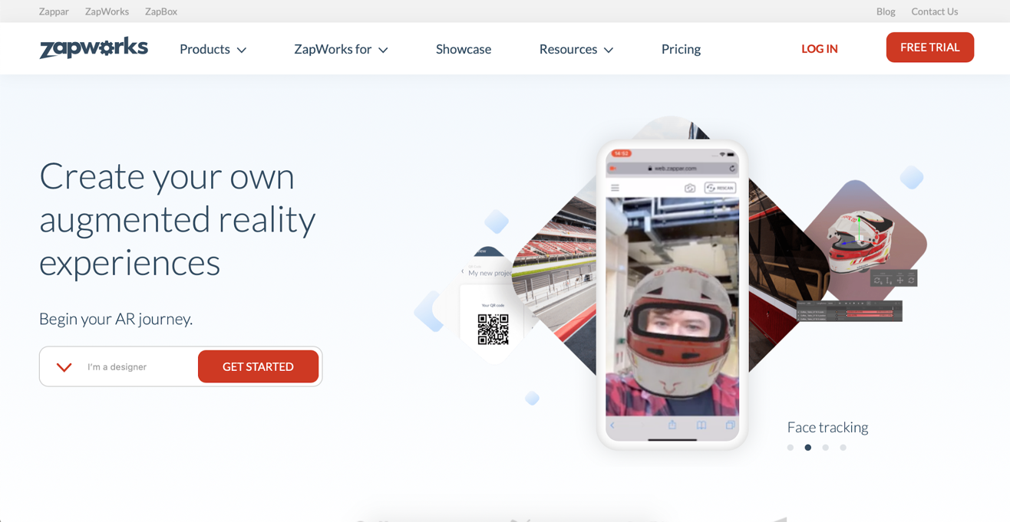
8. Log in to Zap.works

Slide 24
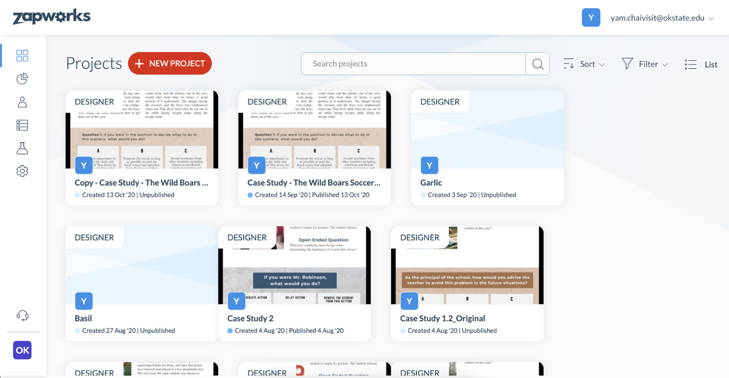
9. Create a new Zapworks project

Slide 25
10. Name the project
Basil Chicken Stir Fried

Slide 26
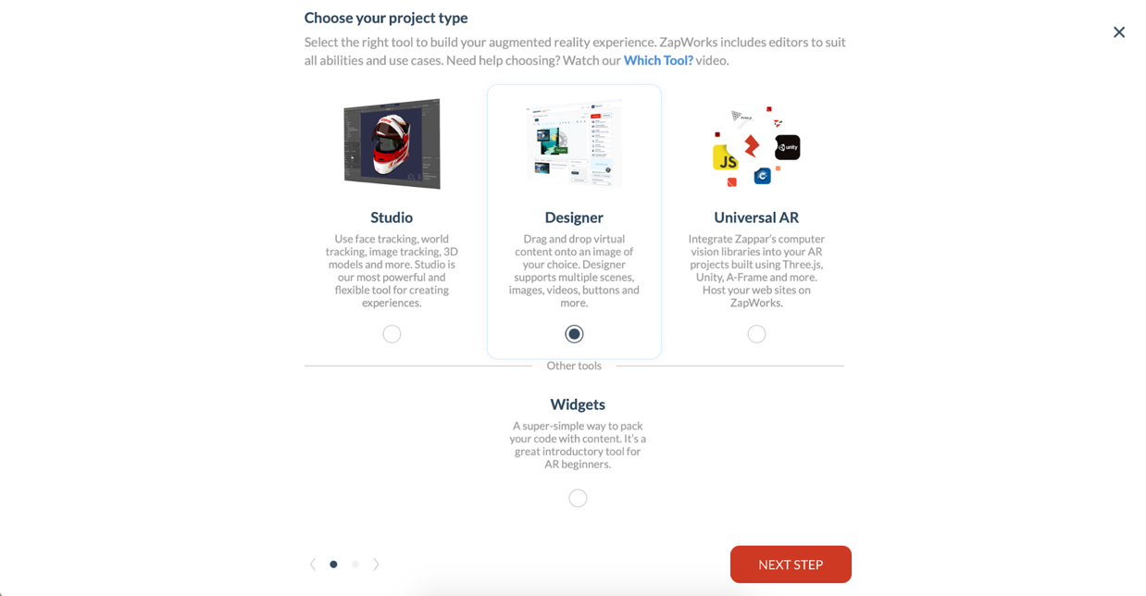
11. Select Designer and click Next Step

Slide 27
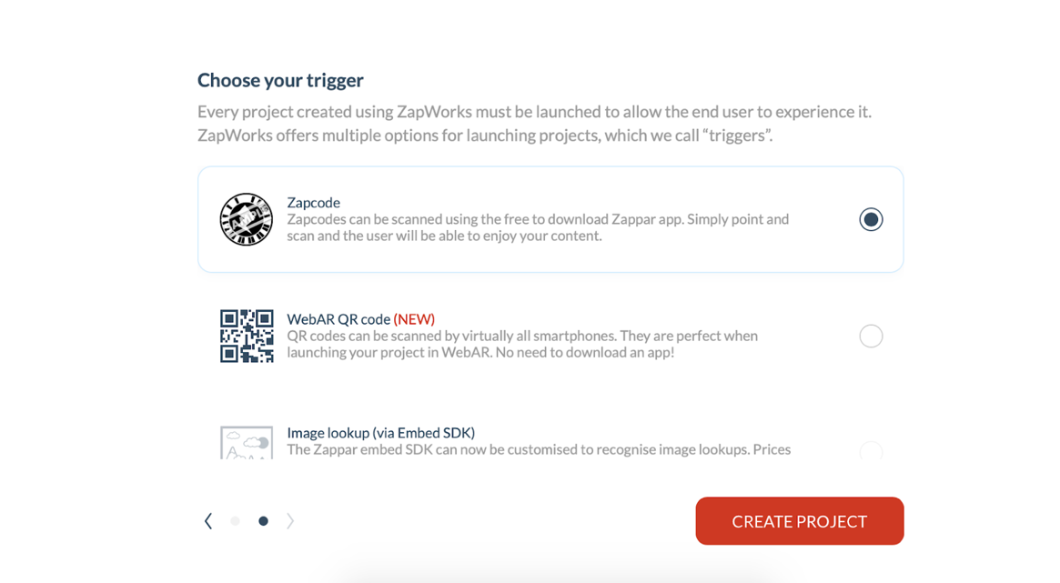
12. Choose Zapcode and click Create Project

Slide 28
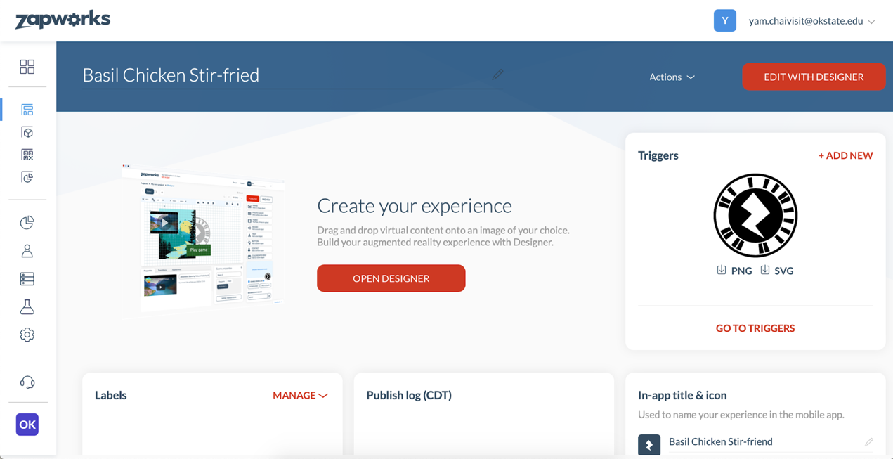
13. Click Open Designer

Slide 29
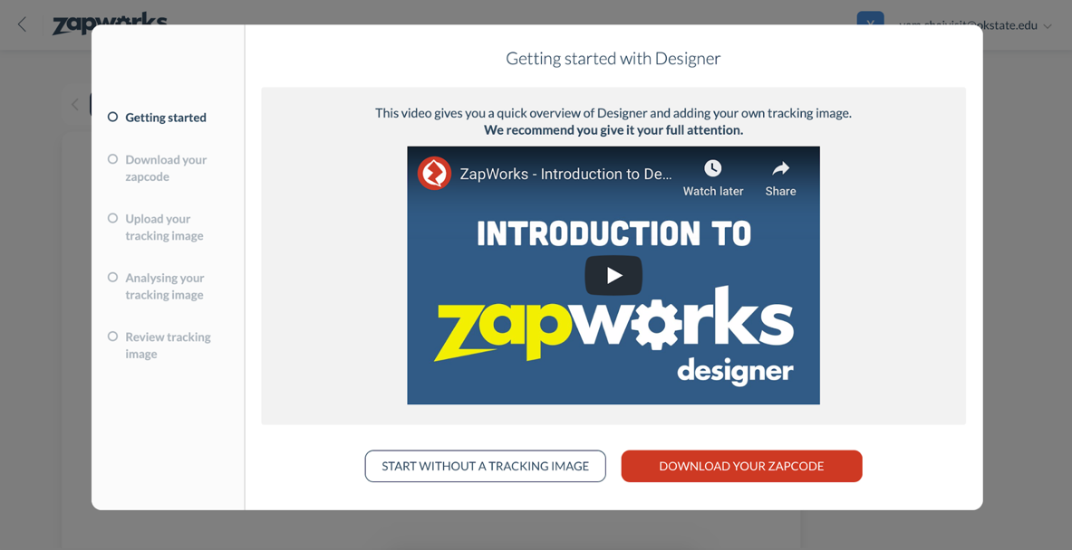
14. Click Download Your Zapcode

Slide 30
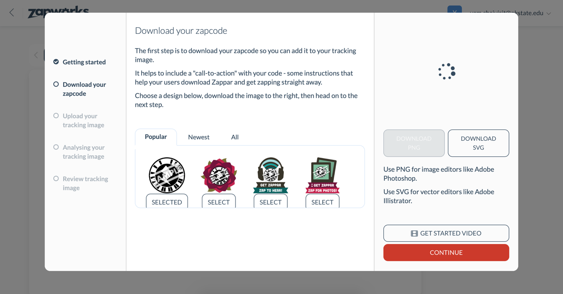
15. Click Continue

Slide 31
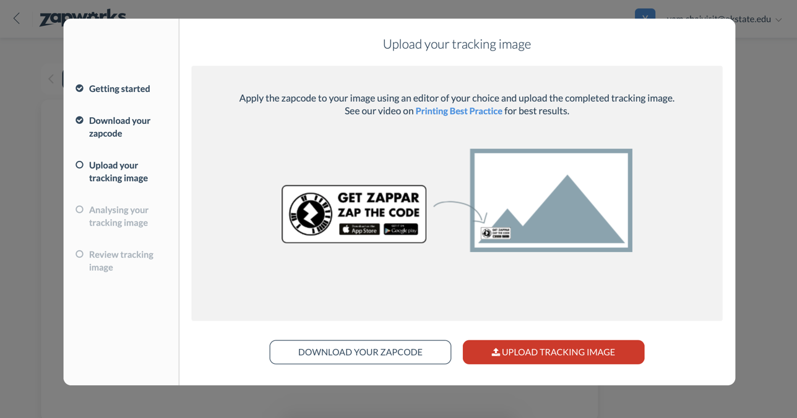
16. Click Upload Tracking Image

Slide 32
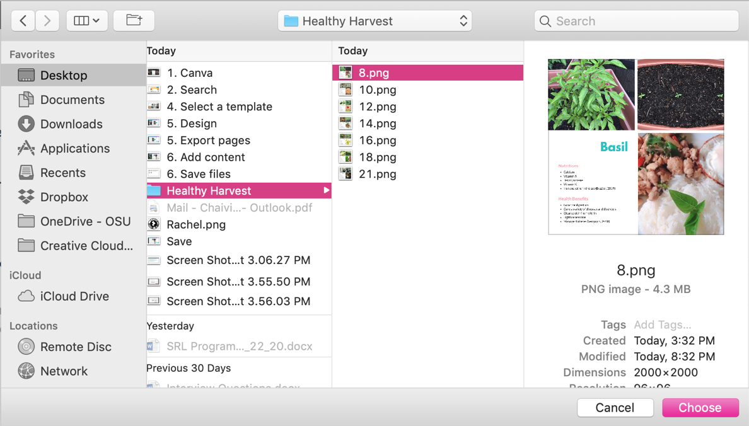
17. Select a tracking image

Slide 33
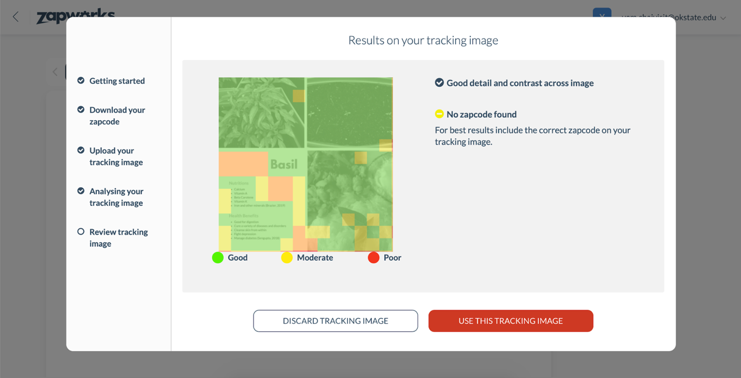
18. Click Use This Tracking Image

Slide 34
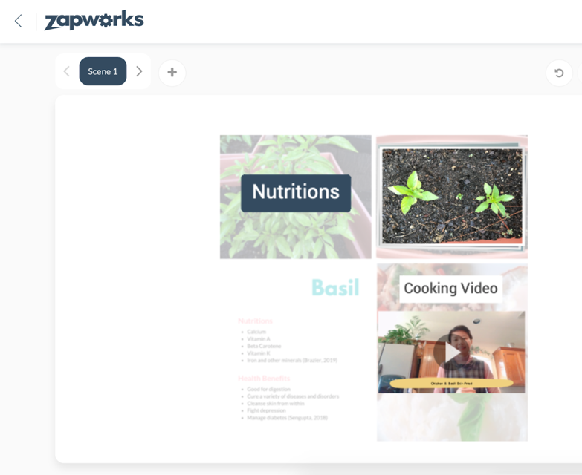
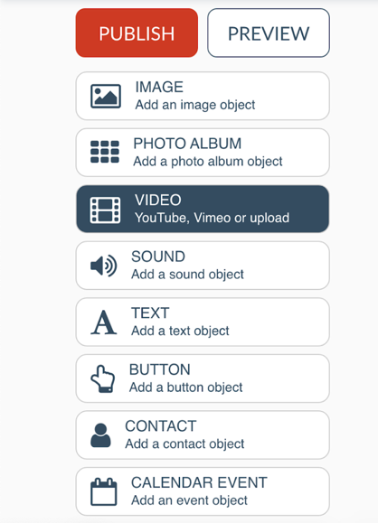
19. Add multimedia content from the menu

Slide 35
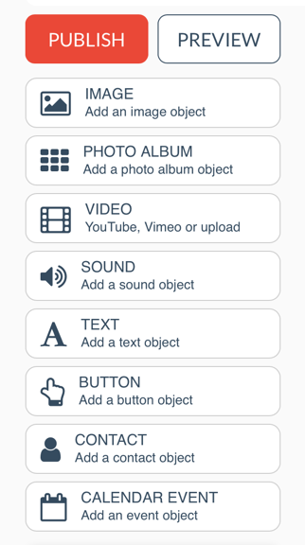
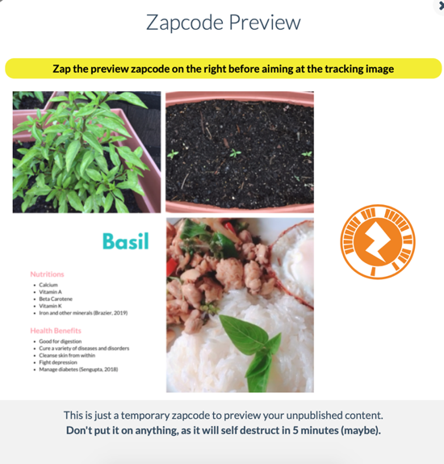
20. Click Publish and Preview. Then, scan a temporary AR code with the Zappar App.

Slide 36
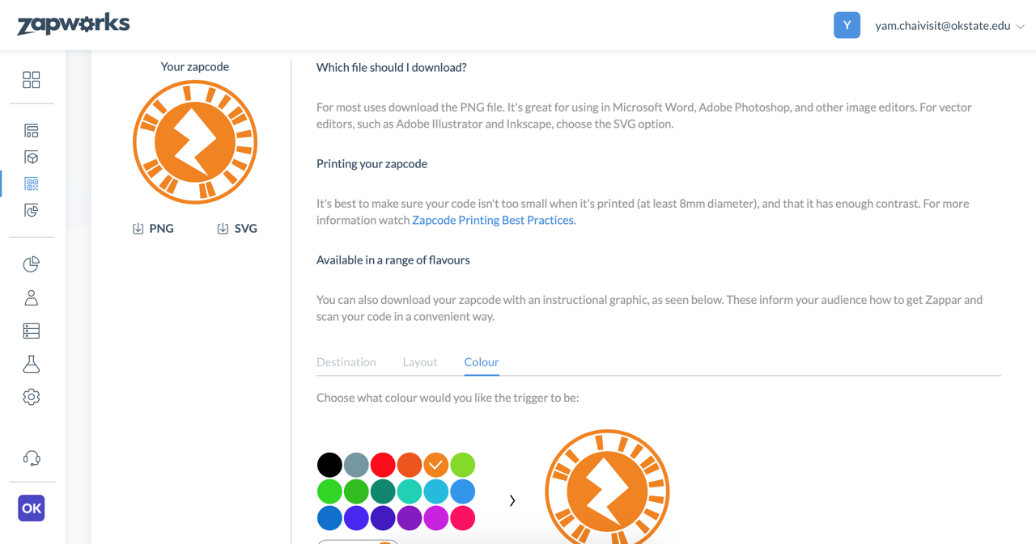
21. Download a Zap code as .PNG file

Slide 37
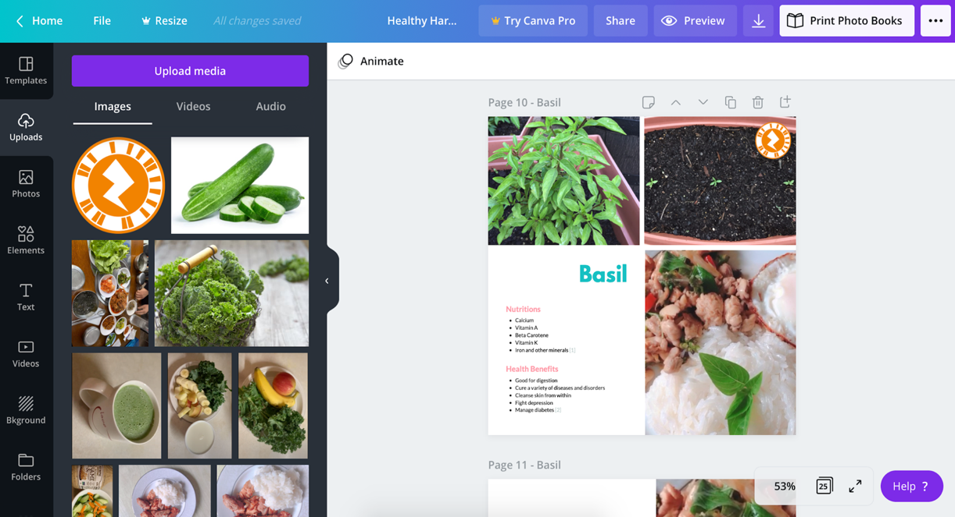
22. Upload the AR code to your Canva design

Slide 38
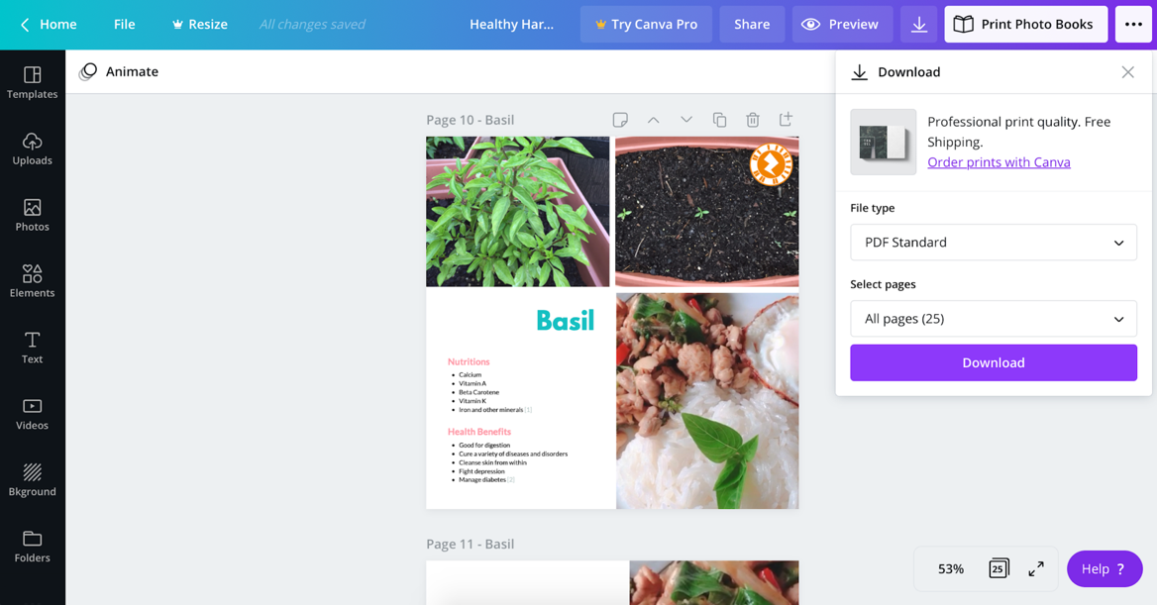
23. Download All pages as PDF Standard
1
2

Slide 39
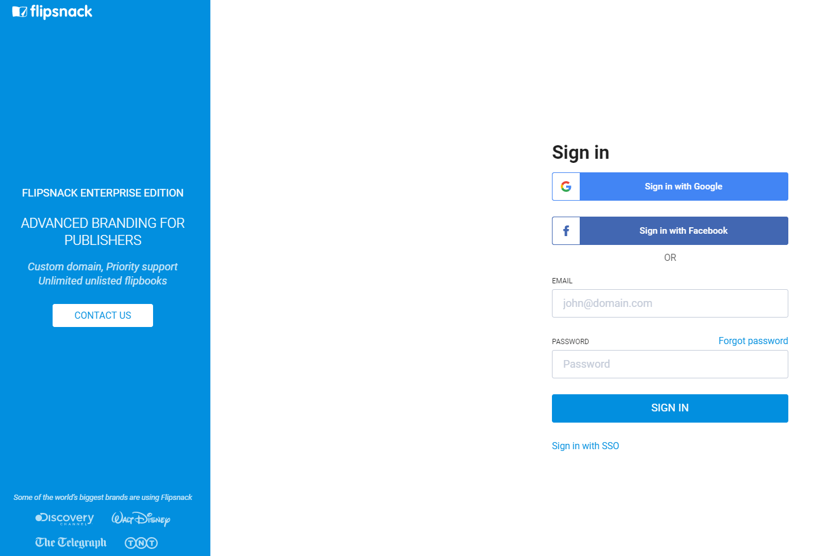
24. Login into Flipsnack

Slide 40
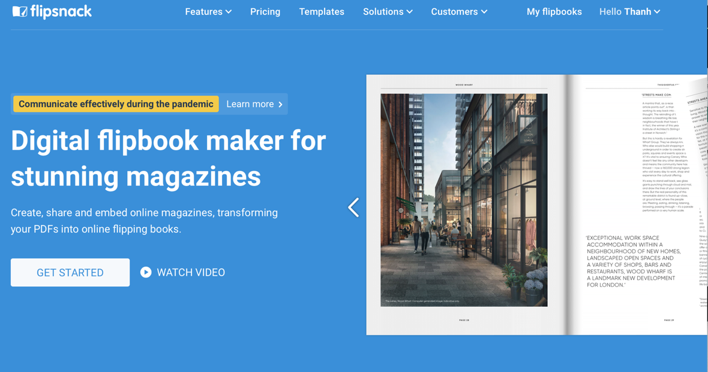
25. Choose My Flipbooks

Slide 41
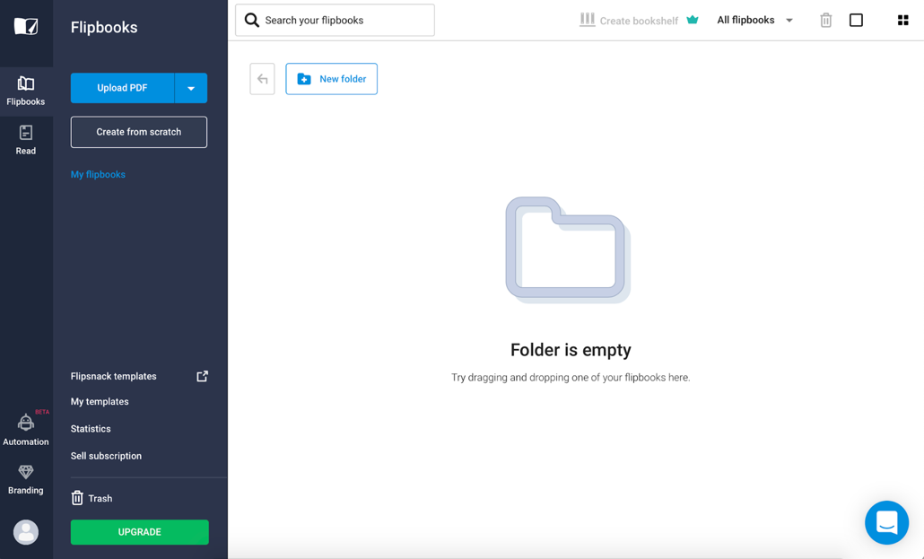
26. Upload PDF

Slide 42
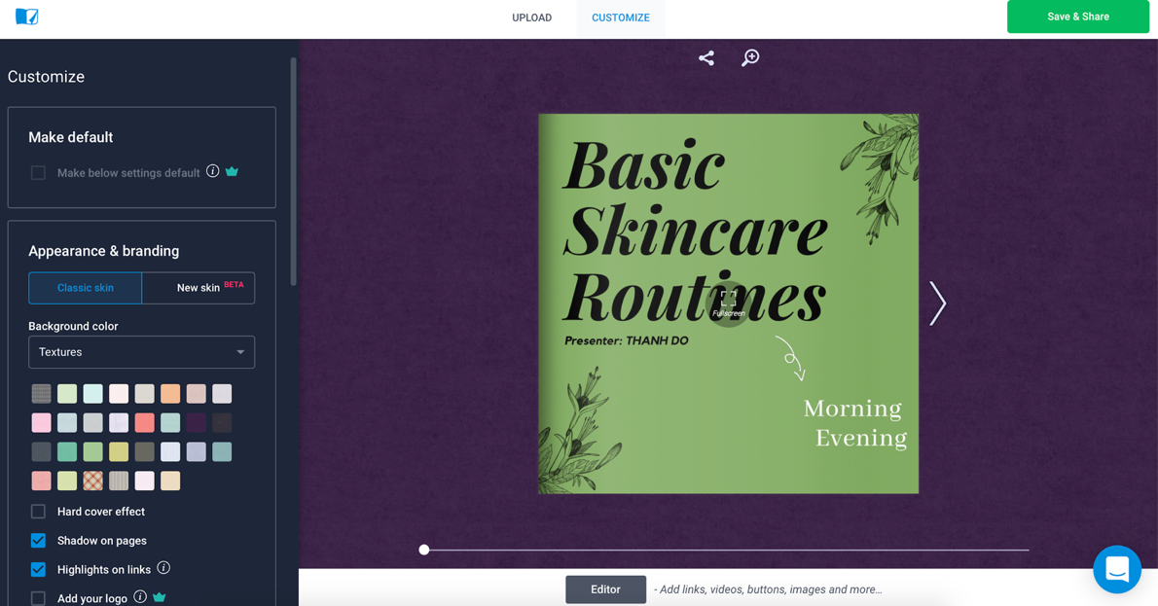
27. Customize the book

Slide 43
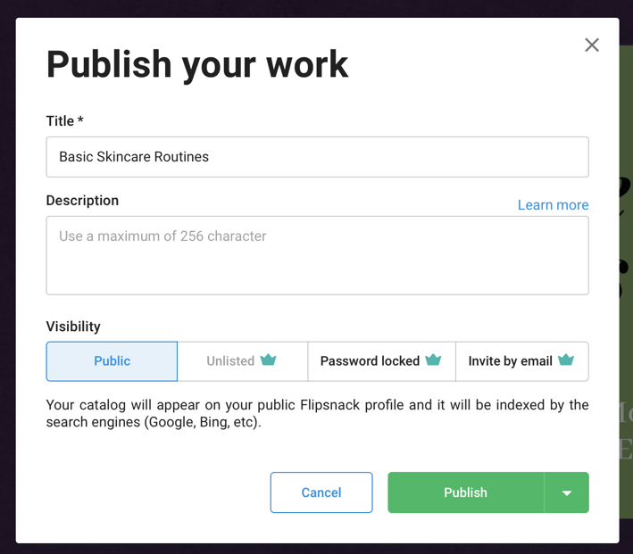
28. Save and Publish

Slide 44
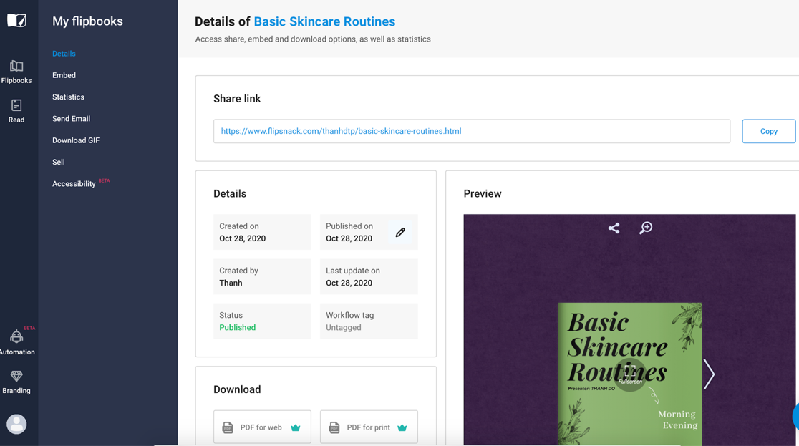
29. Share

Slide 45
Breakout Rooms
About 60 minutes
Canva - 20 minutes
Zappar - 30 minutes (including adding the code in Canva 10 minutes)
Flipsnack - 5 minutes
Q & A - 5 minutes
Group Work
Room 1 - Individual book
Room 2 - General book (cv)

Slide 46
Share your masterpiece and thoughts!
Volunteer attendees will share their screens and present their AR Books that they created.
Could you share your thoughts on creating your AR artifact?
Let’s open Padlet click this link (from the chat)
Share any potential ideas of creating AR books
Share your experience for today
What do you think about making AR books?

Slide 47
Thank you!
Gift: AR Books
Available on Facebook
AR Flourish Books
Follow us:
www.facebook.com/arflourishbooks

