Slide 1
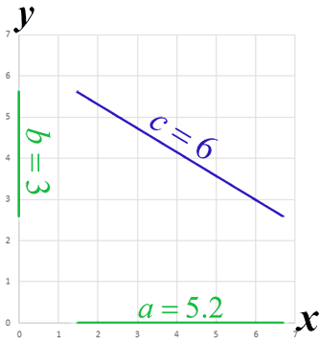
Meets the
Pythagorean Theorem
Photo by Jeet Dhanoa on Unsplash
(Triplight 42, CC 0)

Slide 2
Days 1-2 Lesson Goals
Calculate the Length of sides of right triangles using the Pythagorean Theorem
Calculate the angles of right triangles
Code the Sphero robot to reflect angle and side length calculations
Write block code to move the Sphero robot through a maze

Slide 3
Steps:
Sync your robot to your phone/tablet
Position the Sphero robot on your maze

Slide 4
Inquiry Questions
What are the best speeds to have the robot move through the maze to form a right triangle and a Z?
What angles are needed to successfully navigate the maze?

Slide 5
Set Up Steps
Add the Sphero Edu app to your phone

Slide 6
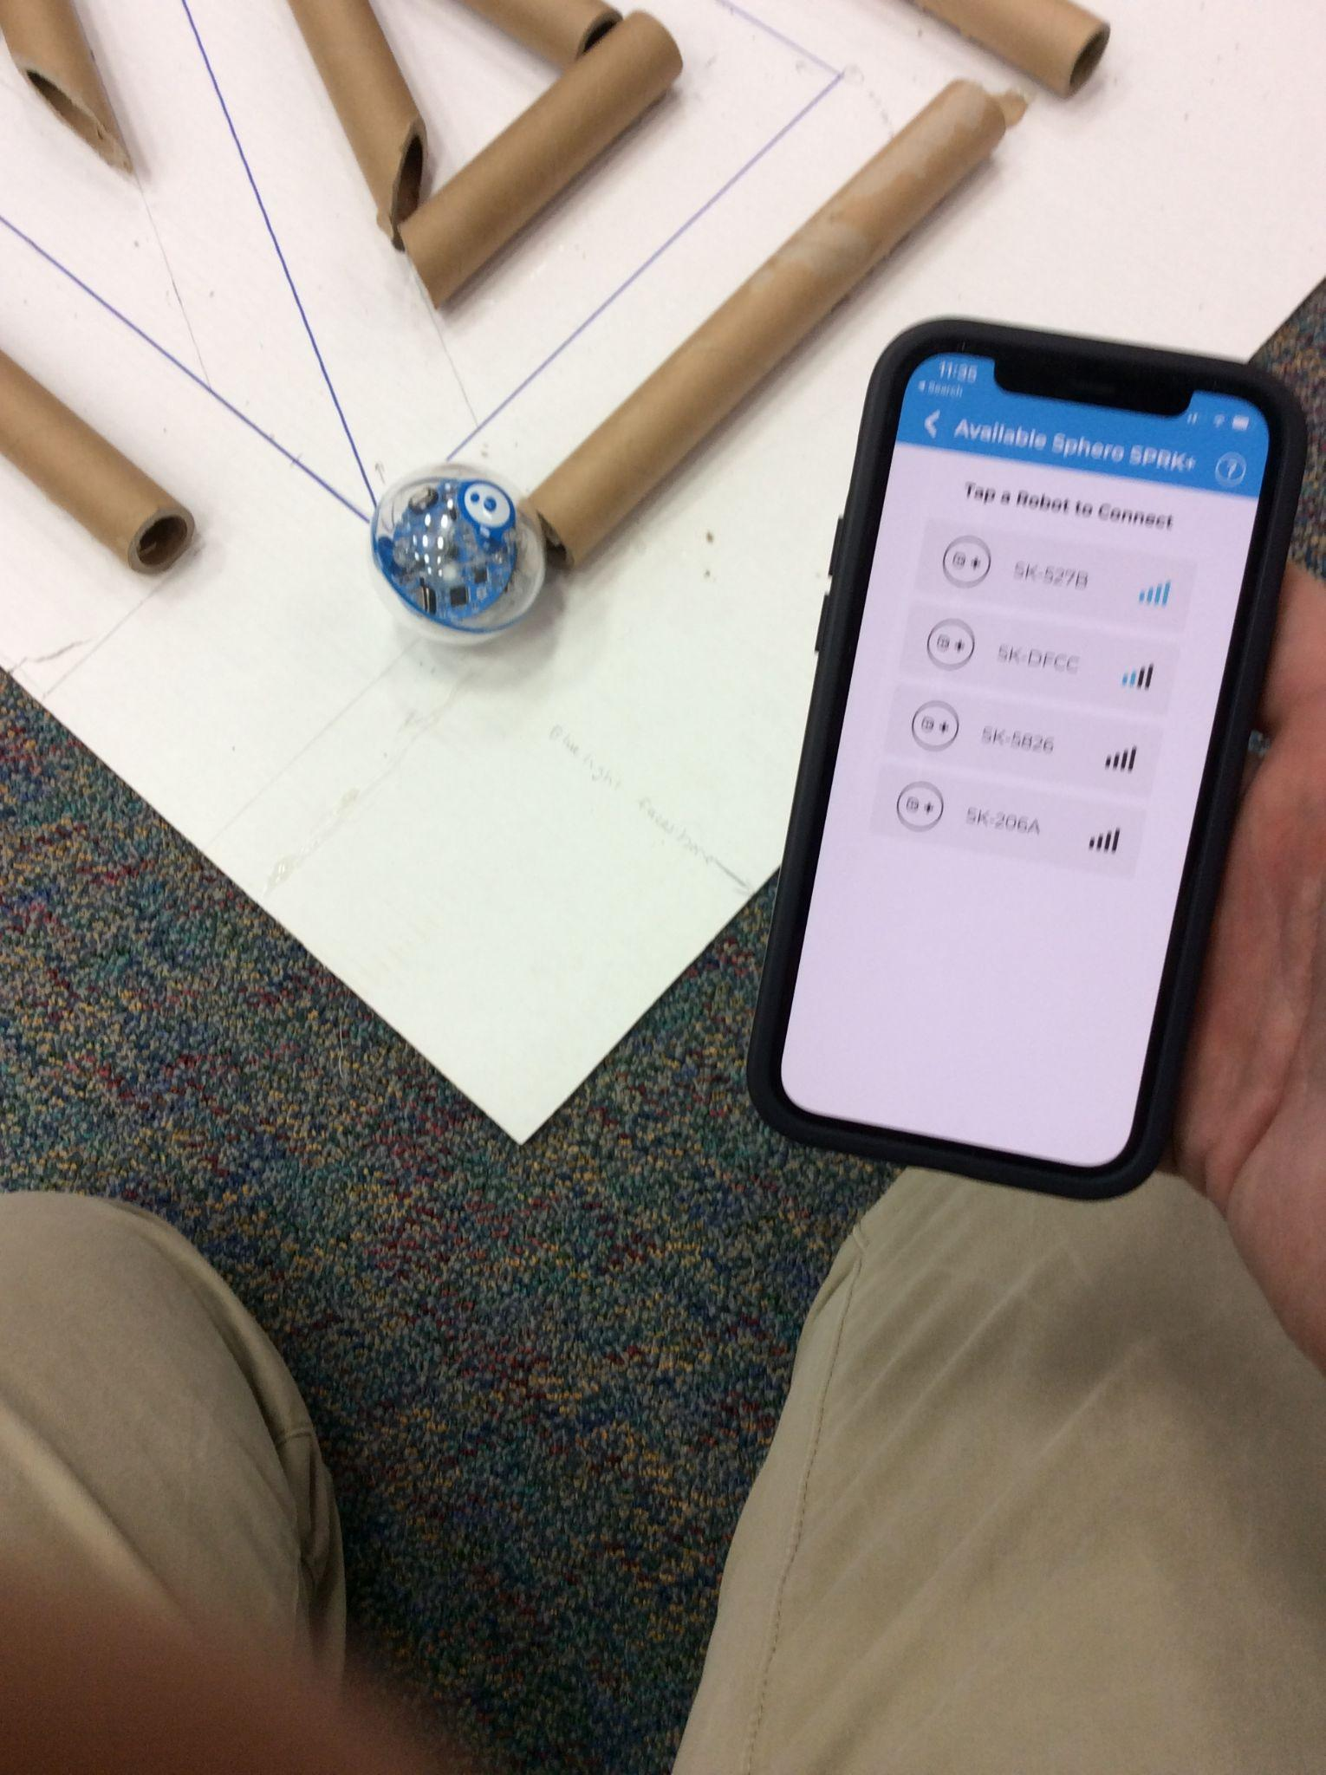
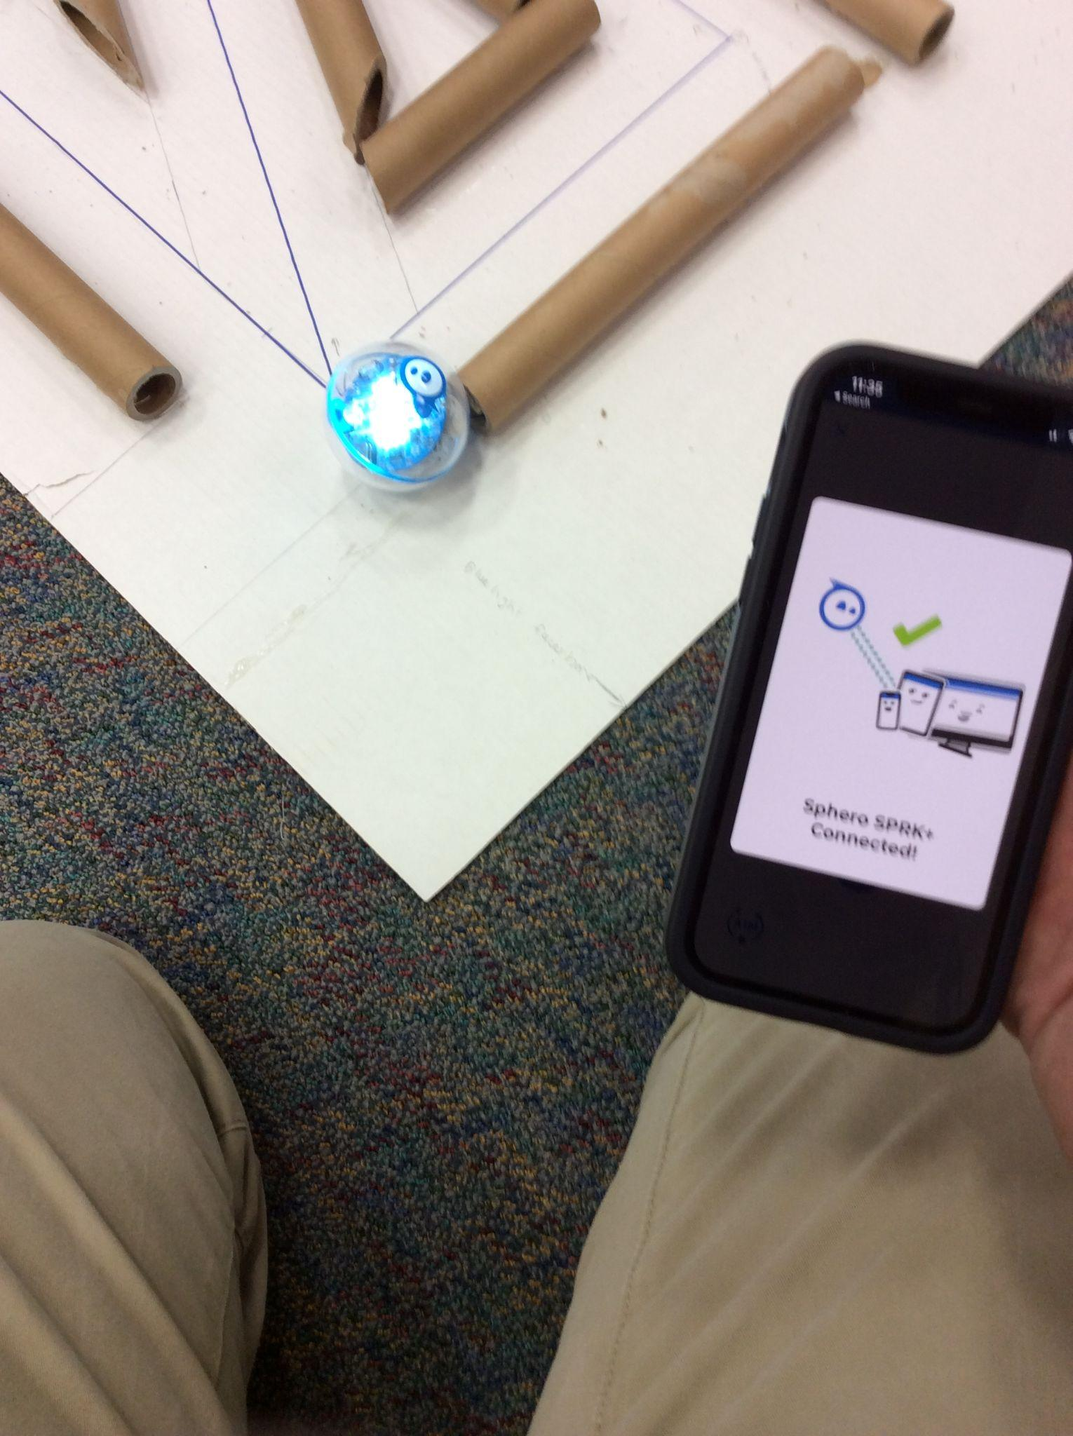
Set Up-Find Your Sphero Robot on Your Phone/Device…
Images are subject to copyright, owned by Sphero, Inc. All rights reserved.

Slide 7
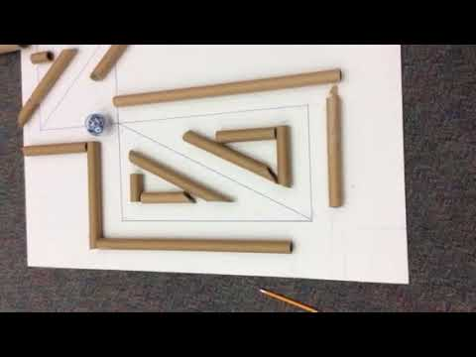
Sphero Code-What’s Wrong….?

Slide 8
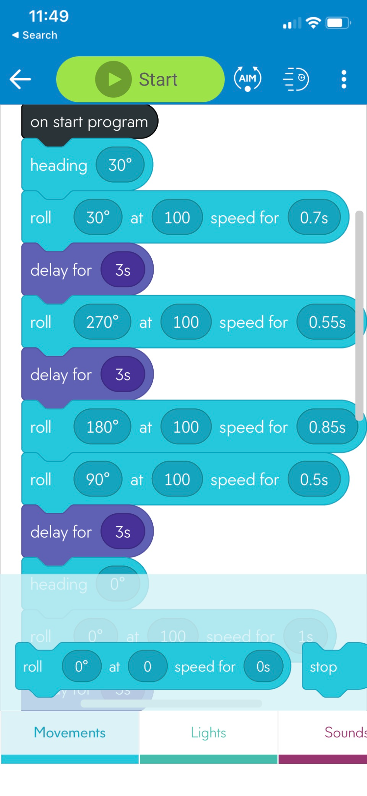
Intro Code
Images are subject to copyright, owned by Sphero, Inc. All rights reserved.

Slide 9
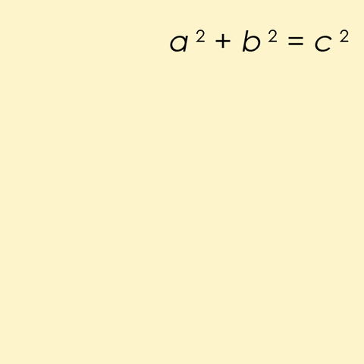
The Pythagorean Theorem
https://media.giphy.com/media/RbOUwWPBinvFe/giphy.gif

Slide 10
Meets the
Pythagorean
Theorem
Day 3-4
Photo by Jeet Dhanoa on Unsplash
(Triplight 42, CC 0)

Slide 11
Days 3-4 Goals:
Add/write the code for the first couple of turns
Get a Sphero robot to test out the opening code
Write the code for both triangles
Program for ….The Tunnel
Complete the Tunnel Test…..

Slide 12
Intro Code
“Stripe” Your Code
Use the Circle protractor for measuring angles
Include the delay blocks between each move/turn (take a breath)
Images are subject to copyright, owned by Sphero, Inc. All rights reserved.

Slide 13
Set Up-Find Your Sphero Robot on Your Phone/Device…
Images are subject to copyright, owned by Sphero, Inc. All rights reserved.

Slide 14
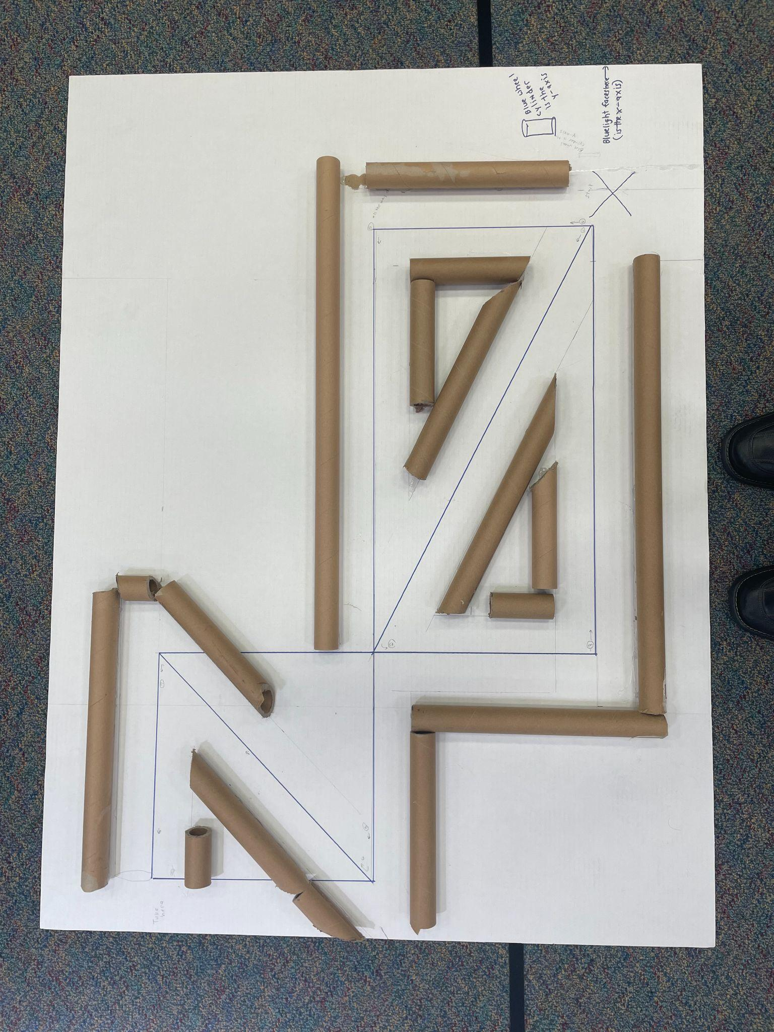
Tunnel Test Criteria
Must travel through the maze-both triangles
Must travel through the tunnel after the two triangles
Must stop on the dime

