Slide 1
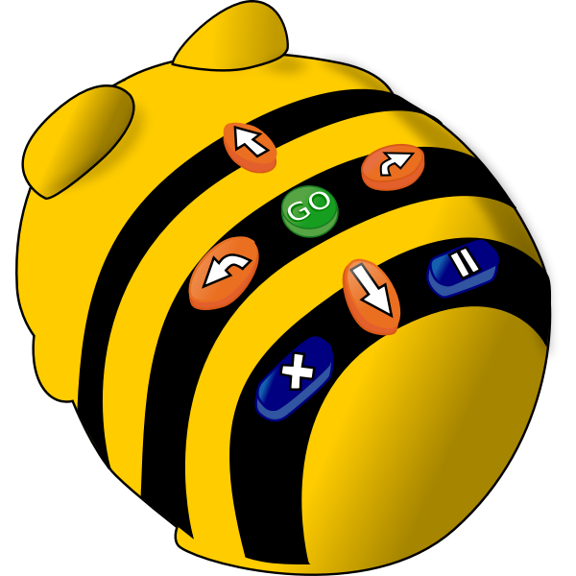
Bee-Bot Buttons
Start
Program
Move
Forward
Turn Right
Pause
Move
Backward
Turn Left
Clear Memory
Bee-Bot in Cartoon Style by OpenClipArt
used under Public Domain License / Text and arrows added to the original
Notes:
The center button is a green circle with the word "Go" printed on it. Press this button for the Bee-Bot to begin moving as programmed.
Located above the center button, the orange oval button with the upward arrow can be pressed for the Bee-Bot to move forward. The Bee-Bot will move forward approximately 15 centimeters for each time this button is pressed.
Located below the center button, the orange oval button with the downward arrow can be pressed for the Bee-Bot to move backward. The Bee-Bot will move backward approximately 15 centimeters for each time this button is pressed.
Located to the right of the center button, the orange oval button with the arrow pointing right can be pressed for the Bee-Bot to turn right. The Bee-Bot’s center will remain in the same spot, but it will rotate to face a direction approximately 90 degrees in the clockwise direction.
Located to the left of the center button, the orange oval button with the arrow pointing left can be pressed for the Bee-Bot to turn left. The Bee-Bot’s center will remain in the same spot, but it will rotate to face a direction approximately 90 degrees in the counter-clockwise direction.
Located in the bottom right corner of the Bee-Bot’s buttons, the blue oval button with the parallel lines can be pressed for the Bee-Bot to pause momentarily. The Bee-Bot’s eyes will blink once to indicate it is pausing and then will continue with the rest of the program.
Located in the bottom left corner of the Bee-Bot’s buttons, the blue oval button with the “X” can be pressed to clear the Bee-Bot’s memory. If the clear button is not pressed between programs, the Bee-Bot adds a child’s new program to the end of the previous program.

Slide 2
Bee-Bot Buttons
Start
Program
Move
Forward
Turn Right
Pause
Move
Backward
Turn Left
Clear Memory
Bee-Bot in Cartoon Style by OpenClipArt
used under Public Domain License / Text and arrows added to the original
Notes:
The center button is a green circle with the word "Go" printed on it. Press this button for the Bee-Bot to begin moving as programmed.
Located above the center button, the orange oval button with the upward arrow can be pressed for the Bee-Bot to move forward. The Bee-Bot will move forward approximately 15 centimeters for each time this button is pressed.
Located below the center button, the orange oval button with the downward arrow can be pressed for the Bee-Bot to move backward. The Bee-Bot will move backward approximately 15 centimeters for each time this button is pressed.
Located to the right of the center button, the orange oval button with the arrow pointing right can be pressed for the Bee-Bot to turn right. The Bee-Bot’s center will remain in the same spot, but it will rotate to face a direction approximately 90 degrees in the clockwise direction.
Located to the left of the center button, the orange oval button with the arrow pointing left can be pressed for the Bee-Bot to turn left. The Bee-Bot’s center will remain in the same spot, but it will rotate to face a direction approximately 90 degrees in the counter-clockwise direction.
Located in the bottom right corner of the Bee-Bot’s buttons, the blue oval button with the parallel lines can be pressed for the Bee-Bot to pause momentarily. The Bee-Bot’s eyes will blink once to indicate it is pausing and then will continue with the rest of the program.
Located in the bottom left corner of the Bee-Bot’s buttons, the blue oval button with the “X” can be pressed to clear the Bee-Bot’s memory. If the clear button is not pressed between programs, the Bee-Bot adds a child’s new program to the end of the previous program.

