Slide 1
Introduction to Cybersecurity
Steganography

Slide 2
The Problem: How did they do it?
A group of students were reported for cheating on a test but after investigation there was no proof of how the students got the test questions or answers. The teacher knew they cheated because they all used the same terms for the answers, but they were not seated next to each other in the exam hall. Also, they all missed the four questions which were a last-minute addition to the test by the teacher.
After reviewing the devices and social media presence of the students, no shared document was found except some picture memes the students shared as a joke between themselves.
How did they cheat?
What do you think happened?
DO NOT TRY THIS BECAUSE YOU WILL BE CAUGHT AND PENALIZED.

Slide 3
Steganography
Goals/objectives
Essential Questions
At the end of this class students will be able to
Explain what steganography is.
Differentiate between steganography and cryptography.
Practice with objects to create your own steganography.
Send a secret message embedded in an image.
What is Steganography?
How can it be used?
How is steganography different from cryptography?
Reminder: Do not practice anything you learn here outside this classroom without parental permission. Always abide by the code of honor and conduct established by the school.

Slide 4
Video: Let Watch this and discuss
Introduction to Steganography:
The Problem: How did they do it?
Watch the following YouTube video to learn about steganography:
https://youtu.be/xepNoHgNj0w
How did they cheat?
What do you think happened?

Slide 5
Back to our students in trouble for cheating..
What do you think happened?
How did they share the test information?

Slide 6
What is Steganography?
Steganography is a technique that can hide code in plain sight, such as within an image file ( Cameron, n.d.)
Click the SentinelOne (2019) link below to see a hidden code example
Hiding Code Inside Images: How Malware Uses Steganography
Cryptography is the practice of writing coded or encrypted messages (Cameron, n.d.)
Click the SentinelOne (2019) link below to see a cryptography code example
Hiding Code Inside Images: How Malware Uses Steganography

Slide 7
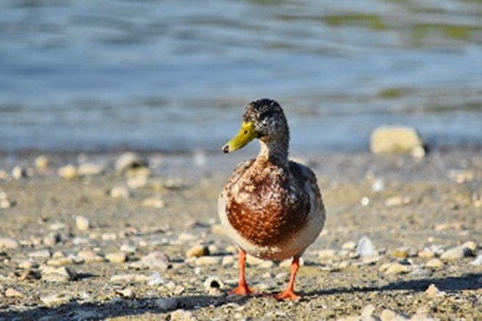
Class Practice: Review this Image
Follow these instructions to download and save the image to your desktop
Locate the Duck1 image on the JTILT website associated with this lesson and presentation.
Download the image to your computer and remember where you saved it.
Figure 1: Duck Image (Bicanski, n.d.)

Slide 8
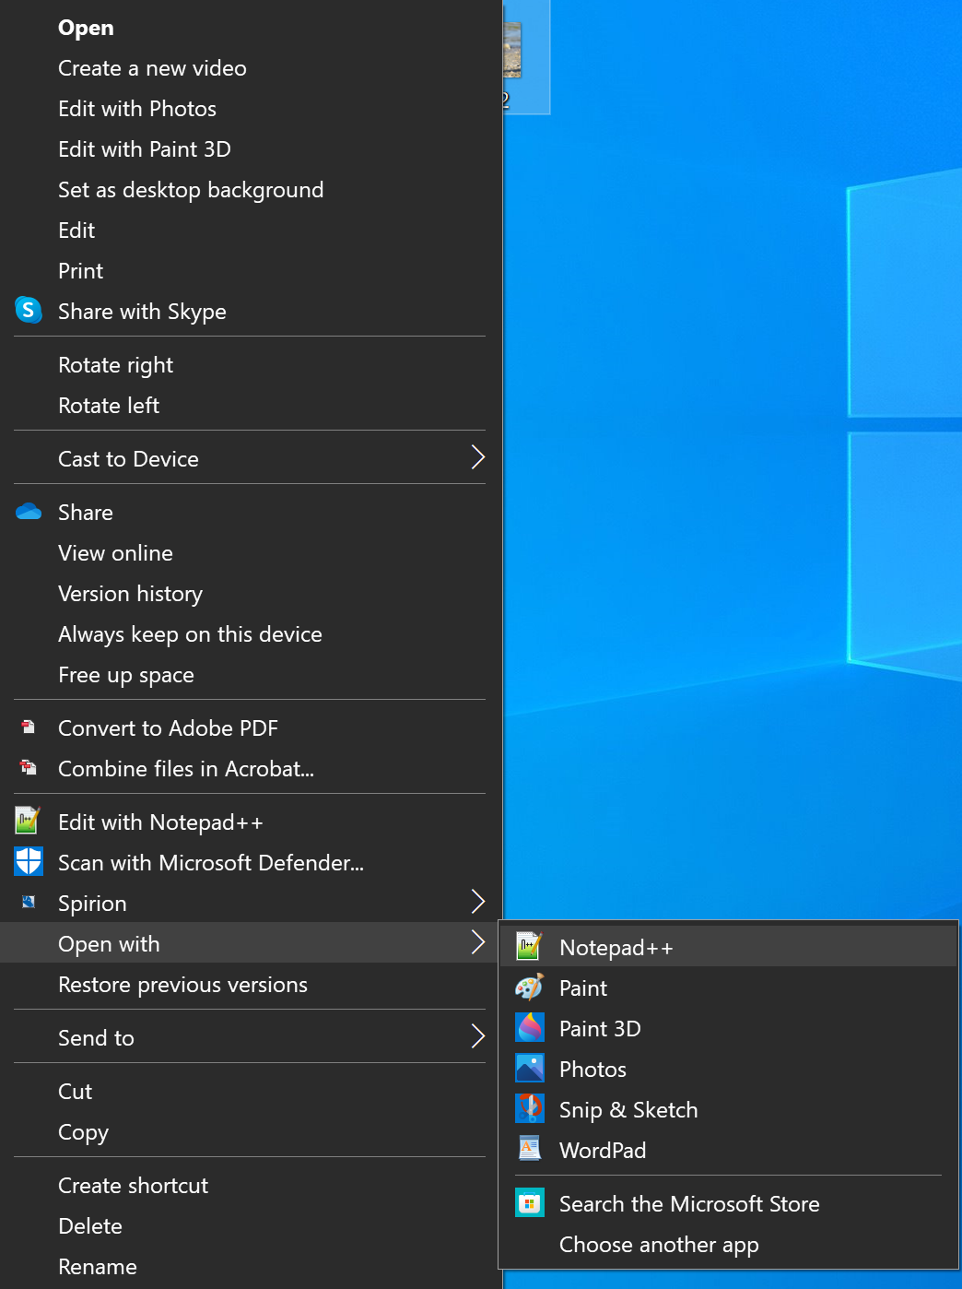
Class Practice: Follow the instruction to view the image codes
Right click on the image
Select the open with option
Select Notepad++
This will display the bits that make up the image as a set of characters shown in the next slide

Slide 9
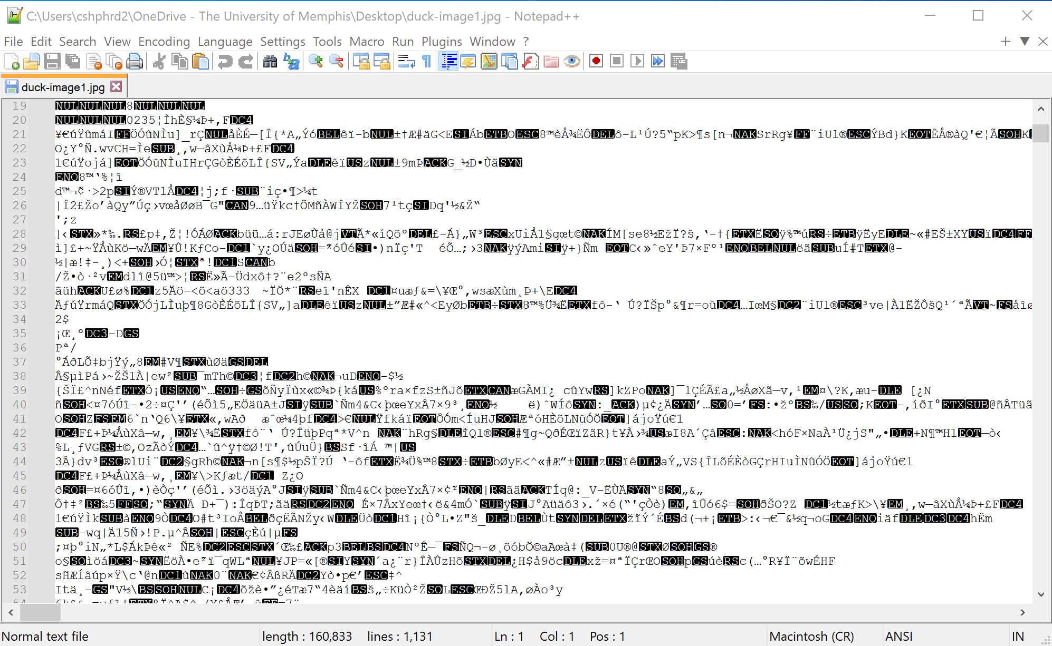
The Duck1 image opened in Notepad++ as a set of character codes.
In Steganography, messages can be hidden between the characters

Slide 10
Let us look at Figure 7
-Figure 7 describes the hierarchy of security systems.
[ To Access Figure 7, use the following article:
Kadhim, I. J., Premaratne, P., Vial, P. J., & Halloran, B. (2019). Comprehensive survey of image steganography: Techniques, Evaluations, and trends in future research. Neurocomputing, 335, 299-326. https://doi.org/10.1016/j.neucom.2018.06.075]

Slide 11
Cryptography: Information Hiding in Plain Sight
Click the Cameron (n.d.) link below to see an example of information hiding with cryptography:
With Cryptography Easier to Detect, Cybercriminals Now Hide Malware in Plain Sight. Call It Steganography. Here's How It Works

Slide 12

- Open the Duck1 image you downloaded and find a secret code.
Did you see it?
Hint: Search for the word code
-Download the duck2 image and save it as duck2.
-Find the secret message
Hint: Search for the word code
Figure 1: Duck Image (Bicanski, n.d.)

Slide 13
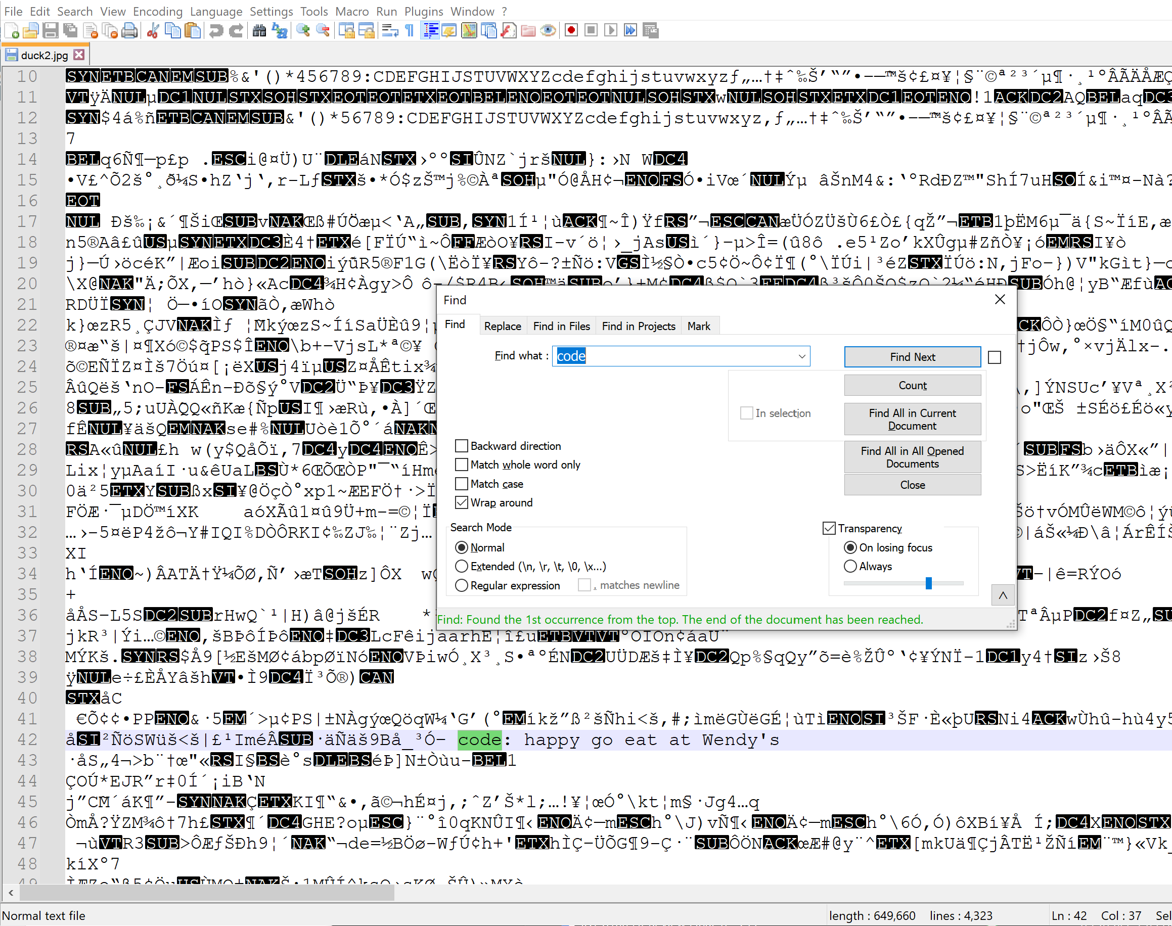
Did you see the message?

Slide 14
Practice: Send your own message
For this practice activity you will work together in groups of 4
Play the Game
Use your cellphones to take eight original pictures.
Download the pictures to a folder allotted to your team on the shared google folder. The link will be shared with you.
Create a game using steganography to amend the pictures you took to provide clues.
Share the pictures with the clues on the google drive
Each team will be given the folder of pictures from another group
The teams should review the pictures using what they have learned about in Stenography to play the game
Think about how the game could be improved as you play

Slide 15
Real Life Application
Read and Discuss the article: Hiding Code Inside Images: How Malware Uses Steganography (Cameron, 2022)
Website: Hiding Code Inside Images: How Malware Uses Steganography

Slide 16
Sources
Berkeley Boot Camps (n.d.). Cybersecurity in education: What teachers, parents and students should know. Berkeley Extension. Retrieved September 1, 2022, from https://bootcamp.berkeley.edu/blog/cybersecurity-in-education-what-teachers-parents-and-students-should-know/
Bicanski. (n.d.) Beach, duck, mallard, natural habitat, shadow, waterfowl, beak, feather, wildlife, bird. Pixnio. Retrieved September 1, 2022, from https://pixnio.com/media/beach-duck-mallard-natural-habitat-shadow
Cameron, L. (n.d.). With cryptography easier to detect, cybercriminals now hide malware in plain sight. Call it steganography. Here’s how it works. IEEE Computer Society. Retrieved September 1, 2022, from https://www.computer.org/publications/tech-news/research/how-steganography-works
edureka! (2019, January 17). Steganography tutorial: How to hide text inside the image | Cybersecurity training | Edureka [Video]. YouTube. https://www.youtube.com/watch?v=xepNoHgNj0w
Kadhim, I. J., Premaratne, P., Vial, P. J., & Halloran, B. (2019). Comprehensive survey of image steganography: Techniques, Evaluations, and trends in future research. Neurocomputing, 335, 299-326. https://doi.org/10.1016/j.neucom.2018.06.075]
SentinelOne. (2019, July 4). Hiding code inside images: How malware uses steganography. SentinelOne Blog. https://www.sentinelone.com/blog/hiding-code-inside-images-malware-steganography/

