Slide 1
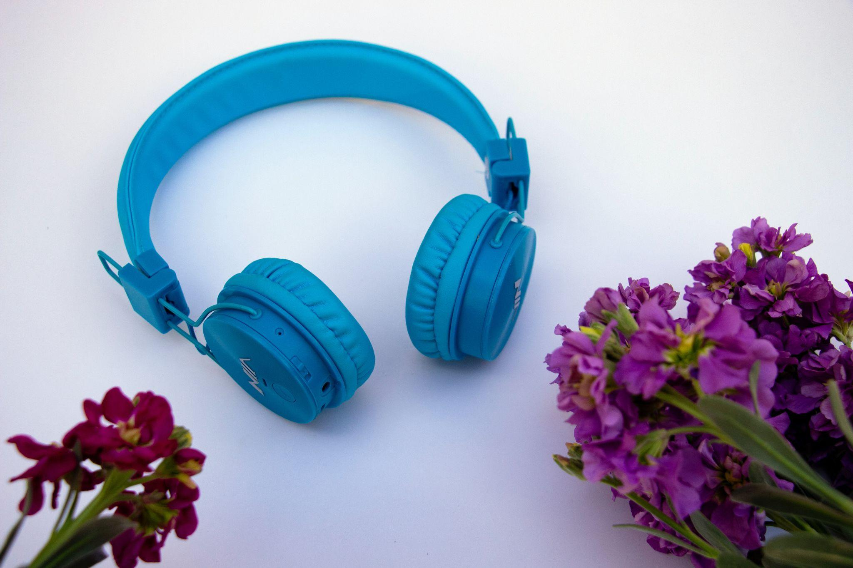
Micro:bit Hero Using MakeCode to Replicate Popular Songs by Brian Johnson
Photo by hosein zanbori on Unsplash

Slide 2
Discussion-Have You Played?
Photo by Cassidy James Blaede on Unsplash

Slide 3
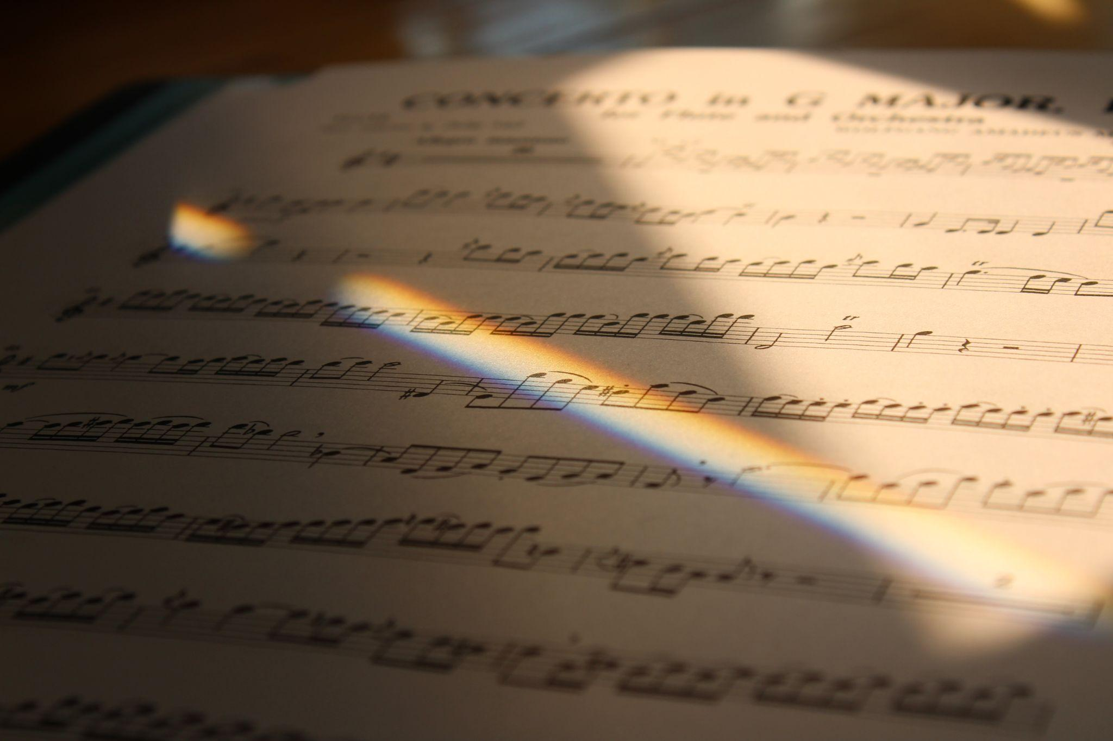
Discussion-Experiences with Musical Notes/Rests
Photo by Sarah Le on Unsplash

Slide 4
Today’s Inquiry Question
What are the best ways to recreate popular music with code and a Micro:bit?

Slide 5
Name That Tune
https://www.youtube.com/watch?v=e5sz3wvjWus

Slide 6
Objectives
Utilize Micro:bits to play music with rests, single, half and quarter notes
Create a nursery rhyme tune using Micro:bit MakeCode
Replicate a popular song using MakeCode
Play Name That Tune with Make Code Creations

Slide 7
Review Past Musical Experiences
What is a musical beat?
What is a musical rythem?
What is a rest?

Slide 8
Accessing Micro:bit to Code
https://makecode.microbit.org/#
Learn/practice how to find, add and delete blocks to write songs

Slide 9
Practice
Pick a nursery rhyme to and code the tune in MakeCode with your Micro:bit to practice coding!
Which one should we practice code?

Slide 10
Row, Row, Row Your Boat
Row, row, row your boat,
C C C D E
Gently down the stream.
E D E F G
Merrily, merrily, merrily, merrily,
C₂C₂C₂ G G G E E E C C C
Life is but a dream.
G F E D C
C
D
E
F
G
A
B
C₂

Slide 11
Twinkle, Twinkle, Little Star
Twinke, twinkle, little star,
C C G G A A G
How I wonder what you are.
F F E E D D C
Up above the world so high,
G G F F E E D
Like a diamond in the sky.
G G F F E E D
Twinke, twinkle, little star,
C C G G A A G
How I wonder what you are.
F F E E D D C
C
D
E
F
G
A
B
C₂

Slide 12
Old MacDonald Had a Farm
Old macDonald had a farm, E I E I O
F F F C D D C A A G G F
And on his farm he had some chicks, E I E I O
C F F F C D D C A A G G F
With a cluck-cluck here and a cluck-cluck there,
C C F F F C C F F F
Here a cluck, there a cluck, everywhere a cluck-cluck.
F F F F F F F F F F A A
Old macDonald had a farm, E I E I O
F F F C D D C A A G G F
C
D
E
F
G
A
B
C₂

Slide 13
C
D
E
F
G
A
B
C₂
B♭
The Itsy-Bitsy Spider
The itsy-bitsy spider climbed up the water spout.
C FF F G A A A G F G A F
Down came the rain And washed the spider out.
A A B♭ C₂ C₂ B♭ A B♭ C₂ A
Out came the sun and dried up all the rain
F F G A A G F G A F
And the itsy-bitsy spider climbed up the spout again.
C C FF F G A A A G F G A F

Slide 14
On Youtube search:
Easy Piano Tutorial

Slide 15
Challenge
Code the Micro Bit to play a popular song using Easy Piano Tutorial as a guide
Play Name that Tune

Slide 16
Try out the Final Countdown

Slide 17
If you finish a whole song challenges….
Add lighting effects to go along with your song
Hint: Use the same timing as the song
Find a different “Easy Piano” song on YouTube and recreate it with the Micro:bit

Slide 18
Reflection on Today’s Activity
In this activity, it was difficult to …..
In this activity, my greatest success was…
A tip or trick that helped me today was….
It was fun to …..
One limitation of today’s activity was….

