Slide 1
A Guide to Copyright, Fair Use, and Creative Commons in the United States
By Craig E. Shepherd craig.shepherd@gmail.com

Slide 2
Copyright
Granting by law to authors/owners of original, creative, tangible works control of distribution and marketing
©

Slide 3
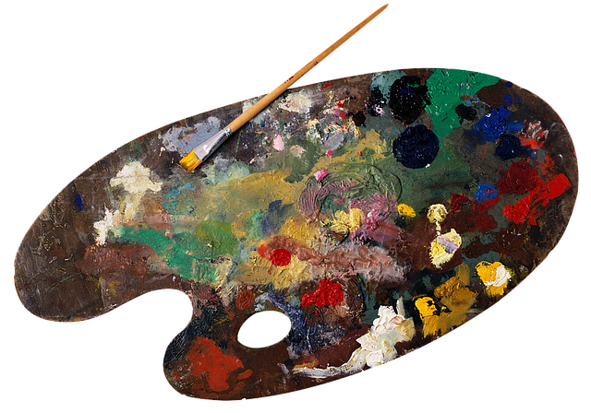
Copyrighted works must be:
Original
Creative
Tangible

Slide 4
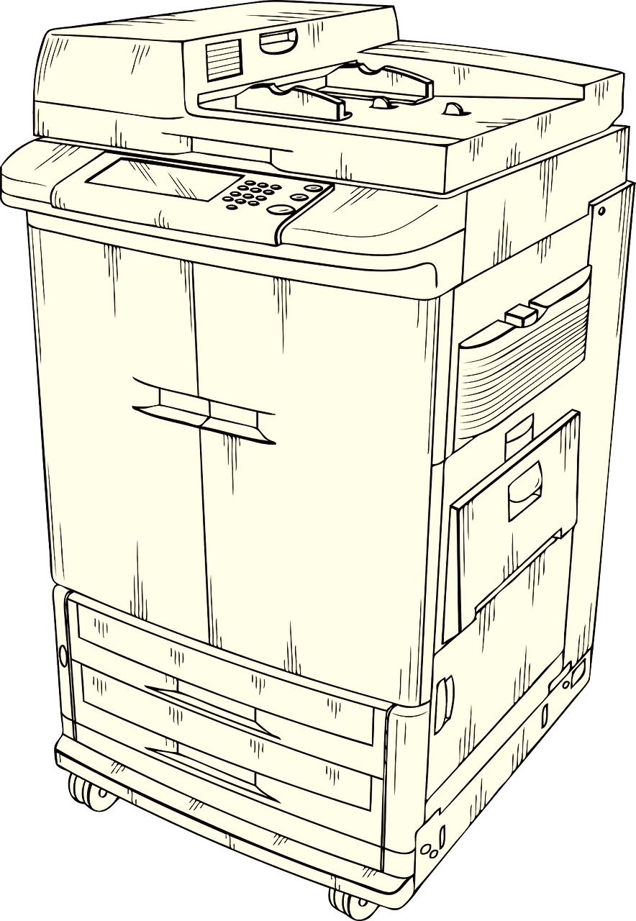
Copyright = Exclusive Rights
Reproduce the work
Prepare derivatives
(e.g., translations, different media, abridgements)
Distribute copies publicly
Perform or display publicly

Slide 5
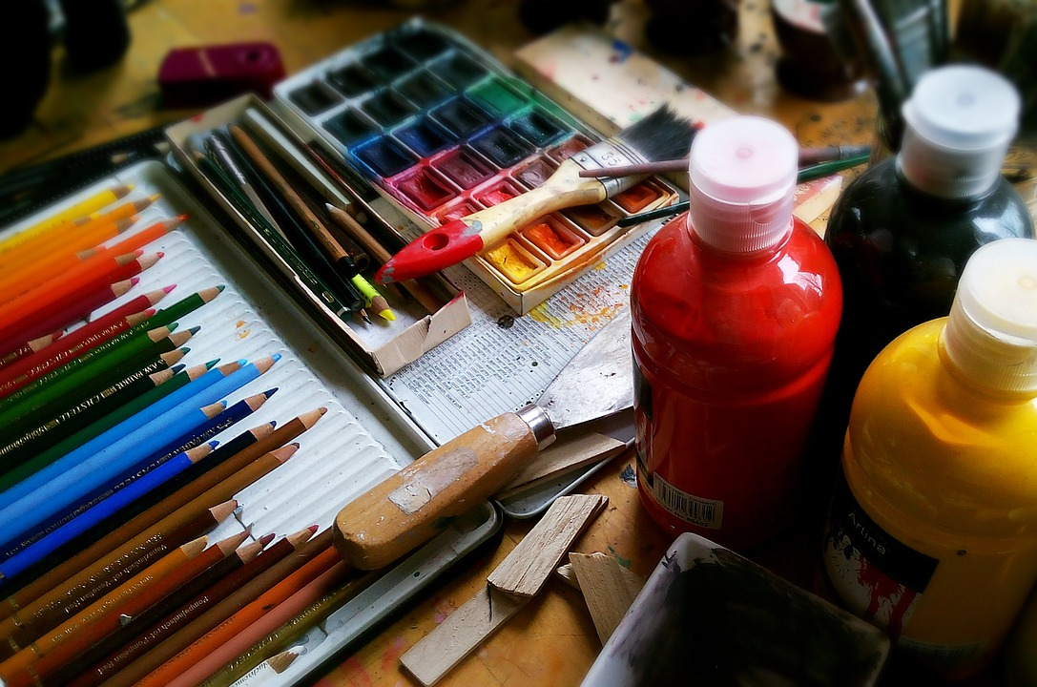
Copyright Scope Continued
  Literary works
  Musical works
  Choreographed works
  Images
  Sculpture
  Audiovisual works
  Sound recordings
  Computer software

Slide 6
Copyright Scope Continued
  Literary works
  Musical works
  Choreographed works
  Images
  Sculpture
  Audiovisual works
  Sound recordings
  Computer software
Registration or ©
unnecessary

Slide 7
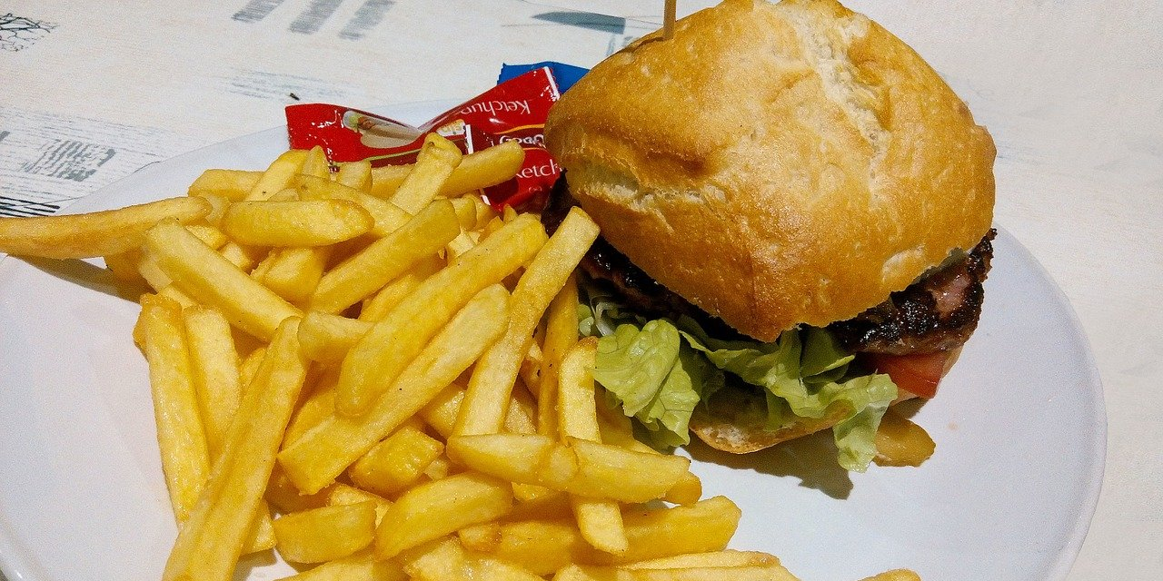
Example

Slide 8
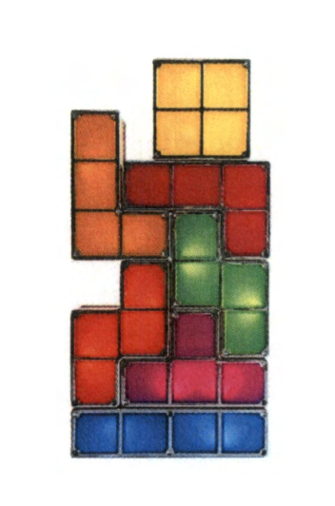
Example 2
“Stackable Multicolor Lamp Game” (2017)
Is this copyrightable?
https://copyright.gov/rulings-filings/review-board/docs/stackable-multi-color-lamp-game.pdf

Slide 9
Copyright = Balancing Act
Copyright seeks to balance author’s rights to make a living and society’s rights to progress through information use.

Slide 10
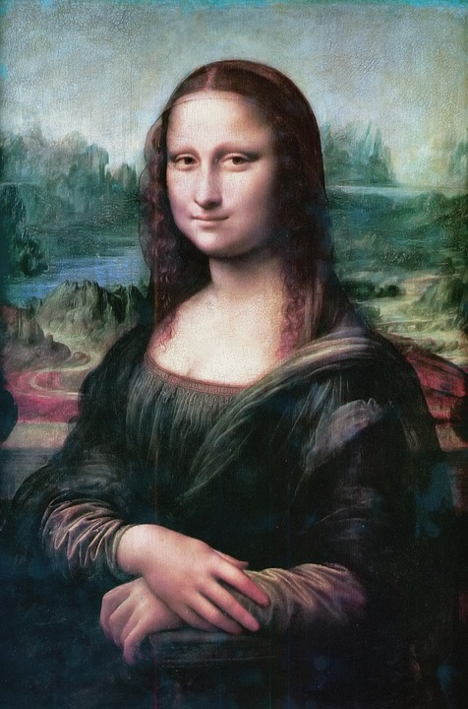
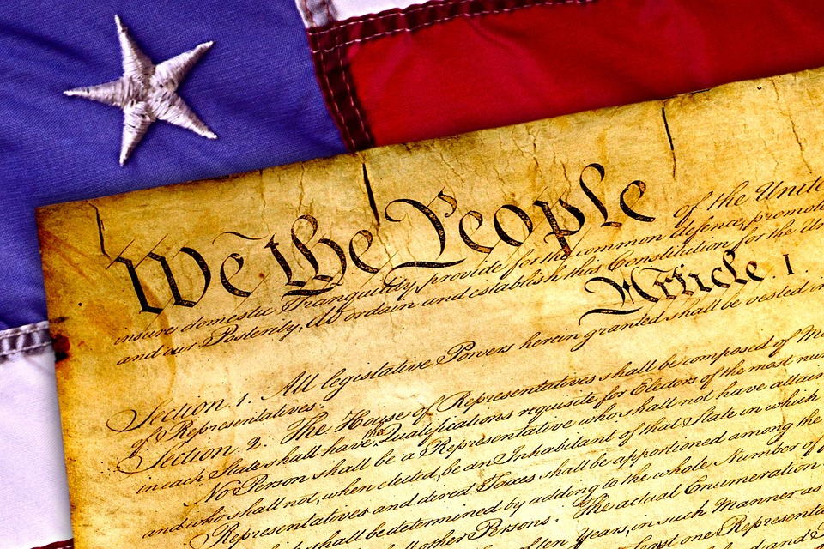
Exceptions
Facts and general knowledge
Ideas, processes, and methods
Public domain
  Published prior to 1926
US Government works
  Those not contracted out
Parody and Satire

Slide 11
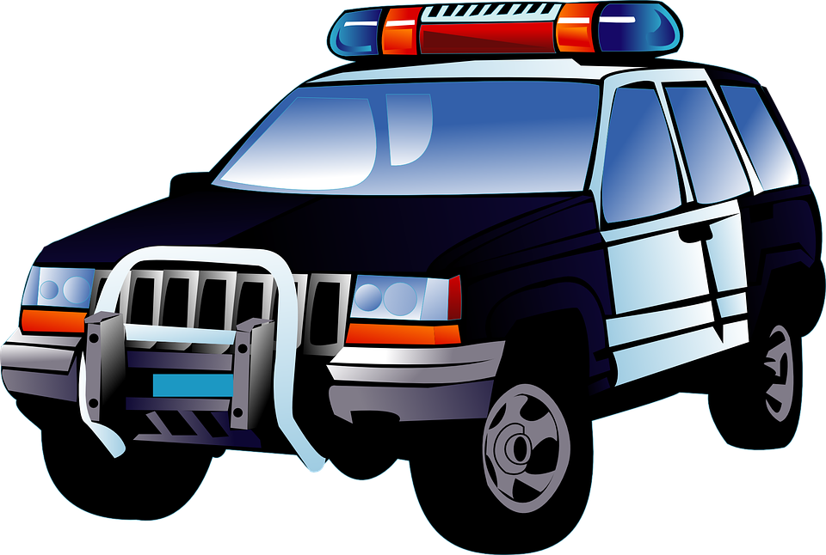
Cost of Violation
Monetary fines
Possible jail time
No institutional legal support
Loss of reputation
Loss of employment

Slide 12
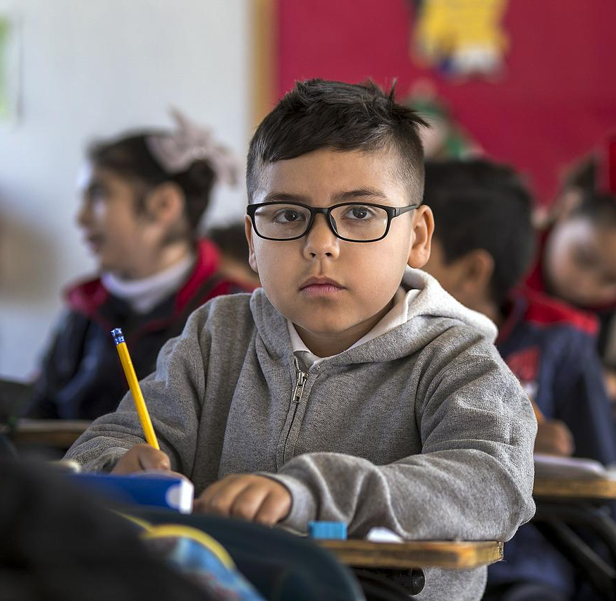
Educational or scientific uses may not guarantee lawful uses

Slide 13

Fair Use

Slide 14
Fair Use Guidelines
Purpose and character of use
Nature of work
Extent of material used
Effect on market
* Other factors may also be considered.

Slide 15

Purpose of Use
Commercial versus educational use
  Multiple classroom copies permitted
Transformative use
  Substantially modifying original work for new meaning or message
Critical or comparative use

Slide 16
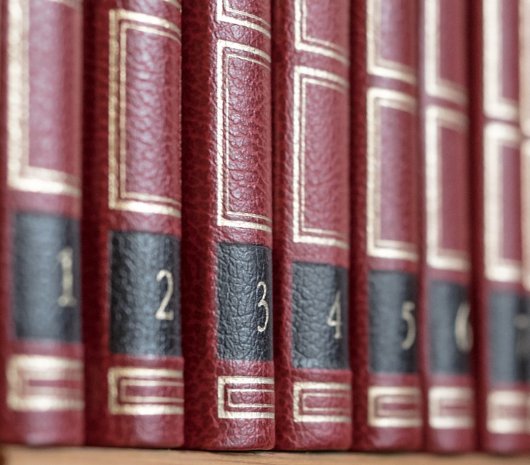
Nature of Work
Non-fiction vs. fiction
Published vs. unpublished
Consumable vs. stable (e.g., workbook, test form)

Slide 17
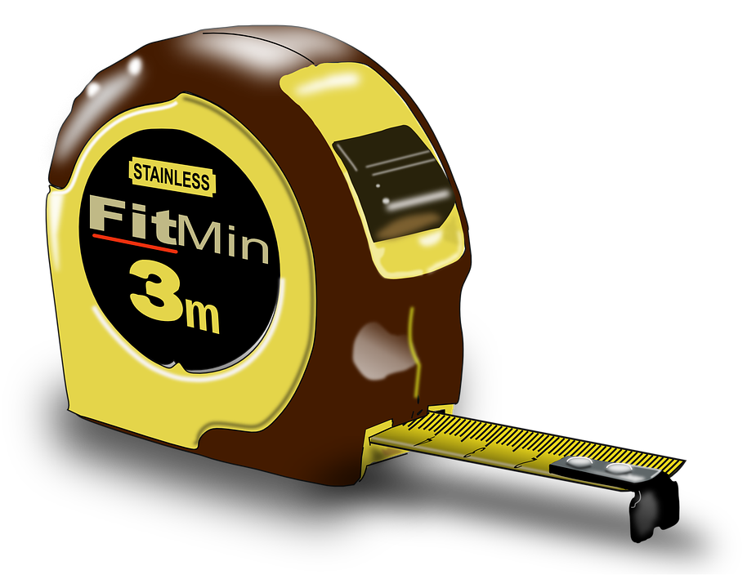
Extent Used
Measured qualitatively & quantitatively
No exact measures exist
  School guidelines
Align with objectives?

Slide 18

Heart of the Work

Slide 19
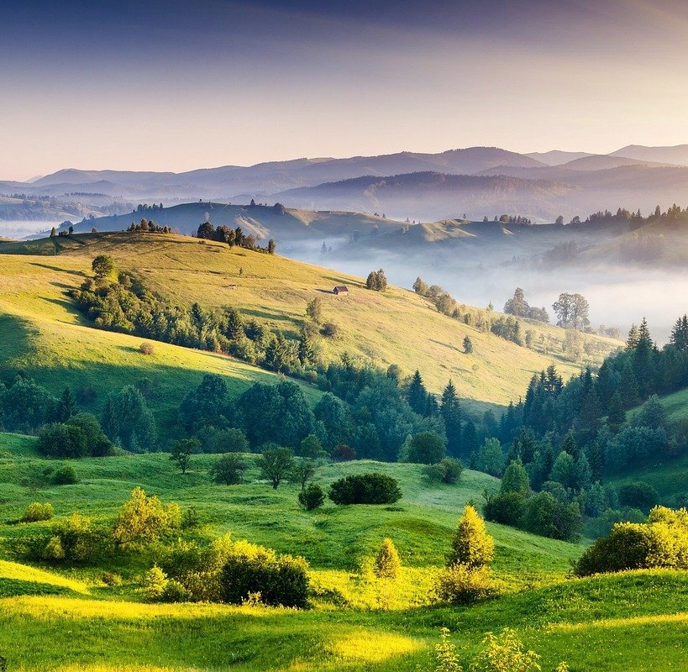
What About Images?

Slide 20
Copying Entire Work
“Any copying of an entire work usually weighs heavily against fair use. Images generate serious controversies because a user nearly always wants the full image, or the full ‘amount.’ A ‘thumbnail,’ or low-resolution version of the image, might be an acceptable ‘amount.’”
http://www.usg.edu/copyright/the_fair_use_exception

Slide 21
Motion Picture Problems
“Motion pictures are also problematic because even short clips may borrow the most extraordinary or creative elements of the work. One may also reproduce only a small portion of any work, but still take ‘the heart of the work.’”
http://www.usg.edu/copyright/the_fair_use_exception

Slide 22
Effect on Market
Does it interfere with the owner’s ability to make a profit on the work?
$

Slide 23
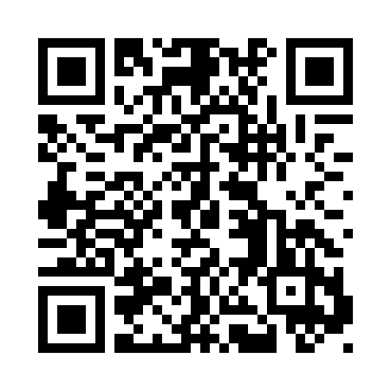
Fair Use Checklist
The University System of Georgia developed this to site to help educators determine fair use decisions:
http://www.usg.edu/copyright/introduction_to_the_fair_use_checklist

Slide 24
Examples

Slide 25
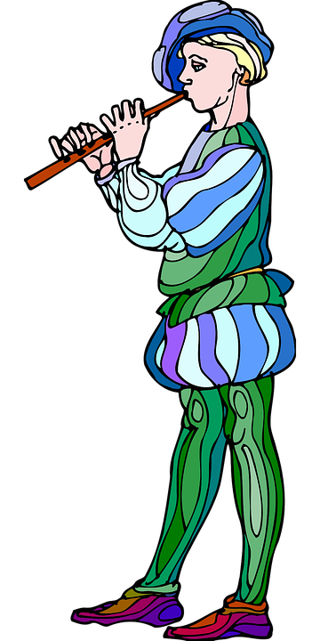
Scenario A
A teacher copies a Shakespearian play from a copyrighted anthology that is currently available in print at Barnes and Noble to help students save money.
QUESTION: Is this a fair use?

Slide 26
Scenario A Answer
Be careful. The play is in the public domain.
Accompanying images, textual explanations, and so forth may be copyrighted.

Slide 27
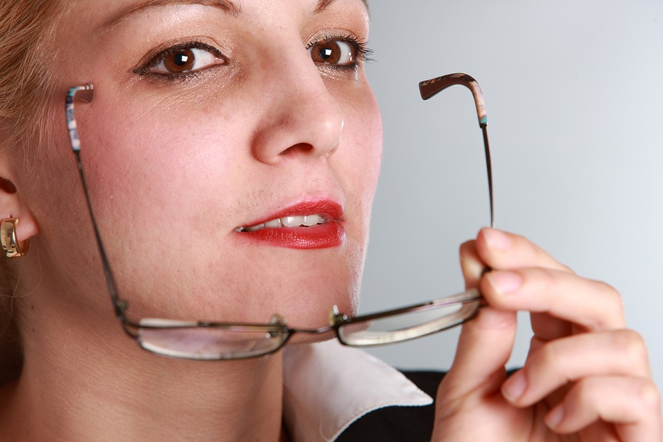
Scenario B
A teacher posted class notes on a public web site for anyone to see that is interested. She wants to scan an article from a peer-reviewed journal and add it to the site.
QUESTION: Is this a fair use?

Slide 28
Scenario B Answer
Probably not.
The site is not limited. It was made for anyone interested. She may not be able to claim an educational use. A lot depends on the nature of the use. Did the educational uses of this piece transform the work or merely distribute it?
No exclusively educational purpose can be guaranteed by putting the article on the Web, and such conduct would arguably violate the copyright holder's right of public distribution.

Slide 29
Video Example
This was a panel on March 31, 2020 in response to the COVID Pandemic. Teachers wondered if they could post read-alouds online with copyrighted materials.
https://www.youtube.com/watch?v=Og0DgELl3_4
(begin at 58:25-1:00:51)
(see also 1:02:18-1:03:43)

Slide 30
What about…
Using a picture in a website
Using a picture in a presentation?
Including music in a movie?

Slide 31
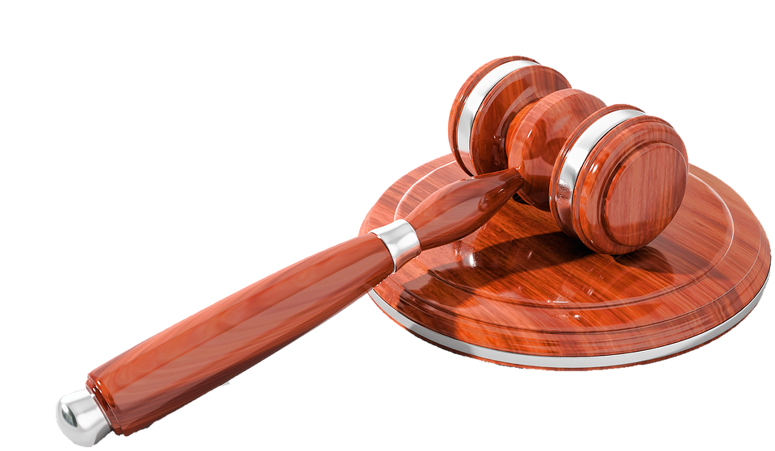
Fair Use Problem

Slide 32

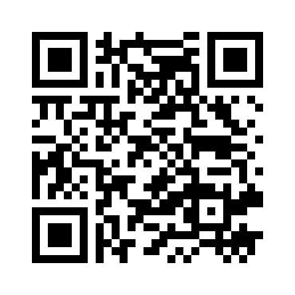
Creative Commons
http://creativecommons.org/licenses/

Slide 33




Licenses
Attribution:
Licensees may copy, distribute, display and perform the work and make derivative works based on it only if they give the author or licensor the credits in the manner specified
Noncommercial:
Licensees may copy, distribute, display, and perform the work and make derivative works based on it only for noncommercial purposes
No Derivative Works:
Licensees may copy, distribute, display and perform only verbatim copies of the work, not derivative works based on it
Share Alike:
Licensees may distribute derivative works only under a license identical to the license that governs the original work

Slide 34





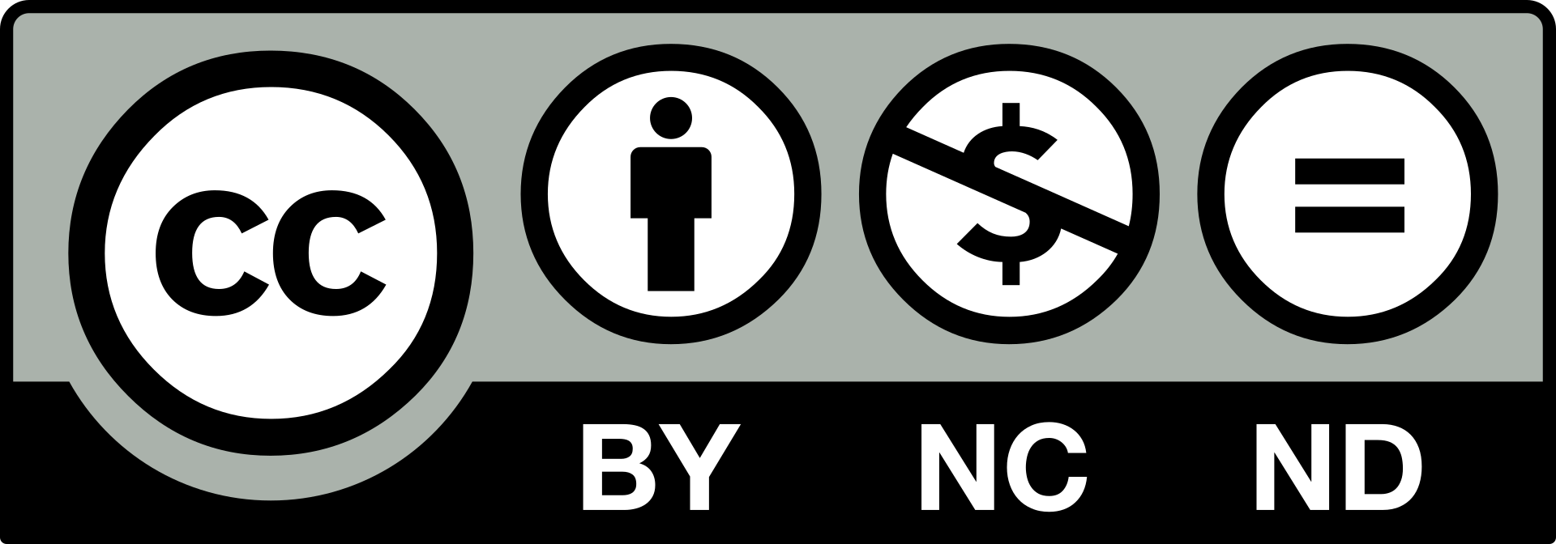
Licenses can be combined

Slide 35
Cannot Combine These Licenses
No Derivative Works:
Licensees may copy, distribute, display and perform only verbatim copies of the work, not derivative works based on it
Share Alike:
Licensees may distribute derivative works only under a license identical to the license that governs the original work

Slide 36
All CC Licenses include Attribution
Attribution:
Licensees may copy, distribute, display and perform the work and make derivative works based on it only if they give the author or licensor the credits in the manner specified

Slide 37
Attribution Elements
“Title of work”
Author
License of the work
Links/URLS to the source, author, and license
Indicate modifications (if license allows them)

Slide 38

CK-12 Example (for Print uses)
Fifteenth Amendment
As a member of the Senate Committee on the Judiciary, William Stewart of Nevada guided the Fifteenth Amendment through the Senate. Ratified February 3, 1870, the amendment prohibited states from disenfranchising voters “on account of race, color, or previous condition of servitude.” The amendment re-opened the possibility, however, that states could institute voter qualifications equally to all races and many former confederate states took advantage of this provision, instituting poll taxes, and literacy tests, among other qualifications.

Slide 39
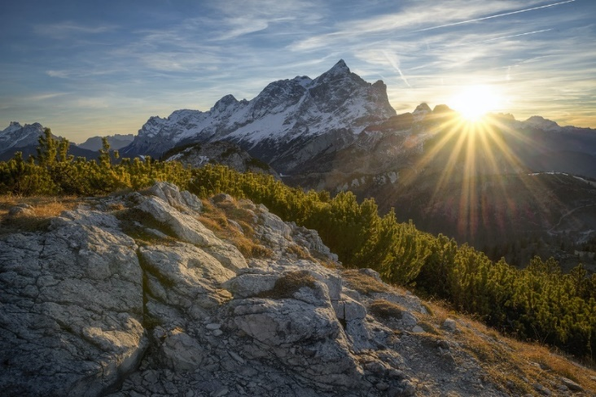
Image Example
Photo by Sagui Andrea from Pexels

Slide 40
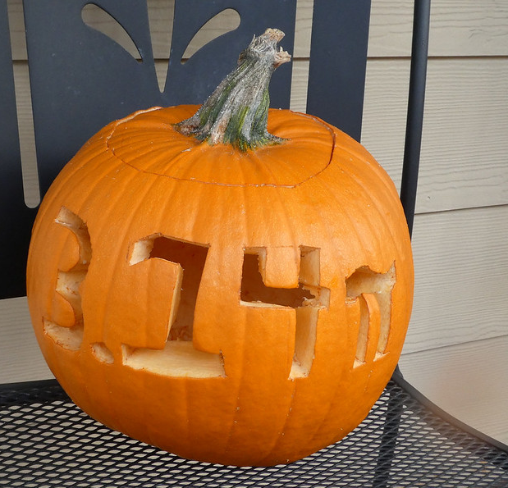
Image Example with modification
“Pumpkin Pi” by Bruce Fingerhood. CC BY-NC /Cropped from the Original.

Slide 41
References
Creative Commons. (n.d.a). About CC Licenses. https://creativecommons.org/about/cclicenses/
Hussain, Z. (2015, June 3). Copyright and copywrong: What are derivative and transformative works? Foundry Law Group. https://foundrylawgroup.com/copyright-copywrong-what-are-derivative-and-transformative-works/
pijipvideo. (2020, April 2). Reading aloud: Fair use enables translating classroom practices into online learning [Video]. YouTube. https://www.youtube.com/watch?v=Og0DgELl3_4
University System of Georgia. (n.d.). Copyright generally. https://www.usg.edu/copyright/copyright_generally
University System of Georgia. (n.d.). Introduction to the fair use checklist. https://www.usg.edu/copyright/introduction_to_the_fair_use_checklist
United States Patent and Trademark Office. (2021, March 31). Trademark, patent, or copyright. Retrieved February 20, 2022 from https://www.uspto.gov/trademarks/basics/trademark-patent-copyright
University of Texas Libraries (2021, April 9). Sorting through ownership. https://guides.lib.utexas.edu/copyright/sortingown
University of Texas Libraries (2021, April 9). TEACH act. https://guides.lib.utexas.edu/copyright/teachact
University of Texas Libraries (2021, January 4). Four factor test. https://guides.lib.utexas.edu/fairuse/fourfactor
United States Copyright Office. (n.d.). What is copyright? Retrieved February 20, 2022 from https://copyright.gov/what-is-copyright/
U.S. Copyright Office (n.d.). U.S. Copyright Office fair use index. Retrieved February 20, 2022 https://copyright.gov/fair-use/

Slide 42
Images
“Paint pallet” by AlLes. Pixabay License.
“Copy machine” by Clker-Free-Vector-Images. Pixabay License. Recolored image.
“Paints and pencils” by bodobe. Pixabay License.
“Burger” by PortalJardin. Pixabay License.
“Stackable Lamp Game” Photo by unknown author.
“Constitution” by wynpnt. Pixabay License.
“Mona Lisa” by janeb13. Pixabay License.
“Police car” by Clker-Free-Vector-Images. Pixabay License. /Cropped image.
“Student at Desk” by ernestoeslava. Pixabay License. /Cropped image.
“Balance” by jpornelasadv. Pixabay License.
“Ticket” by OpenClipart-Vectors. Pixabay License.
“Book volumes” by blickpixel. Pixabay License.
“Measuring tape” by OpenClipart-Vectors. Pixabay License.
“Heart” by OpenClipart-Vectors. Pixabay License.
“Hills” by Yeskay1211. Pixabay License. /Cropped image.

Slide 43
Images Continued
“Flute player” by OpenClipart-Vectors. Pixabay License.
“Woman with glasses” by andreas160578.
“Gavel” by Schwarzenarzisse. Pixabay License.
“CC Logo” Public Domain Image.
“Attribution” Public Domain Image.
“Non-commercial” Public Domain Image.
“No derivative works” Public Domain Image.
“Share-alike” Public Domain Image.
“CC-BY” Public Domain Image.
“CC-BY-SA” Public Domain Image.
“CC-BY-ND” Public Domain Image.
“CC-BY-NC Public Domain Image.
“CC-BY-NC-SA” Public Domain Image.
“CC-BY-NC-ND” Public Domain Image.

