Slide 1
Community Leisure Activity Assessment
Charles Thull, PhD
Old Dominion University

Slide 2
Presentation Note
Note. Images and animated visuals in this presentation were generated using ChatGPT, Sora, DALL·E, and Gemini based on author-developed prompts.

Slide 3
What do you like to do in in the community?
🖼️
🎡
🎢🌊
🍔☕
🚆
🏀
🎤
🏛️
🛍️👜
🎭
🐶
🎬
🎶
🌠
🐘

Slide 4
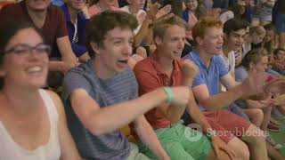
Having Fun in Your Community!

Slide 5
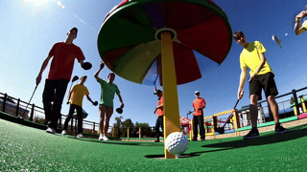
Community Fun
Have fun with friends.

Slide 6
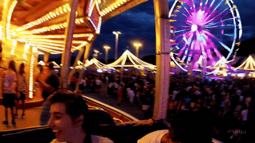
Community Fun
Explore new things you may like.

Slide 7
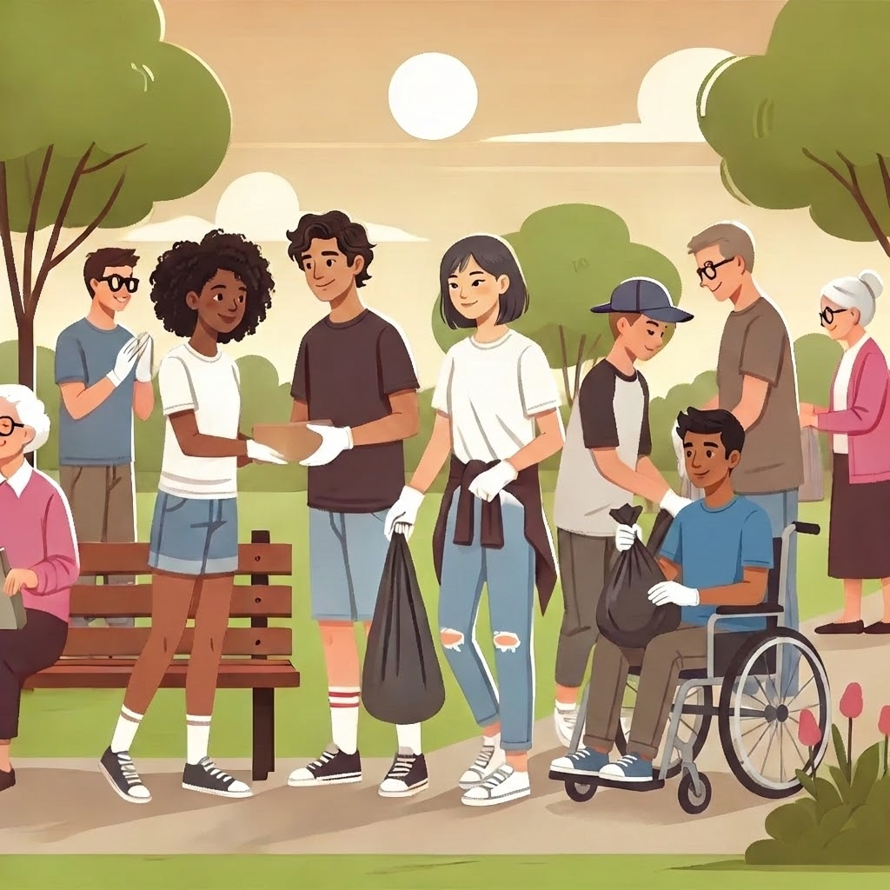
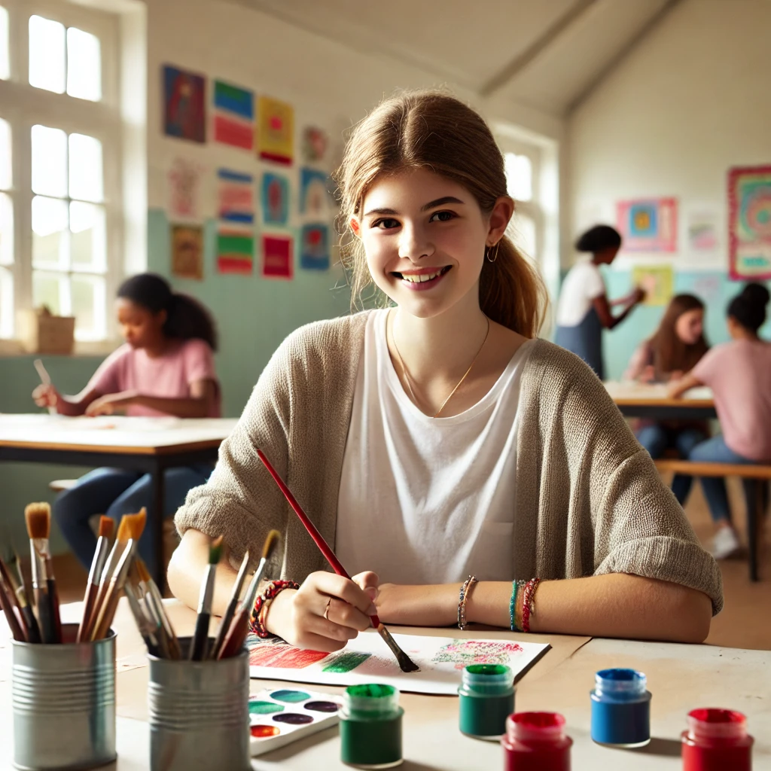
What do you like? (1/21)
Volunteer clean up 🚮
OR
Take a class
(art, cooking, tech) 🎨

Slide 8
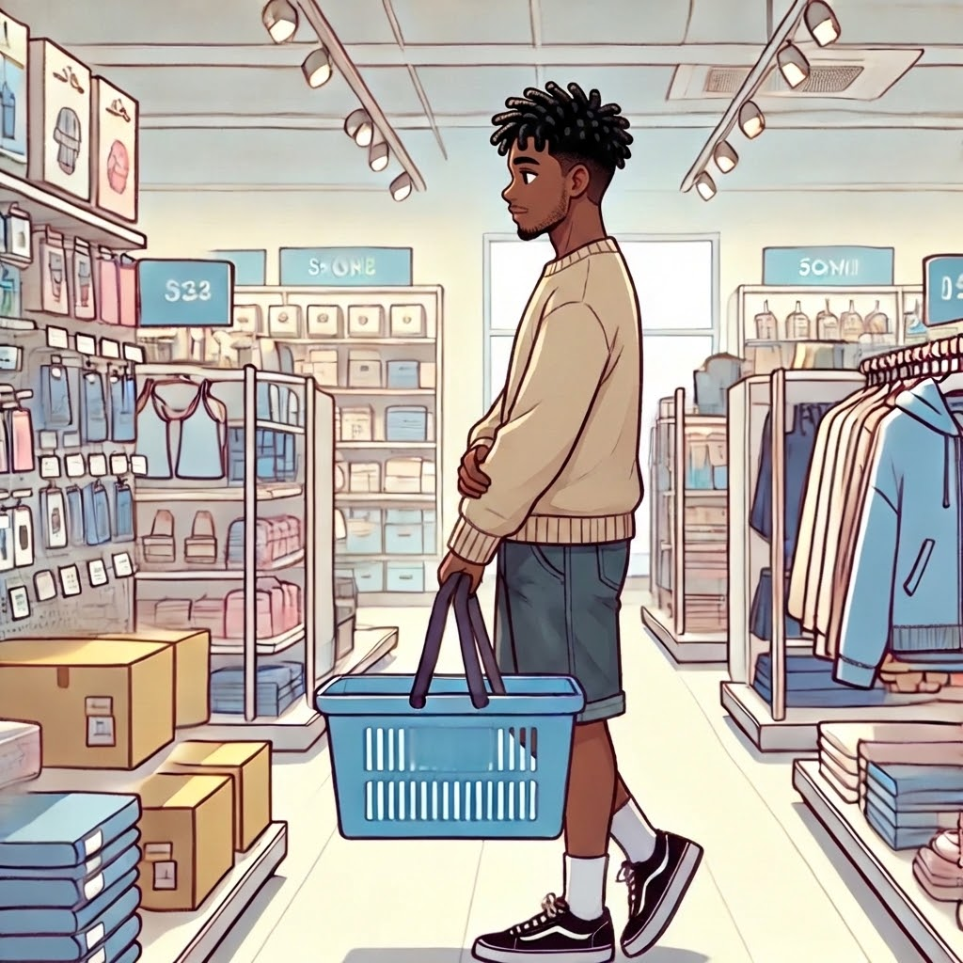
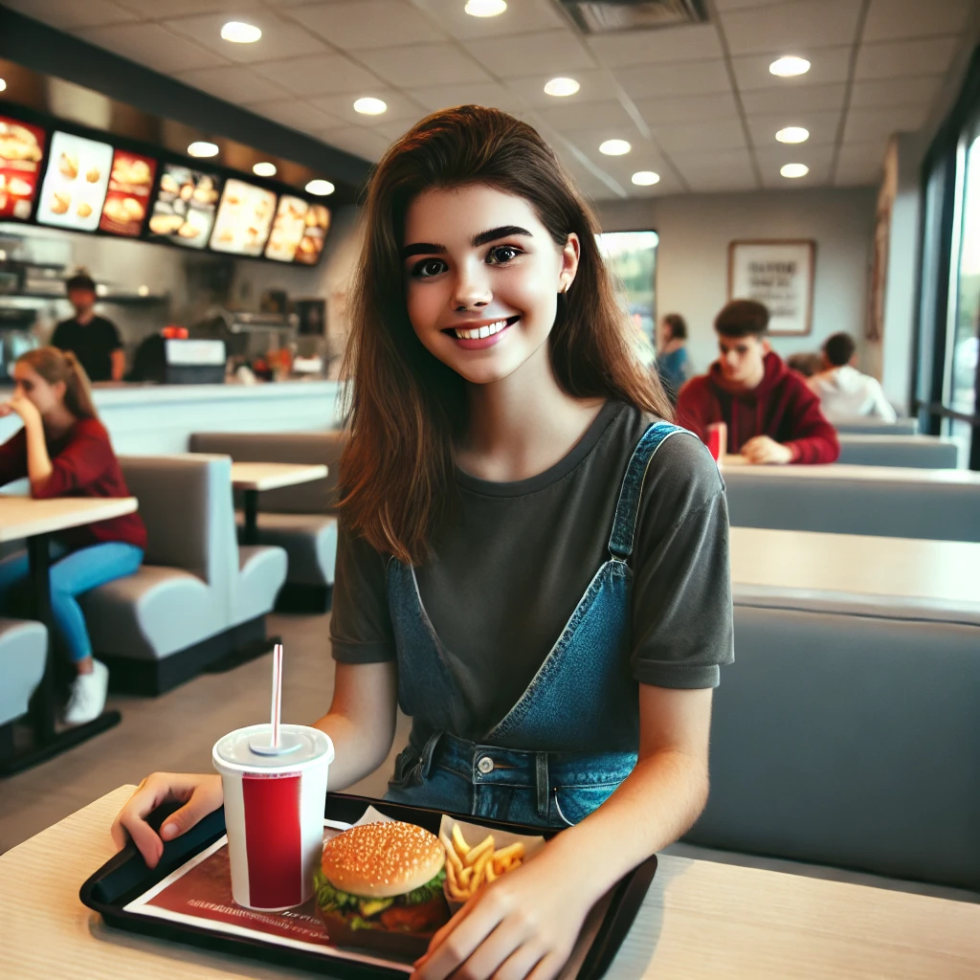
What do you like? (2/21)
🛍️👜 Go shopping
OR
🍔☕Go out to eat

Slide 9
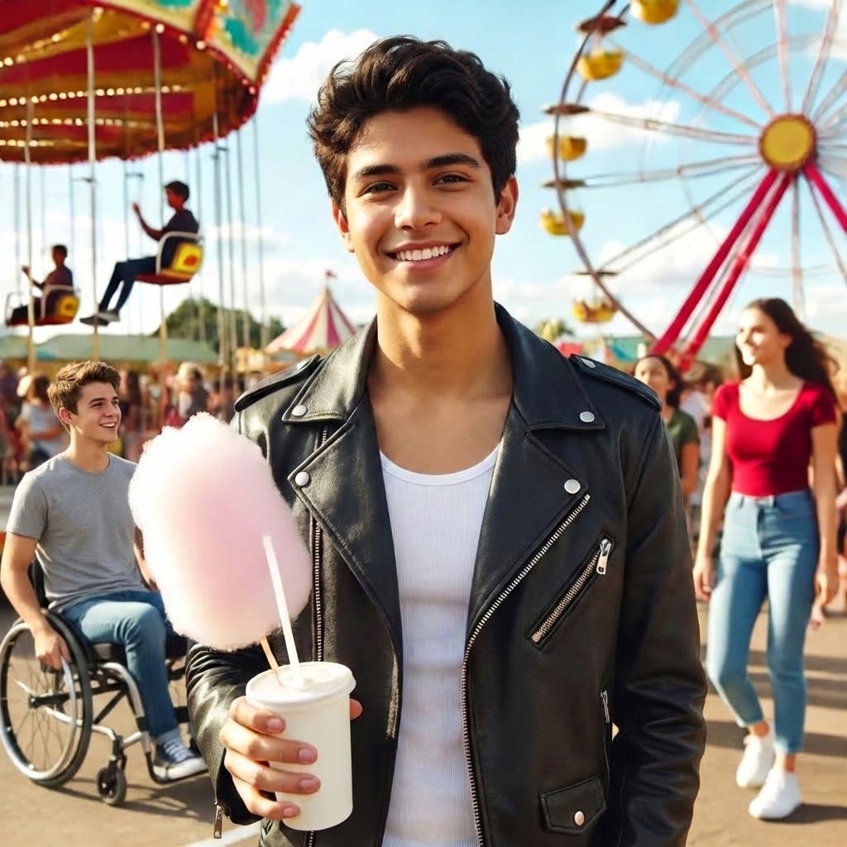
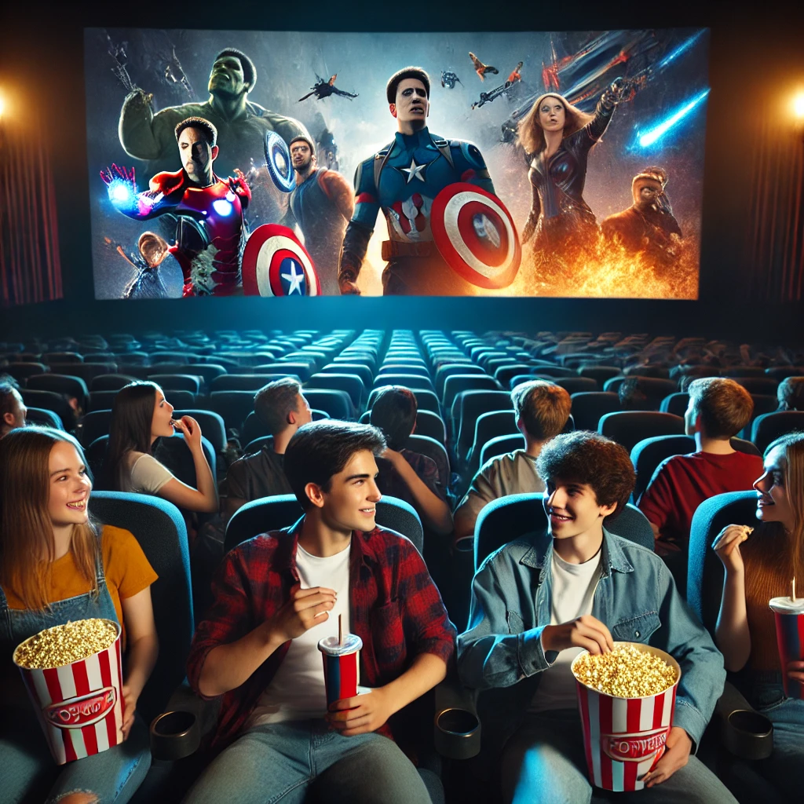
What do you like? (3/21)
🎢🎡 Go to an amusement park
OR
Watch a movie 🎬

Slide 10
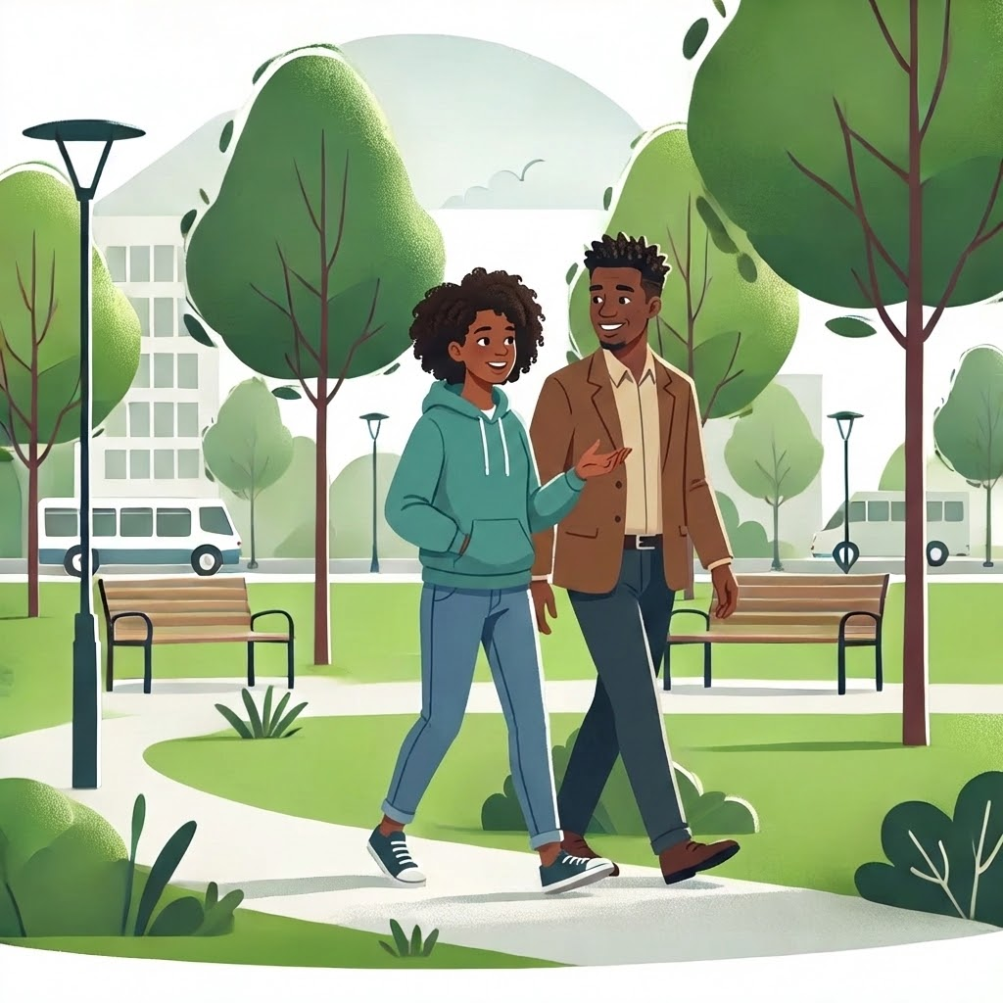
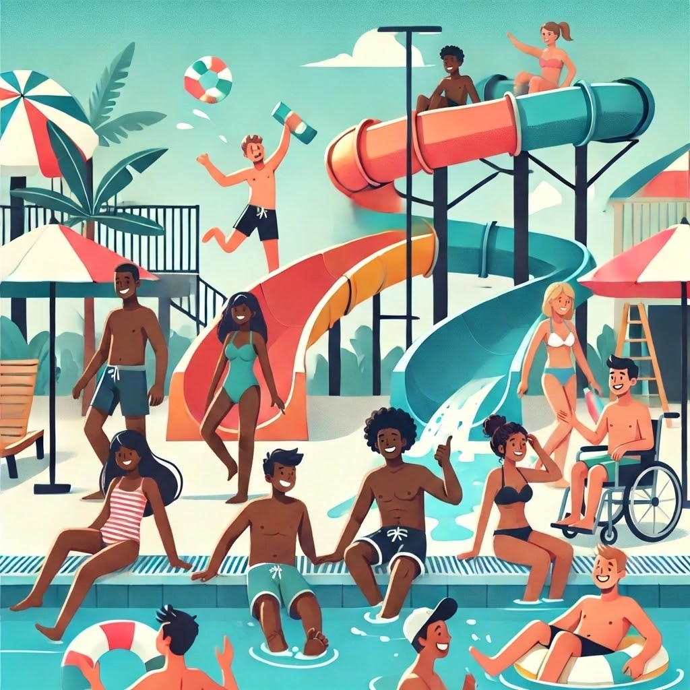
What do you like? (4/21)
🚶Go for walk in park
🌊🏊‍♂️ Go to water park
OR

Slide 11
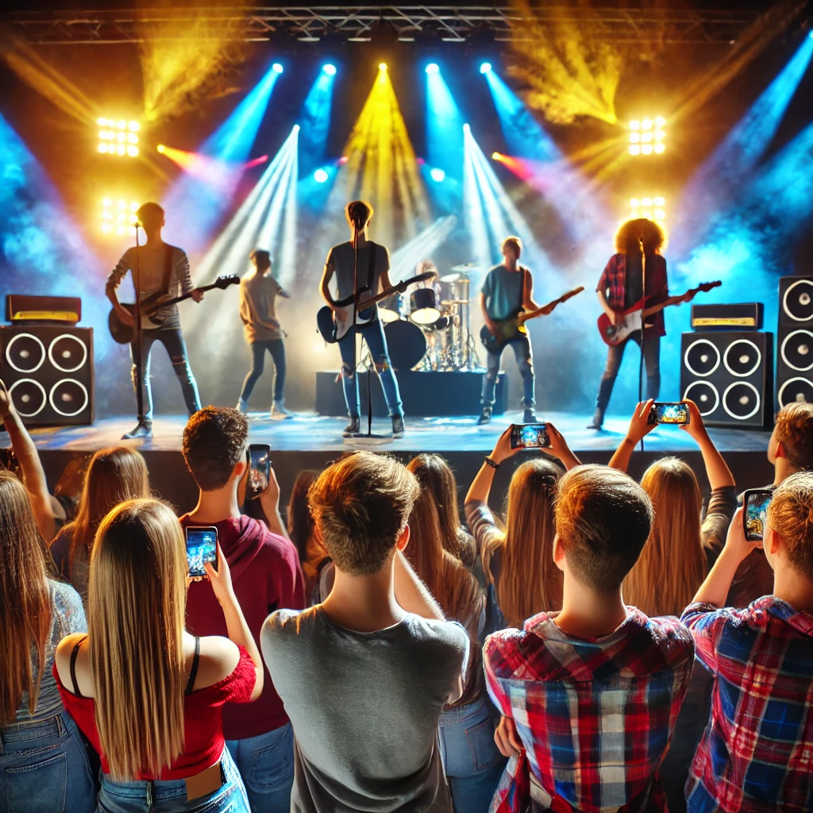
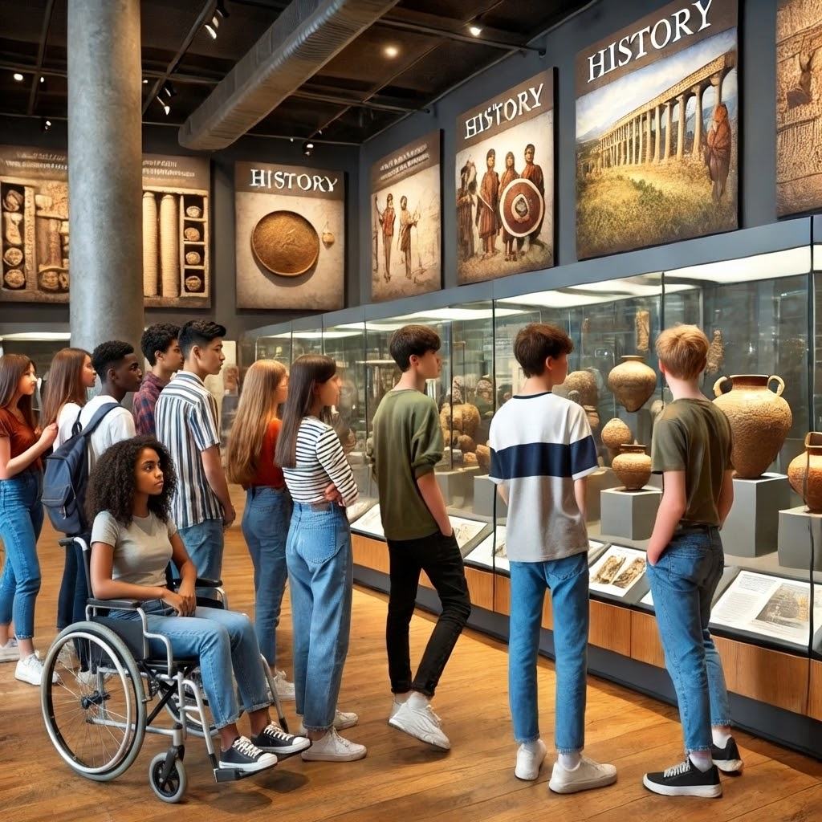
What do you like? (5/21)
🎤Go to music concert
OR
🏛️Go to a museum

Slide 12
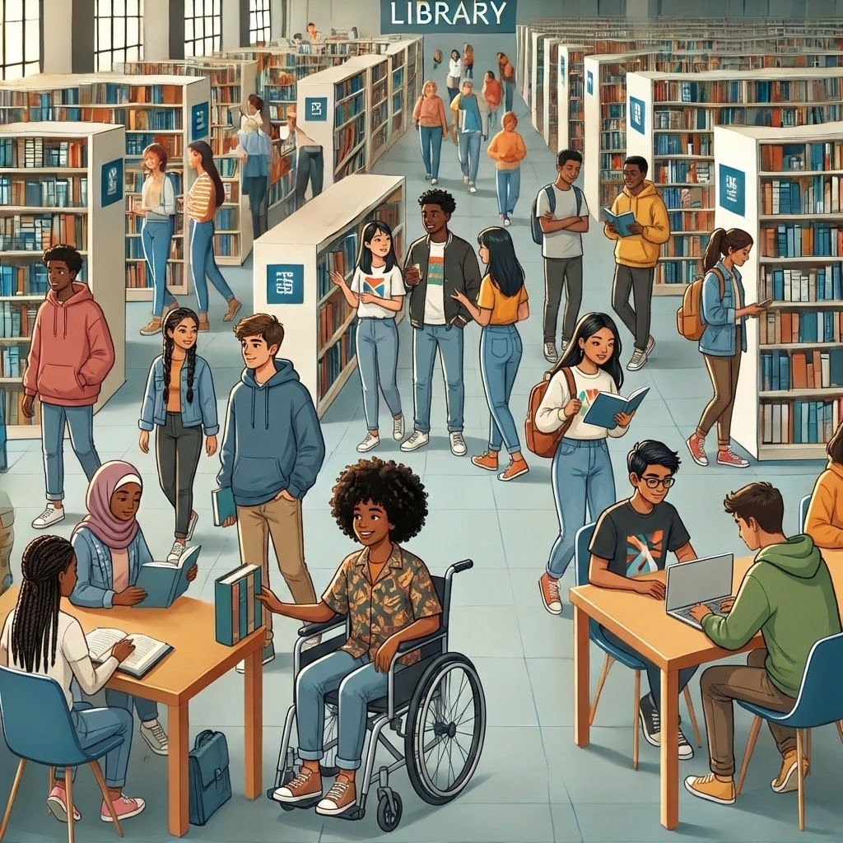
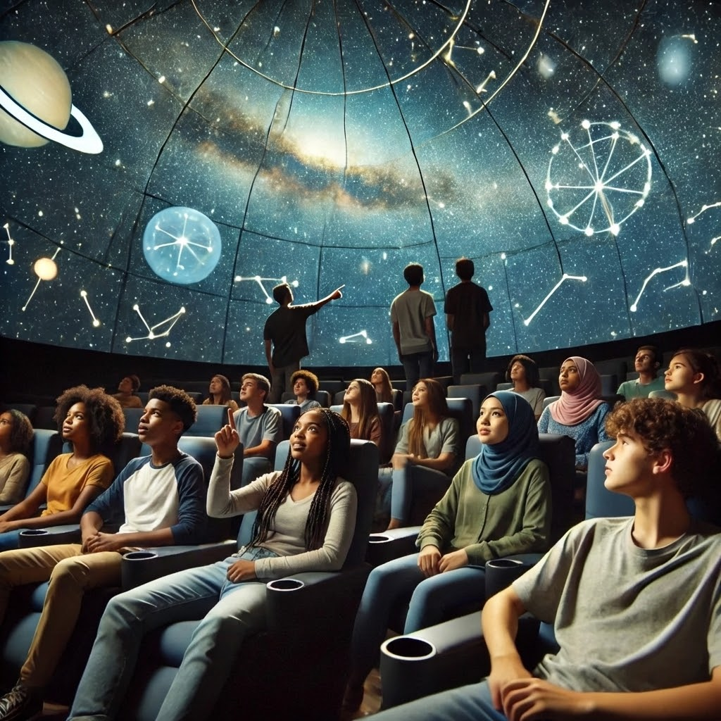
What do you like? (6/21)
Visit a library 📚 OR Visit a planetarium 🌠

Slide 13
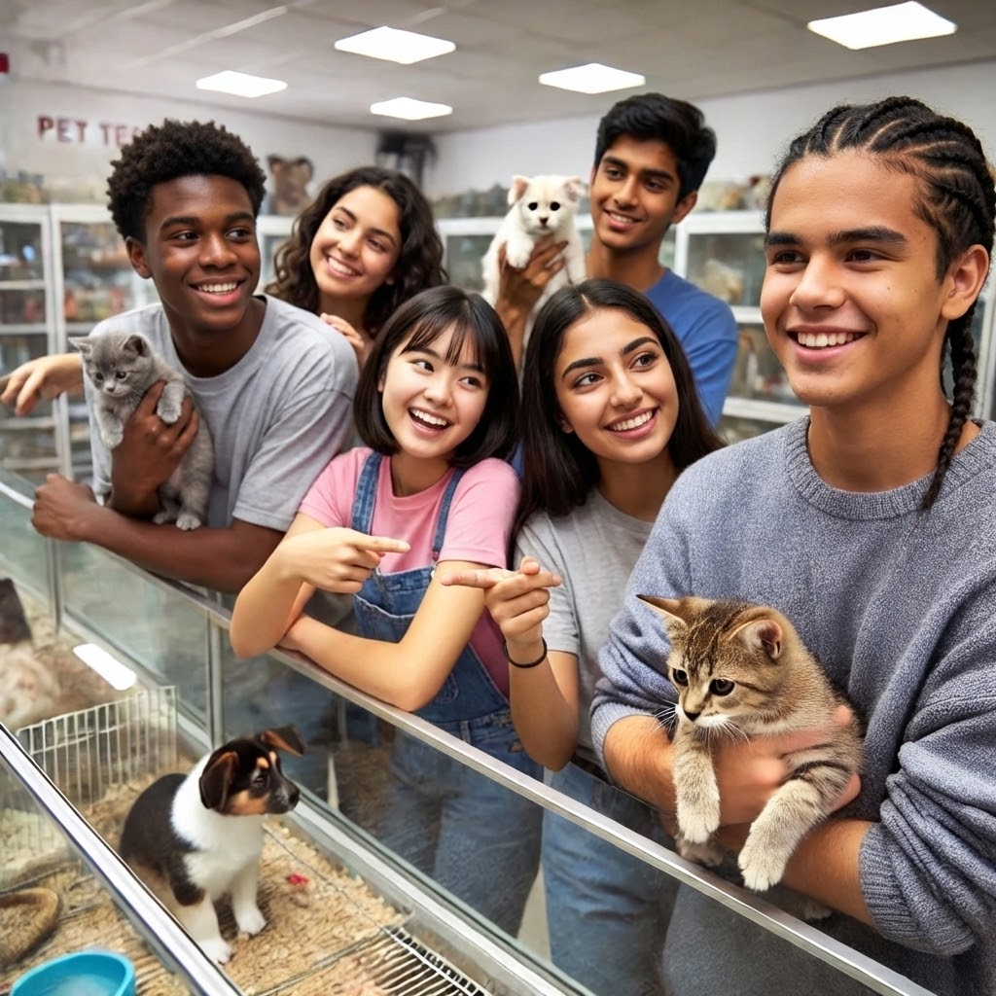
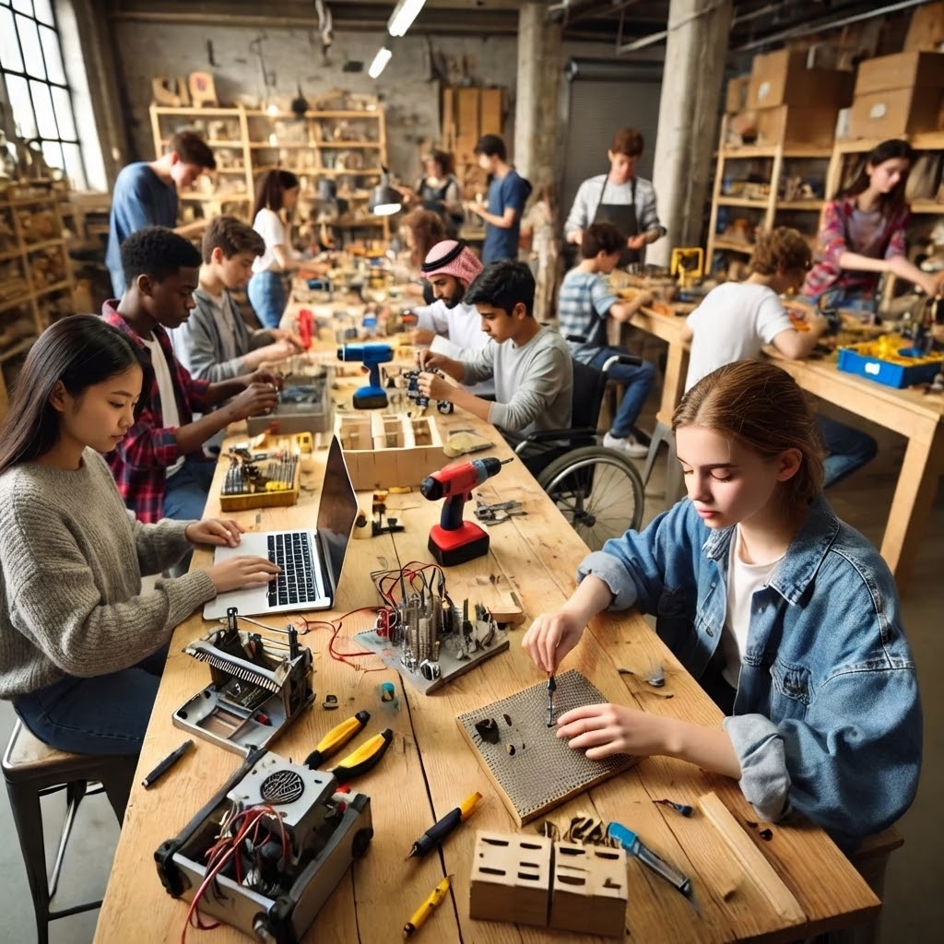
What do you like? (7/21)
Visit a pet store 🐶 OR Build at a makerspace 🛠️

Slide 14
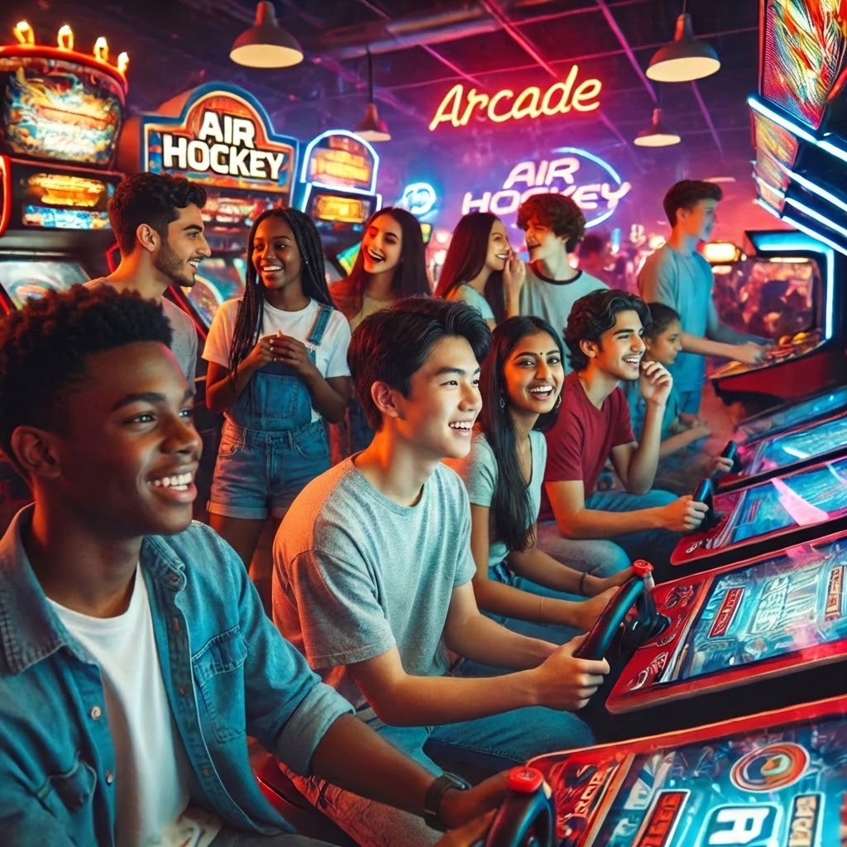
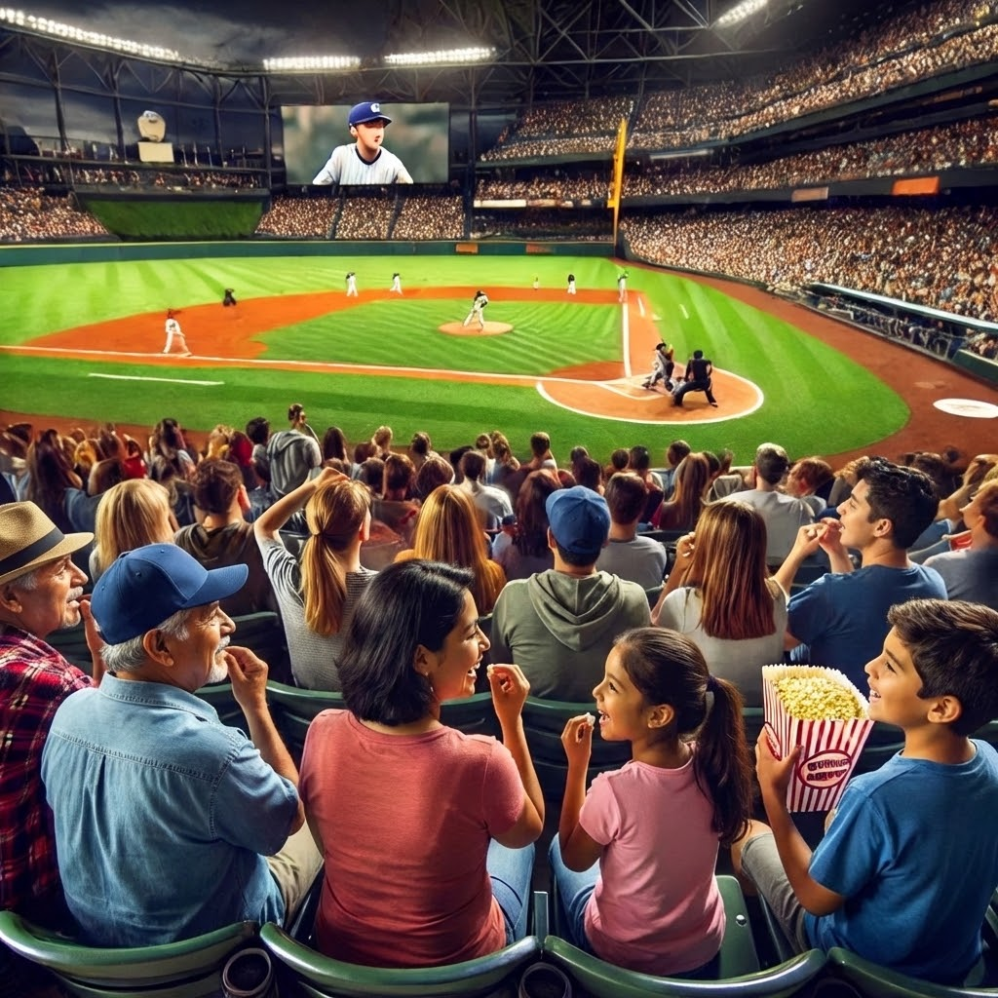
What do you like? (8/21)
Video game arcade 🎮 OR Go to a sports event 🏀

Slide 15
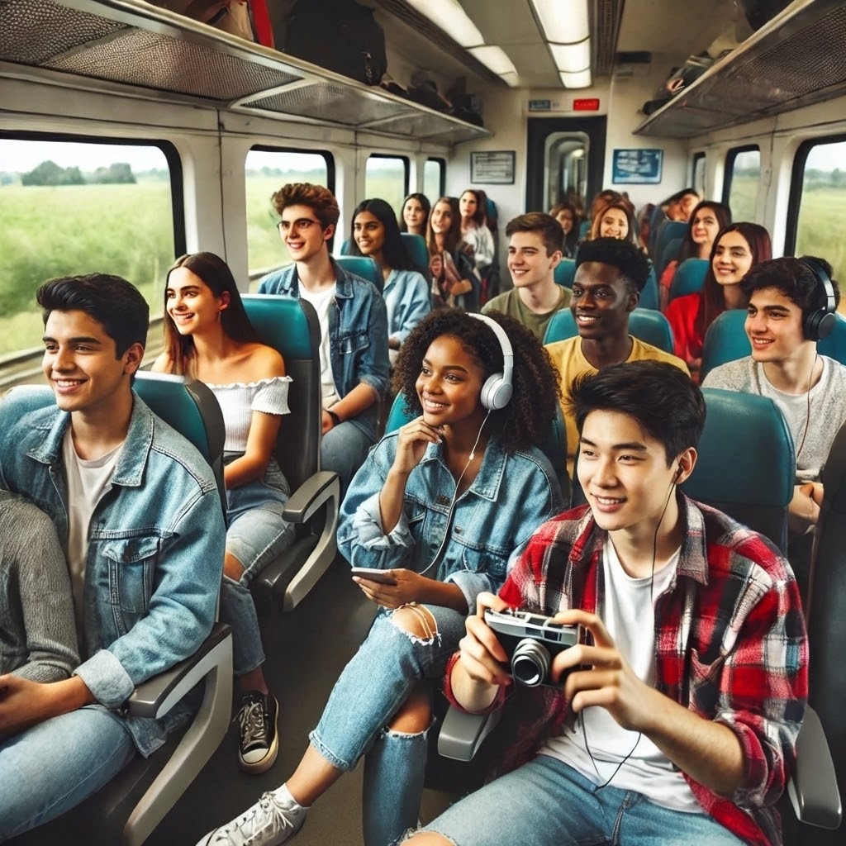
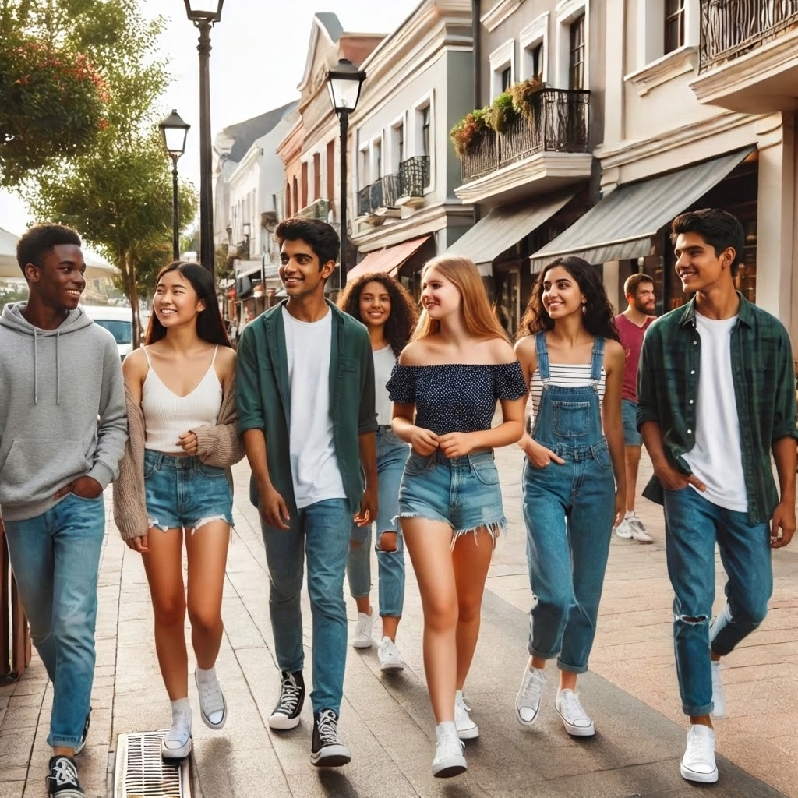
What do you like? (9/21)
Ride public train 🚍 OR Walk around new places🗺️

Slide 16
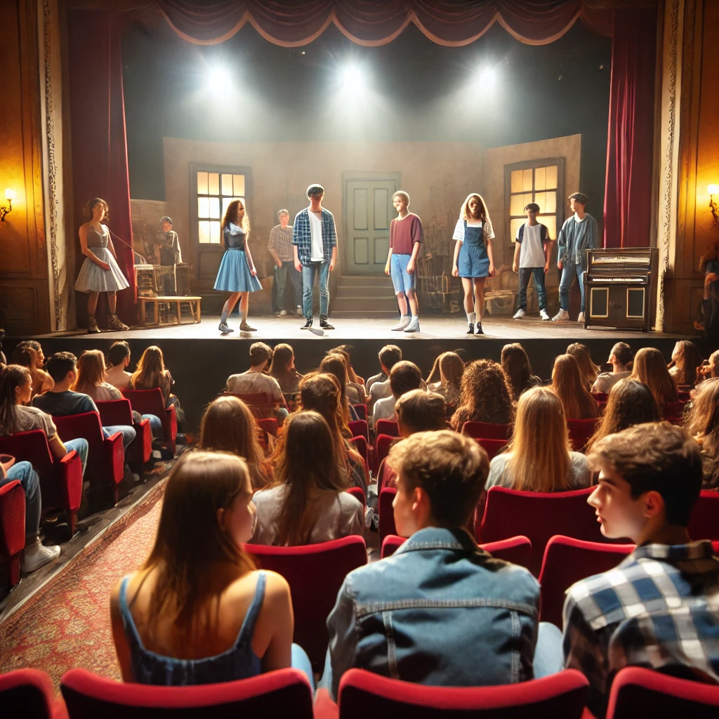
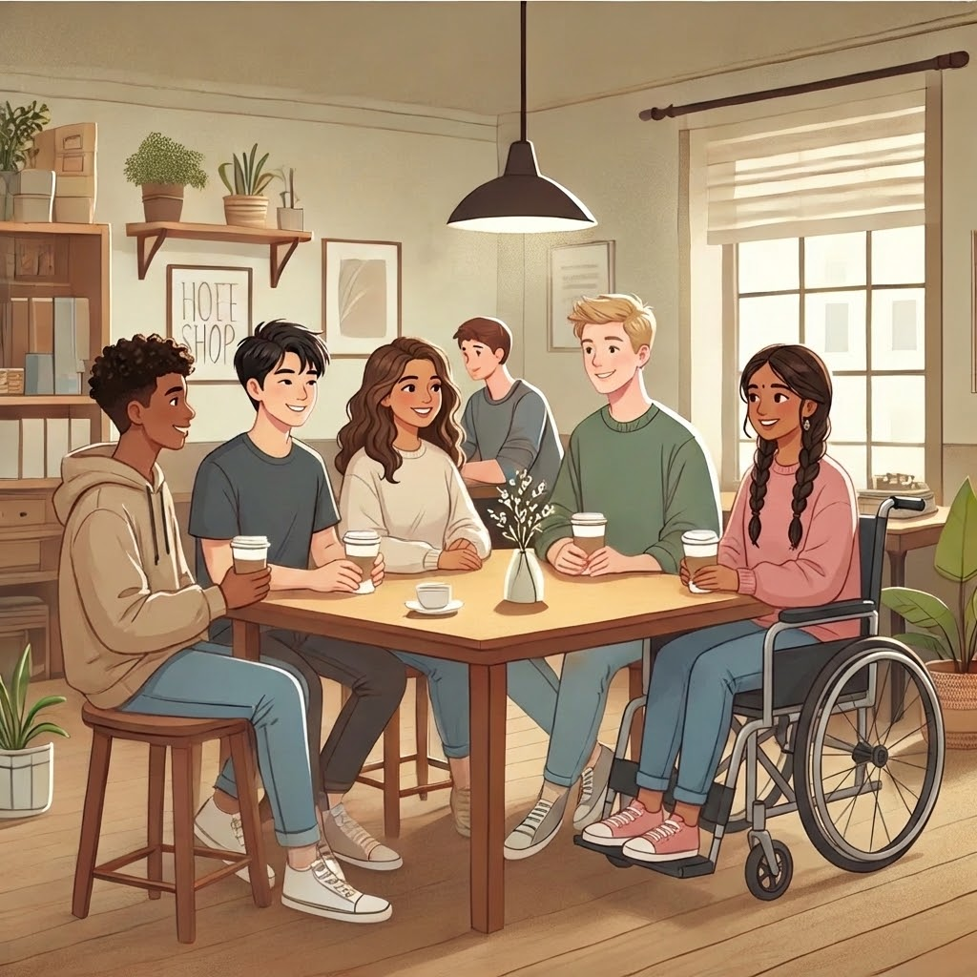
What do you like? (10/21)
Go to a live show 🎭 OR Visit a coffee shop 🧃

Slide 17
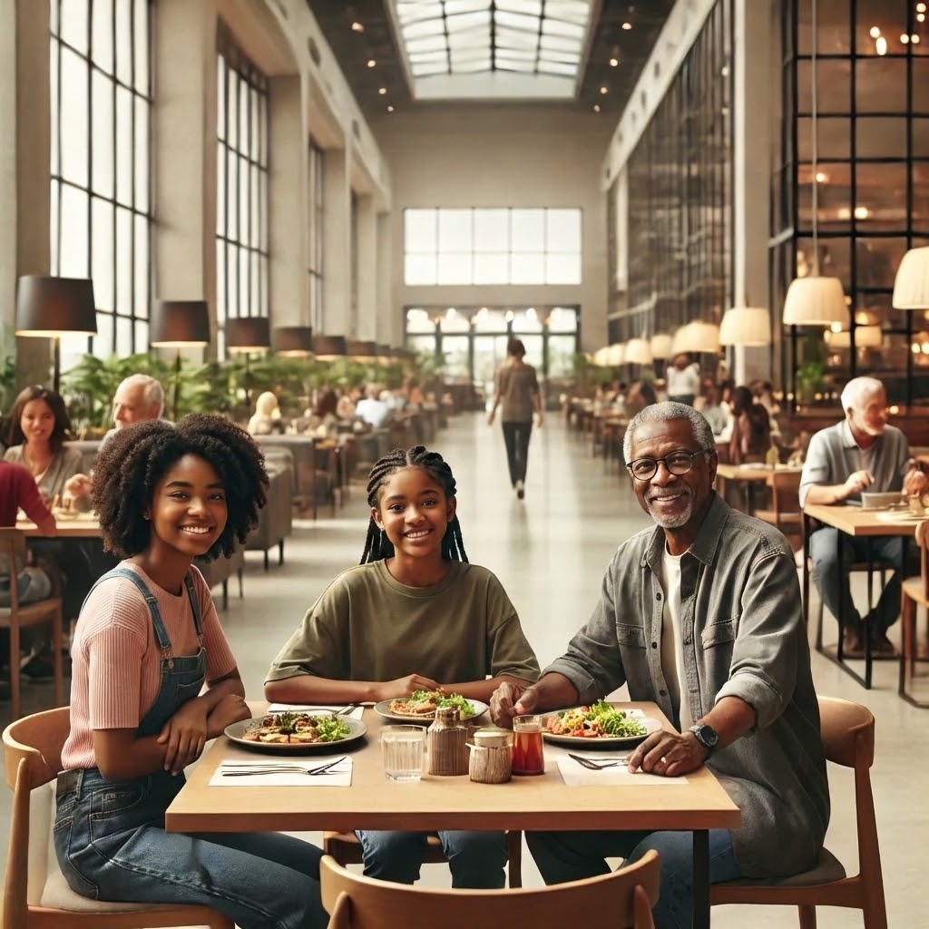
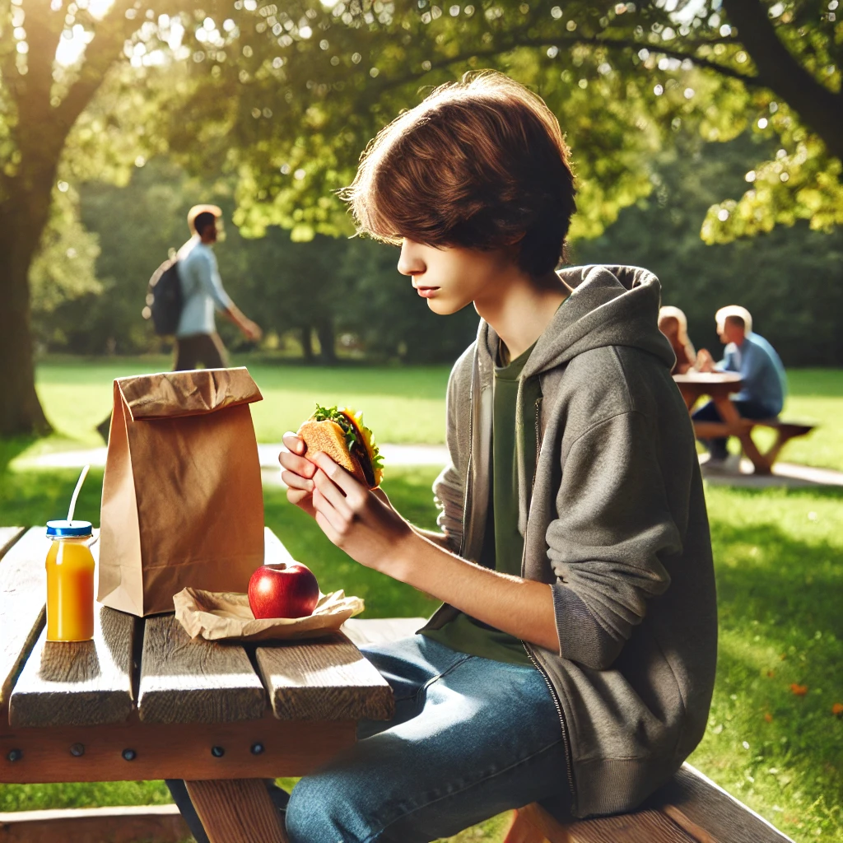
What do you like? (11/21)
🍽️ Try a new restaurant OR 🧃 Pack your own lunch

Slide 18
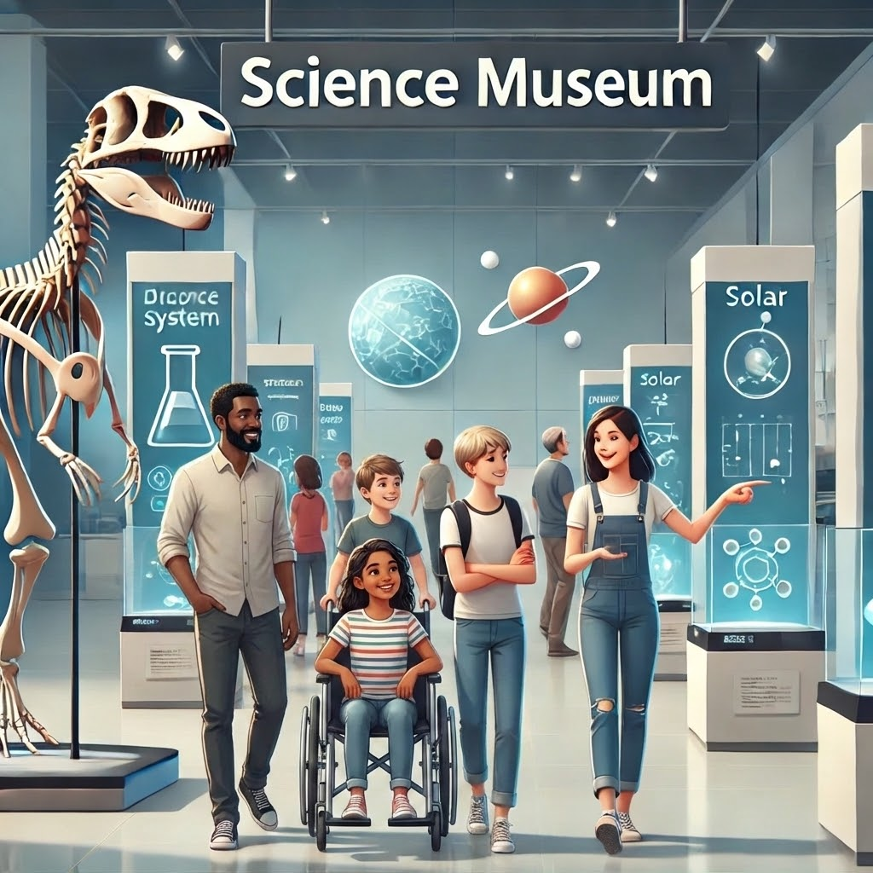
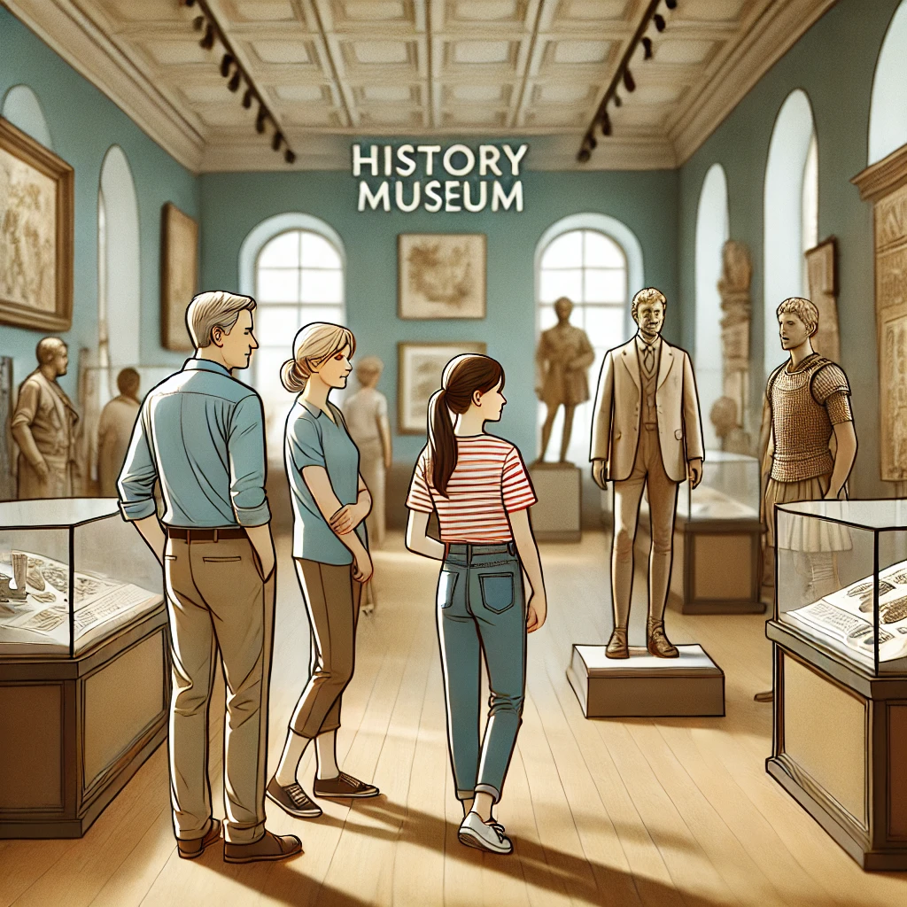
What do you like? (12/21)
Visit science museum 🧪 OR Visit history museum 🏛️

Slide 19
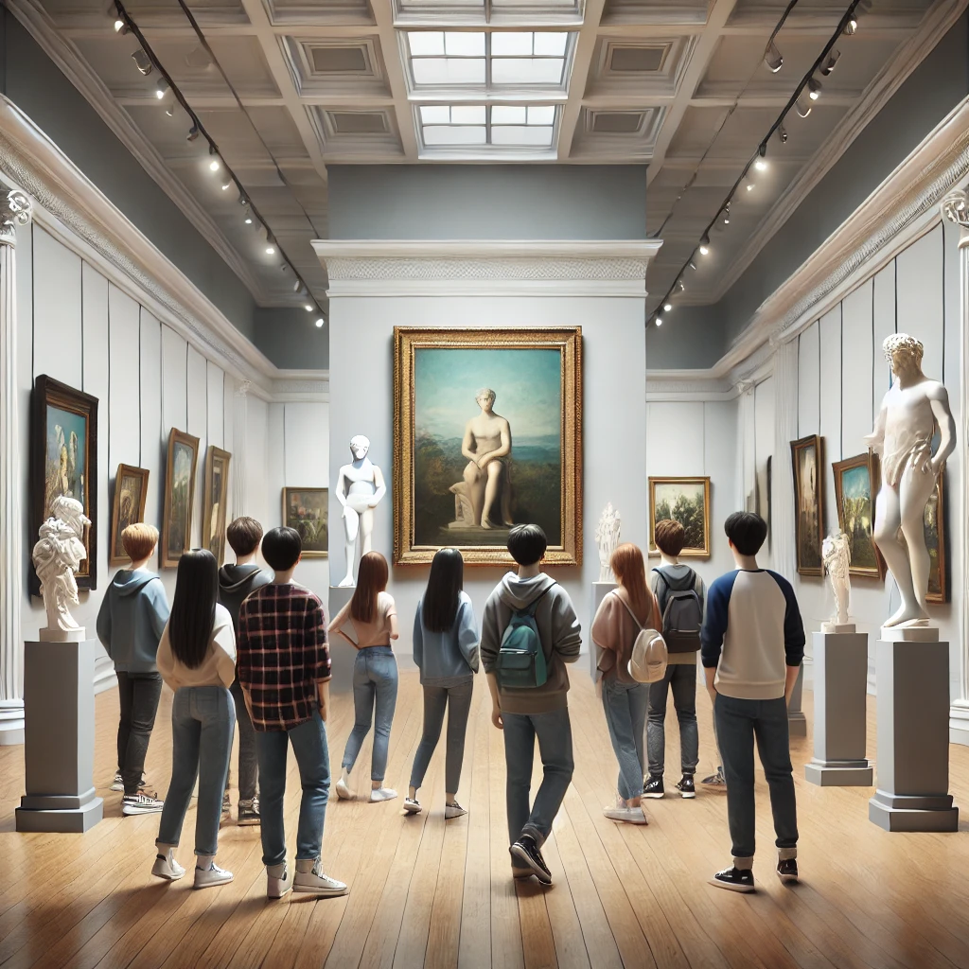
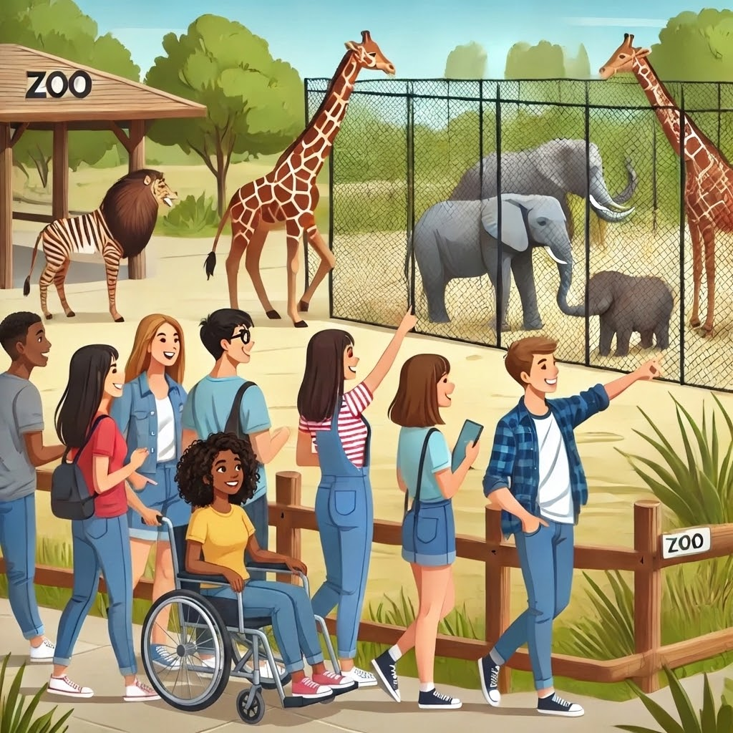
What do you like? (13/21)
Visit an art museum 🎨 OR Go to the zoo 🐘

Slide 20
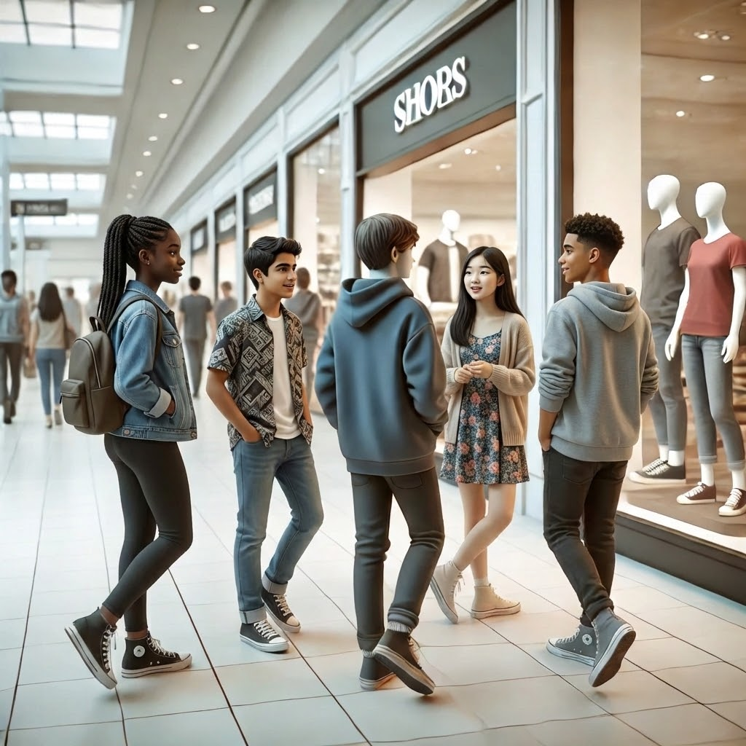
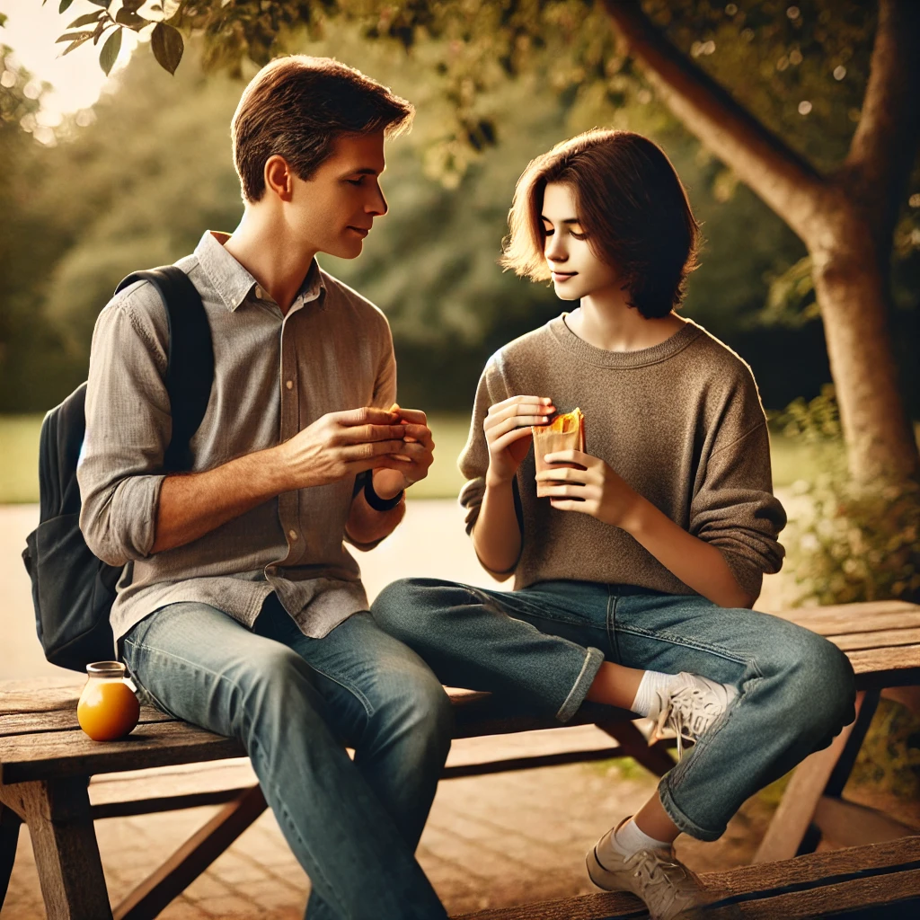
What do you like? (14/21)
🚶 Walk around the mall OR ☕ Sit and have a snack

Slide 21
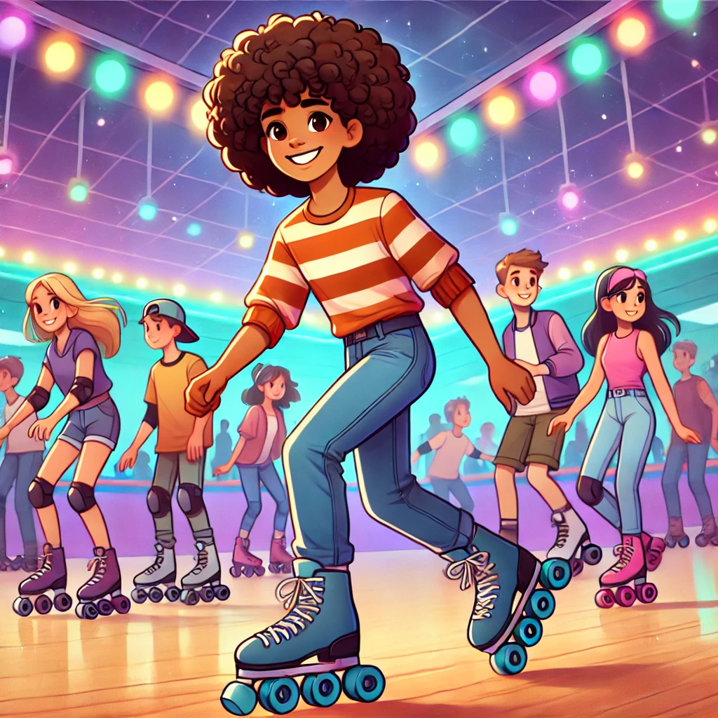
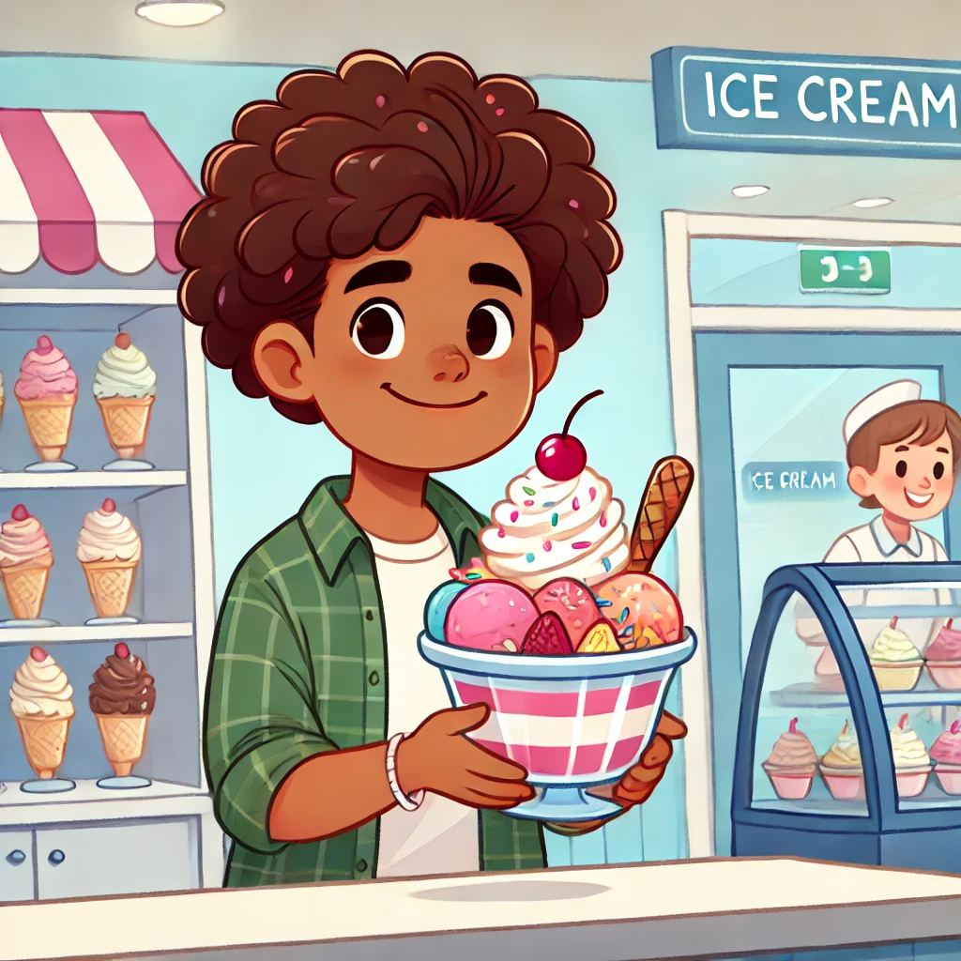
What do you like? (15/21)
🛼 Go rollerskating OR Get a cold snack outside

Slide 22
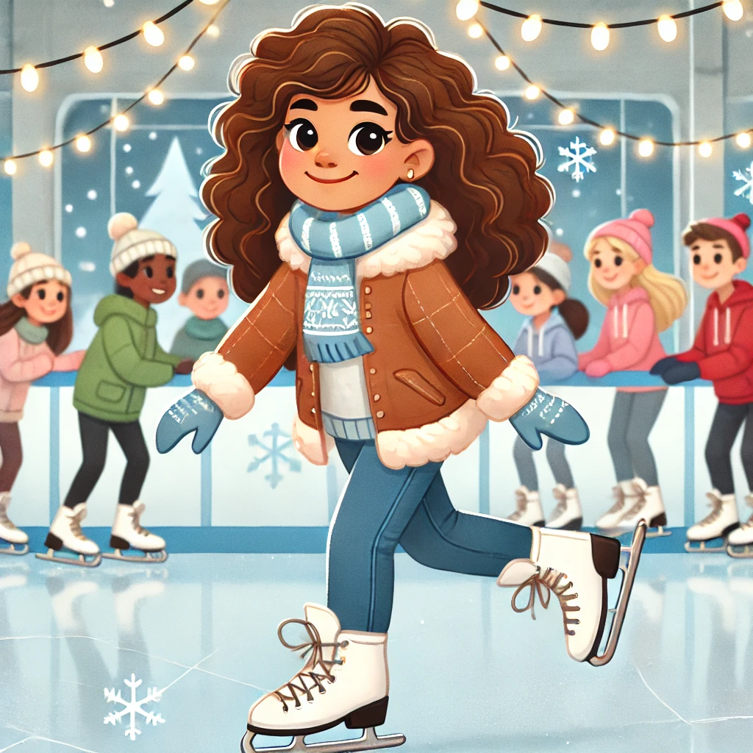
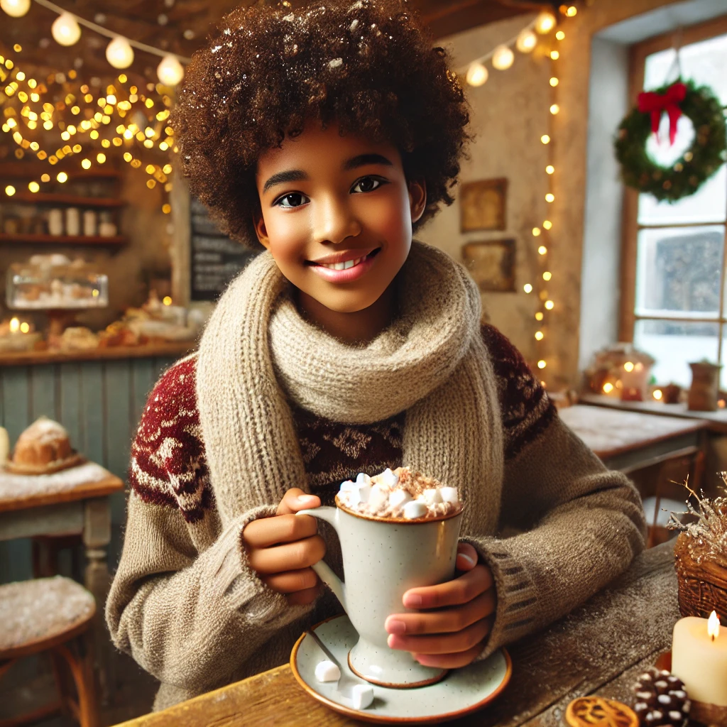
What do you like? (16/21)
☕ Drink a warm drink and relax
⛸️ Go ice skating OR

Slide 23
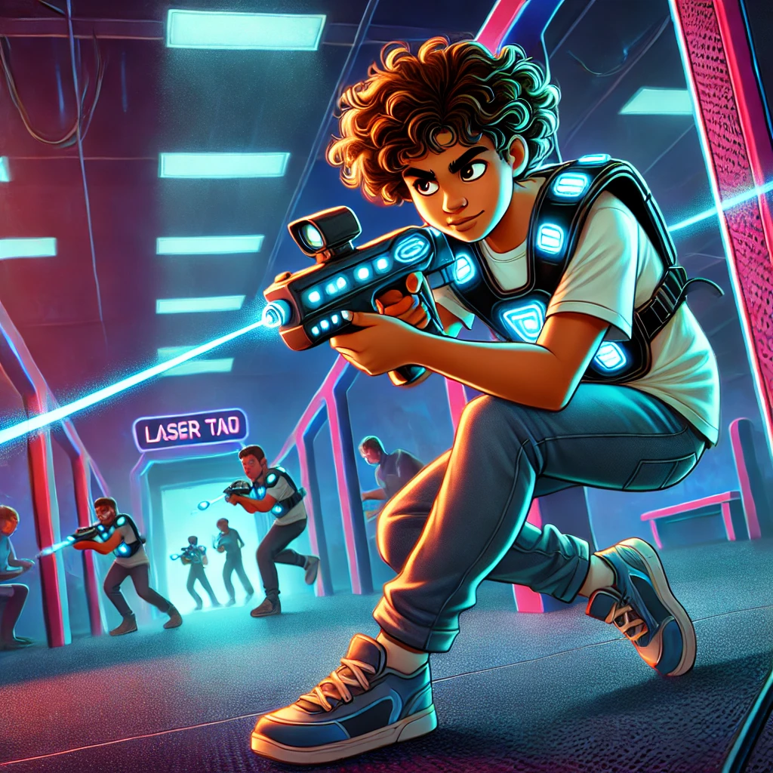
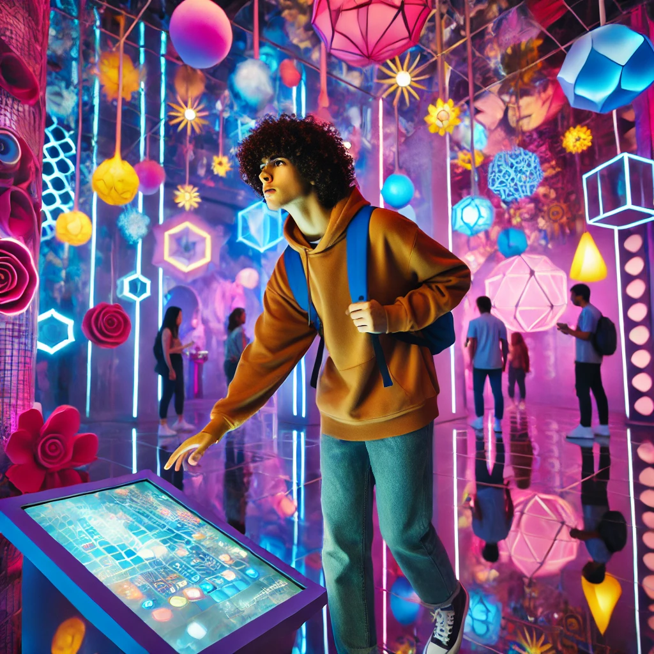
What do you like? (17/21)
🔫 Play laser tag OR 🖼️ Visit an art experience

Slide 24
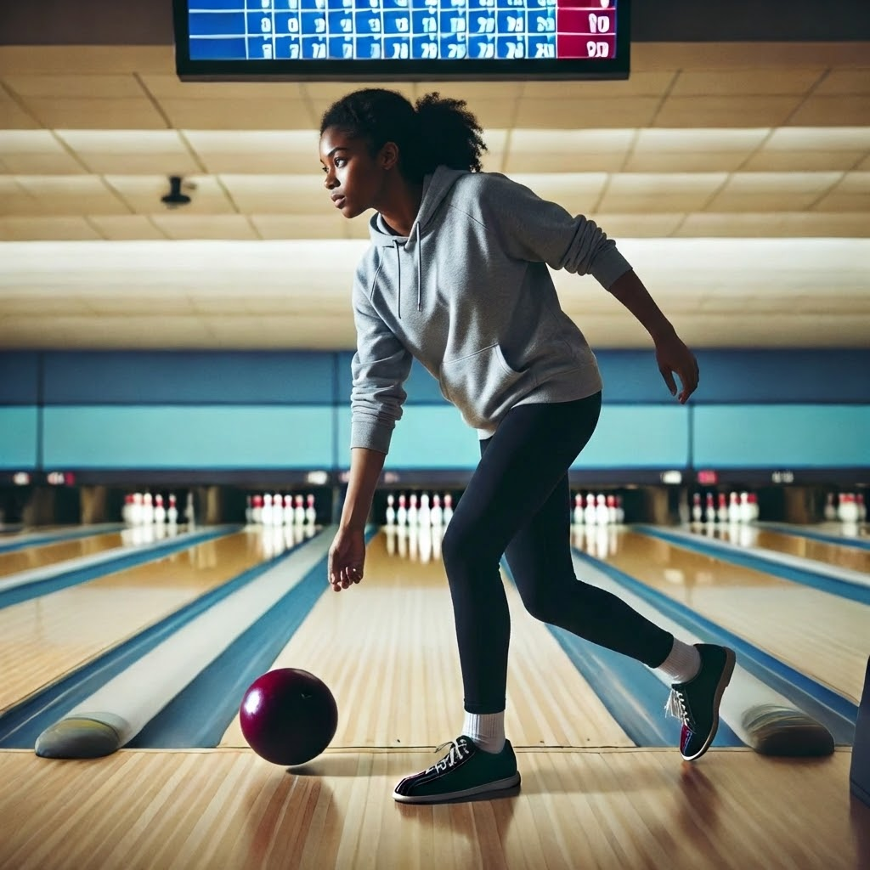
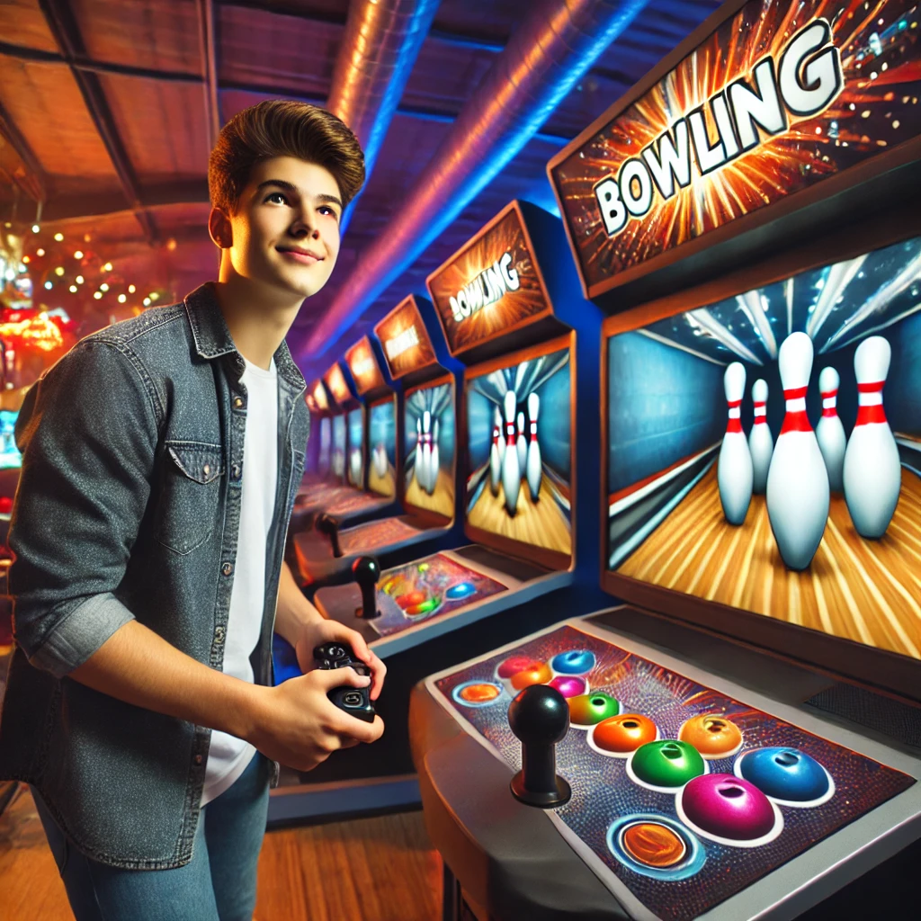
What do you like? (18/21)
🎳 Go Bowling OR 🎮 Play a bowling video game

Slide 25
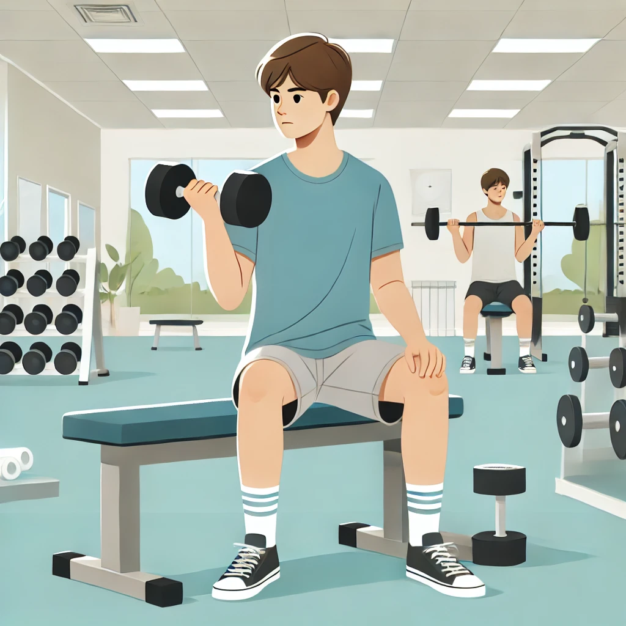
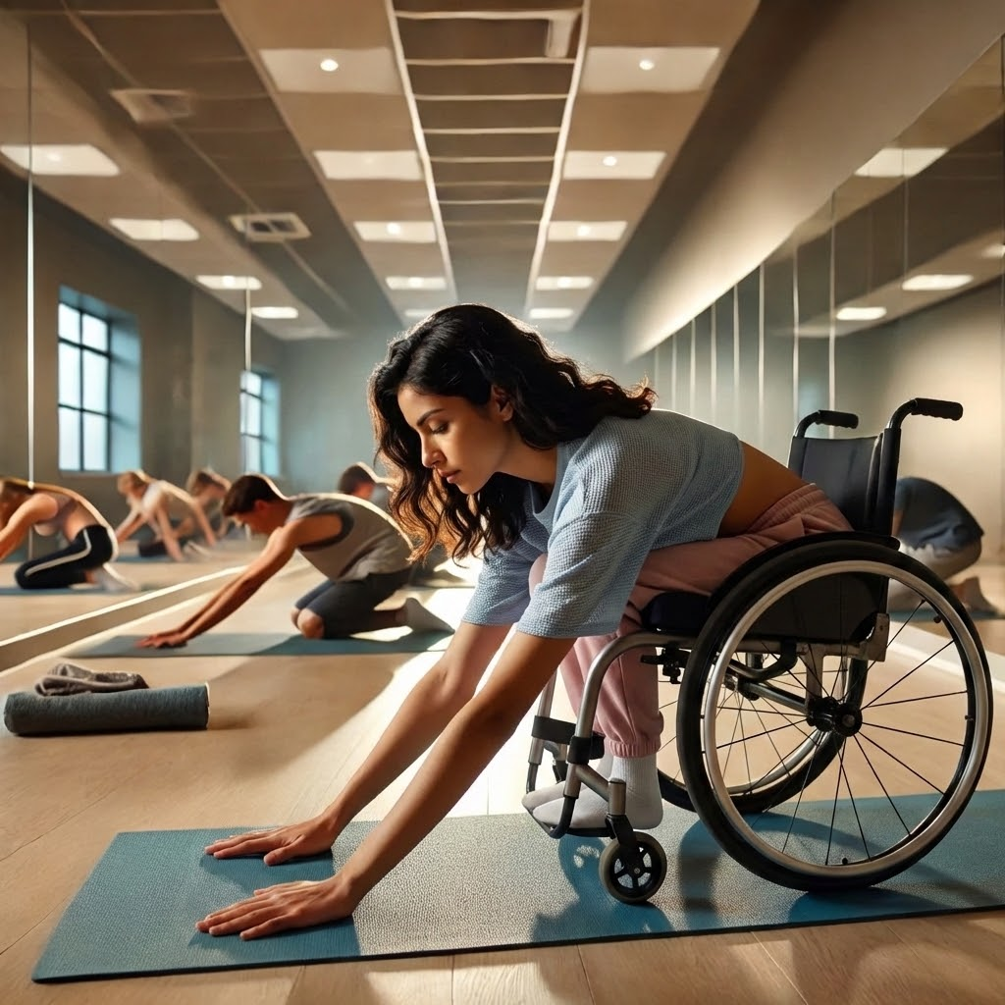
What do you like? (19/21)
🏋️ Weight lifting OR 🧘 Do stretching

Slide 26
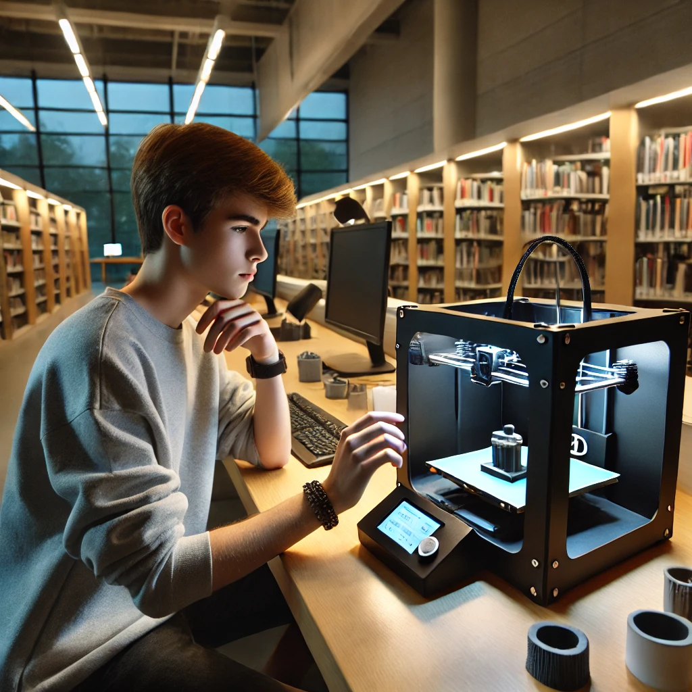
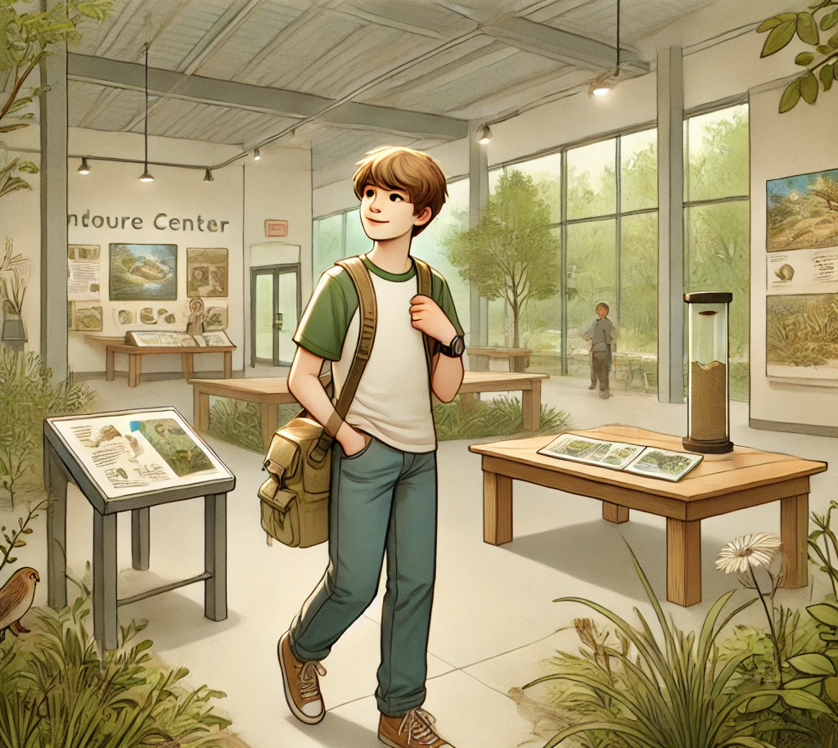
What do you like? (20/21)
🖨️ Use a 3D printer OR 🌳 Explore a nature center

Slide 27
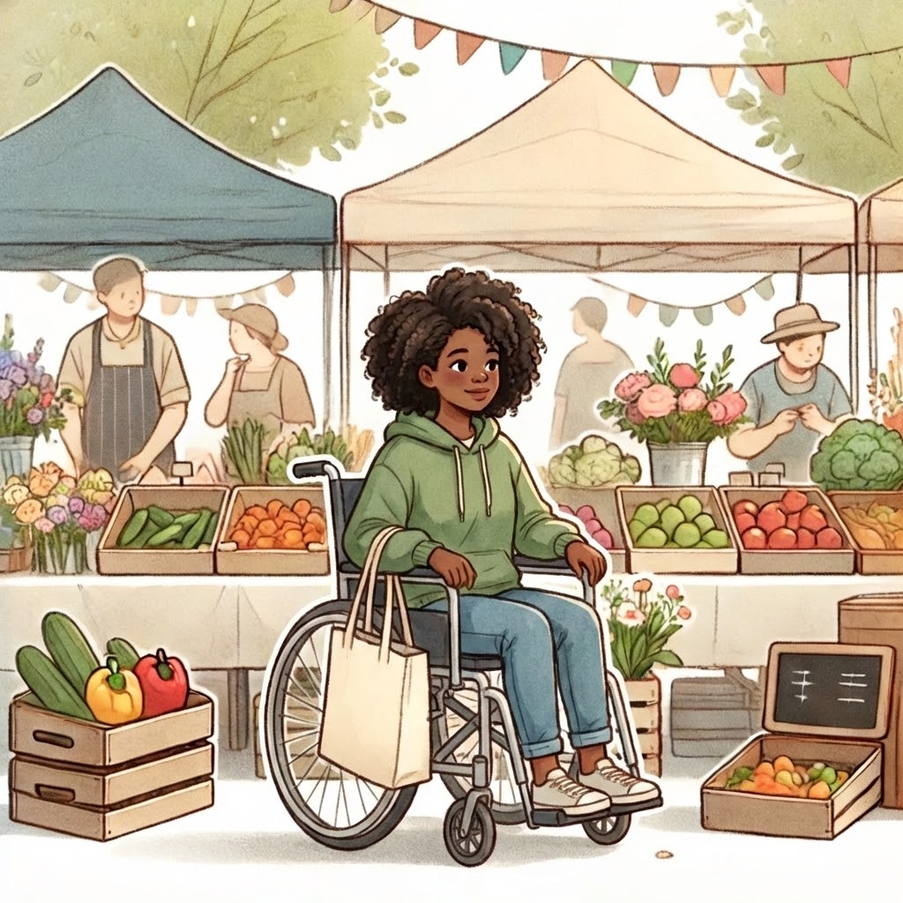
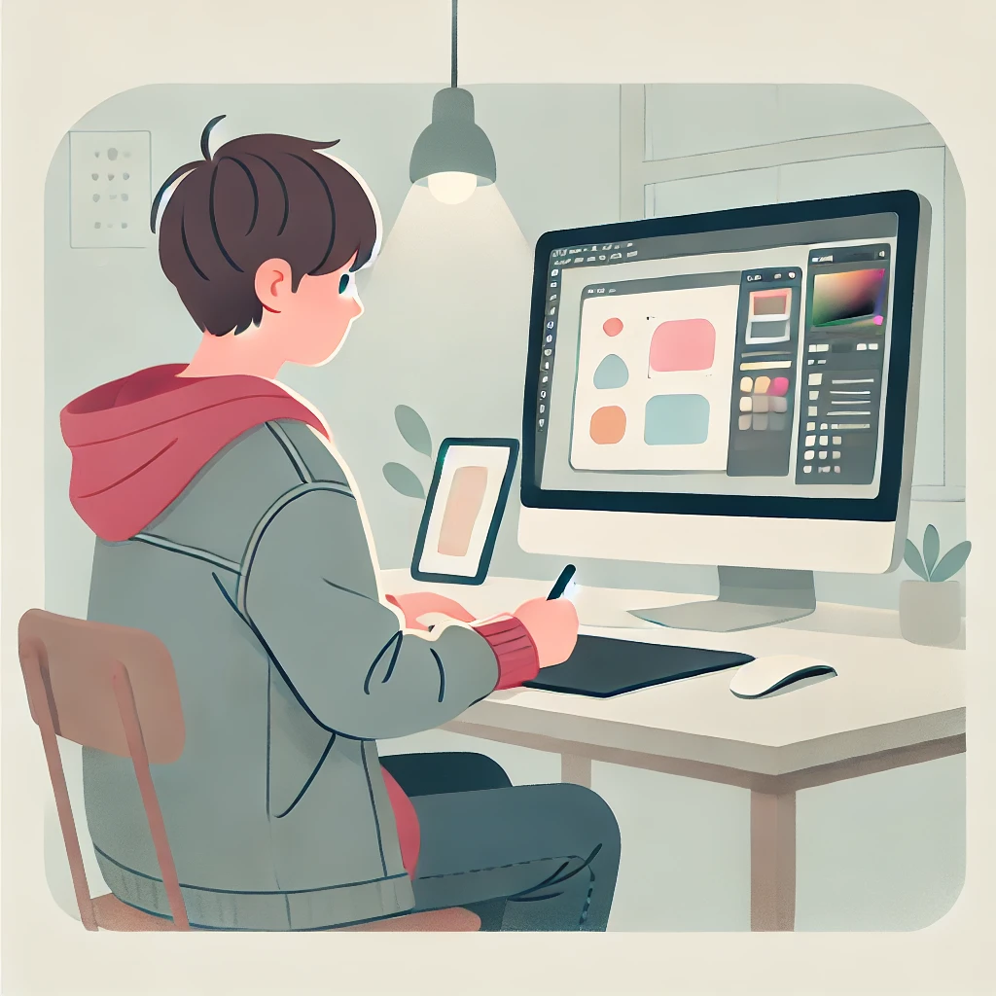
What do you like? (21/21)
🛍️ Visit farmers market OR 🎨 Make computer art

Slide 28

Well Done

