Slide 1
Outside Leisure Activity Assessment
Charles Thull, PhD
Old Dominion University

Slide 2
Presentation Note
Note. Images and animated visuals in this presentation were generated using ChatGPT, Sora, DALL·E, and Gemini based on author-developed prompts.

Slide 3
What do you like to do outside?
🚶‍♂️🥾🏃‍♀️
🌱🧤
🏀⚽
🎣
🏕️ 🧺 🏖️
🪣
🐦
🚲 🛴 🛹
🥏🏓
⛳
🚤
🧘
🏞️ 🛝
🏊‍♂️
🎾

Slide 4
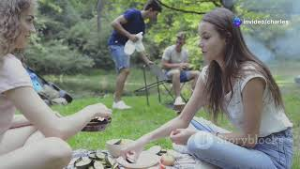
Outdoor Fun!

Slide 5
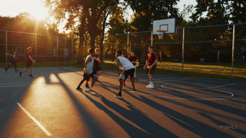
Outdoor Fun
Play sports with others.

Slide 6
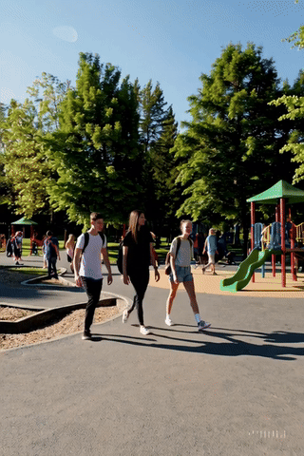
More Outdoor Fun
Explore things you like outside.

Slide 7
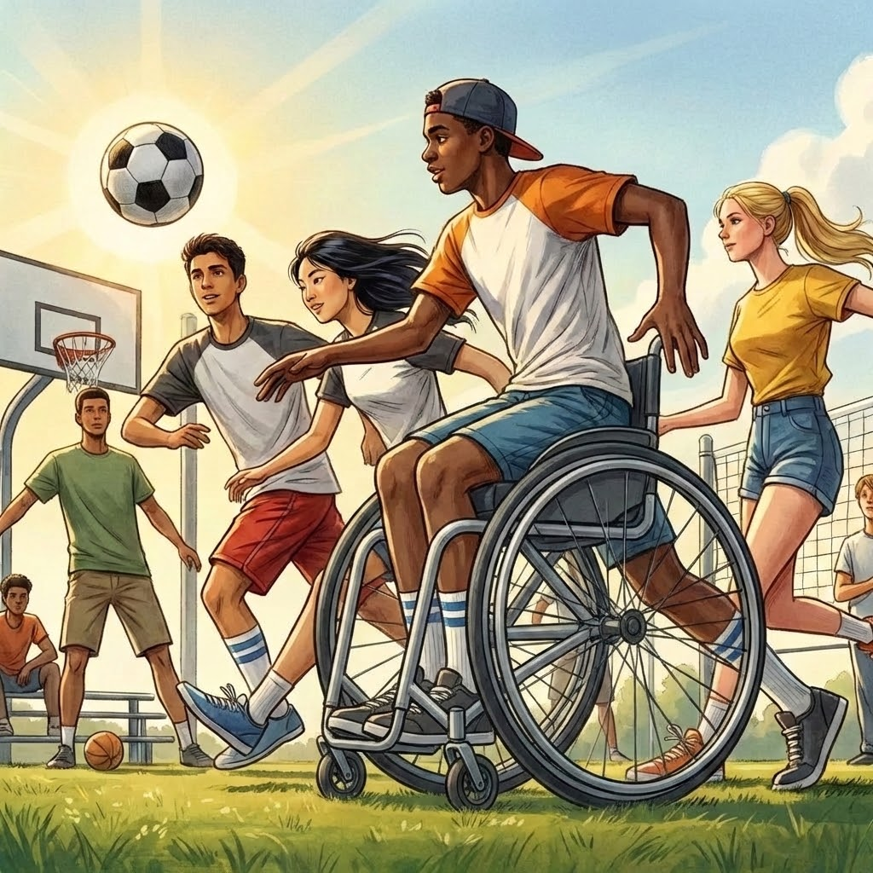
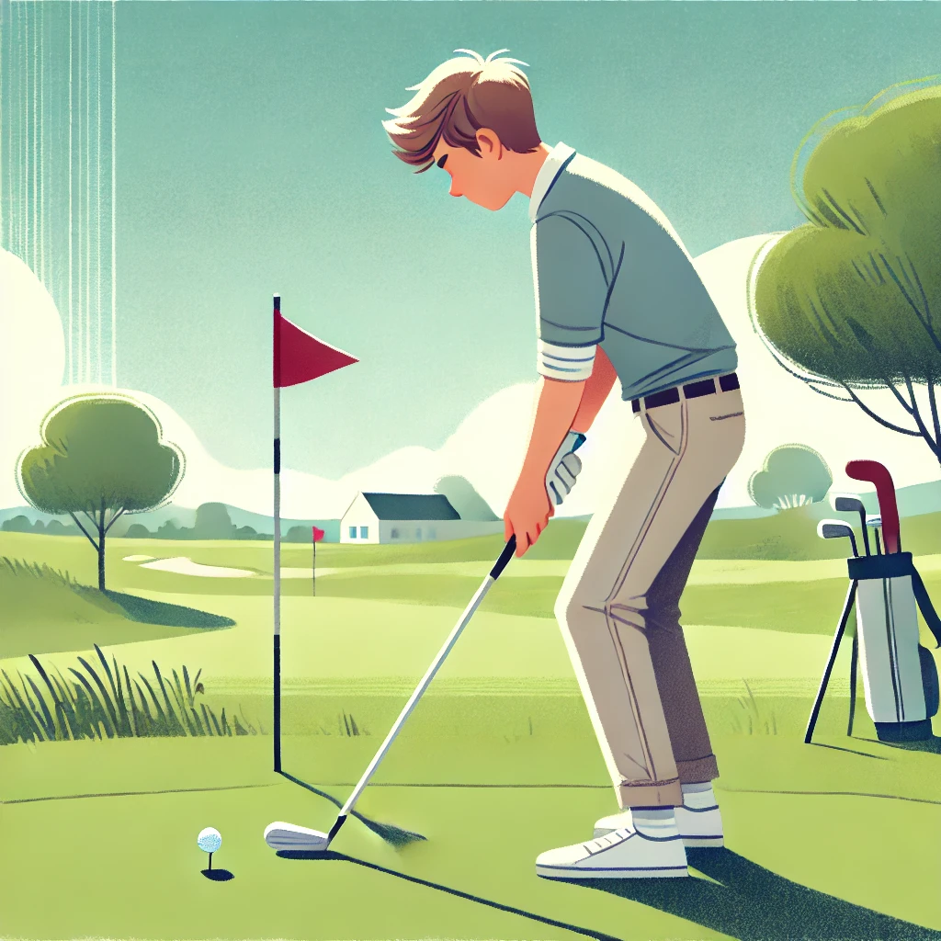
What do you like? (1/23)
🏀⚽🏈⚾Team sports
OR
🎳⛳ Solo sports

Slide 8
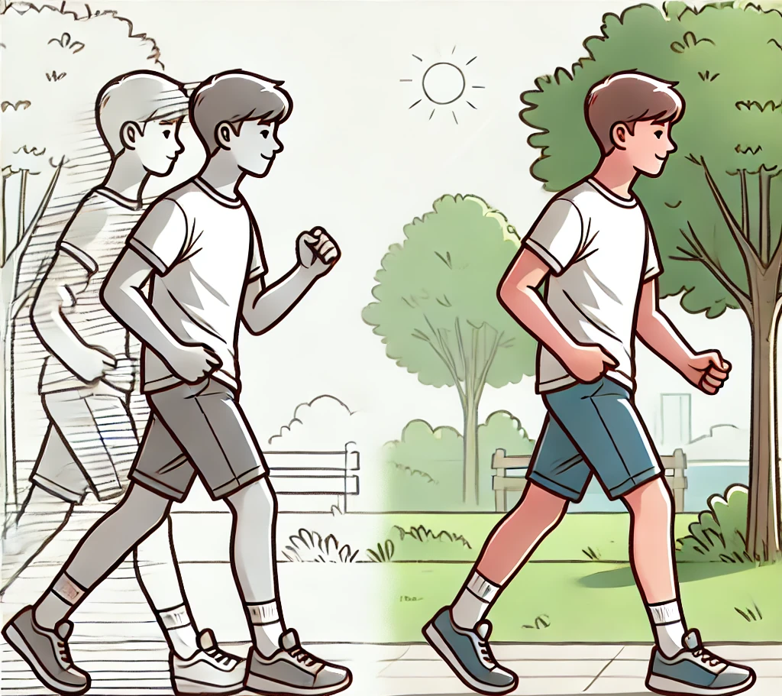
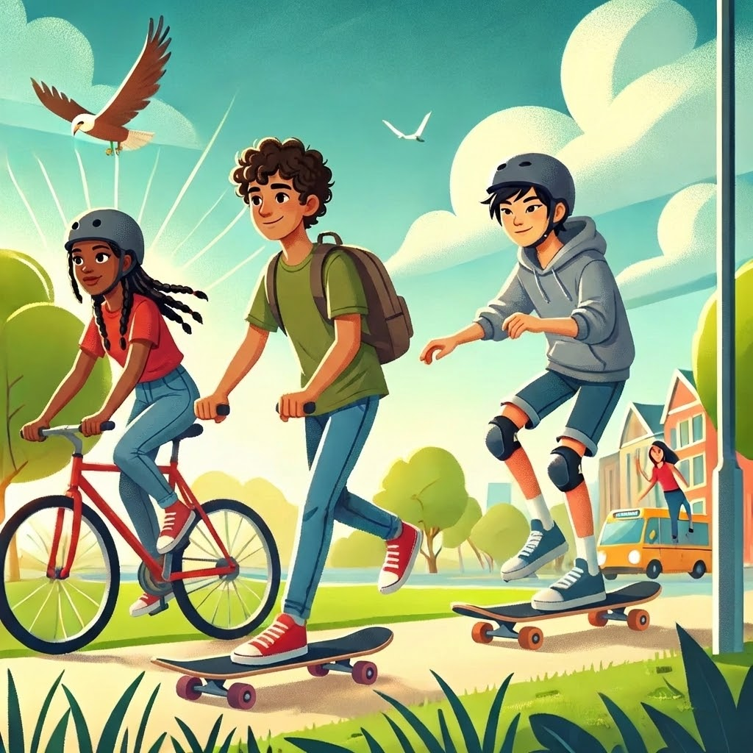
What do you like? (2/23)
🚶‍♂️🏃‍♀️Run/Walk
OR
🚲🛴🛹Move on wheels

Slide 9
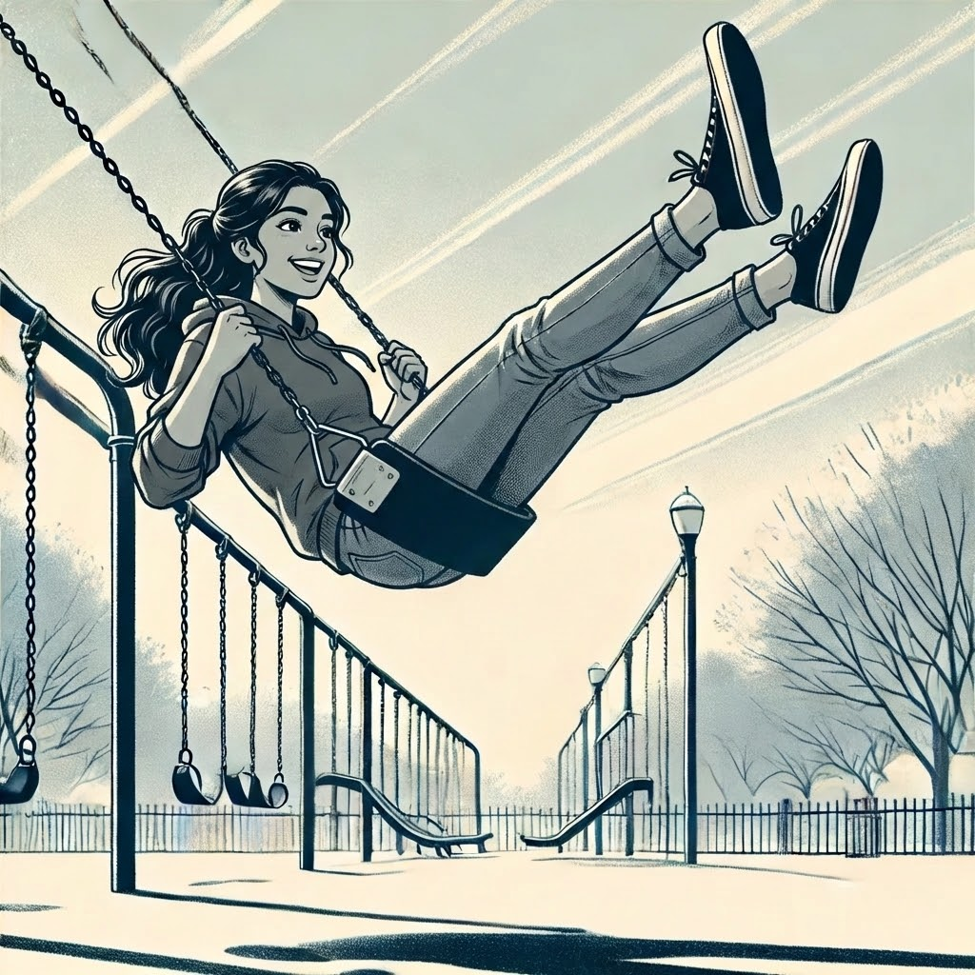
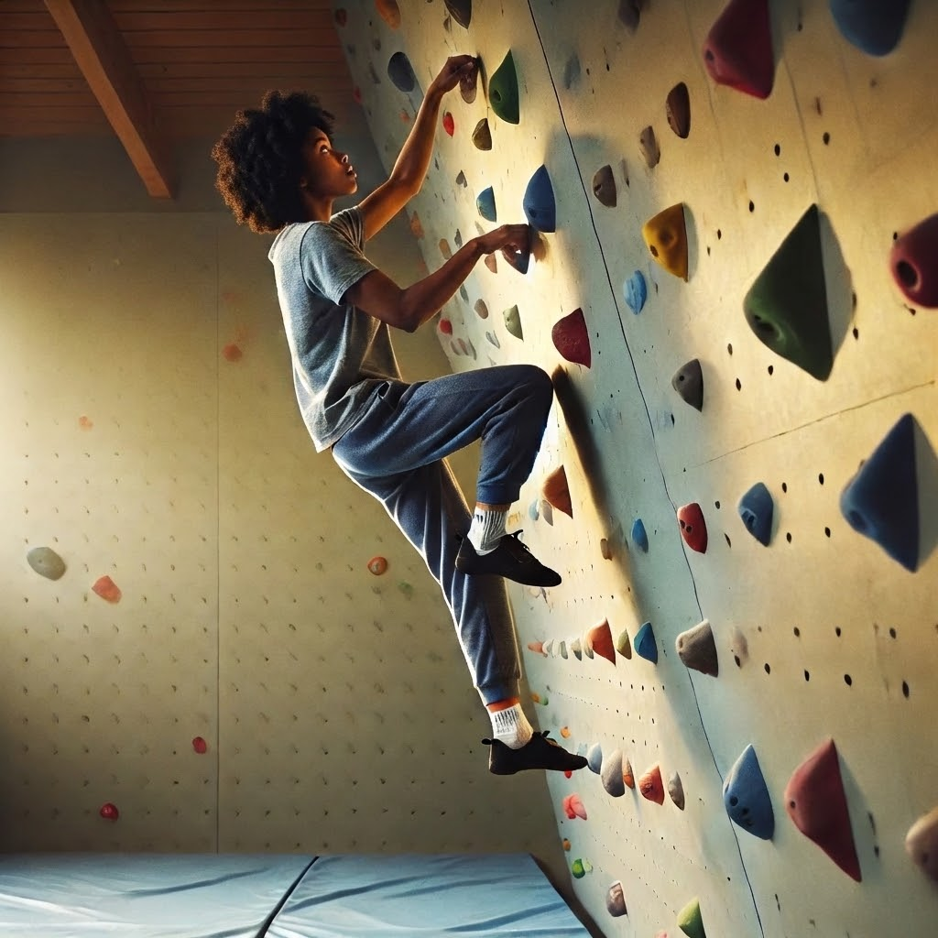
What do you like? (3/23)
🛝 Swing OR 🧗 Climb

Slide 10

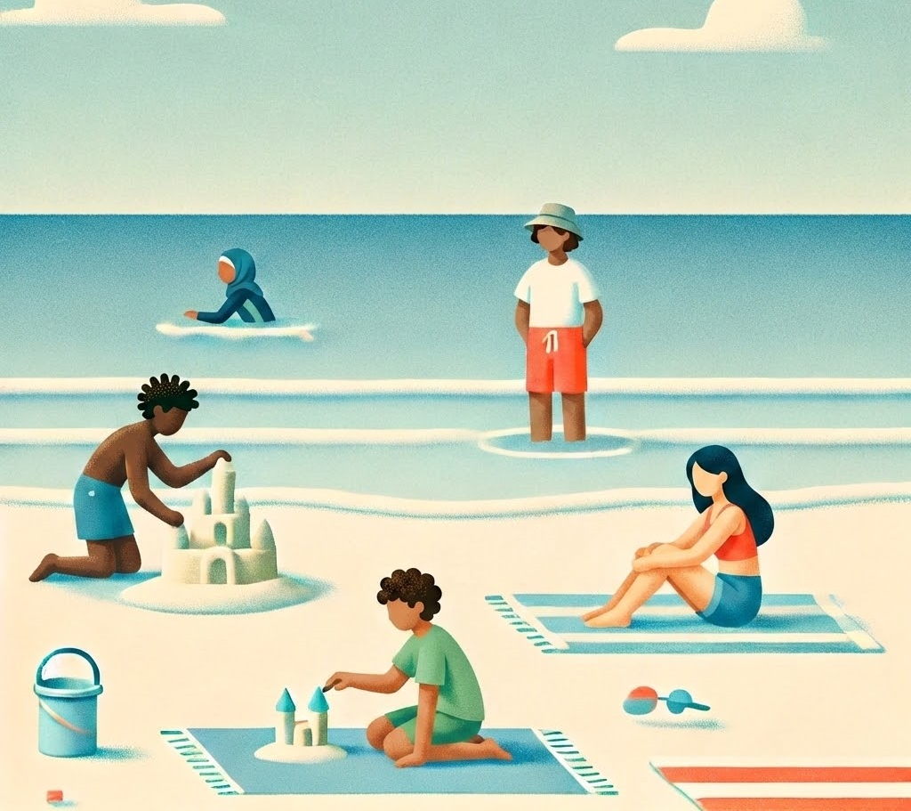
What do you like? (4/23)
🏕️ Camping
OR
🏖️ Beach trip

Slide 11
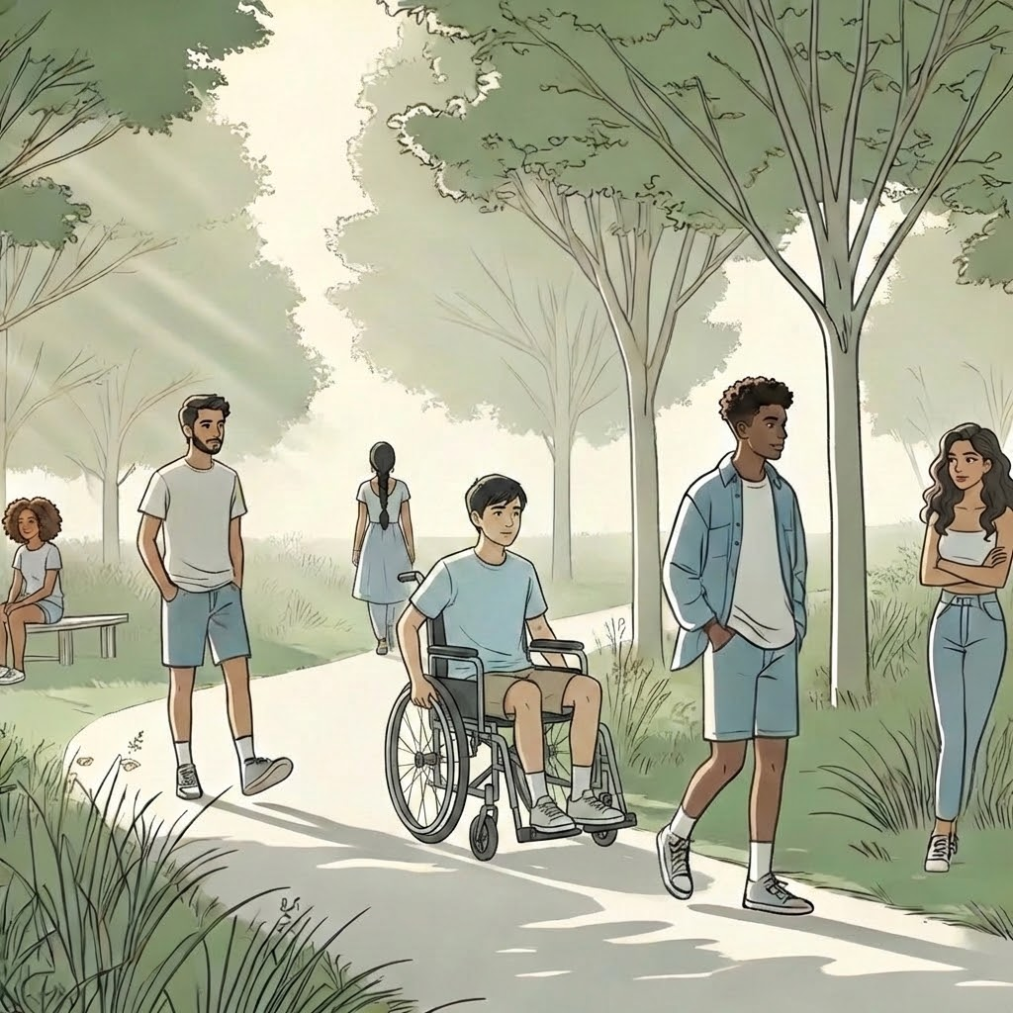
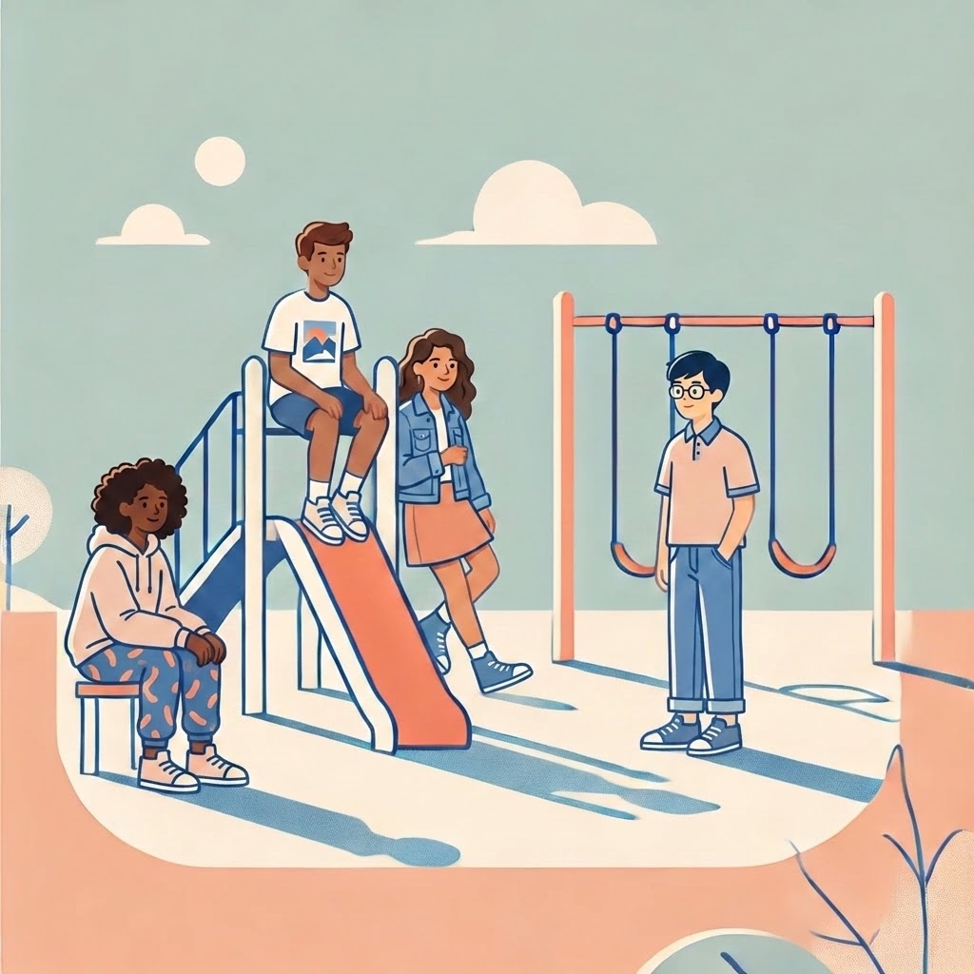
What do you like? (5/23)
🛝 Playground
🏞️ Park visit
OR

Slide 12
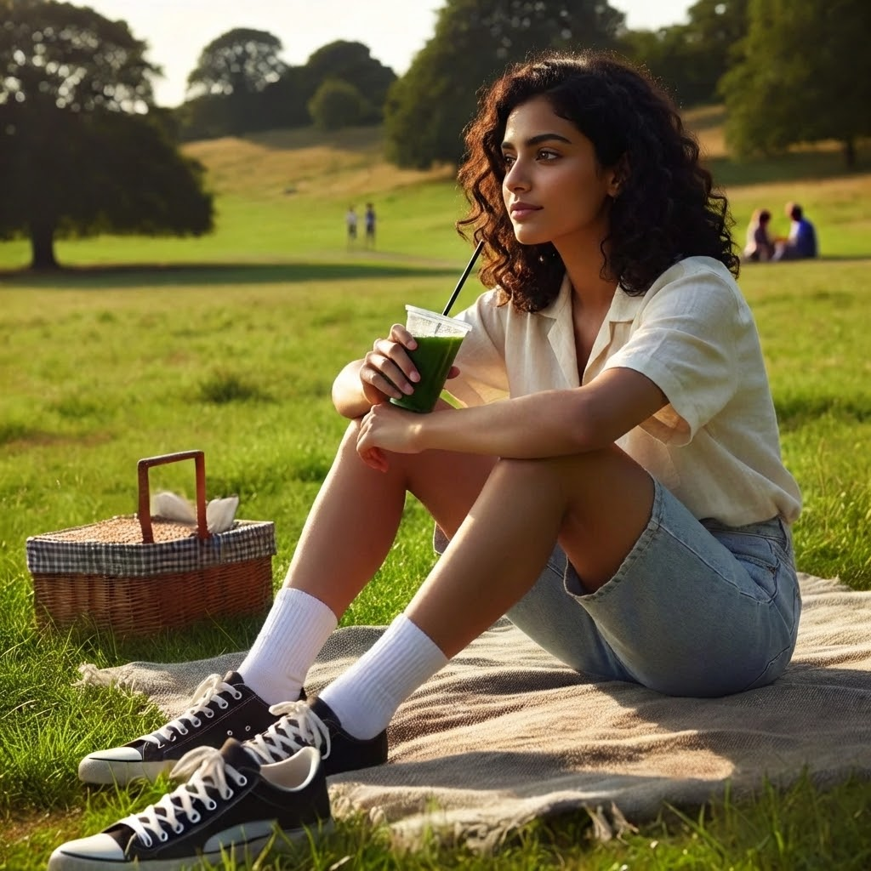
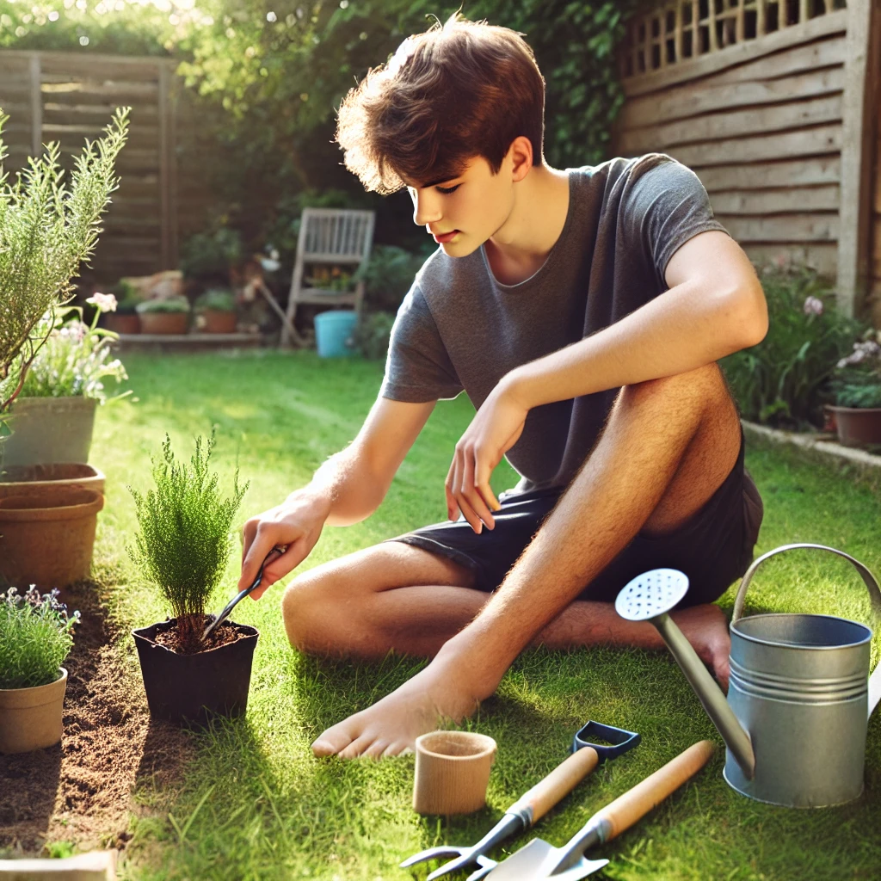
What do you like? (6/23)
🧘🧺Relax & Picnic
OR
🌱🧤Gardening

Slide 13
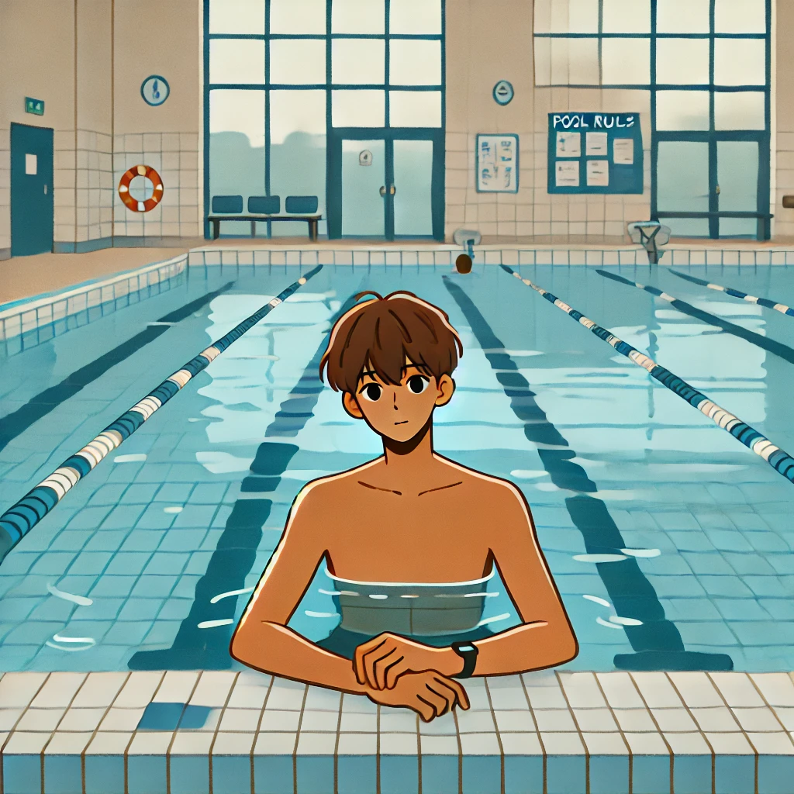
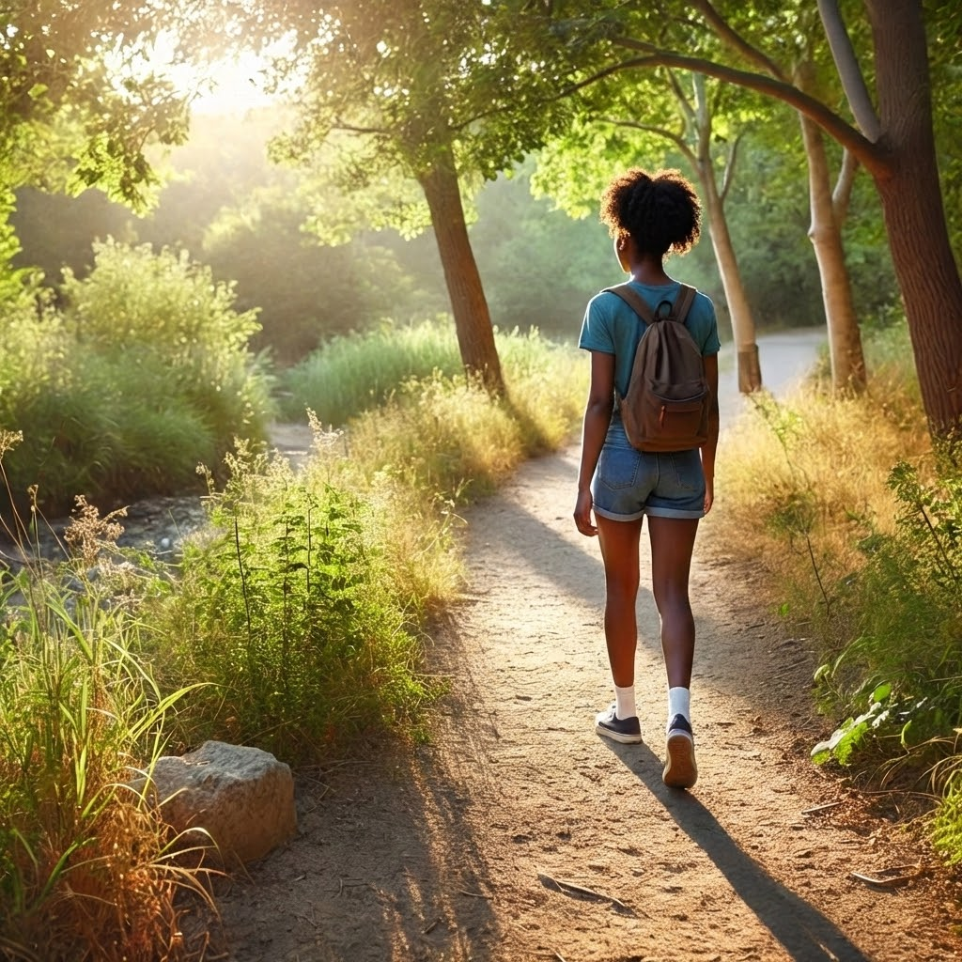
What do you like? (7/23)
🏊‍♂️ Go swim
OR
🚶‍♂️🥾 Go hike

Slide 14
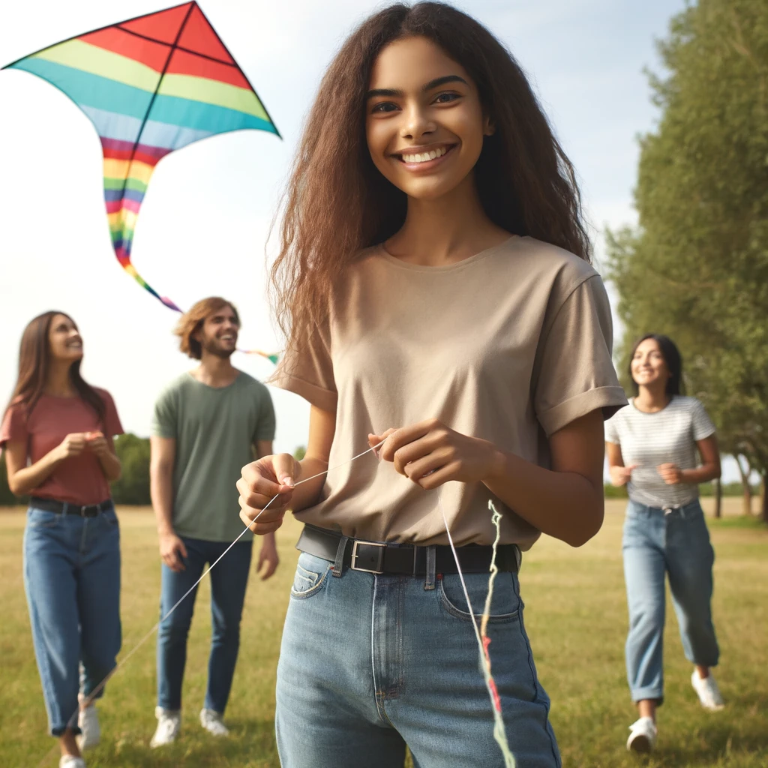
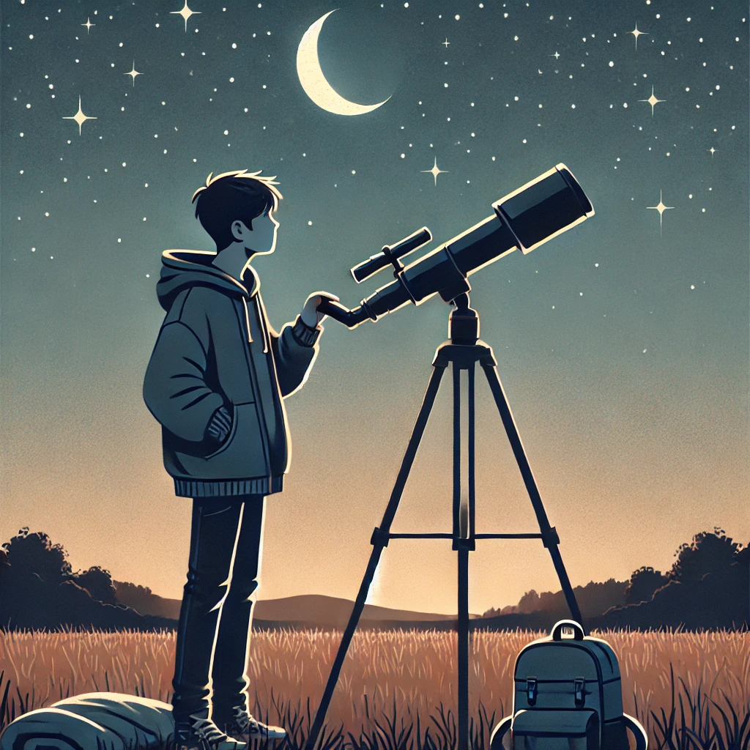
What do you like? (8/23)
Fly a kite 🎏 OR Go stargazing 🌌

Slide 15
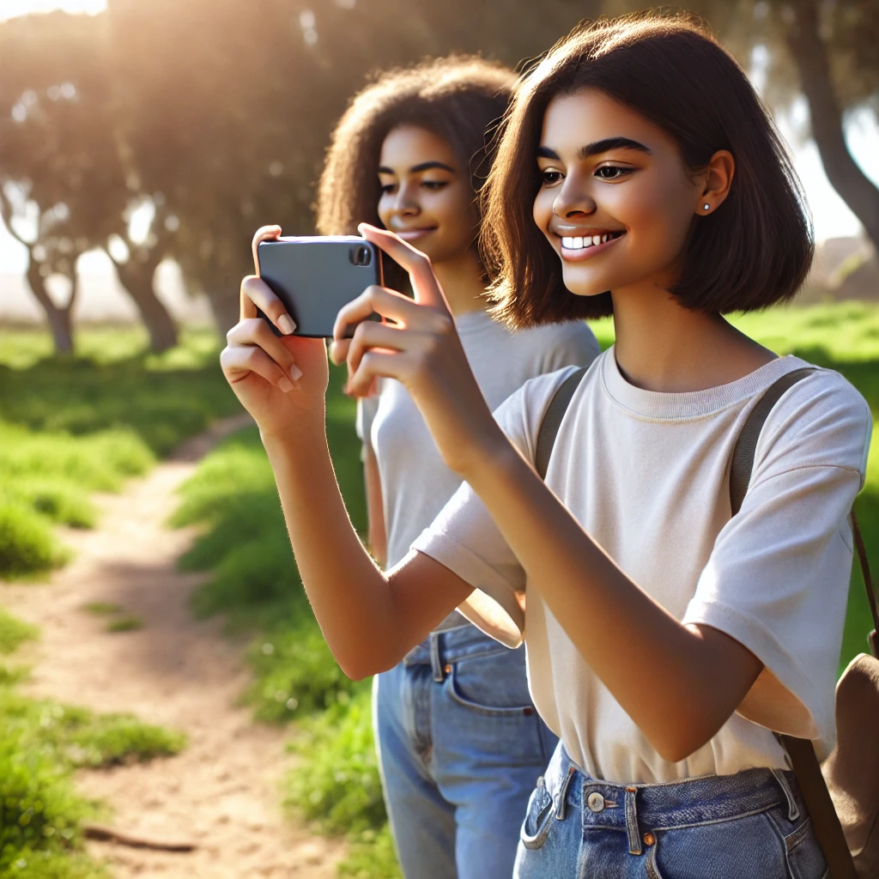
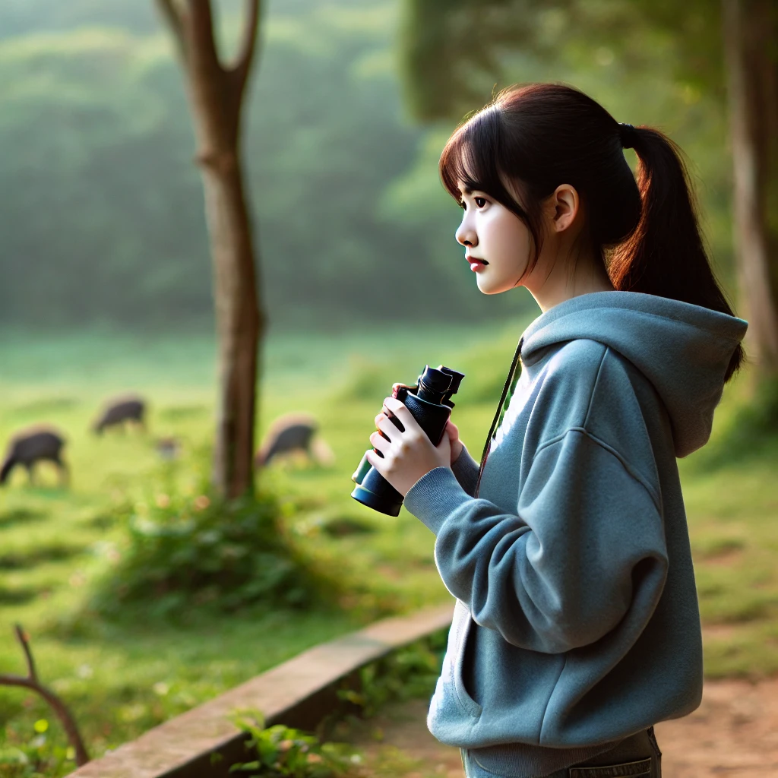
What do you like? (9/23)
Take nature photos 📸 OR Watch animals 🐦

Slide 16
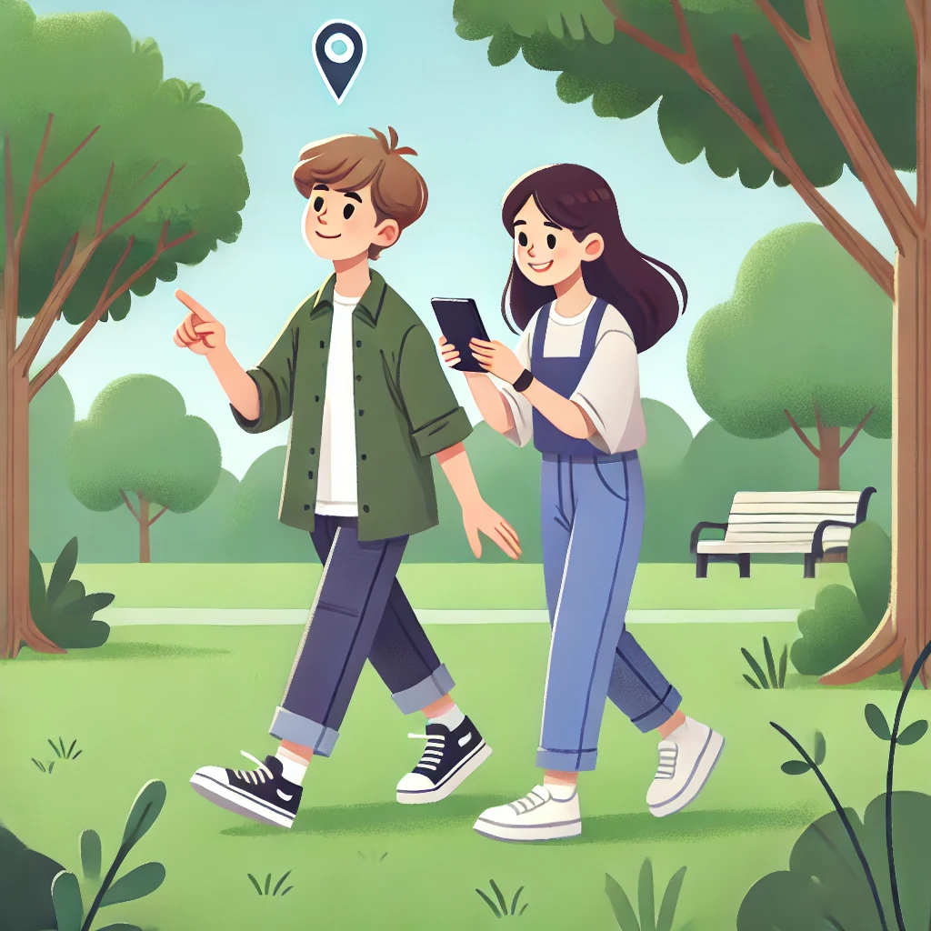
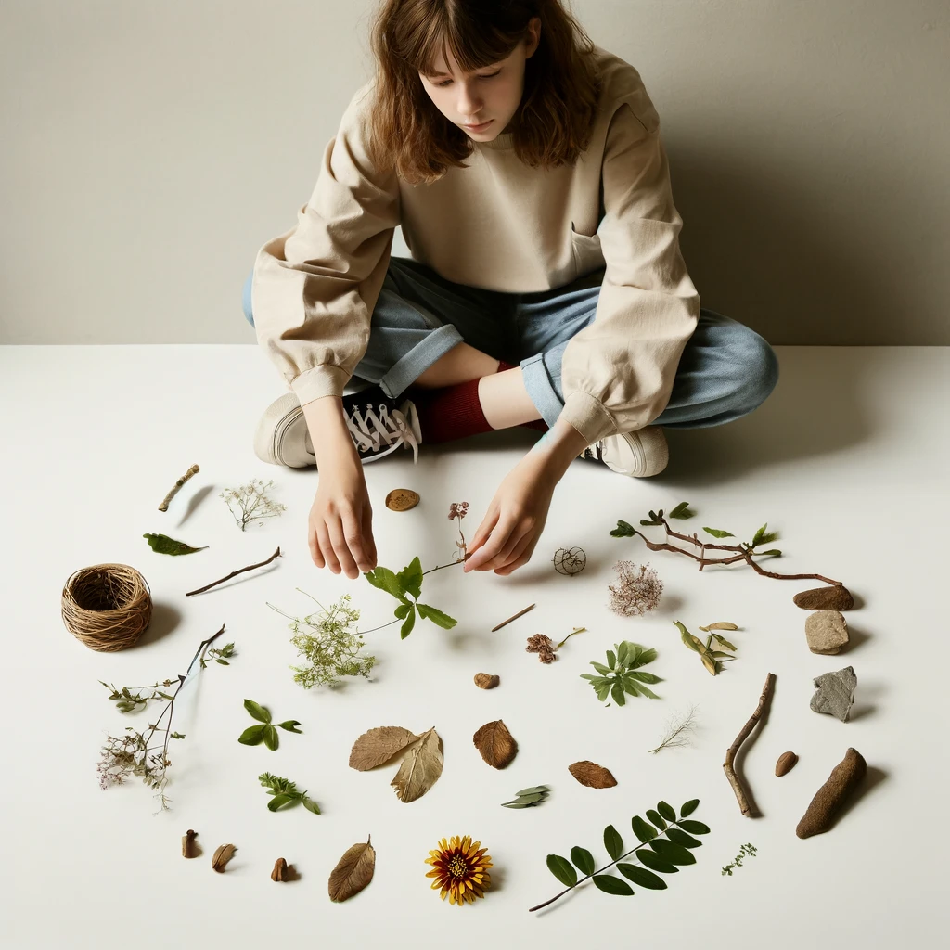
What do you like? (10/23)
Try treasure hunts 🗺️ OR Make art with nature 🍂

Slide 17
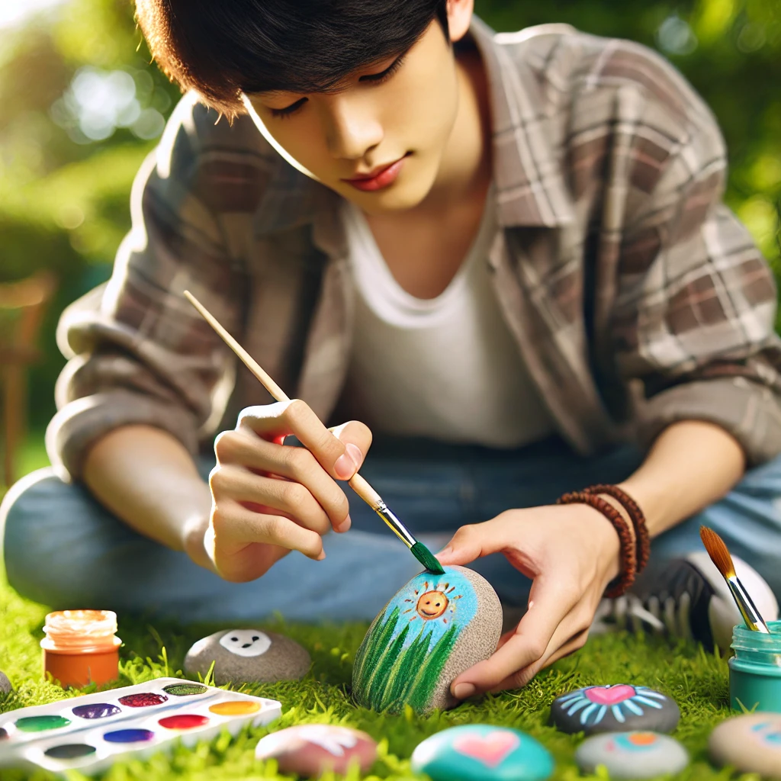
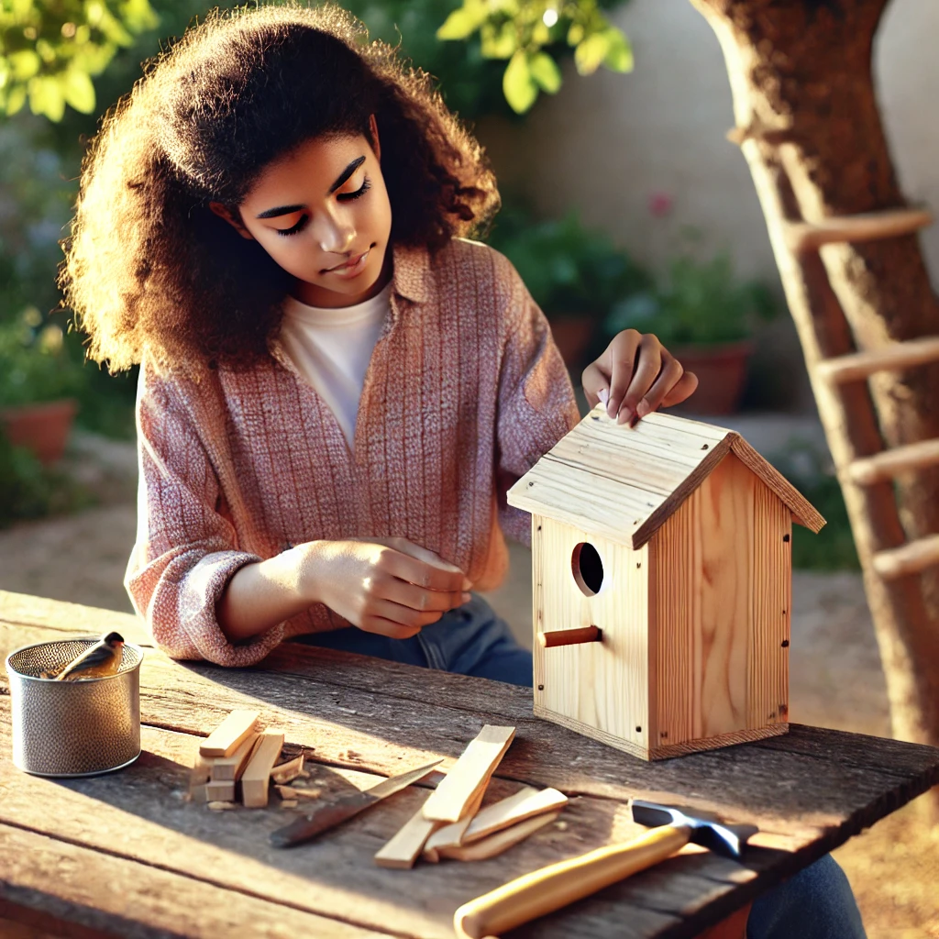
What do you like? (11/23)
🎨 Paint a rock OR Build birdhouse 🪚

Slide 18
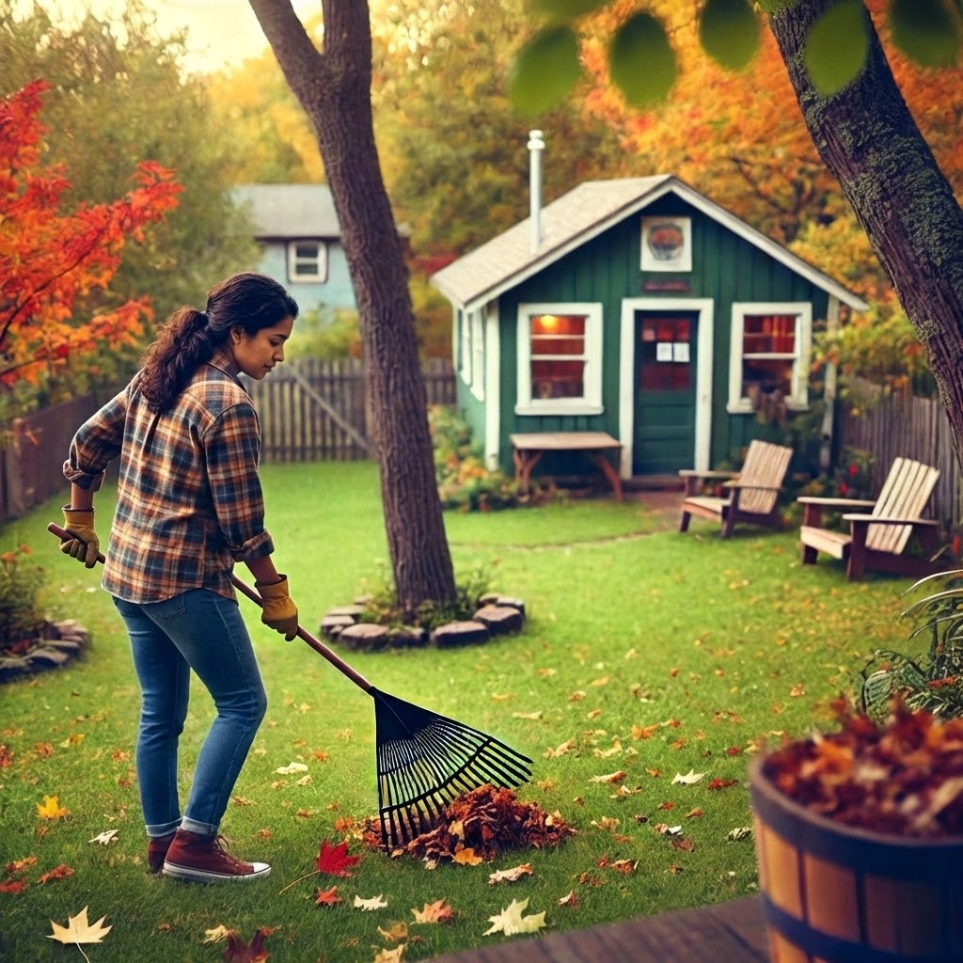
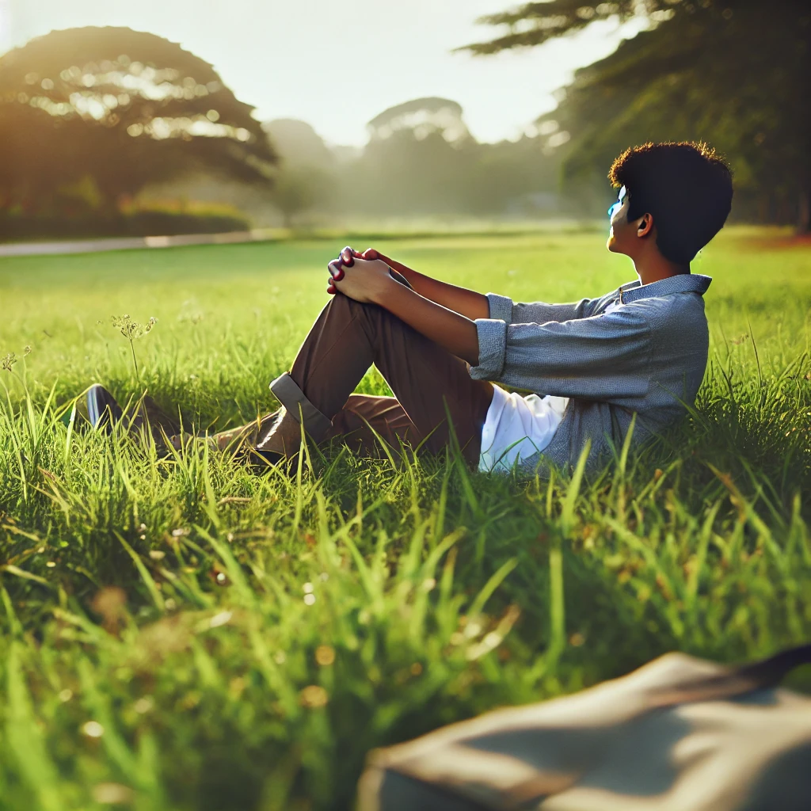
What do you like? (12/23)
Rake leaves🧹 OR Relax in sun ☀️

Slide 19
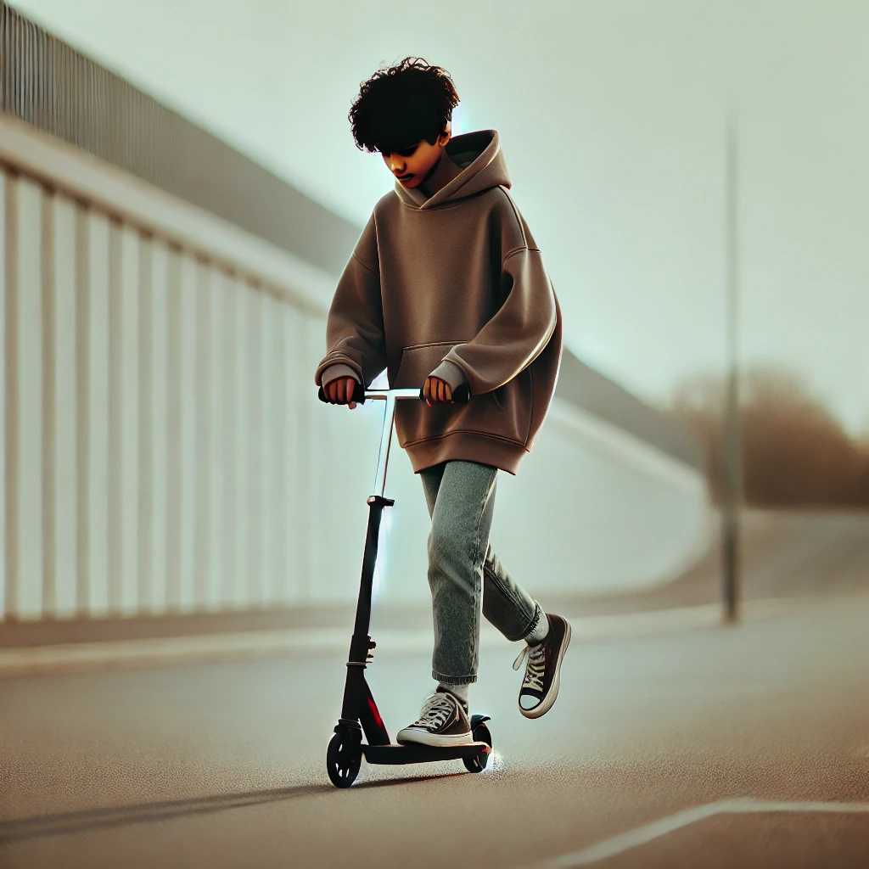
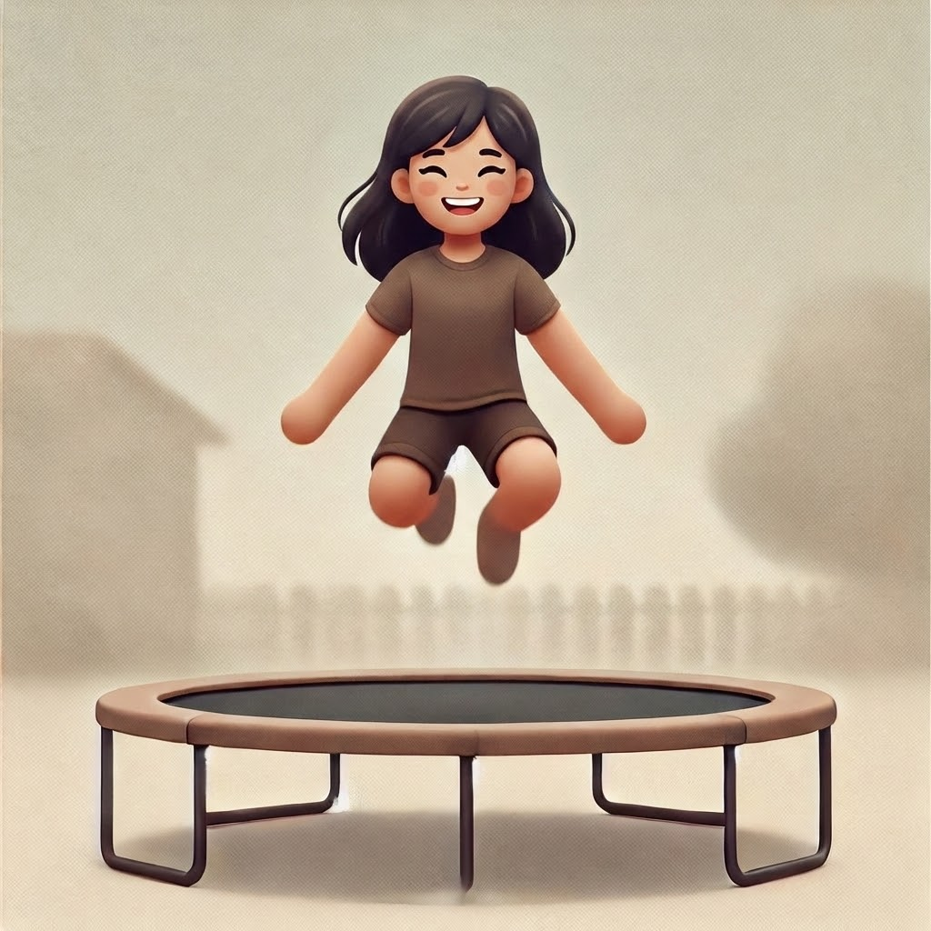
What do you like? (13/23)
Ride a scooter 🛴 OR Jump on a trampoline 🤸

Slide 20
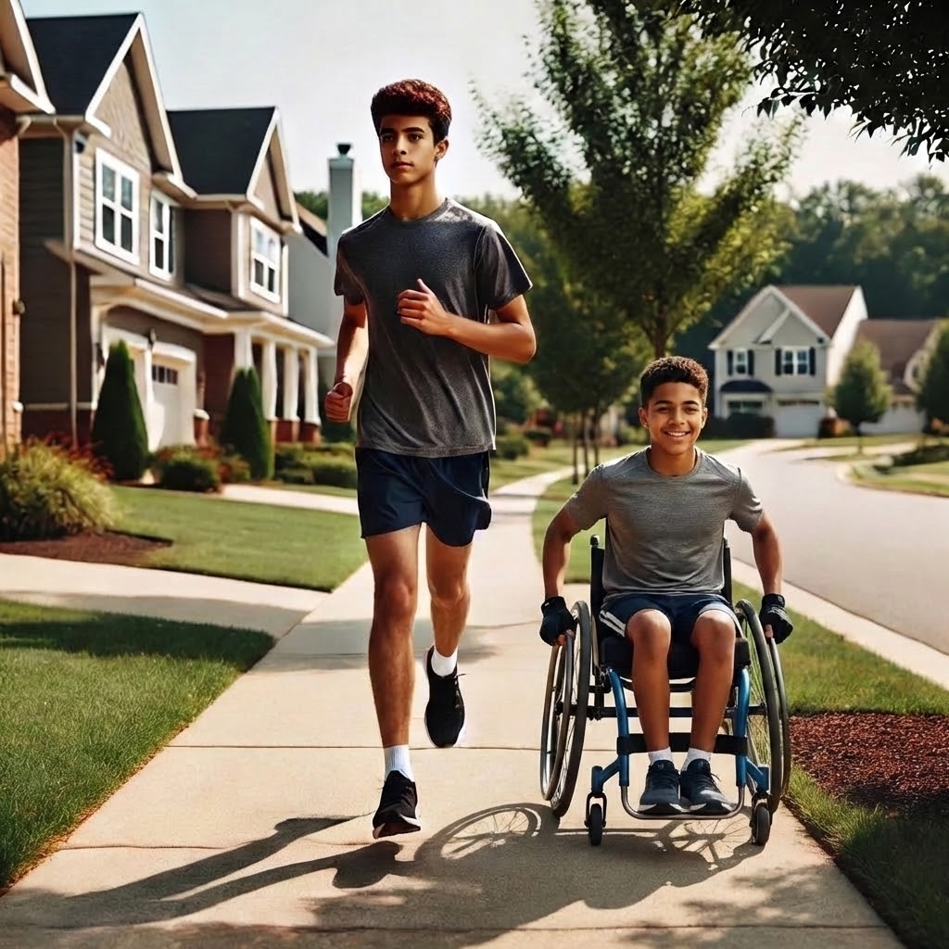
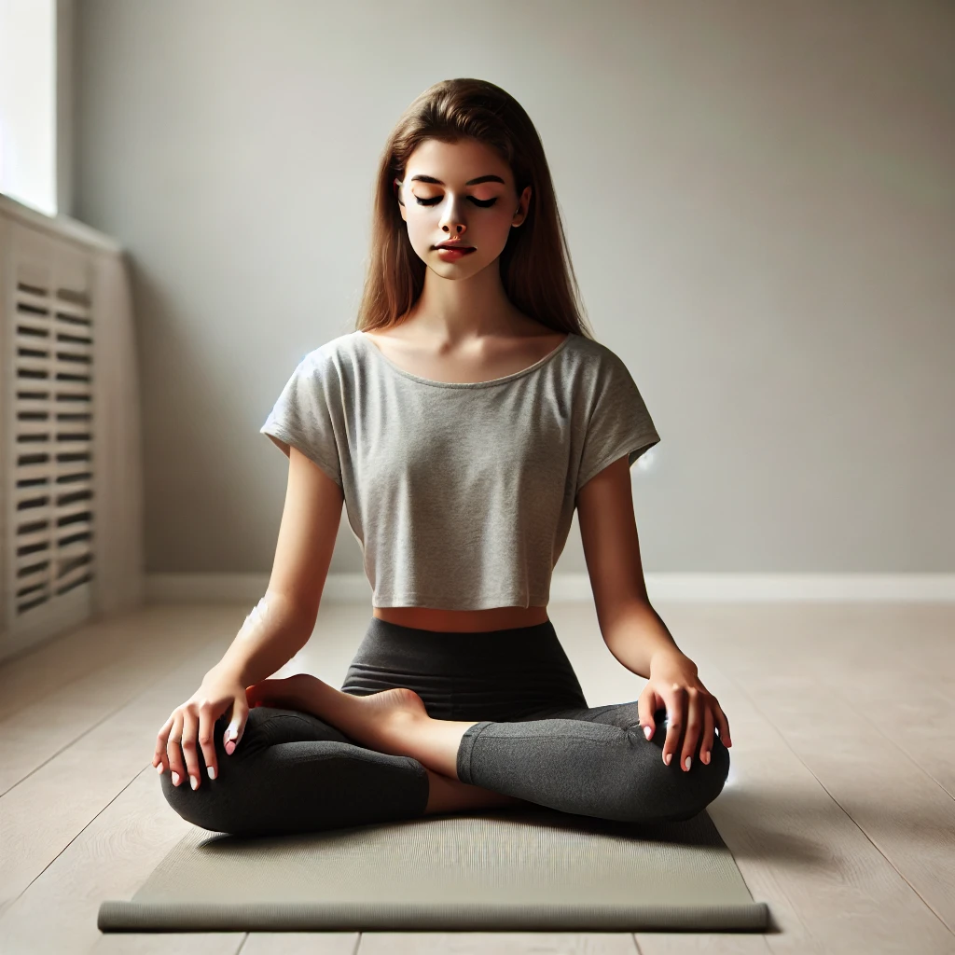
What do you like? (14/23)
Run or jog outside 🏃‍♂️ OR Do yoga or stretching 🧘

Slide 21
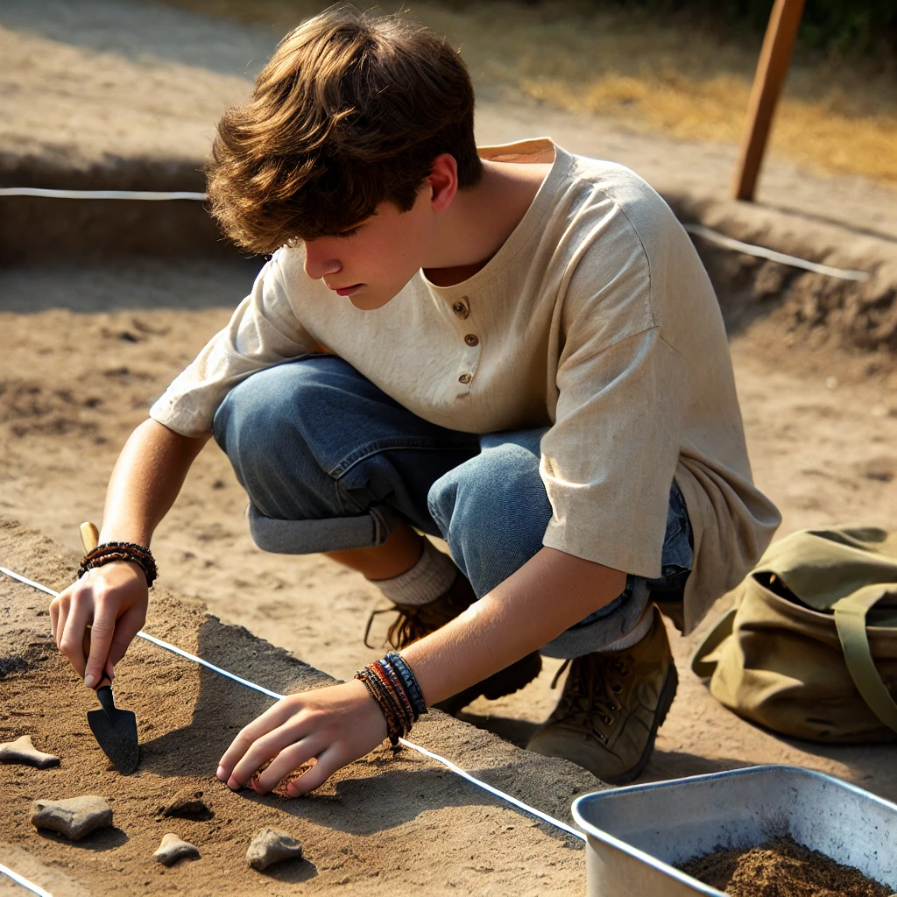
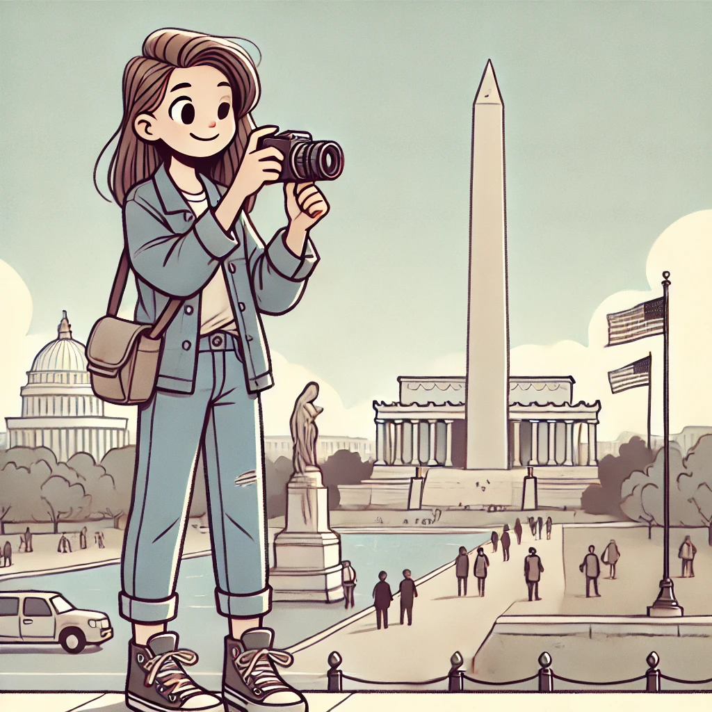
What do you like? (15/23)
Build or dig in dirt 🛠️ OR Go sightseeing 🍂

Slide 22
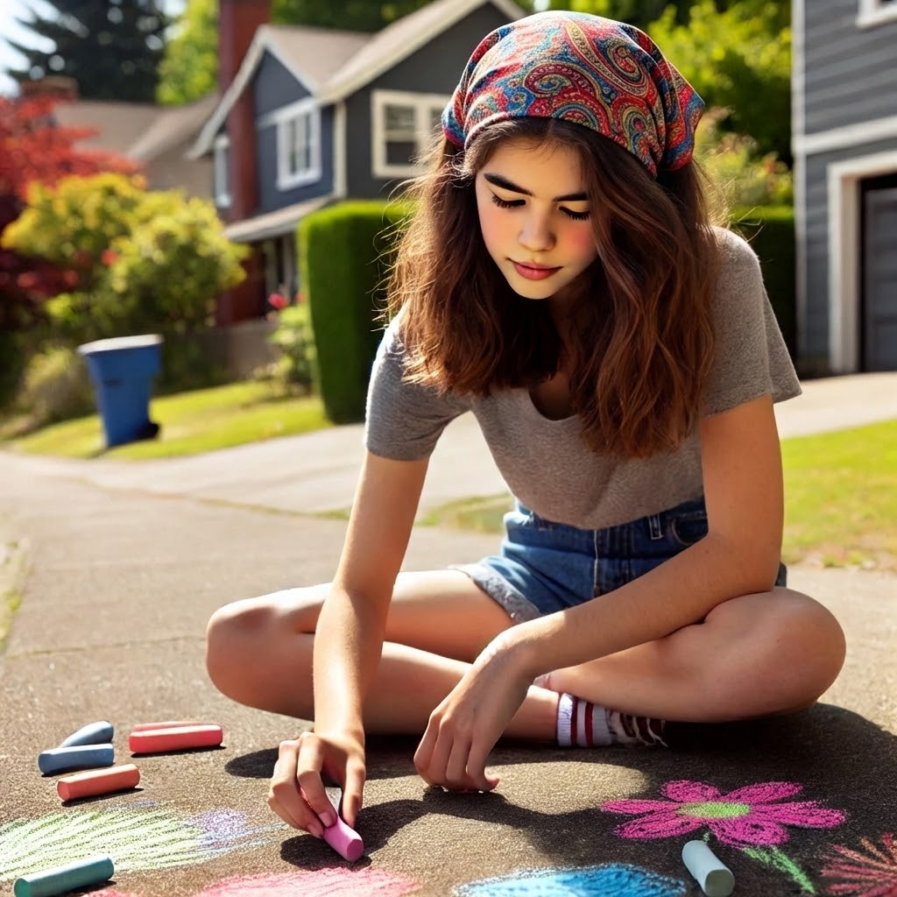
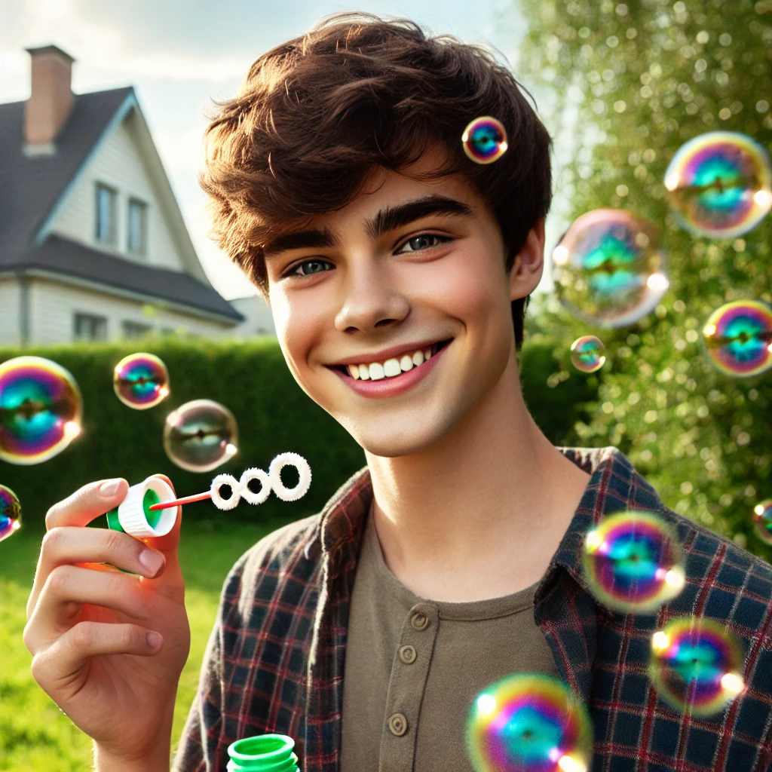
What do you like? (16/23)
Do sidewalk chalk 🎨 OR Do bubbles 🫧

Slide 23
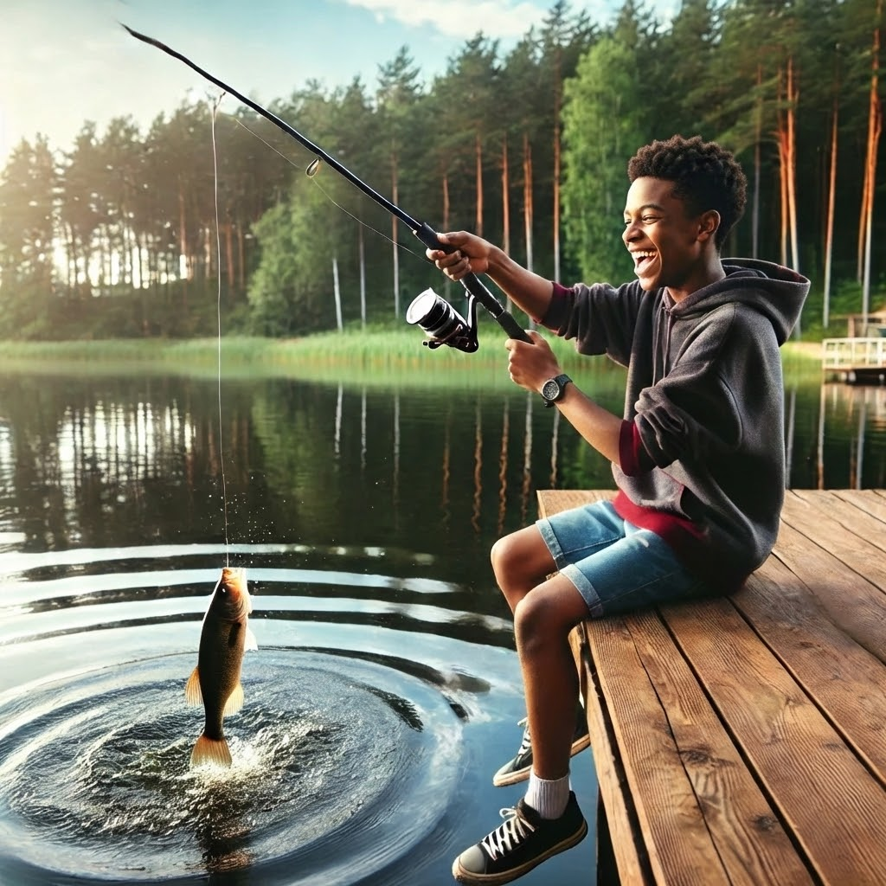
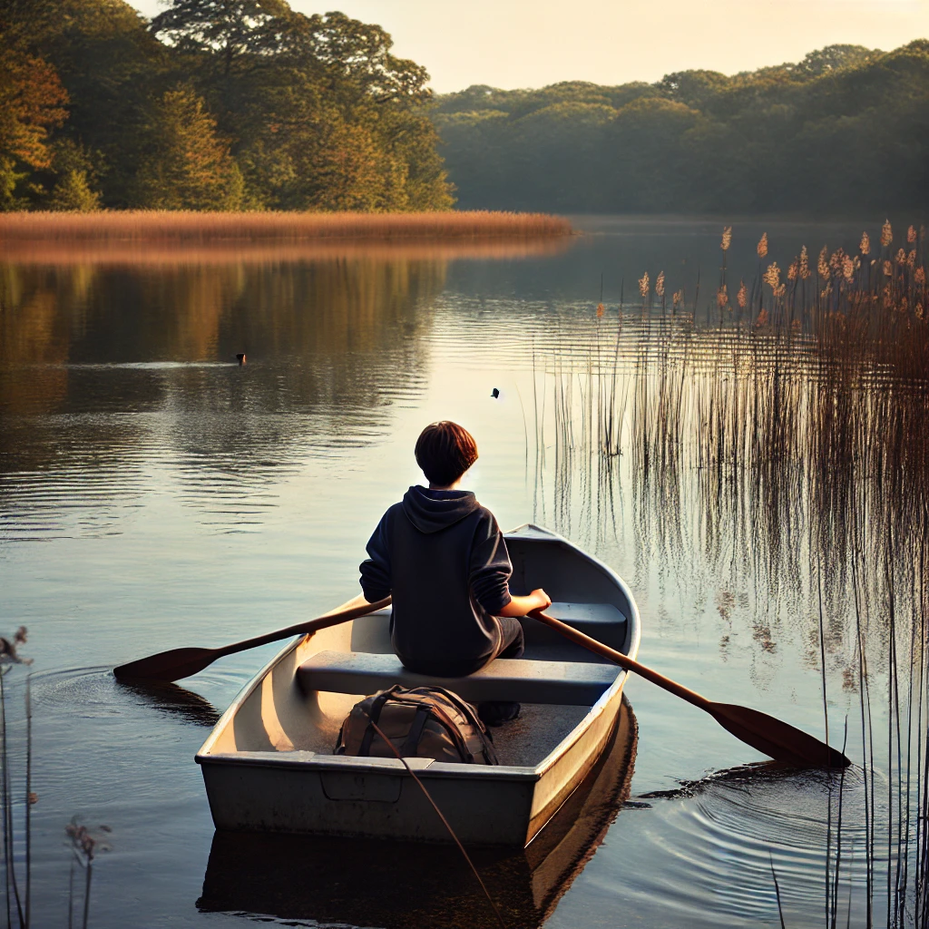
What do you like? (17/23)
🎣 Go fishing OR 🚤 Take a boat ride

Slide 24
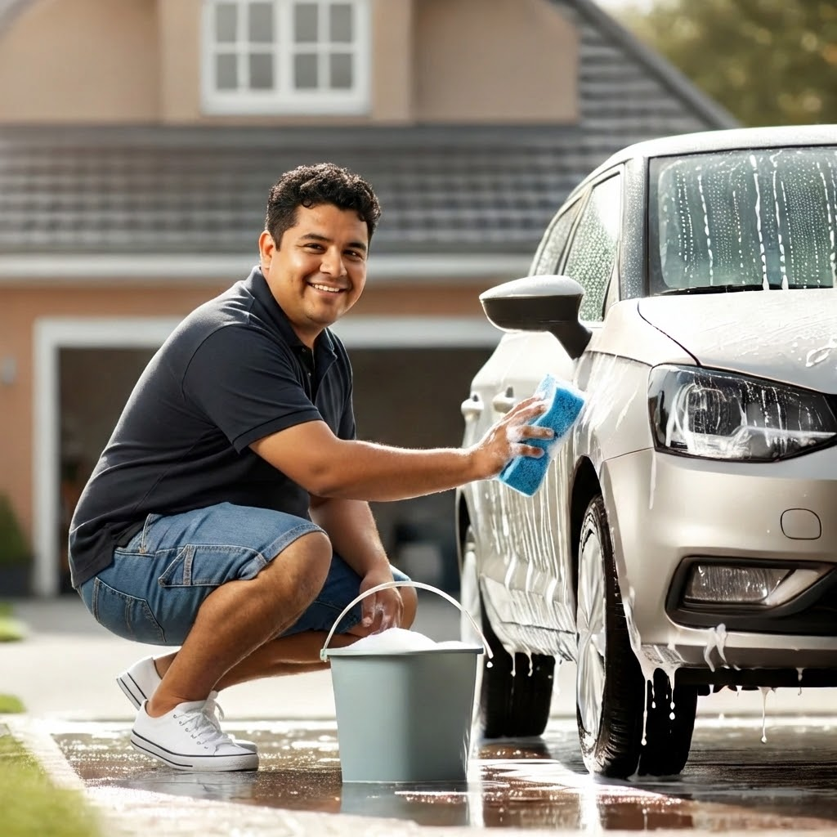
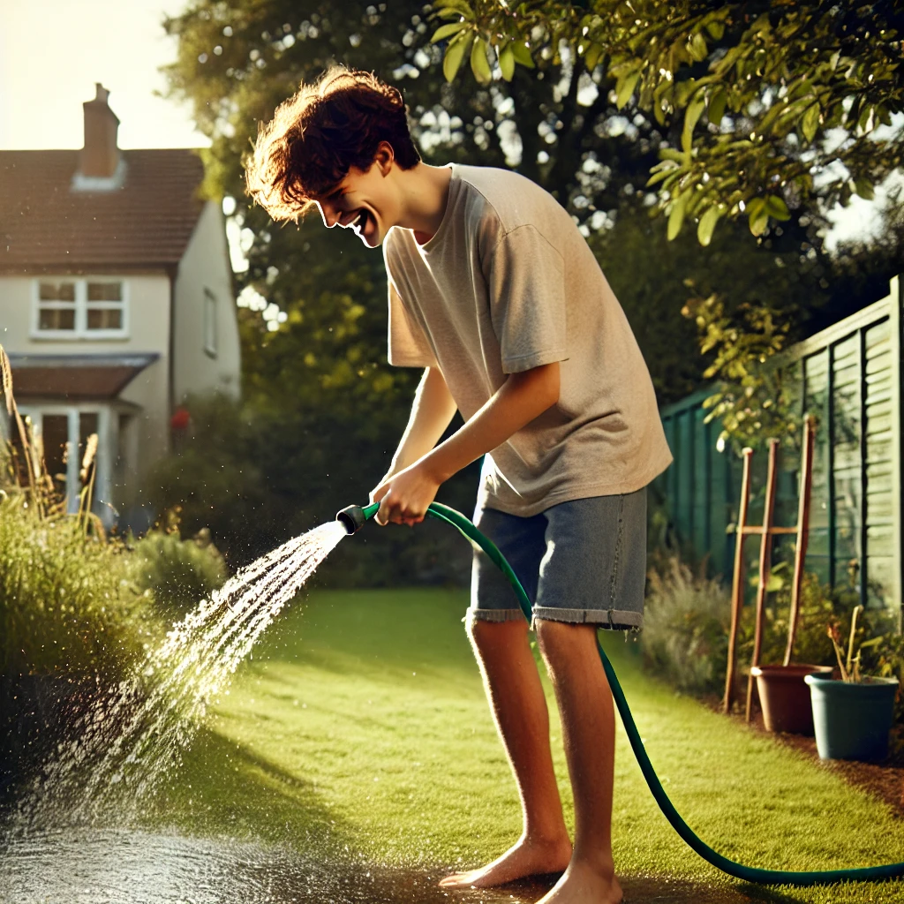
What do you like? (18/23)
🚿 Wash a car OR 💦 Water fun

Slide 25
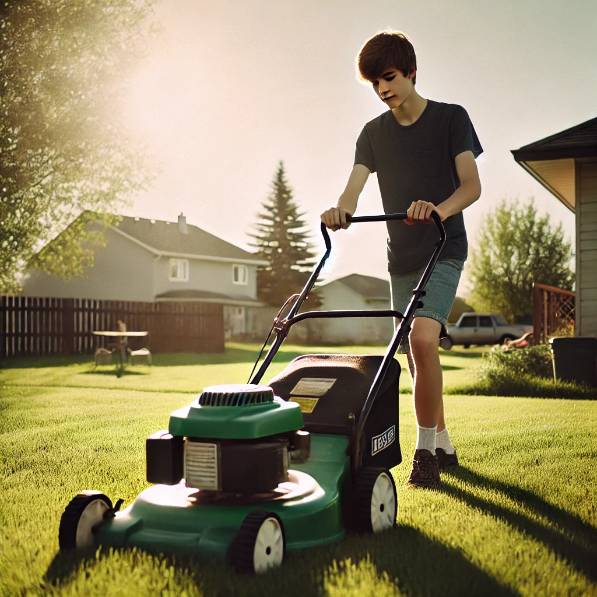
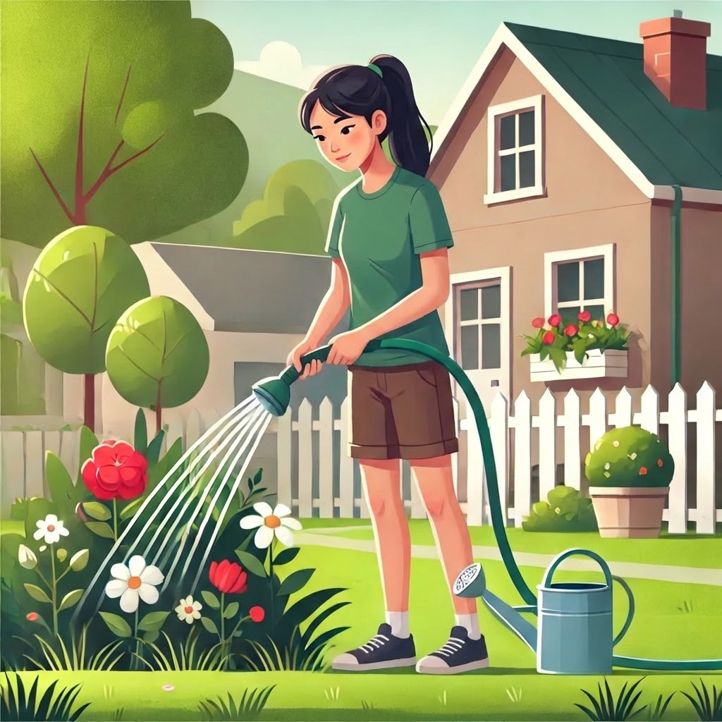
What do you like? (19/23)
🌿 Do yard work OR 🪴 Water plants

Slide 26
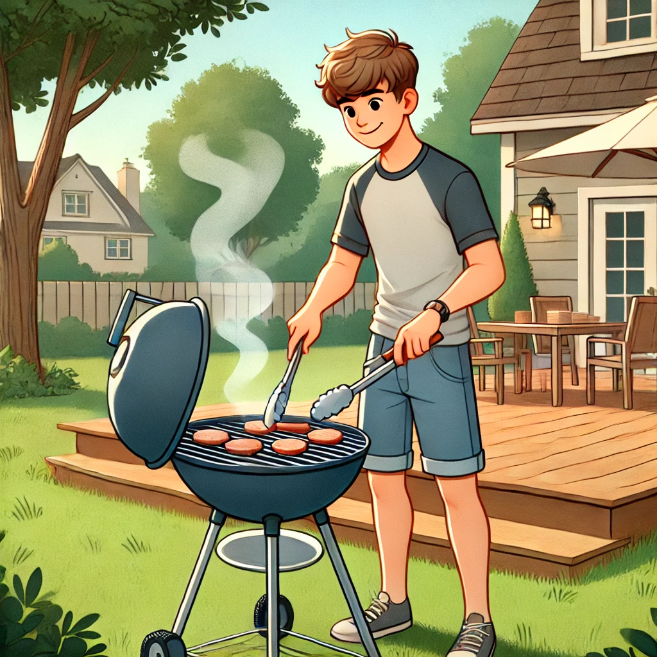
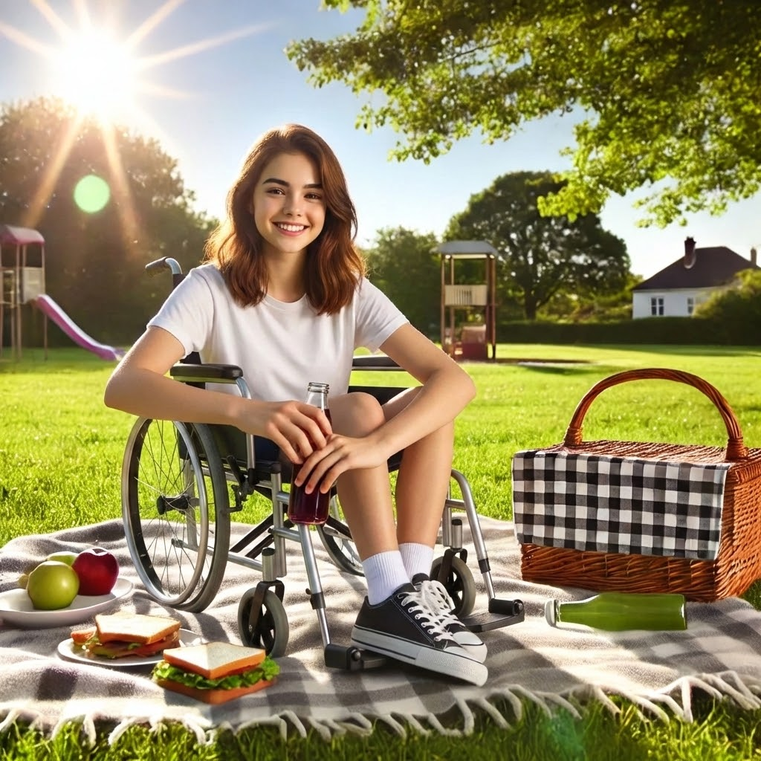
What do you like? (20/23)
🍔 Grilling food outside OR 🧺 Having a picnic

Slide 27
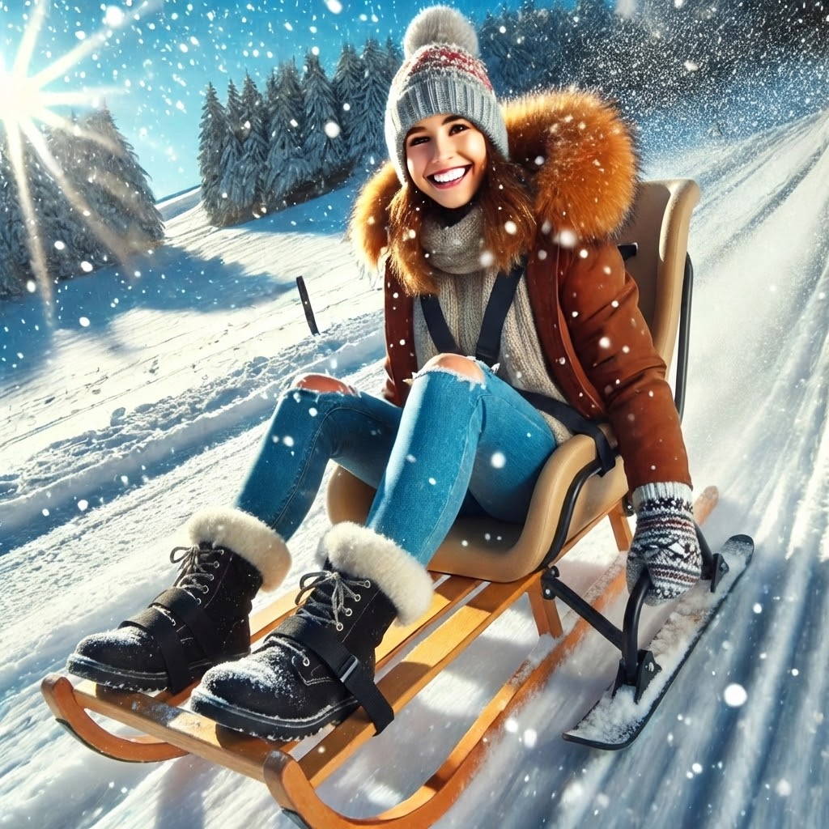
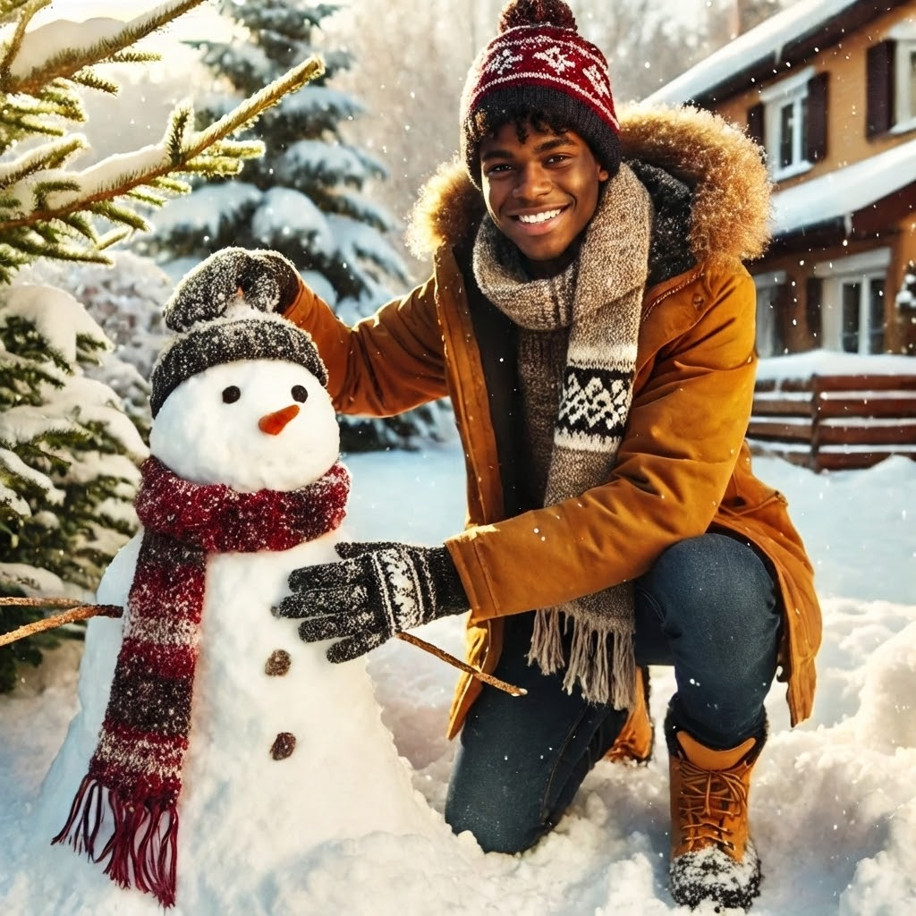
What do you like? (21/23)
🛷 Sledding OR ☃️ Building a snowman

Slide 28
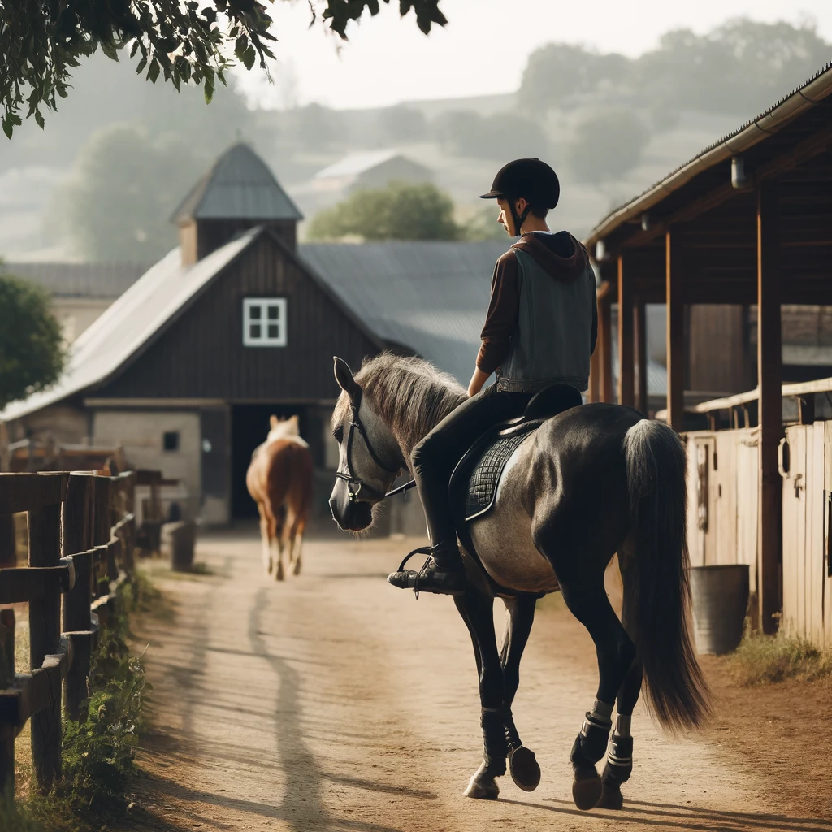
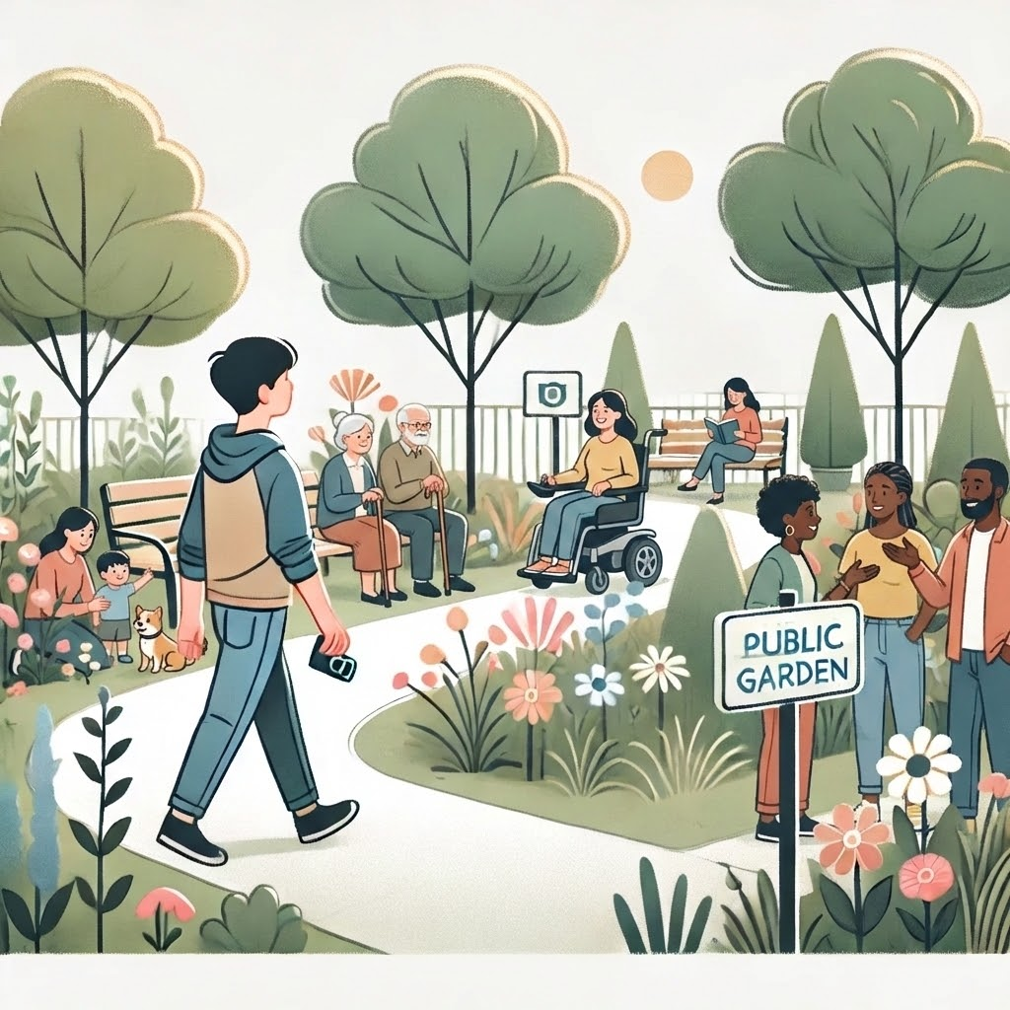
What do you like? (22/23)
🐎 Horseback riding OR 🌳 Explore a garden

Slide 29
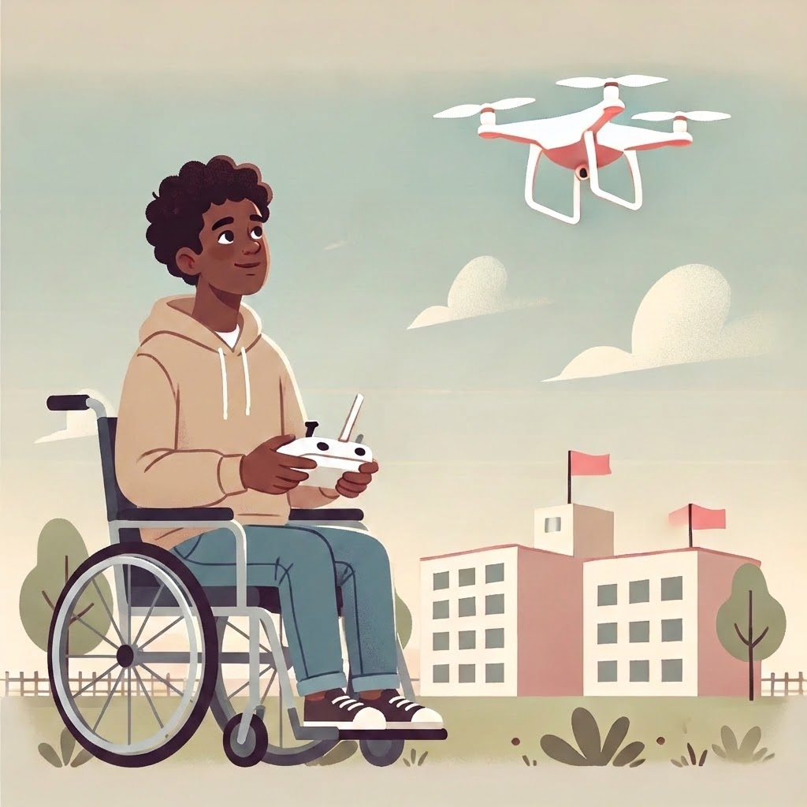
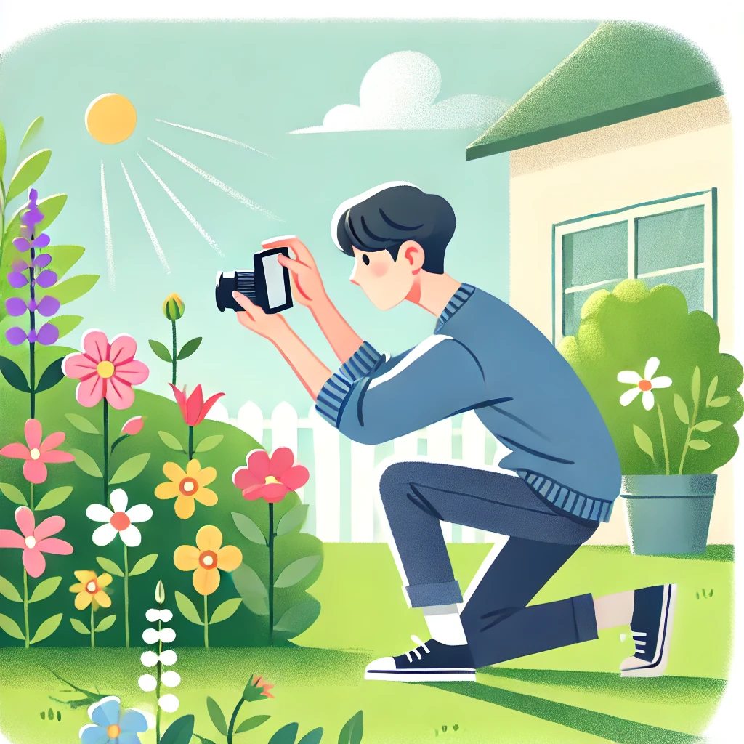
What do you like? (23/23)
✈️ Fly a drone OR 📸 Take photos of nature

Slide 30

Well Done

