Slide 1
Home Leisure Activity Assessment
Charles Thull, PhD
Old Dominion University

Slide 2
Presentation Note
Note. Images and animated visuals in this presentation were generated using ChatGPT, Sora, DALL·E, and Gemini based on author-developed prompts.

Slide 3
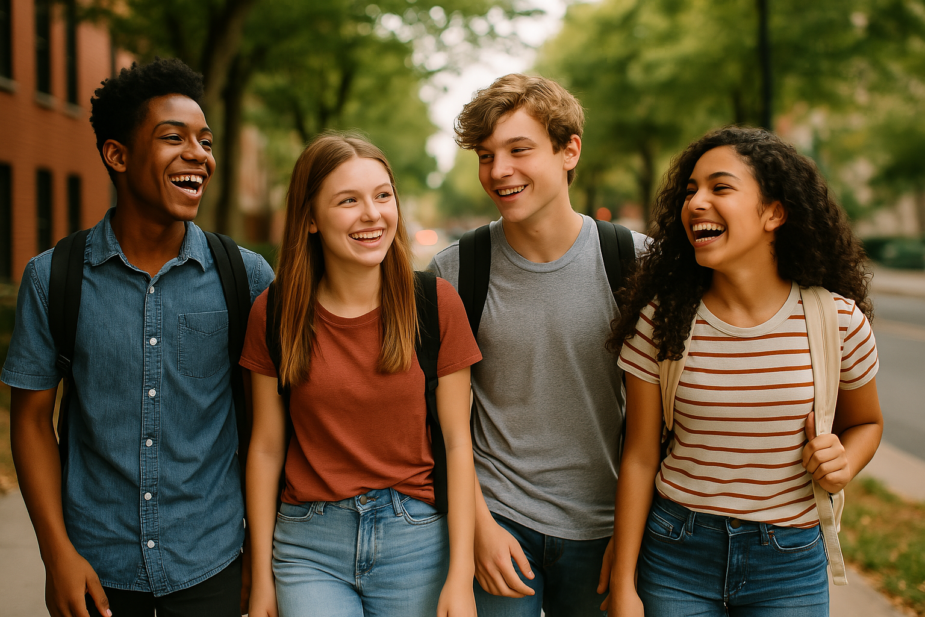
Leisure Preference Assessment
Purpose:
We will talk about fun things you like to do.
Things at home, outside, community, and school.
You’ll choose favorites and learn more about yourself.

Slide 4
Leisure Assessment Structure
4 sections with videos, readings, and two-choice questions
🏠 Home (Slides 5–32) Creative, tech, quiet time, social play, life skills, building | 🌳 Outside (Slides 33–58) Movement, nature, creative play, relaxation, hands-on
🏙️ Community (Slides 59-83) Volunteering, outings, cultural places, social fun, independence | 🏫 School (Slides 84–100) Reading, creative arts, social groups, STEM, helping roles

Slide 5
Instructions for Administering the Leisure Preference Assessment
Print the slides for students. In print settings, select Print Preview, choose Portrait orientation, and set to 2 slides per page, double-sided (front and back).
Print the Student Record Sheet, if needed, to help track individual responses.
Print the Teacher Leisure Summary Sheet to guide next steps and activity suggestions.
Project the slides and review/discuss each slide as a group.
Have students participate by reading from their printed copies or from the board.
Complete the interest inventory with students. They can take turns coming to the board to share their answers.
Complete all 4 assessments (Home, Outside, Community, School) over multiple sessions, as needed.
Consider using the Parent Leisure Survey with Resources confirm and expand planning based on family input.

Slide 6

Leisure time is fun!

Slide 7
What do you like to do at home?
🎮
🍳
🧩
👩‍👩‍👧
🃏
✂️
🎧
🧑‍🤝‍🧑
🧘
🤸
🎨
📖
📺
🍽️
🐶

Slide 8
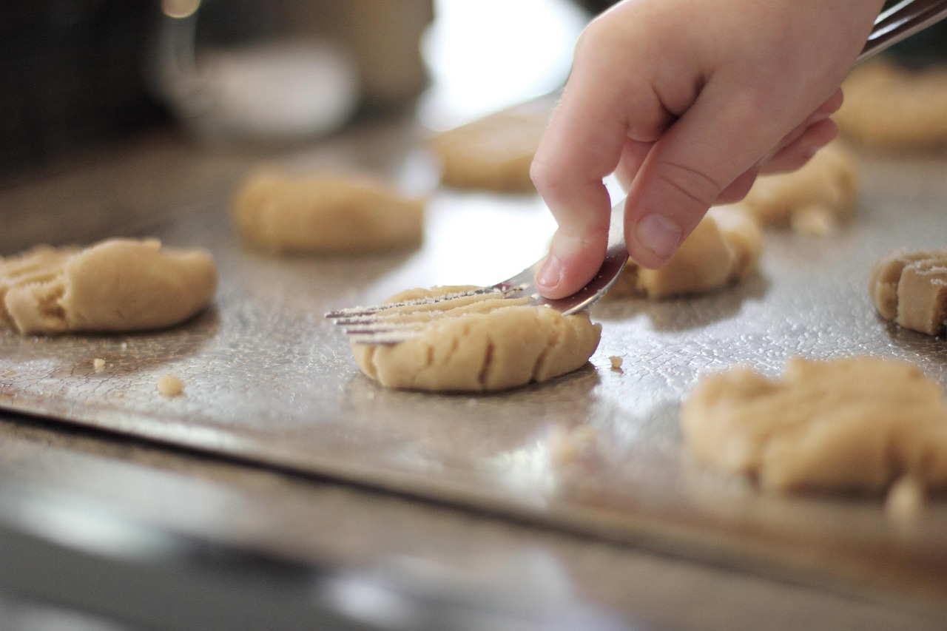
Fun Things to Do at Home

Slide 9
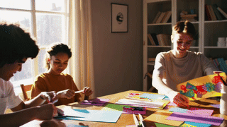
Fun at Home
Do things you like at home.

Slide 10

Fun at Home
Leisure helps you relax after school.

Slide 11
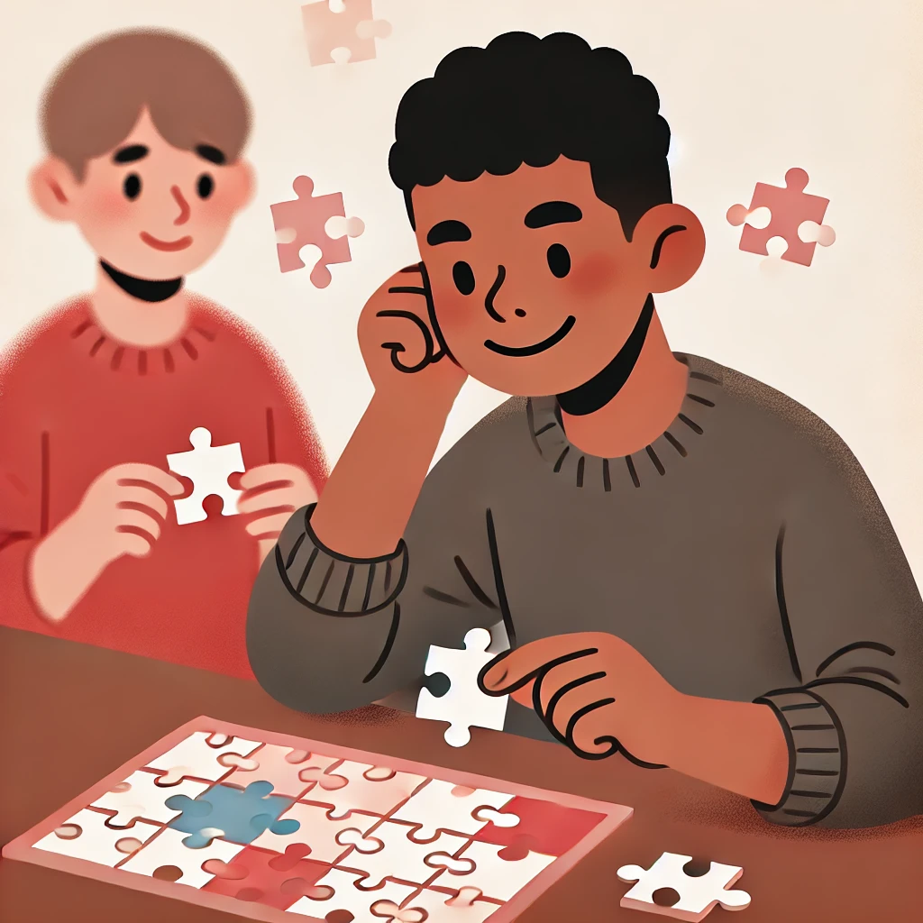
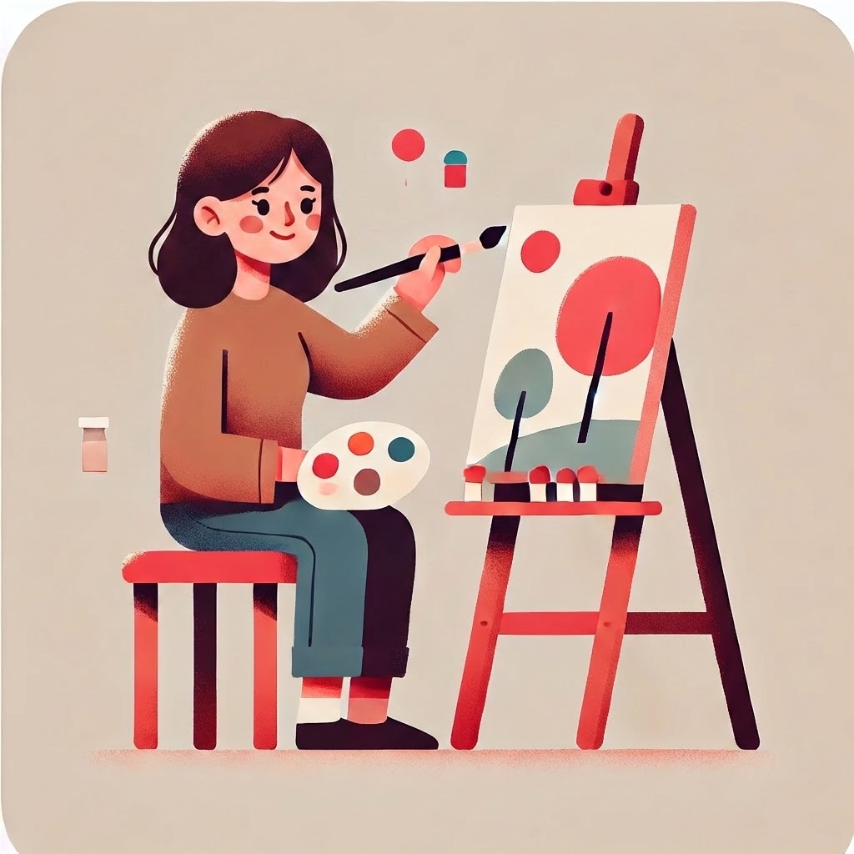
What do you like? (1/24)
🧩Do puzzles
OR
🎨 Make art

Slide 12
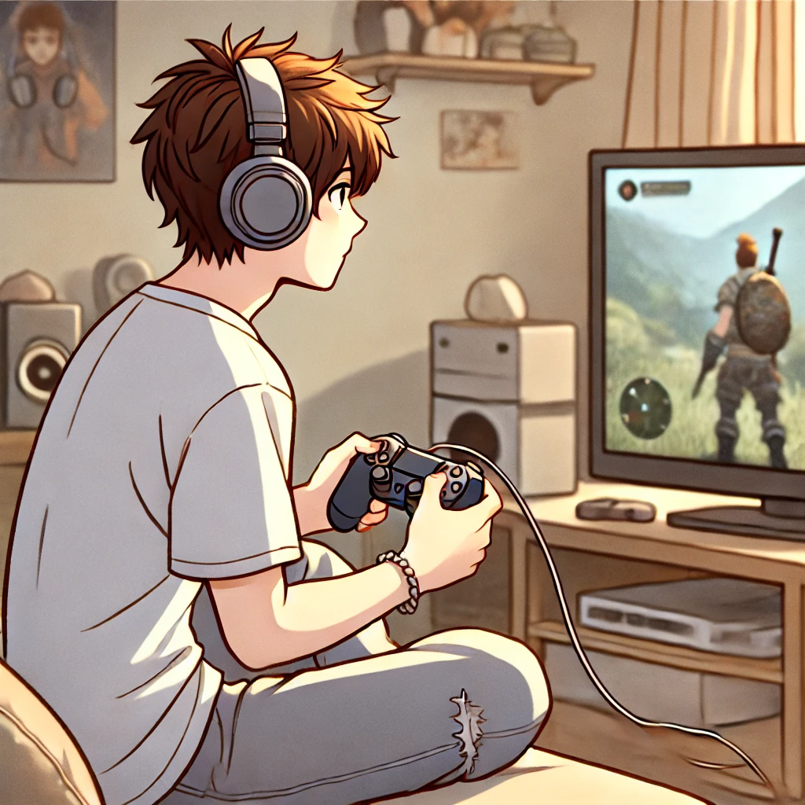
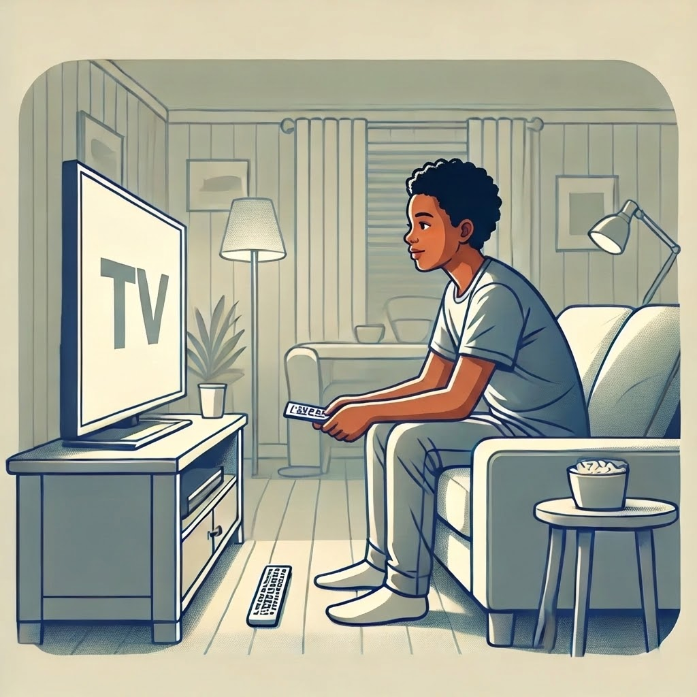
What do you like? (2/24)
🎮Play video games
OR
📺Watch TV shows

Slide 13
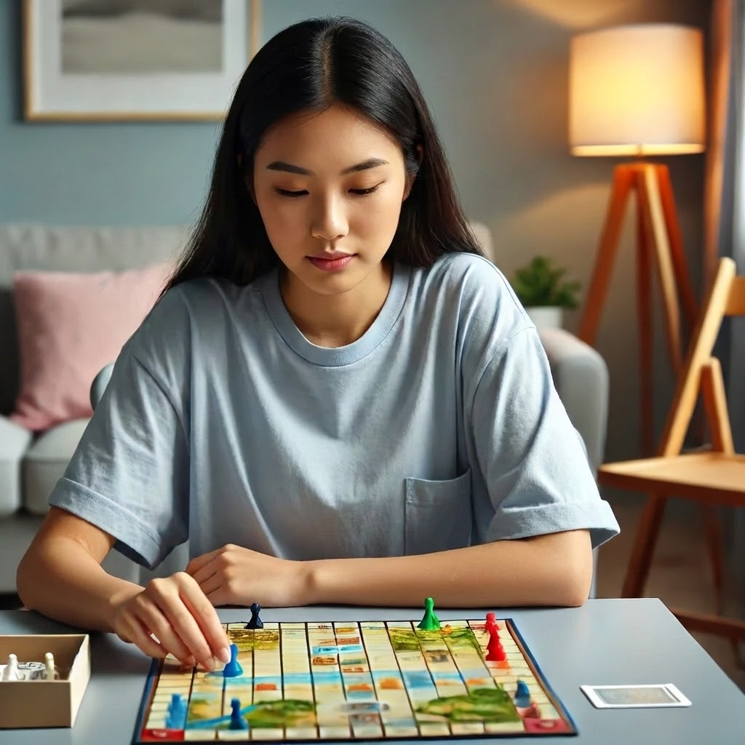
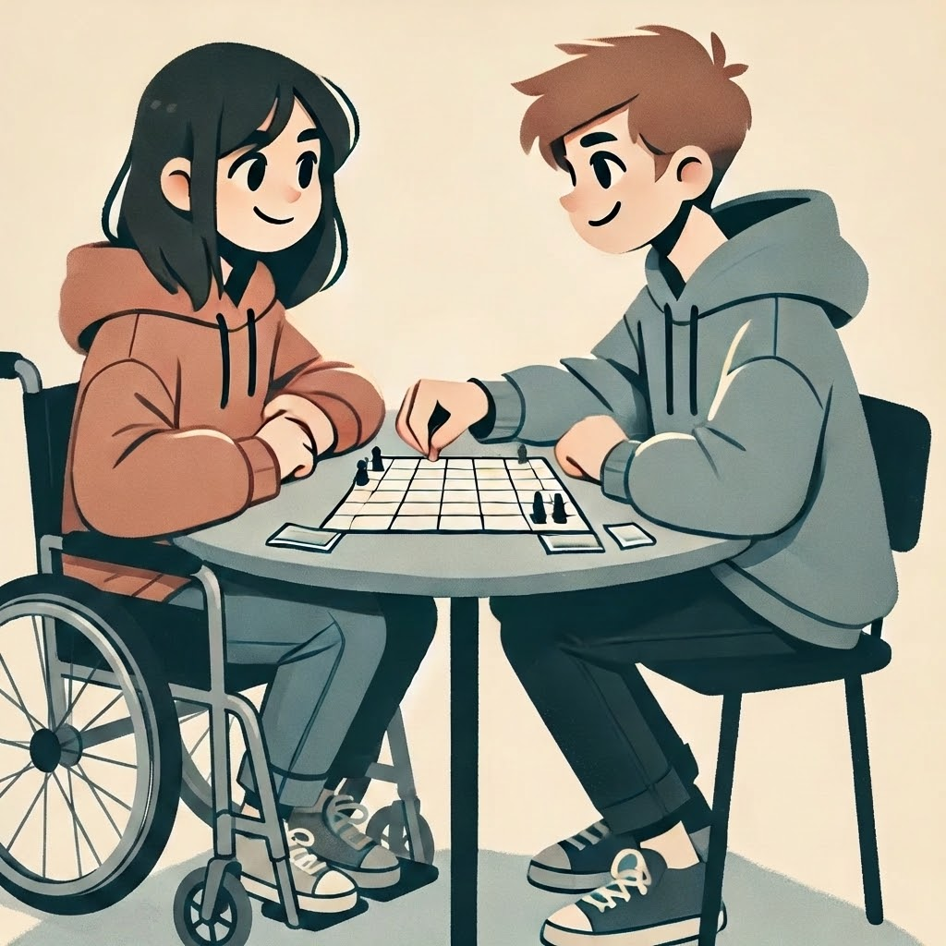
What do you like? (3/24)
🧍🎲 Play a game by myself
OR
👫🎲 Play a game with someone else

Slide 14
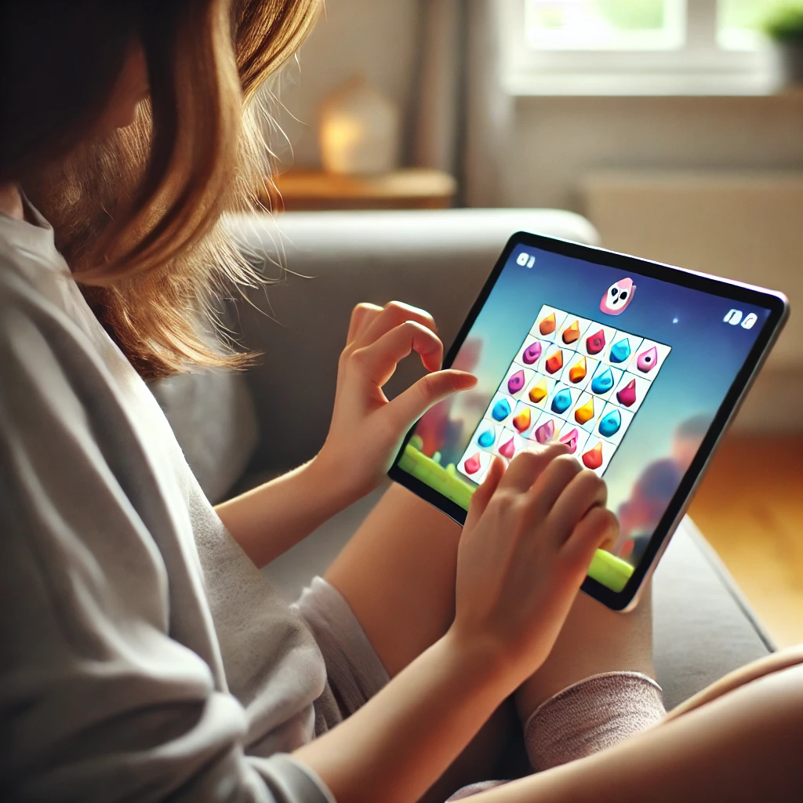

What do you like? (4/24)
📱🎮 Play games
on a tablet
📱📺 Watch videos on a tablet
OR

Slide 15


What do you like? (5/24)
🎧Listen to music
OR
📖 Read

Slide 16
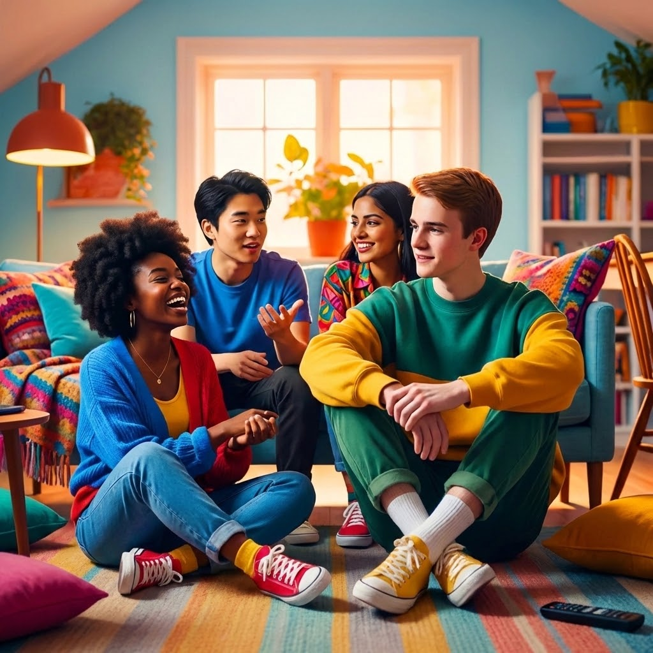
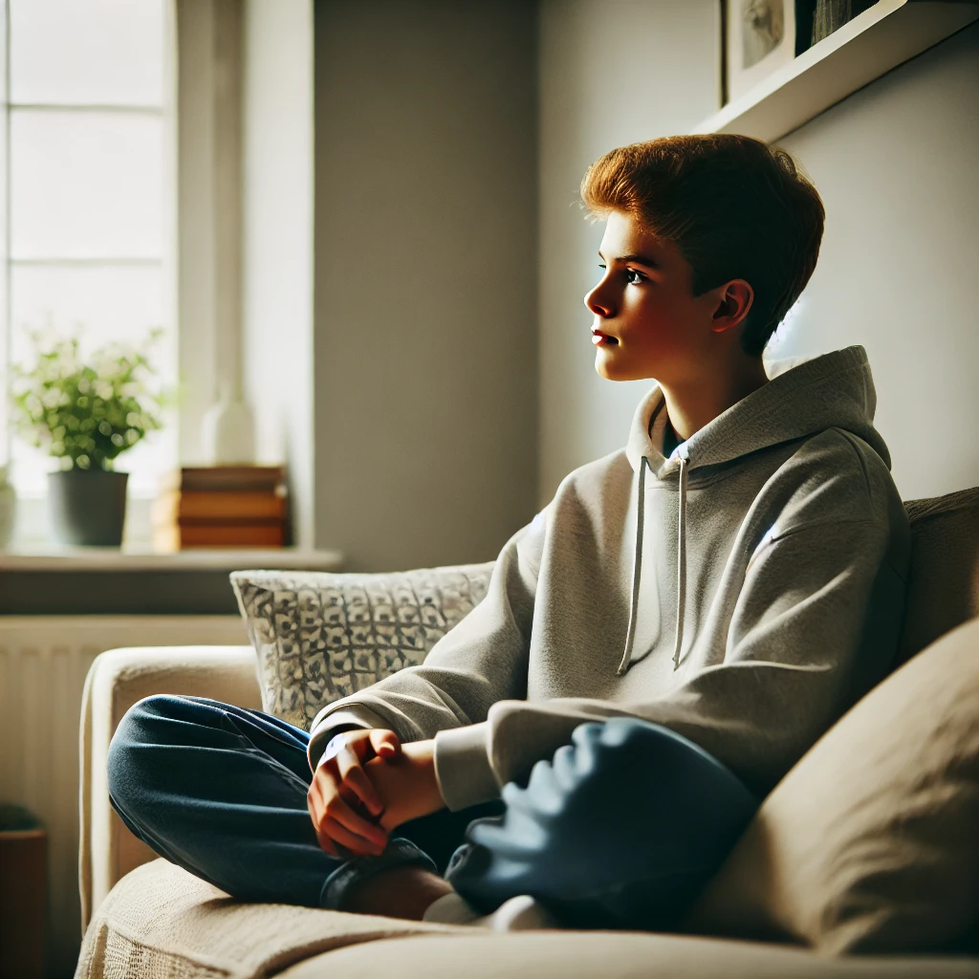
What do you like? (6/24)
🧑‍🤝‍🧑Be with a friend
👩‍👩‍👧 Relax alone
OR

Slide 17
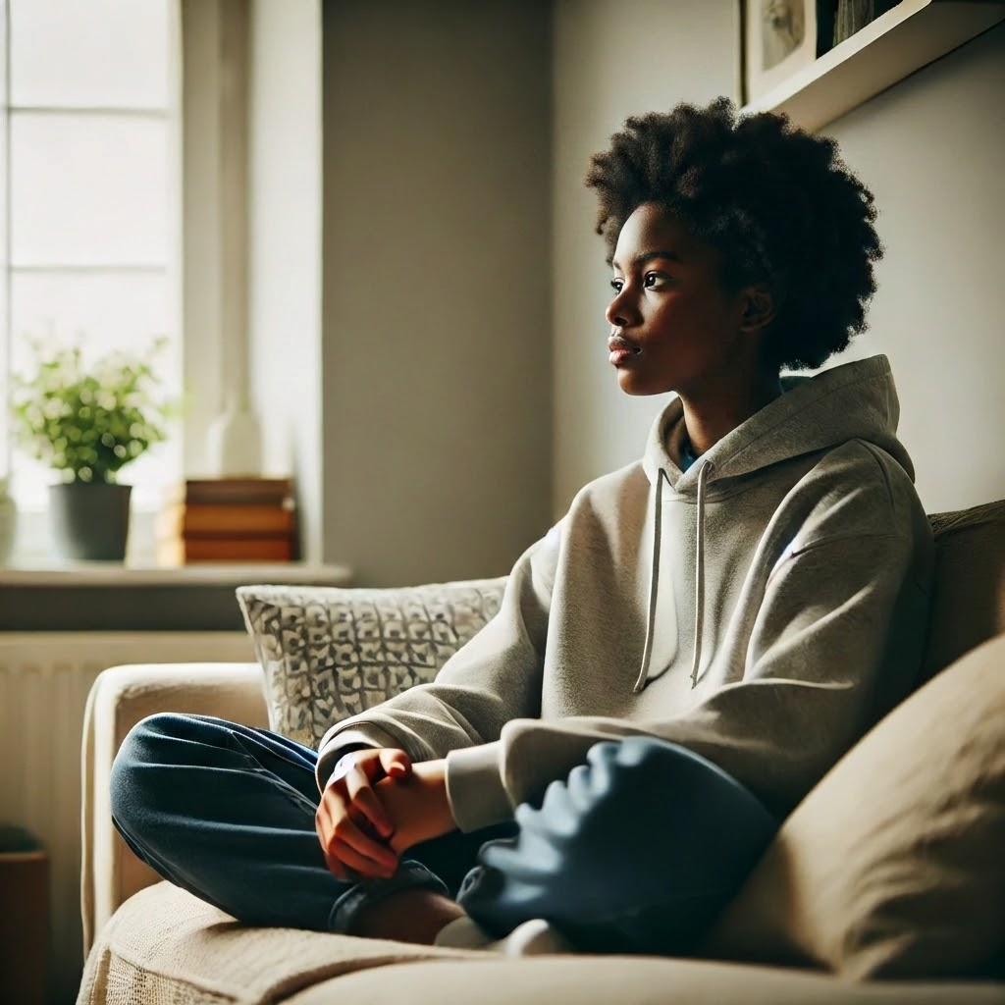
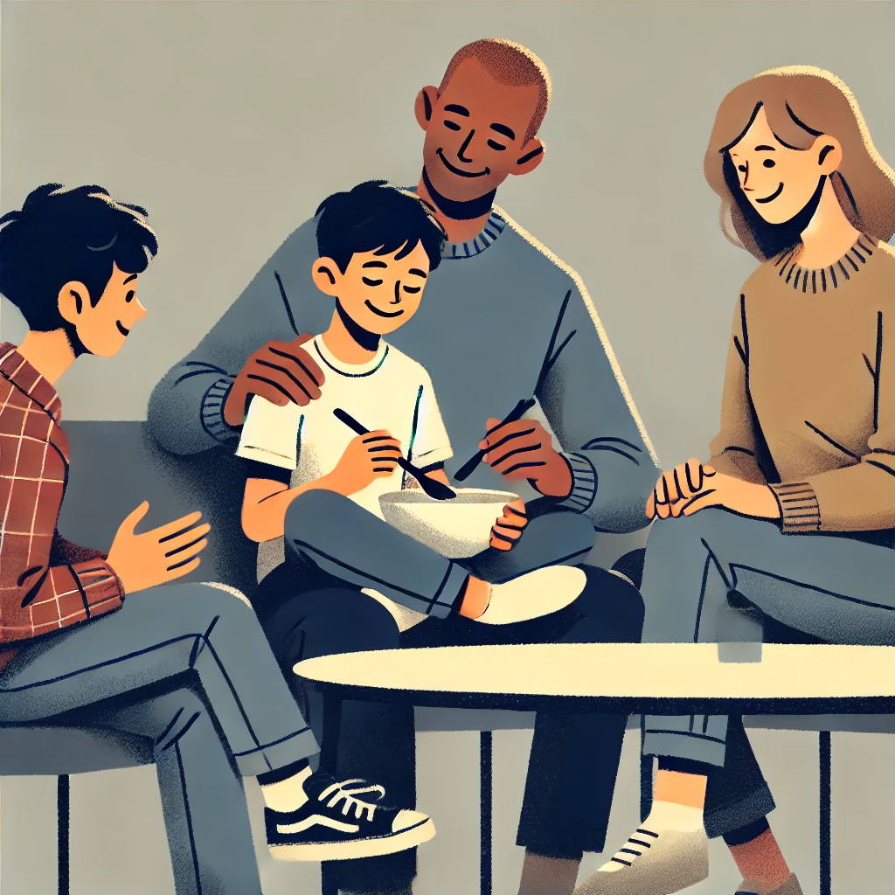
What do you like? (7/24)
👩‍👩‍👧Be with family
🧍 Relax alone
OR

Slide 18
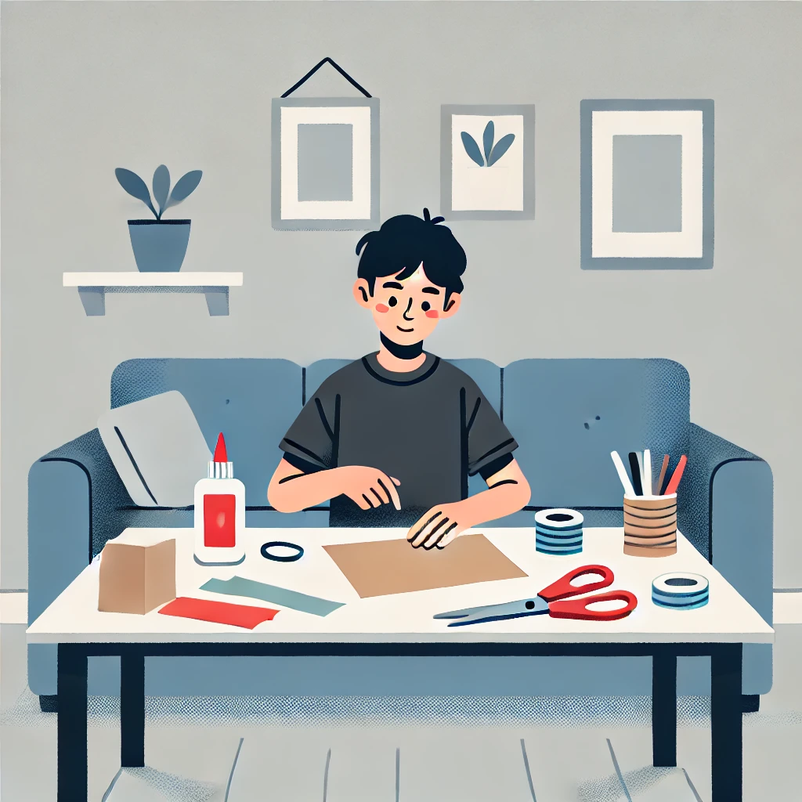
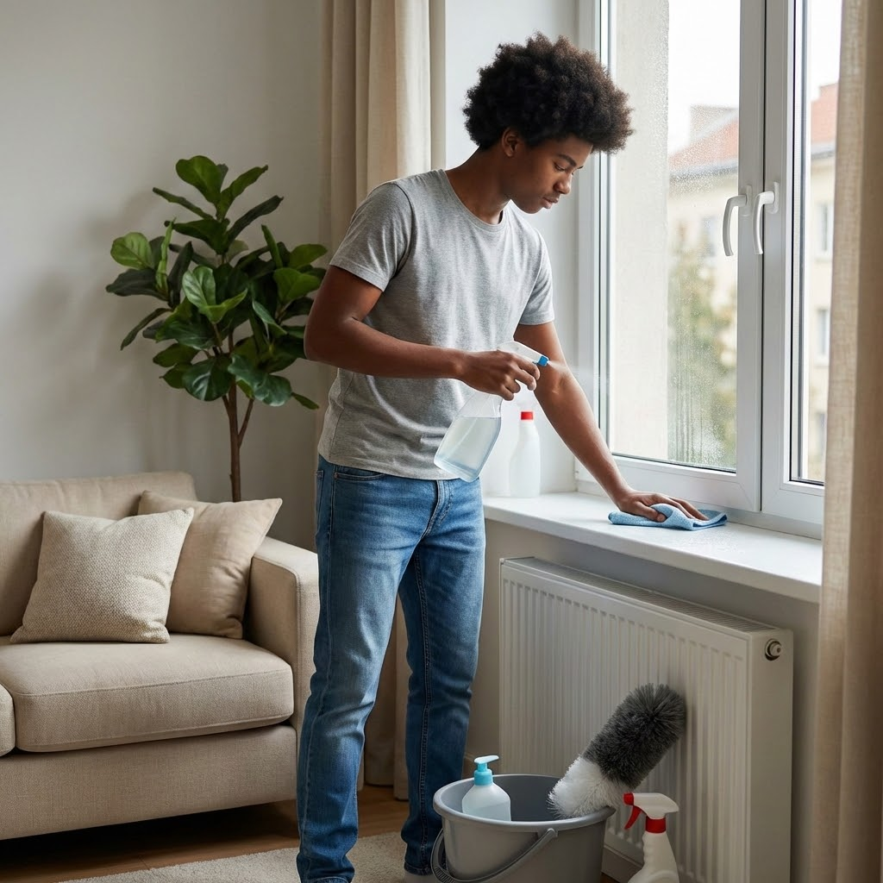
What do you like? (8/24)
✂️Do art crafts
🧼 Help with chores
OR

Slide 19
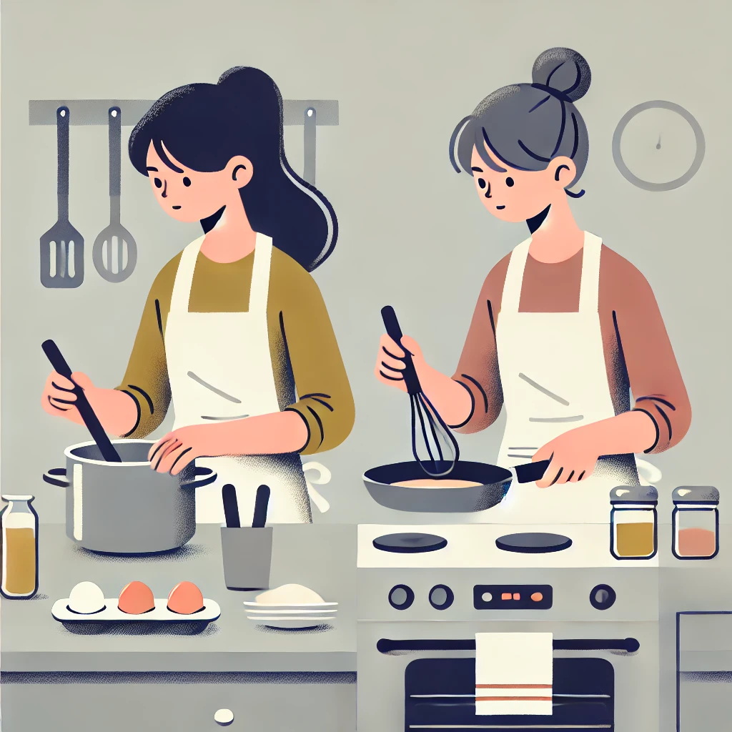
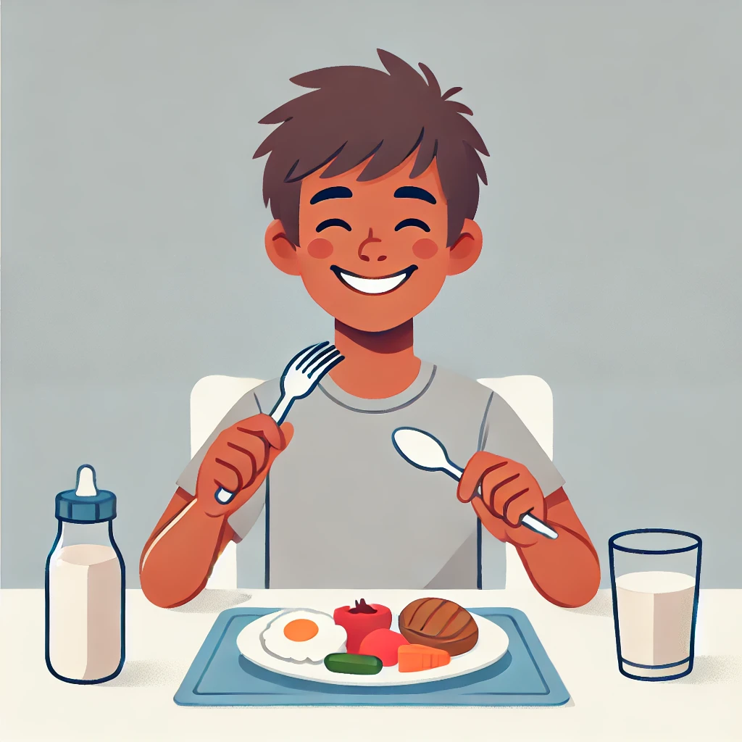
What do you like? (9/24)
🍽️ Enjoy food
🍳 Cook or bake
OR

Slide 20
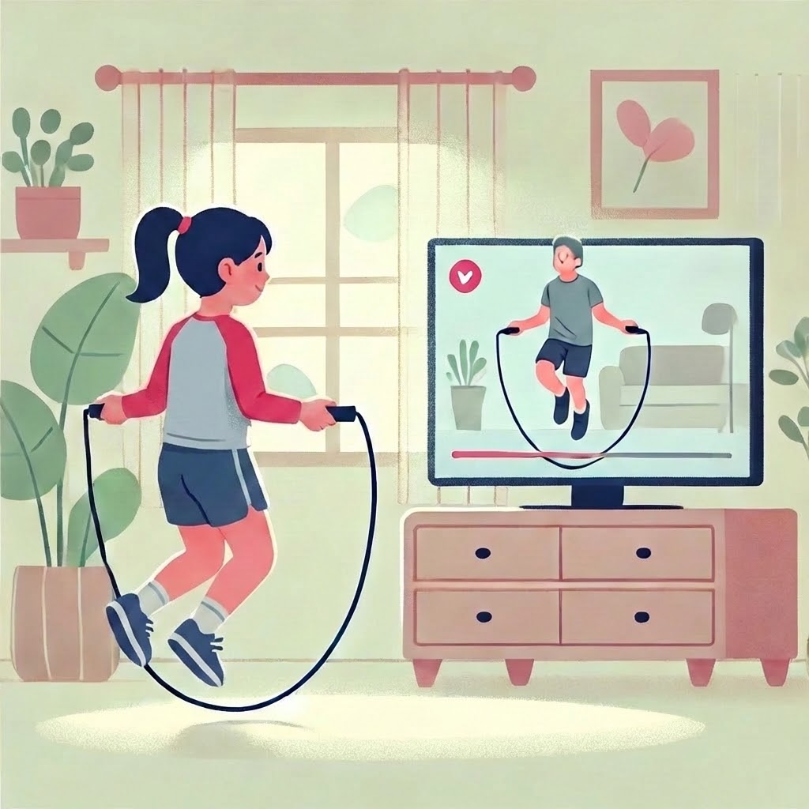
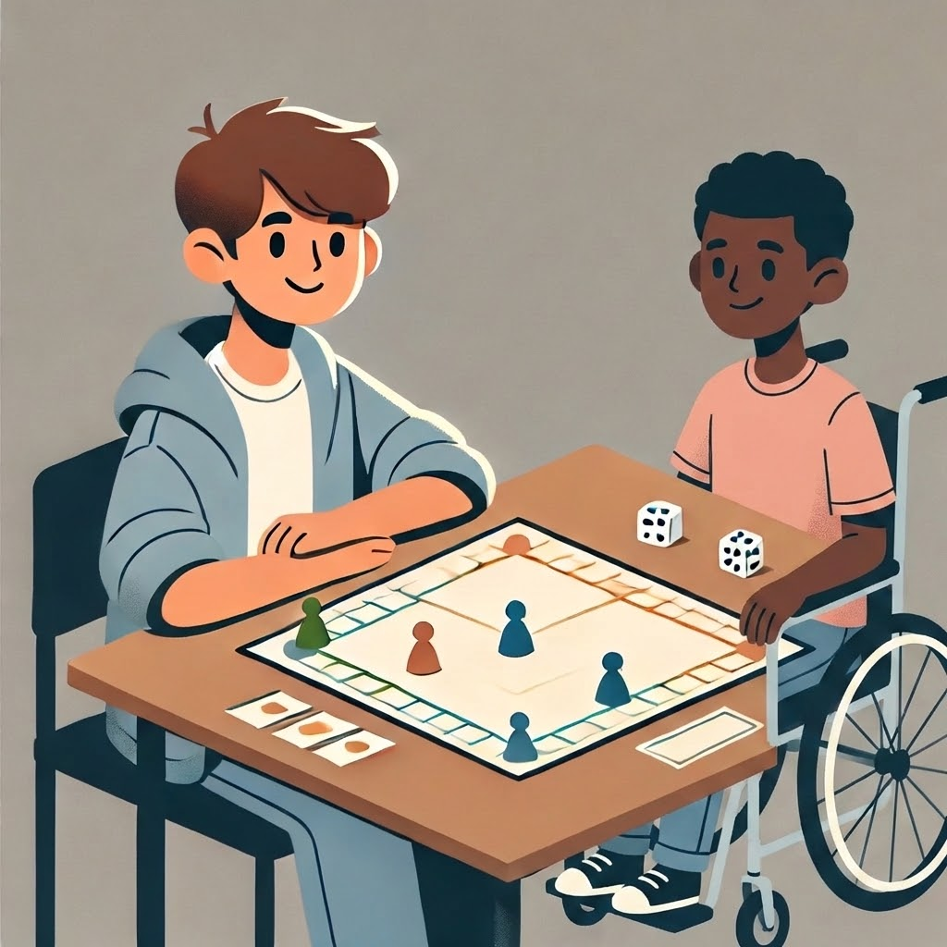
What do you like? (10/24)
🃏Play board games
🤸Exercise
OR

Slide 21
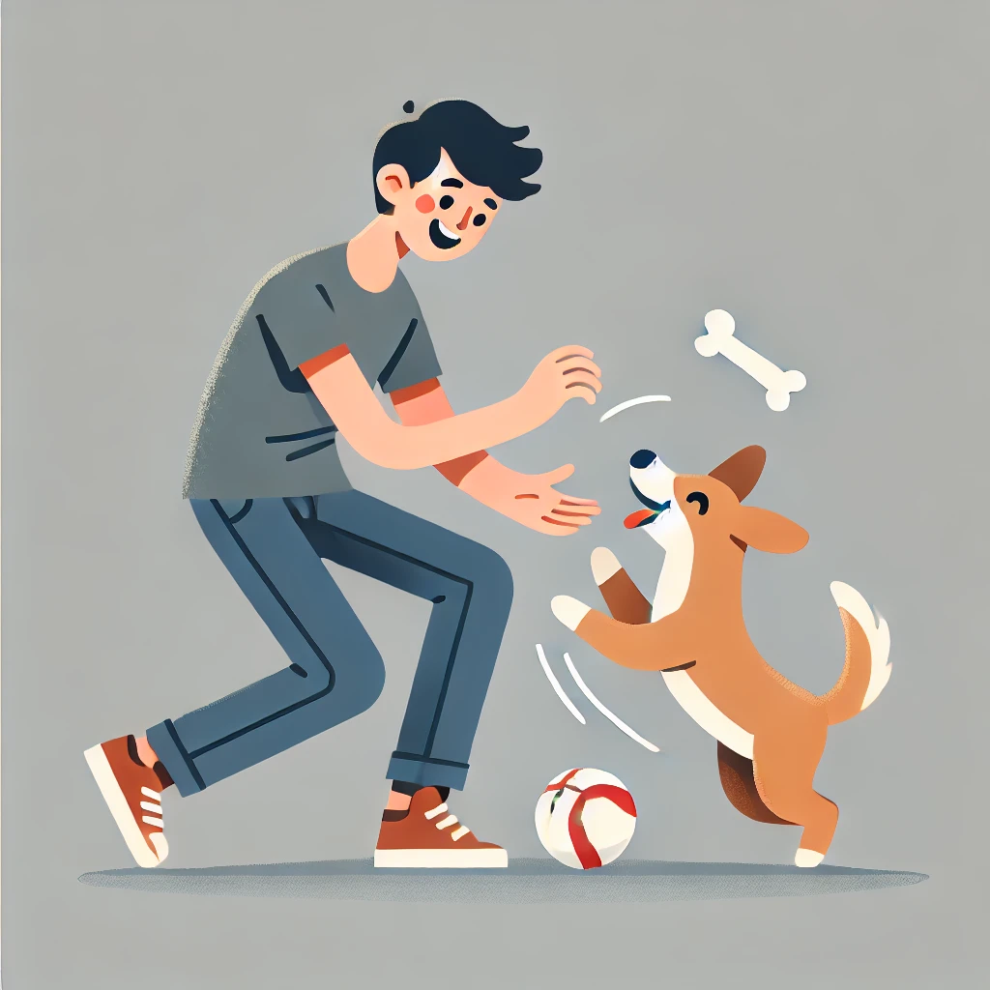

What do you like? (11/24)
🐶 Play with pet
OR
⚽ Play with friend

Slide 22
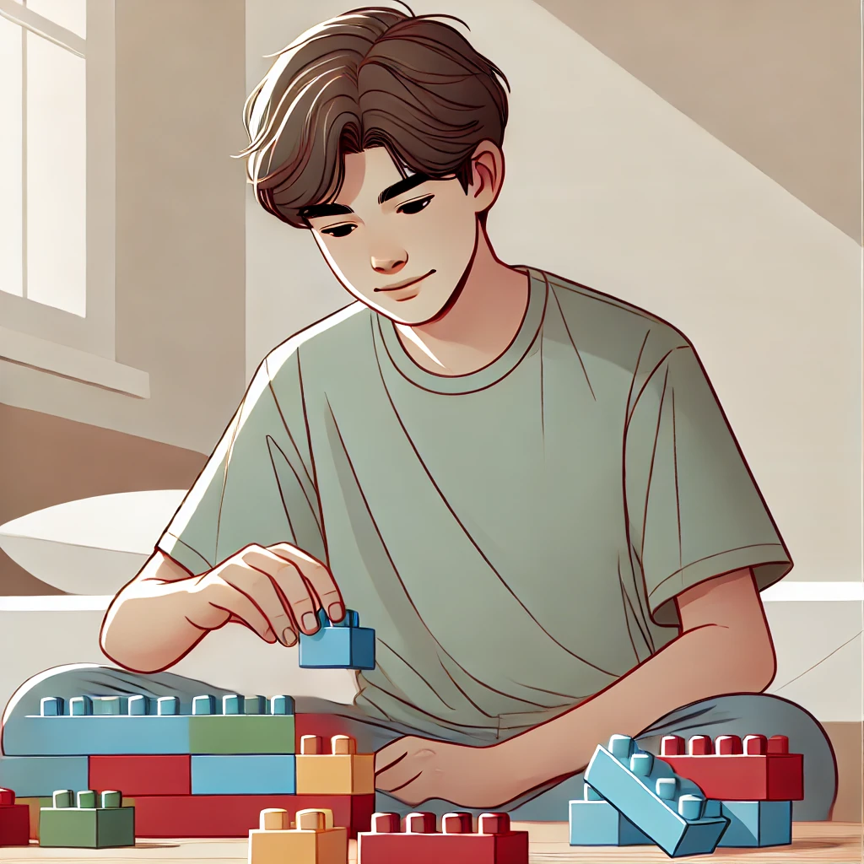

What do you like? (12/24)
Build with blocks 🧱🔧 OR Try science kits 🔬

Slide 23
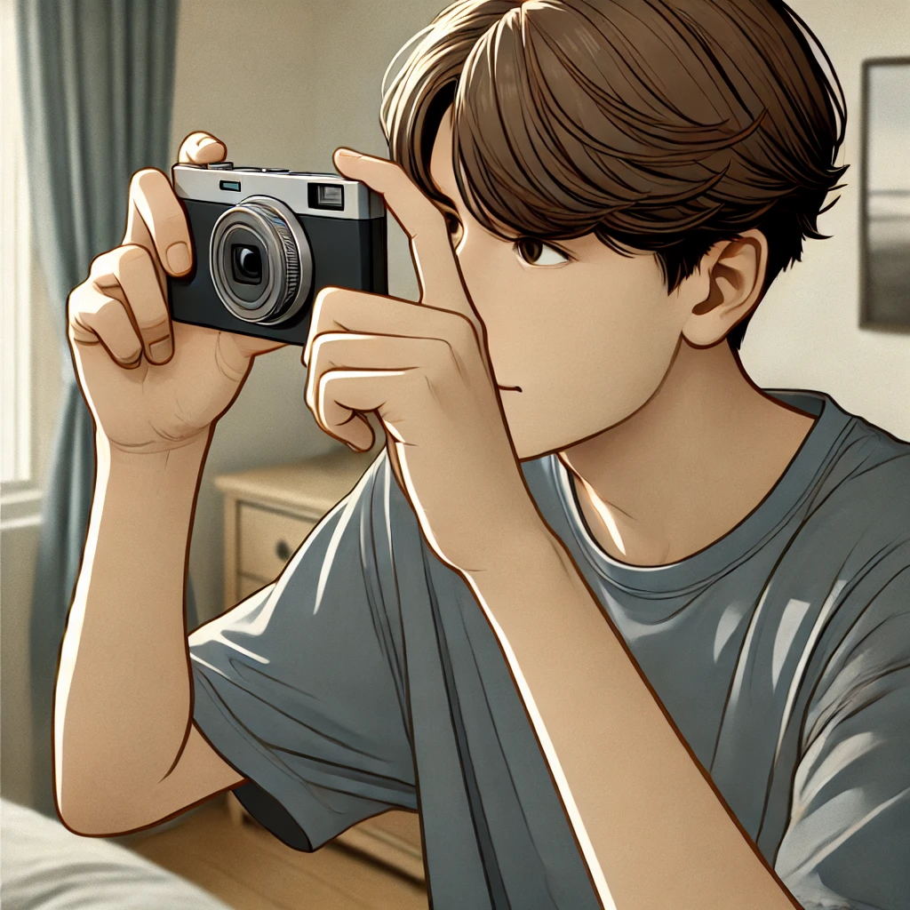
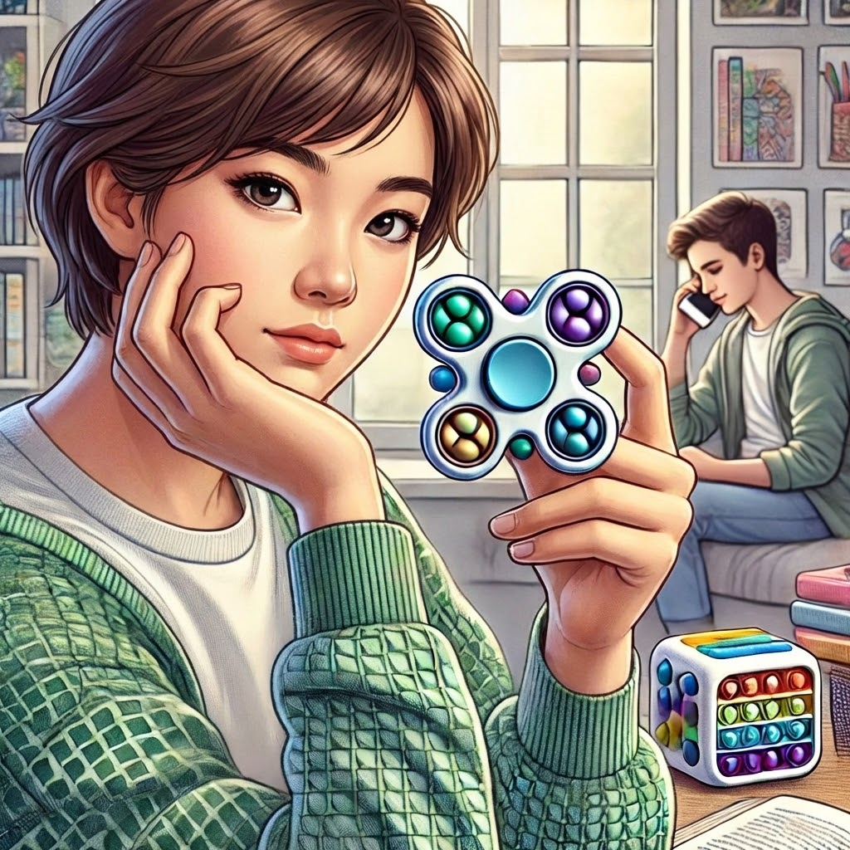
What do you like? (13/24)
Take pictures 📷 OR Use fidgets ✋

Slide 24
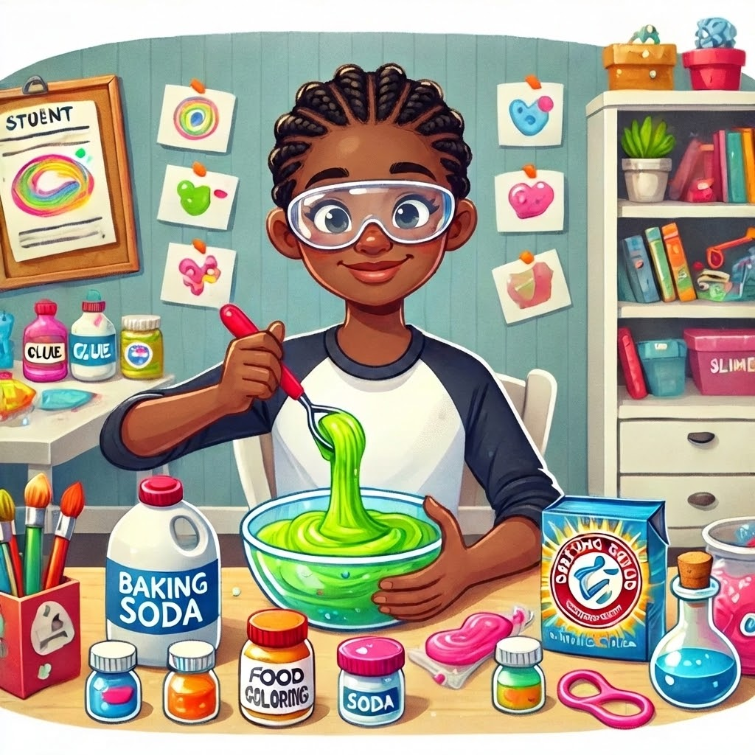
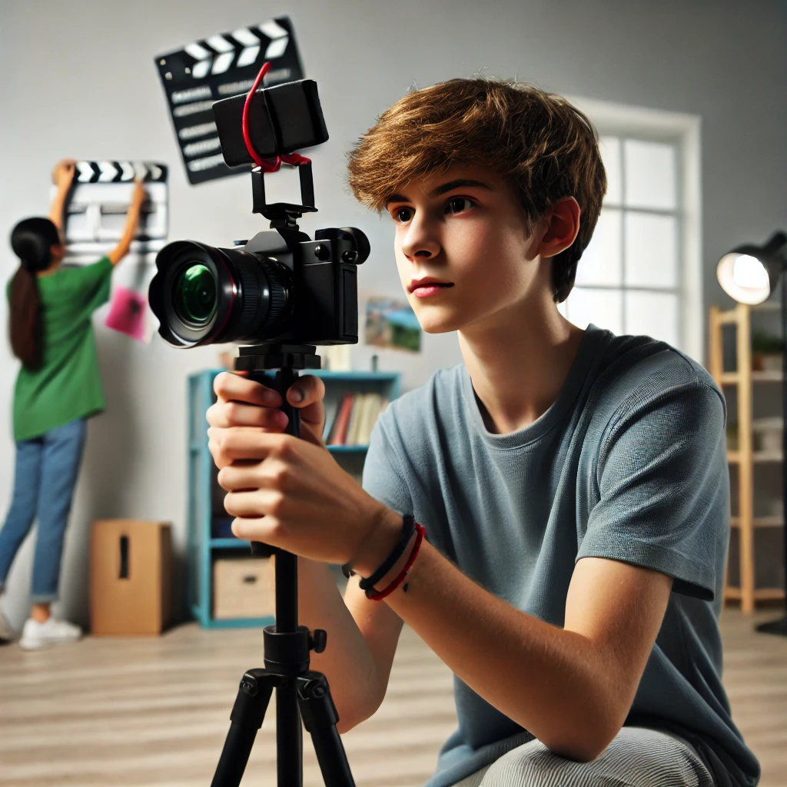
What do you like? (14/24)
Make slime 🧼 OR Make videos 🎥

Slide 25
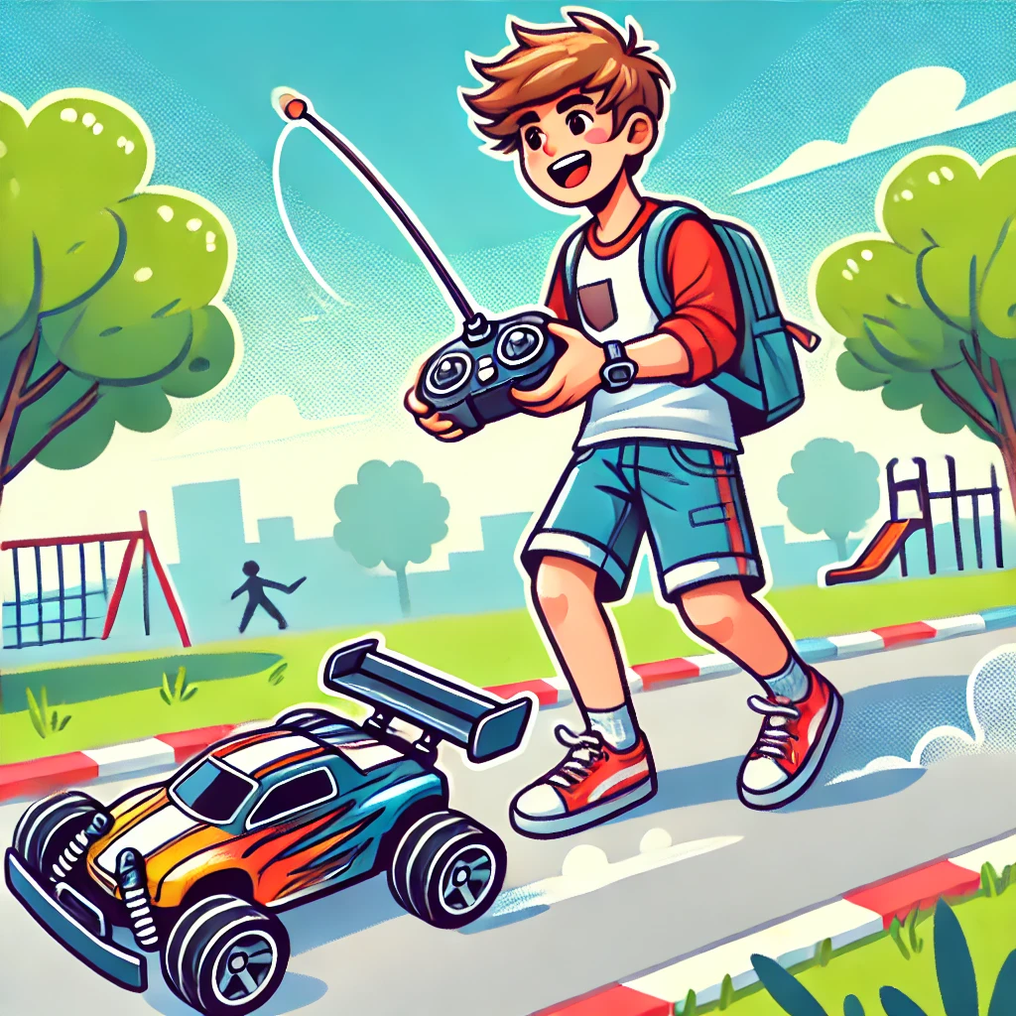
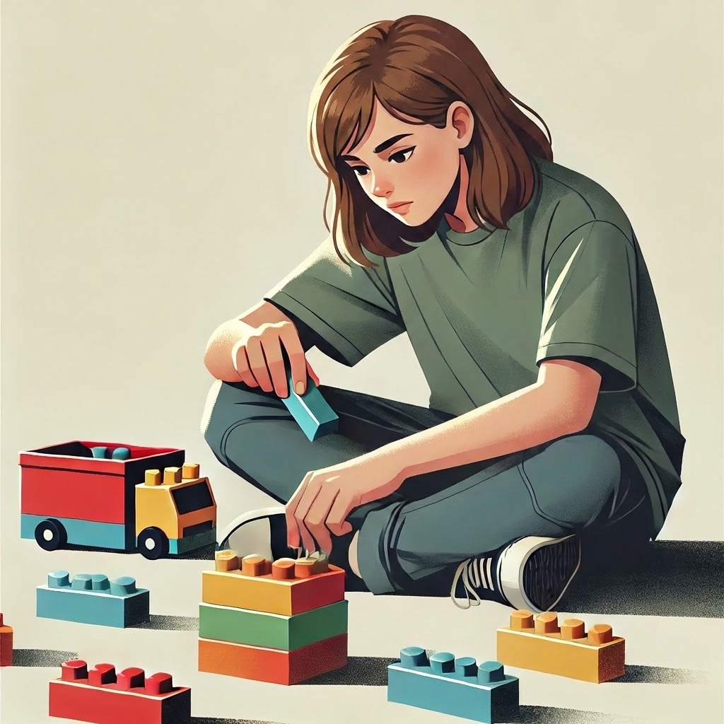
What do you like? (15/24)
Remote-control cars 🚁 OR Build with LEGOs 🧱

Slide 26
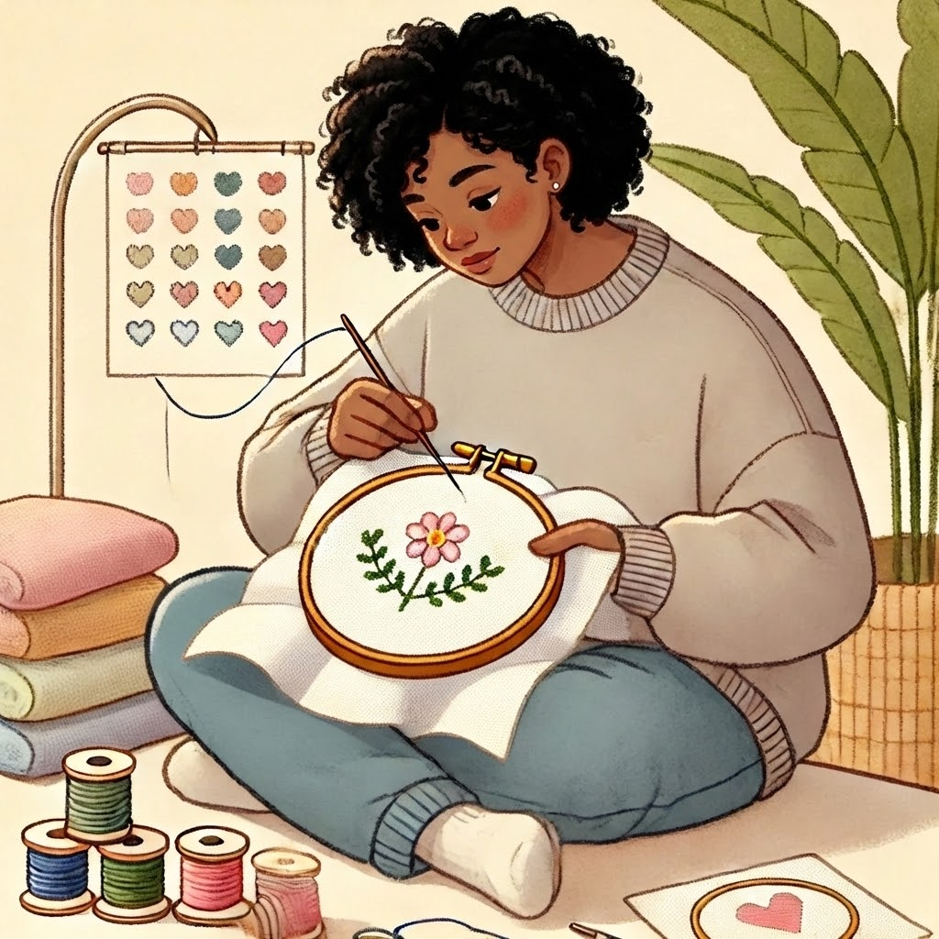
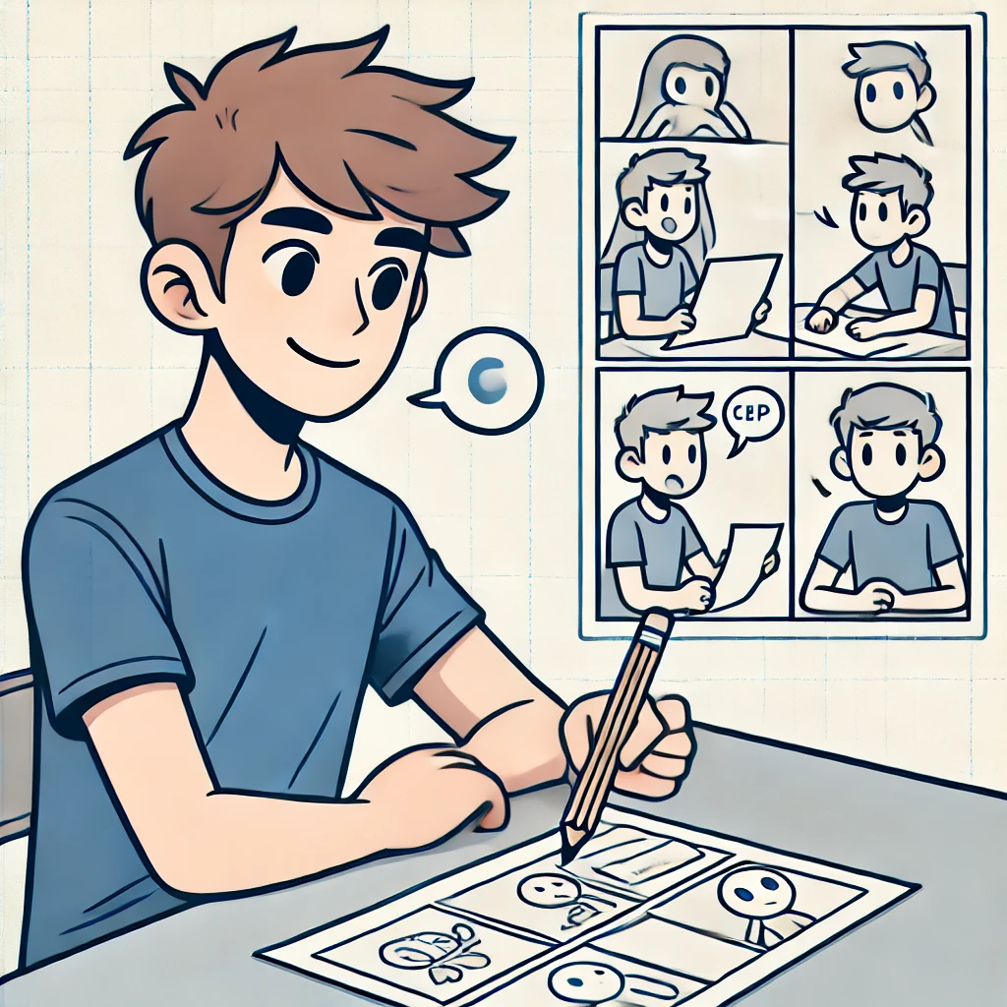
What do you like? (16/24)
Sew or weave 🧵 OR Draw a comic ✏️

Slide 27
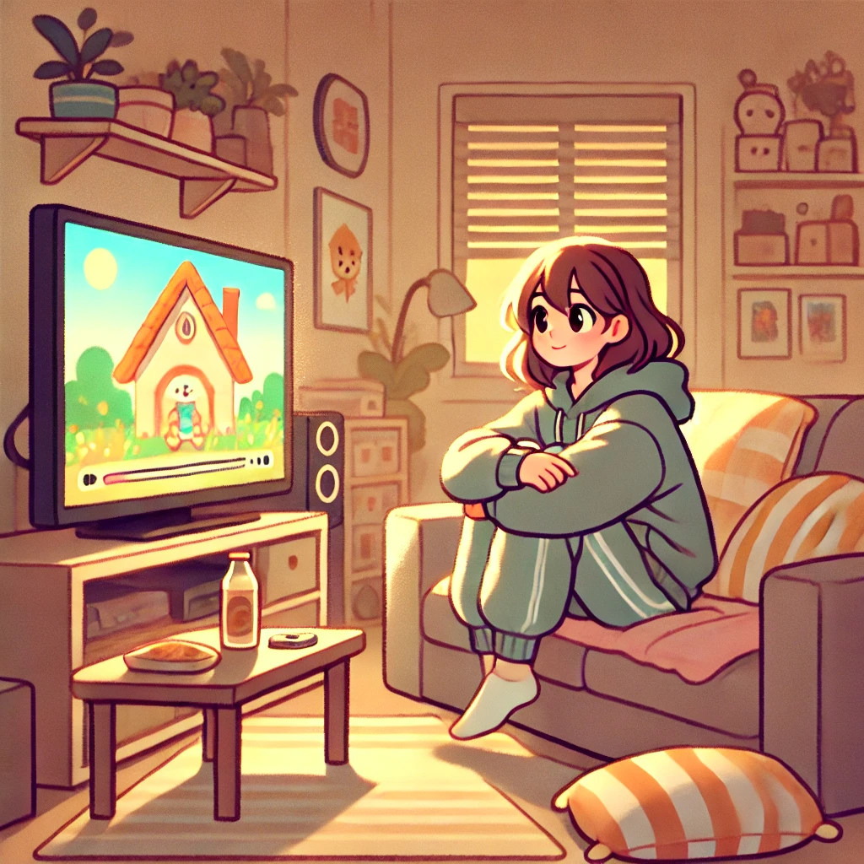

What do you like? (17/24)
Cartoon videos 🐱🐰 OR Nature videos 🍂

Slide 28
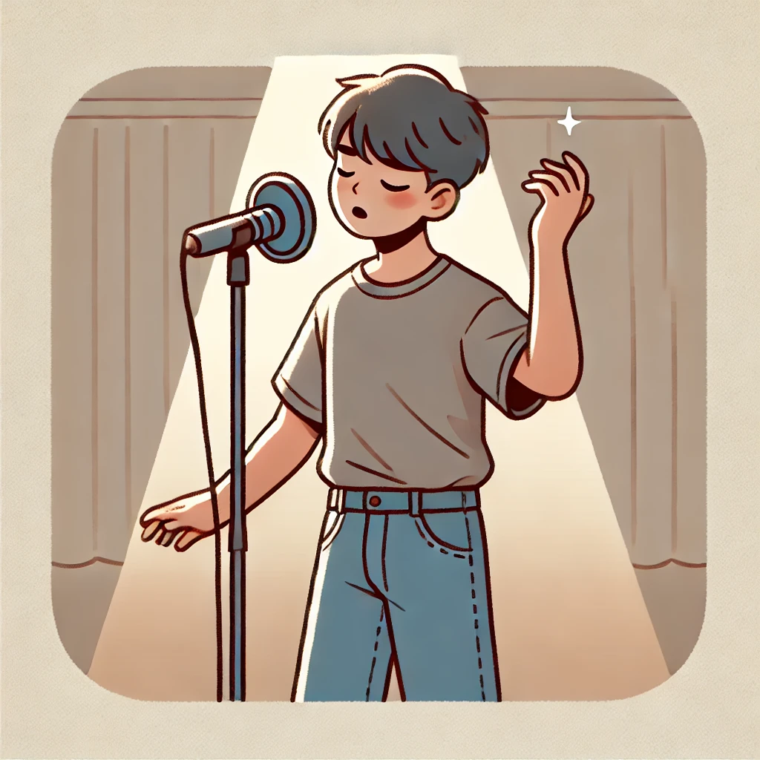
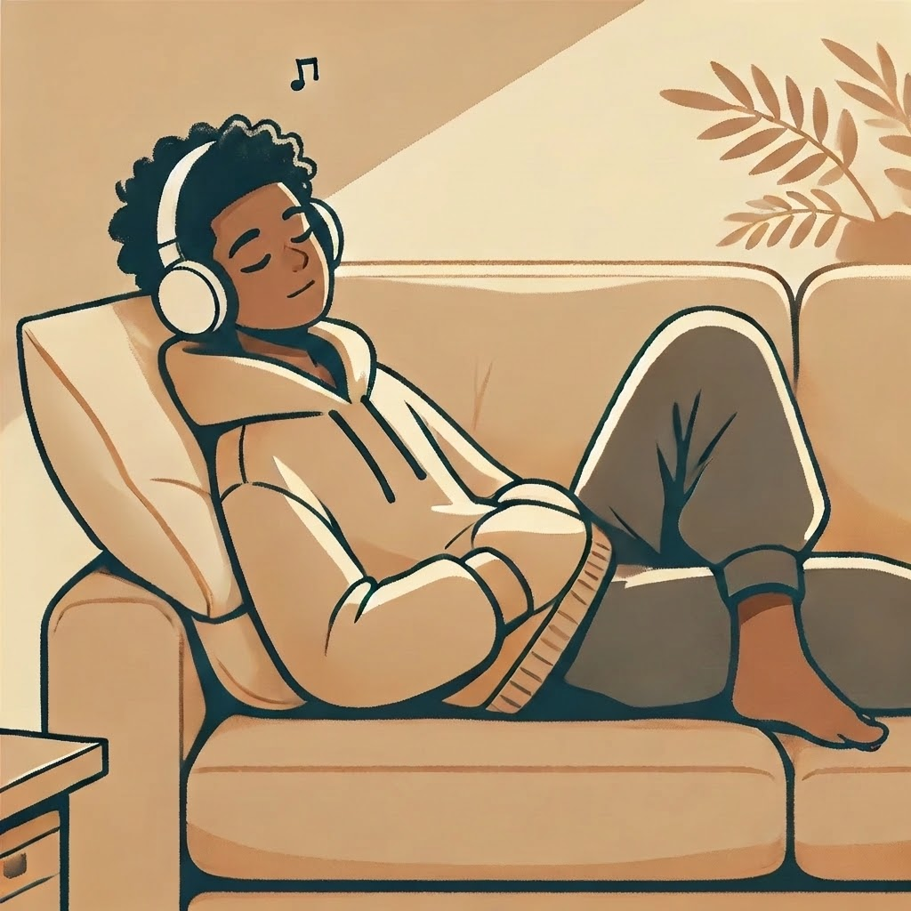
What do you like? (18/24)
🎶 Singing a song OR Listen to music 🎧

Slide 29
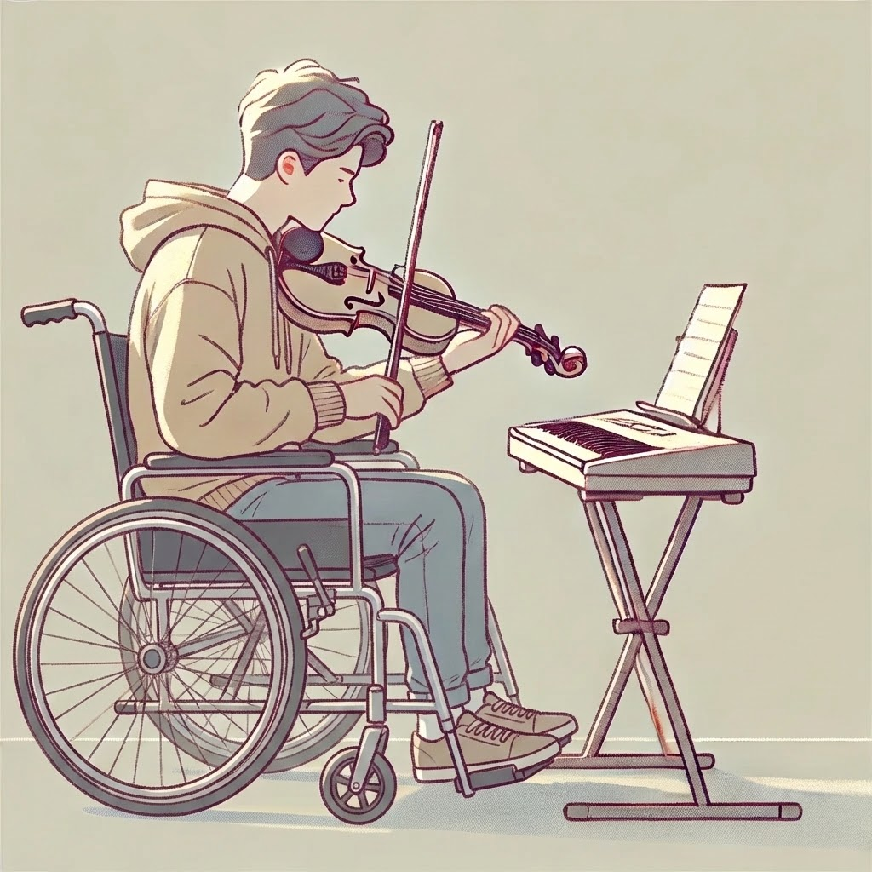
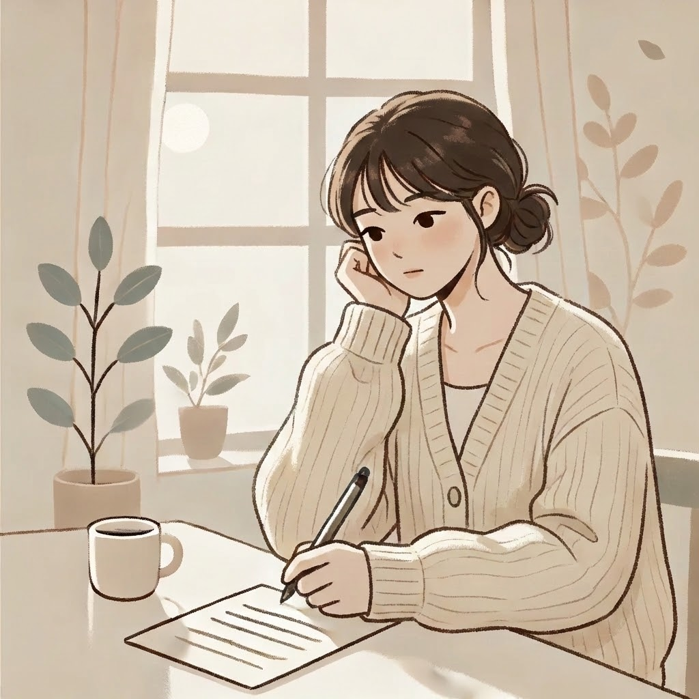
What do you like? (19/24)
🎶 Play an instrument OR Write a poem

Slide 30
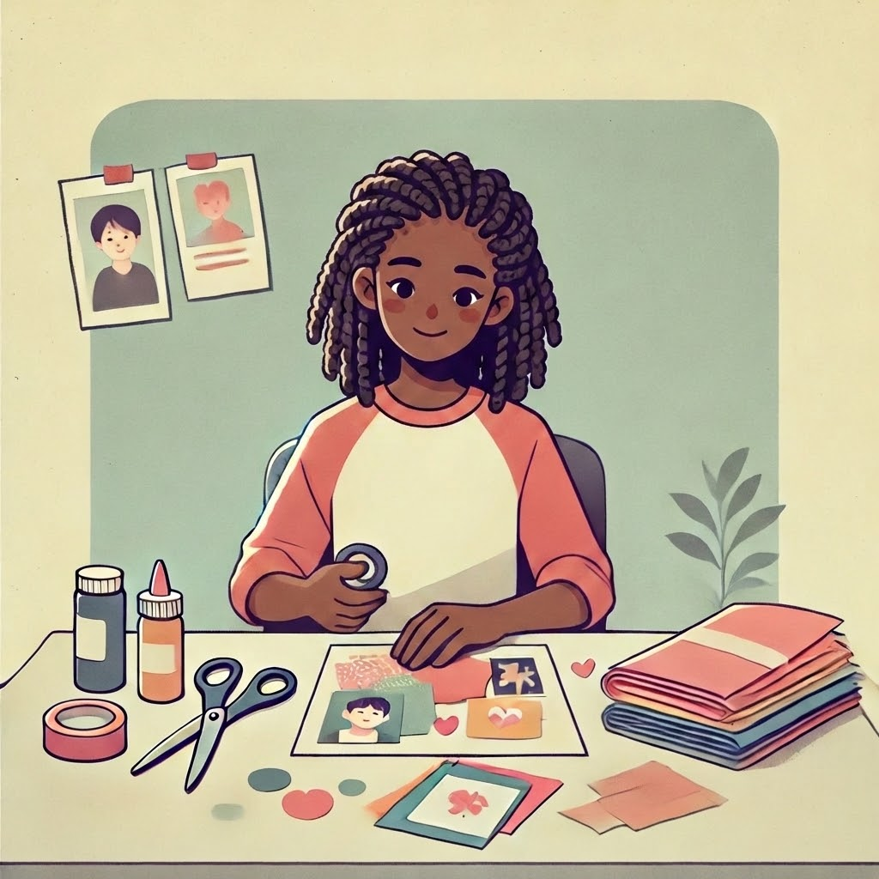
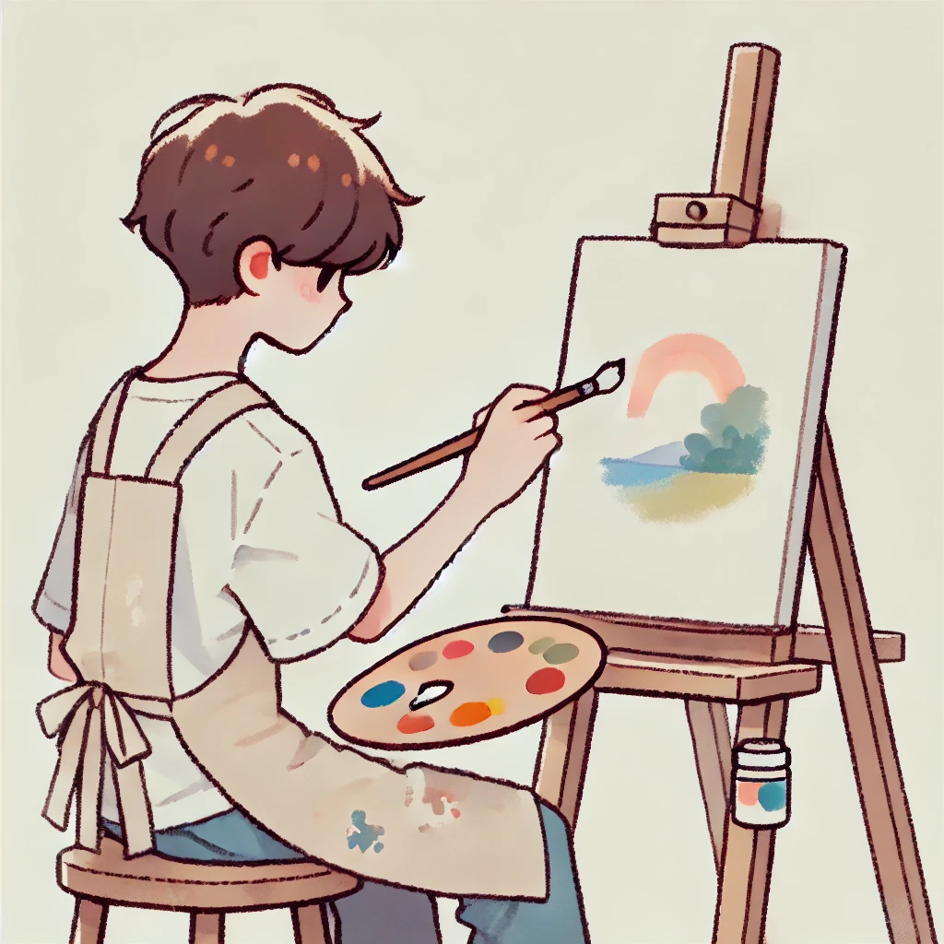
What do you like? (20/24)
📒 Make a scrapbook OR Paint a picture 🎨

Slide 31
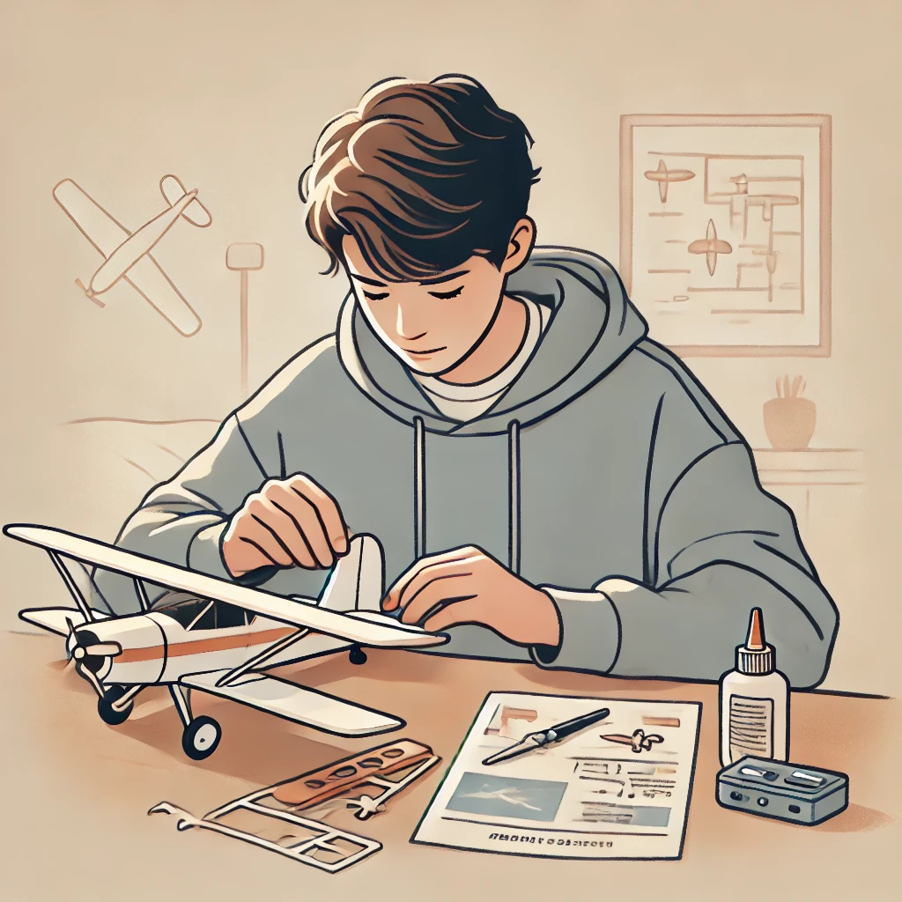
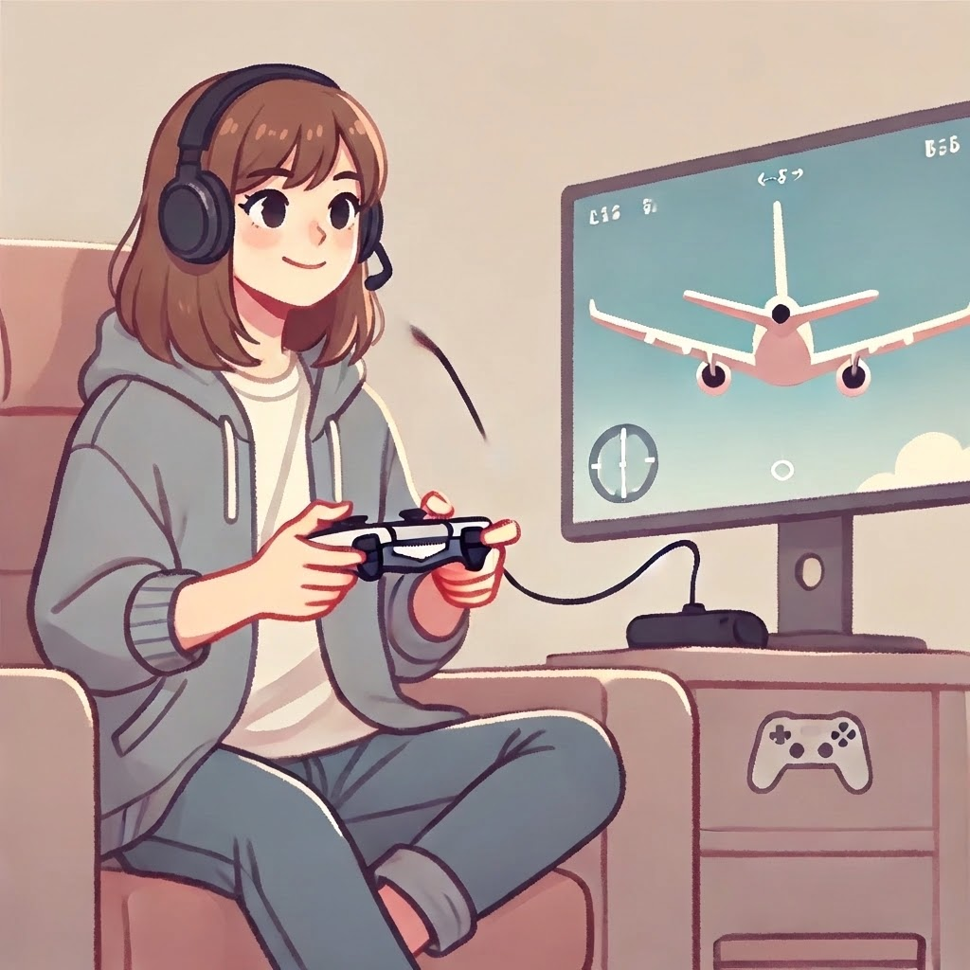
What do you like? (21/24)
✈️ Build a model airplane OR 🎮 Fly plane in video game

Slide 32
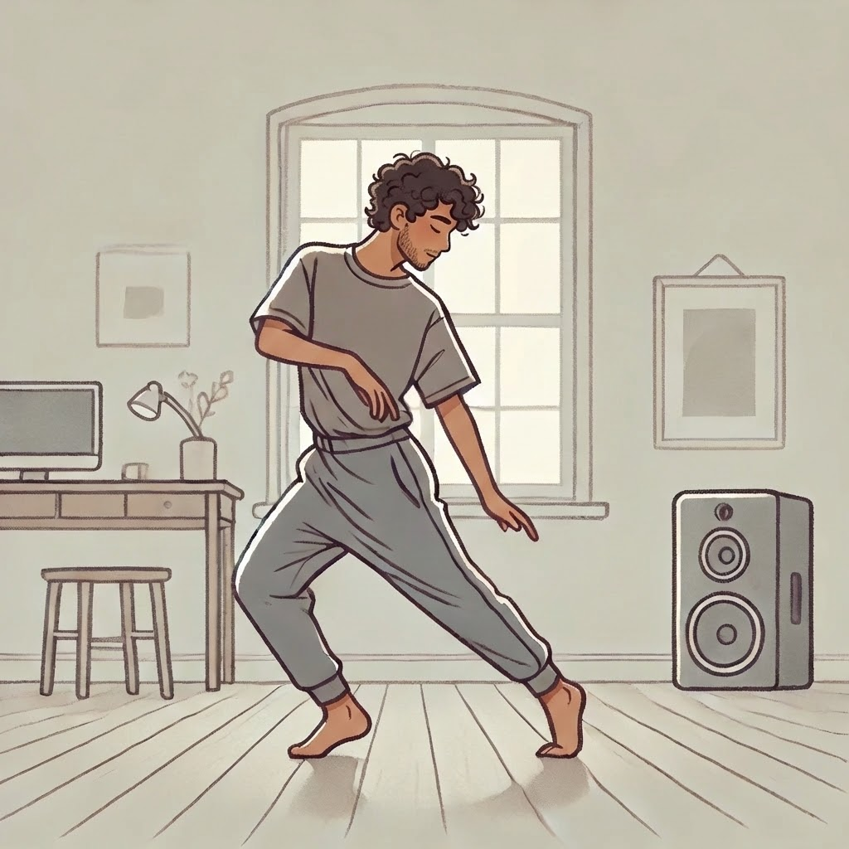
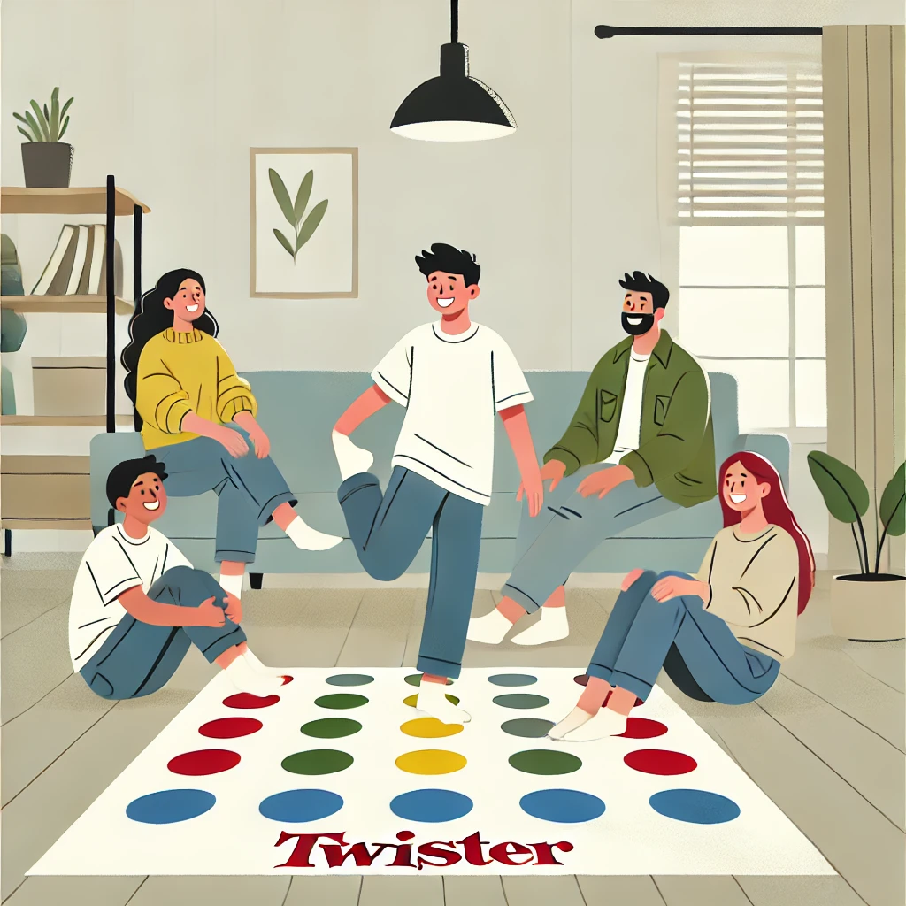
What do you like? (22/24)
💃 Dancing OR 🕺 Play movement game

Slide 33
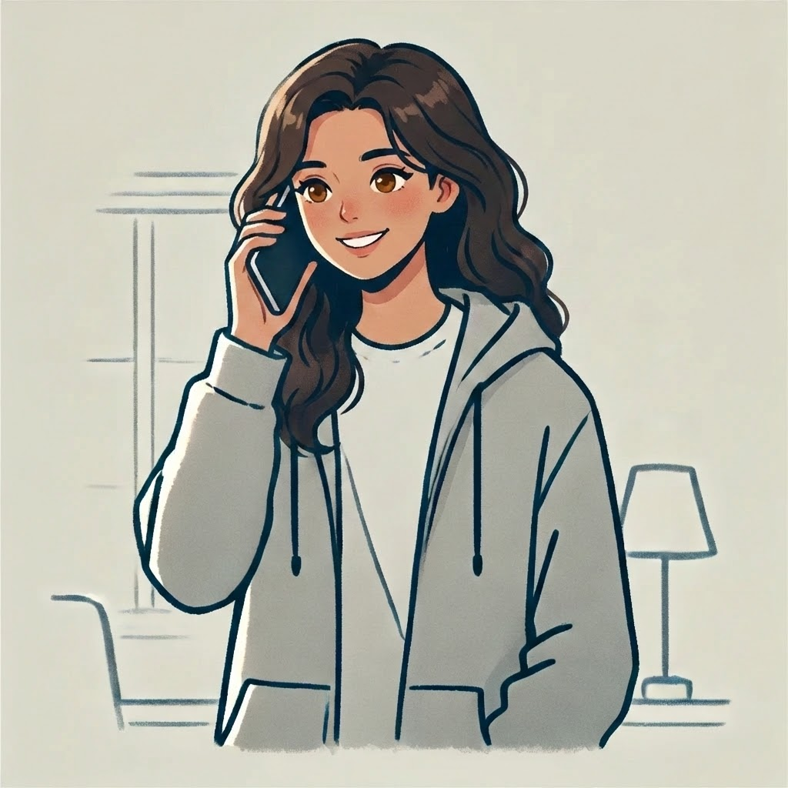
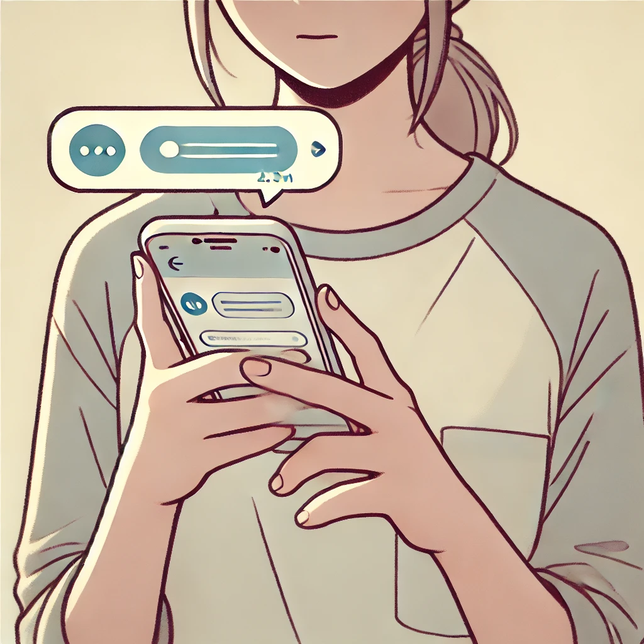
What do you like? (23/24)
📞 Talk on the phone OR 💬 Text on the phone

Slide 34
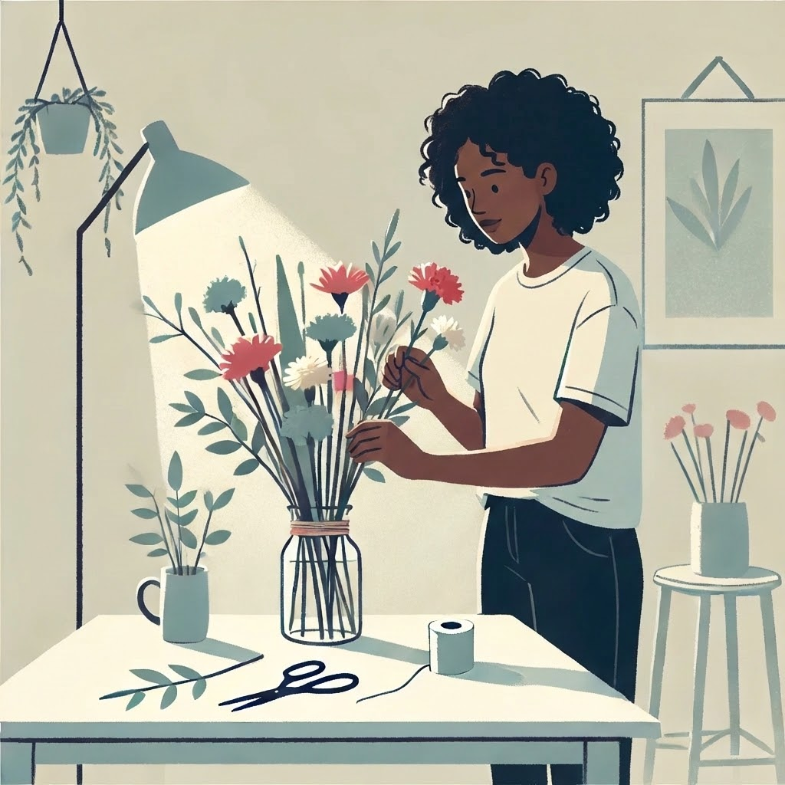
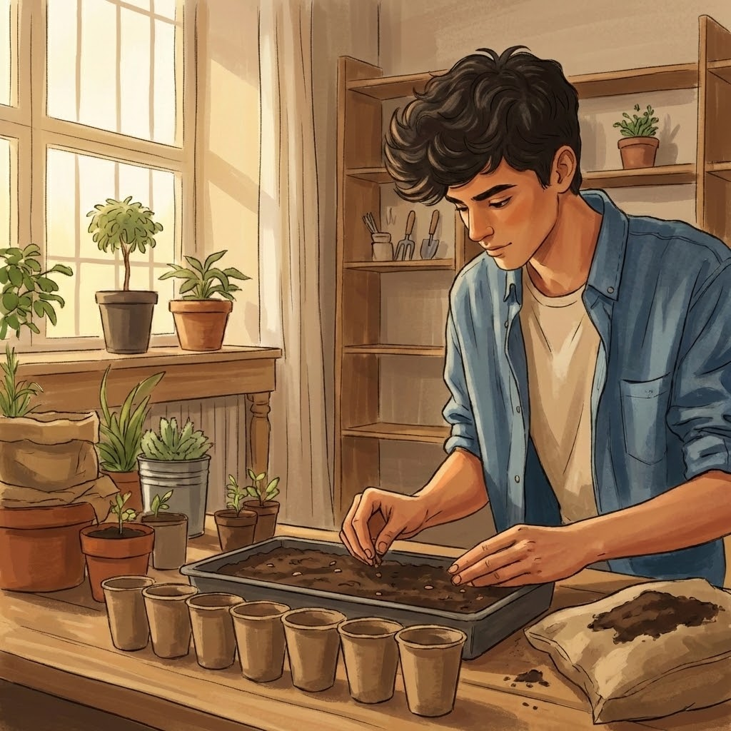
What do you like? (24/24)
🌸 Arranging flowers OR 🌿 Planting seeds

Slide 35

Well Done

