Slide 1
School Leisure Activity Assessment
Charles Thull, PhD
Old Dominion University

Slide 2
Presentation Note
Note. Images and animated visuals in this presentation were generated using ChatGPT, Sora, DALL·E, and Gemini based on author-developed prompts.

Slide 3
What do like to do for fun at school?
📖✏️
📱 🧠
💃🏈
🏀⚽
🎧
🎨🔬
♟️🧩

Slide 4
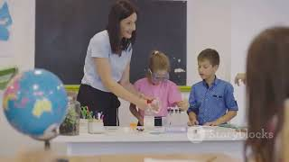
Having Fun at School!

Slide 5
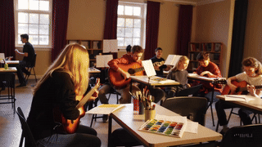
Have Fun at School
Find things you like to do.

Slide 6
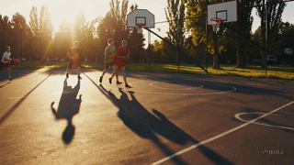
Have More Fun at School
Have fun on your own and with others.

Slide 7


What do you like? (1/13)
📖Read a book
OR
💻Use a computer

Slide 8
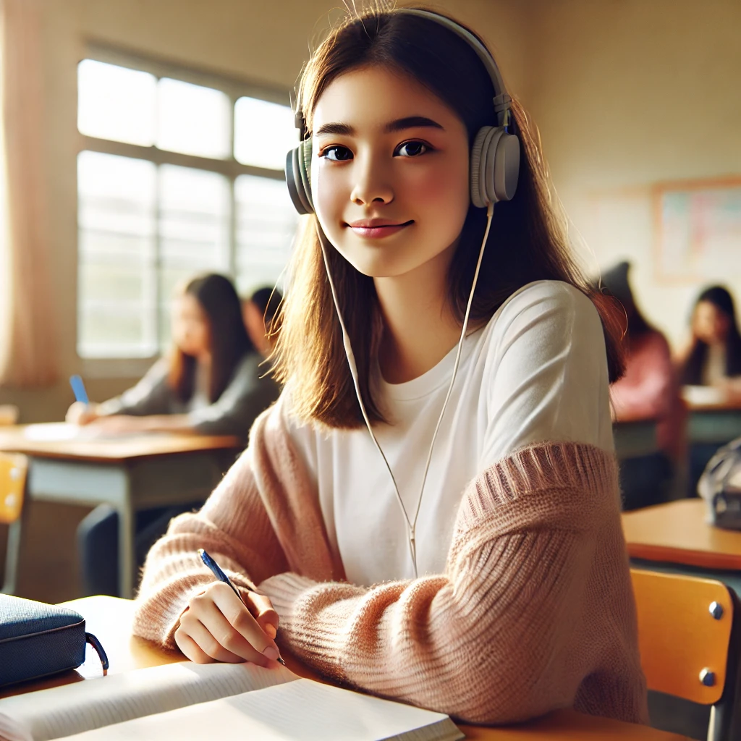
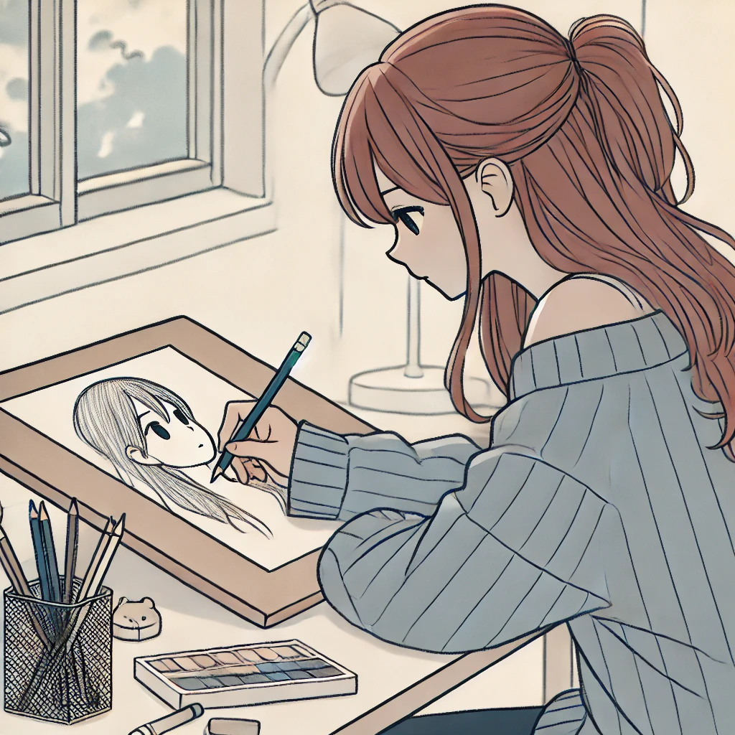
What do you like? (2/13)
🎧Listen to music
OR
✏️Draw a picture

Slide 9
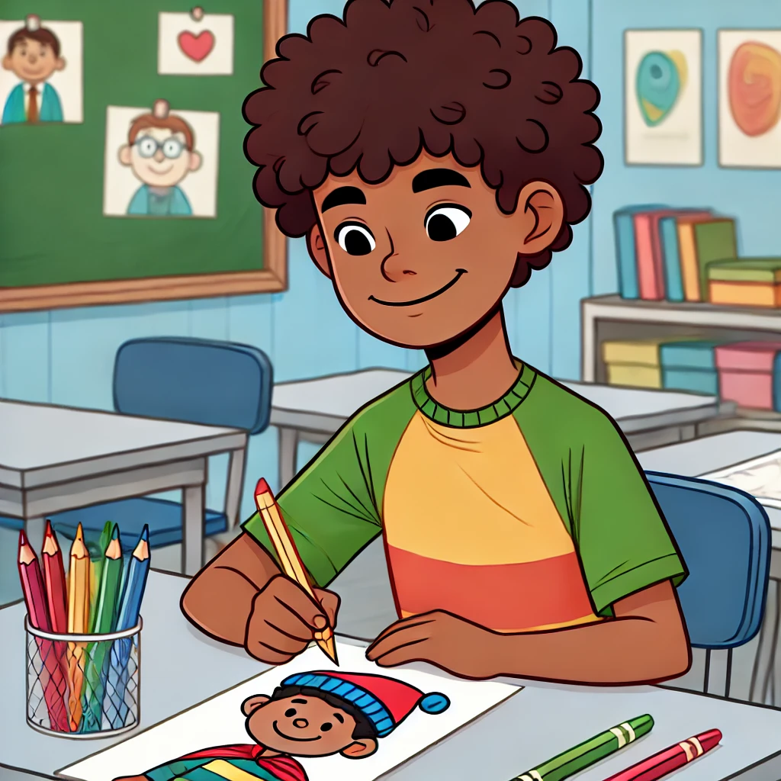
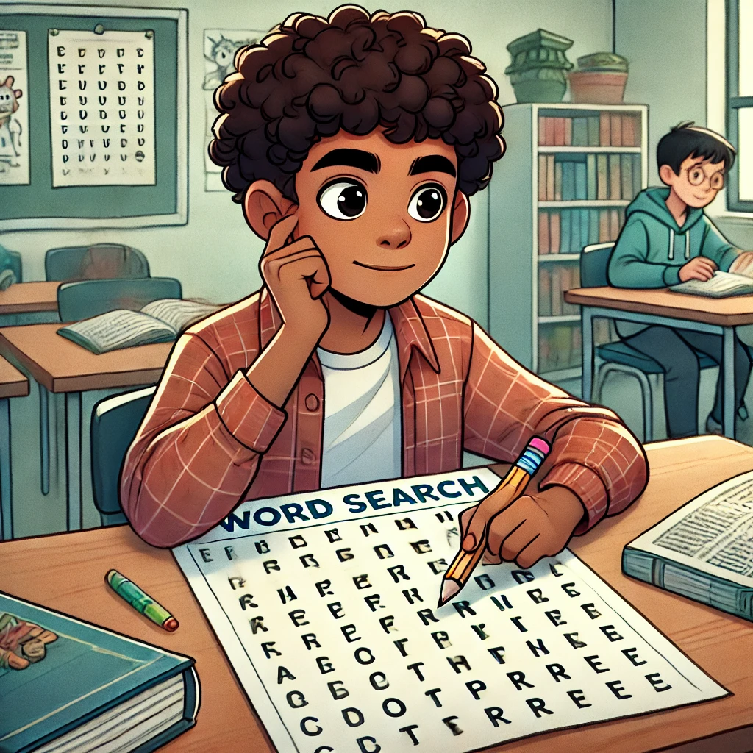
What do you like? (3/13)
🖍️ Color picture
OR
🔍 Do a word search

Slide 10
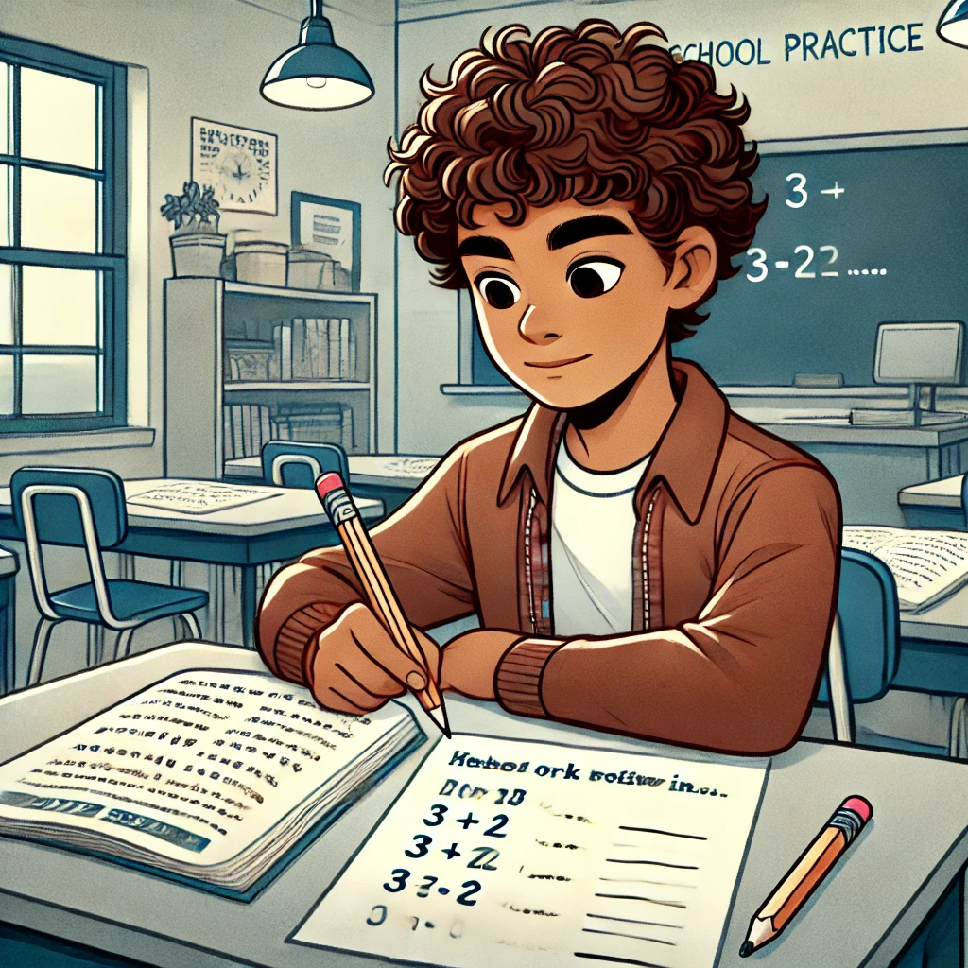
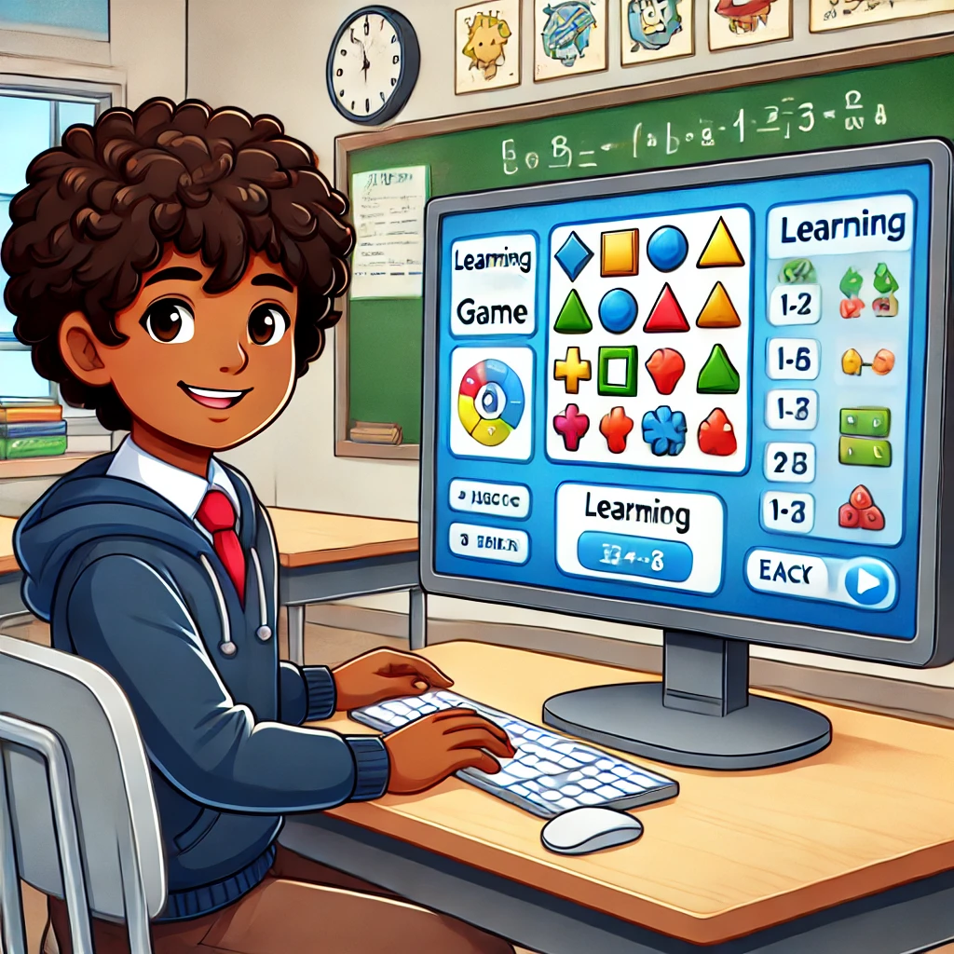
What do you like? (4/13)
📝 school worksheet
OR
💻🎮 Learning game

Slide 11
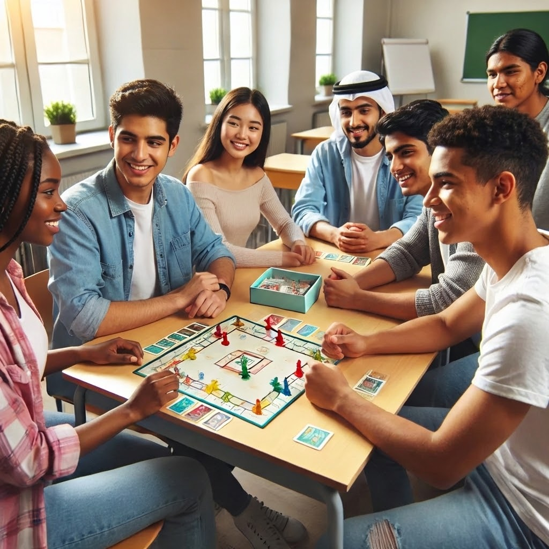
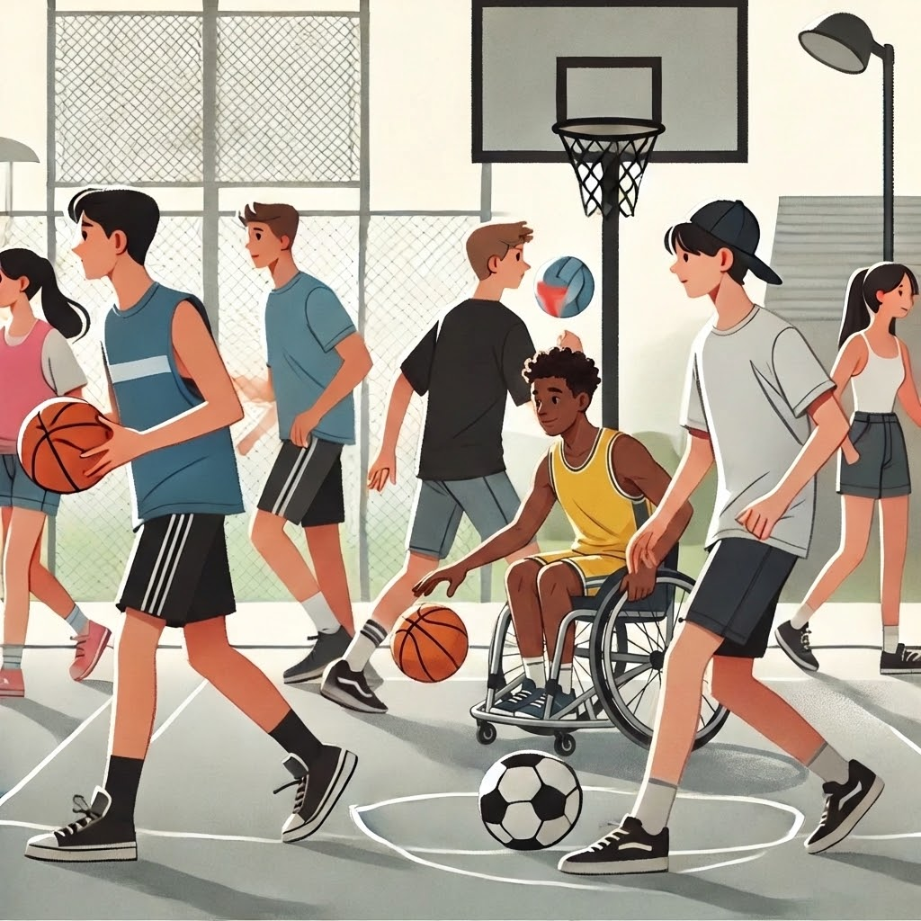
What do you like? (5/13)
♟️🧩Games
OR
🏀⚽Practice sports

Slide 12
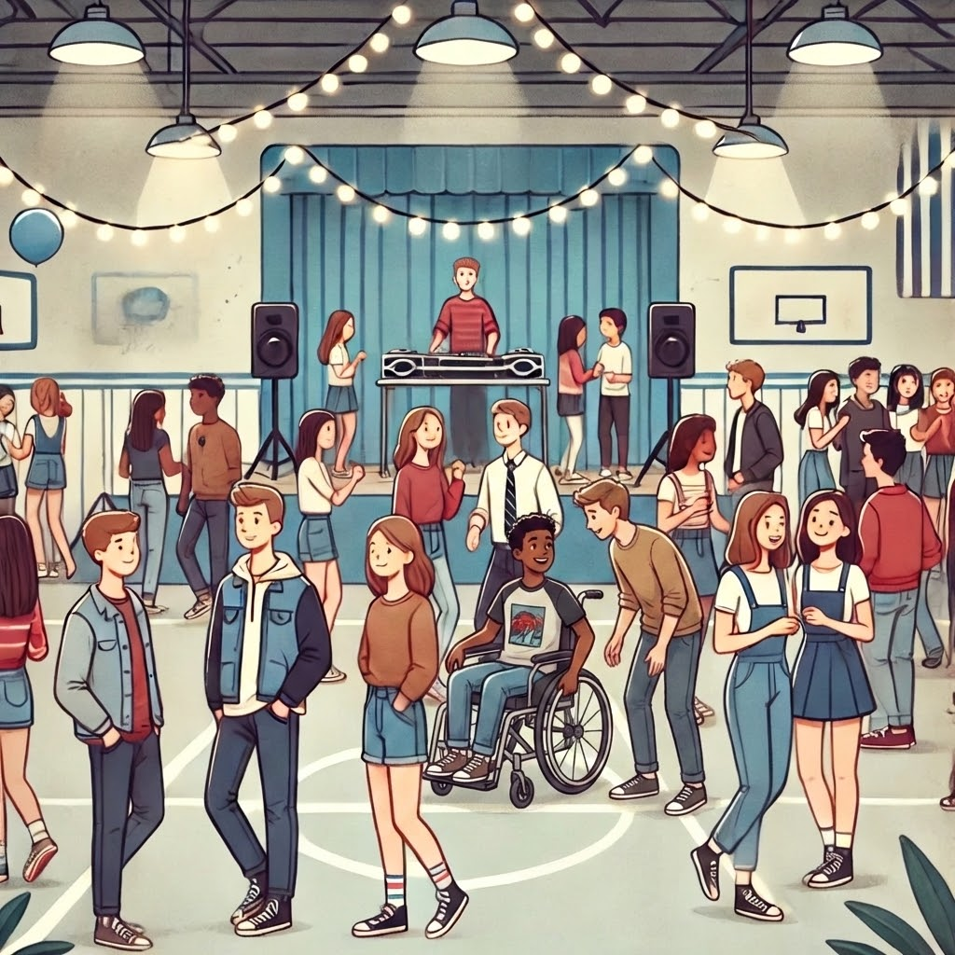
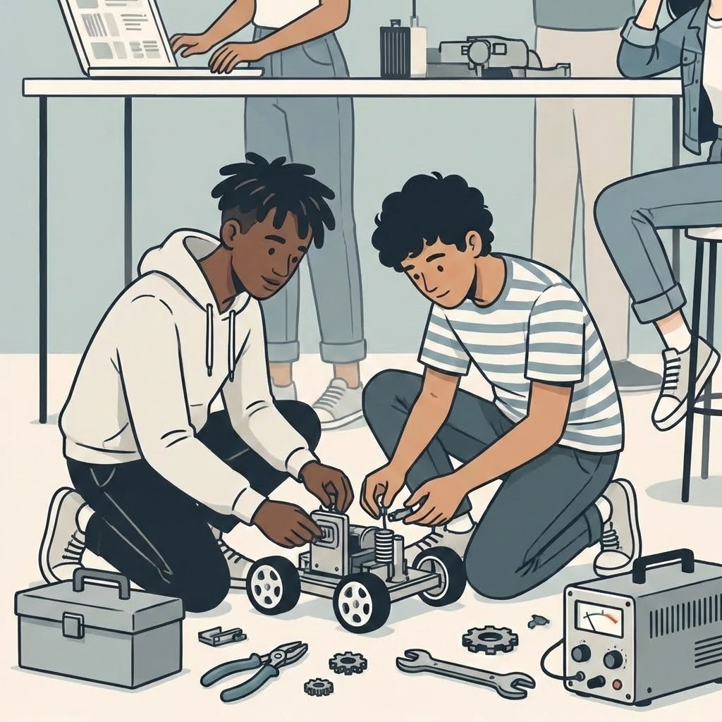
What do you like? (6/13)
💃School dances
OR
Build a robot 🤖

Slide 13
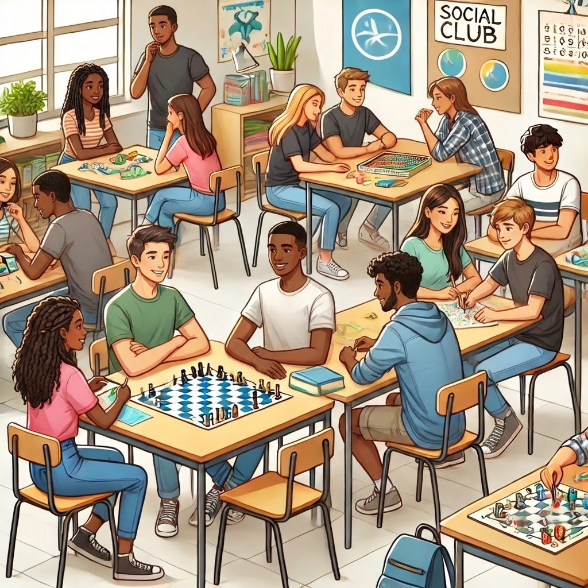
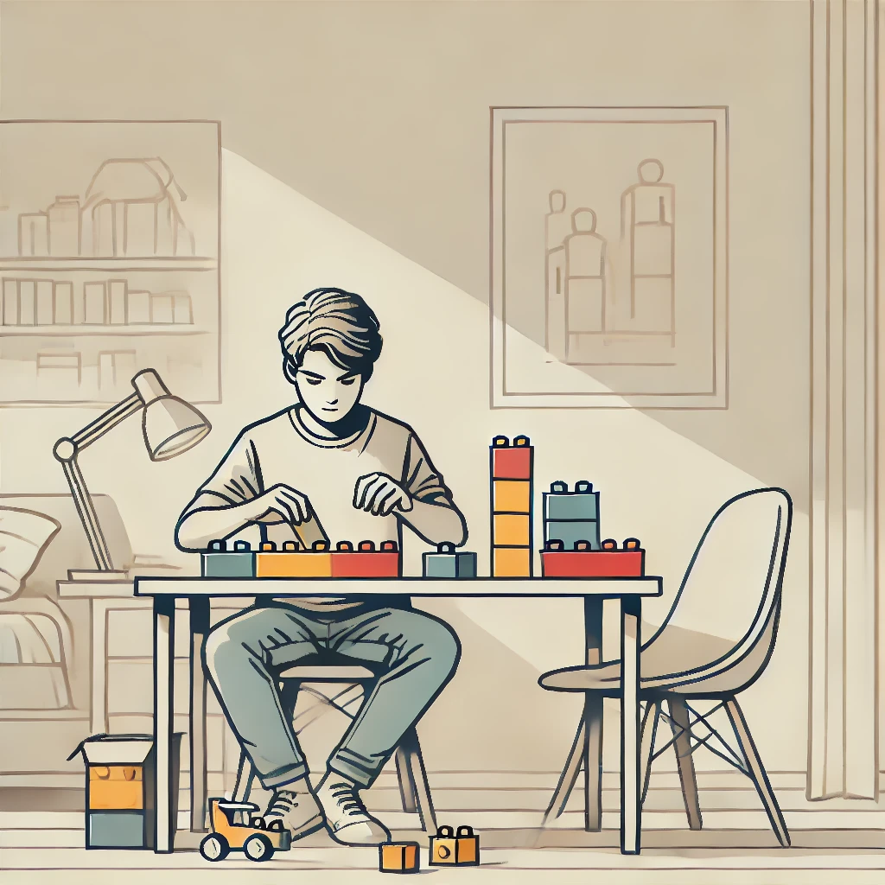
What do you like? (7/13)
🧑‍🤝‍🧑School clubs like Best Buddies
OR Build with LEGOs 🧱

Slide 14
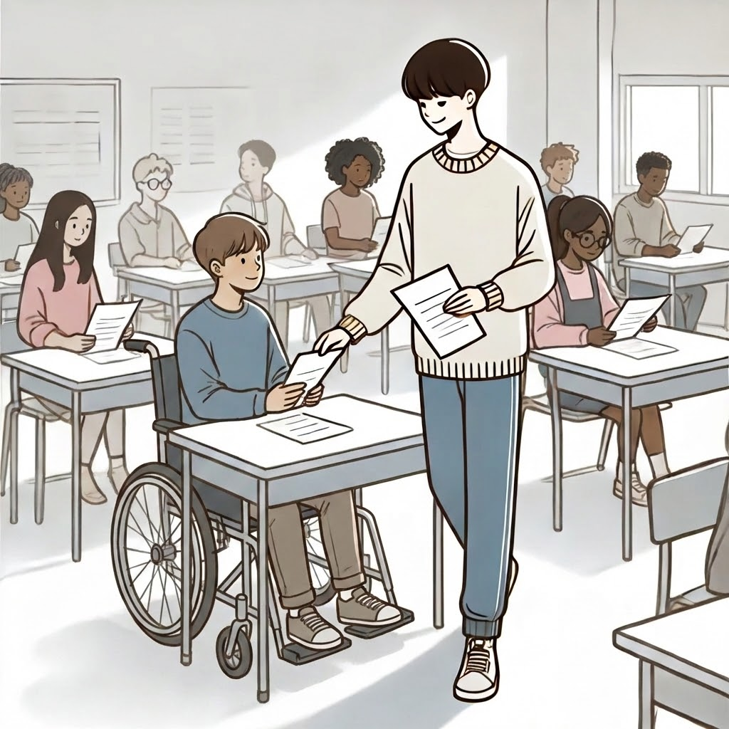
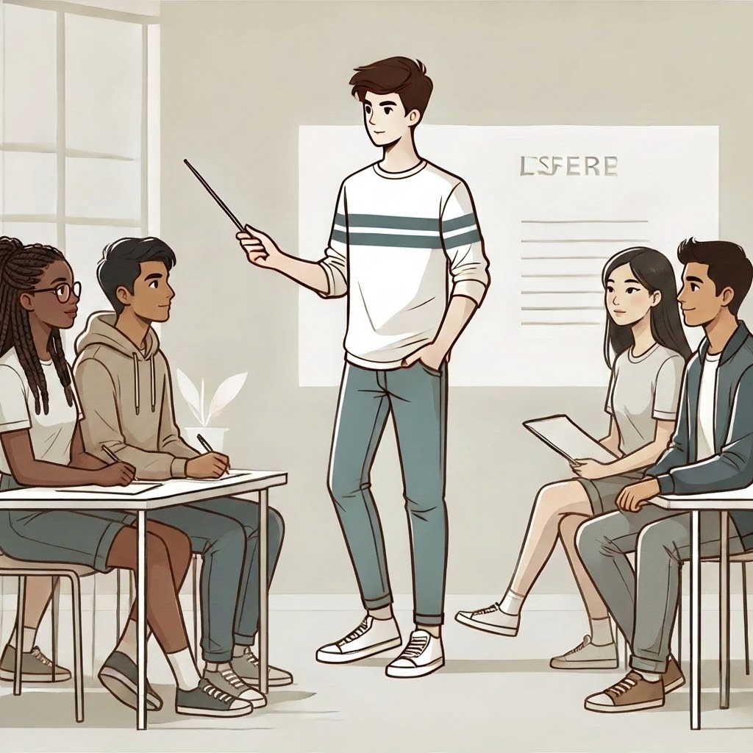
What do you like? (8/13)
Be classroom helper 🧹 OR Lead a group project 🗣️

Slide 15
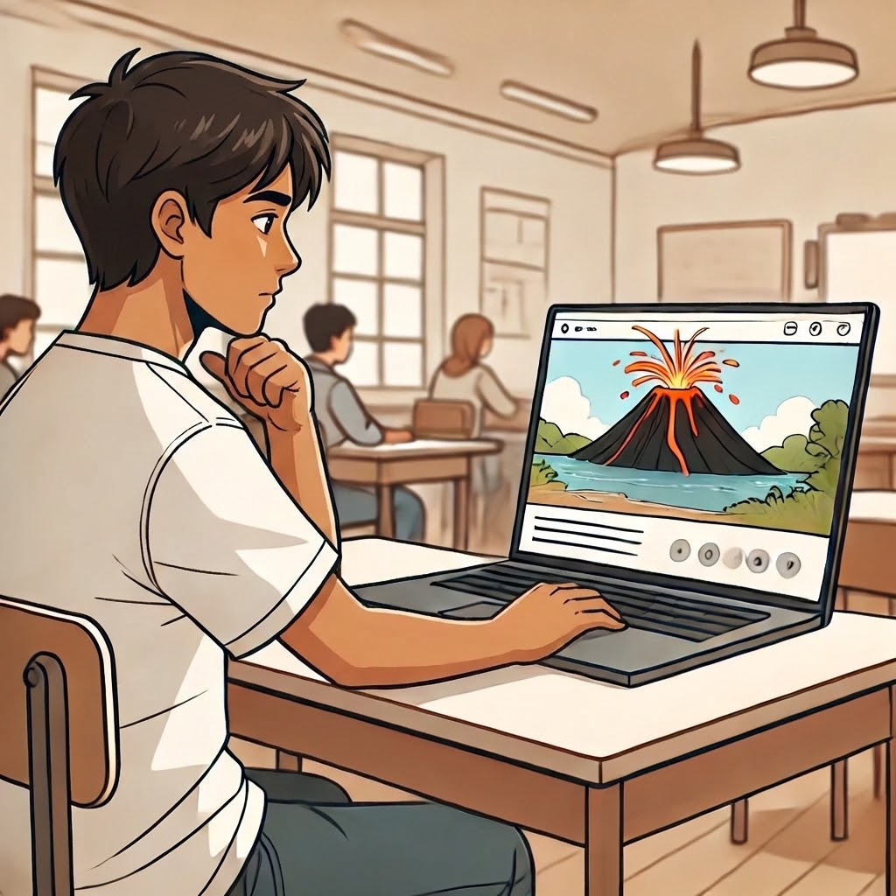
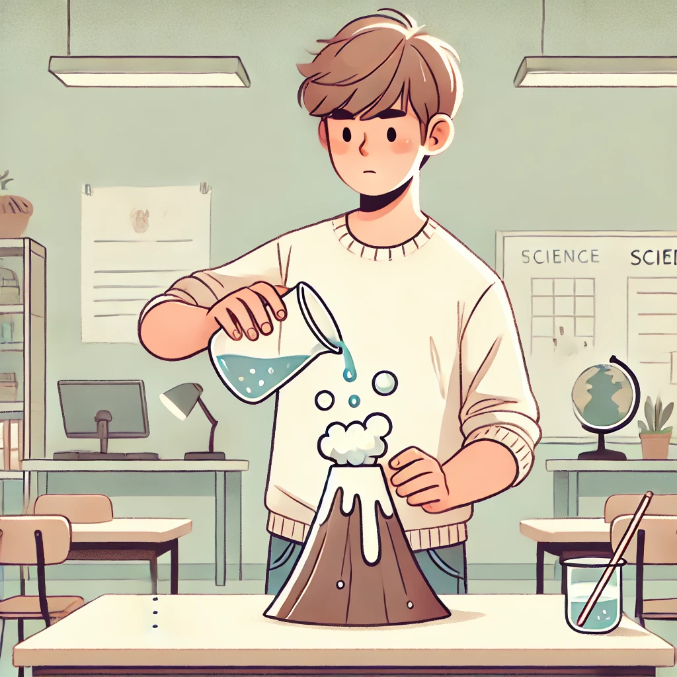
What do you like? (9/13)
Watch science videos 🌋 OR Try experiments 🧪

Slide 16
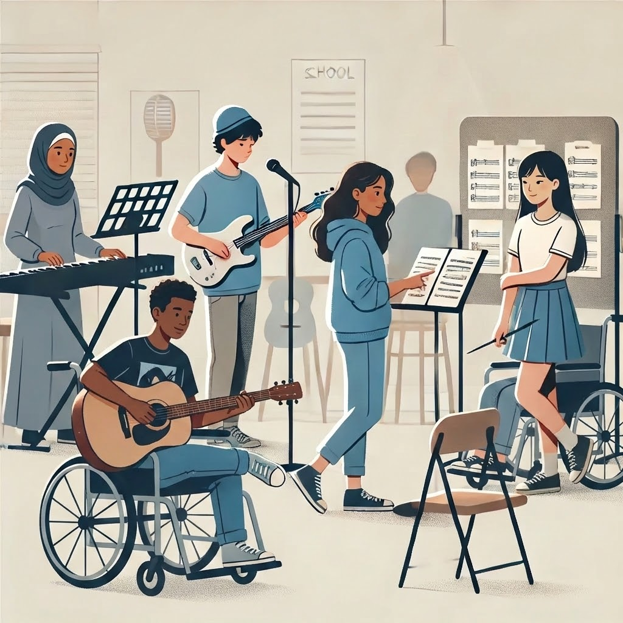
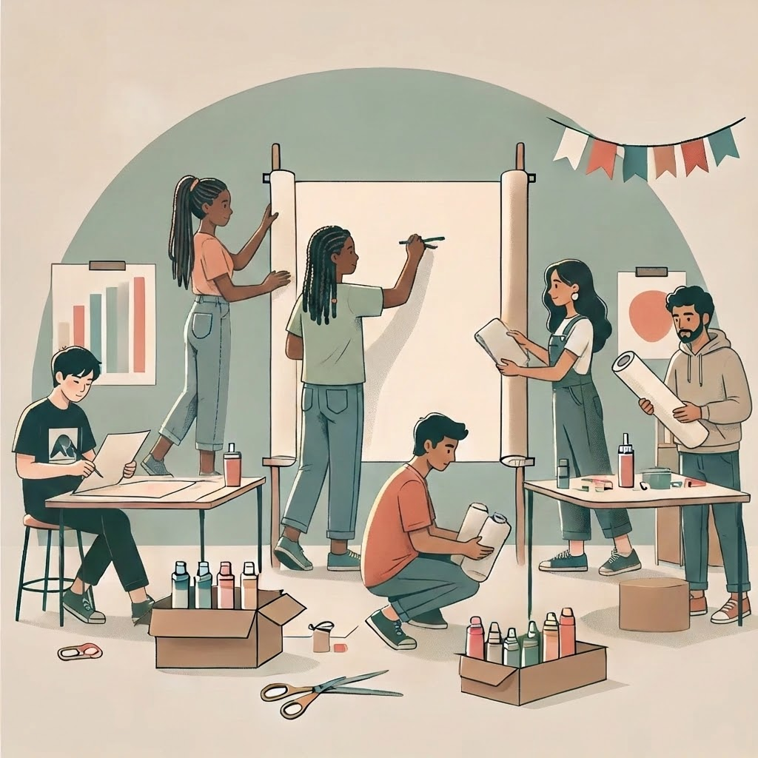
What do you like? (10/13)
Music or theater group 🎭 OR Make art posters 🖍️

Slide 17
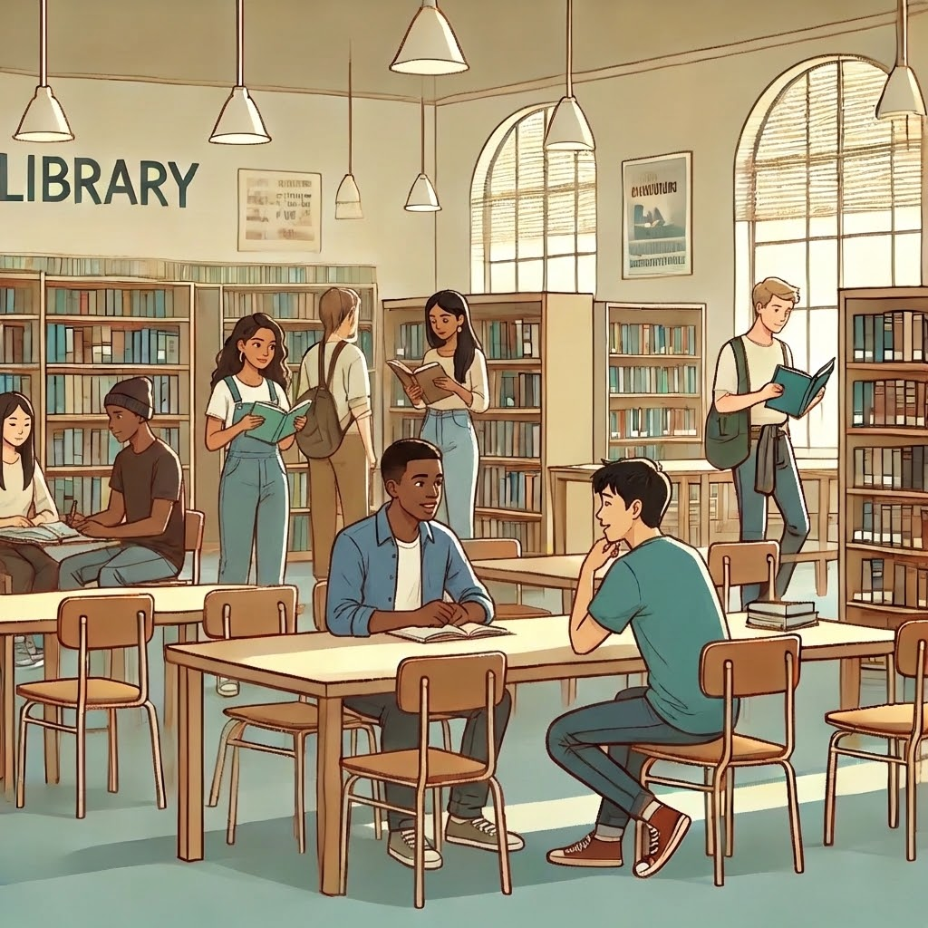
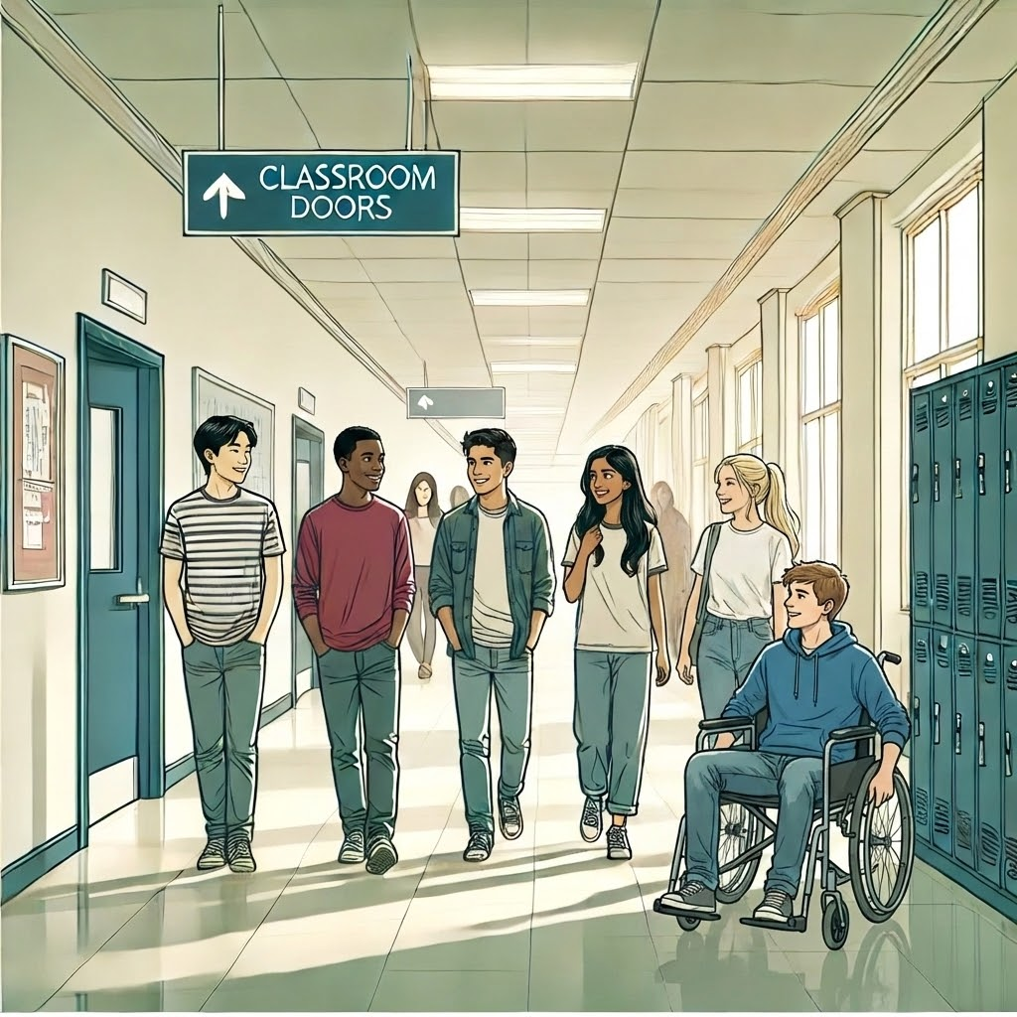
What do you like? (11/13)
📚 Visit library OR 🚶‍♀️ Take walk in hallway

Slide 18
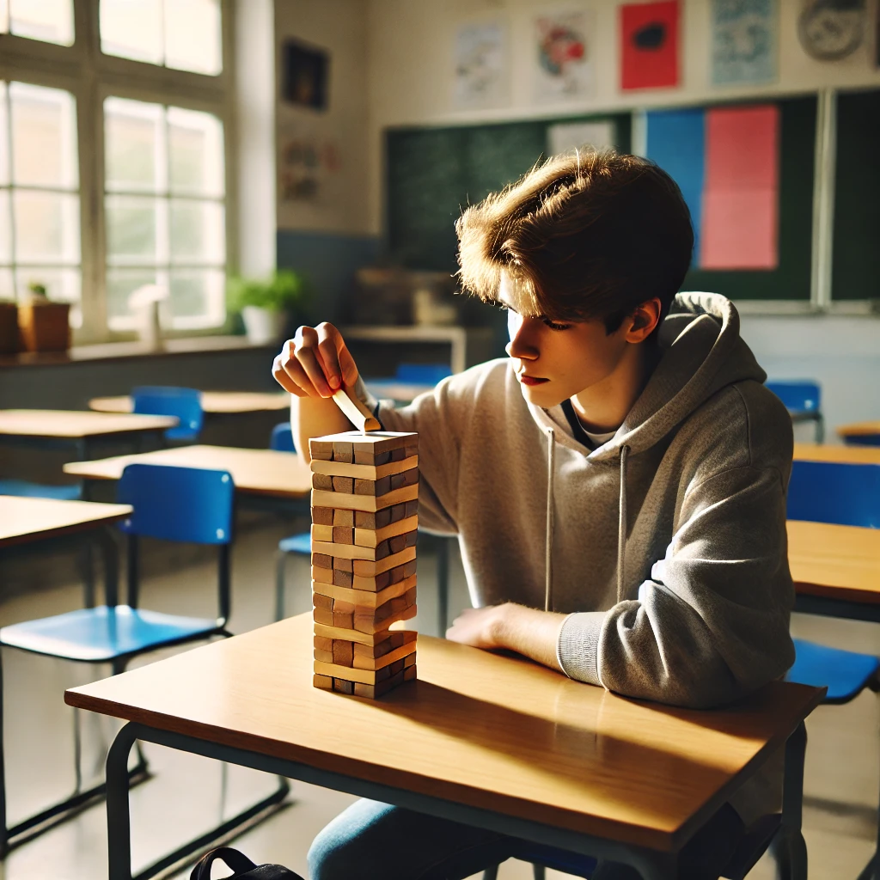
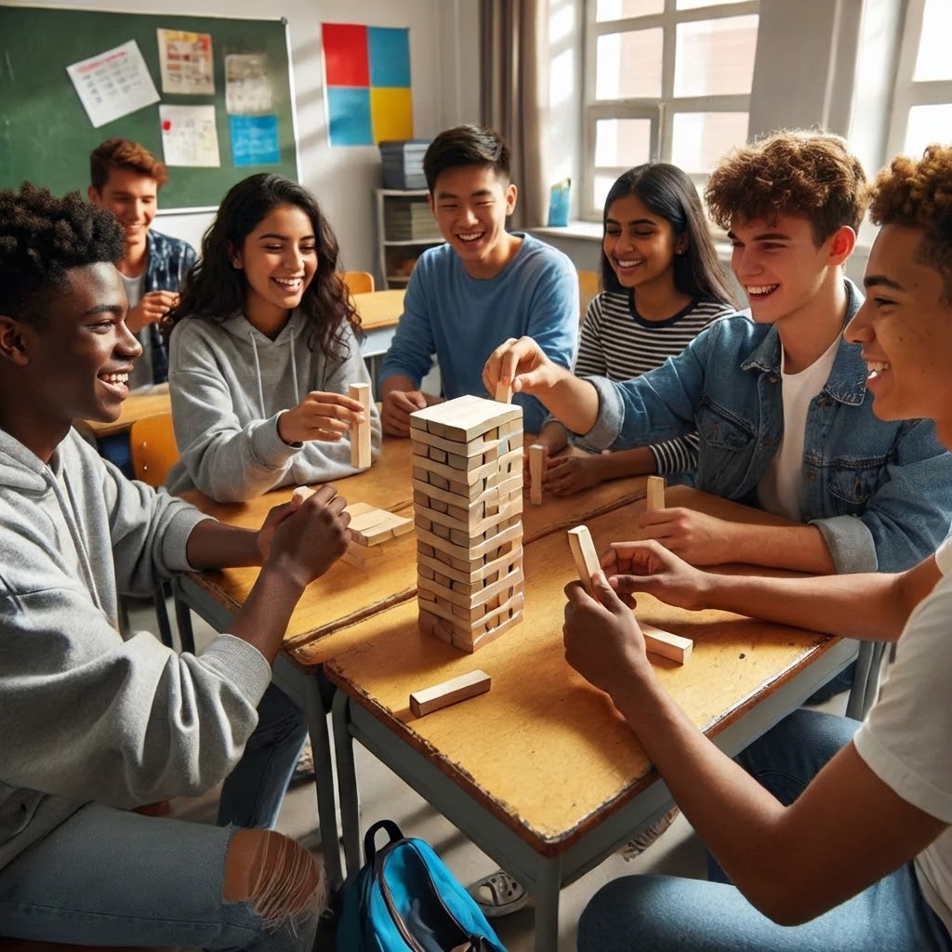
What do you like? (12/13)
🧍🎮 Play game by myself
OR
👫🎲 Play game with friends

Slide 19
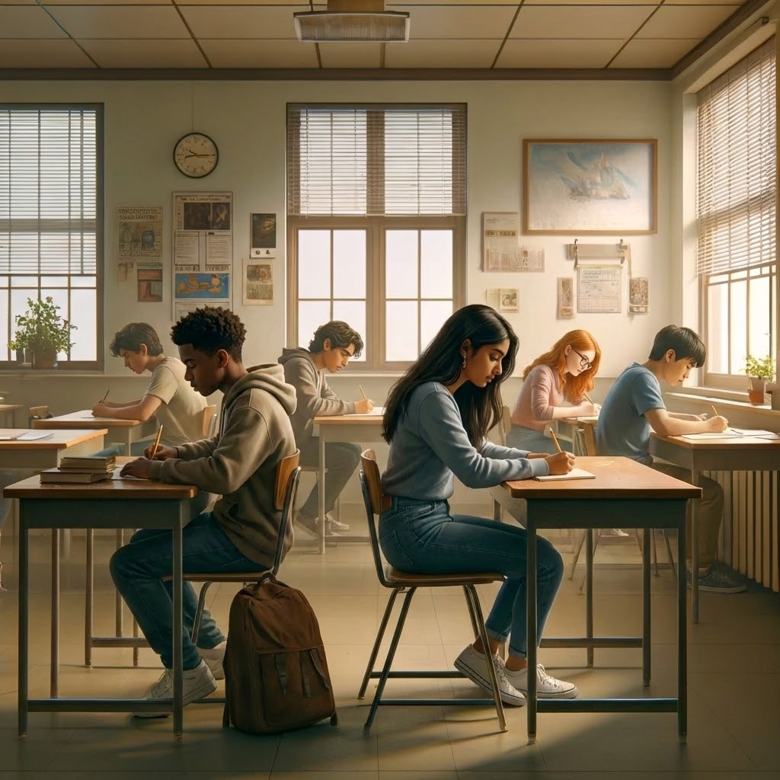
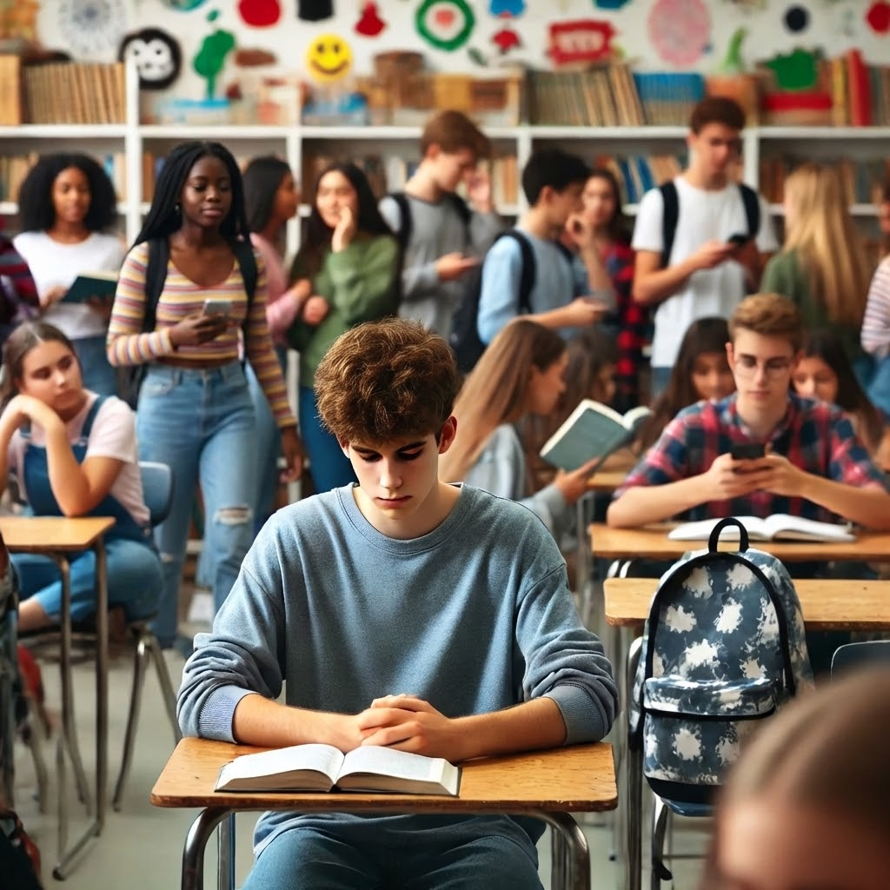
What do you like? (13/13)
👨‍👩‍👧 Be in a small group
OR
👯👯 Be in a large group

Slide 20

Well Done

