Slide 1
AI as a Lesson Planning Thought Partner: Supporting Preservice Teachers’ Strategic AI Use Through Lesson Internalization and Mixed-Reality Rehearsal - Lesson Internalization Slides
Nelson Cubas and Susie L. Gronseth, University of Houston

Slide 2
Lesson Internalization Module
Objectives:
Identify and refine key lesson components through guided internalization.
Revise one section of a lesson internalization plan using peer and AI feedback.
Explain how collaborative and AI-supported planning influences confidence in teaching practice.

Slide 3
Lesson Internalization
Lesson internalization is what you would do if you are given a pre-made lesson plan to teach.
Because lessons are pre-existing, they may not consider or account for the specific details of your classroom.

Slide 4
Lesson Internalization
Teachers who successfully internalize pre-made lessons adapt and personalize materials to their specific classroom context and student needs, rather than following scripts verbatim.

Slide 5
Lesson Internalization
The internalization process involves:
considering the lesson flow
anticipating transition points
preparing thoughtful questions
identifying opportunities to connect content to students' prior knowledge and experiences

Slide 6
Lesson Internalization
Your job is to thoroughly review the lesson plan, not just for the content, but also:
the pedagogical reasoning
learning objectives
anticipated student misconceptions before delivery

Slide 7
Lesson Internalization Scenario

Slide 8
Mursion Simulation
Three weeks after completing this module, you are going to practice teaching your Digital Citizenship lesson in a simulation with 5 students.

Slide 9
Mursion Details
The simulated students are middle schoolers.
The simulated students can hear and respond to you. They can also see you on camera.
The students may not have much prior knowledge of digital citizenship.
If you ask the simulated students to do something they can’t do, they’ll tell you: “The principal said we can’t do that.”

Slide 10

Scenario
You are a *insert your preferred grade level and content area* teacher with an 8th grade homeroom class. Your school is implementing a Digital Citizenship initiative and has given all teachers a selection of lessons to teach in homeroom.
“Media literacy technology” by tiday is licensed under the Pixabay free use license.

Slide 11

Scenario
Homeroom is only scheduled for 10 minutes, and at least a few of those is usually taken by the morning announcements and taking attendance.
Your lesson will have to be done in about 5-minute increments.
“Clock alarm clock time hours"” by artisticmeis licensed under the Pixabay free use license.

Slide 12
Mursion Student Avatar Profiles
Student Avatar A
Student Avatar B
Student Avatar C
Student Avatar D
Student Avatar E
Super objective: To be accepted as an individual
Behavior: Introverted, honest and loyal, repressed feelings/ can be overloaded
Academic Profile
1. Excellent data memory & recall
2. Perfectionist, potential for procrastination but will get the job done
3. Likes a quiet work environment (solo or library)
4. Responds best to learning and engaging with clear directions and what is expected of her
Instructional Tip
Be clear and structured. Don’t put her on the spot. Acknowledge her effort quietly if needed.
Super Objective: To impress intellectually
Behavior: Introverted, intelligent, driven, thoughtful
Academic Profile
1.Self-driven with high standards
2. Can stay unbiased with a sense of order and calm
3. Comfortable with a sense of order and calm
4. Enjoys working through a challenge
Instructional Tip
Let him explore ideas. Use open-ended or high-level thinking questions. Respect his slower pace.
Super Objective: To control (to be liked, to be admired, to control, to be recognized)
Behavior: Extroverted, can be condescending/sarcastic
Academic Profile
1. Enjoys leadership roles
2. Quick thinking - decisive
3. Dislikes slowing down because someone else “doesn’t get it” and busy work
4. Responds negatively to being controlled and/or being called out by a teacher.
Instructional Tip
Channel her leadership, make her group lead or discussion starter. Avoid power struggles.
Super Objective: To please
Behavior: Social introvert, empathic, people pleaser, creative
Academic Profile
1. Very bright, naturally does well in school
2. Can get very passionate about certain subjects, especially science and animal related subjects
3. Craves human understanding but uncomfortable in social situations (thus the comfort with Student Avatar C’s friendship)
4. Avoids conflict (will help find a middle ground with everyone)
Instructional Tip
Use inclusive language. Encourage her voice apart from Ava. Recognize her compassion.
Super Objective: To impress
Behavior: Extrovert, playful, supportive, energetic
Academic Profile
1. Often volunteers in class, doesn’t mind stepping out of his comfort zone
2. Always tries to understand new perspectives
3. Difficulty paying attention when work is detailed or mundane
4. Seeks attention and approval from peers - naturally funny
Instructional Tip
Keep him engaged with quick transitions. Assign class energizer roles (e.g., warm-up reader, closing summary).
Notes:
Note* Student profiles may differ depending on the specific Mursion scenarios that you are using. Consult with the Mursion specialist to get updated profile descriptions for your specific use.

Slide 13
Mursion Simulation Expectations
When you are not teaching, you are silently observing and contributing observations on the Padlet.
1. Teacher Observer | 2. Student Observer | 3. Question Raiser | 4. Advice Giver
What did you observe about the teachers? | What did you observe about the students? | What other questions or concerns does watching this session raise for you? | What might you suggest that the teacher do differently?

Slide 14

Things to Consider
Time is very limited, so make sure all students stay on task for the full mini-lesson.
“Business idea strategy marketing” by talhakhalil007is licensed under the Pixabay free use license.

Slide 15
Lesson Internalization Document
Click here to make a copy of the lesson internalization document.
Click here to access a sample of a filled out lesson internalization activity document.

Slide 16
The Digital Citizenship Lessons
The ISTE website has free digital citizenship lessons for elementary, middle, and high school students.
Become a member with ISTE organization to get access to the lessons for your specific grade levels.
This learning representation used the digital citizenship lessons for middle school students because the Mursion Avatar student profiles are also set for that context.

Slide 17
AI as a Thought Partner for Lesson Internalization
Purpose and use of AI
When not to use AI
AI supports professional instructional reasoning by helping teachers think through:
Anticipatory planning
Student perspective-taking
Instructional coherence
Writing full lessons
Generating teacher scripts
Making pedagogical decisions
Producing final instructional language
Replacing professional reasoning
Automating planning processes
When to use AI
AI Reflection Protocol
AI can be used practically for instructional reasoning tasks
Brainstorming
Lesson Openers
Engagement strategies
Discussion Prompts
Perspective-Taking
Anticipate student questions
Surface student misconceptions
Multiple interpretations of concepts
Instructional Organization
Sequencing instructional moves
Planning transitions
Aligning objectives and activities
If you use AI in any worksheet section:
Place an “X” in the AI use checkbox for that section
Write 1 to 2 sentences explaining how you used and adapted the suggestion in your own words
Every use of AI must follow this structure:
”I used AI to _________________. It suggested _________________, and I changed it by _______________.”
This ensures:
Critical evaluation
Ethical use
Professional accountability

Slide 18
Requesting AI Feedback for Lesson Internalization
https://Aichatbotwebsite.com
You may download your specific ISTE lesson as a DOC or PDF and upload it to your selected chatbot for feedback. You may also attach your lesson internalization worksheet or paste a specific section to help the AI better understand your teaching context.
SAMPLE AI PROMPT:
“I am a preservice teacher in an educational technology course preparing to become a middle grades teacher. I am studying a digital citizenship lesson for eighth grade students so that I can practice teaching it. The lesson is attached. I have already revised one section of my lesson internalization worksheet after receiving peer feedback. I would like feedback on my ‘Articulating Objectives’ section only. Here is what I currently have written: [paste section]. Please identify one clear strength and one concrete suggestion for improvement.”
Ask Anything….

Slide 19
Articulating Objectives
Let’s follow the process with an example.
Write one way you plan to communicate the learning objective to students and one way you plan to have students express the learning objective.
( ) I used AI to support this section. If yes, briefly explain how and what you changed.
I plan to communicate the learning objective by providing a quick gist sentence, such as “today we will be focusing on digital privacy and security” and then asking a student to explain in their own words what they think it means that they will be doing today.

Slide 20
Practicing Lesson Openers
Write two possible opening questions or statements you could use to begin the lesson.
( ) I used AI to support this section. If yes, briefly explain how and what you changed.
Have you ever had to make an online profile or create a username for an online platform?
What was the platform and how did you go about choosing your name?

Slide 21
Identifying Lesson Plan’s Main Concepts
List three main concepts, keywords, or topics in the lesson plan.
( ) I used AI to support this section. If yes, briefly explain how and what you changed.
Personally Identifiable Information (PII), Privacy, Security, Digital Privacy, Data Encryption, Online Presence

Slide 22
Activating Students’ Prior Knowledge
List three ideas or concepts that learners would need to know before this lesson.
( ) I used AI to support this section. If yes, briefly explain how and what you changed.
Data privacy such as how to conduct oneself when navigating online platforms especially like Roblox/Fortnite, What usernames are and how to create them for these different kinds of platforms (Social media/Learning/Gaming), Information that has the potential to be oversharing such as the use of their voice and their names

Slide 23
Predicting Students’ Hypothetical Questions
Write two questions you think students might ask in this lesson and how the teacher could respond.
(X) I used AI to support this section. If yes, briefly explain how and what you changed.
AI Use Explanation Template:
“I used AI to _____. It suggested ________, and I changed it by ___________.”
Q1: Why does choosing a username or email matter if my teacher created my email and password for me?
Teacher response: It is important to be mindful of the ways that your email and password are created to protect you and your personal information from being too obvious to others. This is also important for when you have to create your own accounts/logins as you progress through school and life.
Q2: What if my parents say that I can’t be on social media or other online platforms? How do I tell them that they can trust me to be safe and aware of my online presence?
Teacher response: I would advise a student to tell a parent something along the lines of, “I understand your concerns for my safety online, I also want to be safe and alert. Can we maybe talk about it some more and you can tell me why you feel that way?
AI use explanation:
I used Microsoft Copilot to help me develop a response for Q2. It suggested emphasizing safety and responsibility, and I changed it by simplifying the tone and adding my own example about communication with parents.

Slide 24
Preparing for Diverse Learners
Write one way you can support neurodivergent learners throughout this lesson.
( ) I used AI to support this section. If yes, briefly explain how and what you changed.
I can offer instructional support through different media such as audio/video recordings, text, and even mixed-reality engagements to bolster learning.

Slide 25
Managing Classroom Behavior
Write two possible teacher responses you could use to engage students who are off task.
( ) I used AI to support this section. If yes, briefly explain how and what you changed.
“Well, that’s a valuable insight, but can we bring the discussion back to _____?”
“You can check your phone after class, for now the rest of the classroom would value your input on_______.”

Slide 26
AI Use Reflection
If you used AI tools such as ChatGPT, Microsoft Copilot, or Claude to help internalize this lesson, please describe:
What was the most helpful way AI supported your thinking or planning?
Describe one example of what you asked AI to do, what it gave you, and how you changed or personalized that idea.
How did using AI influence the way you understood or prepared to teach a pre-designed lesson?
How confident do you feel using AI in future planning, and why?
I only used AI to answer one question because I really was not sure about an adequate response for it on my own. The question was about how to help a middle school student convince their parents that they should be allowed to be online and ChatGPT helped me find a good way of opening up that conversation. It essentially created a response that allowed the student to work an agreement with the parent whereby they get to prove to them that they are exemplifying best online practices that they are learning at school. Although this was a good approach, in reality, I think as teachers we should stray away from telling students how to say a specific line to bargain for more online freedom, that is up for their parents to decide, not me. I would instead just ask them why they may feel that way and to get to a common understanding and hopefully come up with solutions on their own. Using AI helped me prepare to teach this pre-designed lesson by having a way to answer more complicated questions that may be out of the scope of my knowledge for now. I thought it was very helpful with finding a teacher's response to that question and feel very confident using AI in future planning because I can get more details about what to do in very specific scenarios, such as when giving advice to students about student-parent interactions.

Slide 27
Lesson Internalization Revision Process
Complete the lesson internalization worksheet
Exchange your worksheet with an assigned critical friend
Revise one section in response to peer feedback
Submit that same section to AI for one strength and one suggestion for improvement
Decide whether to adapt, partially adapt, or decline the AI suggestion
Update your final lesson internalization plan before rehearsal

Slide 28
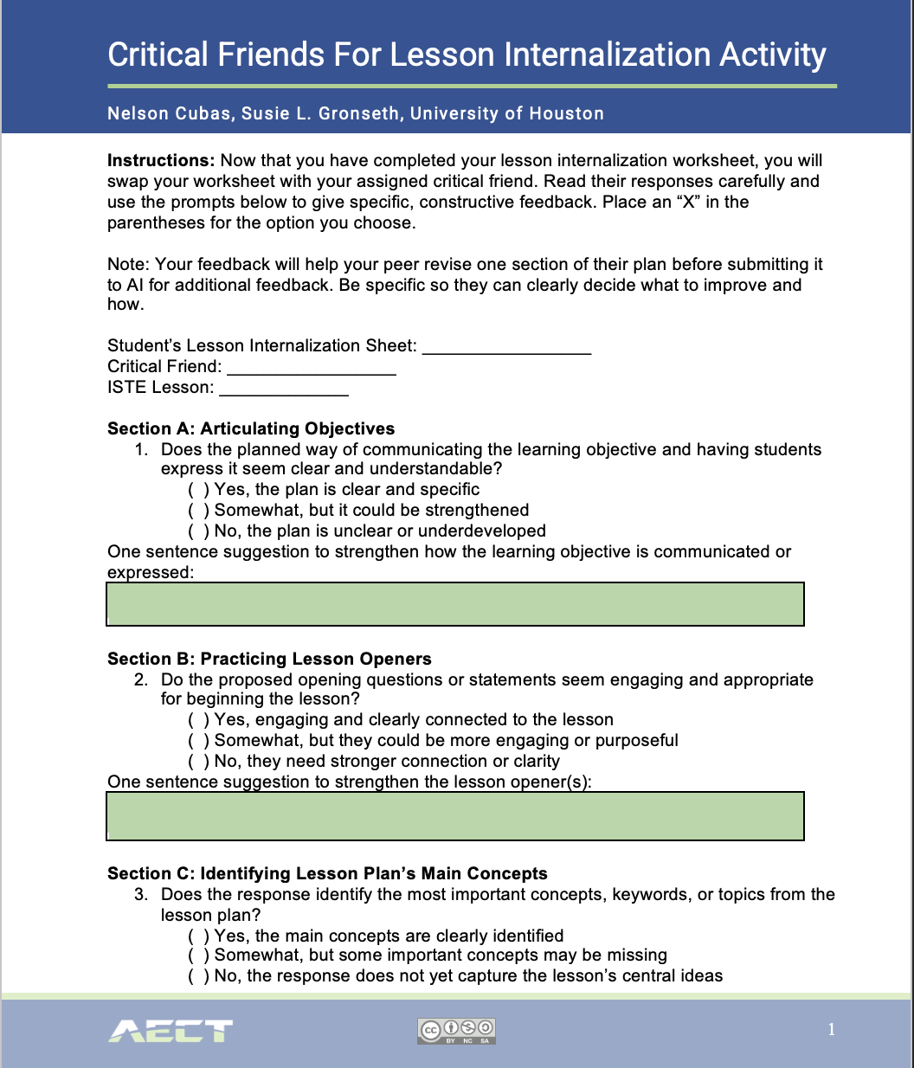
Critical Friends Peer Feedback
After completing your worksheet, swap it with your assigned critical friend.
Read their responses carefully and use the provided prompts to give specific, constructive feedback to improve their sections.

Slide 29
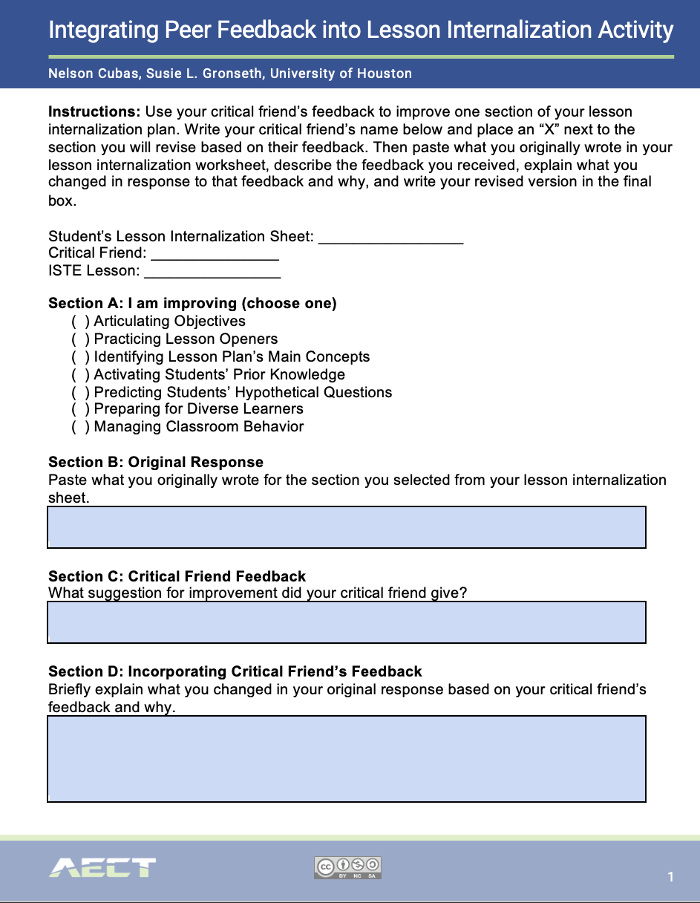
Integrating Peer Feedback Activity
Use your critical friend’s feedback to revise one section of your plan (e.g., objectives, opener, main concepts).
Write your name, critical friend’s name, and selected lesson
Copy your original section from the internalization worksheet.
Record the feedback your critical friend gave
Briefly explain what you changed and why
Rewrite the section in your own words in the final box

Slide 30
Additional Examples of Critical Friend Peer Feedback
Example 1:
“In the explanation section, you mention students will ‘observe reactions,’ but it’s not clear what materials they’ll use. You could add a short example or specify the setup.”
Example 2:
“Your student discussion question is good, but it might be too open. Maybe narrow it so students focus on the main idea, like asking what caused the change they observed.”
Example 3:
“I think your transition to the application phase could be smoother. You could include a short recap or a guiding question to connect both parts.”
Peer Feedback to avoid:
“Looks good!”
“I like it.”
“Seems fine to me.”
These don’t help the partner improve their lesson internalization plan or think critically about their instruction.

Slide 31
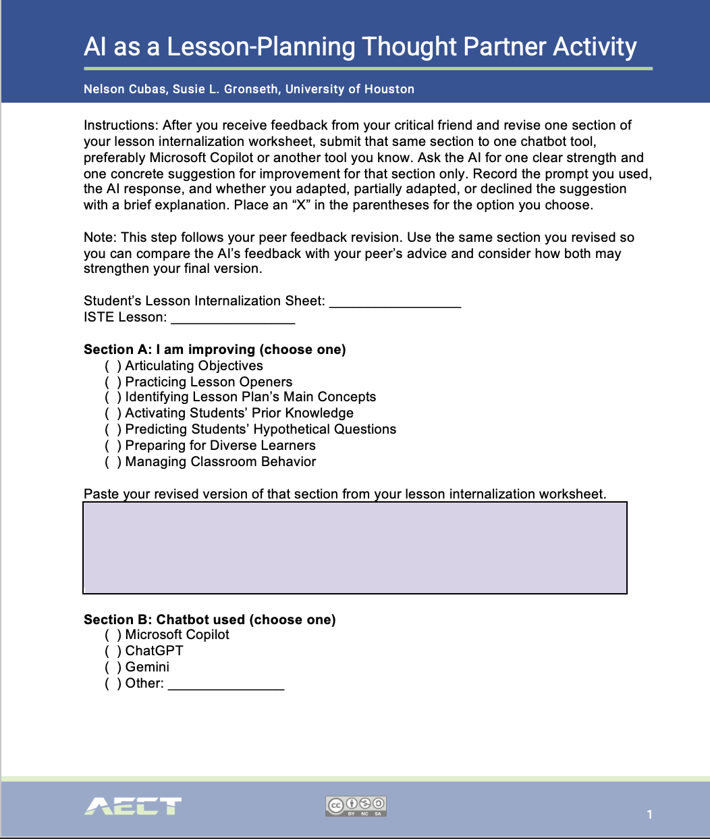
Receiving AI Feedback
After revising one section based on your critical friend’s feedback, submit that same section to a chatbot.
Ask for one clear strength and one concrete suggestion for improvement.
Record your revised section, AI prompt, and full AI response.
Indicate whether you will adapt, partially adapt, or decline the suggestion, and explain why.
Paste your final revised section.

Slide 32
To Earn Credit:
Step 1: Select an ISTE lesson and complete the Lesson Internalization Activity worksheet based on the lesson. Click here to access the worksheet.
Step 2: Complete the Critical Friends for Lesson Internalization Worksheet with your assigned peer. Click here to access the worksheet.
Note * you will turn in the critical friend worksheet that your peer completed based on your lesson worksheet!
Step 3: Complete the Integrating Peer Feedback into Lesson Internalization Activity. Click here to access the worksheet.
Step 4: Complete the AI as a Lesson-Planning Thought Partner Activity. Click here to access the worksheet.
Step 5: Revise your lesson internalization worksheet based on the peer and AI feedback process. Turn in the final version.
How to submit:
Upload all documents together in one Canvas submission.
You can combine them into a single PDF or upload each file separately.
Label clearly:
01_LessonInternalization_Lastname
02_CriticalFriendFeedback_Lastname
03_IntegratingPeerFeedback_Lastname
04_AIThoughtPartner_Lastname

Slide 33
Preparing for the Teaching Simulation
Be early! We will use the full 3 hours and get started at exactly:
  9 am- 12 pm on Wednesday
  5:30 pm- 8:30 pm on Thursday
Each teacher will have about 5-7 minutes.
If teaching in groups, you will have 10-15 minutes.
Our goal is for everyone to have a chance to teach, but we’ll see how time goes.
We’ll start with Volunteers and move on to Volun-tolds.

