Slide 1
CULMINATING PROJECT: HUMAN ACTIVITIES, BIODIVERSITY & ECOSYSTEMS
EXPLORING IMPACTS AND CONNECTIONS WITHIN NATURAL ENVIRONMENTS
Aishat O. Balogun¹ and ²Ajarat O. Balogun
¹Indiana University Bloomington, ²Bloomington High School North
Notes:
---

Slide 2
LEARNING OBJECTIVES
Human Impact on Ecosystems
  Students will analyze how deforestation, urbanization, and industrialization impact biodiversity and ecosystem health.
Environmental Tools and Technologies
  Identify renewable energy, conservation, and restoration technologies that help adapt environments to human needs.
Biodiversity Protection Strategies
  Propose strategies to sustain biodiversity considering ecological, social, and economic factors at various levels.
Notes:
The objectives of this project are multifaceted and aim to deepen students’ understanding of environmental science principles. First, students will analyze how human activities such as deforestation, urbanization, and industrialization affect biodiversity and ecosystem health. Second, they will identify tools and technologies used to adapt and alter environments and natural resources to meet human physical and cultural needs, including renewable energy systems, conservation technologies, and restoration practices. Third, students will propose strategies to protect and sustain biodiversity at local, national, and global levels, considering ecological, social, and economic dimensions. These objectives align with the broader goal of fostering environmental stewardship and equipping students with the skills to evaluate and address complex ecological challenges through informed decision-making and innovative solutions.

Slide 3
GUIDING QUESTIONS AND RESEARCH FOCUS
Notes:
Biome and Ecosystem Description, Human Activities and Threats, Impact of Fragmentation, Pollution, Climate Change, and Invasive Species

Slide 4
BIOME AND ECOSYSTEM DESCRIPTION
Biome Characteristics
  Each biome has unique climate, vegetation, and fauna defining its ecological identity and function.
Ecosystem Identification
  Ecosystems within biomes vary, each supporting distinct communities and ecological processes.
Geographic Distribution
  Biomes and ecosystems are located in specific global regions like Amazon Basin and Congo Basin.
Context for Conservation
  Understanding biomes guides analysis of human impact and conservation strategies for biodiversity.
Notes:
Students will begin by selecting a biome and describing its characteristics, including climate, vegetation, and typical fauna. They should identify various ecosystems within the biome and specify geographic regions where these ecosystems are found globally. This foundational step provides context for understanding biodiversity patterns and ecological interactions. For example, a student choosing the tropical rainforest biome would detail its high rainfall, dense canopy, and species richness, and note regions such as the Amazon Basin, Congo Basin, and Southeast Asia. This description sets the stage for analyzing human impacts and conservation strategies tailored to the selected biome and its ecosystems.

Slide 5
HUMAN ACTIVITIES AND THREATS
Human Activities Threatening Ecosystems
  Deforestation, agricultural expansion, urban development, mining, and pollution threaten species and ecosystem diversity worldwide.
Consequences for Ecosystems
  These activities cause habitat loss, fragmentation, and degradation, which reduce ecosystem resilience and increase species vulnerability.
Biome-Specific Threat Examples
  Logging in rainforests and overfishing in marine ecosystems illustrate how human pressures vary by biome and affect biodiversity.
Importance of Conservation
  Understanding human threats is essential for creating effective conservation strategies and protecting ecological health.
Notes:
Major human activities that threaten species and ecosystem diversity include deforestation, agricultural expansion, urban development, mining, and industrial pollution. These activities lead to habitat loss, fragmentation, and degradation, reducing the resilience of ecosystems and increasing species vulnerability. Students should examine how these pressures manifest in their chosen biome, such as logging in rainforests or overfishing in marine ecosystems. Understanding these threats is critical for developing effective conservation strategies and highlights the interconnectedness of human actions and ecological health.

Slide 6
IMPACT OF FRAGMENTATION, POLLUTION, CLIMATE CHANGE, AND INVASIVE SPECIES
Habitat Fragmentation Effects
  Fragmentation isolates ecosystems, disrupting species migration and genetic exchange, weakening biodiversity resilience.
Pollution Impact
  Chemical runoff and plastic waste contaminate soil and water, harming organisms and nutrient cycles.
Climate Change Effects
  Shifts in temperature and precipitation cause species range shifts and increase extinction risks.
Invasive Species Challenges
  Invasive species outcompete natives, altering ecosystem dynamics and accelerating biodiversity loss.
Notes:
Habitat fragmentation divides ecosystems into smaller, isolated patches, disrupting species migration and genetic exchange. Pollution, including chemical runoff and plastic waste, contaminates soil and water, harming organisms and altering nutrient cycles. Climate change exacerbates these issues by shifting temperature and precipitation patterns, leading to species range shifts and increased extinction risk. Invasive species further compound biodiversity loss by outcompeting native species and altering ecosystem dynamics. Students should provide examples relevant to their biome, such as coral bleaching in marine ecosystems or invasive plants in grasslands, to illustrate these complex interactions.

Slide 7
CONSERVATION STRATEGIES AND RESTORATION PRACTICES
Notes:
Strategies to Sustain Biodiversity, Restoration Projects and Community Involvement

Slide 8
STRATEGIES TO SUSTAIN BIODIVERSITY
Local Conservation Efforts
  Local strategies include habitat restoration, community-led conservation, and sustainable agriculture practices.
National Environmental Policies
  National strategies involve protected areas, environmental regulations, and renewable energy promotion.
Global Biodiversity Initiatives
  Global efforts focus on international treaties, biodiversity monitoring, and climate change mitigation.
Collaborative Conservation
  Collaboration among governments, NGOs, and communities is essential for effective biodiversity conservation.
Notes:
Effective strategies for sustaining biodiversity operate at multiple scales. Locally, initiatives may include habitat restoration, community-led conservation, and sustainable agriculture. National strategies often involve establishing protected areas, enforcing environmental regulations, and promoting renewable energy. Globally, efforts include international treaties, biodiversity monitoring, and climate change mitigation. Students should explore how these strategies apply to their selected biome, emphasizing the role of collaboration among governments, NGOs, and local communities in achieving conservation goals.

Slide 9
RESTORATION PROJECTS AND COMMUNITY INVOLVEMENT
Ecosystem Rehabilitation Efforts
  Restoration projects include reforestation, wetland reconstruction, and species reintroduction to restore degraded ecosystems.
Community Participation
  Local communities contribute essential knowledge, labor, and stewardship for successful restoration projects.
Protected Areas and Education
  Protected areas preserve biodiversity while educational programs raise awareness and encourage participation.
Student Engagement
  Students analyze local restoration projects to understand contributions to ecosystem resilience and sustainability.
Notes:
Restoration projects aim to rehabilitate degraded ecosystems through actions such as reforestation, wetland reconstruction, and species reintroduction. Community involvement is essential for long-term success, as local stakeholders provide knowledge, labor, and stewardship. Protected areas serve as refuges for biodiversity, while educational programs foster environmental awareness and participation. Students should identify existing projects within their biome and analyze how these initiatives contribute to ecosystem resilience and sustainability.

Slide 10
ROLES OF KEY SPECIES AND INDIVIDUAL ACTIONS
Notes:
Keystone, Indicator, and Umbrella Species, Reducing Ecological Footprints

Slide 11
KEYSTONE, INDICATOR, AND UMBRELLA SPECIES
Keystone Species Impact
  Keystone species have a disproportionate effect on ecosystem balance, like wolves controlling prey populations.
Indicator Species Role
  Indicator species reflect environmental health, such as amphibians signaling water quality in habitats.
Umbrella Species Conservation
  Umbrella species require large habitats, and protecting them benefits many other species in the ecosystem.
Notes:
Keystone species exert a disproportionate influence on ecosystem structure and function, such as wolves regulating prey populations in forests. Indicator species signal environmental health, like amphibians reflecting water quality. Umbrella species require large habitats, and their protection benefits numerous other species. Understanding these roles helps prioritize conservation efforts and maintain ecological balance. Students should provide examples from their chosen biome to illustrate these concepts.

Slide 12
REDUCING ECOLOGICAL FOOTPRINTS
Minimizing Resource Consumption
Reducing use of natural resources helps decrease ecological footprints and promotes sustainable living.
Promoting Sustainable Diets and Waste Reduction
Adopting sustainable diets and reducing waste supports biodiversity and lowers environmental impact.
Supporting Conservation and Habitat Restoration
Participating in conservation efforts and habitat restoration helps maintain ecosystem health and biodiversity.
Notes:
Individuals and communities can reduce their ecological footprint through actions such as minimizing resource consumption, adopting sustainable diets, reducing waste, and supporting conservation initiatives. In the context of the selected biome, strategies may include promoting ecotourism, reducing deforestation drivers, and participating in habitat restoration. These efforts collectively contribute to biodiversity conservation and ecosystem health, reinforcing the importance of personal responsibility in global environmental stewardship.

Slide 13
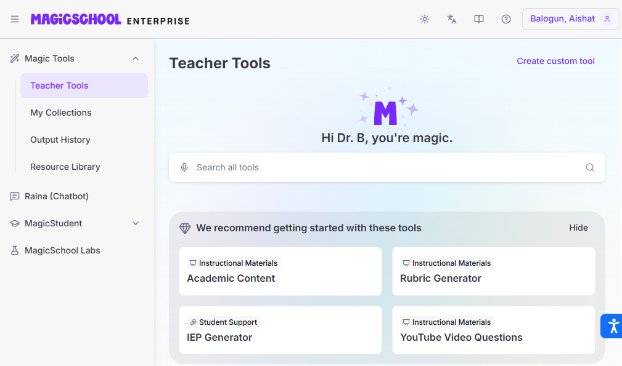
Introduce & Sign in to magic school AI

Slide 14

Option for Student to sign in and join

Slide 15
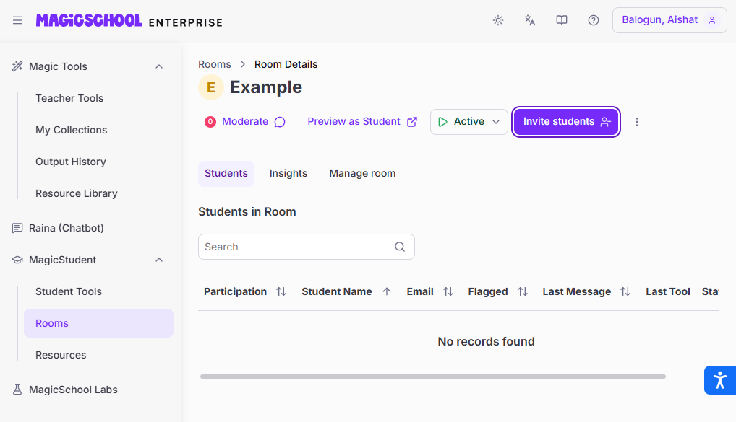
Sign in to magic school AI

Slide 16
Room View

Slide 17
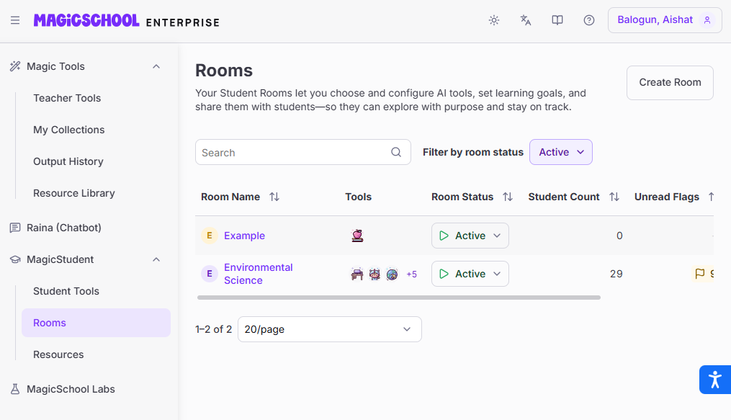
Rooms

Slide 18
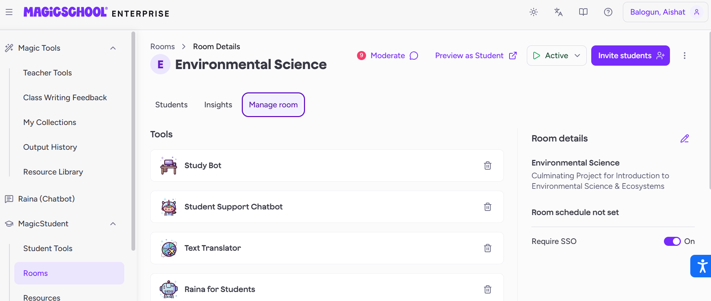
Review AI tools

Slide 19
PROJECT OVERVIEW AND OBJECTIVES
Notes:
Project Overview, Learning Objectives

Slide 20
PROJECT OVERVIEW
Project Purpose and Focus
  The project integrates course knowledge to explore human impact on biodiversity and ecosystem sustainability.
Multimedia Deliverables
  Students create presentations, scripts, posters, and reflection tables using technology tools to express findings.
Skills Developed
  The project promotes critical thinking, collaboration, respectful discussion, and logical reasoning.
Real-World Application
  Students apply environmental concepts to real ecosystems using evidence and AI-assisted multimedia tools.
Notes:
The culminating project for Introduction to Environmental Science and Ecosystems is designed to integrate knowledge gained throughout the course into a comprehensive, creative, and research-based activity. Students will explore how human activities influence biodiversity and ecosystems, and identify strategies to protect and sustain them. The project emphasizes critical thinking, collaboration, and the use of technology tools to present findings in multiple formats. Deliverables include a Google Slides presentation, a science fiction movie script, a media poster, and a technology reflection table. Students are expected to use evidence from class materials and real-world examples, respect differing opinions, and maintain focus on the topic while supporting ideas with logical reasoning. This project encourages students to apply environmental science concepts to real-world ecosystems and communicate their ideas effectively through multimedia and AI-assisted tools.

Slide 21
PROJECT DELIVERABLES AND TECHNOLOGY INTEGRATION
Notes:
Presentation and Creative Components, Technology Tools and Reflection

Slide 22
PRESENTATION AND CREATIVE COMPONENTS
Cohesive Presentation
Students create Google Slides presentations that tell a cohesive story addressing guiding questions.
Science Fiction Script
Developing a sci-fi movie script integrating ecosystem challenges, human impacts, and sustainability themes.
Visual Poster Design
Designing engaging movie promotional posters using graphic design tools like Canva or Pixlr.
Notes:
Students will create a Google Slides presentation addressing all guiding questions, ensuring it is a cohesive narrative rather than a simple Q&A format. Additionally, they will develop a science fiction movie script using MagicSchool AI, incorporating ecosystem challenges, human impacts, and sustainability strategies into the storyline. A visually engaging poster will be designed using Canva or Pixlr to promote the movie concept. These creative components encourage students to synthesize scientific knowledge with storytelling and design skills.

Slide 23
TECHNOLOGY TOOLS AND REFLECTION
Use of Diverse Technology Tools
  Students use AI for script writing, slide software for presentations, and graphic tools for poster creation.
Documentation and Reflection
  Students document tool usage, prompts applied, and outputs in a summary table to reflect on their experience.
Fostering Digital Literacy
  The reflection process enhances critical evaluation of AI-assisted learning, highlighting both strengths and limitations.
Notes:
The project requires students to utilize various technology tools, including MagicSchool AI for script generation, Google Slides for presentations, and Canva or Pixlr for poster design. Students must document how each tool was used, the prompts or queries applied, and the resulting products in a summary table. This reflection fosters digital literacy and critical evaluation of AI-assisted learning, ensuring students understand both the capabilities and limitations of these technologies in academic and creative contexts.

