Slide 1
AI Edu 4 Children Curriculum
Slides Templates
Sohheon Yangª and Anne Winiger^{b}
ªIndiana University
^{b}A Public Elementary School

Slide 2
Let’s Explore Technology Words!
Add a relevant image here for a title page.

Slide 3
Camera
Add a relevant image here.

Slide 4
Camcorder (Video Camera)
Add a relevant image here.

Slide 5
Tripod
Add a relevant image here.

Slide 6
Microphone
Add a relevant image here.

Slide 7
Voice Recorder
Add a relevant image here.

Slide 8
Computer
A machine that helps people find information, write, draw, play games, and do many other tasks.
Add a relevant image here.

Slide 9
Laptop
A small computer that folds and can be carried around easily.
Add a relevant image here.

Slide 10
Phone
A device used to talk to people, send messages, take pictures, and use apps.
Add a relevant image here.

Slide 11
Tablet
A touchscreen computer that is smaller than a laptop but bigger than a phone, used for learning, playing, and watching videos.
Add a relevant image here.

Slide 12
Television (TV)
A screen that shows movies, cartoons, news, and other programs for people to watch.
Add a relevant image here.

Slide 13
Speaker
A device that plays sound or music so people can hear it louder.
Add a relevant image here.

Slide 14
Robot
A machine that can move and follow instructions to help people or do special jobs.
Add a relevant image here.

Slide 15
Device Care
"It's important to value your and others' belongings and treat them well."

Slide 16
Device Care
“How do we take care of our devices?”

Slide 17
Clean Hands, Happy Devices
Add a relevant image here.
Why should we have clean hands before touching a tablet or laptop?

Slide 18
Gentle Hands, No Ouchies
Add a relevant image here.
What happens if we drop a tablet or press too hard on a screen?

Slide 19
Charging is Important
Add a relevant image here.
What happens if we forget to charge a device?

Slide 20
Safe Places Only
Add a relevant image here.
Where should we put a tablet when we are not using it?”

Slide 21
Ask Before Downloading or Clicking
Add a relevant image here.
Should we press buttons or download things without asking a teacher or parent?

Slide 22
Care
When you make sure something or someone is safe and well.

Slide 23
Responsibility
A duty you have to yourself or others.

Slide 24
Circle Time
“What is a map? Have you seen a map before? Why do people use maps? If you could make a map, what kind of map do you want to create?”

Slide 25
What is a Map
Add a relevant image here.
A map is a picture that shows where things are.
It can show places like your house, school, park, or zoo!
A map helps us find where to go and see where things are.

Slide 26
World Map
Add a relevant image here.

Slide 27
The United States Map
Add a relevant image here.

Slide 28
Indiana Tourism Map
Add a relevant image here.

Slide 29
Online Map (Our Kindergarten)
Add a relevant image here.

Slide 30
Zoo Map
This can be any other maps that your students might feel interested.
Add a relevant image here.

Slide 31
What do we think about when we make a map?
What places do we want to put on the map?
Where do those places go? Are they close or far from each other?
Which way are things facing—up, down, left, or right?
We use pictures or symbols to show the places!
Add a relevant image here.

Slide 32
We will make an animal map!

Slide 33
Do we draw everything in a map?

Slide 34
When we make a map, we don’t draw every little detail.
We only show the most important parts so it’s easy to read.

Slide 35
Let’s say we want to draw a cheetah on the map—what’s the most important feature to show so we know it’s a cheetah?
How do we recognize a cheetah as a cheetah?

Slide 36
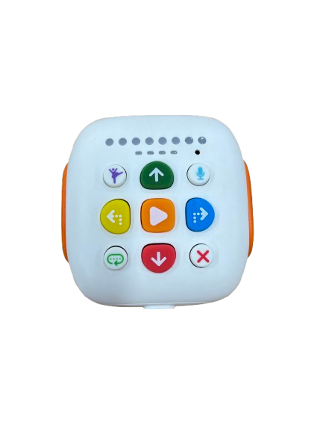
Circle Time
“What did you like about the Tale-Bots, and what was difficult when you played with the Tale-Bots?”

Slide 37
Add a symbol in a map here.
Yesterday, we explored map together.
What does this mean?

Slide 38
Add a symbol in a classroom/school here.
Create enough slides to discuss about different symbols around us.
What does this mean?

Slide 39
A symbol is a picture, shape, or sign that stands for something else.

Slide 40
Computers and robots don't have hearts or minds like we do. They don't understand things on their own. Instead, they follow special signals called symbols. A symbol is like a secret code that tells the computer exactly what to do based on our rules

Slide 41
Can you find any symbols in the classroom or in your daily life?

Slide 42
Tale-bots also have symbols!

Slide 43
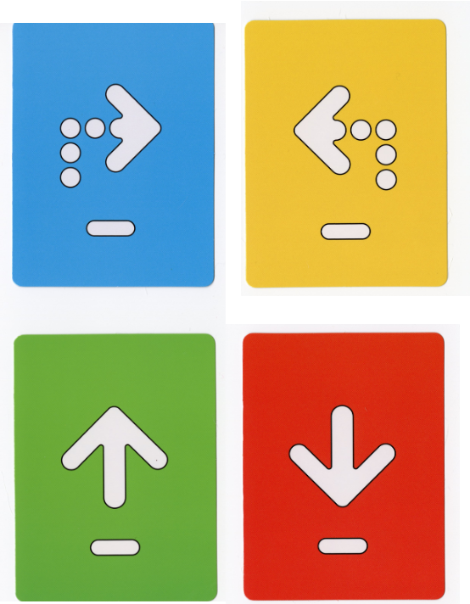
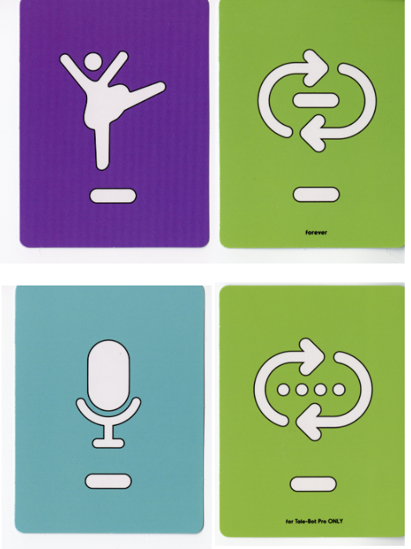
Tale-bots and Symbols
(Use these images to talk about symbols in Tale-Bots)

Slide 44
Circle Time
“Let’s think about how amazing our brains are!”
What do you love to do the most?
What cool things can your brain help you do?
What are you really good at?

Slide 45
Tale-Bot can’t actually learn, but some machines, robots, or computers can learn in a special way by collecting lots of examples.

Slide 46
We call it artificial intelligence, or AI.
What does “artificial” mean?
Can you guess?

Slide 47
Artificial: Made to copy something natural; not real; made by people

Slide 48
Add an image of flowers in nature.
Add an image of artificial flowers.

Slide 49
Add an image of apples in nature.
Add an image of artificial apples (plastic apples).

Slide 50
What does “intelligence” mean?
Can you guess?

Slide 51
Intelligence: the ability to learn, understand, and make judgments or have opinions that are based on reason

Slide 52
What can we do with our brain?

Slide 53
What can we do with our brain?
Our brain helps us do so many things!
We can think, learn, and solve problems.
We can remember fun times and imagine new ideas.
Our brain helps us talk, listen, and understand others.
It also tells our body when to move, eat, or sleep.
Our brain is like a super helper inside our head!

Slide 54
AI is everywhere!
What can it do?
Add many images of AI in your students’ daily lives.

Slide 55
Some children have questions about AI. If you can ask questions and try to find answers, you’re a scientist.
We’ve already found some answers, and we’ll keep figuring out what you’re curious about with AI!

Slide 56
(List students’ questions here.)

Slide 57
Create a Song with AI
What did you do to create a song?
What did your teacher do to create a song?
What did AI technology do?

Slide 58
Circle Time
“What do you do with your five senses—eyes, nose, ears, tongue, and skin?”

Slide 59
Can AI see us? What do you think?
What do we need to see things around us?

Slide 60
AI sees the world through a camera.
Add a relevant image here.

Slide 61
Scroobly
Today, we will create our own brain break video with AI!
Scroobly uses a camera sensor to watch how we move, and it can help our character copy us. You can choose a character—or even make your own!

Slide 62
Circle Time
“How do you learn something new — like tying your shoes or drawing a cat? And how do you think AI learns to do something?”

Slide 63
Auto Draw
Identify the patterns and make a guess!

Slide 64
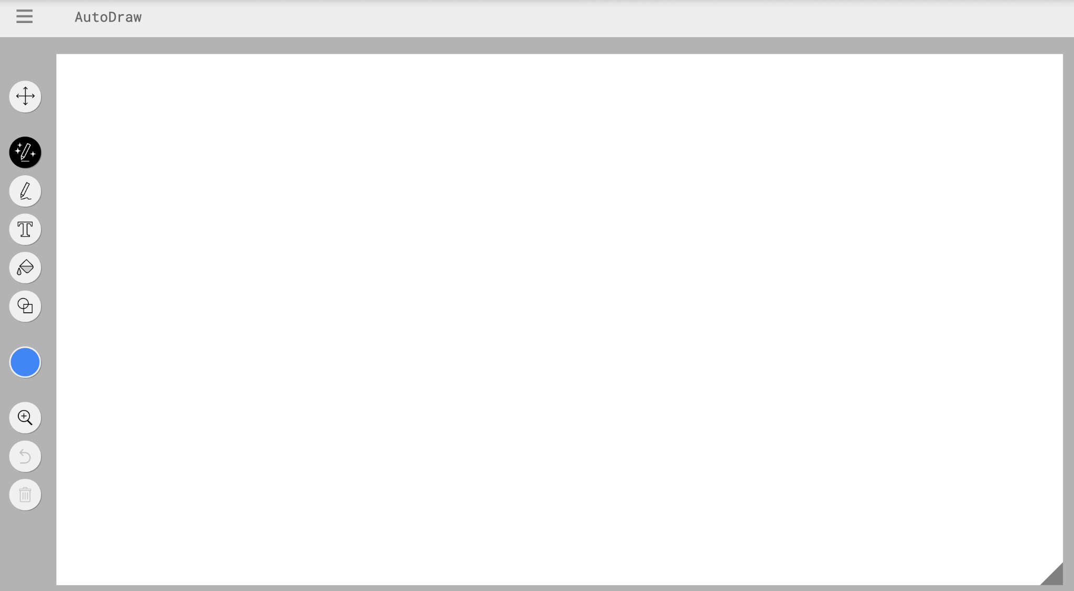
Auto Draw
Let’s guess how and why the AI made a prediction based on what I was drawing.

Slide 65
Auto Draw
We’ll talk about how AI can be fun, but sometimes it gets things wrong or doesn’t understand what we meant.
That’s why it’s important to always check (verify) what the AI made!

Slide 66
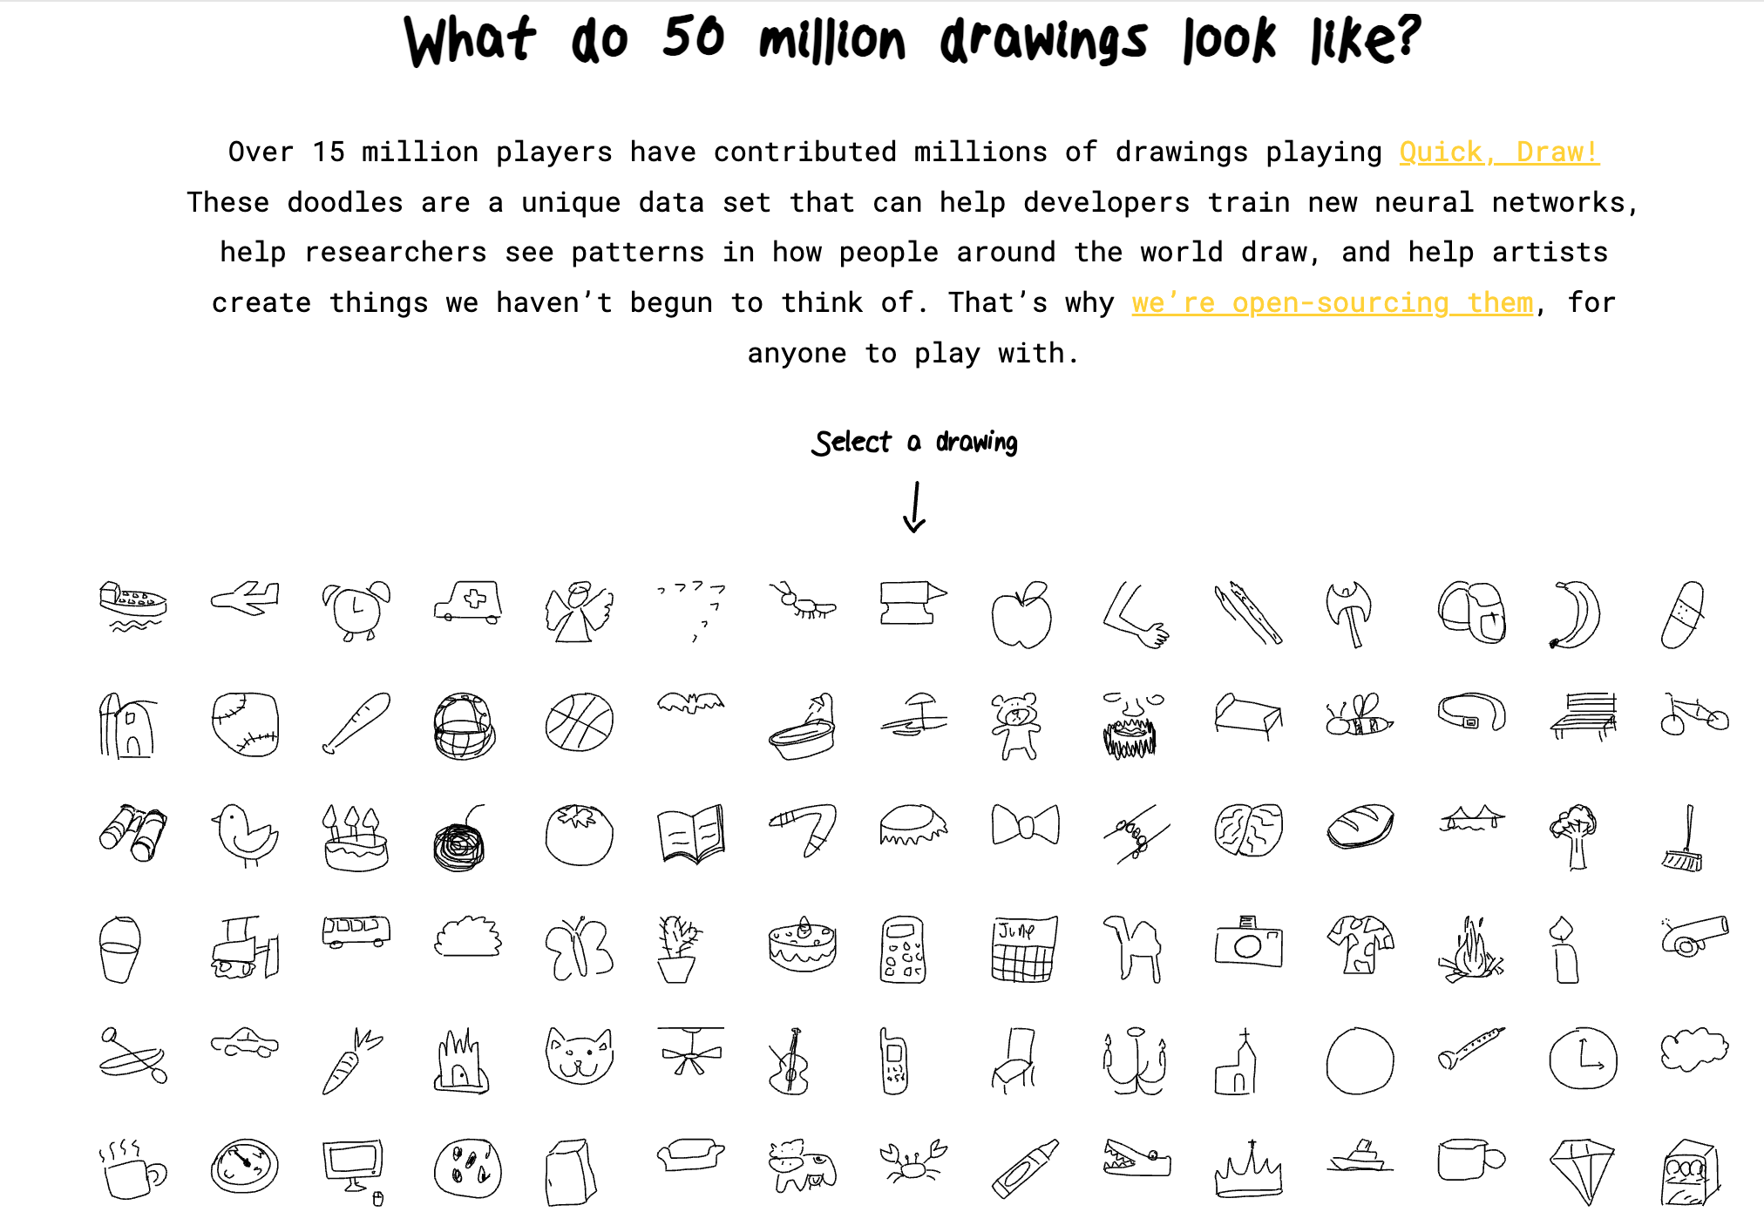
Quick Draw
Lots of doodles to teach AI!
We’ll look at how many pictures the AI needs to learn from—that helps it get better at guessing!

Slide 67
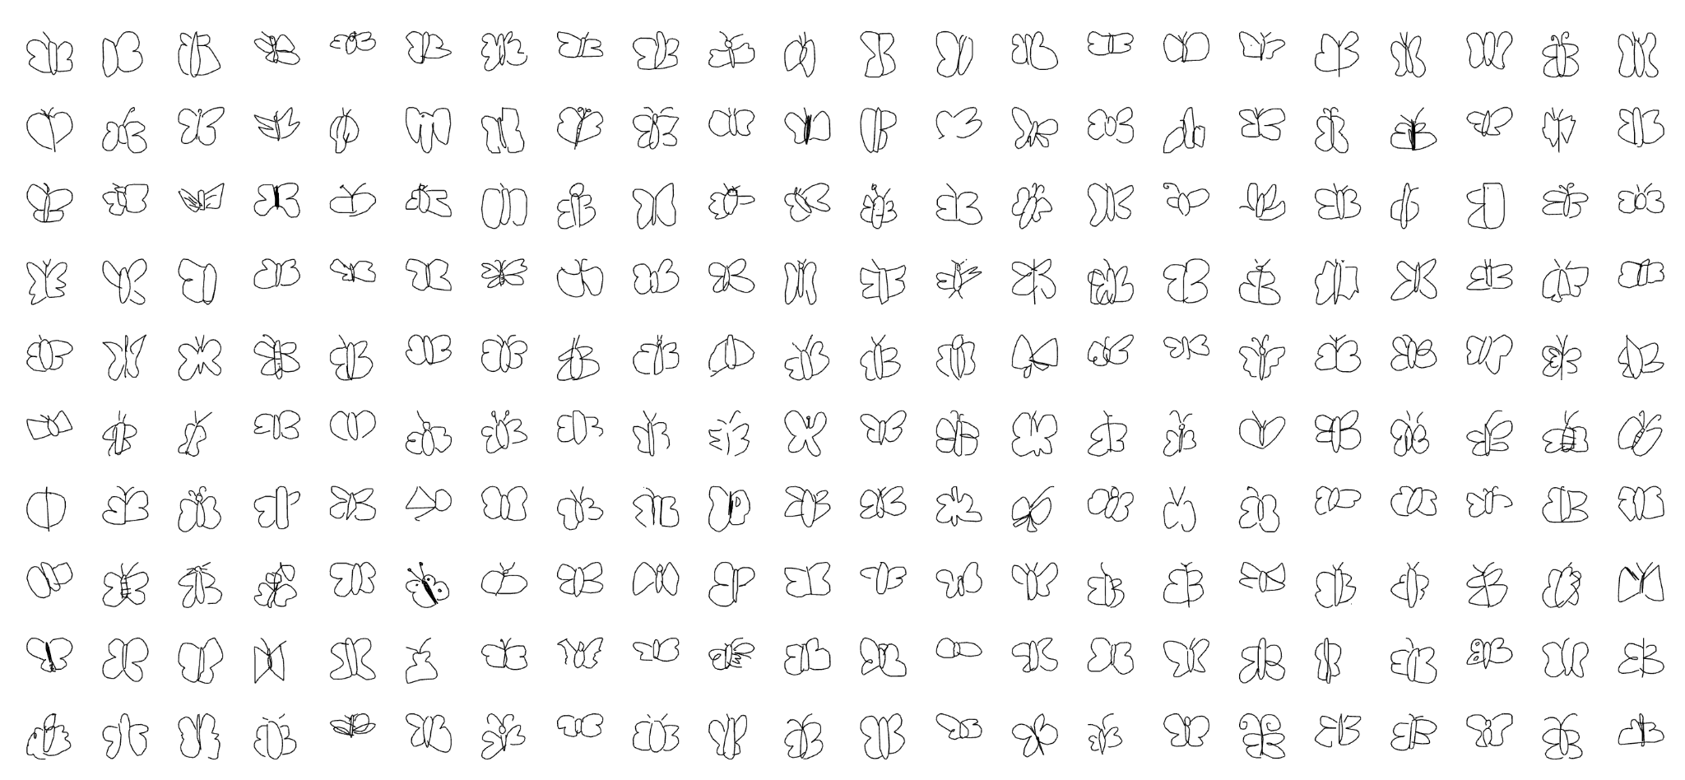
Quick Draw
It’s important to give the AI:
1) enough pictures, and
2) good quality pictures (lots of different kinds of pictures).

Slide 68
We can make an AI machine that learns from lots of examples!
What do you want to teach AI to tell the difference between?

Slide 69
AI is a pattern learner, not a magic brain.
We are the teachers of AI!

Slide 70
Circle Time
Can you think of a time when AI technology could help us — and a time when we should do something ourselves?

Slide 71
Yesterday, we talked about…
We can make an AI machine that learns from lots of examples.
People can teach AI to make smart guesses and help with sorting things.

Slide 72
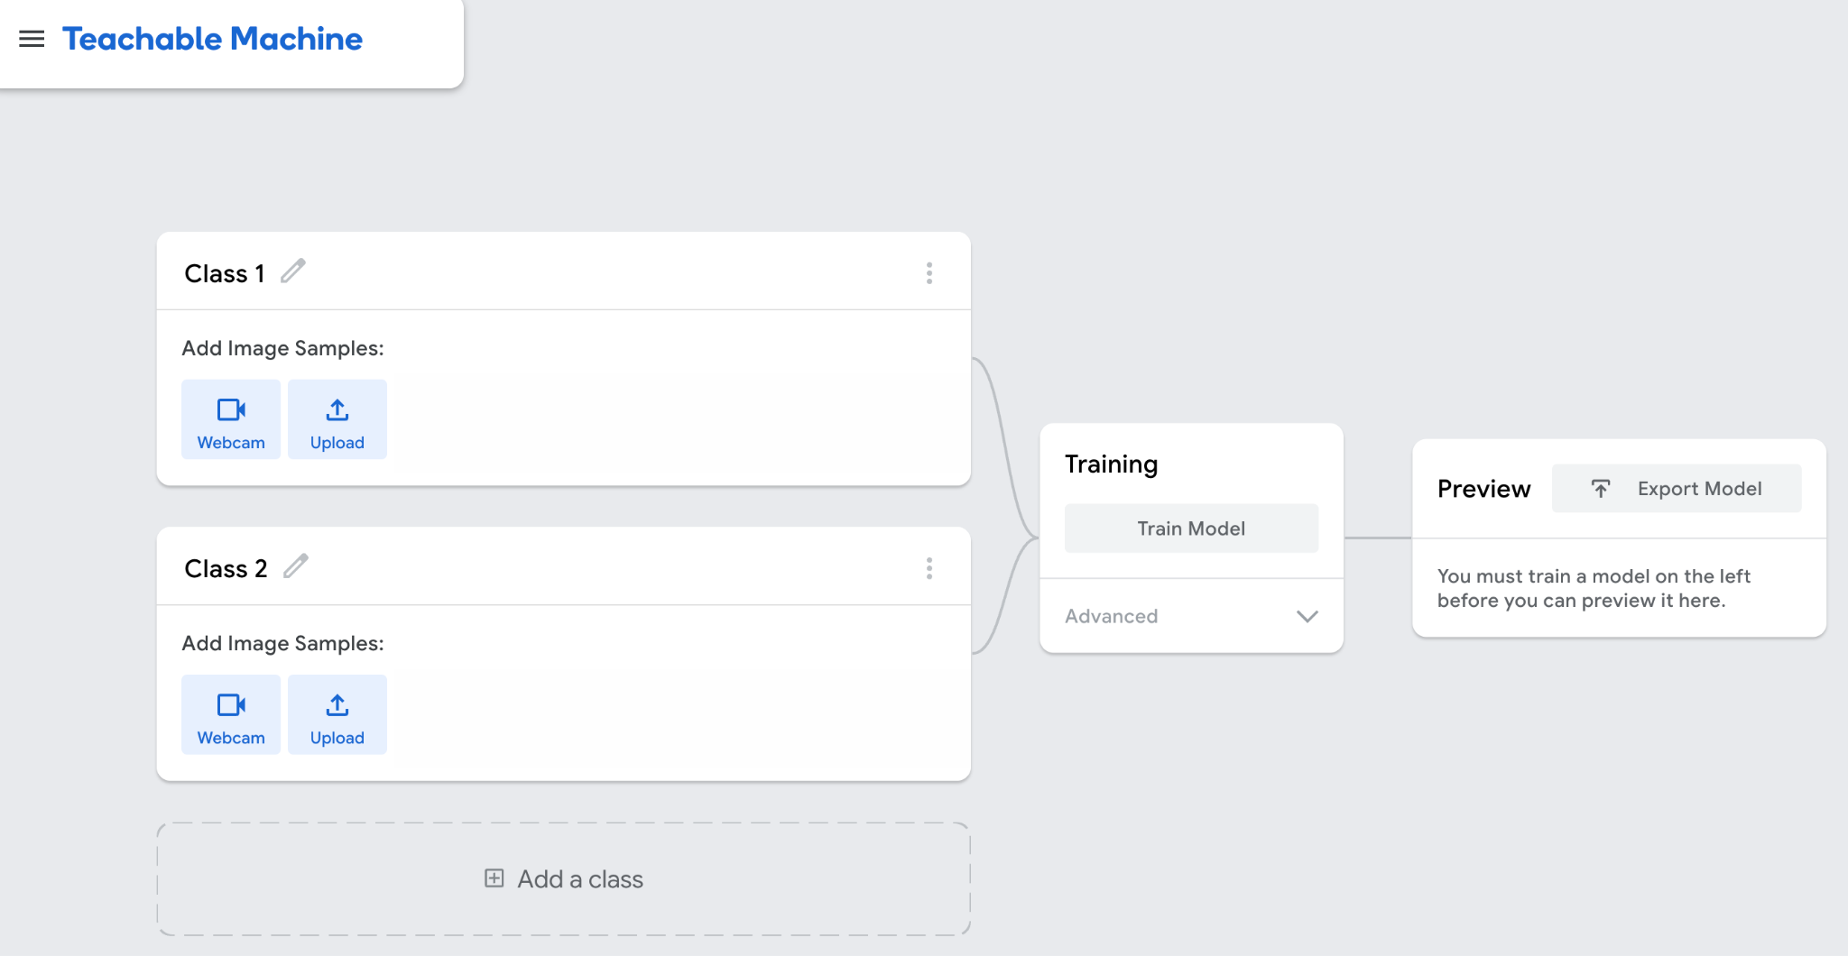
Let’s make our own AI machine!

Slide 73
You are a thinker! (Verification)
Add a relevant image here.
Add a relevant image here.
“Hmm… is AI guessing right?”
“Let’s check with our human brains!”

Slide 74
Protect yourself and others! (Data privacy)
Add a relevant image here.
Have you ever used a camera filter on an app? There are lots of AI filters! AI filters can find your eyes, nose, and mouth by learning from many examples. What is your favorite filter?

Slide 75
Protect yourself and others! (Data privacy)
Add a relevant image here.
AI helps make fun things happen in a camera app.
Filters, face effects, and sounds work because AI sees patterns (like faces or movements).
AI can guess what to do based on what it sees (like adding dog ears to a face).

Slide 76
Protect yourself and others! (Data privacy)
Add a relevant image here.
What should we be careful about when we take pictures of ourselves or others?
What should we do before sharing them with lots of people?

Slide 77
Simple Privacy Tips
❌ “Your face and voice are special. Keep your name and face safe. No name, no face, no address!”
📸 “You should ask for permission from someone to take a picture of them.”
🙅 “You can say no if you don’t want to be in a picture or video.”
🛑 “Not everything we do needs to be shared. Ask adults before you post!”
🧑‍🏫 “Tell a grown-up if something feels weird or not nice.”

Slide 78
Simple Privacy Tips
🧑‍💻 Ask a Grown-Up First
Before you use any type of technology, always ask a grown-up you trust. Different families have different rules!
📱 Not Too Much Screen Time
Children ages 6 and older: Establish personal screen time limits that ensure that media does not interfere with sleep, exercise or other healthy behaviors. (1-2 hours per day)
📤 Think Before You Share
Before you send a picture, video, or message, ask:
"Is this just for my family?"
"Do I want other people to see this?"
“Is it kind? Is it true? Is it safe for me and you?”
🛡️ Be Smart. Be Safe.
We keep ourselves safe by thinking before we click or share — and by talking to a grown-up if we’re not sure.

