Slide 1
AI & Ethics
Ernest Anderson, Towson University

Slide 2
Icebreaker
Please take a moment to answer at least one of these questions on a sticky note & add it to the wall.
Option 1: What is one thing you already know about AI & Ethics?
  This can be something you have read about or learned in class, or an example of how you personally have used an AI tool.
Option 2: What is one thing you want to know about AI & Ethics?
  This can be something practical, an ethical concern, something you’re curious about - anything you want.

Slide 3
Terminology, pt. 1
Generative AI
  an AI tool that can create original output as a response to users' prompts/requests based on patterns the AI learned from its training data
  output types can include text, images, video, audio, and more
(Definitions adapted from Lacy & Chedraoui, 2025 and Stryker & Scapicchio, 2024.)

Slide 4
Terminology, pt. 2
Large Language Model (LLM)
  a type of foundation model that is the basis for many GenAI systems.
  LLMs are trained on huge volumes of raw data and learn from data patterns (ex. the next word in a sentence)
Chatbots
  the interface through which users typically interact with a LLM. Chatbots are designed to create output to match users' prompts.
  examples: ChatGPT, Claude, Copilot, Gemini, Llama

Slide 5
Important Notes
AI is not intelligent.
  Although language models are good at mimicking human writing, they are not truly thinking for themselves. They are replicating patterns and creating “average” output to match users’ prompts.
AI is not truthful.
  AI tools only know what they have learned from their training data. That is their only basis of “reality,” and it does not always line up with the real world. Models can (and do) draw unexpected or false conclusions.

Slide 6
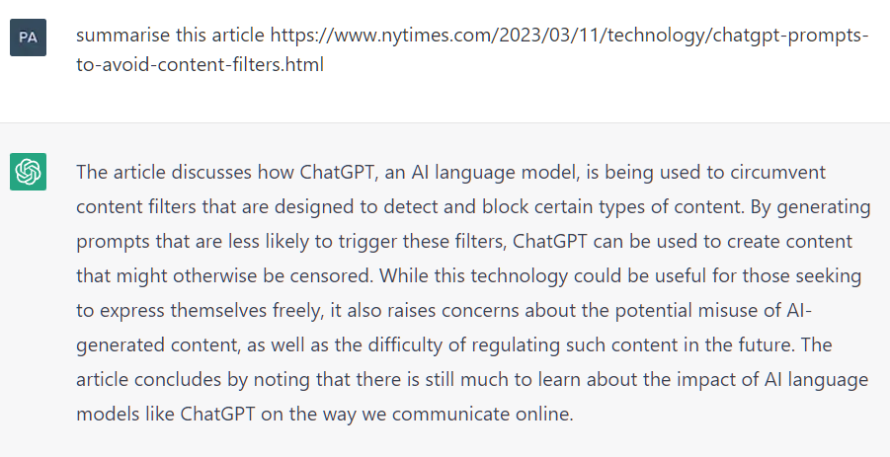
Confabulation
(Often called “Hallucination”)
The tendency of chatbots and other GenAI tools to:
Deliver false information with the same confidence as real facts
Produce fake references/sources or mis-cite real sources
Oversimplify or draw incorrect conclusions when summarizing
The article summarized in the image (right) does not exist.
Yilku1. (2023). ChatGPT hallucination. Wikimedia Commons.

Slide 7
How AI Learns, Pt. 1
1: Dataset Assembly
  Programmers assemble as much data as they can of the type they want the AI model to reproduce (ex. text, photos, code).
  Datasets are often cleaned to remove irrelevant or inappropriate content.
2: Data Labeling
  Supervised learning: human data workers must provide context for items in a dataset.
  Unsupervised learning: the program identifies patterns in unlabeled data.
Adapted from Brown (MIT Sloan, 2021)

Slide 8
How AI Learns, pt. 2
3: Pattern Finding
  The program detects patterns and learns to make predictions based on what is included in its data.
  Programmers can fine-tune accuracy during this time.
4: Reinforcement Learning,
  Programmers (or users of an AI tool after it is deployed) identify good output vs bad output to teach the model to be more accurate.
Adapted from Brown (MIT Sloan, 2021)

Slide 9
AI Learning Discussion
Pick a stage of the AI learning process from the previous slide.
With your group, discuss areas that require extra caution within that learning stage. Be ready to report out.
Starter topics:
Data sources (copyright, privacy, inclusion/ exclusion)
Labor issues
Environmental concerns
Risk of bias
Accuracy vs errors

Slide 10
Two Case Studies in Bias & Efficiency*, pt. 1
A medical AI designed to categorize photographs of skin cancer lesions as either malignant or benign was much more efficient at detecting malignant lesions than expected.
A medical algorithm designed to determine patients’ health risk during hospital stays assigned lower risk levels to Black patients even if they were sicker than their white peers at the same risk level.
Notes:
We are taking a step away from Generative AI to discuss two medical AI systems. Why? Because they provide good examples of the kind of reasoning errors machine learning systems can make, and how humans can fail to notice them. Also, both tools have been studied in-depth in a way that we don’t often get to see with commercial generative AI products that are both 1) proprietary (companies don’t want their competitors knowing how their products work) and 2) built on a much larger scale than a predictive algorithm made to do one kind of specific task.

Slide 11
Two Case Studies in Bias & Efficiency*, pt. 2
In both cases, the AI learned an unexpected “shortcut” pattern
Case 1: Narla et al., 2018:
  Because malignant lesions grow quickly, they are often photographed beside rulers to track their size. The model learned that “ruler in photo” = “malignant lesion”
Case 2:
Obermeyer et al., 2019:
  The model had been trained on public health data, including healthcare spending along demographic lines.
  It learned that “lower spending” = “less likely to get sick”

Slide 12
Ethics Discussion, pt. 1
What questions would you need to answer before you would use an AI tool in your academic work?
Discuss with your group and report back. Use these questions as jumping off points or think of your own.
Privacy & Security
  Who can access the output of an AI model?
  Would I need to share sensitive information with this tool to use it?
Intellectual Property
  Who owns the data that was used to create a dataset?
  Was this data obtained with their permission (or knowledge)?
  Who owns the output?

Slide 13
Ethics Discussion, pt. 2
Errors/Confabulation
  Am I able to “check the AI’s work” to see if it is wrong?
  How does the model approach complex questions with nuanced answers?
Bias
  Does the AI model replicate harmful patterns?
  Are outputs unequal between different populations?
  Is the model answering a different question than it was asked?
Environmental Impact
  How much water and electricity were used to train the model?
  Does the model rely on data centers that strain local infrastructure?
Responsibility
  Which parts of my task(s) are being done by, or in collaboration with, AI?
  How can I make sure AI is supporting my learning instead of interrupting it?

Slide 14
References
Brown, S. (2021, April 21). Machine learning, explained. MIT Sloan. https://mitsloan.mit.edu/ideas-made-to-matter/machine-learning-explained
Lacy, L. & Chedraoui, K. (2025, May 31). LLMs and AI aren’t the same. Everything you should know about what’s behind chatbots. CNET. https://www.cnet.com/tech/services-and-software/llms-and-ai-arent-the-same-everything-you-should-know-about-whats-behind-chatbots/
Obermeyer, Z., Powers, B., Vogeli, C., & Mullainathan, S. (2019). Dissecting racial bias in an algorithm used to manage the health of populations. Science (American Association for the Advancement of Science), 366(6464), 447–453. https://doi.org/10.1126/science.aax2342
Narla, A., Kuprel, B., Sarin, K., Novoa, R., & Ko, J. (2018). Automated classification of skin lesions: From pixels to practice. Journal of Investigative Dermatology, 138(10), 2108–2110. https://doi.org/10.1016/j.jid.2018.06.175
Stryker, C., & Scapicchio, M. (2024, March 22). What is generative AI? IBM Think. https://www.ibm.com/think/topics/generative-ai

