Slide 1
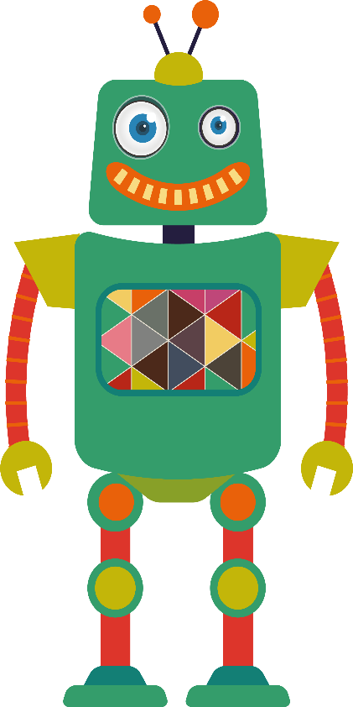
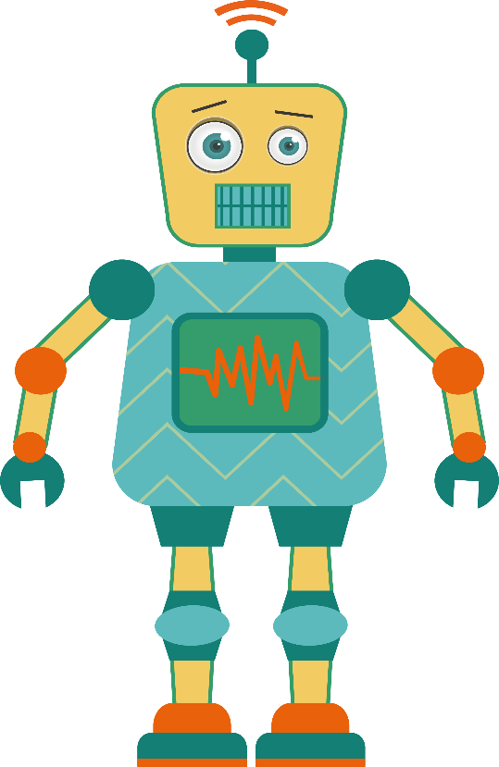
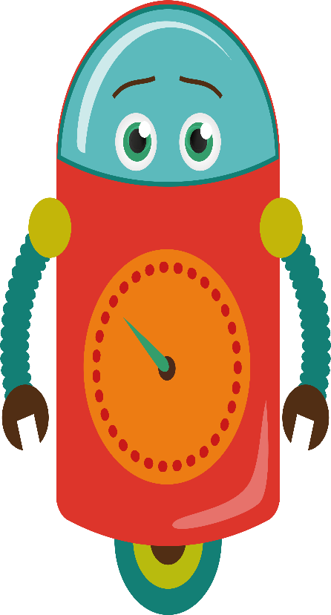
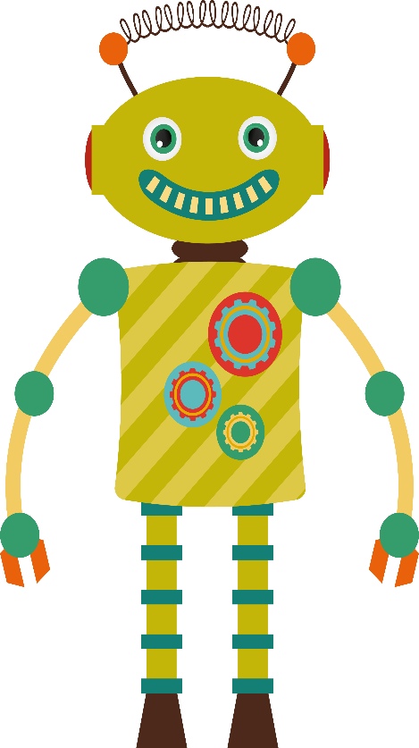
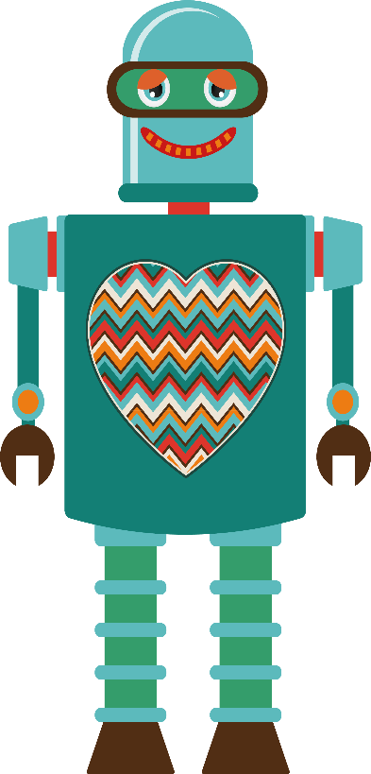
The Changing Landscape of Doctoral Education: Ethics and AI
Identifying Ethical Risks & Blind Spots in Academic AI Use
Sara G. McNeil, University of Houston
Notes:
Today, we're diving into one of the most important issues in doctoral education: how to use AI ethically and effectively in your research journey. You'll notice I have some 'friends' with me today – these AI personas represent the different ways you might interact with AI during your doctoral work.

Slide 2
In a few words, describe your biggest concern about using AI in your doctoral work.
Join by Web
PollEv.com​/saramcneil364
Join by Text
To: 37607
Message: saramcneil364 and your message
Notes:
Before we start, I want to hear from YOU. Please take out your phones and join our poll. You can go to PollEv.com/saramcneil364 or text 'saramcneil364' plus your message to 37607.
The question is: In a few words, describe your biggest concern about using AI in your doctoral work.
[Wait for response to show – could write these on a whiteboard]
These responses tell us so much about where you are in your thinking about AI. I see concerns about [mention 2-3 common themes from responses]. Today, we're going to address these concerns head-on.

Slide 3
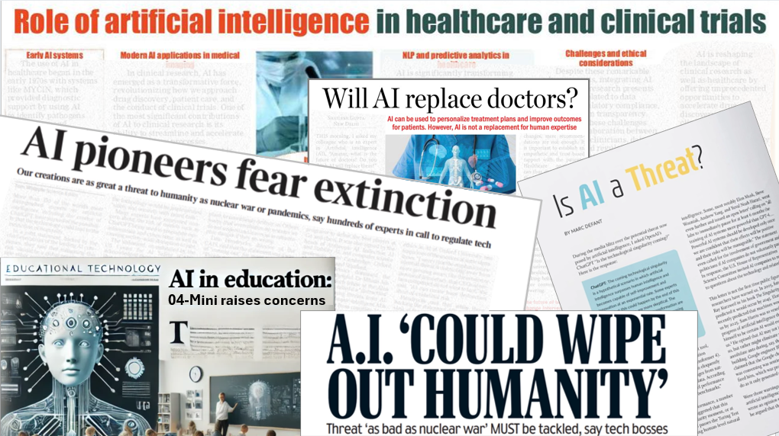
Notes:
[Just let the
Note. Collage created using screenshots of publicly available news headlines and educational materials related to artificial intelligence and public discourse. Original materials remain copyrighted by their respective publishers and authors. Screenshots used for educational commentary and instructional purposes.se headlines sink in]

Slide 4
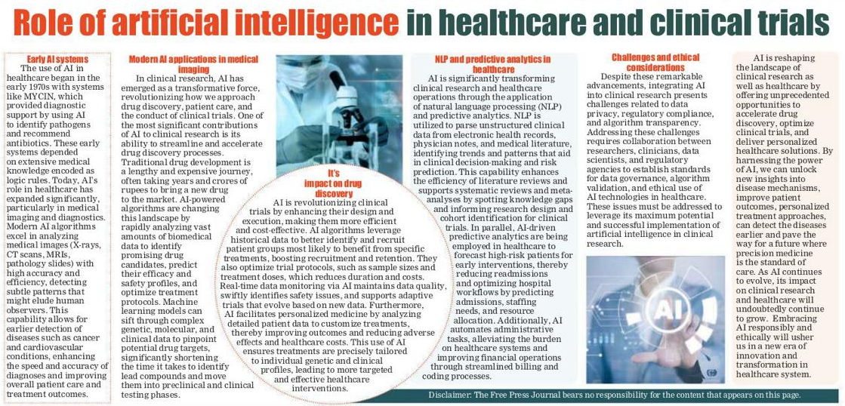
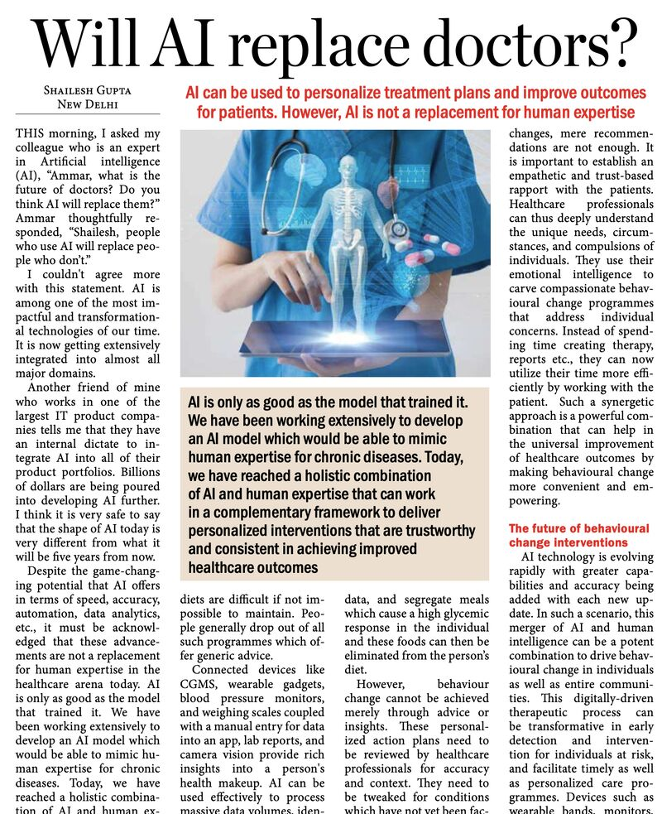
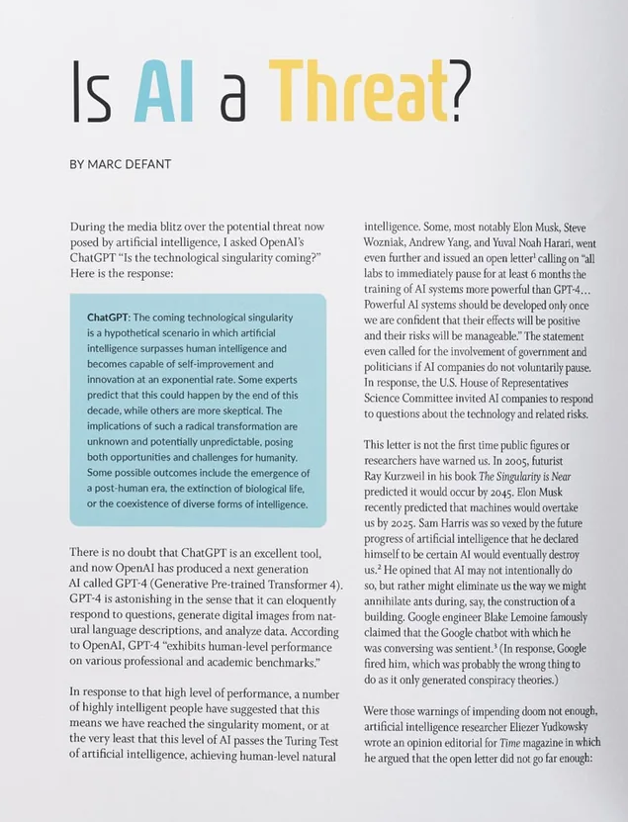
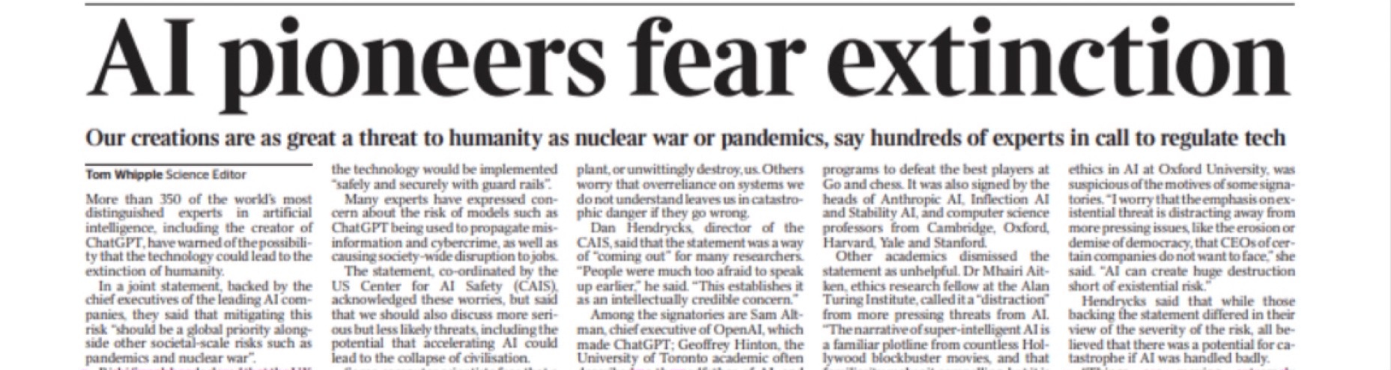


The Reality Check
AI isn't going anywhere.
The question isn't whether to use AI in your doctoral work...
It's HOW to use it ethically and effectively.
Notes:
Here's the reality check we all need to hear: AI isn't going anywhere. The question isn't WHETHER to use AI in your doctoral work – it's HOW to use it ethically and effectively. That's exactly what we're here to figure out today.

Slide 5
By the end of our session, you'll be able to:
Identify at least two common ethical risks or blind spots
when using AI tools in academic writing, research design,
or data analysis.
We're building the foundation for
responsible AI use
in your doctoral journey.
Notes:
By the end of our session, you'll be able to identify at least two common ethical risks or blind spots when using AI tools in academic writing, research design, or data analysis. We're building the foundation for responsible AI use in your doctoral journey. This is just the beginning – think of this as your ethical AI boot camp.

Slide 6

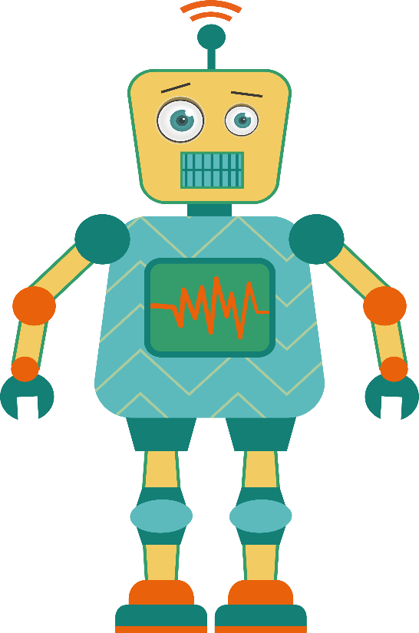

Meet Your AI Research Team
Each one is helpful. Each one is risky.
The Research Assistant
The Writing
Coach
The Data
Detective
The Idea
Generator
The Academic Concierge
Notes:
Let me introduce you to your AI research team. You have five potential teammates here: The Research Assistant, The Writing Coach, The Data Detective, The Idea Generator, and The Academic Concierge. Each one is incredibly helpful. Each one is also risky. Let's meet them.

Slide 7
The Research Assistant
The Research Assistant can:
Summarize articles and books
Identify themes across literature
Suggest search terms and databases
Create annotated bibliographies
Map connections between sources
The Research Assistant
Notes:
First up is the Research Assistant. This persona can summarize articles and books, identify themes across literature, suggest search terms, create annotated bibliographies, and map connections between sources.

Slide 8
The Research Assistant
The Research Assistant can:
Summarize articles and books
Identify themes across literature
Suggest search terms and databases
Create annotated bibliographies
Map connections between sources
Why It's So Tempting
Cuts literature review time from weeks to days
Finds connections you might miss
Finds sources you might miss
Handles tedious organizational work
The Research Assistant
Makes massive amounts of literature manageable
Notes:
Why is it so tempting? It cuts your literature review time from weeks to days. It finds connections you might miss and handles all that tedious organizational work. It makes massive amounts of literature actually manageable.

Slide 9
The Research Assistant
The Ethical Blind Spots
🚩 The Synthesis Trap
Are you understanding the field or just consuming AI's interpretation?
🚩 Citation Integrity
When AI summarizes 50 papers, whose ideas are you actually building on?
🚩 Knowledge Gaps
You might miss methodological details or context that AI filtered out.
The Research Assistant can:
Summarize articles and books
Identify themes across literature
Suggest search terms and databases
Create annotated bibliographies
Map connections between sources
The Research Assistant
Notes:
But here are the ethical blind spots: The Synthesis Trap – are you understanding the field or just consuming AI's interpretation? Citation Integrity – when AI summarizes 50 papers, whose ideas are you actually building on? And Knowledge Gaps – you might miss important methodological details or context that AI filtered out.

Slide 10
The Research Assistant
How to Address These Risks:
✅ Read original sources.
Use AI summaries as starting points, not endpoints.
✅ Cite original authors.
Don't cite “AI summary of Smith and Brown.”
✅ Test your understanding.
Could you explain this to your advisor without the AI summary?
✅ Document your process.
"Based on AI synthesis, I identified themes, then verified through close reading of..."
The Research Assistant
Notes:
How do you address these risks? Always read the original sources – use AI summaries as starting points, not endpoints. Cite original authors, not 'AI summary of Smith et al.' Test your understanding – could you explain this concept to your advisor without the AI summary? And document your process clearly.

Slide 11
The Writing Coach
The Writing Coach can:
Improve sentence structure
Suggest transitions and flow
Help with academic tone
Reorganize arguments
Overcome writer’s block
The Writing
Coach
Notes:
Next is the Writing Coach. This persona improves sentence structure, suggests transitions, helps with academic tone, reorganizes arguments, and helps you overcome writer's block.

Slide 12
The Writing Coach
The Writing Coach can:
Improve sentence structure
Suggest transitions and flow
Help with academic tone
Reorganize arguments
Overcome writer’s block
Why It's So Tempting
Fixes awkward phrases instantly
Helps create transitions and better structure
Makes you sound more “academic”
Organizes logical flow and creates clarity
The Writing
Coach
Break through writer’s block
Notes:
It's tempting to let the Writing Coach do all of the work because it can fix awkward phrases instantly, helps you create better structure, makes you sound more 'academic,' and breaks through writer's block.

Slide 13
The Writing Coach
The Ethical Blind Spots
🚩 Voice Authenticity
At what point does your writing become AI’s writing?
🚩 Intellectual Honesty
Are you developing YOUR scholarly voice or mimicking AI’s version?
🚩 Committee Expectations
Your advisor expects to see your thinking process, including the messy parts.
The Writing Coach can:
Improve sentence structure
Suggest transitions and flow
Help with academic tone
Reorganize arguments
Overcome writer’s block
The Writing
Coach
Notes:
The blind spots: Voice Authenticity – at what point does your writing become AI's writing? Intellectual Honesty – are you developing YOUR scholarly voice or mimicking AI's version? And Committee Expectations – your advisor expects to see your thinking process, including the messy parts.

Slide 14
The Writing Coach
How to Address These Risks
✅ Set clear boundaries.
Use AI for mechanics (Grammar, transitions) not argument development.
✅ Keep your voice.
Save pre-AI versions and ask, “Can I still recognize my thinking?”
✅ Be transparent.
Tell your advisor what AI assistance you are using.
✅ Document changes.
Keep an “AI assistance log” for each chapter.
The Writing
Coach
Notes:
Address these by setting clear boundaries – use AI for mechanics like grammar and transitions, not argument development. Keep your voice by saving pre-AI versions and asking 'Can I still recognize my thinking?' Be transparent with your advisor about what AI assistance you're using, and document all changes in an AI assistance log.

Slide 15
The Data Detective
The Data Detective can:
Suggests statistical approaches
Identifies patterns in datasets
Explains complex analyses
Generates analysis code
Catches potential errors
The Data
Detective
Notes:
The Data Detective suggests statistical approaches, identifies patterns, explains complex analyses, generates code, and catches errors.

Slide 16
The Data Detective
The Data Detective can:
Suggests statistical approaches
Identifies patterns in datasets
Explains complex analyses
Generates analysis code
Catches potential errors
Why It's So Tempting
Explains stats in plain English
Shortens analysis and identification
Makes advanced methods accessible
Speeds up analysis workflow
The Data
Detective
Finds errors you might have missed
Notes:
It's tempting because it explains stats in plain English, makes advanced methods accessible, speeds up your workflow, and finds errors you might miss.

Slide 17
The Data Detective
The Ethical Blind Spots
🚩 The Black Box Problem
Do you understand the analysis well enough to defend it?
🚩 Methodological Rigor
AI might suggest “good enough” rather than the most appropriate methods.
🚩 Reproducibility
Can others replicate your work without your AI prompts?
The Data Detective can:
Suggests statistical approaches
Identifies patterns in datasets
Explains complex analyses
Generates analysis code
Catches potential errors
The Data
Detective
Notes:
But beware of the blind spots: The Black Box Problem – do you understand the analysis well enough to defend it in your defense? Methodological Rigor – AI might suggest 'good enough' rather than most appropriate methods. And Reproducibility – can others replicate your work without your AI prompts?

Slide 18
The Data Detective
How to Address These Risks:
✅ Never use methods you can’t explain.
Use AI to learn, not just to do.
✅ Verify with experts.
Check AI suggestions against discipline best practices.
✅ Document everything.
Record prompts, reasoning, and verification steps.
✅ Test yourself.
Can you explain why it is appropriate, interpret results, defend the choice?
The Data
Detective
Notes:
Never use methods you can't explain – use AI to learn, not just to do. Verify AI suggestions with experts and against discipline best practices. Document everything – prompts, reasoning, verification steps. Test yourself: Can you explain why it's appropriate, interpret results, and defend the choice?

Slide 19
The Idea Generator
The Idea Generator can:
Brainstorm research questions
Suggest theoretical frameworks
Propose novel connections
Offer interdisciplinary perspectives
Break creative blocks
The Idea
Generator
Notes:
The Idea Generator brainstorms research questions, suggests theoretical frameworks, proposes novel connections, offers interdisciplinary perspectives, and breaks creative blocks.

Slide 20
The Idea Generator
The Idea Generator can:
Brainstorm research questions
Suggest theoretical frameworks
Propose novel connections
Offer interdisciplinary perspectives
Break creative blocks
Why It's So Tempting
Provides an unlimited brainstorming partner
Shortens analysis and identification
Suggests interesting and creative ideas
Provides perspectives from outside your field
The Idea
Generator
Breaks through mental blocks
Notes:
It’s so tempting because it offers an unlimited brainstorming partner that can shorten analysis and identification, suggest creative ideas, provide perspectives from outside your field, and breaks through mental blocks.

Slide 21
The Idea Generator
The Ethical Blind Spots
🚩 Originality Questions
Is this insight yours, AI’s or from the interaction?
🚩 Feasibility Reality Check
AI doesn’t know your actual resources, timeline, or constraints.
🚩 Field Contribution
AI might suggest ideas that seem novel but have been explored.
The Idea Generator can:
Brainstorm research questions
Suggest theoretical frameworks
Propose novel connections
Offer interdisciplinary perspectives
Break creative blocks
The Idea
Generator
Notes:
But there are ethical blind spots. Originality Questions – is this insight yours, AI's, or from the interaction? Feasibility Reality Check – AI doesn't know your actual resources, timeline, or constraints. And Field Contribution – AI might suggest ideas that seem novel but have been explored.

Slide 22
The Idea Generator
How to Address These Risks
✅ Treat ideas as raw material.
Add your disciplinary expertise and critical analysis.
✅ Reality-test with humans.
Run ideas past advisors and peers who know your constraints.
✅ Do your homework.
Conduct thorough literature searches on AI-suggested directions.
✅ Attribute clearly.
“Inspired by AI brainstorming, developed through (your process).”
The Idea
Generator
Notes:
Treat AI ideas as raw material that needs your disciplinary expertise. Reality-test with humans who know your constraints. Do thorough literature searches on AI-suggested directions. Attribute clearly: 'Inspired by AI brainstorming, developed through [your specific process].

Slide 23
The Academic Concierge
The Academic Concierge can:
Format citations perfectly
Conduct grammar and style checks
Manage administrative writing
Track deadlines and requirements
Create templates and forms
The Academic Concierge
Notes:
Finally, The Academic Concierge formats citations, conducts grammar checks, manages administrative writing, tracks deadlines, and creates templates.

Slide 24
The Academic Concierge
The Academic Concierge can:
Format citations perfectly
Conduct grammar and style checks
Manage administrative writing
Track deadlines and requirements
Create templates and forms
Why It's So Tempting
Reduces stress about formatting details
Ensures professional presentation
Frees mental energy for high-level thinking
Organizes and schedules important tasks
The Academic Concierge
Handles the “boring”
stuff
Notes:
It's tempting to rely on the Academic Concierge because it reduces stress about formatting, ensures professional presentation, frees mental energy for high-level thinking, organizes and schedules important tasks, and handles the 'boring' stuff.

Slide 25
The Academic Concierge
The Ethical Blind Spots
🚩 Skills Atrophy
Are you losing important academic competencies?
🚩 Quality Control
Small citation errors or “hallucinated” citations can undermine credibility.
🚩 Professional Development
Learning these systems is part of doctoral training.
The Academic Concierge can:
Format citations perfectly
Conduct grammar and style checks
Manage administrative writing
Track deadlines and requirements
Create templates and forms
The Academic Concierge
Notes:
But watch out for Skills Atrophy – are you losing important academic competencies? Quality Control – small citation errors or “hallucinated” can undermine your credibility and wreck the process. And remember that these systems is part of your doctoral training.

Slide 26
The Academic Concierge
How to Address These Risks:
✅ Maintain competency.
Regularly do tasks manually to keep your skills sharp.
✅ Always double-check.
Make sure the references, citations, and technical details are correct.
✅ Follow the 70/30 rule.
AI handles 30% of routine tasks; you practice 70%.
✅ Focus energy wisely.
Use saved time for higher-level skill development.
The Academic Concierge
Notes:
You can address these risks and maintain your skills and competency by regularly doing these tasks manually.
Always double-check, especially references. Follow the 70/30 rule – AI handles 30% of routine tasks while you practice 70%. Focus your saved energy on higher-level skill development.

Slide 27
Universal Red Flags
Before using AI, ask yourself:
Could somebody reproduce my work based on my documentation?
Would I be comfortable defending this choice in my defense?
If my advisor asked me to explain this right now, could I?
Am I using AI to learn faster or to avoid learning?
Notes:
Here are four questions to ask yourself before using any AI. If my advisor asked me to explain this right now, could I? Would I be comfortable defending this choice in my defense? Am I using AI to learn faster or to avoid learning? Could someone reproduce my work based on my documentation?"

Slide 28
Key Takeaways
Each AI persona has specific benefits and blind spots.
Solutions exist.
They require intentionality and documentation.
The biggest risks:
Losing understanding, authenticity, and professional development.
Your committee wants to see YOUR thinking, enhanced by AI,
not replaced by it.
Notes:
Here are your key takeaways: Each AI persona has specific benefits and blind spots. The biggest risks are losing understanding, authenticity, and professional development. But solutions exist – they require intentionality and documentation. Most importantly, your committee wants to see YOUR thinking, enhanced by AI, not replaced by it.

Slide 29

Your Daily AI Ethics Checklist
Before using AI:
Purpose
What exactly am I asking AI to do?
Attribution
How will I acknowledge this assistance?
Understanding
Will I still understand my own work?
Growth
Am I learning or just getting things done?
Notes:
This brings us to your daily AI ethics checklist. Before using AI, ask: Purpose – what exactly am I asking AI to do? Attribution – how will I acknowledge this assistance? Understanding – will I still understand my own work? Growth – am I learning or just getting things done?

Slide 30




Resources for Next Steps
Keep that daily ethics checklist.
Start an AI assistance log.
Talk to your advisor about AI policies.
Connect with peers about best practices.
Notes:
For your next steps: Keep that daily ethics checklist handy.
Start an AI assistance log for your work.
Talk to your advisor about AI policies – they're probably figuring this out too.
Connect with your peers about best practices.

Slide 31


Your future scholarly self
will thank you.
Remember…
The goal is responsible use,
not perfect use.
Start small.
Document everything.
Keep learning.
Notes:
Remember: The goal is responsible use, not perfect use. Start small. Document everything. Keep learning. Your future scholarly self will thank you.

Slide 32
We're building the foundation for
responsible AI use
in your doctoral journey.
Sara McNeil and Friends
Notes:
Thank you for your engagement today. The conversation about AI ethics in doctoral education is just beginning, and you're now part of shaping how we do this responsibly.

