Slide 1
AI and Education
Hua Bai, Northeastern Illinois University

Slide 2
AI, ML, DL and GenAI
AI: Artificial intelligence
ML: Machine learning.
DL: Deep learning
GenAI: Generative artificial intelligence

Slide 3
Generative AI
“Generative artificial intelligence (GenAI) tools use machine learning technologies to analyze prompts, data and images and generate output, including written text, voices, pictures, videos and more. These tools can mimic humans’ ability to learn, reason, solve problems and make decisions.” (2025 Student Guide to Artificial Intelligence, p.3)

Slide 4
Limitations
Limitations due to training data
  Limited scope
  Outdated
  Inaccuracy and bias
Limited in contextualizing new information.
Limited creativity and critical thinking

Slide 5
GenAI and Education
Acts as a thought partner, tutor or a collaborator
Supports differentiation
  Creates or modifies instructional/learning materials/activities
Facilitates personalized learning
  Immediate feedback
  Adaptive learning support
  Real-time dialogic interactions
Helps to address pedagogical and learning challenges

Slide 6
Integration of GenAI
Should enhance, not replace effective instructional strategies
Should align with the learning goals and objectives
Should augment teachers’ pedagogical and content knowledge, and knowledge of students
Should select appropriate tools
  Specialized tools
  Chatbots, custom chatbots

Slide 7
Integration of GenAI (Cont.)
Assessment
  AI-assisted assessment: AI supports, not undermines learning
  AI-integrated assessment: AI enhances traditional assessment
  AI free assessment

Slide 8
Prompt Engineering
Goal: Task
Context: Provides contextual information
Instructions: Gives it specific instruction on what to do including parameters of the output
Role: Gives it a role (optional)
Evaluation: Critically evaluates the output
Feedback: Provides feedback and be specific about clarification, modification or further information
Iterative process

Slide 9
Example
You are a 4th grade teacher. You will teach a lesson on the states of matter. Your task is to create an engaging classroom demonstration for your 4th grade class that will introduce the topic of the states of matter. The demonstration should be 25-30 minutes long and should include a learning objective, a list of materials, a brief introduction, a list of the demonstration steps, and a conclusion.

Slide 10
AI Models for Teachers
MagicSchool
SchoolAI
Eduaid AI

Slide 11
Ethical Concerns
Inaccurate information
Copyright infringement and ambiguity
Data privacy and security
Bias and discrimination
Misinformation and deepfakes
Academic dishonesty

Slide 12
Societal and Environmental Impact
Job security
Over-reliance on AI
Digital divide
Increasing energy demand

Slide 13
Responsible Use
Critically evaluates AI-generated output
Be mindful of data/information security
Transparency is essential
No misuse of AI

Slide 14
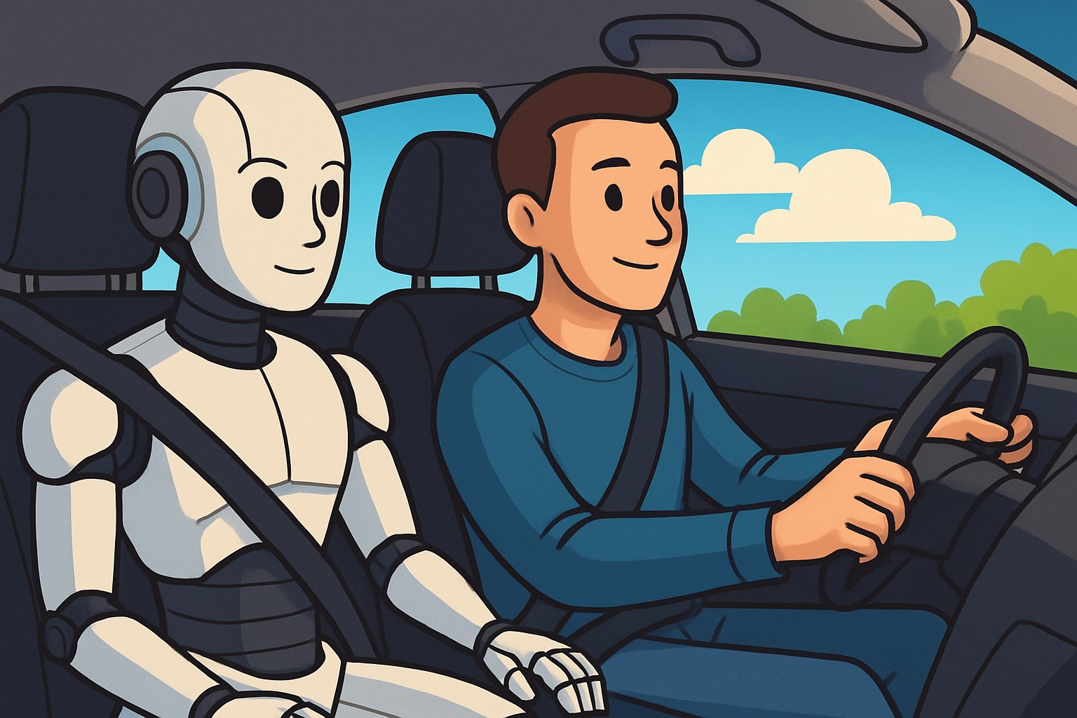
You should be in the driver’s seat.
(OpenAI, 2025)

Slide 15
Questions?

