Slide 1
AI Literacy Packet
Sohheon Yang, Alyse Harris, and Leonardo Alba-Lopez
Indiana University Bloomington

Slide 2
Learning about AI and Learning from/with AI
Learning about AI | Learning from/with AI
Understanding AI theory and concepts Gaining knowledge of AI as a subject or topic AI algorithms, machine learning, neural networks, natural language processing, etc. | Utilizing AI as part of the learning process Incorporating AI technology into educational environments to enhance the learning experience AI-based personalized learning platforms, real-time feedback, AI-powered tools (e.g., Quick Draw, A.I. Eudet), etc.

Slide 3
AI Literacy
A set of competencies that enables individuals to critically evaluate AI technologies; communicate and collaborate effectively with AI; and use AI as a tool online, at home, and in the workplace.
(Long & Magerko, 2020)

Slide 4
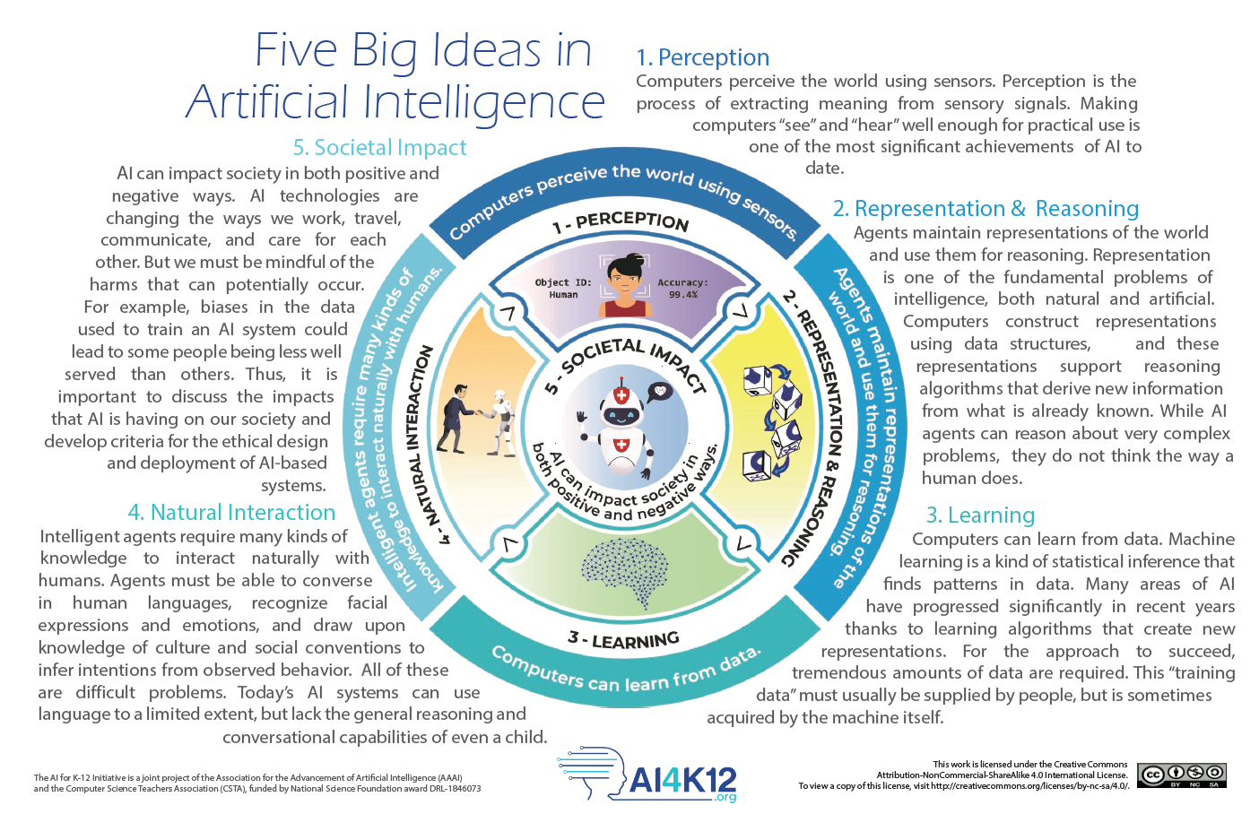
AI4K12: The Artificial Intelligence for K-12 Initiative
Reference: AI for K–12 Initiative. (n.d.). Five big ideas in artificial intelligence (Version 2) [Poster]. Association for the Advancement of Artificial Intelligence & Computer Science Teachers Association. https://ai4k12.org

Slide 5
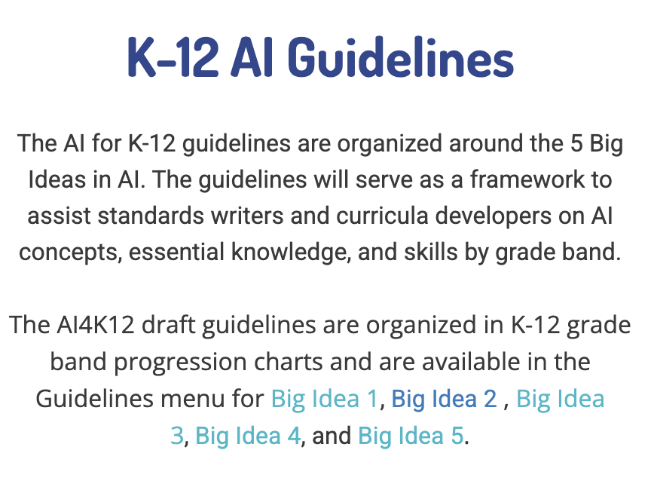
Group Activity 1: Explore 5 Big Ideas
Website
1. Go to Canvas – Discussions
2. Explore the K-12 AI Guidelines
  a. What do you notice?
  b. Is there anything surprising?
  c. Is there anything that concerns you?
  d. Are there any guidelines that you value most?
  e. Any ideas about how to integrate these guidelines into your future teaching practice?
What is your most important teacher values?
Click each area to look into a guideline.
1. Perception
2. Representation & Reasoning
3. Learning
4. Natural Interaction
5. Social Impact

Slide 6
Group Activity 2: Explore Tools and Resources for AI Education
AI Curriculum
AI4ALL
RAISE
Day of AI
B. Generative AI
ChatGPT (Text, Image, …)
Canva AI (Image, Video, …)
Suno (Music)
1. Go to Canvas - Discussions
2. Pick at least one tool/resource under each category from A to E.
3. Brainstorm how you will integrate each tool/resource into your future teaching practices.
4. Present your group’s ideas!
C. AI-powered Tools
Quick, Draw
Auto Draw
AI Duet
Imaginary Soundscape
Scroobly
Google Arts & Culture (Art Filter)
  Works best with phones or iPads.
D. Machine Learning Education Tools
AI for Oceans
Teachable Machine
Machine Learning for Kids
E. Educational AI Assistant
School AI
Magic School AI

