Slide 1
AI and Machine Learning
Sohheon Yang, Alyse Harris, and Leonardo Alba-Lopez
Indiana University Bloomington

Slide 2
What uses AI?
No way! That doesn’t use AI
Yes! That uses AI.
Hmm...
I am not sure.
Note. Slides 2-9: Adapted from “AI vs. Not AI” (pp. 6-17), by AI Goes Rural, 2022, Indiana University. Copyright [2026] by The Trustees of Indiana University

Slide 3
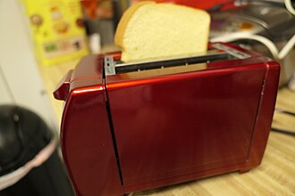
Toaster picture attribution: Kansattica, CC BY 4.0 <https://creativecommons.org/licenses/by/4.0>, via Wikimedia Commons
Toaster

Slide 4
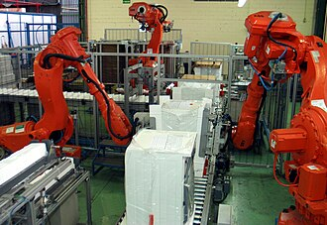
Robot picture attribution: Tecnowey, CC BY-SA 3.0 <https://creativecommons.org/licenses/by-sa/3.0>, via Wikimedia Commons
Industrial Robot

Slide 5
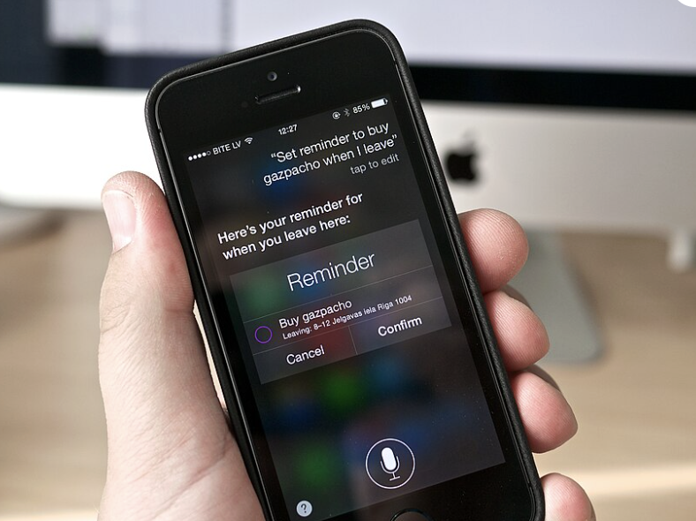
<https://creativecommons.org/licenses/by/2.0>, via Wikimedia Commons
Siri on iPhone

Slide 6
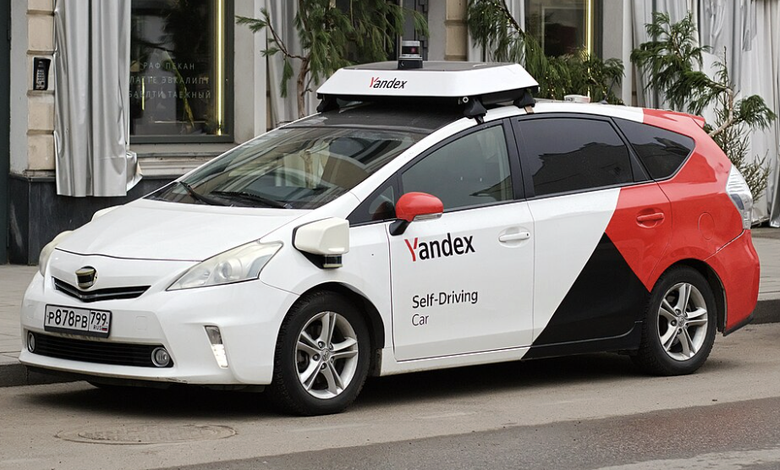
Self Driving Car: Retired electrician, CC0, via Wikimedia Commons
Self-Driving Car

Slide 7
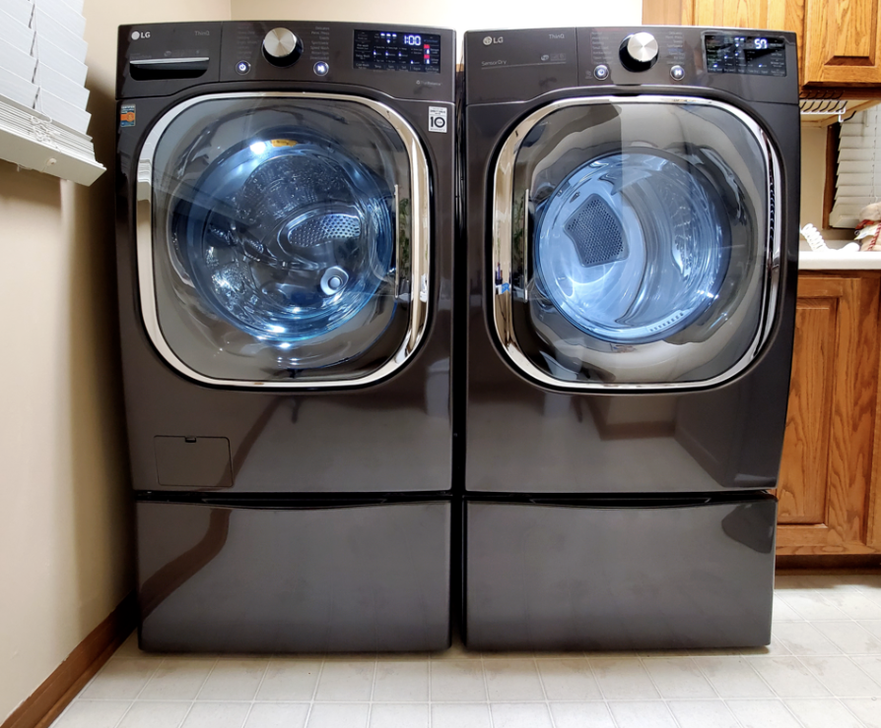
Washer attribution: LG전자, CC BY 2.0 <https://creativecommons.org/licenses/by/2.0>, via Wikimedia Commons
Washing Machine

Slide 8
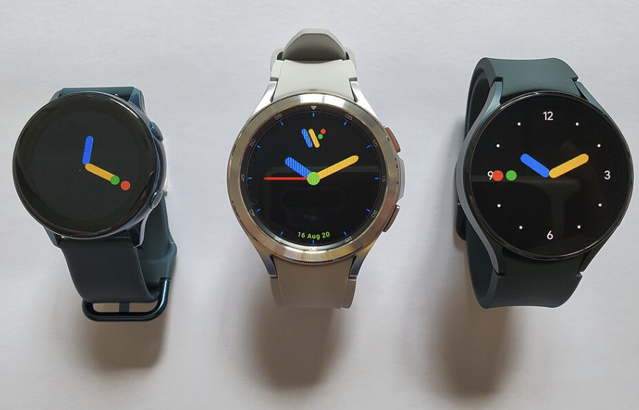
Smart Watches attribution: Google, CC BY 3.0 <https://creativecommons.org/licenses/by/3.0>, via Wikimedia Commons
Smart Watches

Slide 9
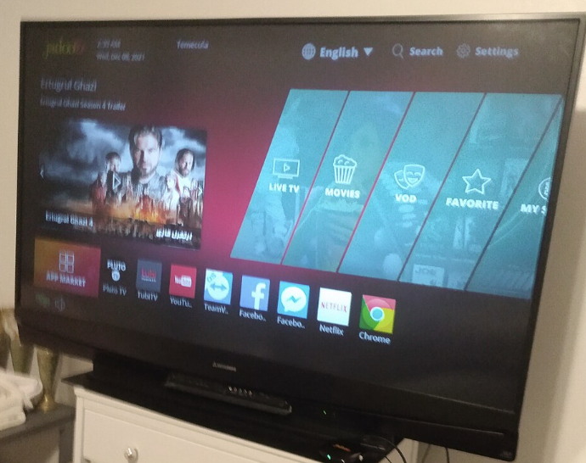
Streaming Services attribution: Dancingpolishcow, CC BY-SA 4.0 <https://creativecommons.org/licenses/by-sa/4.0>, via Wikimedia Commons
Streaming Services

Slide 10
Artificial Intelligence
What is it?

Slide 11
AI is…
A branch of computer science aimed at creating machines that mimic human intelligence.​
Source: ISTE (Click here)

Slide 12
It's used to perform tasks that usually require human thought, like understanding language, recognizing patterns, or making decisions.
Source: ISTE (Click here)

Slide 13
Essentially, AI allows machines to learn, adapt, and perform tasks like Humans.
Source: ISTE (Click here)

Slide 14
Types of Machine Learning
Supervised Learning
Unsupervised Learning
Add an image, diagram, or screenshot illustrating supervised learning.
Add an image, diagram, or screenshot illustrating unsupervised learning.

Slide 15
Types of Machine Learning
Reinforcement Learning
Add an image, diagram, or screenshot illustrating reinforcement learning

Slide 16
Practice Time!
Teachable Machine
Supervised Learning

